Slide 1
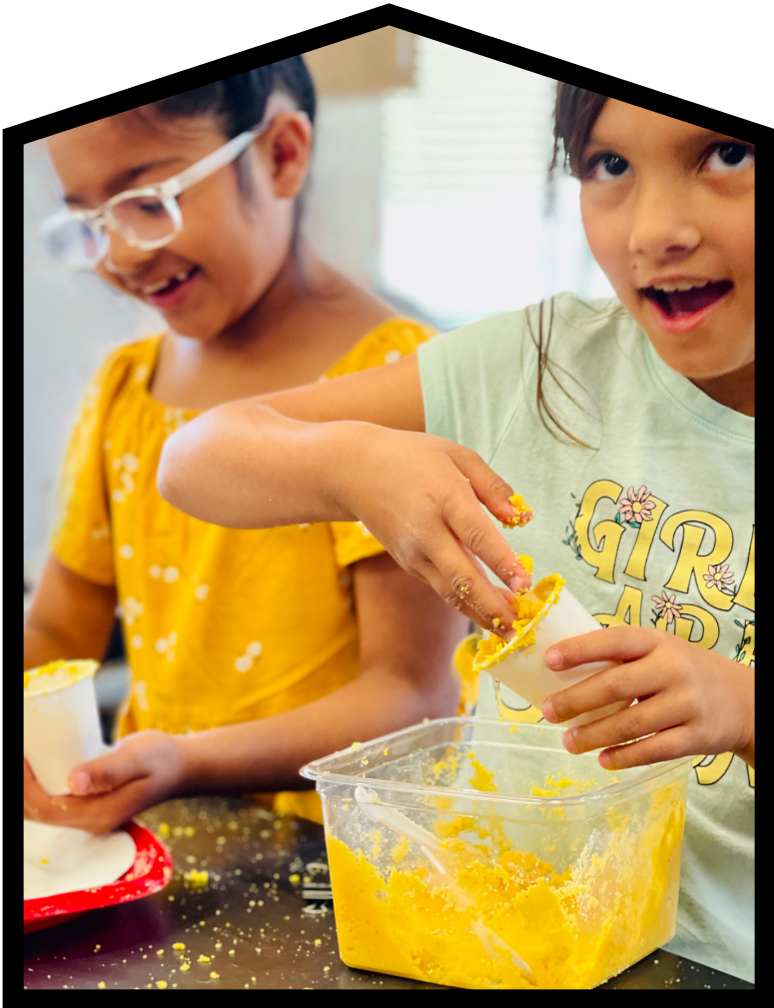

Mystery Science Alignment with Ontario Science Standards
Mystery Science is a hands-on curriculum that aligns with the Ontario Curriculum: Science & Technology (2022).
Mystery Science’s units of study contain:
Hands-on, easy-prep activities with EVERY lesson
Engaging, real-world investigative phenomena
Thoughtful discussions to build background knowledge
Lesson & unit assessments to evaluate comprehension
Curated, cross-curricular extensions
Mystery Science also offers the Anchor Layer, which enriches the unit with an anchor phenomenon, incorporates anchor connections after each lesson, & concludes the unit with a performance task.
Updated 6/14/2025

Slide 2
Ontario Standards Alignment
Table of Contents
1st Grade
Life Systems Animal Needs Plant Needs Matter and Energy Sunlight & Warmth Earth and Space Systems Severe Weather Weather Patterns Day Patterns Night Patterns | Page 3 Page 5 Page 6
2nd Grade
Life Systems Animal Traits & Survival Animal Biodiversity & Habitats Life Cycles Matter and Energy Material Properties States of Matter Structures and Mechanisms Pushes & Pulls Earth and Space Systems Weather & Climate | Page 10 Page 13 Page 15 Page 16
3rd Grade
Life Systems Plant Traits & Survival Plant Growth & Interactions Life Cycles Matter and Energy Forces, Motion, & Magnets Material Properties Earth and Space Systems Erosion & Earth’s Surface | Page 17 Page 20 Page 21
4th Grade
Life Systems Fossils & Changing Environments Heredity, Survival, & Selection Animal & Plant Adaptations Ecosystems & The Food Web Matter and Energy Light, Sound, & Communication Sound, Waves, & Communication Earth and Space Systems Earth’s Features & Processes | Page 24 Page 29 Page 31
5th Grade
Life Systems Human Body, Vision, & The Brain Matter and Energy Chemical Reactions & Properties of Matter Earth and Space Systems Water Cycle & Earth’s Systems Energy & Energy Transfer Electricity, Light, & Heat | Page 32 Page 33 Page 35
6th Grade
Earth and Space Systems Earth & Space Patterns Stars & Planets | Page 37

Slide 3

Ontario Standards Alignment
1st Grade - Life Systems
This unit is found under Kindergarten on our site, but we recommend teaching lessons in 1st grade if you are following Ontario Standards.
Animal Needs (Animal Secrets)
 | Topic & Guiding Question | Student Objectives | Ontario Curriculum: Science & Technology (2022)
Lesson 1 | Animal Needs: Food Why do woodpeckers peck wood? | Students obtain information through virtual observations of different animal behaviors. They use this evidence to explain that one of the basic needs of animals is food. | Grade 1. B. Needs and Characteristics of Living Things. B2. Students will demonstrate an understanding of the basic needs and characteristics of living things, including humans.
Lesson 2 | Animal Needs: Shelter Read-Along Where do animals live? | Students obtain information through media about how different animal homes are built. They use this evidence to explain that animals need shelter. | Grade 1. B. Needs and Characteristics of Living Things. B2. Students will demonstrate an understanding of the basic needs and characteristics of living things, including humans.
Lesson 3 | Animal Needs: Safety How can you find animals in the woods? | Students obtain information through virtual observations of different animal behaviors. They use this evidence to explain that one of the basic needs of animals is shelter. | Grade 1. B. Needs and Characteristics of Living Things. B2. Students will demonstrate an understanding of the basic needs and characteristics of living things, including humans.
Lesson 4 | Animals & Changing the Environment Read-Along How do animals make their homes in the forest? | Students take a nature walk to look for evidence of animal homes. | Grade 1. B. Needs and Characteristics of Living Things. B2. Students will demonstrate an understanding of the basic needs and characteristics of living things, including humans.
Lesson 1
Lesson 2
Lesson 3
Lesson 4
www.mysteryscience.com/docs/ontario

Slide 4
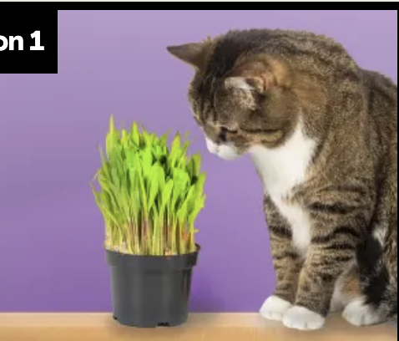
Ontario Standards Alignment
1st Grade - Life Systems
This unit is found under Kindergarten on our site, but we recommend teaching lessons in 1st grade if you are following Ontario Standards.
Plant Needs (Plant Secrets)
 | Topic & Guiding Question | Student Objectives | Ontario Curriculum: Science & Technology (2022)
Lesson 5 | Living & Nonliving Are plants alive? | Students make observations of plants in order to identify their needs and that they are, in fact, living things. | Grade 1. B. Needs and Characteristics of Living Things. B2. Students will demonstrate an understanding of the basic needs and characteristics of living things, including humans.
Lesson 6 | Plant Needs: Water & Light How do plants and trees grow? | Students investigate to determine the basic needs of plants. They observe to identify ways young plants resemble the parent plant and how the plant changes as it proceeds through its life cycle. | Grade 1. B. Needs and Characteristics of Living Things. B2. Students will demonstrate an understanding of the basic needs and characteristics of living things, including humans.
Lesson 7 | Human Impacts on the Environment Read-Along Why would you want an old log in your backyard? | Students obtain evidence of living organisms by virtually keeping watch of a log and the living things that visit it. | Grade 1. B. Needs and Characteristics of Living Things. B2. Students will demonstrate an understanding of the basic needs and characteristics of living things, including humans.
Lesson 1
Lesson 2
Lesson 3
www.mysteryscience.com/docs/ontario

Slide 5

Ontario Standards Alignment
1st Grade - Matter and Energy
This unit is found under Kindergarten on our site, but we recommend teaching lessons in 1st grade if you are following Ontario Standards.
Sunlight & Warmth (Sunny Skies)
 | Topic & Guiding Question | Student Objectives | Ontario Curriculum: Science & Technology (2022)
 | Sunlight, Heat, & Earth’s Surface Read-Along How could you walk barefoot across hot pavement without burning your feet? | Students make observations of the pavement heating up after being warmed by the Sun. Then, they design a solution to build a shade structure that can reduce the warming effect of sunlight. | Grade 1. C. Energy in Our Lives. C2. Students will demonstrate an understanding of how energy affects their lives, and that the Sun is the principal source of energy for Earth.
 | Sunlight, Warming, & Engineering How could you warm up a frozen playground? | Students carry out an investigation to test which materials can redirect the light and heat of sunlight. (*This lesson has students increase the warming effect of sunlight on an area.) | Grade 1. C. Energy in Our Lives. C2. Students will demonstrate an understanding of how energy affects their lives, and that the Sun is the principal source of energy for Earth.
 | Sunlight & Warmth Why does it get cold in winter? | Students construct an explanation for why marshmallows melt in one car and not in another car. Then, they conduct a virtual investigation to determine that the warmth of the Sun is the cause of the melted marshmallows. | Grade 1. C. Energy in Our Lives. C2. Students will demonstrate an understanding of how energy affects their lives, and that the Sun is the principal source of energy for Earth.
Lesson 1
Lesson 2
Lesson 3
www.mysteryscience.com/docs/ontario

Slide 6

Ontario Standards Alignment
1st Grade - Earth and Space Systems
This unit is found under Kindergarten on our site, but we recommend teaching lessons in 1st grade if you are following Ontario Standards.
Severe Weather (Wild Weather)
 | Topic & Guiding Question | Student Objectives | Ontario Curriculum: Science & Technology (2022)
 | Severe Weather & Preparation Read-Along How can you get ready for a big storm? | Students obtain information of different types of severe weather to observe and describe how the weather changes during these events and what students can do to prepare and stay safe. | Grade 1. E. Daily and Seasonal Changes. E2. Students will demonstrate an understanding of daily and seasonal changes and of how living things respond to those changes.
 | Wind & Storms Have you ever watched a storm? | Students create a simple tool that allows them to observe how hard the wind is blowing. They use this tool to observe weather changes and describe the pattern of faster wind speeds right before a storm. | Grade 1. E. Daily and Seasonal Changes. E2. Students will demonstrate an understanding of daily and seasonal changes and of how living things respond to those changes.
 | Weather Conditions How many different kinds of weather are there? | Students obtain information through observations of the weather. They communicate the information by acting as weather watchers and creating drawings of the weather conditions. | Grade 1. E. Daily and Seasonal Changes. E2. Students will demonstrate an understanding of daily and seasonal changes and of how living things respond to those changes.
Lesson 1
Lesson 2
Lesson 3
www.mysteryscience.com/docs/ontario

Slide 7

Ontario Standards Alignment
1st Grade - Earth and Space Systems
This unit is found under Kindergarten on our site, but we recommend teaching lessons in 1st grade if you are following Ontario Standards.
Weather Patterns (Circle of Seasons)
 | Topic & Guiding Question | Student Objectives | Ontario Curriculum: Science & Technology (2022)
 | Daily Weather Patterns Read-Along How do you know what to wear for the weather? | Students track the weather daily and analyze the data by collecting, recording, and sharing their observations to observe patterns of weather changing throughout the day and from day-to-day. | Grade 1. E. Daily and Seasonal Changes. E2. Students will demonstrate an understanding of daily and seasonal changes and of how living things respond to those changes.
 | Seasonal Weather Patterns What will the weather be like on your birthday? | Students evaluate information in a series of unnamed drawings of each season. They use these clues to identify characteristics of each season and describe the yearly cyclical pattern. | Grade 1. E. Daily and Seasonal Changes. E2. Students will demonstrate an understanding of daily and seasonal changes and of how living things respond to those changes.
 | Animals Changing Their Environment Why do birds lay eggs in the spring? | Students identify the reasons why birds lay eggs in the spring. Then, they develop a bird nest model and use this model as evidence for how animals can change the environment to meet their needs. | Grade 1. E. Daily and Seasonal Changes. E2. Students will demonstrate an understanding of daily and seasonal changes and of how living things respond to those changes.
Lesson 1
Lesson 2
Lesson 3
www.mysteryscience.com/docs/ontario

Slide 8

Ontario Standards Alignment
1st Grade - Earth and Space Systems
Day Patterns (Sun & Shadows)
 | Topic & Guiding Question | Student Objectives | Ontario Curriculum: Science & Technology (2022)
Lesson 1 | Sun, Shadows, & Daily Patterns Could a statue’s shadow move? | Students observe how shadows change as time passes, or as the Sun moves across the sky. They analyze how to move a light source to change the shape and direction of shadows, constructing an explanation of what causes a shadow to move. | Grade 1. E. Daily and Seasonal Changes. E2. Students will demonstrate an understanding of daily and seasonal changes and of how living things respond to those changes.
Lesson 2 | Sun, Shadows, & Daily Patterns Read-Along What does your shadow do when you’re not looking? | Students conduct an investigation to gather information about how their shadow changes throughout the day. | Grade 1. E. Daily and Seasonal Changes. E2. Students will demonstrate an understanding of daily and seasonal changes and of how living things respond to those changes.
Lesson 3 | Sun & Daily Patterns How can the Sun help you if you’re lost? | Students develop a Sun Finder, a model of the Sun’s movement across the sky. They use this model to reason about how the Sun can help guide them during the day. | Grade 1. E. Daily and Seasonal Changes. E2. Students will demonstrate an understanding of daily and seasonal changes and of how living things respond to those changes.
Lesson 4 | Daylight & Seasonal Patterns Read-Along Why do you have to go to bed early in the summer? | Students obtain information about the seasonal patterns of sunrise and sunset. | Grade 1. E. Daily and Seasonal Changes. E2. Students will demonstrate an understanding of daily and seasonal changes and of how living things respond to those changes.
Lesson 1
Lesson 2
Lesson 3
Lesson 4
www.mysteryscience.com/docs/ontario

Slide 9

Ontario Standards Alignment
1st Grade - Earth and Space Systems
Night Patterns (Moon & Stars)
 | Topic & Guiding Question | Student Objectives | Ontario Curriculum: Science & Technology (2022)
Lesson 1 | Moon Phases & Patterns When can you see the full moon? | Students record observations of the Moon’s shape using a series of photos collected over the course of four weeks. Using this information, students discover that the Moon follows a cyclical pattern, which they can use to predict when a full moon will appear. | Grade 1. E. Daily and Seasonal Changes. E2. Students will demonstrate an understanding of daily and seasonal changes and of how living things respond to those changes.
Lesson 2 | Stars & Daily Patterns Why do stars come out at night? | Students develop and use a model of the Big Dipper in the night sky. After conducting a simple investigation, students construct an explanation for why stars are only visible in the night sky. | Grade 1. E. Daily and Seasonal Changes. E2. Students will demonstrate an understanding of daily and seasonal changes and of how living things respond to those changes.
Lesson 3 | Stars & Seasonal Patterns Read-Along How can stars help you if you get lost? | Students observe that groups of stars in the sky form a pattern: constellations. Even though the Big Dipper changes its spot in the sky in different seasons, it always points to the North Star. | Grade 1. E. Daily and Seasonal Changes. E2. Students will demonstrate an understanding of daily and seasonal changes and of how living things respond to those changes.
Lesson 1
Lesson 2
Lesson 3
www.mysteryscience.com/docs/ontario

Slide 10
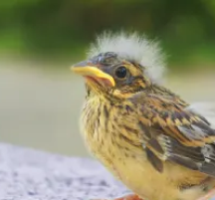
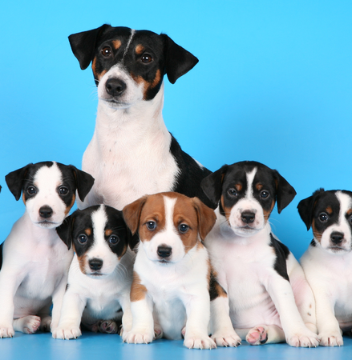

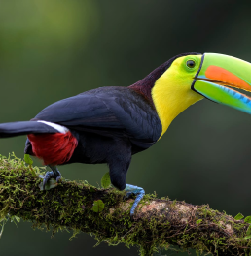
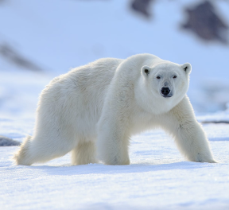
Ontario Standards Alignment
2nd Grade - Life Systems
This unit is found under 1st grade on our site, but we recommend teaching lessons in 2nd grade if you are following Ontario Standards.
✔ Animal Traits & Survival (Animal Superpowers)
 | Topic & Guiding Question | Student Objectives | Ontario Curriculum: Science & Technology (2022)
 | Parent & Offspring Traits How can you help a lost baby animal find its parents? | Students observe the traits of adult and baby animals in order to construct an explanation that most young animals are like, but not exactly like, their parents. | Grade 2. B. Growth and Changes in Animals. B2. Students will demonstrate an understanding that animals grow and change and have distinct characteristics.
 | ✨New!✨ Offspring Trait Variation Can you predict what an animal’s babies will look like? | Students observe the traits of parent and baby animals to construct an explanation that offspring look similar to their parents, but can also vary in many ways. They predict what a puppy might look like based on the traits of the parent dogs. | Grade 2. B. Growth and Changes in Animals. B2. Students will demonstrate an understanding that animals grow and change and have distinct characteristics.
 | Animal Behavior & Offspring Survival Read-Along Why do baby ducks follow their mother? | Students obtain information about the behaviors of animal parents that help their offspring survive. | Grade 2. B. Growth and Changes in Animals. B2. Students will demonstrate an understanding that animals grow and change and have distinct characteristics.
 | Animal Structures & Survival Why do birds have beaks? | Students investigate how different bird beaks are well suited for eating different kinds of food. They explain which beak would help a particular bird survive in a particular environment. | Grade 2. B. Growth and Changes in Animals. B2. Students will demonstrate an understanding that animals grow and change and have distinct characteristics.
 | Camouflage & Animal Survival Why are polar bears white? | Students use observations of animal parents and their offspring to construct an explanation about young plants and animals being similar, but not identical, to their parents. | Grade 2. B. Growth and Changes in Animals. B2. Students will demonstrate an understanding that animals grow and change and have distinct characteristics.
Lesson 1
Lesson 2
Lesson 3
Lesson 4
Lesson 5
✨ New Lesson
✔ Unit Restructured for the 2025-2026 School Year
www.mysteryscience.com/docs/ontario

Slide 11

Ontario Standards Alignment
2nd Grade - Life Systems
Animal Biodiversity & Habitats (Animal Adventures)
 | Topic & Guiding Question | Student Objectives | Ontario Curriculum: Science & Technology (2022)
Lesson 1 | Biodiversity & Classification How many different kinds of animals are there? | Students observe the traits of different animals and use that information to organize them into groups based on their characteristics. | Grade 2. B. Growth and Changes in Animals. B2. Students will demonstrate an understanding that animals grow and change and have distinct characteristics.
Lesson 2 | Habitat Diversity Why would a wild animal visit a playground? | Students observe animals, plants, and the physical characteristics of two different habitats. They collect and analyze data to compare the biodiversity between the two habitats. | Grade 2. B. Growth and Changes in Animals. B2. Students will demonstrate an understanding that animals grow and change and have distinct characteristics.
Lesson 3 | Biodiversity, Habitats, & Species Why do frogs say “ribbit”? | Students identify frogs based on their unique calls and use that information to determine the level of frog species diversity within multiple habitats. | Grade 2. B. Growth and Changes in Animals. B2. Students will demonstrate an understanding that animals grow and change and have distinct characteristics.
Lesson 4 | Biodiversity & Engineering How could you get more birds to visit a bird feeder? | Students investigate which kinds of birds are likely to visit a bird feeder based on what they eat and design and build a prototype bird feeder that attracts a specific type of bird. | Grade 2. B. Growth and Changes in Animals. B2. Students will demonstrate an understanding that animals grow and change and have distinct characteristics.
Lesson 1
Lesson 2
Lesson 3
Lesson 4
www.mysteryscience.com/docs/ontario

Slide 12
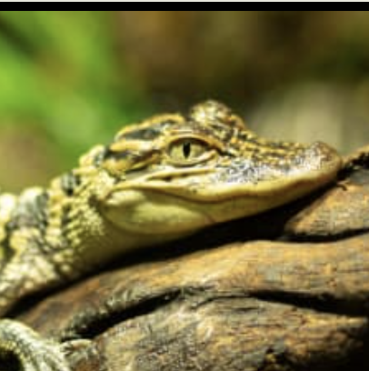


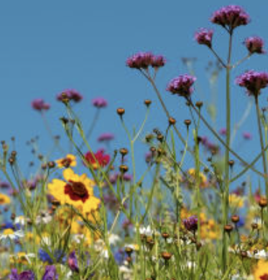
Ontario Standards Alignment
2nd Grade - Life Systems
This unit is found under 3rd grade on our site, but we recommend teaching lessons in 2nd grade if you are following Ontario Standards.
Life Cycles (Circle of Life)
 | Topic & Guiding Question | Student Objectives | Ontario Curriculum: Science & Technology (2022)
 | Animal Life Cycles How is your life like an alligator’s life? | Students create models of several different animal life cycles and compare them to one another. They use these models to discover the pattern that all animals are born, grow, can have babies, and eventually die. | Grade 2. B. Growth and Changes in Animals. B2. Students will demonstrate an understanding that animals grow and change and have distinct characteristics.
 | Environmental Change & Engineering What’s the best way to get rid of mosquitoes? | Students obtain and evaluate information about mosquitoes from different sources. They analyze and interpret information about the mosquito life cycle to reduce the number of mosquitoes that live in a certain area. | Grade 2. B. Growth and Changes in Animals. B2. Students will demonstrate an understanding that animals grow and change and have distinct characteristics.
 | Pollination & Plant Reproduction Why do plants grow flowers? | Students model the structure and function of flower parts that are responsible for creating seeds. | Grade 3. B. Growth and Changes in Plants. B2. Students will demonstrate an understanding of characteristics and uses of plants and of plants’ responses to the natural environment.
 | Fruit, Seeds, & Plant Reproduction Why do plants give us fruit? | Students explore the function of fruits in plants and practice classification. | Grade 3. B. Growth and Changes in Plants. B2. Students will demonstrate an understanding of characteristics and uses of plants and of plants’ responses to the natural environment.
 | Plant Life Cycles Why are there so many different kinds of flowers? | Students play a game that models the stages of the plant life cycle. After playing the game students use the model to show how changes to one part of the life cycle affect all other stages. | Grade 3. Growth and Changes in Plants. B2. Students will demonstrate an understanding of characteristics and uses of plants and of plants’ responses to the natural environment.
Lesson 1
Lesson 2
Lesson 3 Lesson 4 Lesson 5
Although this appears on our site, we recommend teaching this in 3rd grade if following Ontario Standards.
Although this appears on our site, we recommend teaching this in 3rd grade if following Ontario Standards.
Although this appears on our site, we recommend teaching this in 3rd grade if following Ontario Standards.
www.mysteryscience.com/docs/ontario

Slide 13
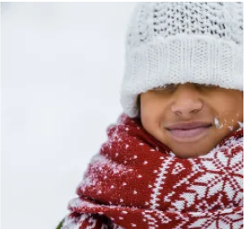
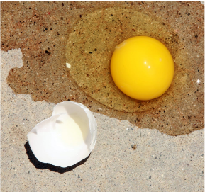
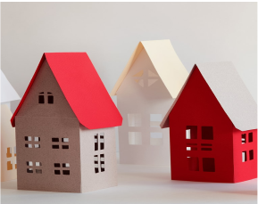
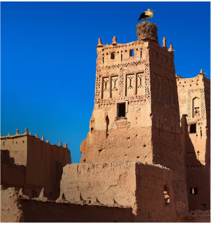
Ontario Standards Alignment
2nd Grade - Matter and Energy
✔ Material Properties (Material Magic)
 | Topic & Guiding Question | Student Objectives | Ontario Curriculum: Science & Technology (2022)
 | Material Properties & Engineering Why do we wear clothes? | Students investigate different material properties, such as flexibility and absorbency, and use those properties to design and build a hat that protects them from the sun. | Grade 2. C. Properties of Liquids and Solids. C2. Students will demonstrate an understanding of the properties and physical changes of liquids and solids.
 | Classify Materials: Insulators & Conductors Can you really fry an egg on a hot sidewalk? | Students conduct an investigation of conductors and insulators in order to determine which are best suited for allowing people to handle hot items. | Grade 2. C. Properties of Liquids and Solids. C2. Students will demonstrate an understanding of the properties and physical changes of liquids and solids.
 | Materials, Properties, & Engineering Could you build a house out of paper? | Students construct an evidence- based account of how a structure built of paper can be disassembled and rebuilt in new ways. | Grade 3. Strong and Stable Structures. D2. Students will demonstrate an understanding of the concepts of strength and stability as they relate to structures with various forms and functions, and of the factors that affect structures’ strength and stability.
 | Soil Properties How do you build a city out of mud? | Students conduct an investigation where they examine three different soil models. They use this information to determine which type of soil has the properties that will result in the best mud that can be used to build a house. | Grade 3. Soils in the Environment. E2. Students will demonstrate an understanding of the composition of soils, of different types of soils, and of processes and practices that can affect the health of soil.
Lesson 1
Lesson 2
Lesson 3
Although this appears on our site, we recommend teaching this in 3rd grade if following Ontario Standards.
Lesson 4
Although this appears on our site, we recommend teaching this in 3rd grade if following Ontario Standards.
✔ Unit Restructured for the 2025-2026 School Year
www.mysteryscience.com/docs/ontario

Slide 14
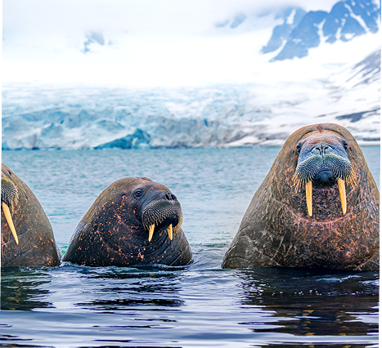

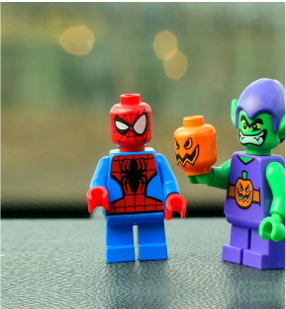
Ontario Standards Alignment
2nd Grade - Matter and Energy
⭐ States of Matter (States of Matter)
 | Topic & Guiding Question | Student Objectives | Ontario Curriculum: Science & Technology (2022)
 | ✨New!✨ Liquid Water & Solid Ice Where do animals find the water they need? | Students obtain information about the liquid water and solid ice that different animals utilize for their survival in the Arctic. | Grade 2. C. Properties of Liquids and Solids. C2. Students will demonstrate an understanding of the properties and physical changes of liquids and solids.
 | ✨New!✨ Reversible & Irreversible Changes How is an ice cube like a crayon? | Students observe the properties of different materials after being heated up and then cooled down. They use these observations to support the explanation that some changes are reversible and others are not. | Grade 2. C. Properties of Liquids and Solids. C2. Students will demonstrate an understanding of the properties and physical changes of liquids and solids.
 | Heating, Cooling, & States of Matter Why are so many toys made out of plastic? | Student conduct an investigation of different materials in order to determine which are most and least easily melted. | Grade 2. C. Properties of Liquids and Solids. C2. Students will demonstrate an understanding of the properties and physical changes of liquids and solids.
Lesson 1
Lesson 2
Lesson 3
✨ New Unit or Lesson
www.mysteryscience.com/docs/ontario

Slide 15

Ontario Standards Alignment
2nd Grade - Structures and Mechanisms
This unit is found under Kindergarten on our site, but we recommend teaching lessons in 2nd grade if you are following Ontario Standards.
Pushes & Pulls (Force Olympics)
 | Topic & Guiding Question | Student Objectives | Ontario Curriculum: Science & Technology (2022)
 | Pushes & Pulls What’s the biggest excavator? | Students observe different machines and use those observations as evidence for why machines make work easier. | Grade 2. D. Simple Machines and Movement. D2. Students will demonstrate an understanding of movement and ways in which simple machines help to move objects.
 | Pushes, Pulls, & “Work Words” Read-Along Why do builders need so many big machines? | Students observe construction equipment being used in different ways to move objects. | Grade 2. D. Simple Machines and Movement. D2. Students will demonstrate an understanding of movement and ways in which simple machines help to move objects.
 | Motion, Speed, & Strength How can you knock down a wall made of concrete? | Students carry out an investigation to determine how far back they should pull a model wrecking ball to knock down a wall, but not the houses behind it. | Grade 2. D. Simple Machines and Movement. D2. Students will demonstrate an understanding of movement and ways in which simple machines help to move objects.
 | Speed & Direction of Force Read-Along How can you knock down the most bowling pins? | Students play a game of bumper bowling to observe the way that objects can move in straight lines, zigzags, and back and forth. | Grade 2. D. Simple Machines and Movement. D2. Students will demonstrate an understanding of movement and ways in which simple machines help to move objects.
 | Direction of Motion & Engineering How can we protect a mountain town from falling rocks? | Students conduct an investigation of how to protect a town from a falling boulder. They design a solution to safely guide the direction of the boulder away from the town. | Grade 2. D. Simple Machines and Movement. D2. Students will demonstrate an understanding of movement and ways in which simple machines help to move objects.
 | Forces & Engineering Read-Along How could you invent a trap? | Students define a problem they would like to solve and then design a solution using what they know about the locations of objects and how they can move. | Grade 2. D. Simple Machines and Movement. D2. Students will demonstrate an understanding of movement and ways in which simple machines help to move objects.
Lesson 1
Lesson 2
Lesson 3
Lesson 4
Lesson 5
Lesson 6
www.mysteryscience.com/docs/ontario

Slide 16

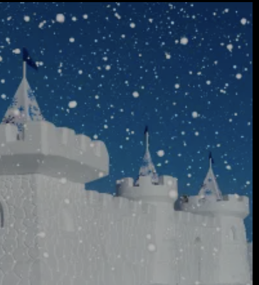
Ontario Standards Alignment
2nd Grade - Earth and Space Systems
This unit is found under 3rd grade on our site, but we recommend teaching lessons in 2nd grade if you are following Ontario Standards.
Weather & Climate (Stormy Skies)
 | Topic & Guiding Question | Student Objectives | Ontario Curriculum: Science & Technology (2022)
Lesson 1 | Water Cycle & States of Matter Where do clouds come from? | Students obtain and combine information that water can change from liquid to gas, but that it is always made of tiny drops. Clouds are made of water that has evaporated. | Grade 2. E. Air and Water in the Environment. E2. Students will demonstrate an understanding of the properties of air and water, including water in various states, and of ways in which living things depend on air and water for their survival.
Lesson 2 | Local Weather Patterns & Weather Prediction How can we predict when it’s going to storm? | Students make observations of clouds and develop a tool to make predictions about what kind of weather might happen next. | Grade 2. E. Air and Water in the Environment. E2. Students will demonstrate an understanding of the properties of air and water, including water in various states, and of ways in which living things depend on air and water for their survival.
Lesson 3 | Seasonal Weather Patterns Where’s the best place to build a snow fort? | Students gather winter temperature data from three different towns. They represent the data in a table to compare the weather and decide which town is the best candidate to host a snow fort festival in future years. | Grade 2. E. Air and Water in the Environment. E2. Students will demonstrate an understanding of the properties of air and water, including water in various states, and of ways in which living things depend on air and water for their survival.
Lesson 4 | Climate & Global Weather Patterns Why are some places always hot? | Students obtain and combine information to describe the different climate regions of the world. | Grade 2. E. Air and Water in the Environment. E2. Students will demonstrate an understanding of the properties of air and water, including water in various states, and of ways in which living things depend on air and water for their survival.
 | Natural Hazards & Engineering How can you keep a house from blowing away in a windstorm? | Students design and build solutions that reduce the hazards associated with strong winds that could damage buildings. | Grade 2. E. Air and Water in the Environment. E2. Students will demonstrate an understanding of the properties of air and water, including water in various states, and of ways in which living things depend on air and water for their survival.
Lesson 1
Lesson 2
Lesson 3
Lesson 4
Lesson 5
www.mysteryscience.com/docs/ontario

Slide 17

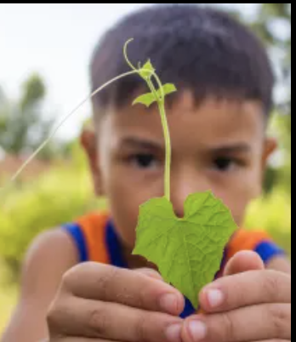
Ontario Standards Alignment
3rd Grade - Life Systems
This unit is found under 1st grade on our site, but we recommend teaching lessons in 3rd grade if you are following Ontario Standards.
Plant Traits & Survival (Plant Superpowers)
 | Topic & Guiding Question | Student Objectives | Ontario Curriculum: Science & Technology (2022)
 | Plant Traits & Offspring What will a baby plant look like when it grows up? | Students observe seedlings and adult plants and use their observations to identify the pattern that young plants are similar to their parent plants. | Grade 3. B. Growth and Changes in Plants. B2. Students will demonstrate an understanding of characteristics and uses of plants and of plants’ responses to the natural environment.
 | Plant Survival & Engineering Why don’t trees blow down in the wind? | Students learn how plants respond to light. They conduct an investigation to compare how the parts of a plant respond to light. | Grade 3. B. Growth and Changes in Plants. B2. Students will demonstrate an understanding of characteristics and uses of plants and of plants’ responses to the natural environment.
 | Plant Movement & Survival Read-Along What do sunflowers do when you’re not looking? | Students learn how plants respond to light. They conduct an investigation to compare how the parts of a plant respond to light. | Grade 3. B. Growth and Changes in Plants. B2. Students will demonstrate an understanding of characteristics and uses of plants and of plants’ responses to the natural environment.
Lesson 1
Lesson 2
Lesson 3
Lesson 1
Lesson 2
Lesson 3
www.mysteryscience.com/docs/ontario

Slide 18

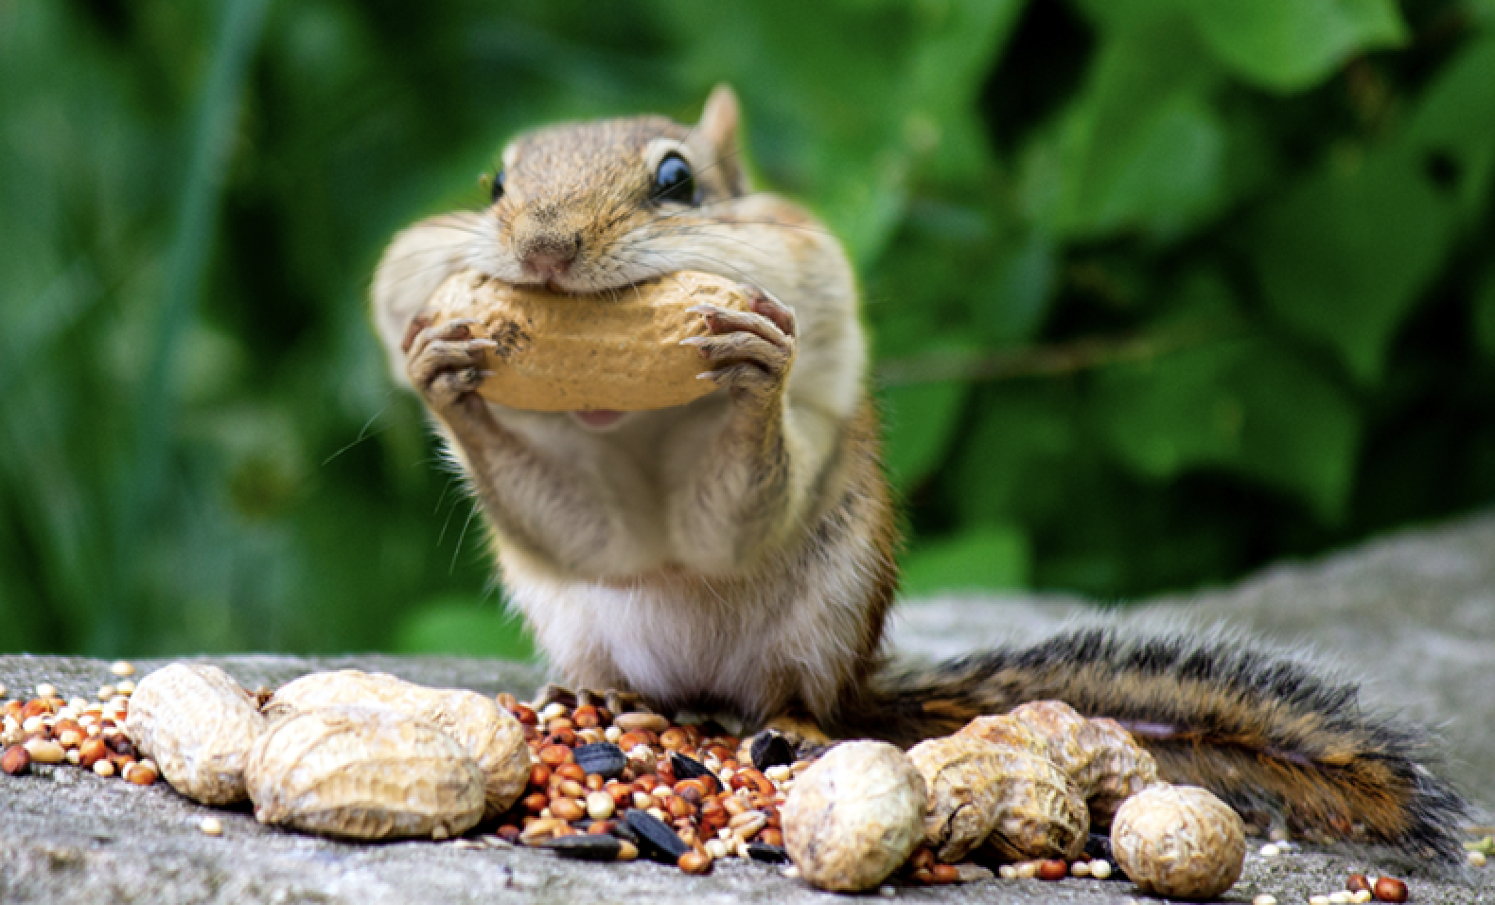
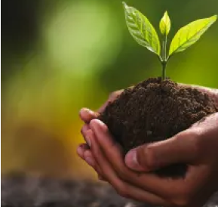
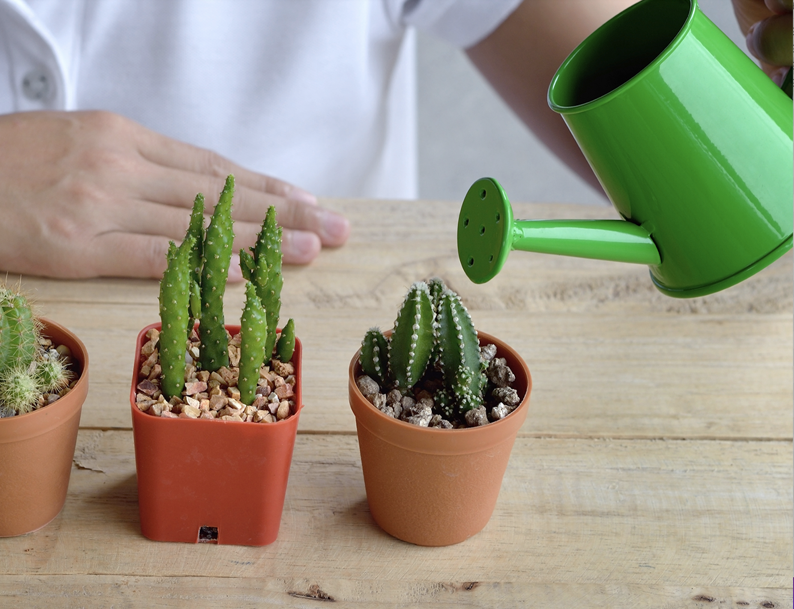
Ontario Standards Alignment
3rd Grade - Life Systems
This unit is found under 2nd grade on our site, but we recommend teaching lessons in 3rd grade if you are following Ontario Standards.
Plant Growth & Interactions (Plant Adventures)
 | Topic & Guiding Question | Student Objectives | Ontario Curriculum: Science & Technology (2022)
 | Seed Dispersal How did a tree travel halfway around the world? | Students develop physical models of seed structures. They observe how structure affects the seed’s function in dispersing away from the tree. | Grade 3. B. Growth and Changes in Plants. B2. Students will demonstrate an understanding of characteristics and uses of plants and of plants’ responses to the natural environment.
 | Animal Seed Dispersal Why do seeds have so many different shapes? | Students develop a model of a furry animal and then use it to test how far seed models with different structures can travel. | Grade 3. B. Growth and Changes in Plants. B2. Students will demonstrate an understanding of characteristics and uses of plants and of plants’ responses to the natural environment.
 | Water, Sunlight, & Plant Growth Could a plant survive without light? | Students conduct an investigation to determine that plants need water and light to grow. | Grade 3. B. Growth and Changes in Plants. B2. Students will demonstrate an understanding of characteristics and uses of plants and of plants’ responses to the natural environment.
 | Plant Needs & Habitats How much water should you give a plant? | Students plan and conduct a series of virtual experiments in order to determine how much water and sunlight a set of mystery plants need in order to stay healthy and survive. | Grade 3. B. Growth and Changes in Plants. B2. Students will demonstrate an understanding of characteristics and uses of plants and of plants’ responses to the natural environment.
Lesson 1
Lesson 2
Lesson 3
Lesson 4
www.mysteryscience.com/docs/ontario

Slide 19
Ontario Standards Alignment
3rd Grade - Life Systems
Life Cycles (Circle of Life)
 | Topic & Guiding Question | Student Objectives | Ontario Curriculum: Science & Technology (2022)
 | Animal Life Cycles How is your life like an alligator’s life? | Students create models of several different animal life cycles and compare them to one another. They use these models to discover the pattern that all animals are born, grow, can have babies, and eventually die. | Grade 2. B. Growth and Changes in Animals. B2. Students will demonstrate an understanding that animals grow and change and have distinct characteristics.
 | Environmental Change & Engineering What’s the best way to get rid of mosquitoes? | Students obtain and evaluate information about mosquitoes from different sources. They analyze and interpret information about the mosquito life cycle to reduce the number of mosquitoes that live in a certain area. | Grade 2. B. Growth and Changes in Animals. B2. Students will demonstrate an understanding that animals grow and change and have distinct characteristics.
 | Pollination & Plant Reproduction Why do plants grow flowers? | Students model the structure and function of flower parts that are responsible for creating seeds. | Grade 3. B. Growth and Changes in Plants. B2. Students will demonstrate an understanding of characteristics and uses of plants and of plants’ responses to the natural environment.
 | Fruit, Seeds, & Plant Reproduction Why do plants give us fruit? | Students explore the function of fruits in plants and practice classification. | Grade 3. B. Growth and Changes in Plants. B2. Students will demonstrate an understanding of characteristics and uses of plants and of plants’ responses to the natural environment.
 | Plant Life Cycles Why are there so many different kinds of flowers? | Students play a game that models the stages of the plant life cycle. After playing the game students use the model to show how changes to one part of the life cycle affect all other stages. | Grade 3. Growth and Changes in Plants. B2. Students will demonstrate an understanding of characteristics and uses of plants and of plants’ responses to the natural environment.
Lesson 1
Lesson 2
Lesson 3
Lesson 4
Lesson 1
Lesson 2
Lesson 3 Lesson 4 Lesson 5
Although this appears on our site, we recommend teaching this in 2nd grade if following Ontario Standards.
Although this appears on our site, we recommend teaching this in 2nd grade if following Ontario Standards.
www.mysteryscience.com/docs/ontario

Slide 20

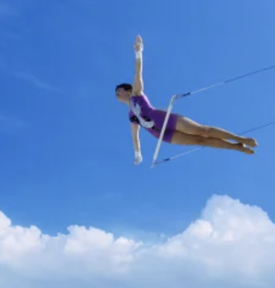
Ontario Standards Alignment
3rd Grade - Matter and Energy; Structures and Mechanisms
Forces, Motion, & Magnets (Invisible Forces)
 | Topic & Guiding Question | Student Objectives | Ontario Curriculum: Science & Technology (2022)
 | Balanced & Unbalanced Forces How could you win a tug-of-war against a bunch of adults? | Students develop a mental model of the nature of forces and motion and use that model to explain the behavior of an elastic jumper. | Grade 3. C. Forces and Motion. C2. Students will demonstrate an understanding of how forces cause motion and changes in motion.
 | Balanced Forces & Engineering What makes bridges so strong? | Students develop and design a bridge to be as strong as possible while working with limited materials. | Grade 3. D. Strong and Stable Structures. D2. Students will demonstrate an understanding of the concepts of strength and stability as they relate to structures with various forms and functions, and of the factors that affect structures’ strength and stability.
 | Pattern of Motion, Gravity, & Friction How high can you swing on a flying trapeze? | Students make observations and measurements of a trapeze model. Then, using that information they predict the motion of a real trapeze. | Grade 3. C. Forces and Motion. C2. Students will demonstrate an understanding of how forces cause motion and changes in motion.
 | Magnets & Forces What can magnets do? | Students investigate the properties of magnets and the fact that they exert forces that act at a distance. | Grade 3. C. Forces and Motion. C2. Students will demonstrate an understanding of how forces cause motion and changes in motion.
 | Magnets & Engineering How can you unlock a door using a magnet? | Students investigate magnetic attraction and repulsion, and design a magnetic lock in the hands-on activity. | Grade 3. C. Forces and Motion. C2. Students will demonstrate an understanding of how forces cause motion and changes in motion.
Lesson 1
Lesson 2
Lesson 3
Lesson 4
Lesson 5
www.mysteryscience.com/docs/ontario

Slide 21
Ontario Standards Alignment
3rd Grade - Earth and Space Systems; Structures and Mechanisms
This unit is found under 2nd grade on our site, but we recommend teaching lessons in 3rd grade if you are following Ontario Standards.
✔ Material Properties (Material Magic)
 | Topic & Guiding Question | Student Objectives | Ontario Curriculum: Science & Technology (2022)
 | Material Properties & Engineering Why do we wear clothes? | Students investigate different material properties, such as flexibility and absorbency, and use those properties to design and build a hat that protects them from the sun. | Grade 2. C. Properties of Liquids and Solids. C2. Students will demonstrate an understanding of the properties and physical changes of liquids and solids.
 | Classify Materials: Insulators Can you really fry an egg on a hot sidewalk? | Students conduct an investigation of conductors and insulators in order to determine which are best suited for allowing people to handle hot items. | Grade 2. C. Properties of Liquids and Solids. C2. Students will demonstrate an understanding of the properties and physical changes of liquids and solids.
 | Material Building Blocks & Engineering Could you build a house out of paper? | Students construct an evidence- based account of how a structure built of paper can be disassembled and rebuilt in new ways. | Grade 3. Strong and Stable Structures. D2. Students will demonstrate an understanding of the concepts of strength and stability as they relate to structures with various forms and functions, and of the factors that affect structures’ strength and stability.
 | Soil Properties How do you build a city out of mud? | Students conduct an investigation where they examine three different soil models. They use this information to determine which type of soil has the properties that will result in the best mud that can be used to build a house. | Grade 3. Soils in the Environment. E2. Students will demonstrate an understanding of the composition of soils, of different types of soils, and of processes and practices that can affect the health of soil.
Lesson 1
Although this appears on our site, we recommend teaching this in 2rd grade if following Ontario Standards.
Lesson 2
Although this appears on our site, we recommend teaching this in 2rd grade if following Ontario Standards.
Lesson 3
Lesson 4
✔ Unit Restructured for the 2025-2026 School Year
www.mysteryscience.com/docs/ontario

Slide 22
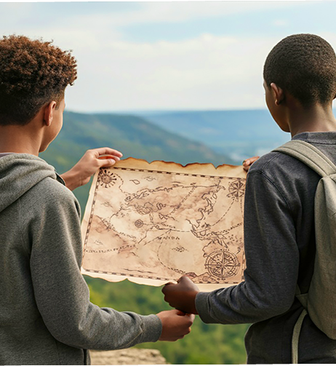
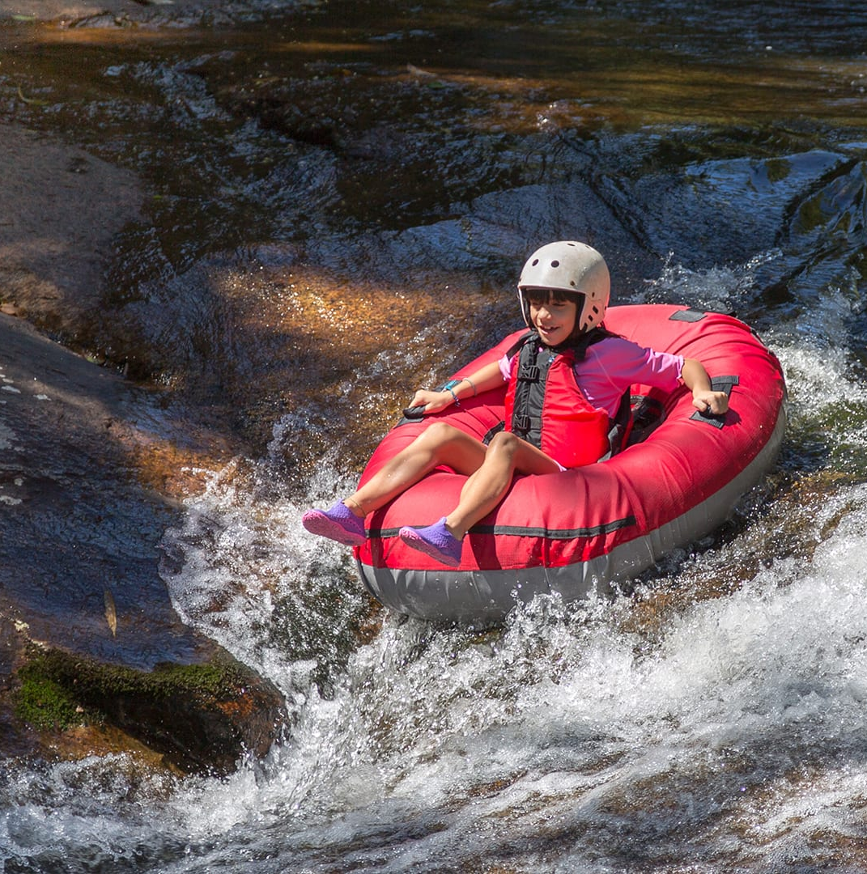
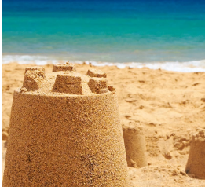
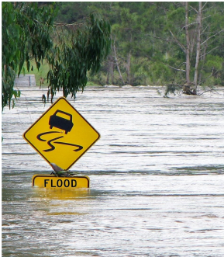
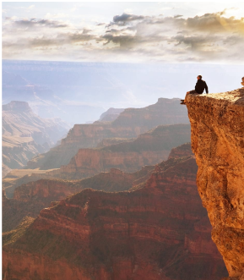
Ontario Standards Alignment
3rd Grade - Earth and Space Systems
This unit is found under 2nd grade on our site, but we recommend teaching lessons in 3rd grade if you are following Ontario Standards.
Erosion & Earth’s Surface (Work of Water) • Page 1 of 2
 | Topic & Guiding Question | Student Objectives | Ontario Curriculum: Science & Technology (2022)
 | ✨New!✨ Mapping Landforms & Bodies of Water Where’s the best place to hide a treasure? | Students develop a model (a map) of different landforms and bodies of water in a given location based on the shape of each feature. | Foundational for Grade 3. E. Soils in the Environment. E2. Students will demonstrate an understanding of the composition of soils, of different types of soils, and of processes and practices that can affect the health of soil.
 | Mapping: Mountains & Rivers If you floated down a river, where would you end up? | Students develop a model of the Earth’s surface and use it to discover an important principle about how rivers work: rivers flow downhill, from high places to low places. | Foundational for Grade 3. E. Soils in the Environment. E2. Students will demonstrate an understanding of the composition of soils, of different types of soils, and of processes and practices that can affect the health of soil.
 | Rocks, Sand, & Erosion Why is there sand at the beach? | Students investigate the effects of rocks tumbling in a river. Based on their observations, they construct an explanation for why rocks on the top of mountains are much bigger than the sand at the beach. | Grade 3. E. Soils in the Environment. E2. Students will demonstrate an understanding of the composition of soils, of different types of soils, and of processes and practices that can affect the health of soil.
 | Mapping & Severe Weather Where do flash floods happen? | Students use a model (i.e. a map) to examine the different factors, including the shapes and kinds of land, that contribute to flash floods. They use this to predict where flash floods are most likely to happen. | Grade 3. E. Soils in the Environment. E2. Students will demonstrate an understanding of the composition of soils, of different types of soils, and of processes and practices that can affect the health of soil.
 | Erosion, Earth’s Surface, & Landforms What’s strong enough to make a canyon? | Students create a model landform and investigate how some Earth events can occur quickly, while others occur slowly. | Grade 3. E. Soils in the Environment. E2. Students will demonstrate an understanding of the composition of soils, of different types of soils, and of processes and practices that can affect the health of soil.
Continued on next page
Lesson 1
Lesson 2
Lesson 3
Lesson 4
Lesson 5
✨ New Lesson
www.mysteryscience.com/docs/ontario

Slide 23
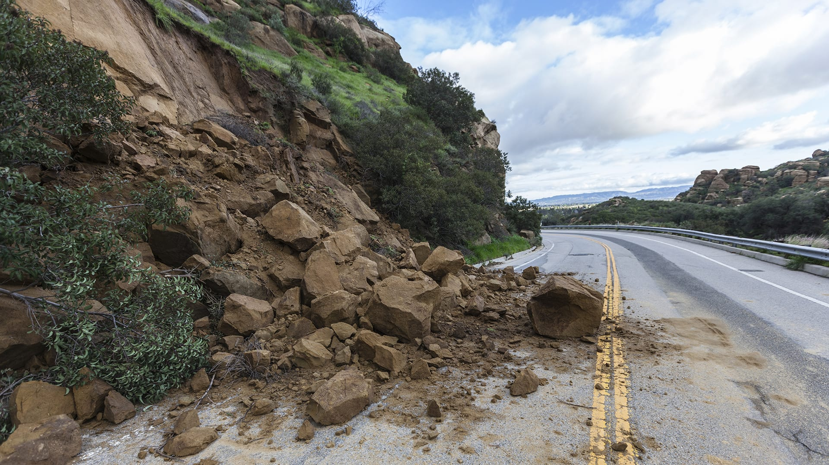
Ontario Standards Alignment
3rd Grade - Earth and Space Systems
This unit is found under 2nd grade on our site, but we recommend teaching lessons in 3rd grade if you are following Ontario Standards.
Erosion & Earth’s Surface (Work of Water) • Page 2 of 2
 | Topic & Guiding Question | Student Objectives | Ontario Curriculum: Science & Technology (2022)
 | Erosion & Engineering How can you stop a landslide? | Students compare multiple solutions for preventing erosion. | Grade 3. E. Soils in the Environment. E2. Students will demonstrate an understanding of the composition of soils, of different types of soils, and of processes and practices that can affect the health of soil.
Lesson 6
www.mysteryscience.com/docs/ontario

Slide 24

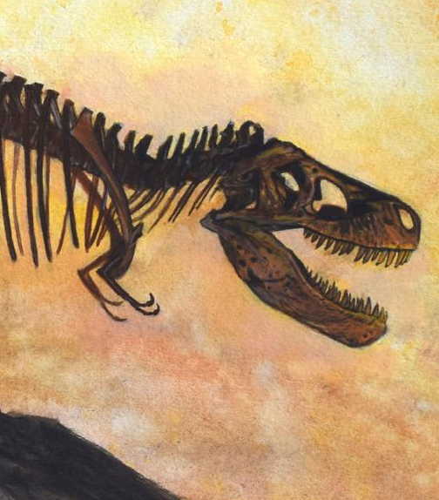
Ontario Standards Alignment
4th Grade - Life Systems
This unit is found under 3rd grade on our site, but we recommend teaching lessons in 4th grade if you are following Ontario Standards.
Fossils & Changing Environments (Animals Through Time)
 | Topic & Guiding Question | Student Objectives | Ontario Curriculum: Science & Technology (2022)
 | Habitats, Fossils, & Environments Over Time Where can you find whales in a desert? | Students explore the idea that the rock under our feet sometimes contains fossils, and investigate how these fossils reveal changes in habitats through time. | Grade 4. B. Habitats and Communities. B2. Students will demonstrate an understanding of habitats and communities and of interrelationships among the organisms that live in them.
 | Fossil Evidence & Dinosaurs How do we know what dinosaurs looked like? | Students learn how we can infer what the outside of an animal looked like by using clues about their skeleton. | Grade 4. B. Habitats and Communities. B2. Students will demonstrate an understanding of habitats and communities and of interrelationships among the organisms that live in them.
 | Trace Fossil Evidence & Animal Movement Can you outrun a dinosaur? | Students learn how fossilized animal tracks can tell us a great deal about the animals that left them. | Grade 4. B. Habitats and Communities. B2. Students will demonstrate an understanding of habitats and communities and of interrelationships among the organisms that live in them.
Lesson 1
Lesson 2
Lesson 3
Lesson 1
Lesson 2
Lesson 3
Lesson 4
www.mysteryscience.com/docs/ontario

Slide 25
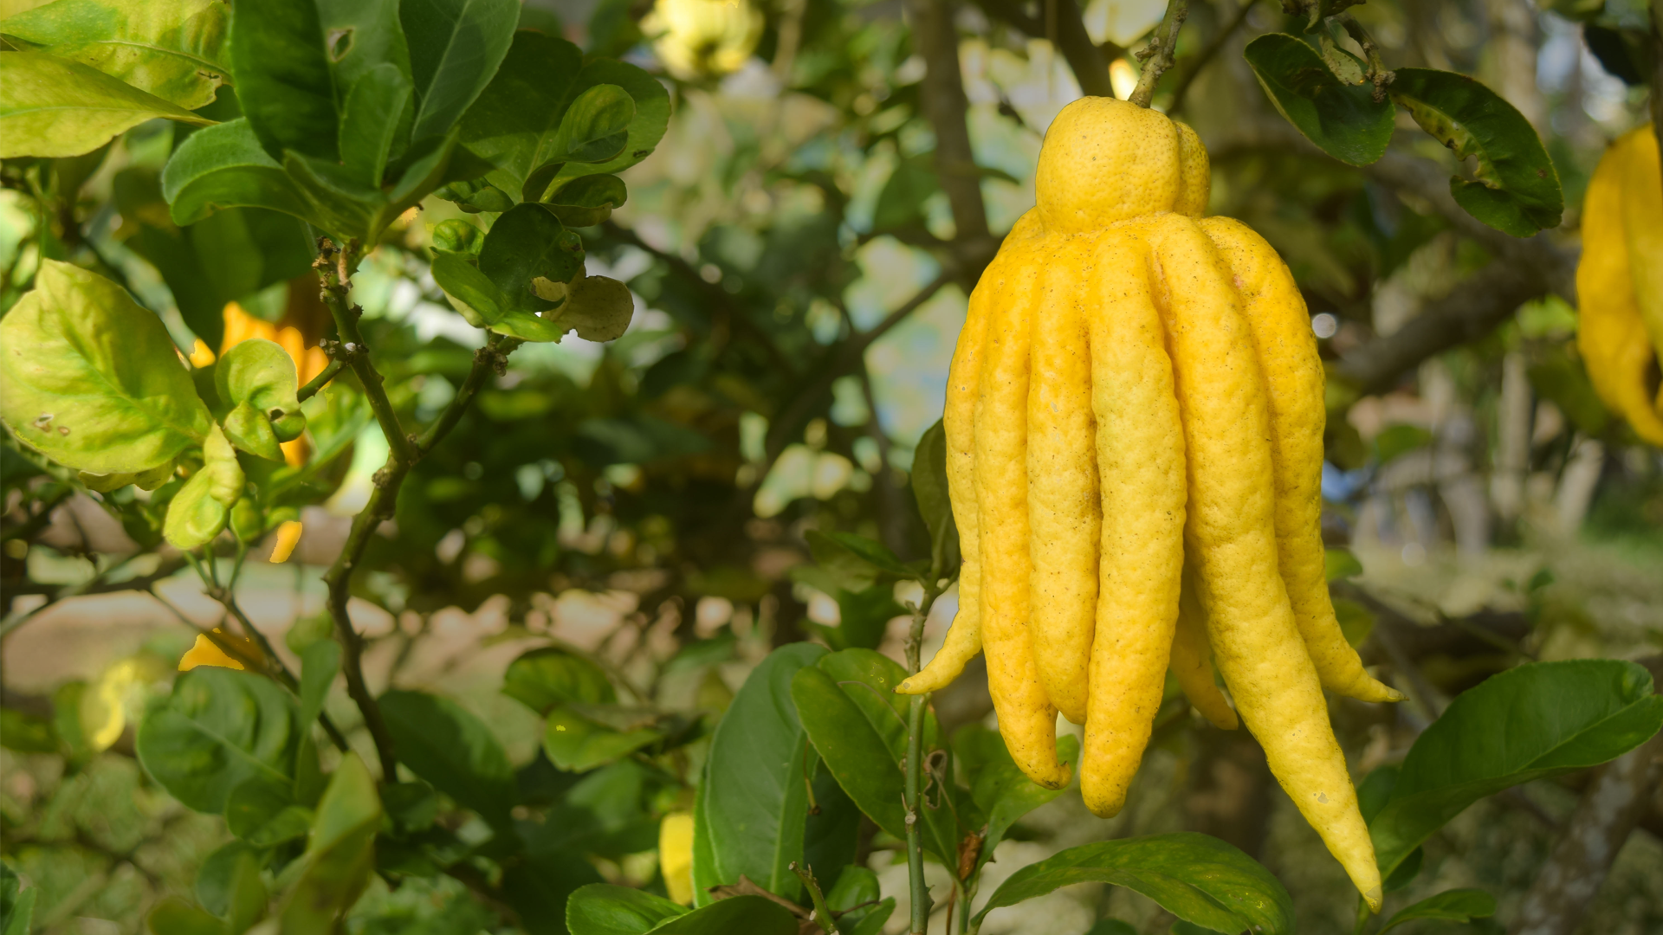
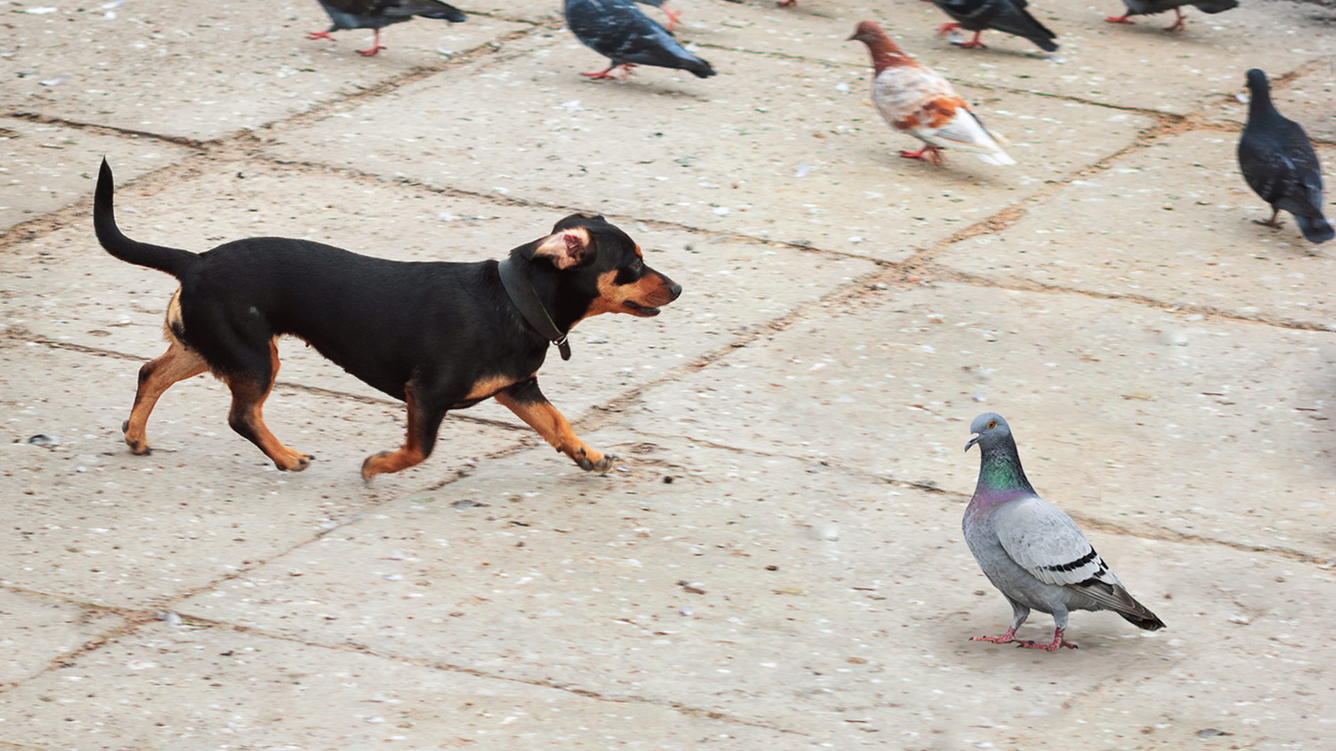
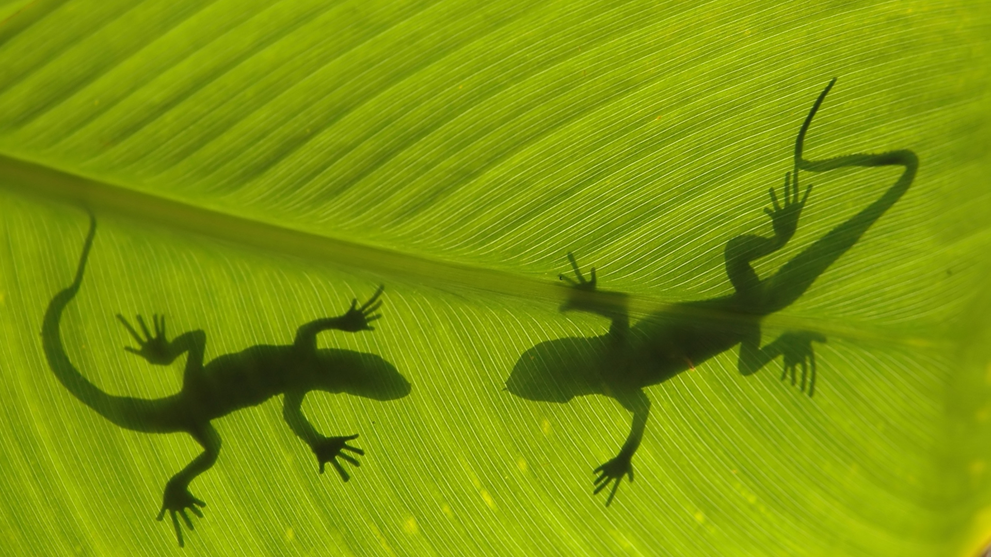
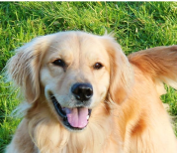

Ontario Standards Alignment
4th Grade - Life Systems
This unit is found under 3rd grade on our site, but we recommend teaching lessons in 4th grade if you are following Ontario Standards.
Heredity, Survival, & Selection (Fates of Traits)
 | Topic & Guiding Question | Student Objectives | Ontario Curriculum: Science & Technology (2022)
 | Traits & Inheritance How do you identify a mysterious fruit? | Students examine plant traits and use that information as evidence to help them identify an unknown fruit. They look for similarities and differences in the leaves, flowers, and fruits of plants to sort them into groups and identify patterns of inheritance. | Grade 4. B. Habitats and Communities. B2. Students will demonstrate an understanding of habitats and communities and of interrelationships among the organisms that live in them
 | Trait Variation, Inheritance, & Artificial Selection What do dogs and pigeons have in common? | Students analyze trait similarities and differences among parent, offspring, and sibling pigeons. They interpret this data to discover that the variation and inheritance of traits creates a pattern that explains why we see such extreme traits in artificially selected animal breeds. | Grade 4. B. Habitats and Communities. B2. Students will demonstrate an understanding of habitats and communities and of interrelationships among the organisms that live in them.
 | Trait Variation, Survival, & Natural Selection How could a lizard’s toes help it survive? | Students compare the structures of lizards that live on an island. They simulate multiple generations of these lizards, and analyze and interpret the data to understand how these structures aid in their survival. | Grade 4. B. Habitats and Communities. B2. Students will demonstrate an understanding of habitats and communities and of interrelationships among the organisms that live in them.
 | Animal Groups & Survival Why do dogs wag their tails? | Students observe animals that live in groups in order to obtain, evaluate, and communicate information about animal social behavior. Students use evidence to show how animals form groups to help them survive. | Grade 4. B. Habitats and Communities. B2. Students will demonstrate an understanding of habitats and communities and of interrelationships among the organisms that live in them.
 | Traits & Environmental Variation How long can people (and animals) survive in outer space? | Students measure and compare their own physical traits (arm strength, balance, and height) and analyze the information to construct an explanation for how the environment can influence traits. | Grade 4. B. Habitats and Communities. B2. Students will demonstrate an understanding of habitats and communities and of interrelationships among the organisms that live in them.
Lesson 1
Lesson 2
Lesson 3
Lesson 4
Lesson 5
www.mysteryscience.com/docs/ontario

Slide 26
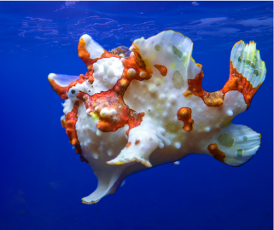
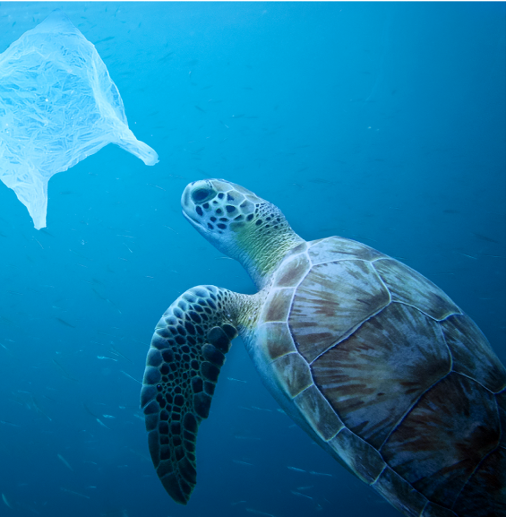
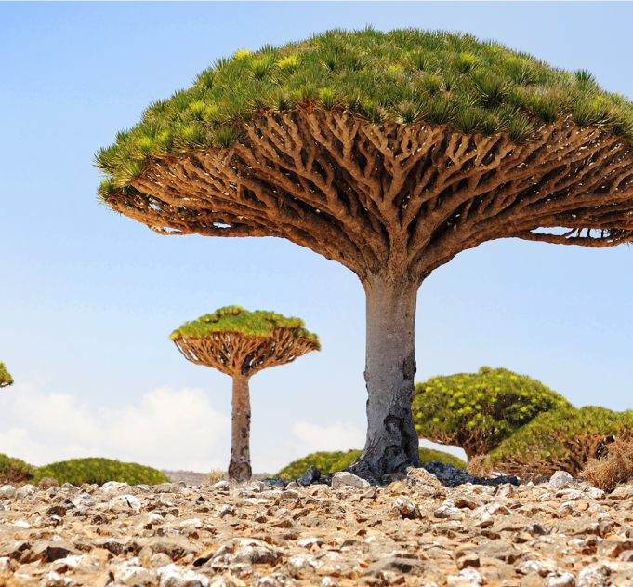
Ontario Standards Alignment
4th Grade - Life Systems
Animal & Plant Adaptations (Animal & Plant Adaptations)
 | Topic & Guiding Question | Student Objectives | Ontario Curriculum: Science & Technology (2022)
 | Animal Adaptations Why do some sea creatures look so strange? | Students make observations of underwater animals in order to collect evidence that external structures serve specific functions. They use their observations to construct an argument that an animal’s structures work together as part of a system to support their growth and survival. | Grade 4. B. Habitats and Communities. B2. Students will demonstrate an understanding of habitats and communities and of interrelationships among the organisms that live in them.
 | Learned Behavior & Instinct Why would a sea turtle eat a plastic bag? | Students use models to understand how an animal’s senses, brain, and memories all work together as a system to influence their behavior and support their survival. | Grade 4. B. Habitats and Communities. B2. Students will demonstrate an understanding of habitats and communities and of interrelationships among the organisms that live in them.
 | Plant Adaptations Why don’t the same trees grow everywhere? | Students use models of roots and branches to explore their functions and then construct an argument about how these structures must work together in order to support the survival of trees in the unique environment of the frozen taiga. | Grade 4. B. Habitats and Communities. B2. Students will demonstrate an understanding of habitats and communities and of interrelationships among the organisms that live in them.
Lesson 1
Lesson 2
Lesson 3
www.mysteryscience.com/docs/ontario

Slide 27
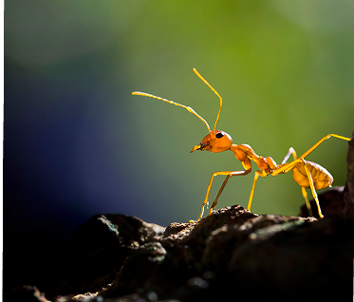
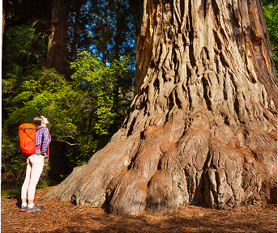
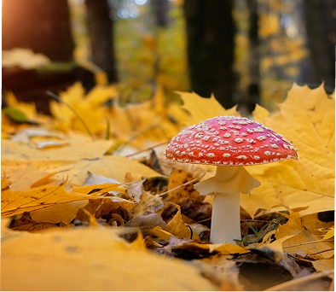
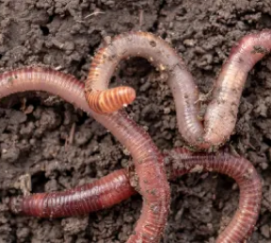
Ontario Standards Alignment
4th Grade - Life Systems
This unit is found under 5th grade on our site, but we recommend teaching lessons in 4th grade if you are following Ontario Standards.
Ecosystems & The Food Web (Web of Life)• Page 1 of 2
 | Topic & Guiding Question | Student Objectives | Ontario Curriculum: Science & Technology (2022)
 | ✨New!✨ Food Chains & Matter Flow What if all the ants disappeared? | Students construct models of food chains by linking cards discovering that different interrelationships exist between organisms. | Grade 4. B. Habitats and Communities. B2. Students will demonstrate an understanding of habitats and communities and of interrelationships among the organisms that live in them.
 | ✨New!✨ Plant Growth & Matter How does a tiny seed become one of the heaviest trees on Earth? | Students gather evidence through a series of virtual experiments to construct an argument that plants use mostly air and water as the materials for their growth. | Grade 4. B. Habitats and Communities. B2. Students will demonstrate an understanding of habitats and communities and of interrelationships among the organisms that live in them.
 | ✨New!✨ Decomposers & Matter Flow Where do fallen leaves go? | Students conduct an investigation to gain an understanding of the important role that decomposers play in recycling matter from dead leaves back into the environment. | Grade 4. B. Habitats and Communities. B2. Students will demonstrate an understanding of habitats and communities and of interrelationships among the organisms that live in them.
 | Decomposers & Soil Nutrients Do worms really eat dirt? | Students make observations of worms to realize that worms act as decomposers to eat dead matter in an ecosystem and cycle nutrients into the soil. | Grade 4. B. Habitats and Communities. B2. Students will demonstrate an understanding of habitats and communities and of interrelationships among the organisms that live in them.
Lesson 1
Lesson 2
Lesson 3
Lesson 4
Continued on next page
✨ New Lesson
www.mysteryscience.com/docs/ontario

Slide 28

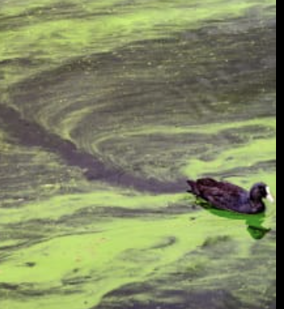
Ontario Standards Alignment
4th Grade - Life Systems
This unit is found under 5th Grade on our site, but we recommend teaching lessons in 4th grade if you are following Ontario Standards.
Ecosystems & The Food Web (Web of Life)• Page 2 of 2
 | Topic & Guiding Question | Student Objectives | Ontario Curriculum: Science & Technology (2022)
 | Ecosystems & Matter Cycle Why do you have to clean a fish tank but not a pond? | Students develop a model of a pond ecosystem and realize that interrelationships exist between decomposers, plants, and animals. Students discover that each organism must be in balance for the pond ecosystem to function. | Grade 4. B. Habitats and Communities. B2. Students will demonstrate an understanding of habitats and communities and of interrelationships among the organisms that live in them.
 | Protecting Environments How can we protect Earth’s environments? | In this lesson, students learn about what happens in unbalanced ecosystems and how that can lead to an overabundance of algae and harmful algal blooms. In the activity, Bloom Busters, students play a game in which they obtain and combine science ideas in order to help a community respond to and prevent harmful algal blooms. | Grade 4. B. Habitats and Communities. B2. Students will demonstrate an understanding of habitats and communities and of interrelationships among the organisms that live in them.
 | Food Webs & Flow of Energy Why did the dinosaurs go extinct? | Students develop a model of a dinosaur food web. Students realize that blocking the sun’s energy would have disastrous effects on the organisms that rely on this energy in the food web and cause the extinction of some entire species. | Grade 4. B. Habitats and Communities. B2. Students will demonstrate an understanding of habitats and communities and of interrelationships among the organisms that live in them.
Lesson 5 Lesson 6
Lesson 7
www.mysteryscience.com/docs/ontario

Slide 29

Ontario Standards Alignment
4th Grade - Matter and Energy
This unit is found under 1st grade on our site, but we recommend teaching lessons in 4th grade if you are following Ontario Standards.
Light, Sound, & Communication (Lights & Sounds)
 | Topic & Guiding Question | Student Objectives | Ontario Curriculum: Science & Technology (2022)
 | Sounds & Vibrations How do they make silly sounds in cartoons? | Students explore how to make different sounds with everyday objects. They construct an explanation that objects vibrate when they make a sound, and if the vibration stops, the sound stops. | Grade 4. C. Light and Sound. C2. Students will demonstrate an understanding of light and sound as forms of energy that have specific characteristics and properties.
 | Sounds & Vibrations Read-Along Where do sounds come from? | Students create three different sound makers and construct an explanation about where the vibrations are happening in each sound experiment. | Grade 4. C. Light and Sound. C2. Students will demonstrate an understanding of light and sound as forms of energy that have specific characteristics and properties.
 | Light, Materials, Transparent & Opaque What if there were no windows? | Students investigate the properties of different materials that they can and cannot see through. Then they create a stained glass window using tissue paper to explore how materials interact with light. | Grade 4. C. Light and Sound. C2. Students will demonstrate an understanding of light and sound as forms of energy that have specific characteristics and properties.
 | Light & Illumination Read-Along Can you see in the dark? | Students look inside a completely dark box to determine if they can see the shape of the object inside. They allow more light into the box to illuminate the object and allow them to see it. Students use their observations explain that objects need light to be seen. | Grade 4. C. Light and Sound. C2. Students will demonstrate an understanding of light and sound as forms of energy that have specific characteristics and properties.
 | Light, Communication, & Engineering How could you send a secret message to someone far away? | Students are presented with the problem that they need to send a message at night, without using noise. They design a solution to create a color-coded message system and communicate with light signals. | Grade 4. C. Light and Sound. C2. Students will demonstrate an understanding of light and sound as forms of energy that have specific characteristics and properties.
 | Lights, Sounds, & Communication Read-Along How do boats find their way in the fog? | Students obtain information about light and sound signals. They analyze different sounds with eyes closed to determine which type of sound they hear. | Grade 4. C. Light and Sound. C2. Students will demonstrate an understanding of light and sound as forms of energy that have specific characteristics and properties.
Lesson 1
Lesson 2
Lesson 3
Lesson 4
Lesson 5
Lesson 6
This unit was developed for 1st grade so may need adjustments for teaching in 4th grade.
www.mysteryscience.com/docs/ontario

Slide 30


Ontario Standards Alignment
4th Grade - Matter and Energy
Sound, Waves, & Communication (Waves of Sound)
 | Topic & Guiding Question | Student Objectives | Ontario Curriculum: Science & Technology (2022)
 | Pattern Transfer & Technology How do you send a secret code? | Students explore how digital devices encode complex information. Students generate their own codes in order to transfer information across the classroom. Then, they compare their codes and evaluate which worked best given the criteria and constraints. | Grade 4. C. Light and Sound. C2. Students will demonstrate an understanding of light and sound as forms of energy that have specific characteristics and properties.
 | Sound, Vibration, & Engineering How far can a whisper travel? | Students investigate sound energy using paper cup telephones. Students figure out that sound is a vibration that can travel through a medium. | Grade 4. C. Light and Sound. C2. Students will demonstrate an understanding of light and sound as forms of energy that have specific characteristics and properties.
 | Sound & Vibrations What would happen if you screamed in outer space? | Students construct a model of sound vibrations to explain how air is a medium that sound vibrations travel through. | Grade 4. C. Light and Sound. C2. Students will demonstrate an understanding of light and sound as forms of energy that have specific characteristics and properties.
 | Sound Waves & Wavelength Why are some sounds high and some sounds low? | Students make observations of vibrations and sound waves to discover that high pitch sounds vibrate faster and have short wavelengths and low pitch sounds vibrate slower and have long wavelengths. | Grade 4. C. Light and Sound. C2. Students will demonstrate an understanding of light and sound as forms of energy that have specific characteristics and properties.
Lesson 1
Lesson 2
Lesson 3 Lesson 4
www.mysteryscience.com/docs/ontario

Slide 31

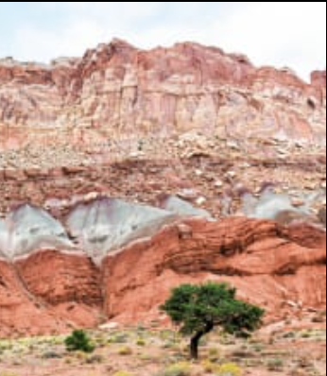
Ontario Standards Alignment
4th Grade - Earth and Space Systems
Earth’s Features & Processes (The Birth of Rocks)
 | Topic & Guiding Question | Student Objectives | Ontario Curriculum: Science & Technology (2022)
Lesson 1 | Volcanoes & Patterns of Earth’s Features Could a volcano pop up where you live? | Students use coordinates to develop a map of volcanoes to discover a pattern of where volcanoes exist on Earth. Students identify the pattern of volcanoes in the “Ring of Fire.” | Grade 4. E. Rocks, Minerals, and Geological Processes. E2. Students will demonstrate an understanding of rocks, minerals, and Earth’s geological processes.
Lesson 2 | Volcanoes & Rock Cycle Why do some volcanoes explode? | Students investigate the properties of thin and thick lava by attempting to create air bubbles. Students realize that thick lava will cause a volcano to explode, while thin lava will not. | Grade 4. E. Rocks, Minerals, and Geological Processes. E2. Students will demonstrate an understanding of rocks, minerals, and Earth’s geological processes.
Lesson 3 | Weathering & Erosion Will a mountain last forever? | Students make observations of the effects of weathering to discover that rocks will become rounded and break into small pieces when they tumble down a mountain. | Grade 4. E. Rocks, Minerals, and Geological Processes. E2. Students will demonstrate an understanding of rocks, minerals, and Earth’s geological processes.
Lesson 4 | Sedimentary Rock & Fossils What did your town look like 100 million years ago? | Students create a model canyon and use the pattern of fossils found in each rock layer to support the explanation that the landscape has changed many times over millions of years. | Grade 4. E. Rocks, Minerals, and Geological Processes. E2. Students will demonstrate an understanding of rocks, minerals, and Earth’s geological processes.
 | Erosion, Natural Hazards, & Engineering How could you survive a landslide? | Students generate multiple possible solutions to protect homes from a landslide. Students realize that there are many causes for the erosion that causes rocks to fall in landslides. | Grade 4. E. Rocks, Minerals, and Geological Processes. E2. Students will demonstrate an understanding of rocks, minerals, and Earth’s geological processes.
Lesson 1
Lesson 2
Lesson 3
Lesson 4
Lesson 5
www.mysteryscience.com/docs/ontario

Slide 32

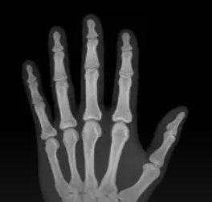
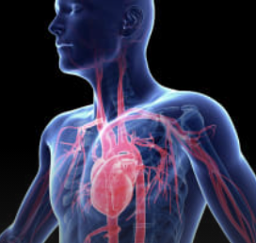
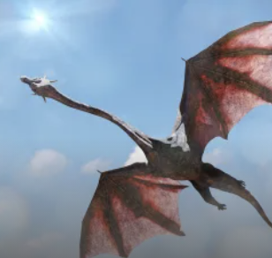
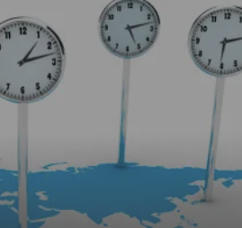
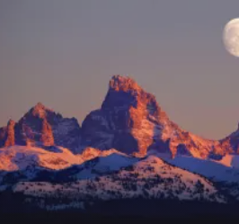
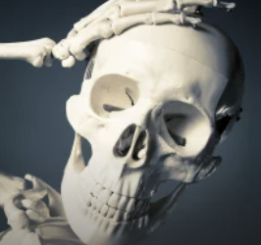
Ontario Standards Alignment
5th Grade - Life Systems
This unit is found under 4th grade on our site, but we recommend teaching lessons in 5th grade if you are following Ontario Standards.
Human Body, Vision, & The Brain (Human Machine)
 | Topic & Guiding Question | Student Objectives | Ontario Curriculum: Science & Technology (2022)
 | Muscles & Skeleton Why do your biceps bulge? | Students construct a model of the human hand to explain how muscles pull on bones to create movement. | Grade 5. B. Human Health and Body Systems. B2. Students will demonstrate an understanding of the structure and function of human body systems and interactions within and between systems.
 | Light, Eyes, & Vision What do people who are blind see? | Students develop a working model of an eye. They use the model to reason about how light reflects off an object and into the eye, helping an organism process information from the environment. | Grade 5. B. Human Health and Body Systems. B2. Students will demonstrate an understanding of the structure and function of human body systems and interactions within and between systems.
 | Structure & Function of Eyes How can some animals see in the dark? | Students use their eye model to discover that the pupil controls the amount of light let into the eye. In the dark, pupils get larger to let in more light. | Grade 5. B. Human Health and Body Systems. B2. Students will demonstrate an understanding of the structure and function of human body systems and interactions within and between systems.
 | Brain, Nerves, & Information Processing How does your brain control your body? | Students investigate how their own brain works by testing their reflexes. They discover that the brain receives information from the senses, processes the information, and sends signals to the muscles to enable movement. | Grade 5. B. Human Health and Body Systems. B2. Students will demonstrate an understanding of the structure and function of human body systems and interactions within and between systems.
Lesson 1
Lesson 2
Lesson 3
Lesson 4
Mini-lesson
Mini-lesson
Grade 5. B. Human Health and Body Systems. B2. Why does our skeleton have so many bones?
Grade 5. B. Human Health and Body Systems. B2. Why does the heart pump blood?
Mini-lesson
Grade 5. B. Human Health and Body Systems. B2. What would happen if you didn’t have a skull?
www.mysteryscience.com/docs/ontario

Slide 33

Ontario Standards Alignment
5th Grade - Matter and Energy
Chemical Reactions & Properties of Matter (Chemical Magic)
 | Topic & Guiding Question | Student Objectives | Ontario Curriculum: Science & Technology (2022)
 | Conservation of Matter Are magic potions real? | Students observe that a salt and vinegar solution will turn a dull penny shiny again indicating that substances can change other substances. | Grade 5. C. Properties of and Changes in Matter. C2. Students will demonstrate an understanding of the properties of matter, changes of state, and physical and chemical change.
 | Dissolving & Particulate Nature of Matter Could you transform something worthless into gold? | Students coat a steel nail in copper by placing it into the solution that dissolved bits of the penny. Students realize that substances can change to become particles too small to be seen, but they still exist. | Grade 5. C. Properties of and Changes in Matter. C2. Students will demonstrate an understanding of the properties of matter, changes of state, and physical and chemical change.
 | Properties of Matter: Acids What would happen if you drank a glass of acid? | Students figure out that acids are very reactive substances. Students investigate reactions between different substances to determine how known acids react with other materials. | Grade 5. C. Properties of and Changes in Matter. C2. Students will demonstrate an understanding of the properties of matter, changes of state, and physical and chemical change.
 | Chemical Reactions What do fireworks, rubber, and Silly Putty have in common? | Students combine different substances together to discover that chemical reactions can create new substances. | Grade 5. C. Properties of and Changes in Matter. C2. Students will demonstrate an understanding of the properties of matter, changes of state, and physical and chemical change.
 | Gases & Particle Models Why do some things explode? | Students investigate and model the reaction between baking soda and vinegar. They figure out that gases are made of particles too small to be seen. | Grade 5. C. Properties of and Changes in Matter. C2. Students will demonstrate an understanding of the properties of matter, changes of state, and physical and chemical change.
Lesson 1
Lesson 2
Lesson 3
Lesson 4
Lesson 5
www.mysteryscience.com/docs/ontario

Slide 34

Ontario Standards Alignment
5th Grade - Matter and Energy; Earth and Space Systems
Water Cycle & Earth’s Systems (Watery Planet)
 | Topic & Guiding Question | Student Objectives | Ontario Curriculum: Science & Technology (2022)
Lesson 1 | Hydrosphere & Water Distribution How much water is in the world? | Students analyze and interpret data from world maps to determine the relative amounts of fresh, salt, and frozen water. Students figure out that while the Earth has a lot of water, most of Earth’s water is not fresh or accessible. | Grade 5. E. Conservation of Energy and Resources. E1. Students will assess effects of energy and resource use on society and the environment, and suggest options for conserving energy and resources.
Lesson 2 | Mixtures & Solutions How much salt is in the ocean? | Students create a model ocean to observe how salt seems to completely vanish when dissolved in water. Students measure and graph quantities to provide evidence that the salt is still in the solution, even though we can’t see it. | Grade 5. C. Properties of and Changes in Matter. C2. Students will demonstrate an understanding of the properties of matter, changes of state, and physical and chemical change.
Lesson 3 | Groundwater as a Natural Resource When you turn on the faucet, where does the water come from? | Students learn most people get fresh water from underground sources. Students determine the best place to settle a town by considering features of the landscape & the characteristics of the plants that thrive there. | Grade 5. E. Conservation of Energy and Resources. E1. Students will assess effects of energy and resource use on society and the environment, and suggest options for conserving energy and resources.
Lesson 4 | Water Cycle Can we make it rain? | Students create a model of the ocean and sky to investigate how temperature influences evaporation and condensation. Students figure out that higher ocean temperatures lead to more evaporation, thus leading to more rain. | Grade 5. C. Properties of and Changes in Matter. C2. Students will demonstrate an understanding of the properties of matter, changes of state, and physical and chemical change.
 | Natural Disasters & Engineering How can you save a town from a hurricane? | Students define the problem that a town needs protection from flooding. They design solutions using different types of flood protection. They realize flooding is caused by severe rainfall generated by hurricanes. Hurricanes are created where ocean temperatures are warm. | Grade 5. D. Forces Acting on Structures. D2. Students will demonstrate an understanding of forces that act on structures, and how various structures withstand them.
Lesson 1
Lesson 2
Lesson 3
Lesson 4
Lesson 5
www.mysteryscience.com/docs/ontario

Slide 35

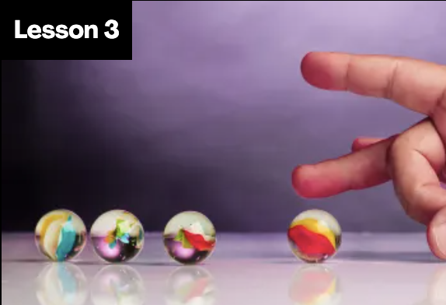

Ontario Standards Alignment
5th Grade - Earth and Space Systems
This unit is found under 4th Grade on our site, but we recommend teaching lessons in 5th grade if you are following Ontario Standards.
Energy & Energy Transfer (Energizing Everything)
 | Topic & Guiding Question | Student Objectives | Ontario Curriculum: Science & Technology (2022)
 | Speed & Energy How is your body similar to a car? | Students learn about stored energy and about the relationship between motion and energy. Students build models of an amusement park ride and discover how energy can be stored in materials. Stored energy can be converted to speed. | Grade 5. E. Conservation of Energy and Resources. E2. Students will demonstrate an understanding of the conservation of energy, and the forms, sources, and uses of energy and resources.
 | Gravitational Energy, Speed, & Collisions What makes roller coasters go so fast? | Students build a model of a roller coaster and carry out an investigation using marbles. Students learn that lifting an object up stores energy in the object. When the object falls, that stored energy is released. They realize that energy is transferred when objects collide. | Grade 5. E. Conservation of Energy and Resources. E2. Students will demonstrate an understanding of the conservation of energy, and the forms, sources, and uses of energy and resources.
 | Collisions & Energy Transfer How can marbles save the world? | Students investigate how energy transfers when objects collide. In the activity, Bumper Jumper, students ask questions and make predictions about how far a marble will launch over a jump after colliding with other objects. | Grade 5. E. Conservation of Energy and Resources. E2. Students will demonstrate an understanding of the conservation of energy, and the forms, sources, and uses of energy and resources.
 | Energy Transfer & Engineering Could you knock down a building using only dominoes? | Students experiment with ways to store and release energy, creating the beginning of a chain reaction machine with a lever and a ramp. Students figure out that a domino standing on end is storing energy, only requiring a small amount of energy (a tiny push) to release the stored energy. | Grade 5. E. Conservation of Energy and Resources. E2. Students will demonstrate an understanding of the conservation of energy, and the forms, sources, and uses of energy and resources.
 | Energy Transfer & Engineering Can you build a chain reaction machine? | Students continue to build a chain reaction machine — identifying a goal, brainstorming and testing multiple ideas, and determining an optimal solution. The chain reaction machine uses multiple components to transfer energy from one part to the next. | Grade 5. E. Conservation of Energy and Resources. E2. Students will demonstrate an understanding of the conservation of energy, and the forms, sources, and uses of energy and resources.
Lesson 1
Lesson 2
Lesson 3
Lesson 4 Lesson 5
www.mysteryscience.com/docs/ontario

Slide 36

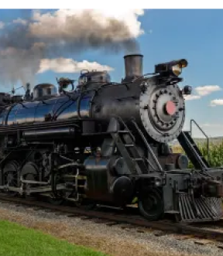
Ontario Standards Alignment
5th Grade - Earth and Space Systems
This unit is found under 4th Grade on our site, but we recommend teaching lessons in 5th grade if you are following Ontario Standards.
Electricity, Light, & Heat (Electricity, Light & Heat)
 | Topic & Guiding Question | Student Objectives | Ontario Curriculum: Science & Technology (2022)
 | Renewable Energy & Natural Resources What’s the best way to light up a city? | Students evaluate the advantages and disadvantages of wind, water, and solar energy to power a town. Students obtain and evaluate information about the needs of each source of energy and analyze and interpret data about the town’s resources. | Grade 5. E. Conservation of Energy and Resources. E2. Students will demonstrate an understanding of the conservation of energy, and the forms, sources, and uses of energy and resources.
 | Electrical Energy What if there were no electricity? | Students design a flashlight with an on/off switch, using batteries, flights, and tin foil. Students figure out that electricity can be transformed to other forms of energy, such as movement, light, and heat. | Grade 5. E. Conservation of Energy and Resources. E2. Students will demonstrate an understanding of the conservation of energy, and the forms, sources, and uses of energy and resources.
 | Heat Energy & Energy Transfer How long did it take to travel across the country before cars and planes? | Students build a paper spinner and conduct an investigation to explain how heat makes things move. Students realize that heat energy can be transformed into motion energy using a turbine. | Grade 5. E. Conservation of Energy and Resources. E2. Students will demonstrate an understanding of the conservation of energy, and the forms, sources, and uses of energy and resources.
Lesson 1
Lesson 2
Lesson 3
www.mysteryscience.com/docs/ontario

Slide 37
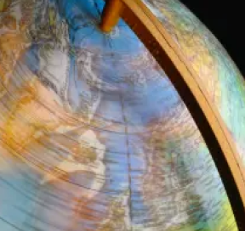

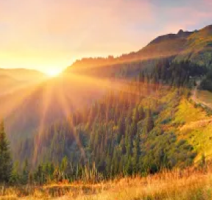


Ontario Standards Alignment
6th Grade - Earth and Space Systems
This unit is found under 5th Grade on our site, but we recommend teaching lessons in 6th grade if you are following Ontario Standards.
Earth & Space Patterns (Spaceship Earth)
 | Topic & Guiding Question | Student Objectives | Ontario Curriculum: Science & Technology (2022)
 | Day, Night, & Earth’s Rotation How fast does the Earth spin? | Students model the rotation of the Earth and investigate why the Sun looks like it’s moving across the sky. Using evidence they gathered in the investigation, students build a model that explains how the Earth’s rotation around its own axis causes the Sun to appear to rise and set. | Grade 6. E. Space. E2. Students will demonstrate an understanding of the solar system, the phenomena that result from the movement of different bodies within it, and the technologies used in space exploration.
 | Earth’s Rotation & Daily Shadow Patterns Who set the first clock? | Students make a shadow clock (sundial) and investigate how the direction and length of shadows change with the position of the light shining on the sundial. Students realize that the Sun’s position in the sky can be used to tell the time of day. | Grade 6. E. Space. E2. Students will demonstrate an understanding of the solar system, the phenomena that result from the movement of different bodies within it, and the technologies used in space exploration.
 | Seasonal Changes & Shadow Length How can the Sun tell you the season? | Students examine photos taken at different times of year and figure out the time of year that each photo was taken. Students discover that the Sun’s path changes with the seasons, as does the time of sunrise and sunset. The Sun is always highest in the sky at noon, but that height changes with the season. | Grade 6. E. Space. E2. Students will demonstrate an understanding of the solar system, the phenomena that result from the movement of different bodies within it, and the technologies used in space exploration.
 | Seasonal Patterns & Earth’s Orbit Why do the stars change with the seasons? | Students build a model of the universe and use it to explain why different stars are visible at different times of year. Using evidence from this model, students make an argument that supports the claim that the Earth orbits the Sun. | Grade 6. E. Space. E2. Students will demonstrate an understanding of the solar system, the phenomena that result from the movement of different bodies within it, and the technologies used in space exploration.
 | Moon Phases, Lunar Cycle Why does the Moon change shape? | Students use a physical model of the Sun and Moon to investigate how the Moon’s phase relates to its position relative to the Sun. Students notice that the Moon’s phases repeat in a predictable pattern. | Grade 6. E. Space. E2. Students will demonstrate an understanding of the solar system, the phenomena that result from the movement of different bodies within it, and the technologies used in space exploration.
Lesson 1
Lesson 2
Lesson 3
Lesson 4
Lesson 5
www.mysteryscience.com/docs/ontario

Slide 38



Ontario Standards Alignment
6th Grade - Earth and Space Systems
This unit is found under 5th Grade on our site, but we recommend teaching lessons in 6th grade if you are following Ontario Standards.
Stars & Planets (Stars & Planets)
 | Topic & Guiding Question | Student Objectives | Ontario Curriculum: Science & Technology (2022)
 | Solar System & Sun Brightness How can the Sun help us explore other planets? | Students gather evidence to support an argument that the apparent brightness of the Sun is dependent upon an observer’s distance from the Sun. They construct a model of the solar system and gather observations of the Sun’s apparent brightness from each planet within their model. | Grade 6. E. Space. E2. Students will demonstrate an understanding of the solar system, the phenomena that result from the movement of different bodies within it, and the technologies used in space exploration.
 | Gravity Why is gravity different on other planets? | Using mathematics and computational thinking, students calculate how high they could jump on planets and moons that have stronger or weaker gravity than Earth. Students analyze and interpret this data to construct an explanation for why the amount of gravity is different on other planets. | Grade 6. E. Space. E2. Students will demonstrate an understanding of the solar system, the phenomena that result from the movement of different bodies within it, and the technologies used in space exploration.
 | Star Brightness & Habitable Planets Could there be life on other planets? | Sun with the right amount of light and heat for life to exist. Students evaluate other solar systems, comparing their stars to our Sun. Based on their analysis, students plan a space mission to a planet with conditions similar to those on Earth. | Grade 6. E. Space. E2. Students will demonstrate an understanding of the solar system, the phenomena that result from the movement of different bodies within it, and the technologies used in space exploration.
Lesson 1
Lesson 2
Lesson 3
www.mysteryscience.com/docs/ontario

