Slide 1

MARRIAGE ALBUM
Powerpoint Template
WWW.FREEPPTBACKGROUNDS.NET

Slide 2
CONTENTS
Authorize
Bill
Brand
Budget

Slide 3
1
AUTHORIZE

Slide 4
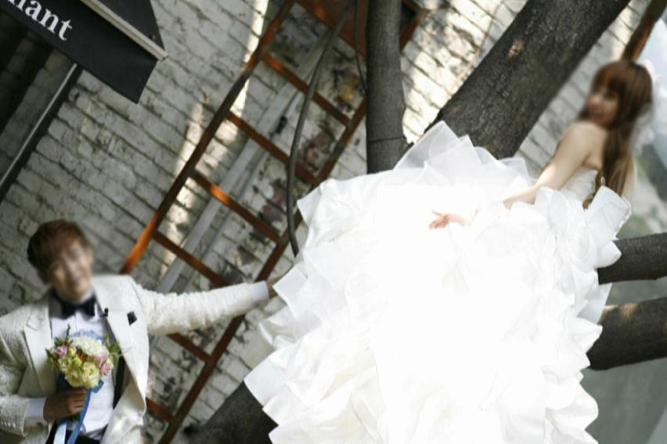
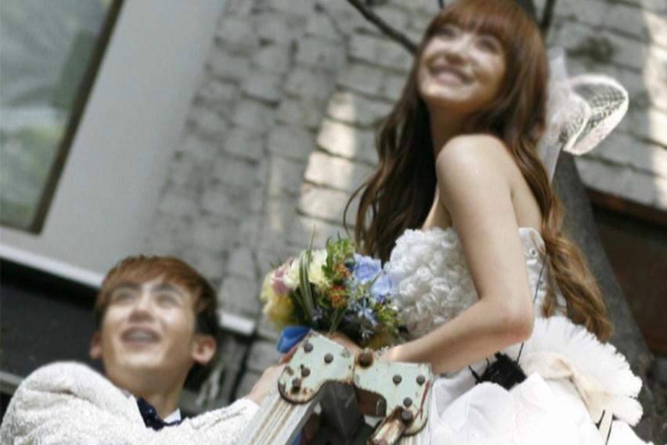
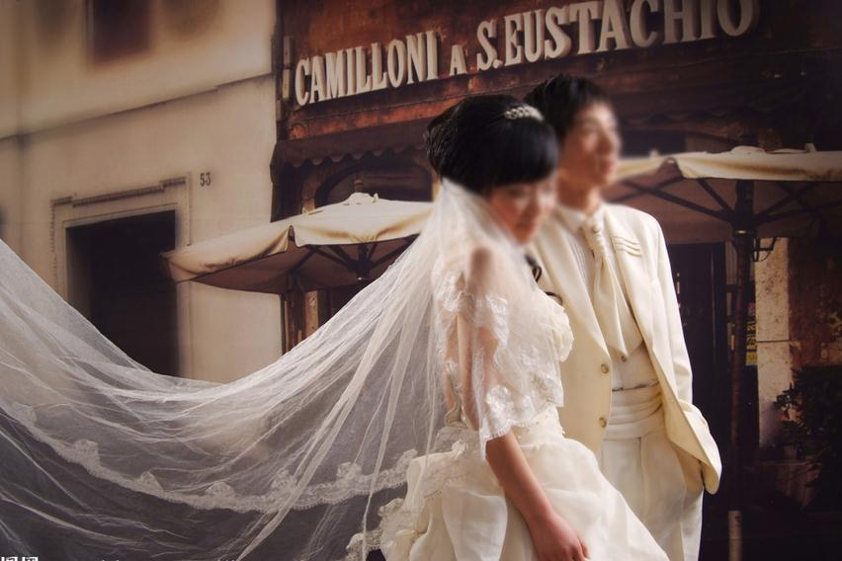
Show and explain your web, app or software projects using these
2011
Buy

Slide 5
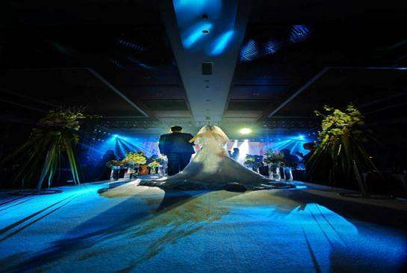

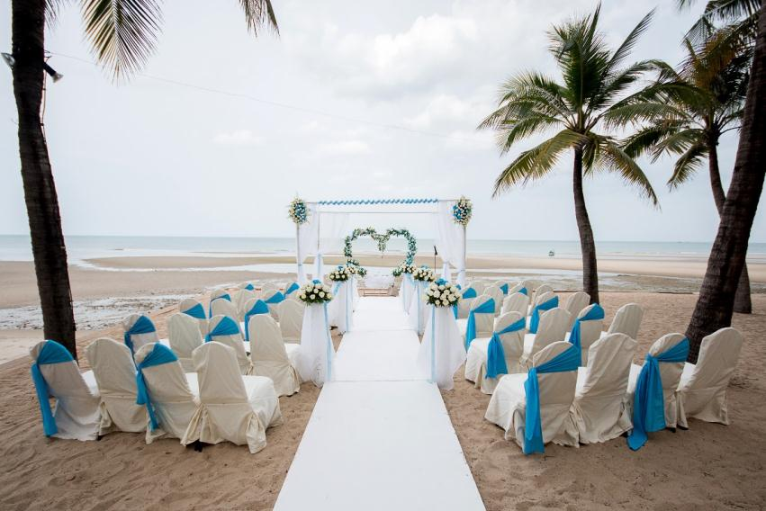
A complex idea can be conveyed with just a single still image, namely making it possible to absorb large
2012
Calculate

Slide 6
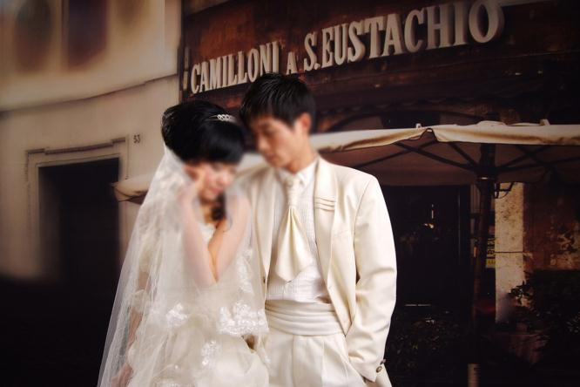

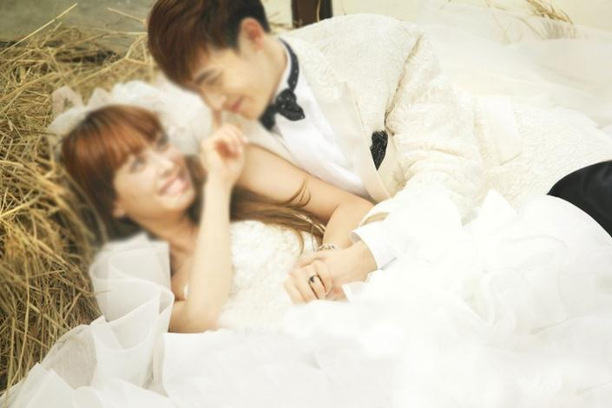
Cancel
2013
I hope and I believe that this Template will your Time, Money and Reputation.

Slide 7
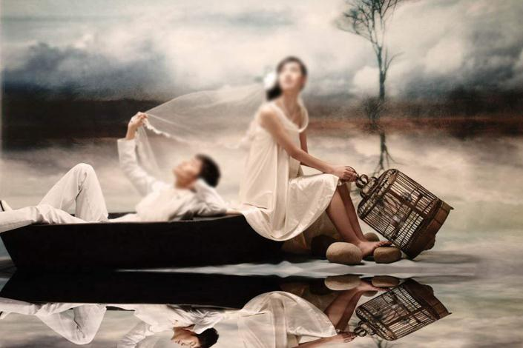
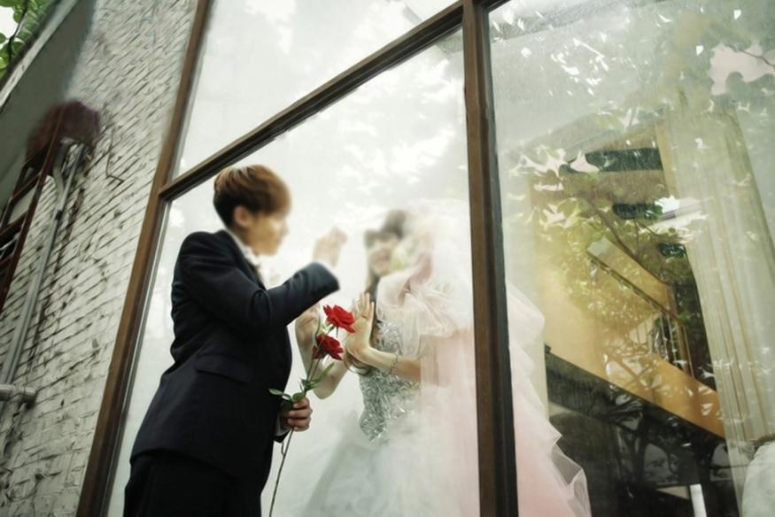
2014
Certification
Easy
to change colors,
photos and Text.

Slide 8


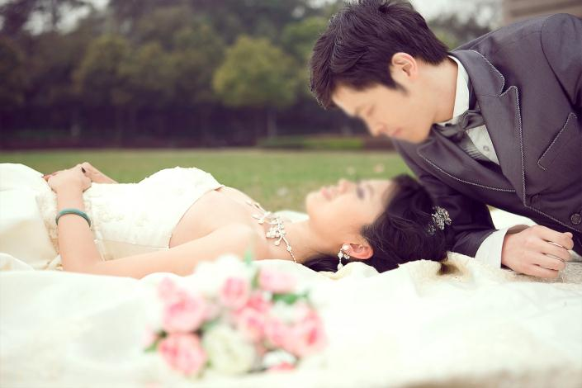
Get a modern PowerPoint Presentation that is beautifully designed.
Choose
2015

Slide 9
2
BILL

Slide 10
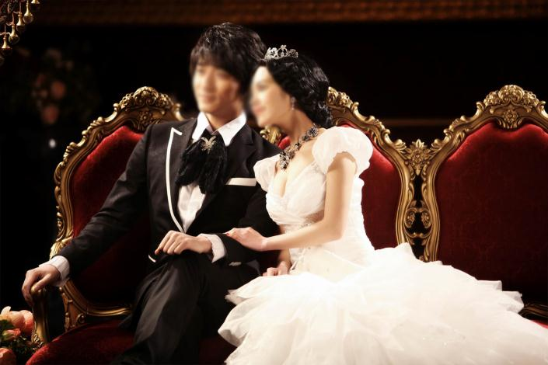
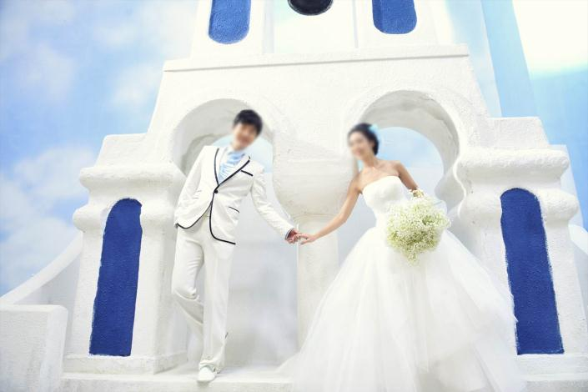

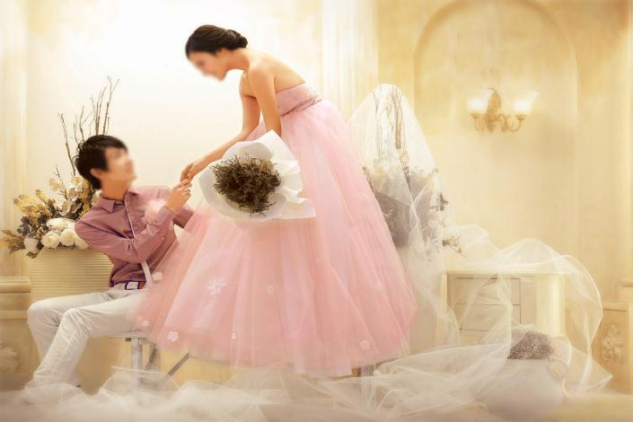
Far far away, behind the word mountains, far from the countries Vokalia and Consonantia, there live the blind texts.
Commission
2001

Slide 11

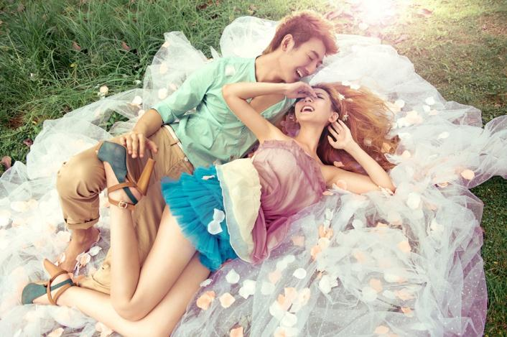
Click on the button under the presentation preview that says
"Use as Google Slides Theme.
Comparison
2002

Slide 12



“You will get a copy of this document on your Google Drive and will be able to edit, add or delete slides.
Competition
2003

Slide 13



Complain
2004
Add or delete slides. You have to be signed in to your Google account. in PowerPoint. Remember to download and

Slide 14
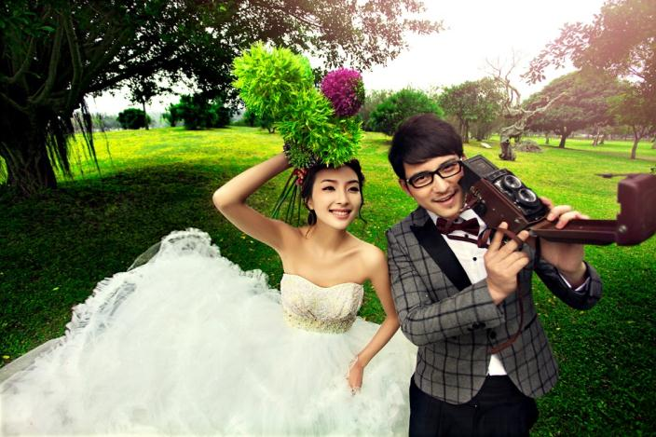

2004
Complete
Is the color
of gold, butter

Slide 15
3
BRAND

Slide 16
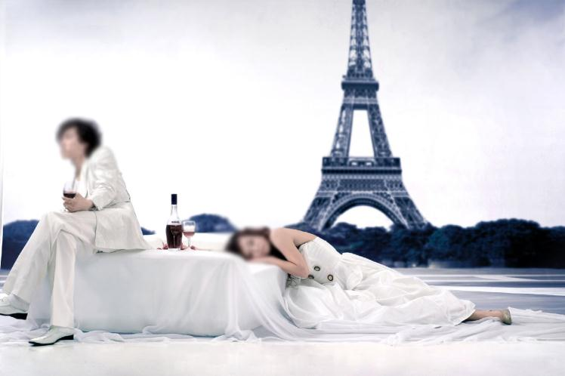
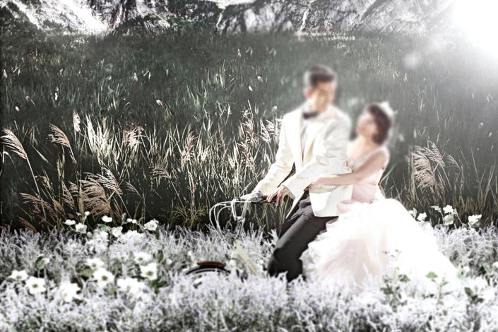
We use well-known development methodologies to create a customized approach for each of the
2005
Confirm

Slide 17

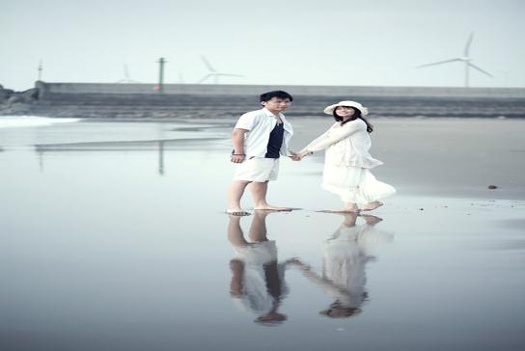
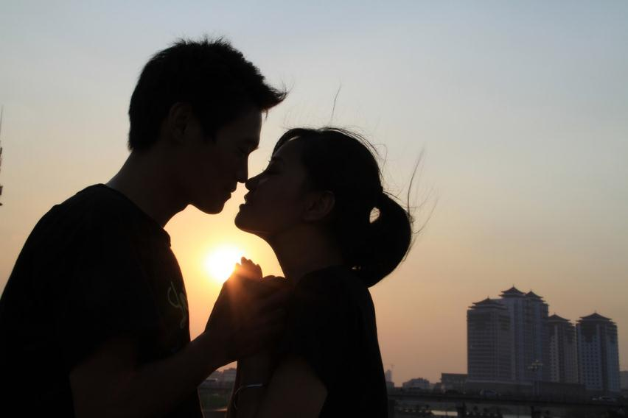
We press play on your digital story
2006
Convince

Slide 18

Customer
2007
We press play on your digital story. Using conceptual, digital design, we work with you to build

Slide 19



Moving from creative ideas to solid strategy and execution, we help your target market resonate fully
2008
Date

Slide 20



Simple & Smooth, exactly how purchasing experiences should be. We align with your
2008
Deadline

Slide 21
4
BUDGET

Slide 22



Your audience relate and absorb information on different sensory levels. We know visual stories
2010
Decide

Slide 23

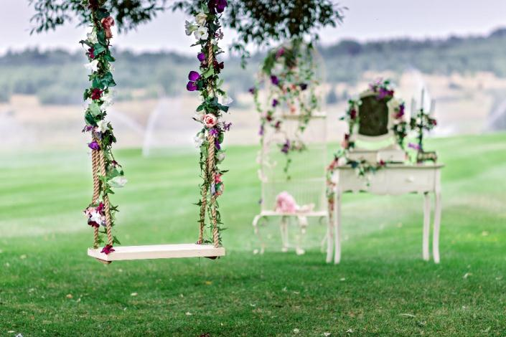
The user can demonstrate on a projector or computer, or print the presentation and make it into a film to be used in a wider field.
Department
Description
2009

Slide 24



The user can make a presentation on a projector or computer, or print out the
Develop
Difference
2010

Slide 25

The user can make a presentation on a projector or computer, and can also make a presentation. You can also print out the presentation
Dismiss
Dispatch
2011

Slide 26
THANK YOU !
Marriage Album
Powerpoint Template
WWW.FREEPPTBACKGROUNDS.NET

