Slide 1
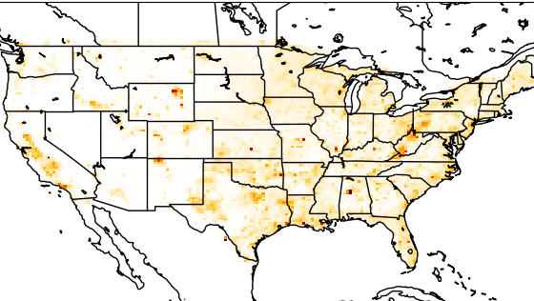



Quantifying U.S. methane emission trends (2019-2024) through high resolution inversion of satellite observations
Lucas Estrada¹, Daniel Jacob¹, Daniel Varon¹, Megan He¹, James East¹, Melissa Sulprizio¹, Nicholas Balasus¹, Sarah Hancock¹, and Kevin Bowman¹
1 Harvard University; 2 NASA JPL
Harvard University
School of Engineering
and Applied Science

Slide 2
Toward a satellite-based system for continuous emissions monitoring
Growing constellation of methane-observing satellites enables near-real-time monitoring
Supports transparent country-scale emissions reporting and verification
Key challenge:
Relating observed concentrations to reliable emission estimates with low-latency
Jacob et al., 2022

Slide 3

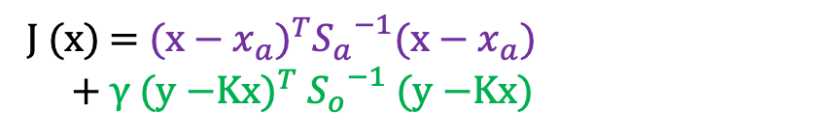
Establishing an open-source and transparent system for monitoring CONUS emissions
Open-source IMI 2.0 inversion framework
ML corrected TROPOMI+GOSAT blended dataset
Optimizes multi-resolution state vector of emissions at up to 25 km resolution
TROPOMI smoothed boundary conditions at domain edges
+ optimized as part of inversion
US GHGI: GreenHouse Gas Inventory
Results report mean of ensemble of estimates varying inversion params and error distributions
Minimizes Bayesian cost function analytically:
J (x) = ${\text{(}\text{x}\text{ − }x_{a}\text{)}}^{T}{S_{a}}^{−1}\text{(}\text{x}\text{ − }x_{a}\text{)}$
+ γ ${\text{(}\text{y}\text{ −}\text{Kx}\text{)}}^{T}$ ${S_{o}}^{−1}$ $\text{(}\text{y}\text{ −}\text{K}\text{x}\text{)}$
Exploits information from prior term
and the observational term

Slide 4
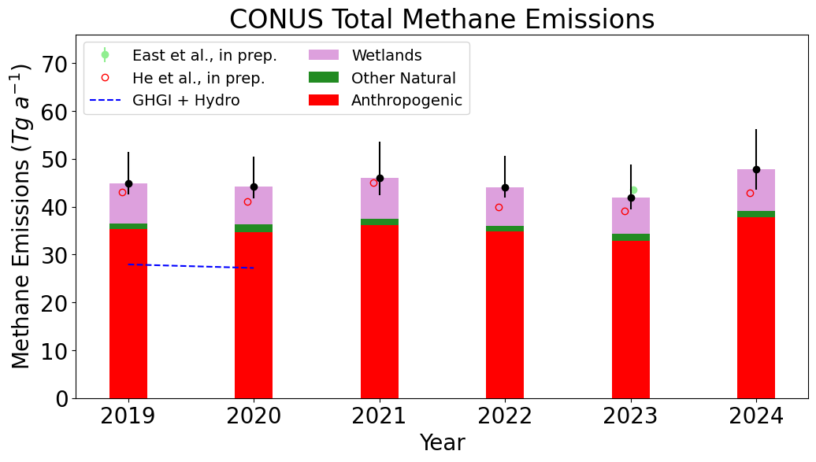
Inversion confirms gas and coal emission declines in the US
Total emissions trends are flat –
  Total emissions 27% higher than GHGI (57% higher for oil/gas)
  Gas emissions decreasing faster than inventories suggest ↓
  Coal emissions decreasing slower than inventories suggest ↓
  Hydroelectric reservoirs (not included in GHGI) account for 3% of emissions
5%
35%
3%
7%

Slide 5
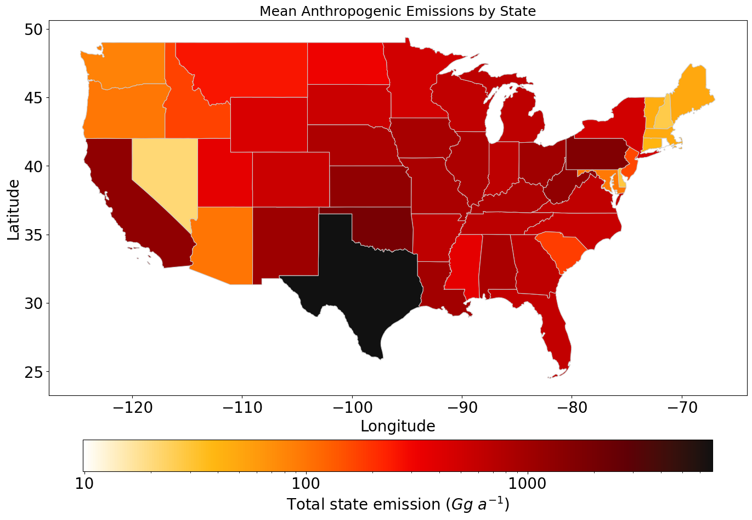
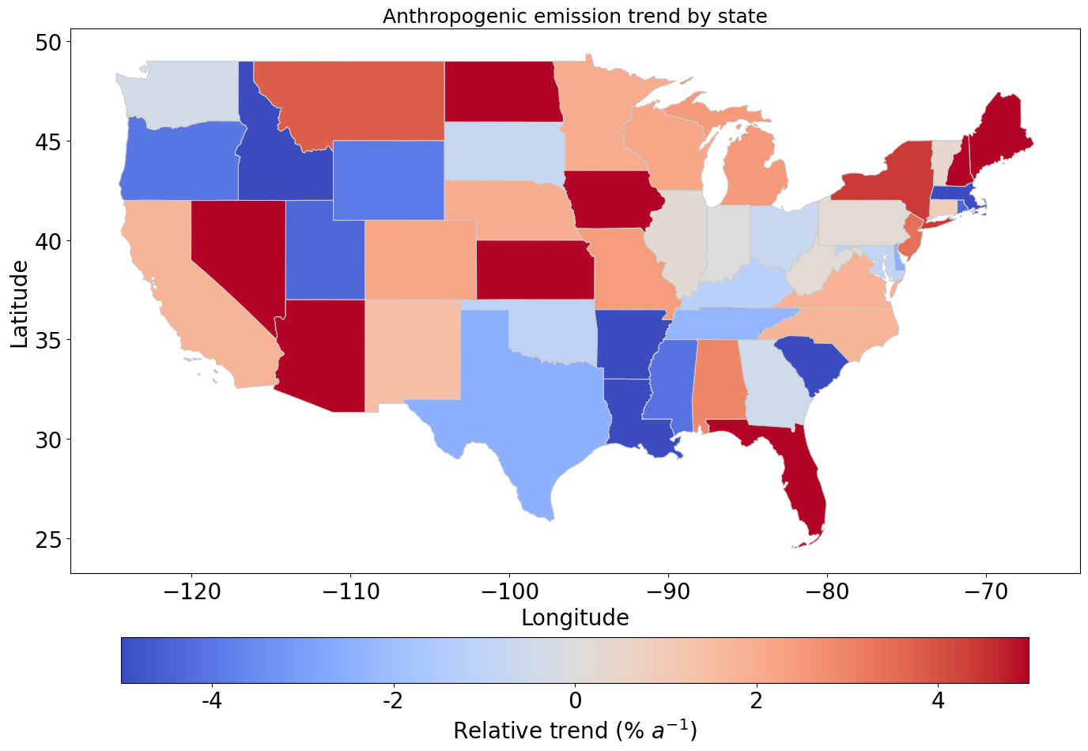
State-level emissions and trends
Anthropogenic emissions by state
Relative emission trends from 2019 to 2024
Texas makes up 19% of total US emissions (primarily from ONG and livestock)
Pennsylvania emissions remain constant due to already very low methane intensity in gas brought to market
California declining gas emissions are offset by rising landfill emissions

Slide 6
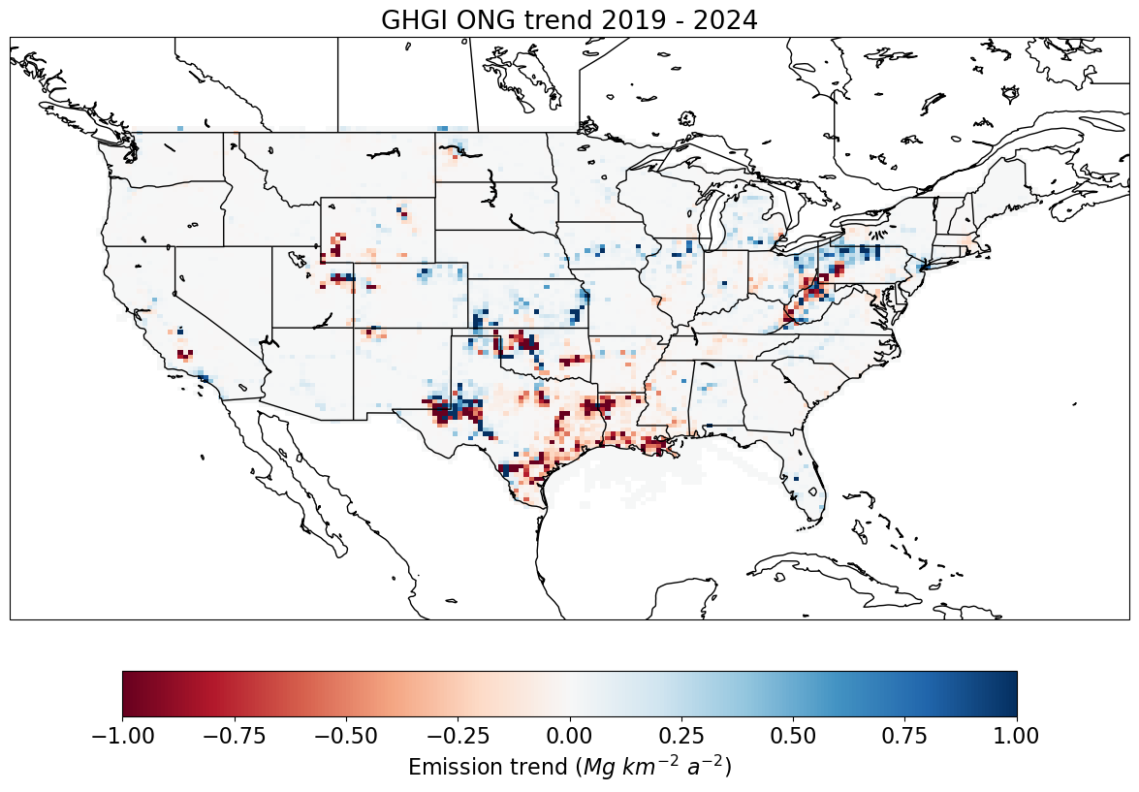
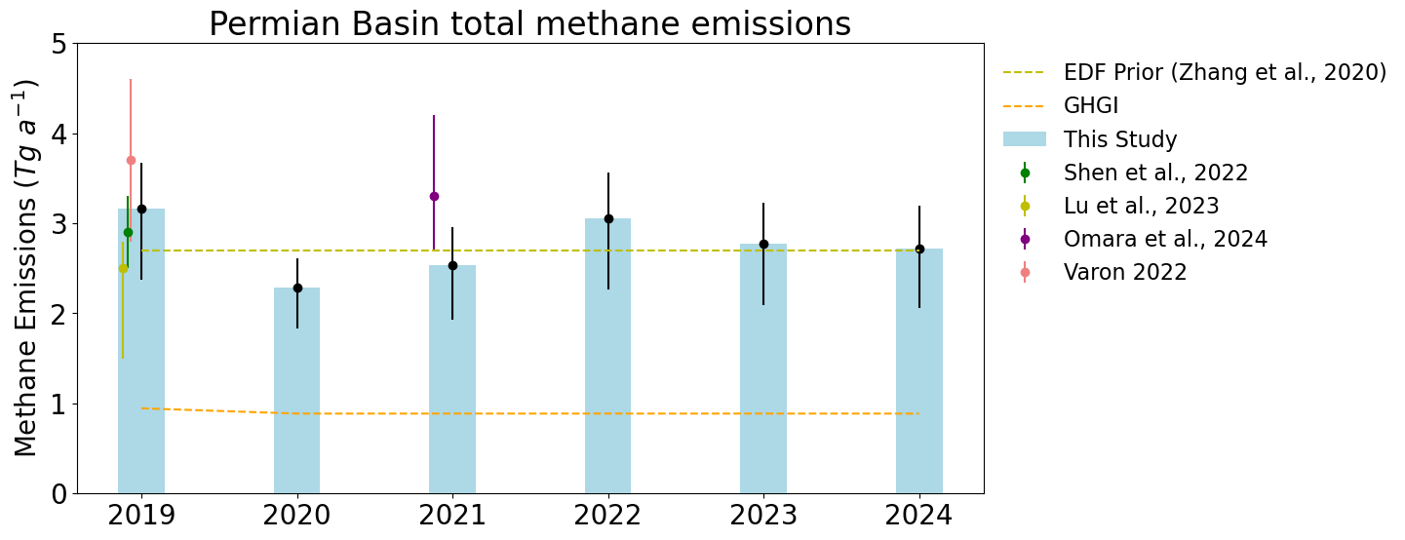
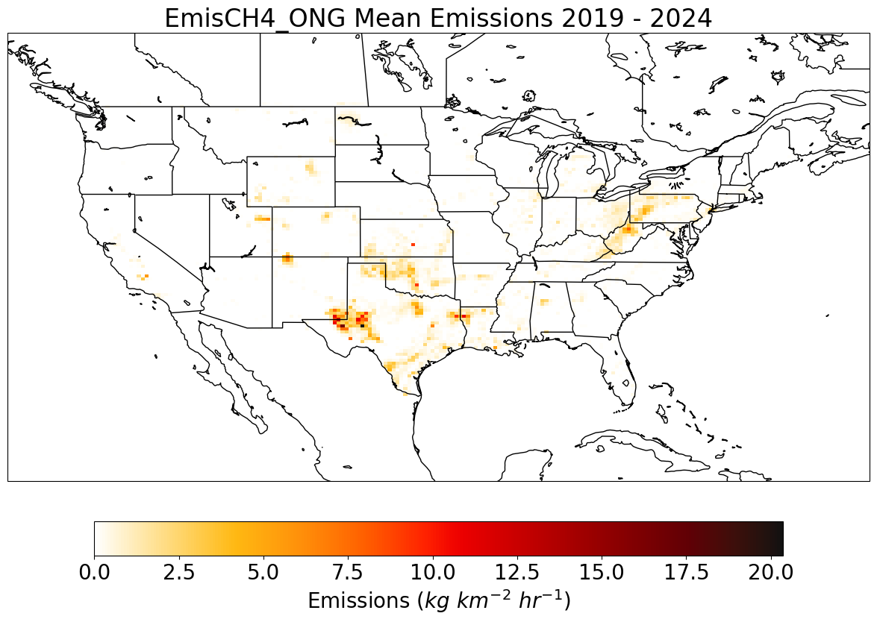
Analysis of emissions and trends across sectors: example of oil and gas
ONG emission trends 2019 - 2024
Mean ONG emissions 2019 - 2024
Largest oil and gas (ONG) basin in the US shows stable emissions despite increases in production

Slide 7
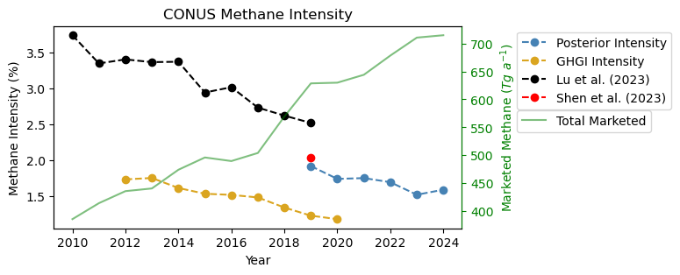
National ONG methane intensity continues to decrease
Production is not a predictor of emissions
Sustained intensity decrease in future would make large contribution to national emissions decrease

Slide 8


Takeaways
IMI framework enables continuous monitoring of annual emissions from individual countries using TROPOMI observations
Total US emissions were flat over 2019-2024 but significant decreases in gas (2% per year) and coal (2.5% per year)
Methane intensity from the oil and gas sector continues to decrease, from 2% in 2019 to 1.6% in 2024
IMI Website
carboninversion.com

Slide 9
This research has been funded in part in the framework of UNEP’s International Methane Emissions Observatory (IMEO).
All results are preliminary and not yet peer-reviewed
Contact: Lucas Estrada
lestrada@g.harvard.edu

