Slide 1

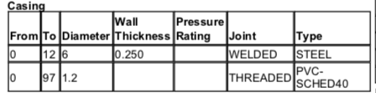

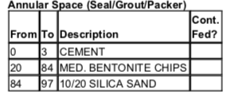
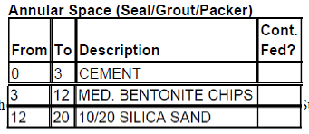
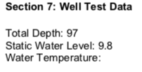
Well Log Interpretation
Well
0’
Subsurface
6”
9.8’
12’
6”
20’
1.2”
87’
97’

Slide 2
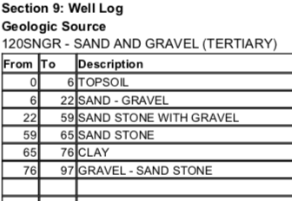
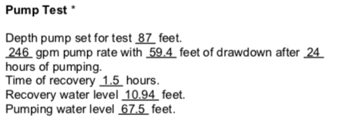
Well Log Interpretation
Well
0’
Topsoil
6”
6’
9.8’
Sand - gravel
12’
6”
20’
22’
1.2”
Sand stone with gravel
59’
Sand stone
65’
Clay
*This particular well did not have pump test results. These are from the MSU EPI well 2
76’
87’
Gravel - Sand stone
97’

Slide 3
Stream – subsurface exchange: Stream depletion zones
Floodplain
Drawdown curve,
Cone of depression

Slide 4




Theis analytical solution
Ground-water equation in polar coordinates
Pumping rate, [L³T⁻¹]
$$\frac{∂^{2}\text{h}}{∂r^{2}}+\frac{1}{r}∗\frac{∂h}{∂r}=\frac{S_{y}}{K_{h}∗h_{0}}∗\frac{∂h}{∂t}$$
Drawdown, [L]
$h_{0}−h\left(r,t\right)=\frac{Q_{w}}{4∗π∗K_{h}∗h_{0}}∗W[u\left(r,t\right)]$
Total hydraulic head [L]
Distance from well [L]
Time elapsed since pumping [T]
Well function
$$W\left[u\left(r,t\right)\right]= \int_{u(r,t)}^{∞}{\frac{\exp\left[−u\left(r,t\right)\right]}{u(r,t)}}∗du(r,t)$$
For an aquifer with a given S_{y ,}K_{h}, and h₀ pumped a rate of Q_{w,} the Theis analytical solution calculates drawdown (h₀ – h) as a function of:
Distance from the well, r
Time elapsed since pumping began, t
Aquifer parameter
$$u_{r,t}=\frac{{S_{y}∗r}^{2}}{4∗K_{h}∗h_{0}∗t}$$
Well Function spreadsheet calculator uses these equations
* See Dingman textbook pages 441-446 for more info

Slide 5
Spread
Drawdown
How would a lower K affect the drawdown and spread?
Drawdown would increase and
Spread would decrease because water movement toward the well would be slower

Slide 6
Spread
Drawdown
How would a higher K affect the drawdown and spread?
Drawdown would decrease and
Spread would increase because water movement toward the well would be faster

Slide 7
Spread
Drawdown
How would a lower S_{y} affect the drawdown and spread?
Drawdown would increase and
Spread would increase because a larger volume of aquifer would need to drain to provide stored water

Slide 8
Spread
Drawdown
How would a higher S_{y} affect the drawdown and spread?
Drawdown would decrease and
Spread would decrease because a smaller volume of the aquifer would need to be drained to provide stored water

