Slide 1

ABAI 38th Annual Convention
The Influence of External Contingencies
on Individual School Cultures
You Believe What???
Randy Keyworth
Notes:
By way of introduction on why this is so important
we are extremely bad at school reform
one of the reasons is or failure to address the issue of culture
there are strategies we can use

Slide 2
Today
We have a spectacularly bad track record with Education Reform.
Existing school cultures are often one of the
biggest roadblocks to effective change.
3. School cultures are a function of stakeholder’s learning histories and external contingencies over which we have very little control.
4. There are strategies for building an effective individual school culture in this context / environment

Slide 3
30 years studying “research to practice” issues…
from the “practice” side

Slide 4
2004 - present
independent, non-profit operating foundation
promote evidence-based education policies and practices
act as a catalyst to facilitate communication, cooperation and collaboration between individuals and organizations currently engaged in evidence based education
engage in data-mining, gathering, analyzing and disseminating data

Slide 5
1978 - 2004
Operated a large non-profit organization in SF Bay Area
six spec. ed schools adult programs
residential programs employment supportive services
public school consultation teacher training campus
Deliberately implemented a organizational culture based on:
Evidence-based Clinical problem solving
research to practice data-based decision making
Performance feedback Positive reinforcement
student, staff, organization student, staff, organization
Notes:
How many worked for us ?

Slide 6
“real world” challenges
Operating within direct service funding (no grants, research, university students)
Perpetual growth mode (services, programs, technology)
Serving extremely “high risk” kids w/ challenging behaviors
(requiring high treatment integrity implementing sophisticated programs)
High profile (regulatory oversight, parents, districts, community)
Constant shortage of trained staff (staff turnover, failure of Universities to train in effective teaching strategies)
Notes:
150 new staff

Slide 7
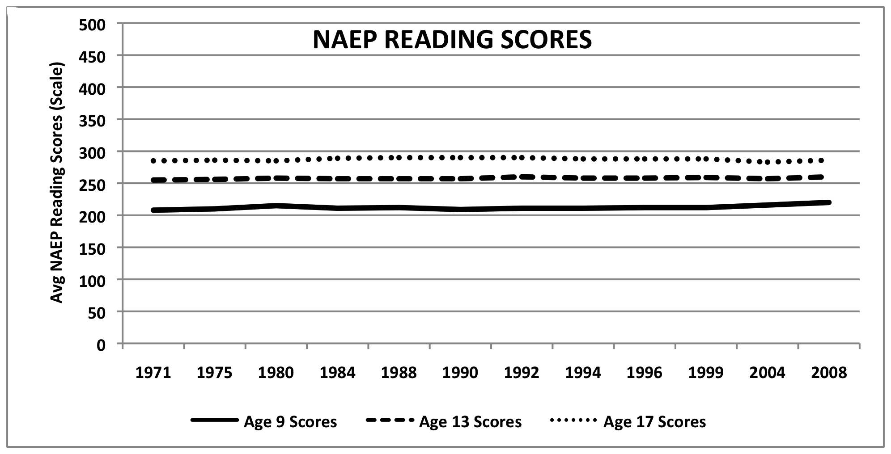
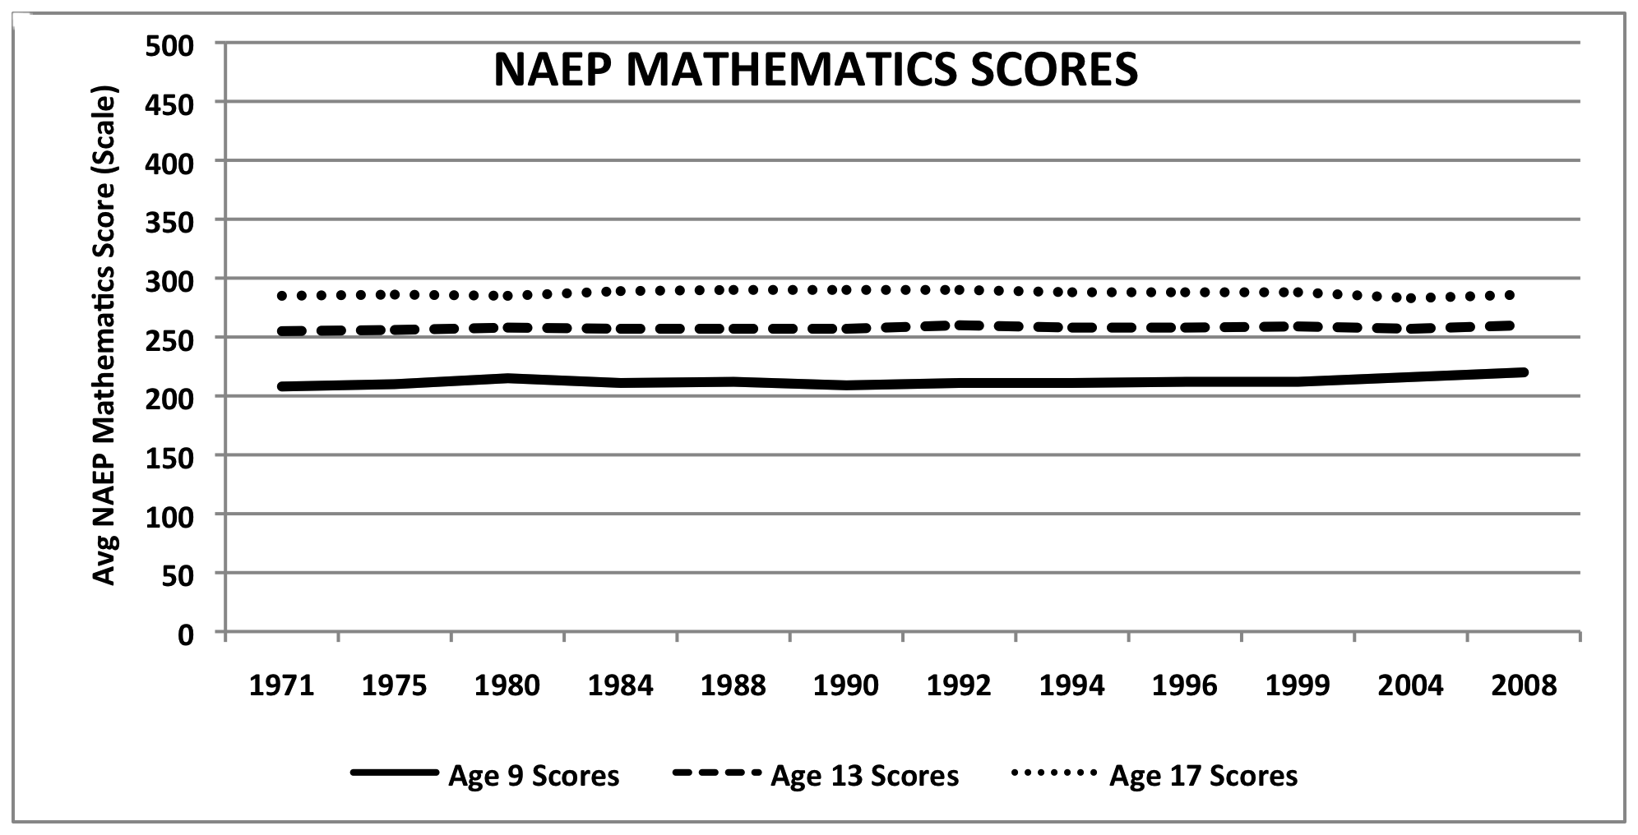
Education Reform’s Track Record
2011 NAEP Reading
At or above proficiency
4th Grade = 34%
8th Grade = 34%
12th Grade = 38%
2011 NAEP Math
At or above proficiency
4th Grade = 40%
8th Grade = 35%
12th Grade = 26%
National Assessment
of Educational
Progress (NAEP)

Slide 8
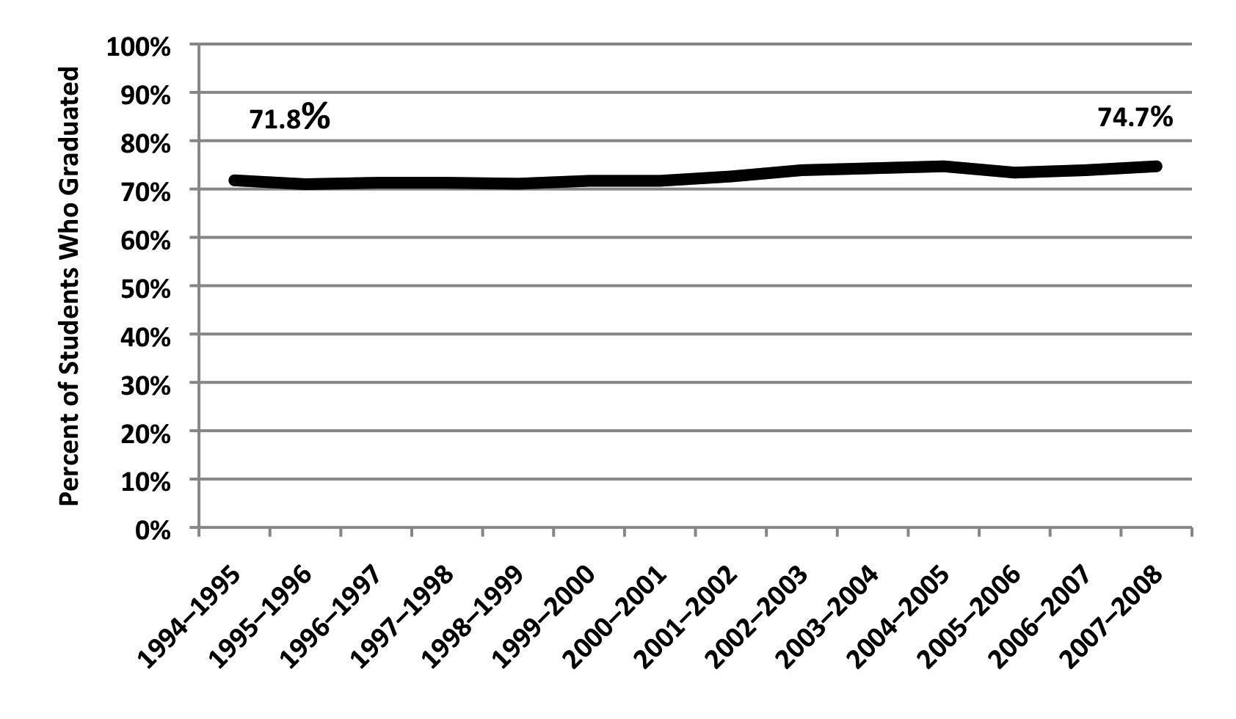
Education Reform’s Track Record
Graduation Rate

Slide 9
Education Reform’s Track Record
average life of an education innovation is 18-48 months (Latham, 1988)
Comprehensive School Reform Demonstration Program (1998)
nearly 6,000 schools implemented more than 700 different CSR Models
Implementation Findings
1 in 5 maintained reforms through 2002
1 in 10 maintained reforms through 2004
(American Institute for Research)

Slide 10
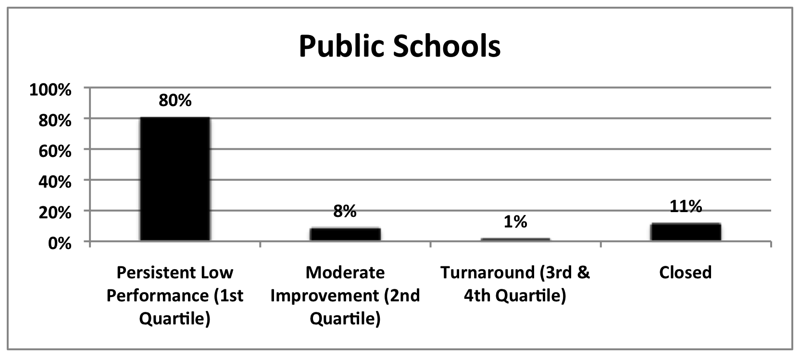
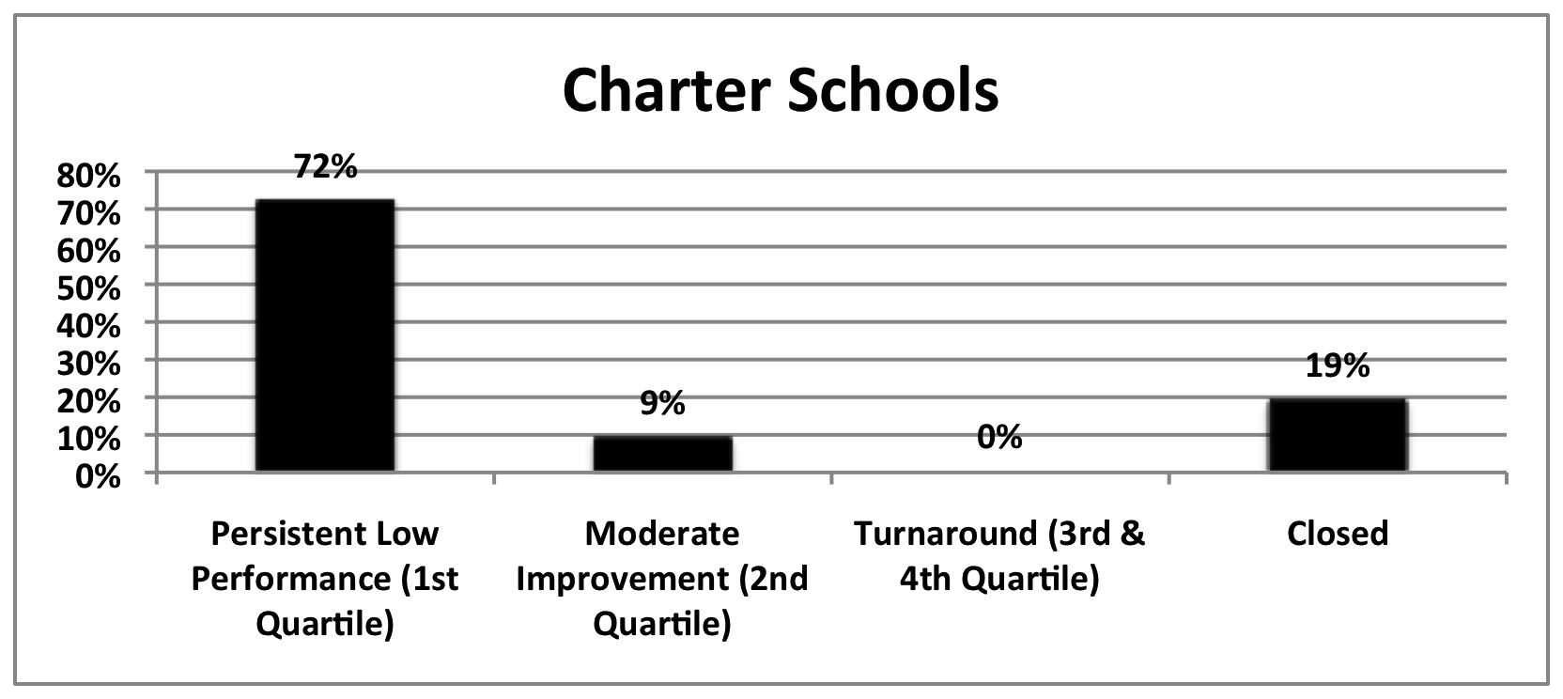
Education Structural Interventions No Child Left Behind
Tracked progress of
2,025 low-performing
charter & district schools
across 10 states
(2003-04 TO 2008-09)
Thomas B. Fordham Institute,
Are Bad Schools Immortal? (2010)
2005/06 was the first year
for “restructuring sanction”
Over the next three years
(2006-07, 2007-08, 2008-09 )
1521 more schools entered
restructuring than exited restructuring.
U.S. Department of Education
Notes:
Low performing schools = avg. combined 02/03, 03/04 reading and math proficiency in lowest 10%
= schools failed to meet AYP proficiency targets two years in a row
Turnaround = test scores above 50th percentile in last two years 07/08, 08/09

Slide 11
Successful Implementation and Culture Change
evidence-based and effective practices often fail due to ineffective implementation strategies
requires a systematic and deliberate cultural change process across all levels of an organization:
changes in adult professional behavior (all stakeholders)
changes in organizational structures, systems, policies, contingencies, values, procedures, both formal and informal
changes in relationships to consumers, stakeholders, and systems partners
National Implementation Research Network (NIRN)

Slide 12

A Behavioral View of Culture
“As a set of contingencies of reinforcement maintained by a group…
it has…
a continuing existence beyond the lives of members of the group,
a changing pattern as practices are added, discarded, or modified…
A culture so defined controls the behavior of the members of the group that practice it.”
B.F. Skinner

Slide 13

A Behavioral View of Culture
…culture reflects a collection of common verbal & overt
behaviors that are learned & maintained by a set of
similar social & environmental contingencies
(i.e., learning history).
Sugai (2011)

Slide 14
What is a School Culture?
The complex interaction of learning histories and contingencies (formal and informal) governing the behavior of all stakeholders, embodied in:
Stakeholders
External Contingencies
policy makers
parents
administrators
teachers
students
teacher preparation
school governance
union contracts
funding
Internal Contingencies
recruitment & hiring
job expectations
compensation
staff training
staff coaching
staff feedback
policies
practices
resource allocations
data systems
feedback systems
reporting requirements
Notes:
Governance

Slide 15
Desired Cultural Values
Evidence-based
scientific research to practice
Performance feedback
reliable, valid, frequent, used
student, staff, organization
Clinical problem solving
data-based decision making
Positive reinforcement
student, staff, organization
Systematic instruction
explicit & deliberate

Slide 16
Teacher Preparation: Evidence Based?
Review of 1,206 Teacher Preparation Programs (1,434 in 2011)
(220,000 students)
Programs vary in every way imaginable
selectivity, design, duration, course and fieldwork requirements
2. Programs are driven by ideology and personal predilection
relativism is the rule
Programs have fundamental disagreements with scientific evidence and data
science vs. art
profession vs. craft
anti-science, anti-systematic instruction
(whole language, post modernism, constructivism)
Levine (2006)

Slide 17
Teacher Preparation: Evidence Based?
National Council on Teacher Quality (2012)
DATA DRIVEN INSTRUCTION
using student & treatment integrity data to inform / improve instruction
estimated that teachers make 11,000 significant instructional decisions in any given year (Hosp 2010)
over $ 500 million of federal funding for developing states’ technology infrastructure to support data-driven decision making
TEACHER REQUISITE SKILLS
ASSESSMENT LITERACY: the taxonomy of assessment
(formative vs. summative, norm-referenced, criterion-referenced)
ANALYTIC SKILS: collect, dissect, describe and display data
INSTRUCTIONAL DECISION MAKING: using data to make effective decisions about teaching strategies

Slide 18
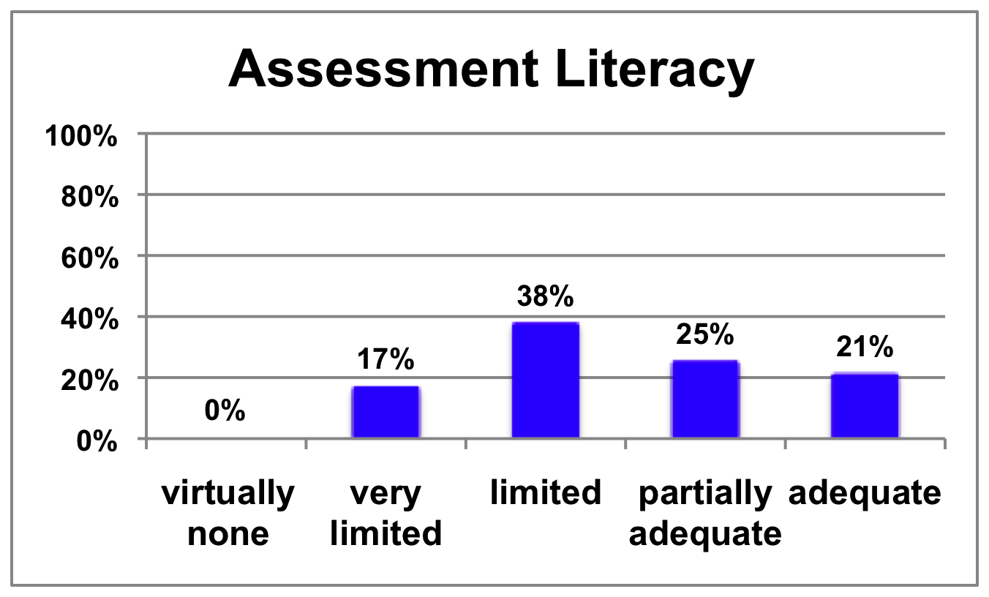
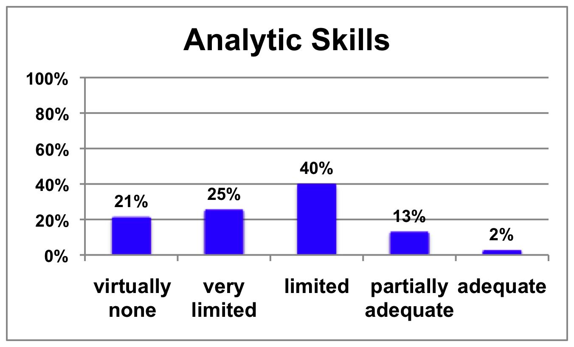
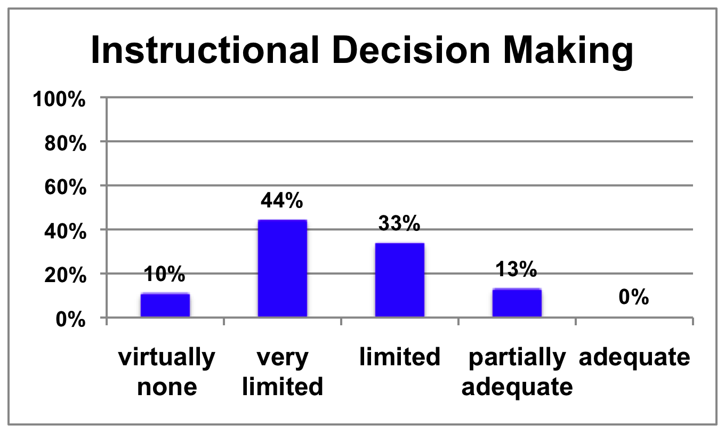
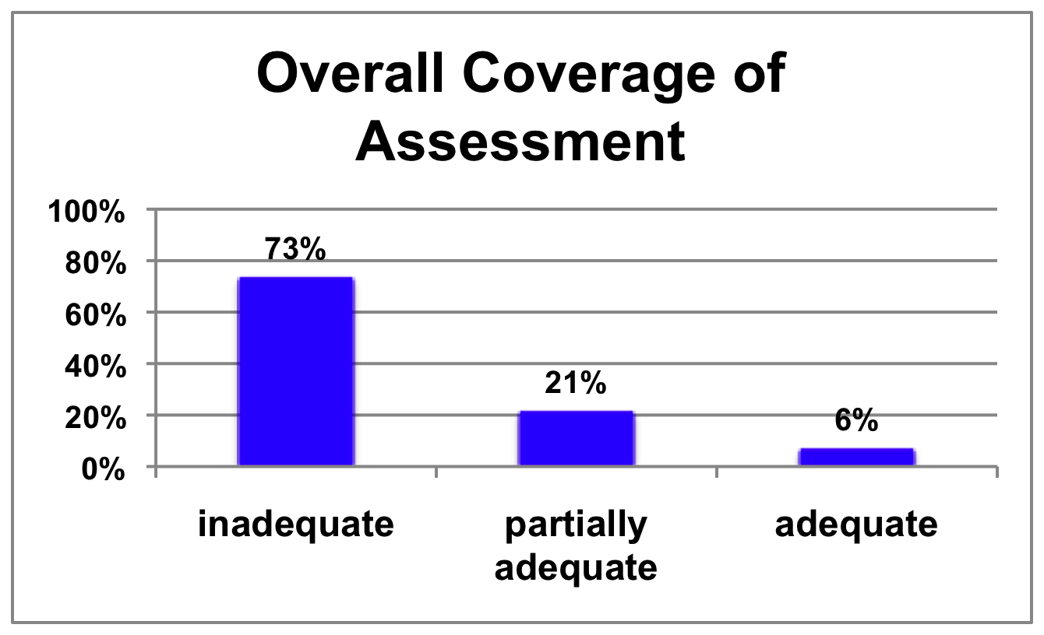
Teacher Preparation: Evidence Based?
National Council on Teacher Quality 2012

Slide 19
Teacher Preparation: Evidence Based?
National Reading Panel (2000)
overwhelming evidence that effective reading instruction includes explicit and systematic teaching of:
Phonemic awareness
Phonics
Fluency
Vocabulary
Comprehension
“whole language” instruction that ignores phonics and phonemic awareness was ineffective, especially for students with poor language skills and little exposure to print.”
National Council on Teacher Quality (2012)

Slide 20
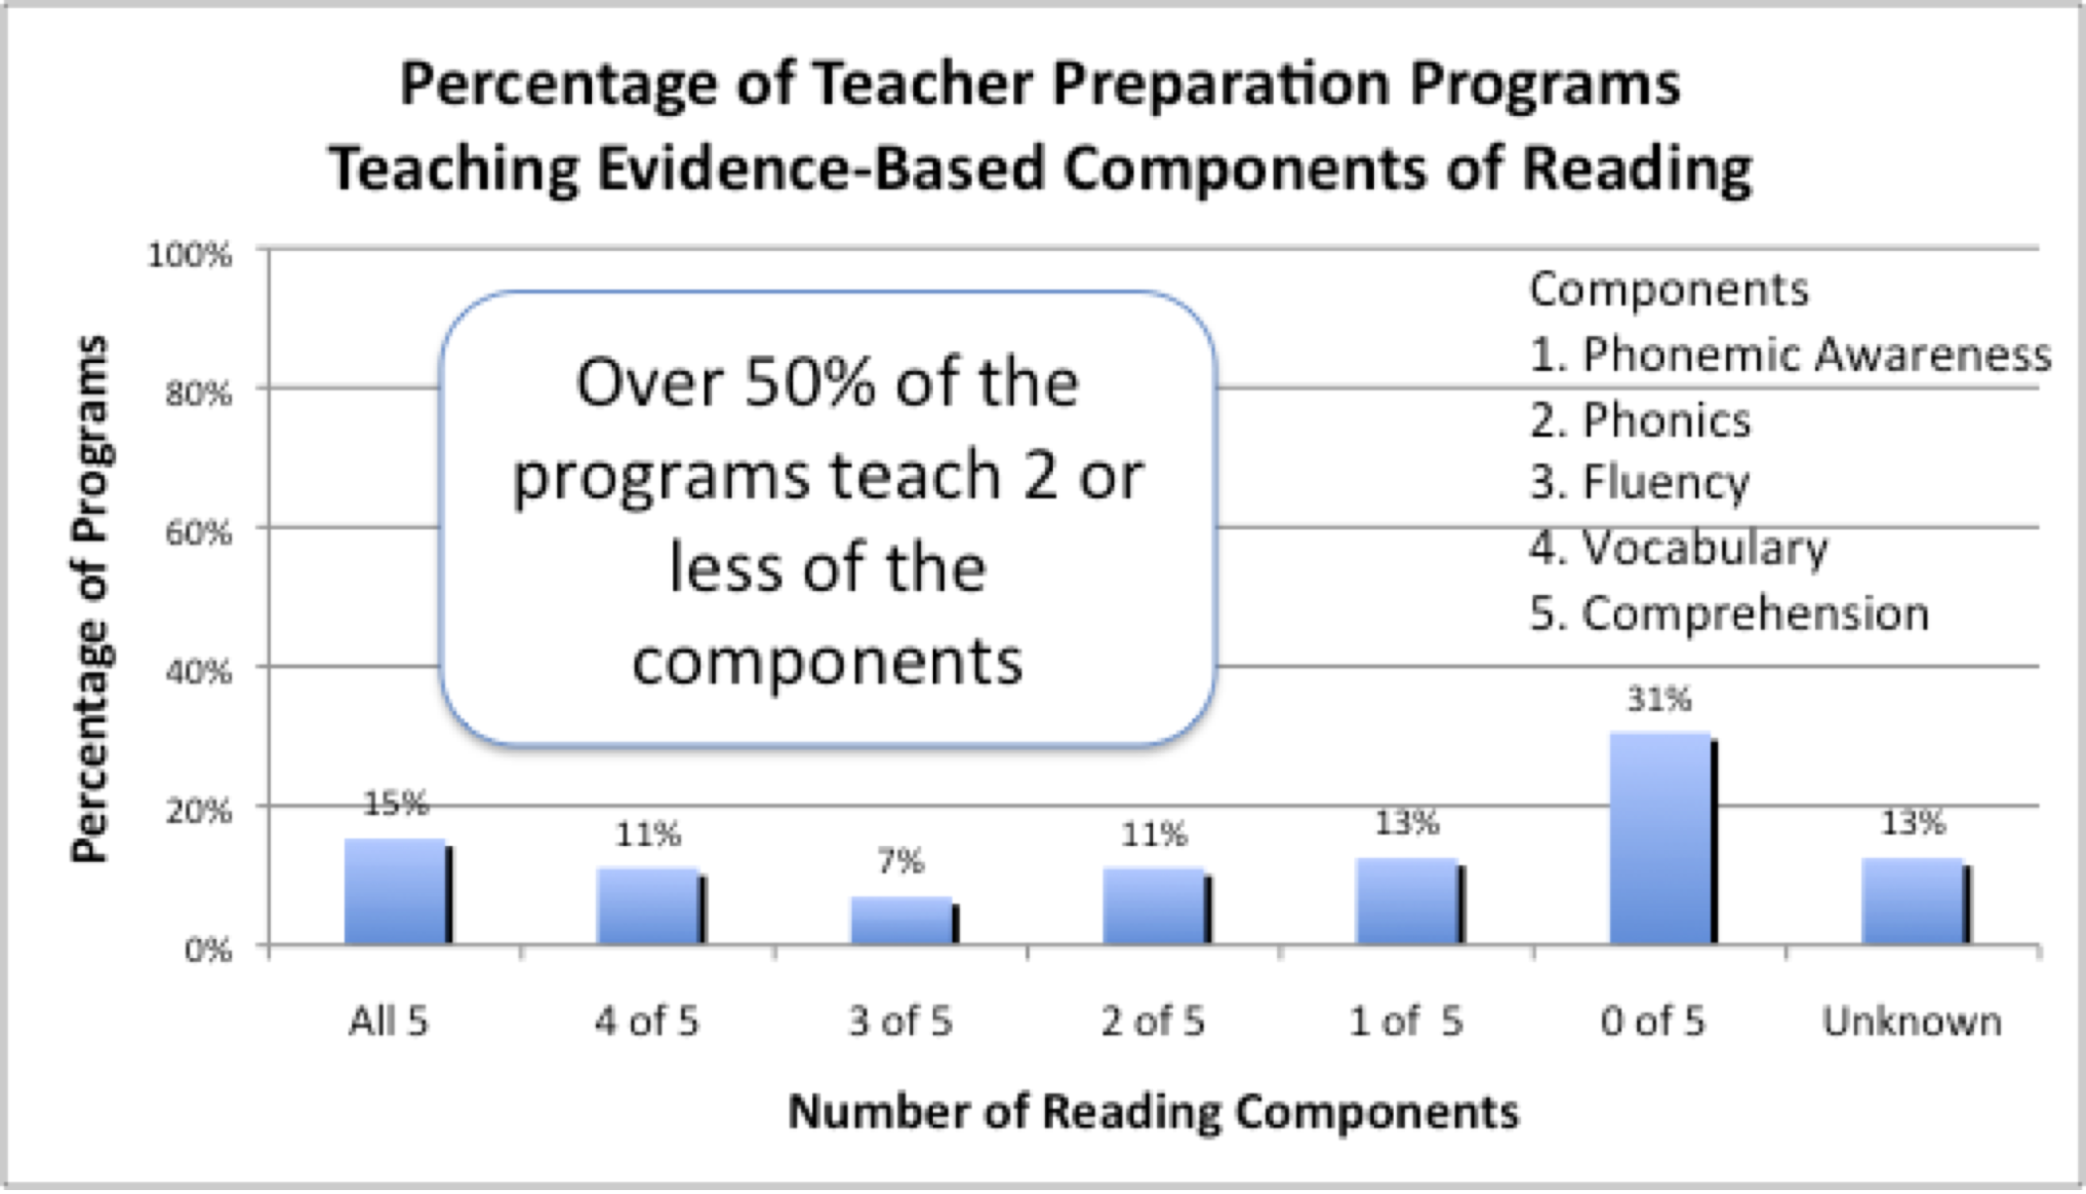
Teacher Preparation: The Science of Reading
Only 4 of 227 required reading text books met acceptable standards for reading science.
National Council on Teacher Quality (2006)
Notes:
Randomly sampled 72 programs, 223 reading courses
“Balanced Literacy”
Much of current reading instruction is incompatible with science.
organic process, reading develops naturally
kids learn to read as a result of life experience
you should dvelope your own theories of teaching reading and writing
only 4 of 227 text books met acceptable standards

Slide 21
Review of multiple years of teacher evaluations from:
Large districts: Chicago, Denver, Cincinnati, Akron, Toledo
Smaller Districts: Jonesboro, Pueblo City, Springdale, Rockford
Out of 52,337 teacher evaluations,
only 233 were unsatisfactory or improvement needed,
99.6% of all teachers evaluated were satisfactory or above.
In the districts that gave “above satisfactory” ratings,
92.6% were rated as very good, distinguished, superior,
excellent, or outstanding.
School Governance: Performance Feedback?
New Teacher Project: The Widget Effect (2009)

Slide 22
School Governance: Performance Feedback?
Irrespective of school performance…
in Denver schools that did not make adequate yearly
progress (AYP), more than 98 percent of tenured
teachers received the highest rating—satisfactory.
in Chicago 87 Schools met criteria for being identified
as “failing schools”, 79% of these schools did not
issue a single “unsatisfactory rating”
New Teacher Project: The Widget Effect (2009)

Slide 23
School Governance: Performance Feedback?
School districts fail to acknowledge or act on differences in teacher performance almost entirely.
Failure to recognize excellence among top performers
Failure to identify and provide support to the broad plurality of hard working teachers who operate in the middle of the performance spectrum
Failure to identify and dismiss consistently poor performers
New Teacher Project: The Widget Effect (2009)

Slide 24
Impact of Learning Histories and External Contingencies on Changing School Cultures
Teacher Preparation
School Governance
Teachers…
need to know what to do
lack of
evidence- based pedagogy
teacher autonomy
no systematic pedagogy
need to know how to do it
lack of effective feedback, clinical training
lack of effective feedback, support
need to be motivated to do it
ideologies often anti-science, anti-data
consequences driven by process not outcomes

Slide 25
Impact on School Culture
staff resistance to an evidence-based, performance feedback culture:
strong expectation that they will receive outstanding evaluations
long standing mistrust of the purpose of data
educator autonomy, implicit power relationships
cynicism about fads, new ideas, education reform
resistance to performance feedback
resistance to data collection
art vs. science
desired outcomes take too long to materialize
perceived costs exceed perceived benefits

Slide 26

Will it make the boat go faster?
Will it help students learn?
Notes:
SHARED VISION, COMMON GOALS

Slide 27
Using Performance Feedback to Overcome Baseline Cultural Obstacles: Calibration, Process, Engagement and Recognition
a “learner centered” culture (calibration)
focus on student learning and educational practices
establishing consensus on standards, definitions, goals
shifts away from ideologies, philosophies, fads
a culture of “inquiry” rather than “compliance” (process)
use of data to answer questions, problem solve
use of data-based decision making at all levels of the organization
not having all of the answers

Slide 28
Using Performance Feedback to Overcome Baseline Cultural Obstacles: Calibration, Process, Engagement and Recognition
a culture of “universal participation” (engagement)
wide-spread involvement (ownership, pride, participation)
collaboration across disciplines
giving, receiving, and using feedback
data analysis as positive, non-threatening experience
a culture of “meritocracy” (recognition)
reinforcement for excellent teachers
support for middle range performing teachers
dismissal of consistently poor performing teachers
performance feedback for all staff

Slide 29
Overcoming Baseline Cultural Obstacles: Alignment
Alignment of all organizational cultural components so that contingencies consistently, systematically and explicitly support the culture
job expectations
recruitment & hiring
staff induction
compensation
staff training
staff coaching
staff feedback
policies
practices
values
resource allocations
data systems
feedback systems
reporting requirements

Slide 30
Thank you

