Slide 1
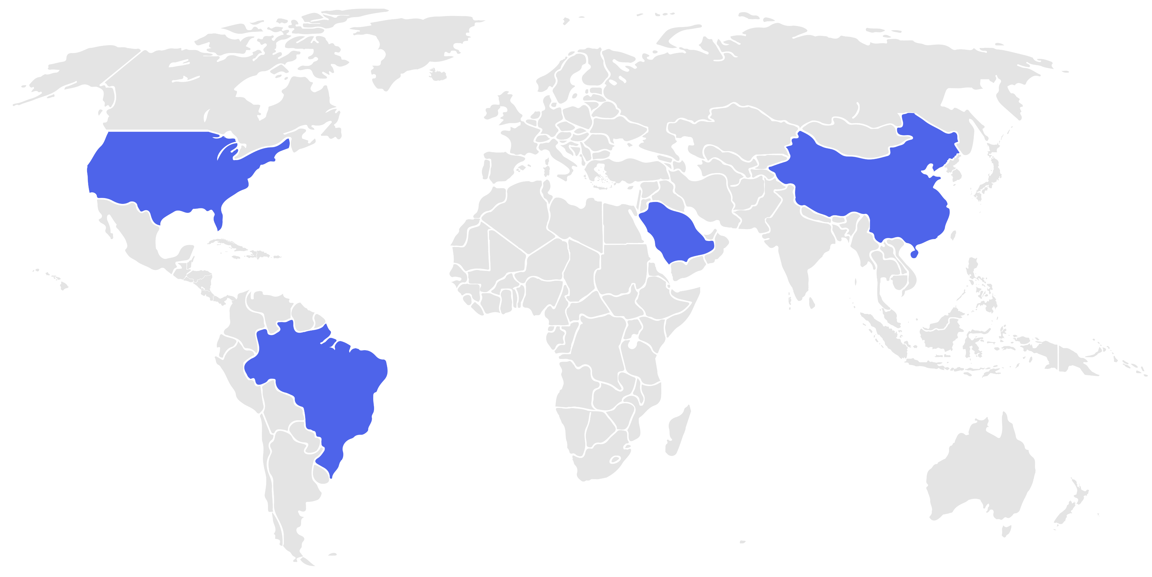




Global Impact of Digital Transformation Initiatives
Key Countries Leading the Shift Toward Digital-First Business Models
AI & Cloud Powerhouses
Smart Tech Innovators
Home to tech giants and innovation hubs driving enterprise AI, cloud, and data analytics adoption.
Rapid growth in mobile-first digital services, e-commerce, and advanced manufacturing automation.
United States
China
Saudi
Arabia
Brazil
Fintech and Cloud Expansion
Smart Cities
Emerging markets investing in digital financial services and cloud infrastructure expansion.
Focus on smart cities, AI-powered public services, and digital government initiatives.
01
Introduction
Global Impact of Digital Transformation Initiatives

