Slide 1


Slide 2
Creating a request (Telegram)

Slide 3
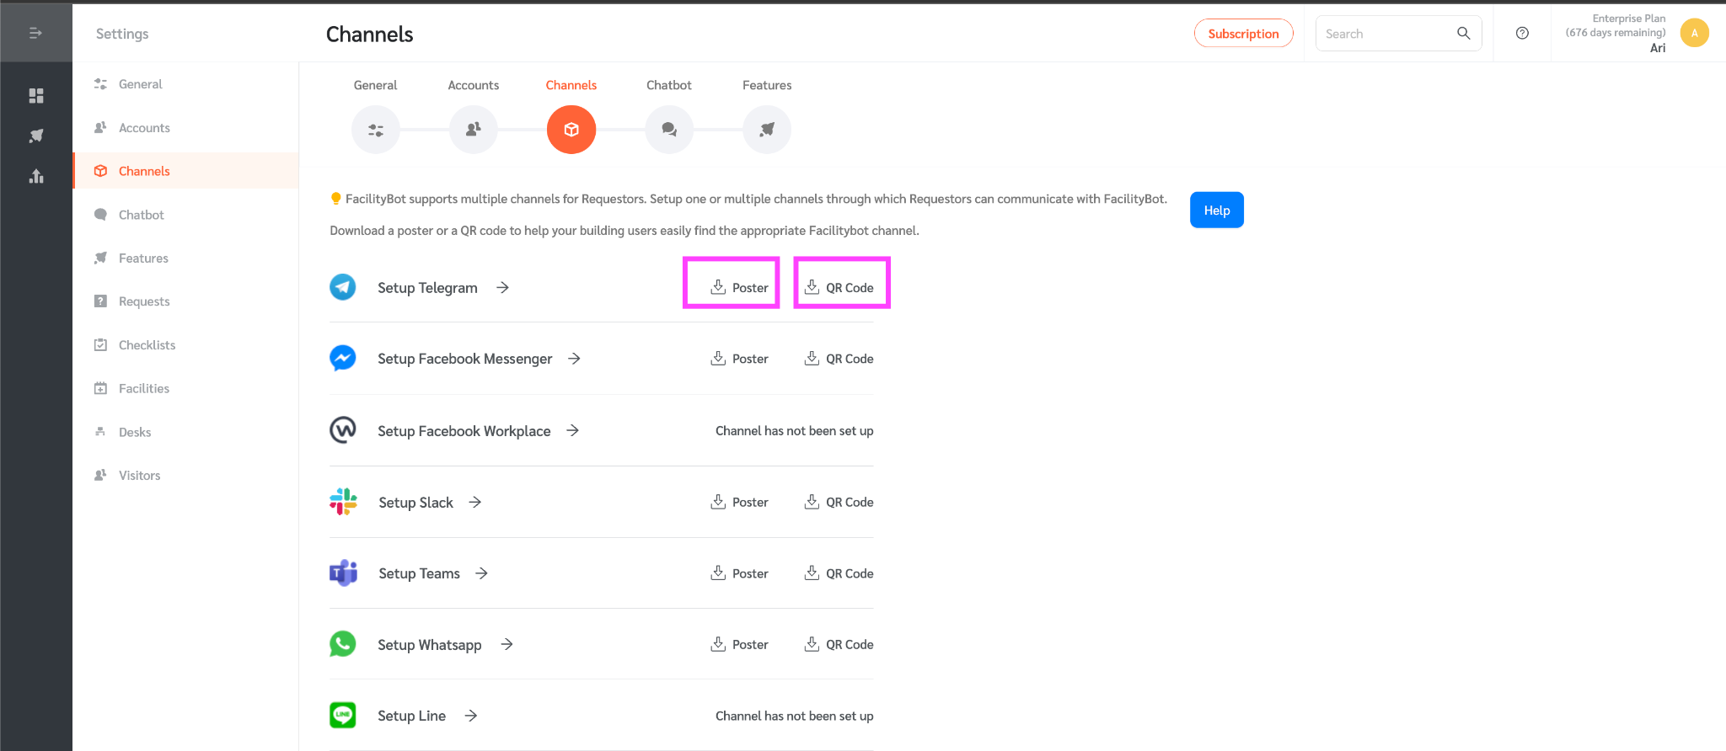
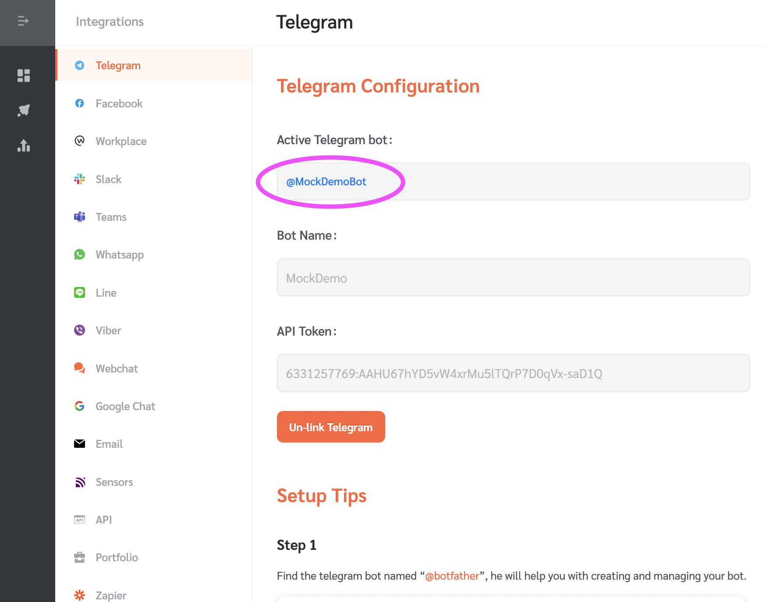
Notes for admin/manager
Get the QR code from the Settings>Channels then download either poster or QR code.
Share the QR code with the requestors. Requestors can also find the Telegram bot via the Telegram Bot ID (Integrations>Telegram).
Poster or QR Code
Telegram Bot ID

Slide 4
Creating a request (QR CODE / Poster)
Using your mobile device, SCAN The following QR Code:
QR CODE
Poster located at _________

Slide 5
Creating a request (Telegram Bot ID)
Find the Telegram bot by searching / adding this ID:
@XXXXXXX

Slide 6
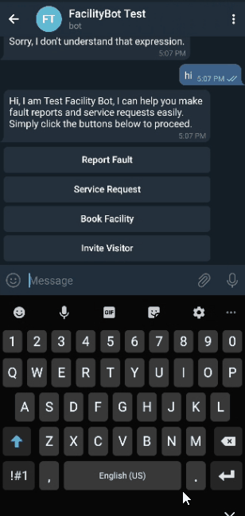
Creating a request / fault report (Telegram)
Once you have managed to find the bot, you can now start creating a request! Follow the easy steps to report a fault or make a request as guided by the bot. You will receive a case ID once the request is successfully made.

