Slide 1


SIP Application
Guide to SIP Issue Troubleshooting and Escalation

Slide 2
Agenda
SIP Troubleshooting for Partners
How to test & specify an Issue
Escalation Process
SIP Troubleshooting for Customers
How to test
How to Report

Slide 3
SIP Troubleshooting for Partners
How to Test
Incoming Call Issue
Outgoing Call Issue
Dropped Calls
Voice Quality
How to Report

Slide 4
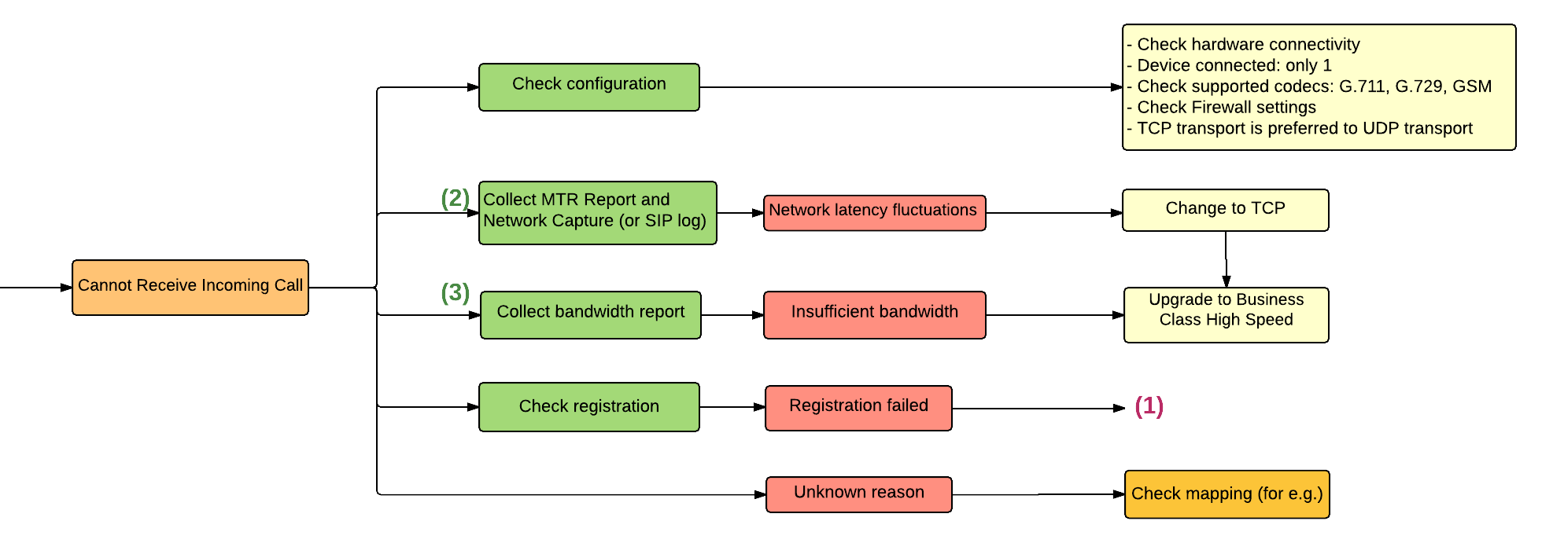
[How to Test] Incoming Call Issue

Slide 5
[How to Test] Incoming Call
First, check if the backup line is activated. If not, and customer cannot receive calls to their SIP device, then follow the diagram below to check on Device Connectivity.
Is there any device connected?
How many?
Yes
One
> Test on Softphone or another device.
Make sure device/s are connected to Internet
If line works, Reboot Device or check Device Configuration
If test fails, Report to Support Team
No
More than one
Connect/ Reboot Device
Only 1 device should be connected to 1 SIP Trunk

Slide 6
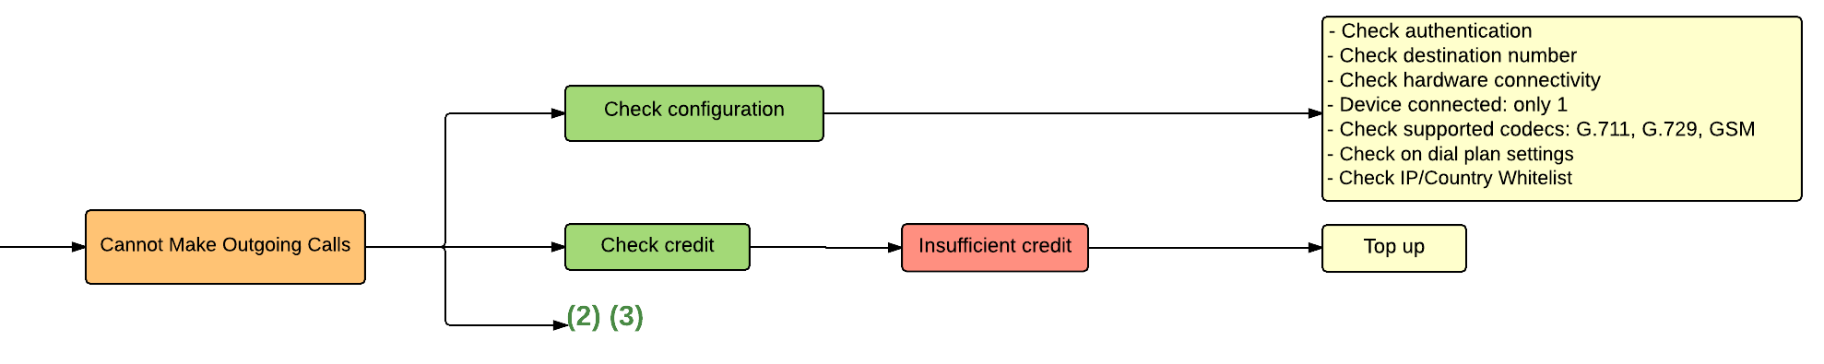
[How to Test] Outgoing Call Issue

Slide 7
[How to Test] Outgoing Call Caller ID
Which Caller ID is expected to show ?
Not SIP Number
Anonymous
No
SIP Number
No
CallerID
Retention
Registered?
No
Register
Yes
Yes
Yes
Caller ID = Anonymous
Caller ID = SIP Number
Set Default Number
Caller ID = SIP Number
Set Default Number
Escalate to
VoIP Engineer

Slide 8
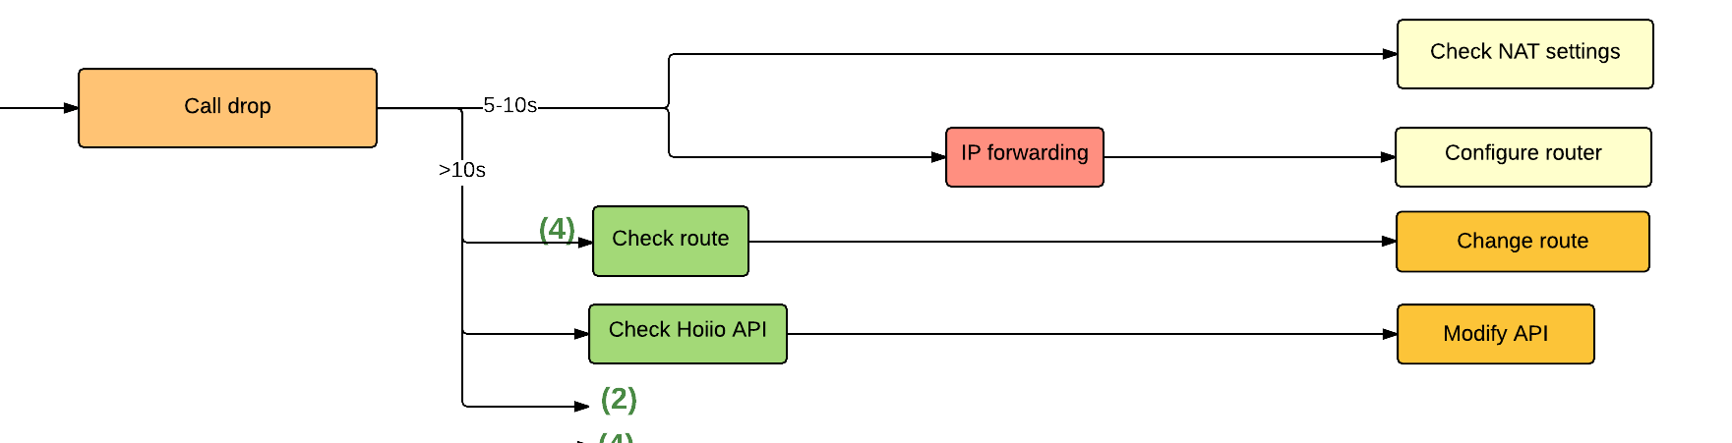
[How to Test] Dropped Calls

Slide 9
[How to Test] Dropped Calls
How to determine routing issue
Test on softphone and company phone
Report to VoIP Engineer on result and call details

Slide 10
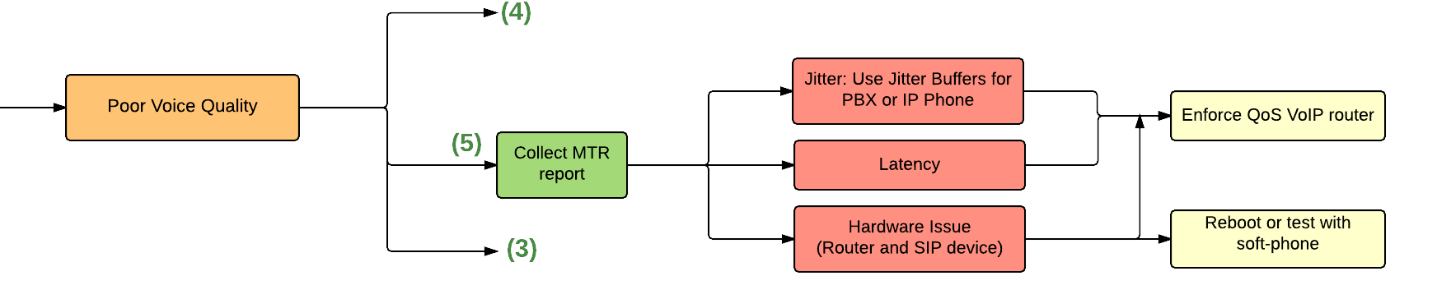
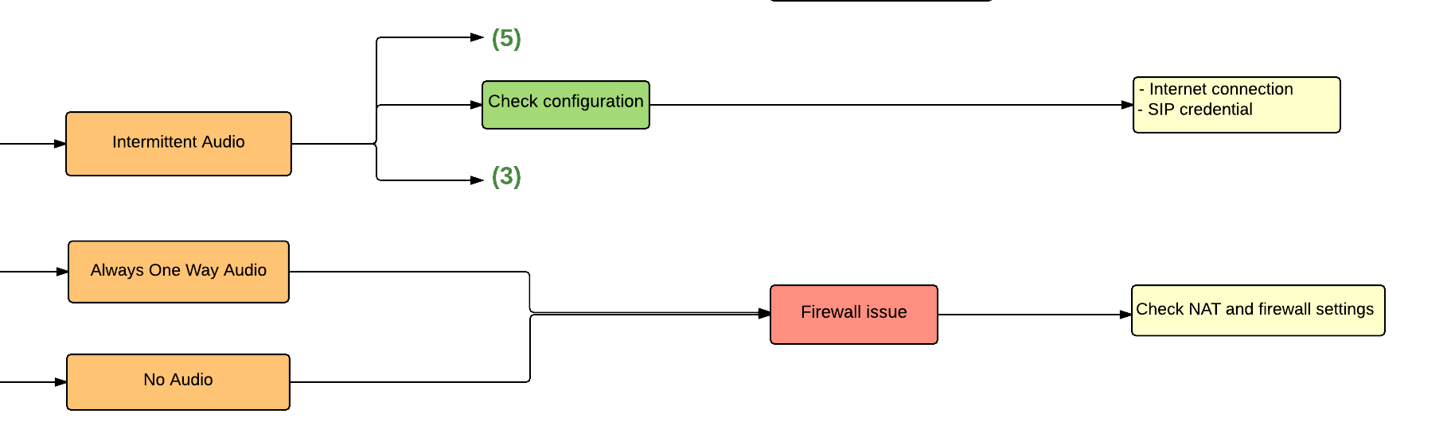
[How to Test] Voice Quality

Slide 11
[How to Test] Voice Quality
Route
Bandwidth
Network fluctuation
No
No
Yes
Yes
Yes
Ask
Engineer to check the route
Collect Bandwidth report
Collect MTR report and Network Capture
Escalate to VoIP Engineer
How to pinpoint if it is down to the route?
Call the number by SIP as well as Mobile Phone and compare the quality

Slide 12
[How To Report] Checklist
Please make sure to do a round of testing to replicate user experience and eliminate possibilities such as:
Account Issue (Lack of Credits, Subscription Expired)
Wrong configuration
Multiple devices connected
Network Issues (Unstable Internet connection, Firewall restrictions)
Wrong number entry (dial plan settings, destination number format)
Security Issues (IP Whitelist, Country Whitelist)
Test on separate device first
Using Zoiper or another IP Phone
In a different Network (using WiFi, Mobile Data)
For Outgoing call issue, call the number using Mobile to check
After clearing the enumerated factors, you may escalate to Tech Support Team with the ff details:
Domain:
Org UUID (Required) + Name (Optional):
SIP Account:
Destination number:
Date & time:
Symptom: Incoming/Outgoing
Issue:
*If possible, lay out the tests done w/ supporting call transactions and describe the issues faced, e.g
Unable to receive Incoming Call
Unable to make Outgoing Calls
Calls dropping/getting disconnected
Poor Voice Quality

Slide 13
SIP Troubleshooting for Customers
Checklist
How to Test
Incoming Call
Outgoing Call
How to Report

Slide 14
[Checklist]
First check your Account
Does the Account still have Credits? If not, top up.
Is the Subscription still Active? If not, contact Sales Team to renew subscription
Eliminate Device Issue
How to check if there is any device connected ?
On the portal go to Health > Connected device
How many devices are connected ?
Look into to the User Agent and Device Endpoint
Look into the time register (the time must be w/in 1 hour as of checking)
Reboot device and try again.
Eliminate Network Issue
Do you have a stable internet connection? If not, contact your Internet provider.
Try connecting to Mobile Data instead of WiFi

Slide 15
[Checklist] Outgoing Call
How to know if IP Whitelist is configured correctly?
Compare the IP addresses in the IP whitelist and the one that the connected device is using. They must be the same.
How to know what is my IP?
Google “my ip”
Dial string must match with Dial Plan.
If there is no Dial Plan set, dial string must match w/ default dialing pattern:
<Country Code>+<Area Code>+<Phone Number>

Slide 16
[How to Test] Incoming Call
First, check if the backup line is activated. If not, and customer cannot receive calls to their SIP device, then follow the diagram below to check on Device Connectivity.
Is there any device connected?
How many?
Test on Softphone or another device.
Make sure device/s are connected to Internet
If line works, Reboot Device or check Device Configuration
If test fails, Report to Support Team
Yes
One
No
More than one
Connect/ Reboot Device
Only 1 device should be connected to 1 SIP Trunk

Slide 17
[How to Test] Outgoing Call
Out of Credits
No
Invalid Dial String
No
DNC Number
No
Country/IP in Whitelist
No
Adjust the whitelist
Yes
Yes
Yes
Yes
Request
Top up
Dial Correctly
(CC + AC + Number)
Check Dial Plan
Inform
> Try calling the number using Mobile
> Test on another line
> If number can be reached otherwise, report to Support with complete call details

Slide 18
[How to Test] Outgoing Call Issue
How to know if IP Whitelist is configured correctly?
Compare the IP addresses in the IP whitelist and the one that the connected device is using. They must be the same.
If IP Whitelist is enabled, caller can only make calls from devices connected to the same network.
How to know what the current network’s IP Address is?
Google “What is my IP”
Dial string must match with Dial Plan.
Default dial pattern is Country Code + Area Code + Phone Number
If Dial Plan Settings is in place, follow configured pattern
Is the Destination Number valid?
Try calling the number using Mobile

Slide 19
[How to Report]
How to note the Test Call Detail & Result ?
Call Detail:
Date/Time
Caller (SIP) Number
Destination number
Result:
Is the call successful or not ?
If not : Is there any symptom/error message ?
Include other related information like
SIP account (Required)
Organization Name (Optional)
Send to {Support Email}

Slide 20
Thank You
For comments and feedbacks please contact academy@b3networks.com.

