Slide 1
Obstacles to Building
Effective School Leadership in Education:
Part II

Slide 2
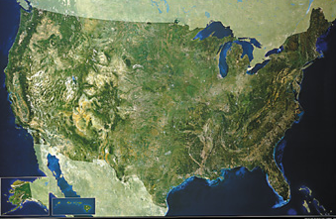
What is the Current State of Principal Preparation, Evaluation and Support?
Notes:
By way of introduction on why this is so important
we are extremely bad at school reform
one of the reasons is or failure to address the issue of culture
there are strategies we can use

Slide 3
Teacher Professional Development
Industrial Complex

Slide 4
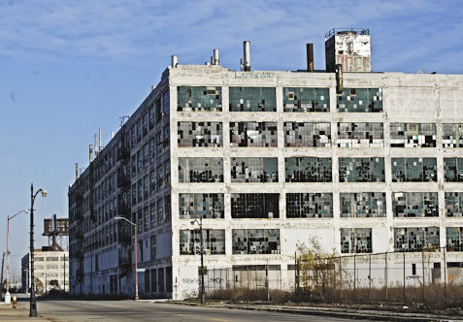
Principal Professional Development
Industrial Complex

Slide 5
The Challenge: Developing Effective Principals “At SCALE”
SY 2012-13
Principal Attrition and Mobility, National Center for Education Statistics (2014)

Slide 6
Principal Development Universe: Programs
University-based preparation program 825 (84%)
Non-University-based preparation program 153 (16%)
Private Organizations (nonprofit)
New Leaders for New Schools
NYC Aspiring Principal Program
District-based Programs
Ohio Advisory Leadership Council
Charter School Programs
KIPP
Over 95% of America’s …K-12 principals graduate from a university-based preparation program. Levine (2005)
27,289 M.A degrees 4,676 Ph.D. degrees NCES (2013)
1600 leaders over 10 years
500 leaders over 11 years
Notes:
2011-12

Slide 7
LACK OF RESEARCH ON PRINCIPAL PREPARATION
“…a general dearth of systematic scholarly inquiry…
bleak, scant…
no systematic data”
Hess & Kelly (2007)
“…lack of rigorous scholarship…
low standards…
dubious reliability and validity…
data of questionable value…
inappropriate analysis of data”…
Levine (2005)

Slide 8
State Oversight Responsibilities
Principal Competency Standards
Principal Preparation Program Approval
Set requirements School-based learning experiences
Specific coursework Faculty qualifications
Track performance outcomes
Principal Licensure
Initial licensure Renewal licensure
Principal outcome data
Briggs, et. al. (2013)

Slide 9
LACK OF PERFORMANCE DATA ON PRINCIPAL PREPARATION
STATE OUTCOME DATA
19 states were unable to report how many people graduate from state-approved principal preparation programs in their state on an annual basis
7 states could not report how many principal licenses are granted on an annual basis
Briggs et al., (2013)

Slide 10
LACK OF PERFORMANCE DATA ON PRINCIPAL PREPARATION
STATE OUTCOME DATA
28 states report than neither the state nor principal preparation programs are required to collect any outcome data on principal preparation program graduates
33 states do not have data on principal job placement rates
39 states do not have data on principal job retention rates
36 states do not have data on principal job effectiveness (by evaluation)
37 states do not have data on principal job effectiveness (as measured by student achievement data)
Briggs et al., (2013)

Slide 11
LACK OF PERFORMANCE DATA ON PRINCIPAL PREPARATION
UNIVERSITIES
Self-assessment is largely absent.
Levine, (2015)

Slide 12
Punch Lines
“Traditionally, the processes and standards by which many principal preparation programs screen, select, and graduate candidates often lack rigor and do not adequately equip principals for the multi-faceted role of effective instructional leader.” Cheney, et. al. (2010)
“it is distressing that inappropriate content ineffectively packaged should also be so poorly delivered…” Murphy (1992)
“The majority of programs range from inadequate to appalling, even at some of the country’s leading universities.” Levine (2005)

Slide 13
Critical Core Components of Principal Preparation
Principal competency framework
Strategic and and proactive recruiting
Rigorous selection process
4. Relevant and practical coursework
5. Experiential, clinical school-based opportunities
6. Placement and on-the-job support
7. Robust data collection and continuous learning
Rainwater Leadership Alliance Cheney, et.al. (2010)
Notes:
set of skills, knowledge, and dispositions that a principal must have in order to drive high levels of student achievement
it guides ALL aspects of the system
Leadership-Centered

Slide 14
Principal competency framework: University Programs
‘’The typical course of study…
…has nothing to do with the job of being a principal
…a nearly random collection of courses…
…little more than a grab bag of survey courses”
Levine 2005
“Programs offer a …
…disparate array of courses and program elements
…without a governing set of competencies”
Cheney & Davis 2011

Slide 15
Strategic and and proactive recruiting
&
3. Rigorous selection process
Recruitment / Selection “Gateways”:
admission to UNIVERSITY GRADUATE PROGRAMS
selection via district PIPELINE
acquisition & renewal of ADMINISTRATIVE LICENSES

Slide 16
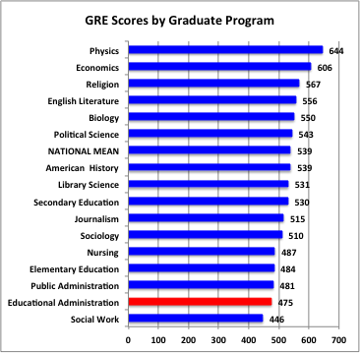
Recruitment / Selection: UNIVERSITY
ADMISSION AND GRADUATION STANDARDS
For all intents and purposes, the majority of educational administration programs admit nearly everyone who applies.
Levine 2005
Most programs are open enrollment programs and do not target or cultivate relationships with high-potential candidates. Instead, these programs passively accept who comes to them through their applicant pool.
Cheney & Davis 2011
Education Testing Service 2004

Slide 17
Recruitment / Selection: PIPELINE
Most recruiting and selection of principals is done internally…tends to be a very laissez-faire process…often valuing the following traditional qualifications…
Years of experience as a teacher
Years of experience as an Assistant Principal
Having a M.A. degree
Selectivity of principal’s college
Traditional principal training programs
Job-embedded principal training programs
Research on relationship between qualifications and effect on student performance.
(NYC, 1987 – 2007, employs well over 1,000 school principals)
(student test scores, absences and suspensions) Clark, Martorell, Rockoff (2009)
no effect
no effect *
no effect
no effect
no effect
small effect

Slide 18
Recruitment / Selection: ADMINISTRATIVE LICENSES
focused primarily on inputs, not outputs (competencies):
Initial License Requirements
• completion of MA from an approved principal prep program
• years of teaching
• passed an exam
License Renewal
• hours of professional development
• no standards for quality outcomes of training
• no standards for performance on the job
Cheney & Davis (2012)

Slide 19
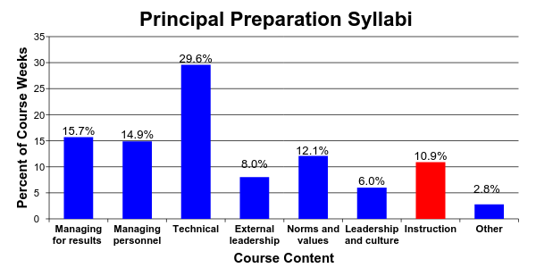
4. Relevant and practical coursework: University Programs
31 Preparation Programs
Hess and Kelly, 2007

Slide 20
4. Relevant and practical coursework: University Programs
Managing for results
• 2% of curricula addressed accountability as it relates to school management
• 5% addressed use of data, research, or technology as it relates to managing school improvement
Managing personnel
• 1% of curricula focused on systematic and “assertive” efforts to identify, enhance and reward teacher quality…the majority failed to mention termination or compensation at all.
Technical knowledge
• 7.4% data management and utilization
• 10% research skills
• 4.7% technology
Hess & Kelly (2007)
Notes:
If equal each 14%
Technical: law, finance, facilities, data, and research

Slide 21
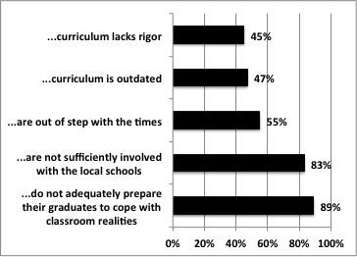
4. Relevant and practical coursework: University Programs
Schools of education…
Levine (2005)

Slide 22
4. Relevant and practical coursework: University Programs
PEDAGOGY
classes are predominately:
teacher-centered and lecture-styled
from a theoretical context
with little opportunity to practice critical leadership skills
and no content involving the real-life situations they are likely to confront on the job.
Cheney & Davis 2011

Slide 23
4. Relevant and practical coursework: University Programs
FACULTY
• the field depends too heavily on practitioners serving as part-time faculty
lack of instructional experience, knowledge of research, and rely on anecdotal “war stories”
• it employs too many full time professors who have minimal, if any, recent experience in the practice of school administration
only 8% of faculty who have had experience as school administrators
only 22% of deans who have had experience as school administrators
Levine (2005)

Slide 24
5. Experiential, clinical school-based opportunities: University Programs
Internship Mentors
• vague or unclear goals
• insufficient focus on instructional leadership and / or overemphasis on managerial role
• weak or non-existent training for mentors
• insufficient mentoring time or duration
The Wallace Foundation (2007)
• weak or non-existent evaluation of mentors
• weak or non-existent evaluation of principal interns
Southern Regional Education Board (2007)

Slide 25
6. Placement and on-the-job support
Principal Supervisors
Professional Development
Principal Feedback & Evaluation

Slide 26
6. Placement and on-the-job support: Supervision
Principal Supervisors
• Principal supervisors oversee an average of 24 schools, ranging from 6 to 67
• Districts by and large have not articulated an explicit set of principal supervisory competencies on which to base evaluations.
• Few districts select principal supervisors on the basis of their explicit results and measurable student achievement gains.
The Wallace Foundation and Council of the Great City Schools
Survey of 41 urban public school districts Corcoran. et.al. (2012)

Slide 27
6. Placement and on-the-job support: Evaluation
INSTRUMENT CONTENT ANALYSIS
Learning Centered Leadership: A Behavior-Anchored Framework
(Vanderbilt Assessment of Leadership in Education)
high standards for student learning culture of learning
rigorous curriculum connections to external communities
quality instruction performance accountability
INSTRUMENT USAGE ANALYSIS
UTILITY: information is used to improvement performance
ACCURACY: instrument produces sound information about the principal’s performance (e.g. sound psychometric development)
The Wallace Foundation and Council of the Great City Schools. Survey of 65 Principal Assessment Instruments from 65 districts (43 states and DC)
Goldring, et.al. (2012)

Slide 28
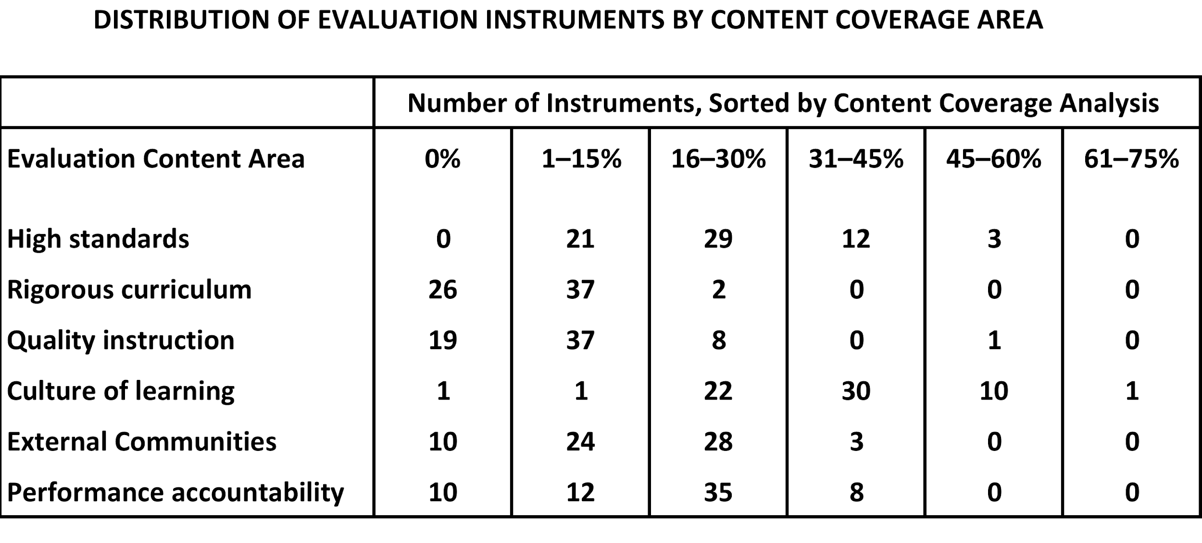
6. Placement and on-the-job support: Evaluation
CONTENT: Principal evaluation systems do not focus on the most critical items: student outcomes and teacher effectiveness
• only 25 instruments (38%) touched on all six core components
Goldring, et.al. (2012)

Slide 29
6. Placement and on-the-job support: Evaluation
UTILITY: Principal evaluation systems are not used effectively to improve principal performance
• 43% of the reviewed instruments failed to give leaders clear feedback on what they could be doing more or better to improve teaching and learning
• there are often inconsistent (or nonexistent) connections between evaluation and professional development plans
ACCURACY: Principal evaluation systems are not used effectively to improve principal performance
• evaluation systems are seldom based on clear performance standards
• there is little attention paid to the skills, qualifications, or authority of the reviewer
• few have been tested for important psychometric properties for validity and reliability
Goldring, et.al. (2012)

Slide 30
6. Placement and on-the-job support: Supervision
Professional Development
Professional development is generally not seen as sufficient to support school principals as instructional leaders.
The Wallace Foundation and Council of the Great City Schools Corcoran. et.al. (2012)
Principal development opportunities are based more on “whims, fads, opportunism and ideology” than sound research and that while participation rates were high, it rarely lead to any changes in practice that had an impact on student achievement.
National Association of State Boards of Education Sun (2011)

Slide 31
7. Robust data collection and continuous learning: State Oversight
Performance data
• 19 states were unable to report how many people graduate from state-approved principal preparation programs in their state on an annual basis
• 28 states report than neither the state nor principal preparation programs are required to collect any outcome data on principal preparation program graduates to know if they secure jobs, retain them, show impact on student achievement, or earn effective ratings on principal evaluations program
• Universities typically do not track performance outcomes

Slide 32
Critical Core Components of Principal Preparation
Principal competency framework
Strategic and and proactive recruiting
Rigorous selection process
4. Relevant and practical coursework
5. Experiential, clinical school-based opportunities
6. Placement and on-the-job support
7. Robust data collection and continuous learning
Rainwater Leadership Alliance Cheney, et.al. (2010)
Poor
Poor
Poor
Poor
Poor
Poor
Poor
Notes:
set of skills, knowledge, and dispositions that a principal must have in order to drive high levels of student achievement
it guides ALL aspects of the system
Leadership-Centered

Slide 33
Now What?
Dealing with “passive” incompetence vs. “active” incompetence
Less ideological opposition, active resistance
An Innovative Look, A Recalcitrant Reality: The Politics of Principal Preparation Reform, Hess & Kelly 2005

Slide 34
Now What?
Dealing with “passive” incompetence vs. “active” incompetence
There is movement in the public policy level to recognize the changing role of school principal and the need to strengthen principal effectiveness standards, preparation program oversight, licensure and outcome data.
U.S. Department of Education
National Association of State Boards of Education
National Conference of State Legislators
Education Commission of the States
Council of State Chief School Officers
National Association of Elementary School Principals
National Association of Secondary School Principals

Slide 35
Now What?
Dealing with “passive” incompetence vs. “active” incompetence
There is movement in the public policy level to recognize the changing role of school principal and the need to strengthen principal effectiveness standards, preparation program oversight, licensure and outcome data.
There is an increasing amount of research on principal competencies and principal preparation systems.
U.S. Department of Education is funding a large-scale randomized control trial evaluation of principal professional development beginning in 2015.
Rand studies on New Leaders performance outcomes

Slide 36
Now What?
Dealing with “passive” incompetence vs. “active” incompetence
There is movement in the public policy level to recognize the changing role of school principal and the need to strengthen principal effectiveness standards, preparation program oversight, licensure and outcome data.
There is an increasing amount of research on principal competencies and principal preparation systems.
There are an increasing number of “exemplar” principal preparation programs and research organizations:
New Leaders, etc.
The Wallace Foundation Pipeline
Southern Regional Education Board

Slide 37
Thank You

