Slide 1







































WELCOME
TO FANTASY CLASS
A free presentation template by EaTemp

Slide 2














GOOD MORNING
  Introduction to Fantasy as a genre
  The elements of Fantasy
  Character development in Fantasy
  Plot and storytelling in Fantasy
  Writing Fantasy: tips and tricks
  Q&A and open discussion
  Conclusion and next steps.

Slide 3



AGENDA
Today Date: Feb 14
TARGETS
TO-DO
  Explore key elements of the Fantasy genre
  Learn about world-building, character development, and storytelling
  Unleash imagination and creativity
  Engage in class discussions and activities
  Participate in world-building and character creation exercises
  Start crafting your own Fantasy story

Slide 4

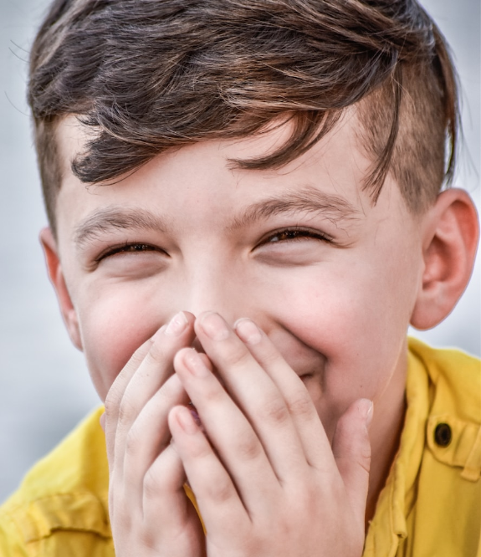

Today, we have a special guest in our class. Meet Harry, who will be sharing his favorite Fantasy book, character, and why he loves the Fantasy genre. Get ready to learn from our talented student of the day!
STUDENT OF THE DAY
HARRY

Slide 5

MUST DO
MAY DO
  Attend class and actively participate in discussions
  Complete all assigned readings and homework
  Show respect for classmates and the teacher
  Share personal experiences related to Fantasy
  Ask questions and seek clarification when needed
  Offer insights and suggestions during class discussions.

Slide 6



DIRECTIONS
Follow instructions carefully: read, follow steps, ask for help, check, pay attention to details.

Slide 7


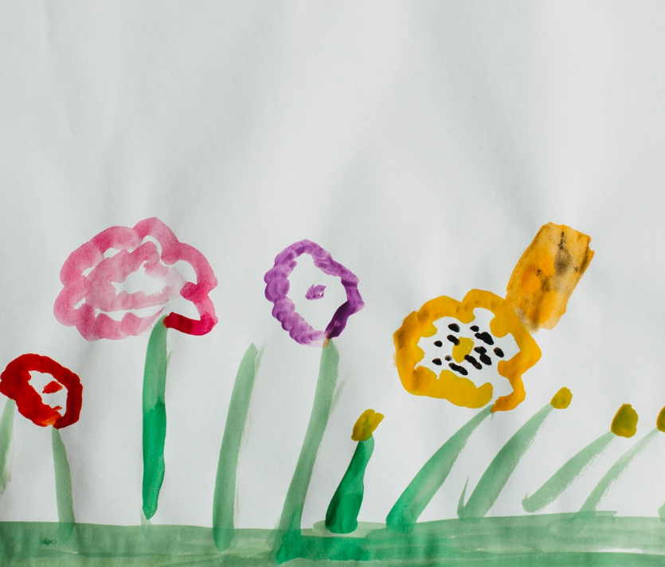
REMINDERS
A friendly reminder to ensure success in completing any task or activity: carefully follow the given instructions, ask for help if needed, double-check your work before submitting.

Slide 8


STEP 1
STEP 2
STEP 3
  Read the instructions thoroughly
  Proceed with the steps in the order provided
  Clarify any questions or confusion
  Don't hesitate to ask for help
  Reach out to the teacher or classmates
  Utilize resources and materials available
  Verify that everything is correct before submitting
  Pay close attention to details
  Double-check all work.

Slide 9



STATIONS
Explore your creativity and let your imagination run wild.
Test your knowledge of magic and hone your skills.
Step into the world of fairy tales and immerse in your favorite stories.
Visit the unicorn meadow and meet the magical unicorns.
Take a walk in the enchanted forest and discover the magic within.
Enter the crystal cave and marvel at the beauty of the crystals.

Slide 10




REMINDER
Stay focused, be organized, and ask questions if needed.
TO DO
  Focus on the task at hand
  Stay organized with materials and notes
  Ask questions if there is any confusion or uncertainty.

Slide 11








TODAY’S SCHEDULE
9:00 AM - Imagination Station
10:00 AM - Spellbinding Station
11:00 AM - Fairy Tale Station
12:00 PM - Dragon Den Station
1:00 PM - Enchanted Forest Station
Explore your creativity and let your imagination run wild.
Use provided materials to create something unique and magical.

Slide 12


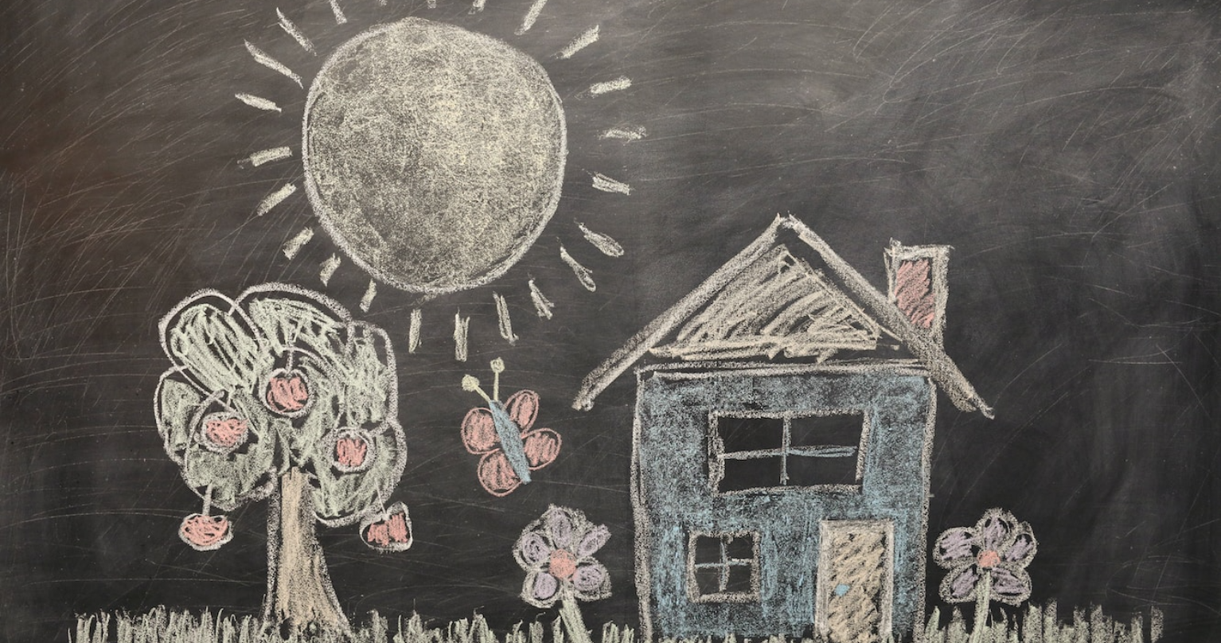
FINISH EARLY?

Slide 13

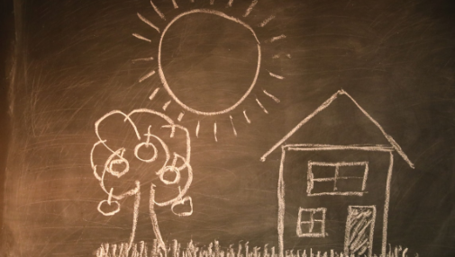
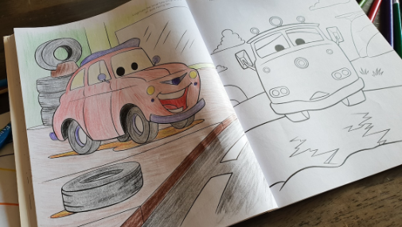

GROUP 1
GROUP 2
GROUP 3
  Illustrate mythical creature
  Write story about creature
  Present creation & process
  Make magical potion
  Experiment with recipes
  Present potion & effects
  Build fantastical world
  Incorporate elements
  Present world & features.

Slide 14
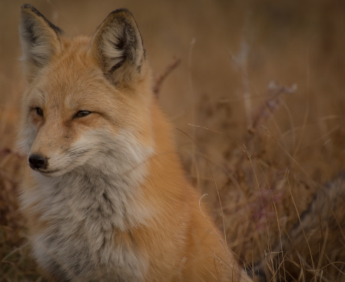
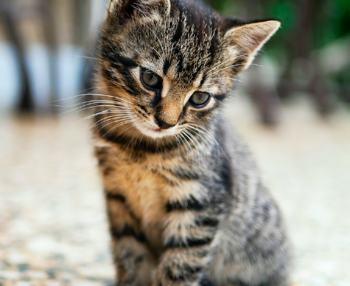
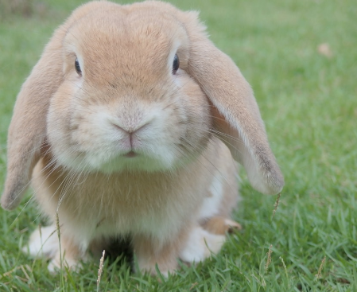

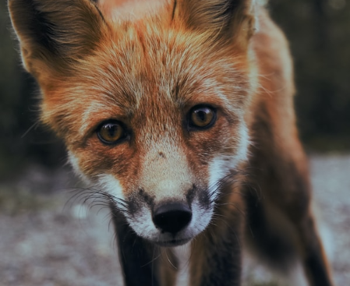
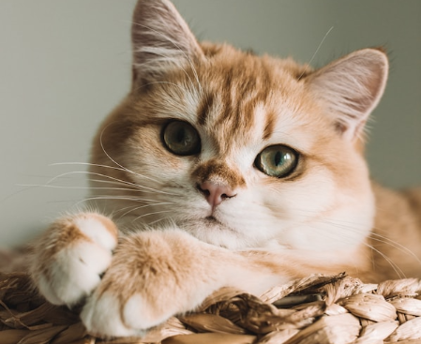
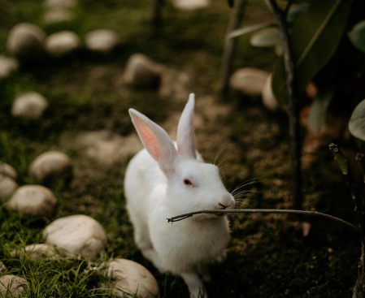

SPELLING
FOX
CAT
RABBIT

Slide 15



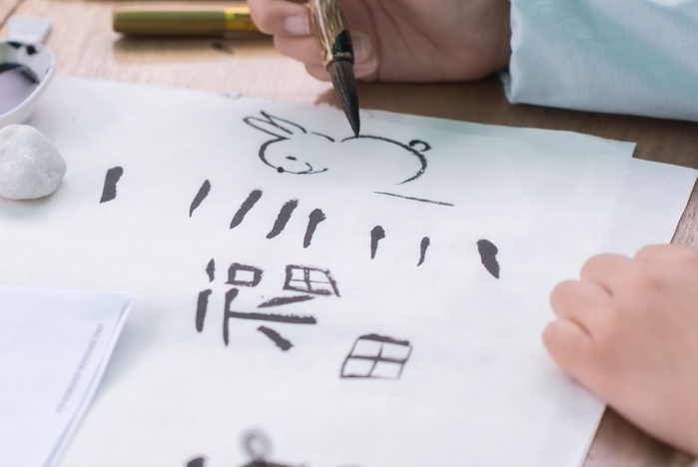
MAGIC
  Learn about different types of magic.
  Explore the history and origins of magic in various cultures.
  Discuss ethical considerations and responsibilities when practicing magic.

Slide 16























MEET THE TEACHER
ABOUT ME
FUN FACTS
I am a Fantasy educator and lover of imagination. My goal is to inspire students to unleash their creativity.
I collect antique maps of imaginary lands, a reminder of the limitless possibilities in Fantasy storytelling.
AGELINA

Slide 17



MORNING MEETING
Don’t forget to hand in your homeword

Slide 18




TODAY’S GOAL
  Explore the key elements of Fantasy
  Learn about world-building, character development, and storytelling
  Bring our own stories to life
  Ignite our imagination
  Gain a deeper understanding of the Fantasy genre

Slide 19



REMINDER
Don't forget to bring your imagination and creativity to class today as we delve into the exciting world of Fantasy!

Slide 20


WEEK AT A GLANCE
M
T
W
TH
F
Adventure
Realms
The Magic
Myths
Legends
Character
Enchanted
Art
Power
Creatures
Plot
Mystical
Settings
Myths
Realms
Adventure
Realms
The Magic
Enchanted
Legends
Myths
Realms
The Magic
Art
Enchanted

Slide 21










THANK YOU
Help us keep bringing free content by spreading the word about EaTemp.
If you have any questions, please email us: contact@eatemp.com

