Slide 1


Effective Classroom Management
Principal Professional Learning
February 2025
Notes:
Time frame: under 1 minute
Talking points:
Welcome and introductions

Slide 2

CCR Updates
National Counselors Appreciation Week (Secondary)
Anxious Generation SW Survey (Voluntary)
2025-26 SW Staffing Considerations
Screening Nights (Secondary)
  Andrea Abbott: ext. 0087 / email: aabbott@graniteschools.org
Counselor Reviews coming in March (Secondary)
Notes:
Time frame: under 1 minute
Talking points:
Share the standard we will be covering

Slide 3
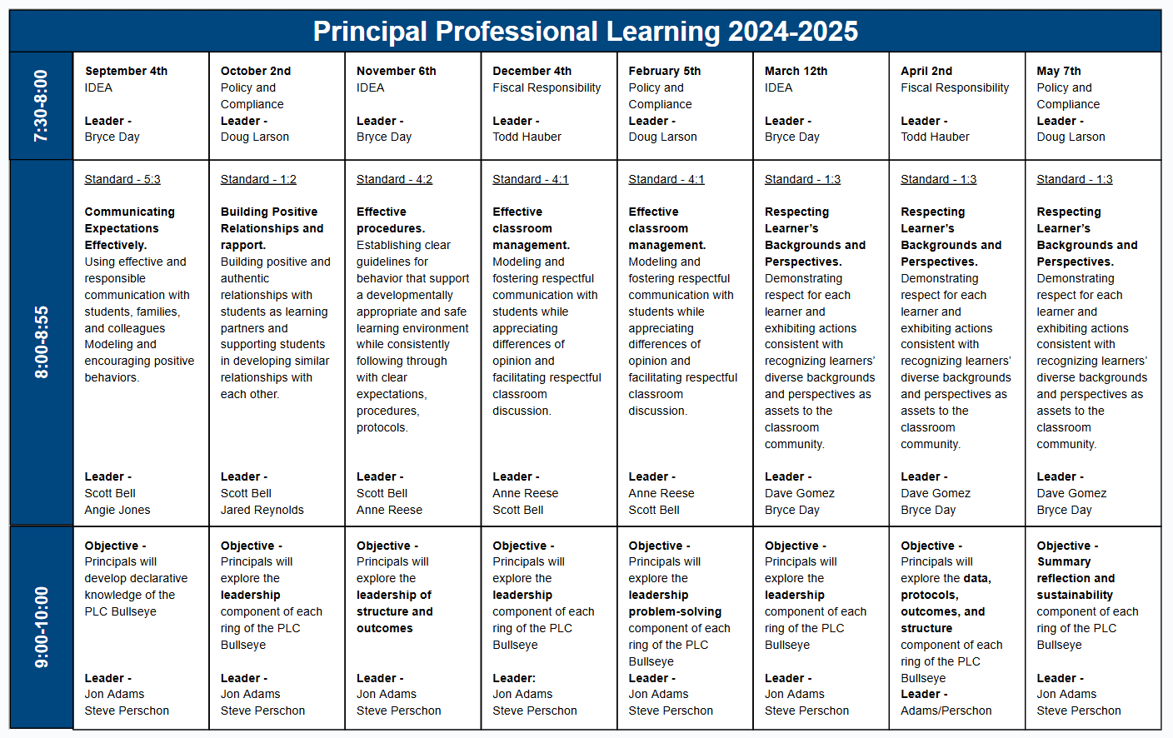
Notes:
Time frame: under 1 minute
Talking points:
Share the scope and sequence for the year

Slide 4
Standards
Teacher Standard 4.1
Effective classroom management
  Modeling and fostering respectful communication with students while appreciating differences of opinion and facilitating respectful classroom discussion.
* With a focus on classroom Tier 2 & 3 behaviors & attendance
Notes:
Time frame: under 1 minute
Talking points:
Share the standard we will be covering

Slide 5
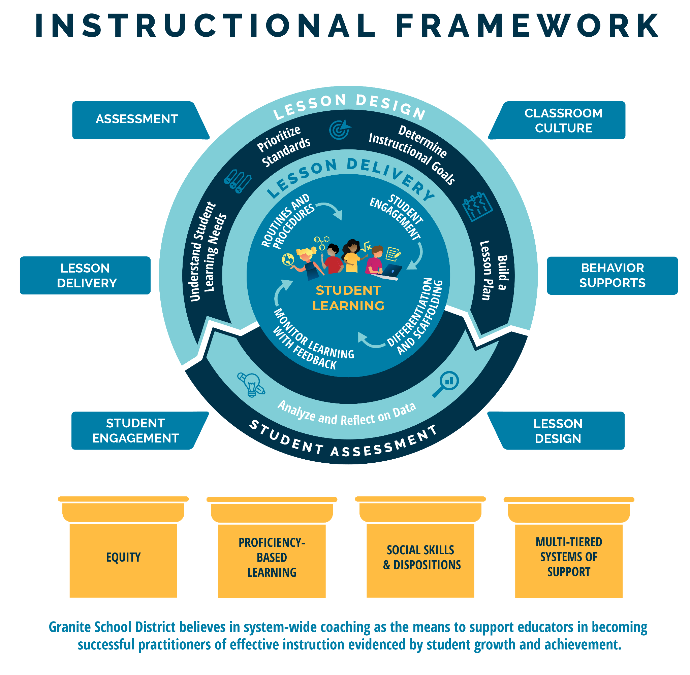
Notes:
Time frame: under 1 minute
Talking points:
This is the Granite School District Instructional Framework. This framework is based on the evidence-based instructional practices embedded in the GSD Strategic Plan and represents all of Granite School District priorities. You will notice student learning is at the heart of the framework as it represents our commitment to student learning around which everything else is built. The framework features the basic elements of a high quality instructional cycle including Lesson Design, Lesson Delivery, and Student Assessment. You will notice the evidence-based practices at the lesson delivery level that we expect to see in what the teacher and the student are doing during the lesson. The high quality instructional cycle components are reinforced through ongoing, job-embedded coaching in: lesson design, student engagement, lesson delivery, assessment classroom culture and behavior supports, all of which contribute to meaningful learning and career and college readiness. The framework rests on the foundational pillars of Granite School District’s commitment to Equity, Proficiency-Based Learning, Social Skills and Dispositions and Multi-Tiered Systems of Support.

Slide 6
Objectives
Review and discuss current and future implementation of strategies, interventions and skills learned during Summer 2024 Boot Camp.
  Crisis Cycle
  Student Support Process
  Restorative Practices
Notes:
Time frame: under 1 minute
Talking points:
Review the objective

Slide 7
Essential Questions
“How are the strategies, interventions, and skills learned in MTSS Boot Camp being effectively integrated into our current practices for crisis management, student support, and restorative practices?”
“How are the strategies, interventions, and skills learned in MTSS Boot Camp being effectively integrated into future practices for crisis management, student support, and restorative practices to enhance overall school climate and student outcomes?”
Notes:
Time frame: under 1 minute
Talking points:
Review the essential questions

Slide 8
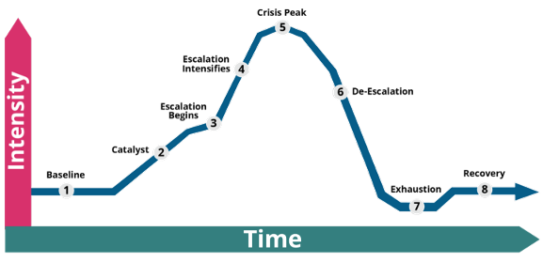
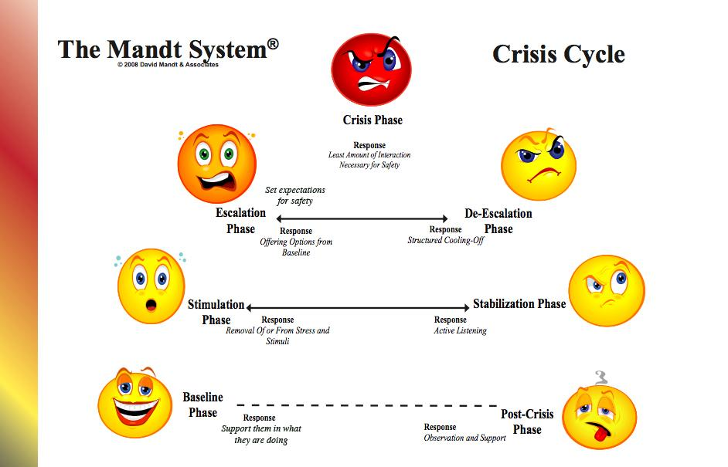
Crisis Cycle
Description of the Crisis Cycle Phases and Adult Responses
Crisis Prevention and De-Escalation Slidedeck
Strategies for De-Escalating Students in the Classroom
Notes:
Time frame: 3 minutes
Talking points:
Remind participants of the resources they have been given to use to teach their stakeholders about the Crisis Cycle
Open each link to show the resources

Slide 9

Crisis Cycle Table Talk
What has been working at your school?
Notes:
Time frame: 8 minutes
Talking points:
Give the participants 5 minutes to discuss at their tables ways they have been successfully sharing/using the Crisis Cycle with their stakeholders
Give the participants 3 minutes to share with the group strategies/activities that they feel have been a successful

Slide 10

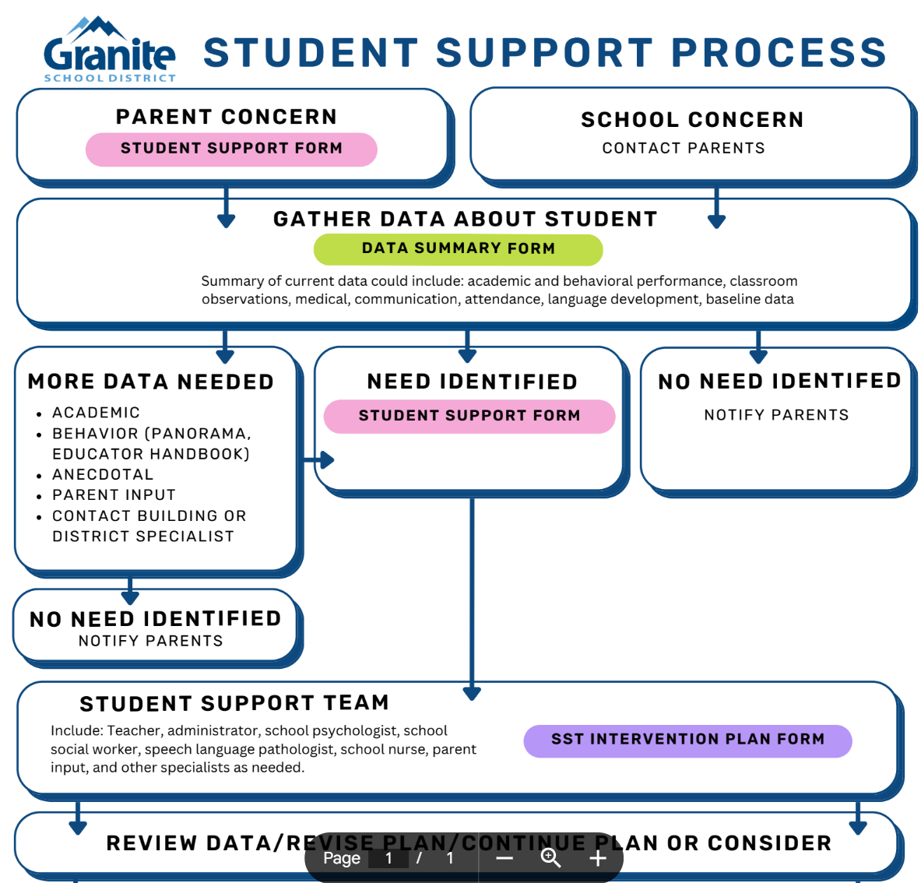
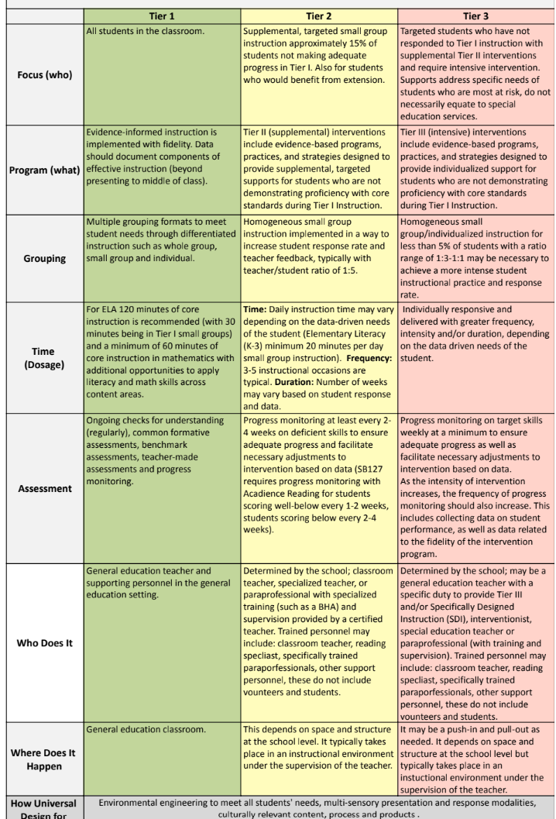
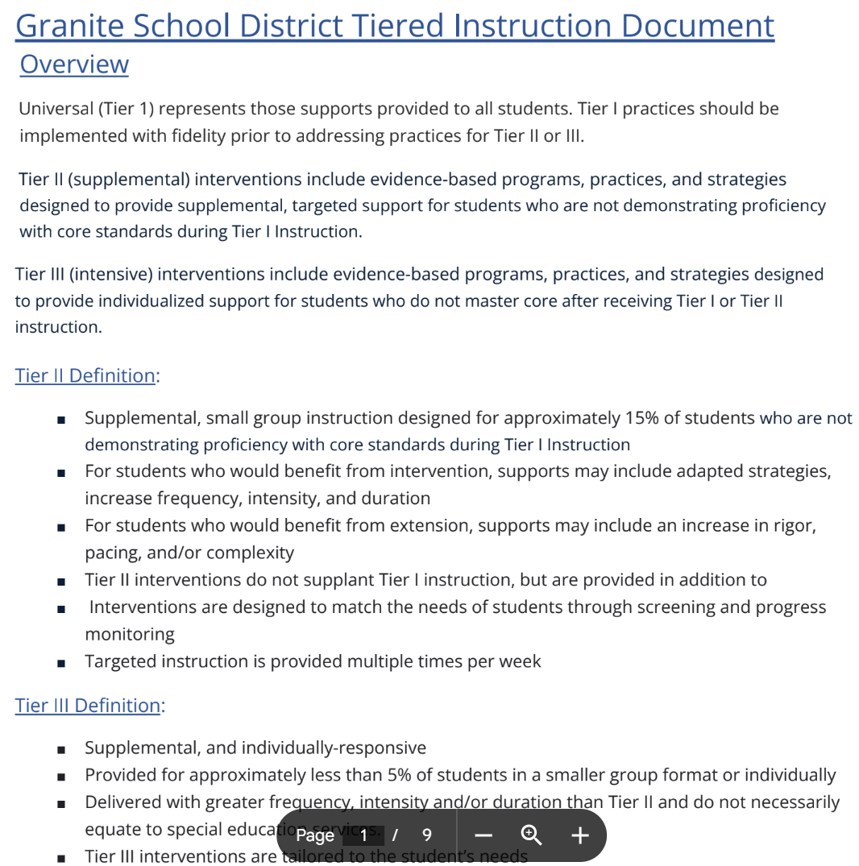
Student Support Process
Granite School District Tiered Instruction Document
Student Support Process Flowchart
GMTSS Critical Components Chart
Tier II Behavior Supports
Notes:
Time frame: 3 minutes
Talking points:
Remind participants of the resources they have been given to use to teach their stakeholders about the Student Support Process (SSP)
Highlight that we will be having schools use the documents in Focus next year

Slide 11
Student Support Process Table Talk
What has been working at your school?
What challenges are you seeing?
Notes:
Time frame: 8 minutes
Talking points:
Give the participants 5 minutes to discuss at their tables ways they have been successfully utilizing the Student Support Process (SSP) at their school
Give the participants 3 minutes to share with the group strategies/activities that they feel have been a successful

Slide 12

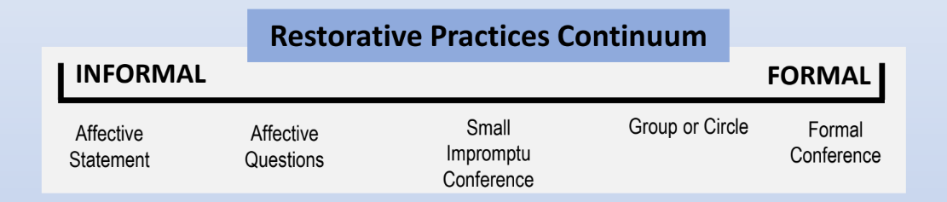
Restorative Practices
Calm Space Best Practices Checklist
Restorative Practices for Schools
Notes:
Time frame: 2 minute
Talking points:
Remind participants of the resources they have been given to use to teach their stakeholders about Restorative Practices
Open each link to show the resources

Slide 13
Restorative Practices
Four Guiding Principles of Trauma-Informed Teaching
1. Build Strong Teacher-Student Relationships
2. Create an Emotionally Safe Environment
3. Teach Students Self-Regulation Skills
4. Prioritize Teacher Trauma Stewardship
Trauma Informed Teaching PL
Notes:
Time frame: 1 minute
Talking points:
Remind participants of the resources they have been given to use to teach their stakeholders about Trauma Informed Practices

Slide 14
Restorative Practices
Closing the Communication Loop - Strategies for Re-Entry
It’s Over. Now what? Teacher and Student Mindset
You must be ready to accept that student back into the classroom/space/activity
The student must be ready to come back to the classroom/space/activity
The classroom environment must be ready to accept the student back
Are you ok?
Is the student ok?
Is the space ok?
Notes:
Time Frame: 3 min
Objective: Discuss Re-entry strategies for students, teacher, and the environment
Talking Points:
After a crisis, a lot of emotions can be felt by everyone involved. It’s important to take in account the mindset of the student who was in crisis, the students and adults involved, and the environment.
As the teacher you must be ready to welcome that student back into the classroom/space/activity. Ask yourself, are you ok?
The student who was in crisis must also be ready to come back to the classroom/space/activity. Is the student ok?
The environment must be ready to accept the student back. Is the space ok? Is it put back together and calm. Are the other students calm?
When we are ready and the space is to accept the student who is ready back, we are setting up for success.
If we reintroduce the student back to an environment and people that are not ready, then we are introducing everyone to an environment that isn’t viewed as safe and supportive.
An environment that isn’t safe and supportive often sets the student and us up for failure.

Slide 15

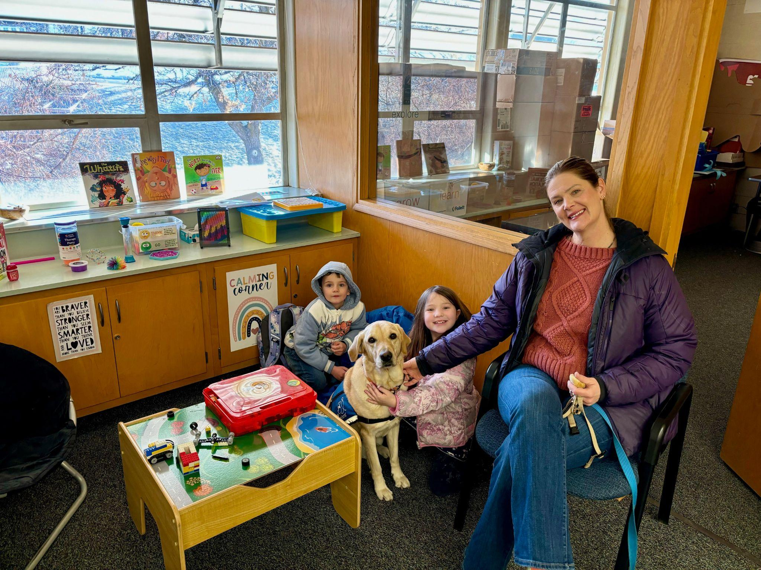
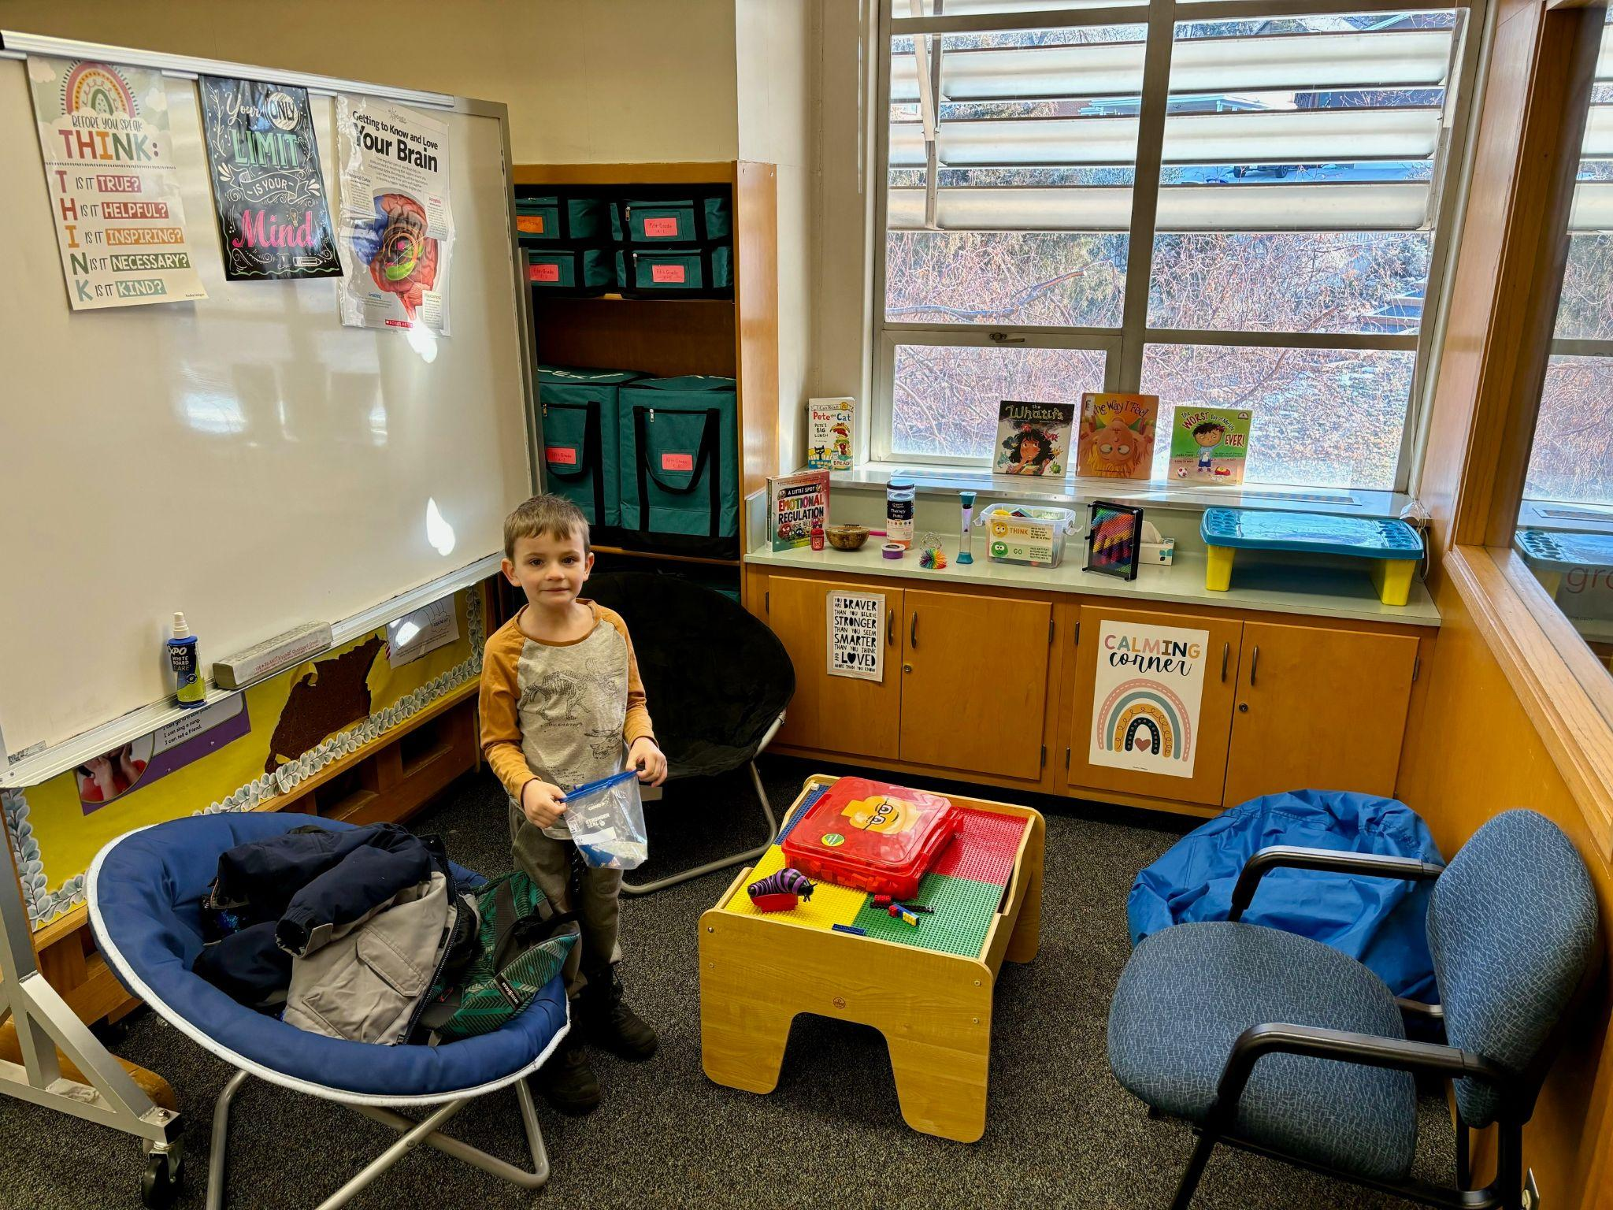
Upland Terrace - “Serenity Squad”
Notes:
Time frame: 3 - 5 minutes
Talking points:

Slide 16
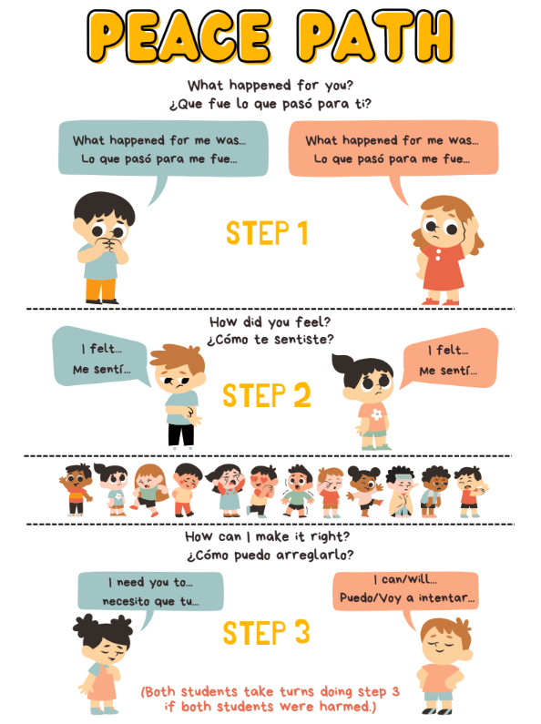
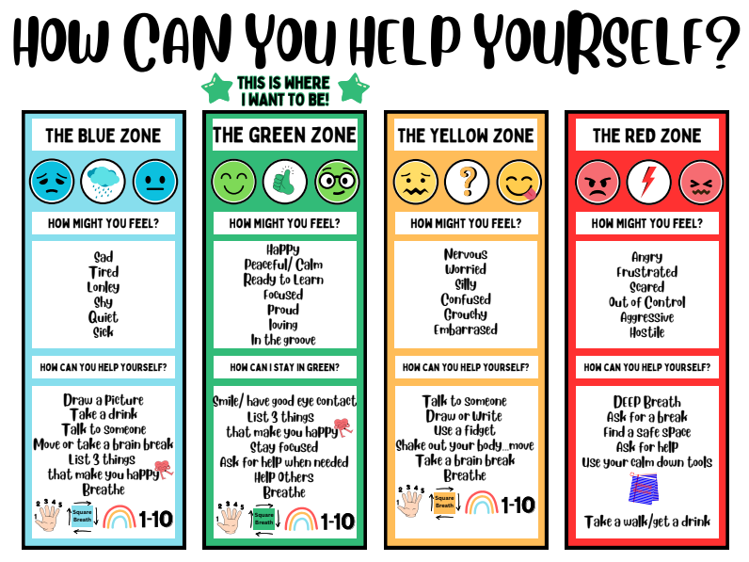
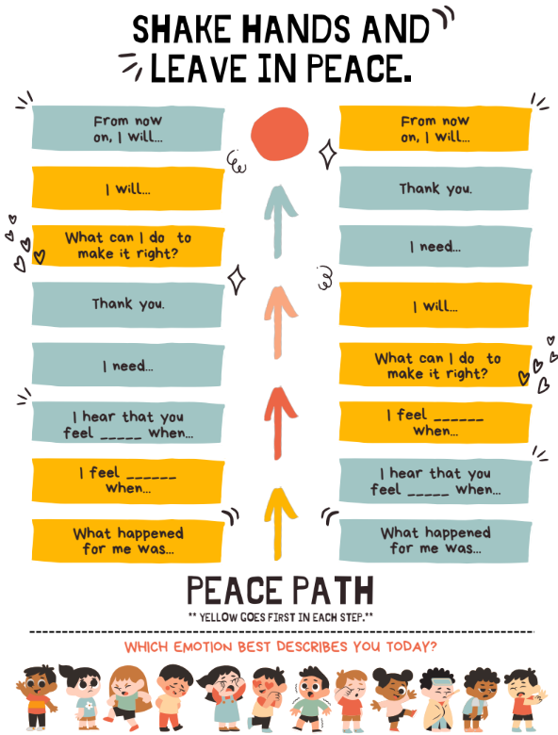
South Kearns - “Peace Path” & “Zones”
Notes:
Time frame: 3 - 5 minutes
Talking points:

Slide 17
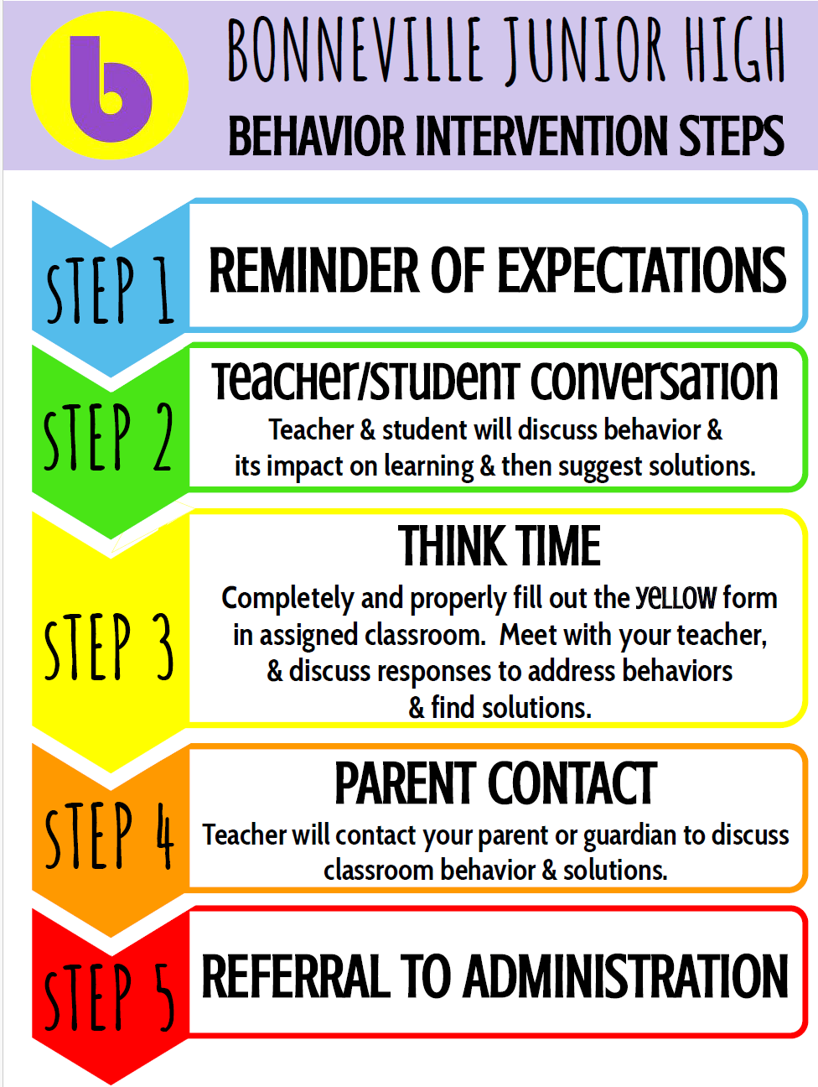
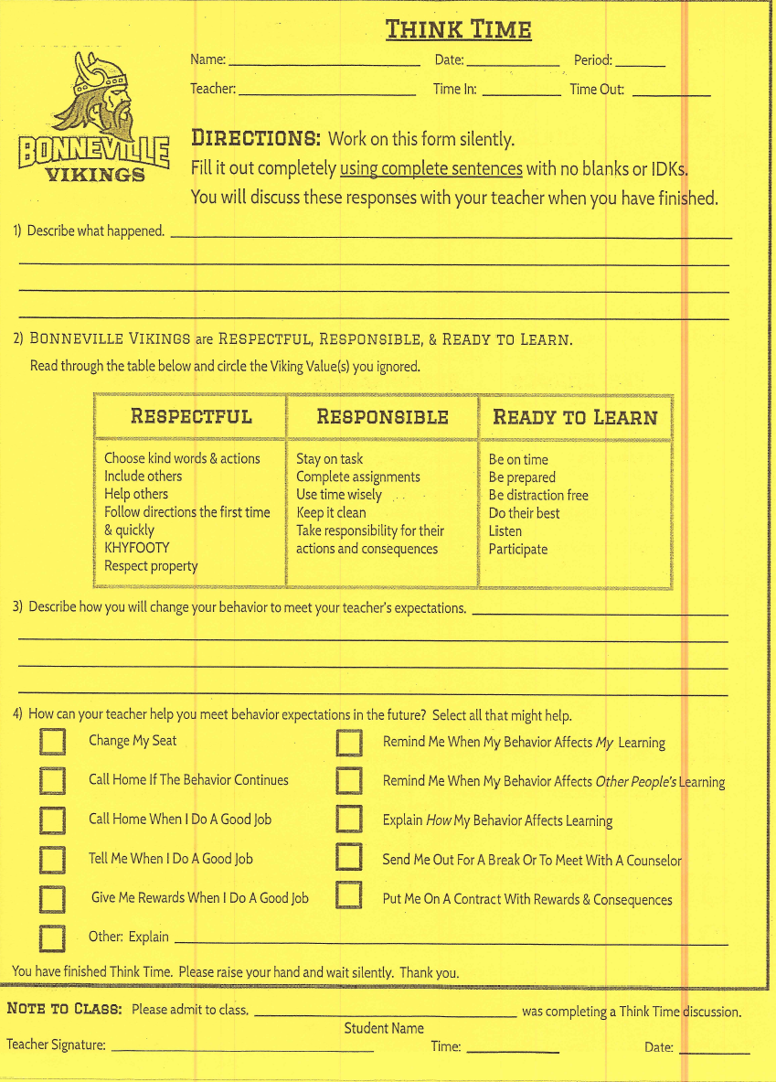
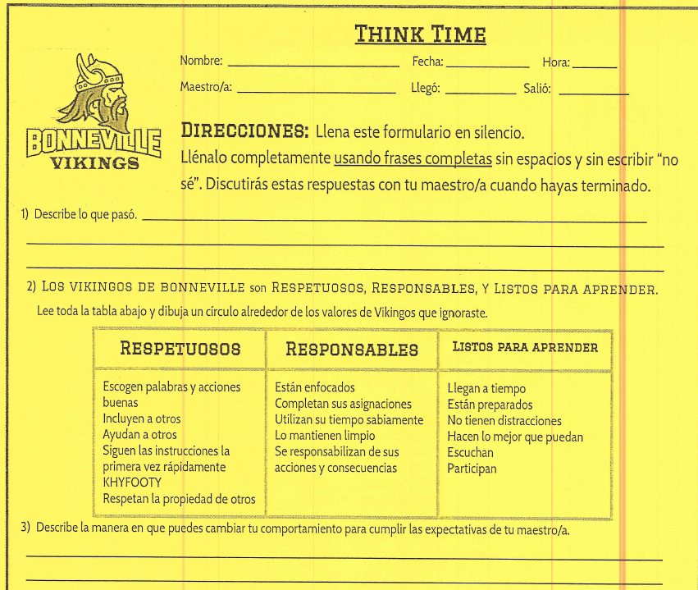
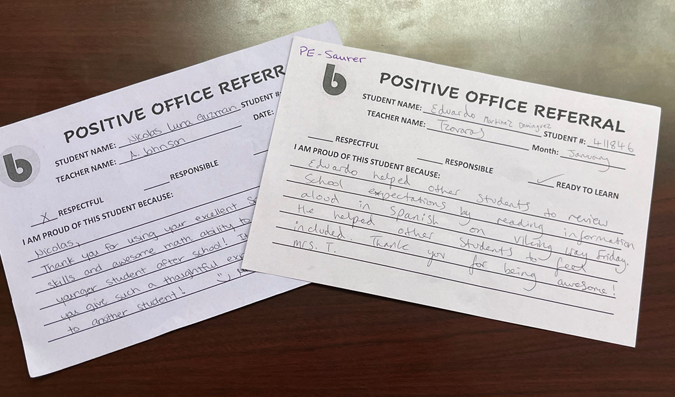
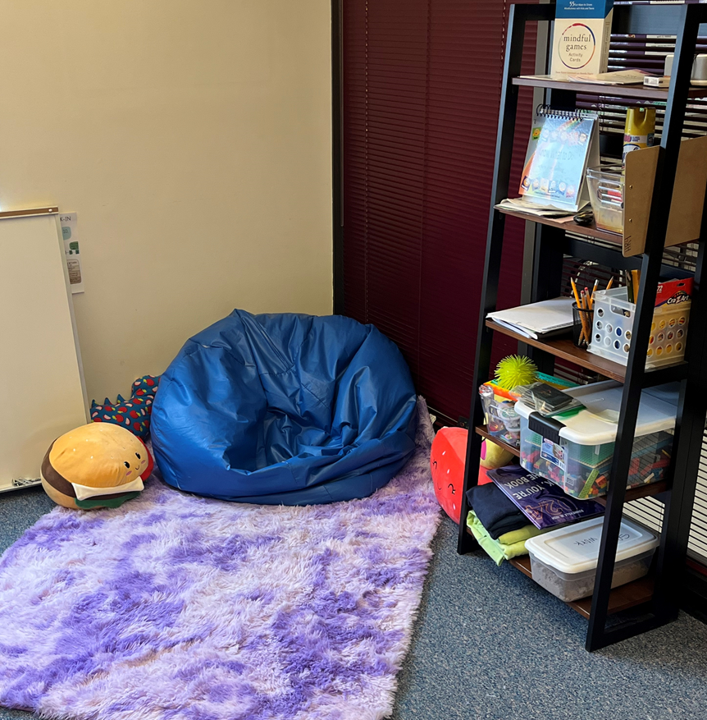
Bonneville Junior High
Positive Office Referral
Calming Zone with BHA and Check and Connect Mentor
Notes:
Time frame: 3 - 5 minutes
Talking points:

Slide 18

Kearns High School
Restorative Justice
Peer Court
Mediations
Community Service
Make it Right
Communication
Notes:
Time frame: 3 - 5 minutes
Talking points:

Slide 19
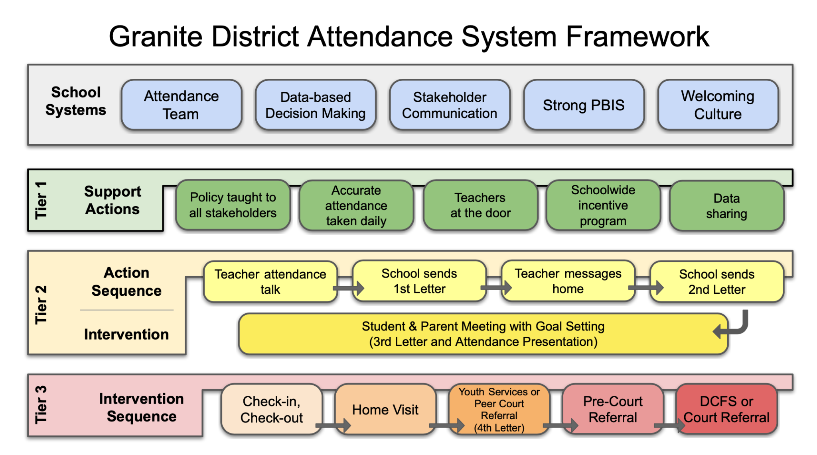
Attendance - Jared Reynolds
Notes:
Time frame: 10 minutes
Talking points:

Slide 20

Next Steps Self-Reflection
In regards to:
  The Crisis Cycle
  The Student Support Process (SSP)
  Restorative Practices
  Attendance
What can you incorporate into your future practices at your school to enhance your current practices?
Notes:
Time frame: 2 minutes
Talking points:
Give the participants 2 minutes to self reflect on ways they will incorporate things they learned or were reminded of into their future practices at school

Slide 21
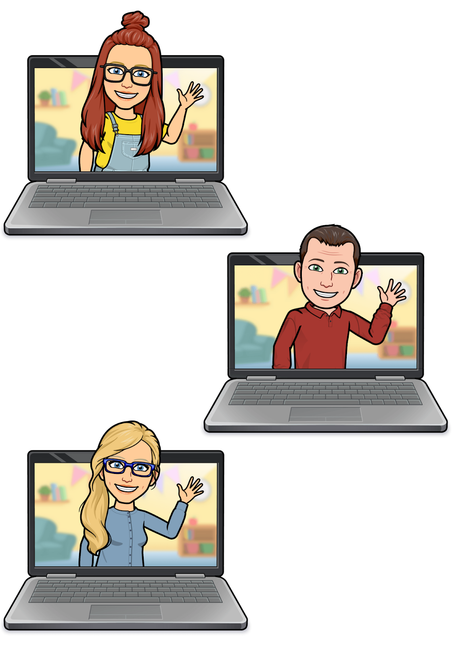
Resources
General Education Behavior Specialists Team:
Nicole Baird, M.S., BCBA, LBA
Lennea Bower, M.A., BCBA, LBA
Russell Howarth, M.Ed., BCBA, LBA
Have a question about our services or need general information? Contact the Team: Gen Ed Behavior Team
BCBA Consultation / Office Hours
WHO
Social workers, psychologists, administrators.
WHAT
Book a 15 minute Microsoft Teams consultation with a BCBA (Board Certified Behavior Analyst) to answer questions regarding behavior support needs or basic behavior strategies. Please come prepared with data.
WHEN
Monday 12:00pm - 1:00pm BOOK HERE
Tuesday 9:30am - 10:30am BOOK HERE
Thursday 1:00pm - 2:00pm BOOK HERE
Request for GSD General Education Behavior Support Referral Form
Notes:
Time frame: less than 1 minute
Talking points:
They are General Education
They have consultation hours
They do not have a waiting list

Slide 22
Resources
MTSS Library (Portal)
  Social Skills and Dispositions - PBIS Section
iirp School Resources
Getting Consistent with Consequences Article
Understanding Trauma Informed Education Article
Notes:
Time frame: less than 1 minute
Talking points:
Review resources

Slide 23
Thank You!
Notes:
Time frame: > 1 min.
Talking points:

