Slide 1


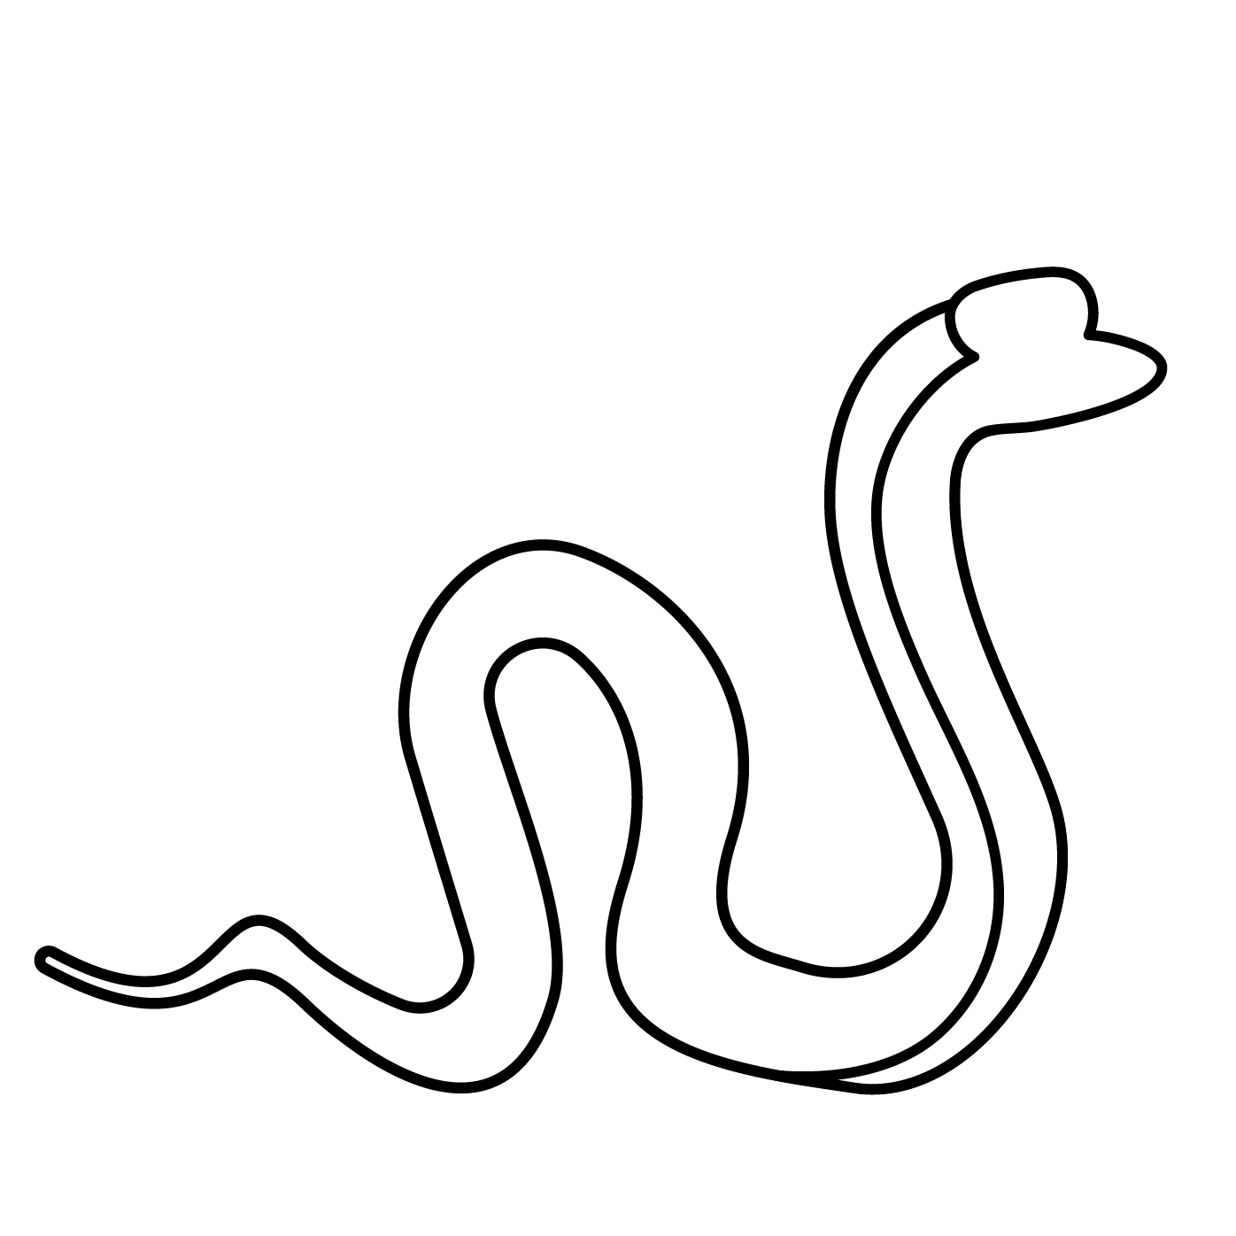


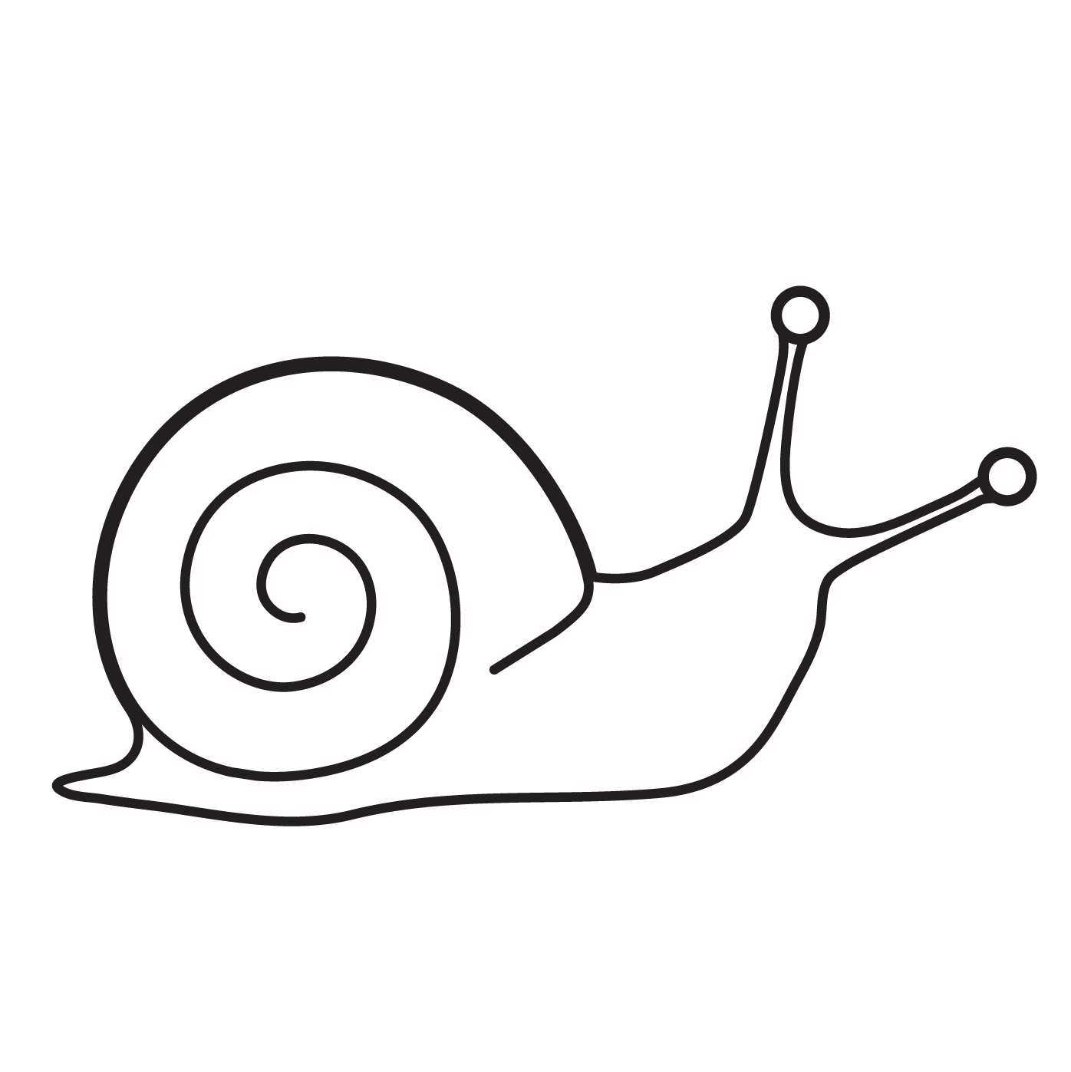

Phonics: s (sat)
What sound does each picture start with? Colour the letter that matches the sound.
t
s
s
a
a
s
s
t
© State of New South Wales (Department of Education), 2023. Except for the Department of Education logo, other logos and trademark-protected material, this resource is licensed under the Creative Commons Attribution 4.0 International Licence

Slide 2

Phonics: s (sat)
Colour the boxes that have the letter s. Practise saying the sound that s makes.
a
a
s
a
p
s
s
t
a
s
© State of New South Wales (Department of Education), 2023. Except for the Department of Education logo, other logos and trademark-protected material, this resource is licensed under the Creative Commons Attribution 4.0 International Licence

Slide 3


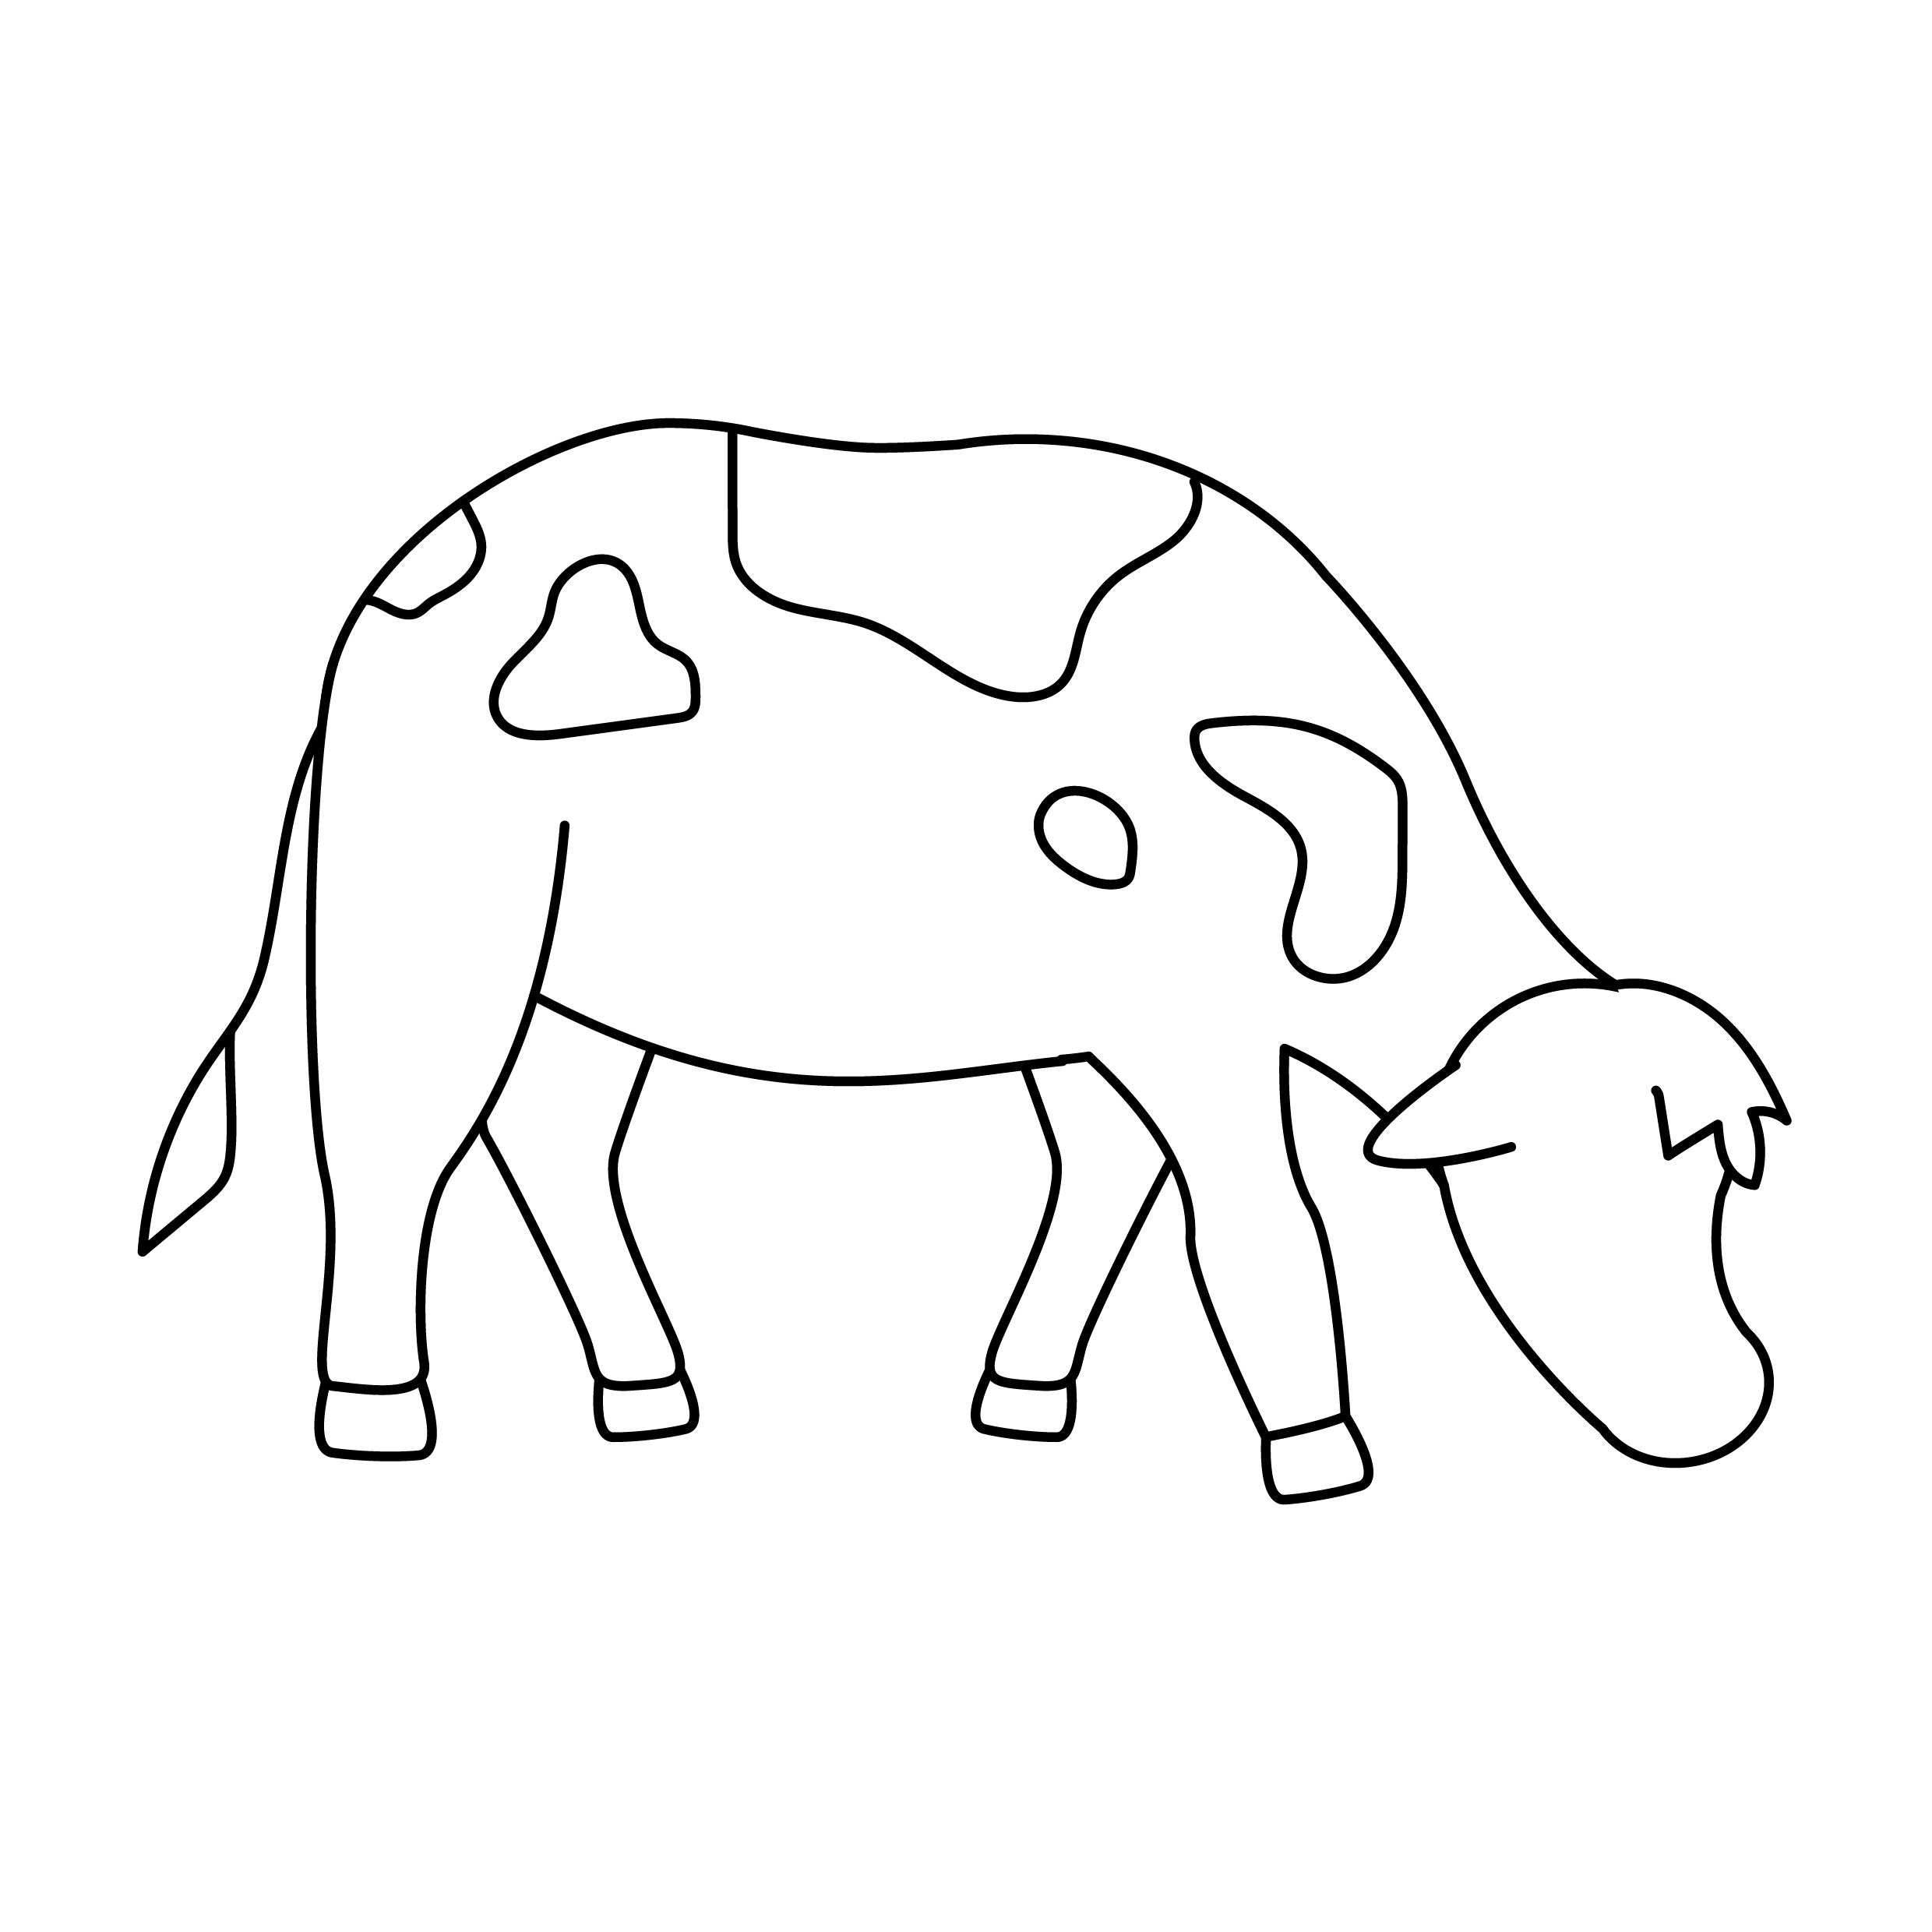



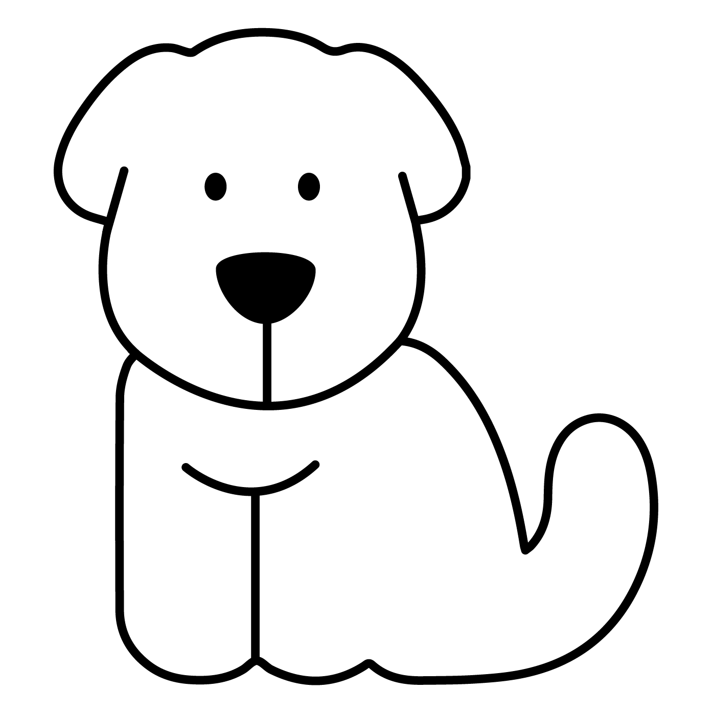
Phonics: s (sat)
Colour the pictures that begin with the s sound.
s
Draw your own pictures that start with the s sound.
© State of New South Wales (Department of Education), 2023. Except for the Department of Education logo, other logos and trademark-protected material, this resource is licensed under the Creative Commons Attribution 4.0 International Licence

