Slide 1



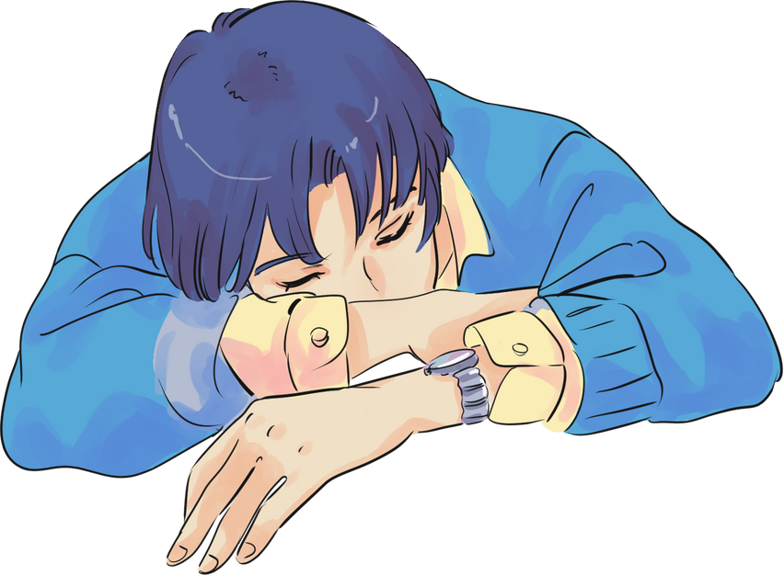




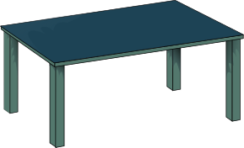


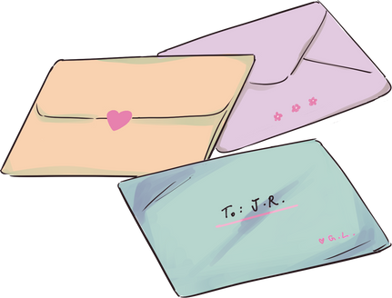
AN ANIME PRESENTATION
Presented by: Alfredo Torres

Slide 2

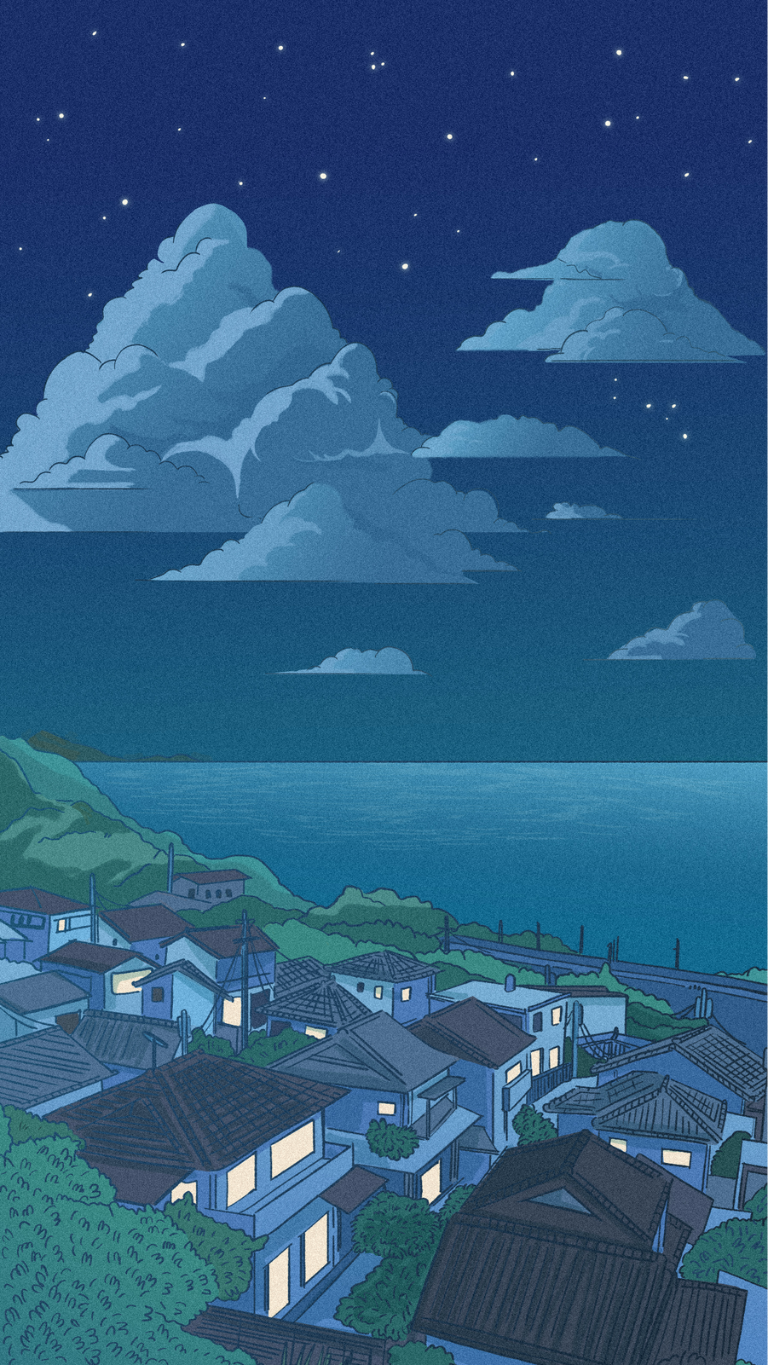
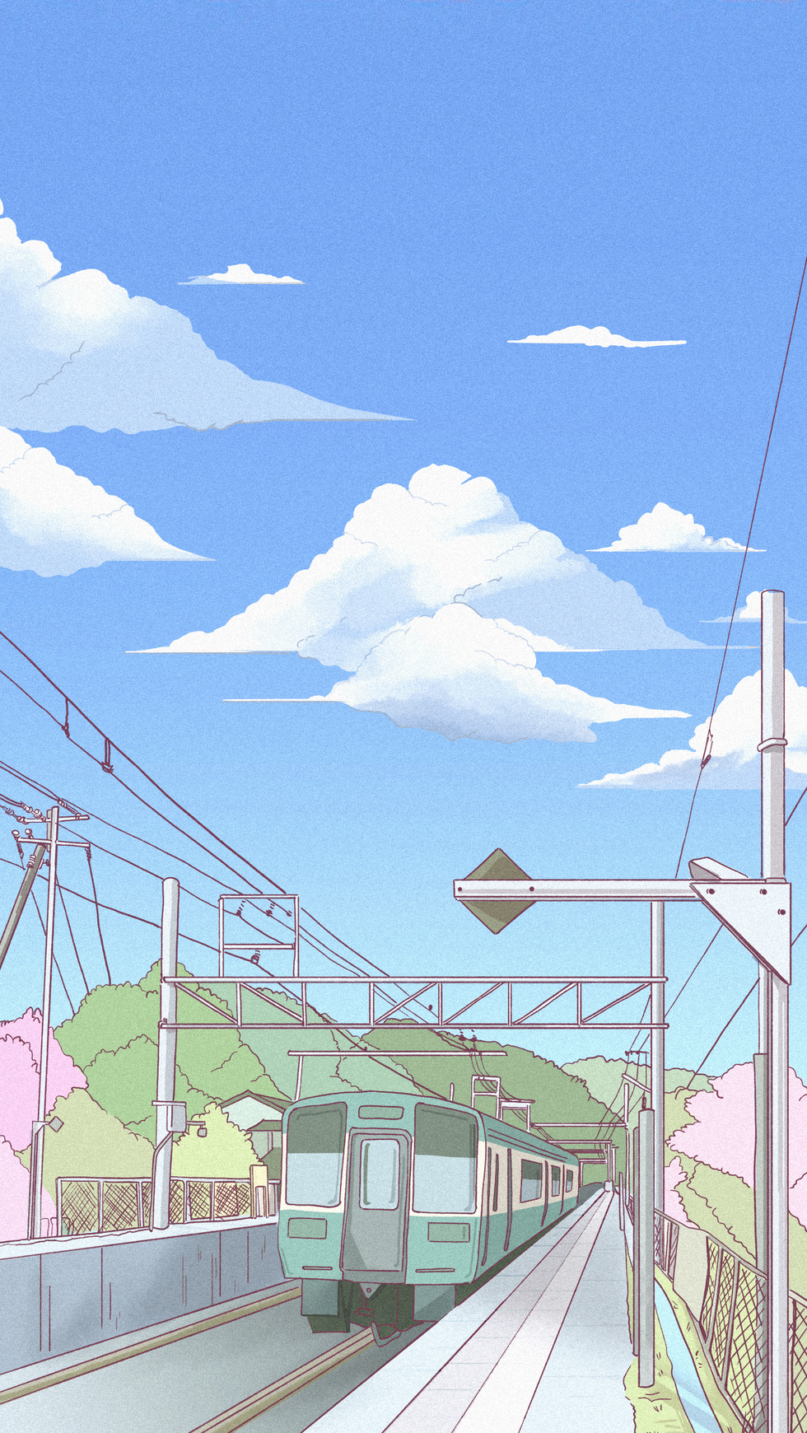
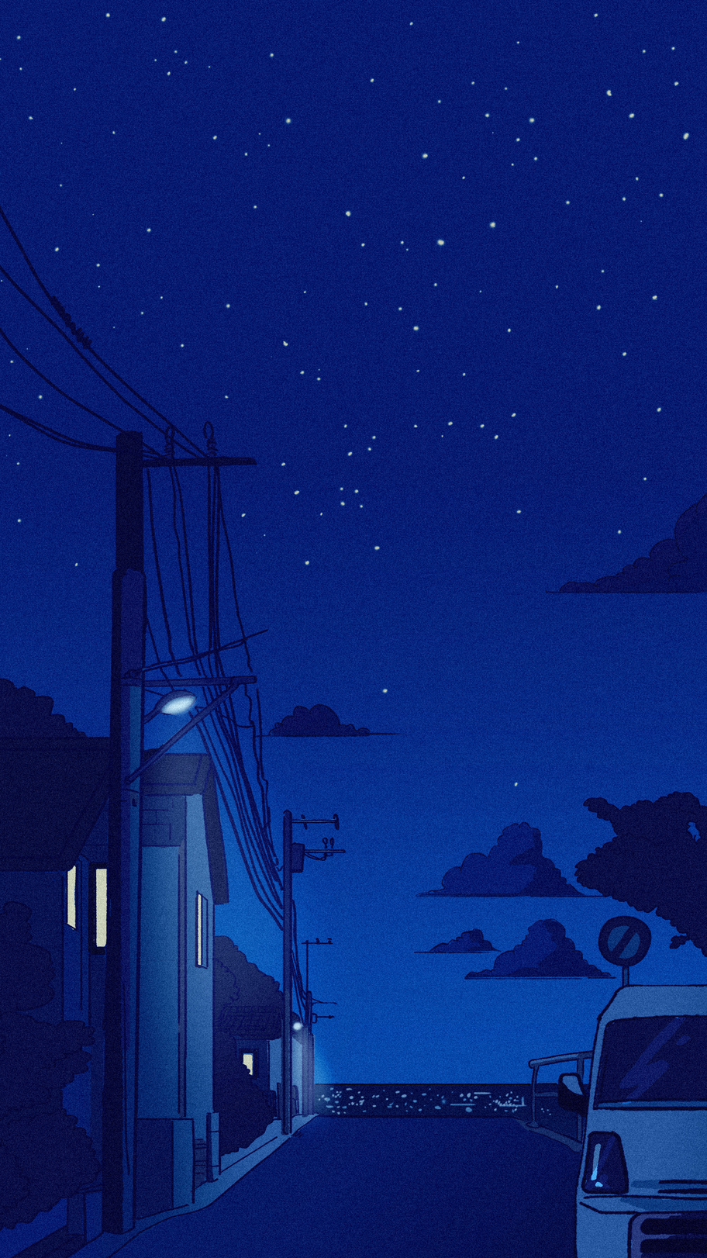
TOPIC OUTLINE
INTRODUCTION TO ANIME
HISTORY OF ANIME
ANIME GENRES

Slide 3

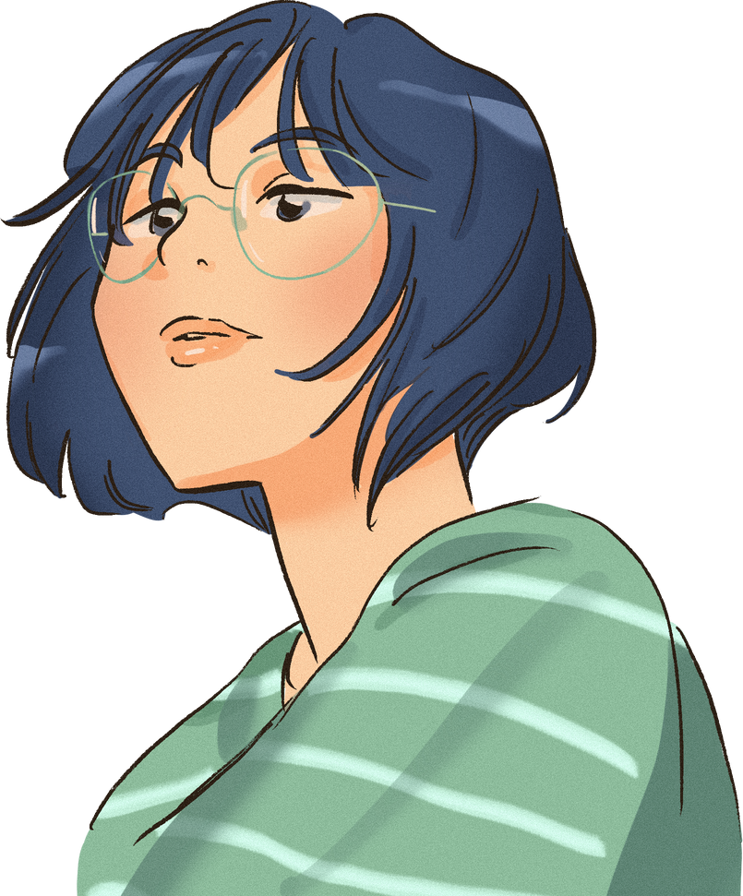
INTRODUCTION
WHAT IS ANIME?
Jumpstart your presentation by introducing the concepts and topics for the day. Then, ask questions to interact with your audience. Add a personal touch by customizing this layout as much as you want.

Slide 4






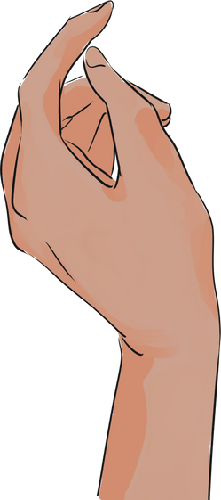




CHARACTERISTICS OF ANIME
Add a personal touch by personalizing this layout as much as you want.
You can also add other related visuals to capture the attention of your audience.

Slide 5


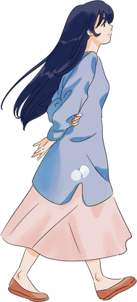


HISTORY
HISTORY OF ANIME
Then, ask questions to interact with your audience. Add a personal touch by customizing this layout as much as you want.

Slide 6

DURING THE 1960'S
DURING THE 1980'S
Add a personal touch by personalizing this layout as much as you want.
You can also add other related visuals to capture the attention of your audience.

Slide 7

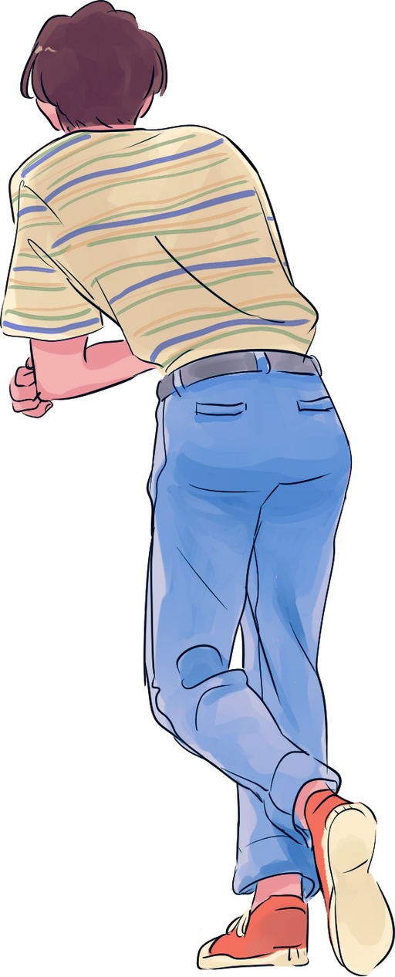

GENRES
WHAT ARE THE GENRES OF ANIME?
Then, ask questions to interact with your audience. Add a personal touch by customizing this layout as much as you want.Personalize your presentation by customizing this slide as much as you want.

Slide 8
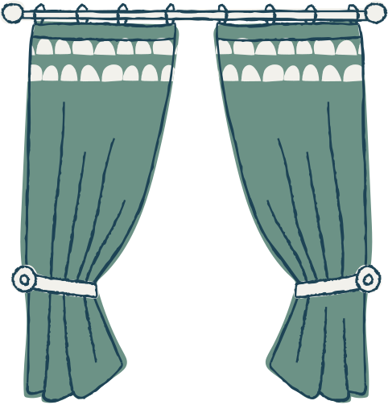






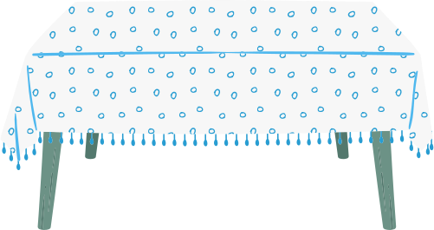
ADVENTURE
Add a personal touch by personalizing this layout as much as you want.
SLICE OF LIFE
You can also add other related visuals to capture the attention of your audience.

Slide 9

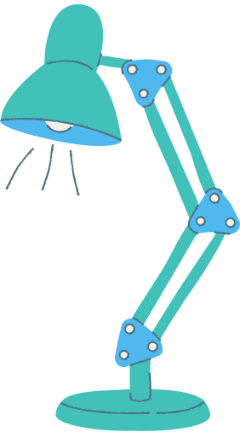

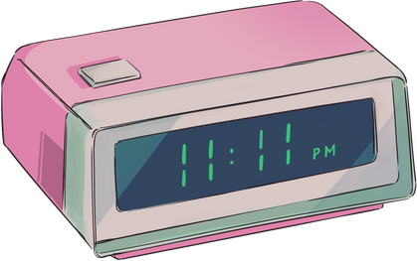
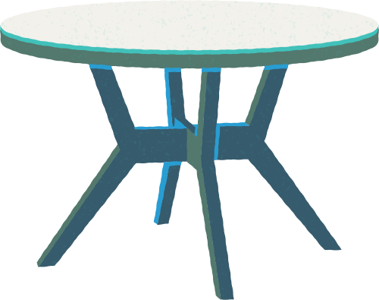


IMPORTANCE
WHY IS ANIME CULTURALLY IMPORTANT?
Add a personal touch by customizing this layout as much as you want.Personalize your presentation by customizing this slide as much as you want.

Slide 10
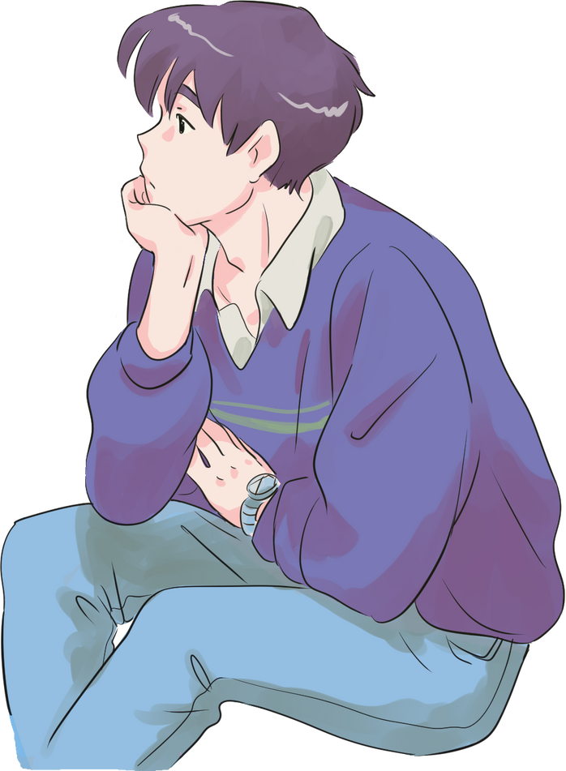


SUMMARY
Add a personal touch by personalizing this layout as much as you want.
You can also add other related visuals to capture the attention of your audience.

Slide 11


THANK YOU FOR LISTENING!
Don't hesitate to ask any questions!

