Slide 1

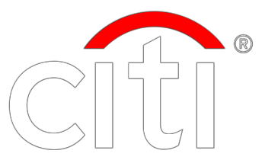
2017 Investor Day
Franchise Overview & Strategy
Michael Corbat, Chief Executive Officer
July 25, 2017

Slide 2

Agenda
Citi Today
Franchise Transformation
Strategy
&
Execution
Priorities
1

Slide 3
Citi Today
Streamlined model
focused on target clients in two core franchises: Consumer & Institutional
banking
•
•
•
•
Largest proprietary global network (98 markets)
Largest direct clearing and custody network (63 markets)
Largest global credit card issuer with strong proprietary offerings and partner relationships
Unique presence in faster-growing financial markets in the emerging markets
Unparalleled
Global
Presence
•
•
•
•
#1 Treasury and trade solutions franchise⁽¹⁾
#2 Fixed income markets franchise⁽²⁾
#1 Global credit card issuer⁽³⁾
#5 Global investment banking franchise⁽⁴⁾
Industry
Leading
Franchises
•
•
•
•
Currently above every minimum regulatory requirement
Able to support our clients’ growing needs
Significant capital generation and return capacity
Increased planned capital return by 55% to ~$19B in 2017 CCAR Cycle
Robust
Capital & Liquidity
Strong Franchise Position and Capital Return Potential
Note:
(1)
Source: Coalition. Results are based upon Citi’s internal product offering taxonomy. LTM’17 as of 2Q’17. 2Q'17 reflects results based on preliminary industry revenue pool.
BARC, BNP, DB, HSBC, JPM, SG, SCB and WFC.
Source: Coalition. Results are based upon Citi’s internal product offering taxonomy. LTM’17 as of 2Q’17. 2Q'17 reflects results based on preliminary industry revenue pool. BARC, BNP, CS, DB, GS, JPM, MS, RBS and UBS.
Based on loans outstanding as of 2Q’17.
Based on wallet share per Dealogic as of June 30, 2017.
Peer group includes: BAC,
(2)
Peer group includes: BAC,
2 (3)
(4)

Slide 4
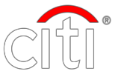
Simplified, Integrated Business Model
Institutional
Consumer
∙
Largest proprietary global network
with physical presence in 98
markets
∙
Consumer operations
in 19 markets
Markets &
Investment
Banking
∙
#1 global credit card issuer by
loans
∙
Facilitating ~$4 trillion of flows
daily
Wealth
Management
∙
~$300B in loans
∙
11% share of global FX volumes⁽¹⁾
Corporate Lending
& Private Bank
Retail Banking
∙
~$310B in deposits
∙
~$320B in loans
∙
~$150B in assets under
management
∙
~$625B in deposits
Treasury & Trade
Solutions and Securities
Services
Global Cards
Common
Process
Common
Platform
Common
Data
Strong Risk Management
3
Note:
(1)
Loans, deposits and assets under management as of June 30, 2017.
Source: Euromoney FX Survey 2017 as of 1Q’17.

Slide 5
Radically Streamlined the Franchise…
Consumer Markets
Institutional
Clients
(54)%
~32,000
(57)%
41
~21,000
36
35
24
~17,000
19
~15,500
~14,000
2012
2013
2014
2015
2016
2012
2013
2014
2015
2016
Legacy Assets
Headcount
($B)
(000’s)
(15)%
$211
(74)%
259
251
241
$164
231
219
$138
$81
$54
2012
2013
2014
2015
2016
2012
2013
2014
2015
2016
4

Slide 6
…Resulting in I mpr oved Operating Efficiency and ROA
Operating Efficiency
ROA
Achievements
•
•
Divested non-core assets
Maintained scale in attractive, global franchises
Grew base of efficient, recurring accrual revenues
Simplified product offerings Rationalized infrastructure Improved credit quality
~(600)bps
•
65%
25bps
84bps
59%
59bps
•
•
•
Headwinds
•
•
•
Muted economic recovery
Lower than expected interest rates
Increased regulatory and compliance costs
Increased liquidity to satisfy LCR
and resolution requirements
•
₂₀₁₂ ⁽¹⁾
LTM'17
₂₀₁₂⁽¹⁾
LTM'17
Note:
(1)
Totals may not sum due to rounding. Throughout this presentation, LTM’17 is defined as last twelve months ending June 30, 2017. LCR: Liquidity Coverage Ratio.
As used throughout this presentation, results in 2012 exclude CVA / DVA, the impact of gains / (losses) on the sales of minor ity interests in certain financial institutions and a tax benefit and are non-GAAP financial measures. For additional information, please refer to Slide 15.
5

Slide 7
While Significantly
Improving Our Capital Strength
($B)
DTA Utilization
CET1 Capital Generation
Growth in Net Income to Common
Net Income + OCI Related
DTA Related
Net Income
Preferred Dividends
RoTCE⁽²⁾:
7.4%
7.8%
~$(9)
$73
$55
15
$46
58
$155
27%
$(23)
$105
$14
$11
15
11
2012
2Q'17
2012
Capital
Build
Common
Buybacks &
Dividends
2Q'17
₍₁₎
₂₀₁₂⁽³⁾
LTM'17
TCE Supporting Disallowed DTA⁽¹⁾
^{$43} $28
CET1 Capital Ratio⁽²⁾
^{8.7%} 13.0%
Average TCE⁽²⁾
^{$151} $183
Note:
(1)
Totals may not sum due to rounding. All information for 2Q’17 is preliminary.
The amount that is excluded from average tangible common equity represents the average net DTAs excluded for purposes of calculating Citigroup’s CET1 Capital under full implementation of the
U.S Basel III rules.
As used throughout this presentation, Common Equity Tier 1 (CET1) Capital Ratio, Tangible Common Equity (TCE) and Return on TCE (RoTCE) are non-GAAP financial measures. For additional information on these measures, please refer to Slides 13, 14 and 15.
Results in 2012 exclude CVA / DVA, the impact of gains / (losses) on the sales of minority interests in certain financial ins titutions and a tax benefit. For additional information, please refer to Slide 15.
(2)
6
(3)

Slide 8
Strategic Priorities to Increase Returns
Serving as trusted partner providing financial services that enable growth and
economic progress
•
Invest and innovate to deepen relationships and transform the client
experience
Extend leadership positions and continue to gain wallet share in areas where we have a differentiated ability to serve our target clients
Client-led
Revenue
Growth
•
Improving
Return on Capital
•
Leverage our global footprint and expertise on behalf of our clients
Capabilities
& Operating
Discipline
•
•
Drive scale efficiencies through common platforms and processes
Rapidly seed innovation across markets and businesses, with unique
ability to leverage digital capabilities across global footprint
•
•
Optimize capital deployment to deliver improved returns
Return capital above the amount needed to prudently operate and invest
Increasing
Return of Capital
Capital
Optimization
in the businesses
7

Slide 9
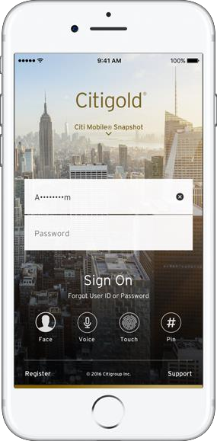

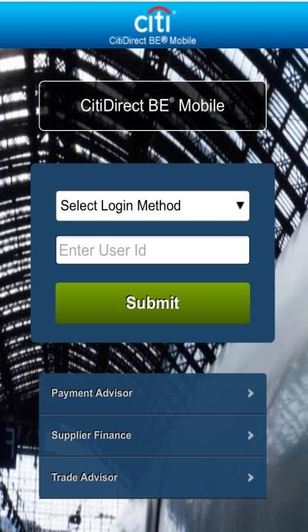
Leveraging and Extending Global Capabilities – Digital
Transforming the client experience while
improving our cost to serve
Mobile Consumer Banking
Mobile Corporate Banking
Transforming the client experience
with Citigold integrated app
with CitiDirect BE
Accelerating time to market with new features
Sharing and leveraging across the firm
Sourcing innovation from a broad network
Co-creating with our clients
8

Slide 10
Poised to Deliver Attractive and Sustainable Returns
Our Future
Sustainable Growth⁽¹⁾
Consumer bank with light physical
and high digital capabilities
footprint
•
•
•
•
Revenue CAGR: 3%+/-
Net Income CAGR: 5 – 10%
Implies ~$20B of Net Income in 2020
EPS CAGR: 15 – 20%
•
•
•
#1 global card issuer
Bank of choice for affluent clients globally
Leveraging global capabilities to drive local advantages
2020 Target Results
Institutional bank with unparalleled global
reach and leading market positions
•
•
•
•
Efficiency Ratio: Low – 50%
ROA: 90bps – 110bps
RoTCE: ~11%
RoTCE ex. DTA: ~13%
•
•
•
•
#1 global cash management
Leader in fixed income
Top 5 in equities
Top 3 in investment banking
9
Note:
(1) Illustrative results through 2020.

Slide 11
Agenda & Key Takeaways
•
•
•
Large-scale restructuring is over but we continue to optimize for improved returns
Well-positioned for growth with our target clients
Demonstrated progress in addressing surplus capital with 2017 CCAR approval
Franchise Overview:
Michael Corbat
•
•
•
Path to achieving ~14% RoTCE longer-term – through both earnings growth and capital optimization
Revenue and efficiency levers to drive operating efficiency to low-50% range
Capital optimization to drive CET1 Capital ratio to target level by end of 2019
Financial Overview:
John Gerspach
Global Consumer
Banking:
Stephen Bird
Jud Linville
•
•
•
Path to achieving 20%+ RoTCE longer-term – revenue growth, operating leverage and credit drivers
Diversified franchise with strong market positions
Leveraging digital innovation to drive acquisitions and differentiate the client experience
Institutional Clients
Group:
Jamie Forese
•
•
•
Path to achieving 14%+ RoTCE longer-term – revenue growth, operating leverage and credit drivers
Diversified franchise with strong market positions
Extending leadership positions and gaining market share in other key products
10 Note: RoTCE for the Total Firm, Global Consumer Banking and the Institutional Clients Group represent longer-term targets.

Slide 12
Certain statements in this presentation are “forward-looking statements” within the
meaning of the rules and regulations of the U.S. Securities and Exchange Commission (SEC). Such statements may be identified by words such as believe, expect, anticipate, intend, estimate, may increase, may fluctuate, target, illustrative and similar expressions or future or conditional verbs such as will, should, would and could. These statements are based on management’s current expectations and are subject to uncertainty and changes in circumstances. These statements are not guarantees of future results or occurrences. Actual results and capital and other financial condition may differ materially from those included in these statements due to a variety of factors, including, among others, the efficacy of Citi’s business strategies and execution of those strategies, such
as those relating to its key investment, efficiency and capital optimization initiatives, governmental or regulatory actions or approvals, macroeconomic challenges and conditions, such as the level of interest rates, the precautionary statements included in this presentation and those contained in Citigroup’s filings with the SEC, including without limitation the “Risk Factors” section of Citigroup’s 2016 Form 10-K. Any forward- looking statements made by or on behalf of Citigroup speak only as to the date they are made, and Citi does not undertake to update forward-looking statements to reflect the impact of circumstances or events that arise after the date the forward-looking statements were made.
11

Slide 14
Common Equity Tier 1 Capital
Ratio
and Components⁽¹⁾
($MM)
6/30/2017⁽²⁾
12/31/2016
12/31/2015
12/31/2014
12/31/2013
12/31/2012
Citigroup Common Stockholders' Equity⁽³⁾
Add: Qualifying noncontrolling interests
Regulatory Capital Adjustments and Deductions:
Less:
Accumulated net unrealized losses on cash flow hedges, net of tax⁽⁴⁾
Cumulative unrealized net gain (loss) related to changes in fair value of financial
liabilities attributable to own creditworthiness, net of tax⁽⁵⁾
Intangible Assets:
Goodwill, net of related deferred tax liabilities (DTLs)⁽⁶⁾
Identifiable intangible assets other than mortgage servicing rights (MSRs),
net of related DTLs
$210,950
143
$206,051
129
$205,286
145
$199,841
165
$197,347
182
$186,155
171
(445)
(560)
(617)
(909)
(1,245)
(2,293)
(291)
(61)
441
279
177
587
21,589
20,858
21,980
22,805
24,518
25,488
4,587
796
4,876
857
3,586
794
4,373
936
4,950
1,125
5,632
732
Defined benefit pension plan net assets
Deferred tax assets (DTAs) arising from net operating loss, foreign tax credit
and general business credit carry-forwards
Excess over 10% / 15% limitations for other DTAs, certain common stock
investments and MSRs⁽⁷⁾
20,832
21,337
23,659
23,626
26,438
29,100
8,851
9,357
8,723
12,299
16,217
21,940
Common Equity Tier 1 Capital (CET1)
$155,174
$149,516
$146,865
$136,597
$125,349
$105,140
Risk-Weighted Assets (RWA)
$1,189,490
$1,189,680
$1,216,277
$1,292,605
$1,185,443
$1,205,820
Common Equity Tier 1 Capital Ratio (CET1 / RWA)
13.0%
12.6%
12.1%
10.6%
10.6%
8.7%
Note:
(1)
Citi's reported CET1 Capital ratios were derived under the U.S. Basel III Standardized Approach framework for June 30, 2017 and U.S. Basel III Advanced Approaches framework for periods prior to June 30, 2017.
This
reflects the lower of the CET1 Capital ratios under both the Standardized Approach and the Advanced Approaches under the Collins Amendment. Citigroup’s risk-based capital ratios, which reflect full implementation of the U.S. Basel III rules, are non-GAAP financial measures.
Preliminary.
Excludes issuance costs related to outstanding preferred stock in accordance with Federal Reserve Board regulatory reporting requirements.
Common Equity Tier 1 Capital is adjusted for accumulated net unrealized gains (losses) on cash flow hedges included in accumulated other comprehensive income that relate to the hedging of items not recognized at fair value on the balance sheet.
The cumulative impact of changes in Citigroup’s own creditworthiness in valuing liabilities for which the fair value option has been elected and own-credit valuation adjustments on derivatives are excluded from Common
Equity Tier 1 Capital, in accordance with the U.S. Basel III rules.
Includes goodwill “embedded” in the valuation of significant common stock investments in unconsolidated financial institutions.
Assets subject to 10% / 15% limitations include MSRs, DTAs arising from temporary differences and significant common stock investments in unconsolidated financial institutions. Commencing with December 31, 2015 and for the reporting periods thereafter, the deduction related only to DTAs arising from temporary differences that exceeded the 10% limitation while at December 31, 2014 and prior, this deduction related to all three assets which exceeded the 10% and 15% limitations.
(2)
(3)
(4)
(5)
(6)
(7)
13

Slide 15
TCE
Reconciliation
($MM)
_{2Q'17}⁽¹⁾
4Q'16
4Q'15
4Q'14
4Q'13
4Q'12
Total Citigroup Stockholders' Equity
Less: Preferred Stock
Common Stockholders' Equity
$230,019
19,253
$225,120
19,253
$221,857
16,718
$210,185
10,468
$203,992
6,738
$188,717
2,562
$210,766
$205,867
$205,139
$199,717
$197,254
$186,155
Less:
Goodwill
22,349
21,659
22,349
23,592
25,009
25,673
Intangible Assets (other than Mortgage Servicing Rights)
Goodwill and Identifiable Intangible Assets (other than Mortgage
Servicing Rights) Related to Assets Held-for-Sale
4,887
5,114
3,721
4,566
5,056
5,697
120
72
68
71
-
32
Net Deferred Taxes - Related to Goodwill and Intangible Assets Above
-
-
-
-
-
32
Tangible Common Equity (TCE)
$183,410
$179,022
$179,001
$171,488
$167,189
$154,721
14
Note:
(1) Preliminary.

Slide 16
Reconciliations
($MM, except balance sheet items in $B)
Citigroup LTM'17 2012
Reported Revenues (GAAP)
Impact of: CVA / DVA MSSB⁽¹⁾ HDFC⁽¹⁾ Akbank⁽¹⁾ SPDB⁽¹⁾
Adjusted Revenues
Reported Expenses (GAAP)
Impact of:
HDFC
Adjusted Expenses
Adjusted Efficiency Ratio
Reported Net Income (GAAP)
Impact of:
CVA / DVA
MSSB
HDFC
Akbank
SPDB
Tax Item
Adjusted Net Income
Preferred Dividends
Adjusted Net Income to Common
Average Assets ($B)
Adjusted ROA
Average TCE ($B)
Adjusted RoTCE⁽²⁾
$70,793
$69,530
-
-
-
-
-
(2,330)
(4,684)
1,116
(1,605)
542
$70,793
$41,507
$76,491
$50,036
-
(4)
$41,507
59%
$15,375
$50,032
65%
$7,491
-
-
-
-
-
-
(1,446)
(2,897)
722
(1,037)
349
582
$15,375
1,166
$11,218
26
$14,209
$1,837
0.84%
$183
7.8%
$11,192
$1,911
0.59%
$151
7.4%
Note:
(1)
(2)
All information for 2Q’17 is preliminary.
For additional information, please refer to Citigroup’s 2012 Form 10-K.
RoTCE represents net income available to common shareholders as a percentage of average TCE.
15

