Slide 1
Groundwater and surface-subsurface exchange
1
NOTE: Slides for each module are numbered for easier cross-referencing with class notes
NOTE: My slides have TONS of animations and building graphics. These do not translate well to D2L, so it is best to download the power point to work through the logic behind the animations

Slide 2
Water balance: internal balances
2
Energy
Precipitation
Evaporation
Interception
Throughfall
Sublimation
Snowpack
Snowmelt
Energy
(latent heat)
Evapotranspiration
Surface detention
Evaporation
Infiltration
Overland flow
Transpiration
Soil water
Percolation
Groundwater
Stream flow generation
Evaporation
Streams and lakes
Watershed
Runoff

Slide 3
Water balance: internal balances
3
Energy
Precipitation
Evaporation
Interception
Throughfall
Sublimation
Snowpack
Snowmelt
Energy
(latent heat)
Evapotranspiration
Surface detention
Evaporation
Infiltration
Overland flow
Transpiration
Soil water
Percolation
Groundwater
Surface-subsurface exchange
Evaporation
Streams and lakes
Watershed
Runoff

Slide 4
Groundwater: topics covered
4
Water in porous substrate: the fundamental vocabulary and concepts necessary for defining aquifers
Storage in aquifers: describing the amount of water that can be stored in porous media relative to a given change in the total hydraulic head
Groundwater movement: basic principles of predicting the direction and flux of groundwater movement
Understanding variation in groundwater flow nets: the characteristics of surface and subsurface topography that cause equipotential and flow lines to “bend”
Exchange with surface waters: interpreting the consequences of the intersection of subsurface flow nets with surface waters
Groundwater flux and velocity: basic calculations of different characteristics of groundwater movement based on Darcy’s law

Slide 5
Groundwater: topics covered
5
Water in porous substrate: the fundamental vocabulary and concepts necessary for defining aquifers
Storage in aquifers: describing the amount of water that can be stored in porous media relative to a given change in the total hydraulic head
Groundwater movement: basic principles of predicting the direction and flux of groundwater movement
Understanding variation in groundwater flow nets: the characteristics of surface and subsurface topography that cause equipotential and flow lines to “bend”
Exchange with surface waters: interpreting the consequences of the intersection of subsurface flow nets with surface waters
Groundwater flux and velocity: basic calculations of different characteristics of groundwater movement based on Darcy’s law

Slide 6

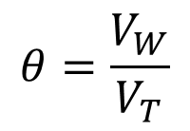


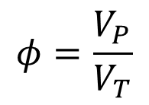







Water in porous media: the basics
6
Total volume is sum of
solid, water, and air volumes
Dimensionless ratios [1]
Porosity
$$V_{T}=$$
$$V_{S}$$
$${+V}_{W}$$
$${+V}_{A}$$
$$φ=\frac{V_{P}}{V_{T}}$$
Water content (volumetric)
$$θ=\frac{V_{W}}{V_{T}}$$
$$V_{A}$$
$$V_{P}$$
Pore volume
$$V_{S}$$
$$V_{P}=V_{T}−V_{S}$$
Soil (solid) particles
$$V_{W}$$
$$=V_{A}+V_{W}^{∗}$$
Liquid water
*if water is the only liquid in pores

Slide 7
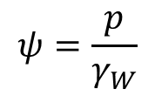
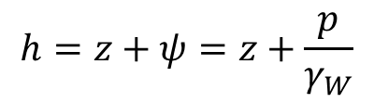


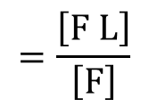


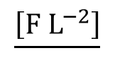
7
Water in porous media: pressure head
Hydraulic gradient – change in hydraulic head per unit length of flow path
Hydraulic head – potential mechanical energy of water per unit weight
$$\frac{\left[E\right]}{\left[F\right]}$$
$$=\frac{\left[F L\right]}{\left[F\right]}$$
$$=\left[L\right]$$
Elevation head ($z$) – potential mechanical energy due to gravity
(gravitational head)
Pressure head ($ψ$) – potential mechanical energy due to compression/tension
(+)
(-)
pressure
$$ψ=\frac{p}{γ_{W}}$$
$$\frac{\left[F L^{−2}\right]}{}$$
$$=\left[L\right]$$
weight density
$$\left[F L^{−3}\right]$$
Total hydraulic head (hydrostatic):
$$h=z+ψ=z+\frac{p}{γ_{W}}$$

Slide 8

Physics of water
8
Why isn’t the water churning due to the difference in pressure?
What is the pressure head at the surface?
~1 atm absolute pressure
0 atm gauge pressure
Total hydraulic head is uniform throughout the bucket
What is the pressure head near the bottom?
$$h=z+ψ=C$$
For a hydrostatic situation (i.e. water not moving) the increase in pressure head with depth is exactly the same as the decrease in elevation head.
Notes:
Before we an start describing the unique physical properties of water, we have to establish some basic context for how we think about reality.
We can build from the basics starting with the most fundamental physical properties. Physical properties are broken down into a couple basic categories: Mass-energy and Space-time. Let’s start as simple as we can get, and just think about liquid water in a bucket.
Q: Water can be described as matter. Based on the definition of matter, what are the 2 properties we know the water in this bucket must have?
A: Water has mass and occupies a volume in space.
Mass and volume are things we can measure. Mass is measured as proportional to the gravitational force of the Earth on the water. This force is also known as the water’s weight. Volume can be measured in many ways.
So if we want to be able to talk to each other about how much mass or how much volume is associated with a given amount of water, then we have to make sure we are thinking in the same context. This is where we have to be sure we are thinking in the same reference frame, and properly defining the dimensions for mass and volume variables in that reference frame. This idea is the domain of dimensional analysis.

Slide 9



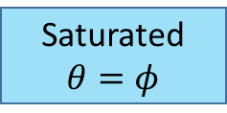

Groundwater: the water table
9
Subsurface
$$ψ<0$$
$ψ=0$ (gauge pressure)
$$h=z$$
Where is the saturated surface?
$$ψ>0$$
Saturated$θ=φ$

Slide 10
Snowmelt: periods and phases
10
Accumulation and warming phase
T < 0 °C
Ripening phase
T = 0 °C (isothermal)
Output phase
T = 0 °C (isothermal)
Snow (ice) particles
Liquid water

Slide 11
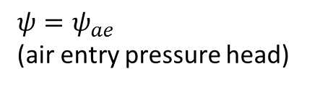
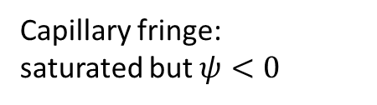
Groundwater: the water table
11
Well casing
Where will the water level be in the well?
Well
Screening
Subsurface
$ψ=ψ_{ae}$
(air entry pressure head)
$$ψ<0$$
Capillary fringe:
saturated but $ψ<0$
$ψ=0$ (gauge pressure)
$$h=z$$
Where is the saturated surface?
$$ψ>0$$
Aquifer
Saturated$θ=φ$

Slide 12
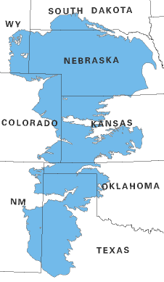
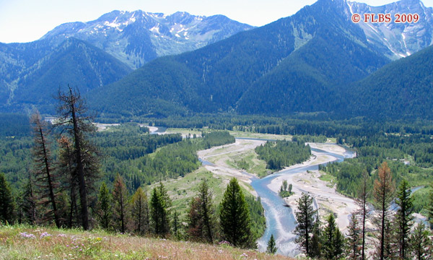
Groundwater: aquifers have many scales
12
Ogallala aquifer – 450,000 km²
Nyack floodplain aquifer – 16 km²
Public domain (USGS)

Slide 13
Groundwater: topics covered
13
Water in porous substrate: the fundamental vocabulary and concepts necessary for defining aquifers
Storage in aquifers: describing the amount of water that can be stored in porous media relative to a given change in the total hydraulic head
Groundwater movement: basic principles of predicting the direction and flux of groundwater movement
Understanding variation in groundwater flow nets: the characteristics of surface and subsurface topography that cause equipotential and flow lines to “bend”
Exchange with surface waters: interpreting the consequences of the intersection of subsurface flow nets with surface waters
Groundwater flux and velocity: basic calculations of different characteristics of groundwater movement based on Darcy’s law

Slide 14

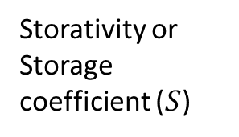

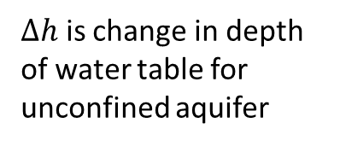
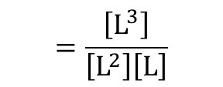
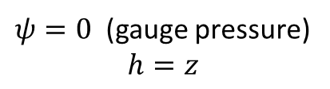
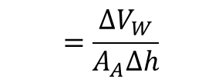
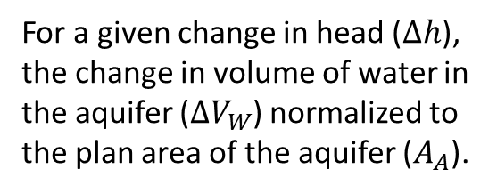
Groundwater: unconfined aquifer
14
Well
Storativity or Storage coefficient ($S$)
Subsurface
$$=\frac{∆V_{W}}{A_{A}∆h}$$
$$=\frac{\left[L^{3}\right]}{\left[L^{2}\right]\left[L\right]}$$
Air pressure =
atmospheric pressure
For a given change in head ($∆h$), the change in volume of water in the aquifer ($∆V_{W}$) normalized to the plan area of the aquifer ($A_{A}$).
$ψ=0$ (gauge pressure)
$$h=z$$
Unconfined aquifer:
$∆h$ is change in depth of water table for unconfined aquifer
$$S_{y}=φ−θ_{fc}$$
Amount of water substrate can hold against gravity.
$S≈S_{y}$ or specific yield
Saturated$θ=φ$
Confining layer - Aquitard

Slide 15

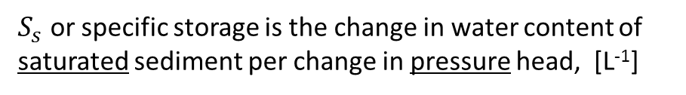
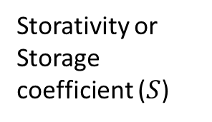
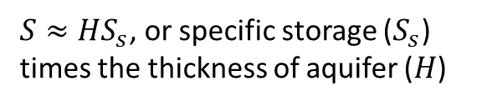


Groundwater: confined aquifer
15
Subsurface
Potentiometric surface
Confining layer - Aquitard
Storativity or Storage coefficient ($S$)
$∆h$ is change in pressure in the aquifer and does not drain pore space
Confining layer - Aquitard
$$=\frac{∆V_{W}}{A_{A}∆h}$$
$$=\frac{\left[L^{3}\right]}{\left[L^{2}\right]\left[L\right]}$$
$S_{s}$ or specific storage is the change in water content of saturated sediment per change in pressure head, [L⁻¹]
$S≈HS_{s}$, or specific storage ($S_{s}$) times the thickness of aquifer ($H$)

Slide 16
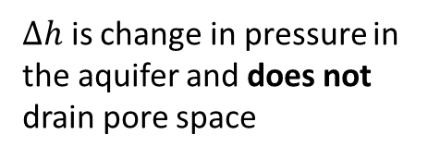

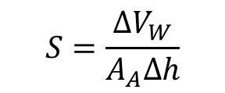
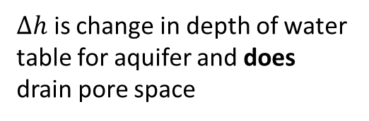
Groundwater: specific storage vs. specific yield
16
Storativity
(or “storage coefficient”)
$$S=\frac{∆V_{W}}{A_{A}∆h}$$
$$S=HS_{s}+S_{y}$$
Specific storage
Specific yield
$∆h$ is change in pressure in the aquifer and does not drain pore space
$∆h$ is change in depth of water table for aquifer and does drain pore space
Volume of water provided by specific storage
<<
Volume of water provided by specific yield
Dominant mechanism of storage in confined aquifers
Dominant mechanism of storage in unconfined aquifers

Slide 17
Groundwater: topics covered
17
Water in porous substrate: the fundamental vocabulary and concepts necessary for defining aquifers
Storage in aquifers: describing the amount of water that can be stored in porous media relative to a given change in the total hydraulic head
Groundwater movement: basic principles of predicting the direction and flux of groundwater movement
Understanding variation in groundwater flow nets: the characteristics of surface and subsurface topography that cause equipotential and flow lines to “bend”
Exchange with surface waters: interpreting the consequences of the intersection of subsurface flow nets with surface waters
Groundwater flux and velocity: basic calculations of different characteristics of groundwater movement based on Darcy’s law

Slide 18
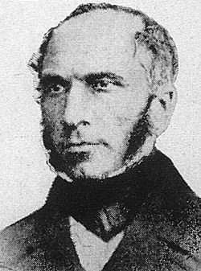
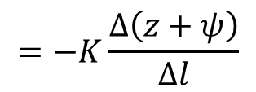
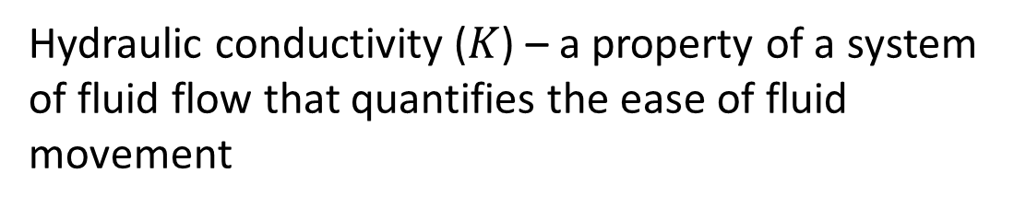
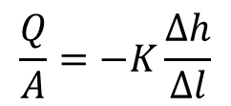



18
Groundwater movement: Darcy’s law
$h=z+ψ=z+\frac{p}{γ_{W}}$
Positive water flux is proportional to a
negative hydraulic gradient (for laminar flow through pores)
$$\frac{Q}{A}$$
$$=−K\frac{Δ\left(z+ψ\right)}{Δl}$$
[L T⁻¹]
(Darcian flux)
$$\frac{Q}{A}=−K\frac{Δh}{Δl}$$
$$\frac{Δh}{Δl}$$
[1]
Hydraulic conductivity ($K$) – a property of a system of fluid flow that quantifies the ease of fluid movement
Henry Darcy
French Engineer
mid-1800s
[L T⁻¹]
Hydraulic conductivity is strongly controlled by the size and connectivity of pores (and viscosity of the fluid)
This is permeability (not porosity)

Slide 19
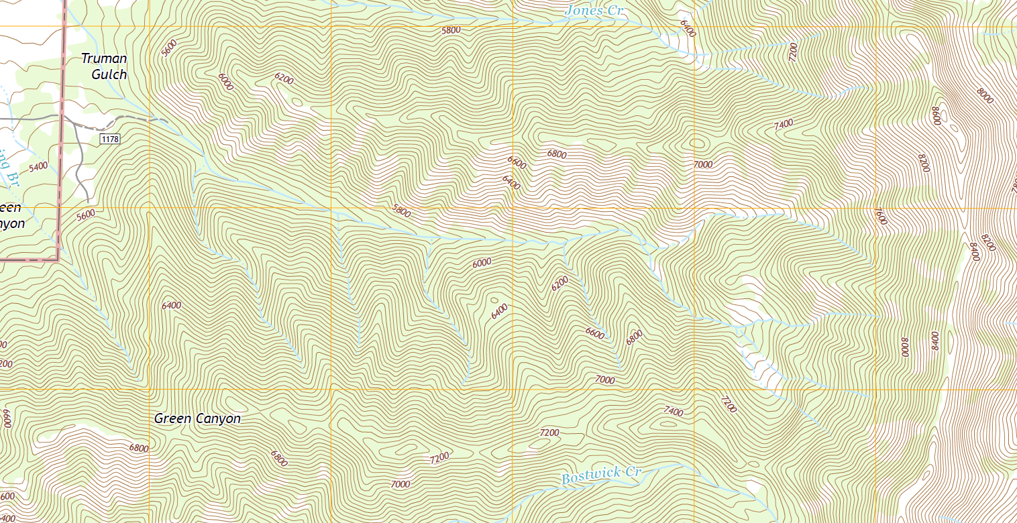
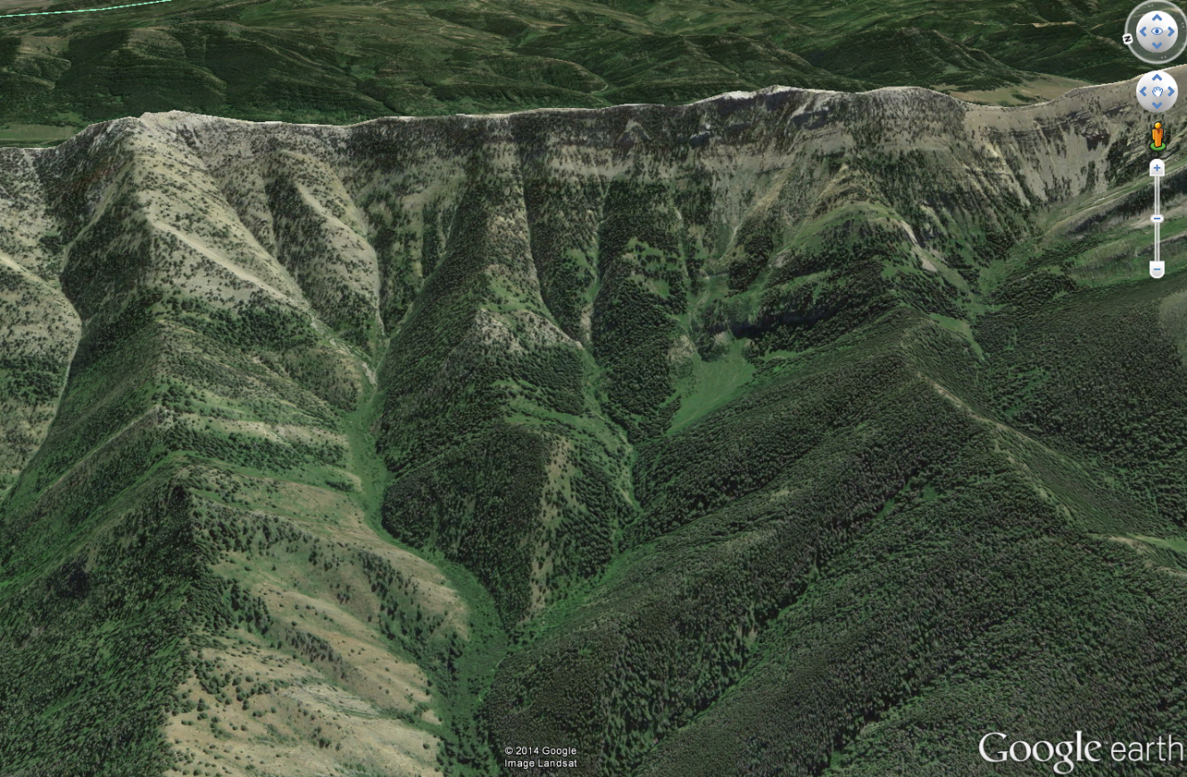
19
Watershed delineation: consequences of elevation head
Gauging station (pour point)
Flow lines + Equipotential lines =
Flow net

Slide 20

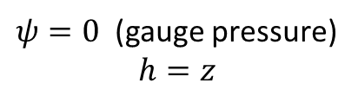






Groundwater: water movement
20
Well
Subsurface
Horizontal flows: Increase in pressure head with depth is the same as the decrease in elevation head.
Perpendicular
$$h_{1}=z_{1}$$
$ψ=0$ (gauge pressure)
$$h=z$$
$$h_{1}=h_{2}$$
$$ψ_{2}=z_{1}−z_{2}$$
$$h_{2}=z_{2}+ψ_{2}$$
$$ψ_{3}=z_{1}−z_{3}$$
$$h_{1}=h_{2}=h_{3}$$
$$ψ_{3}−ψ_{2}=z_{2}−z_{3}$$
$$ψ>0$$
$$h_{3}=z_{3}+ψ_{3}$$
Saturated$θ=φ$
Flow line
Confining layer - Aquitard
Equipotential line

Slide 21
Groundwater: flow nets
21
Well
Subsurface
Perpendicular
$ψ=0$ (gauge pressure)
$$h=z$$
$$ψ>0$$
Equipotential lines are perpendicular to no-flow boundaries
Saturated$θ=φ$
Flow line
Confining layer - Aquitard
Equipotential line

Slide 22
Groundwater: topics covered
22
Water in porous substrate: the fundamental vocabulary and concepts necessary for defining aquifers
Storage in aquifers: describing the amount of water that can be stored in porous media relative to a given change in the total hydraulic head
Groundwater movement: basic principles of predicting the direction and flux of groundwater movement
Understanding variation in groundwater flow nets: the characteristics of surface and subsurface topography that cause equipotential and flow lines to “bend”
Exchange with surface waters: interpreting the consequences of the intersection of subsurface flow nets with surface waters
Groundwater flux and velocity: basic calculations of different characteristics of groundwater movement based on Darcy’s law

Slide 23
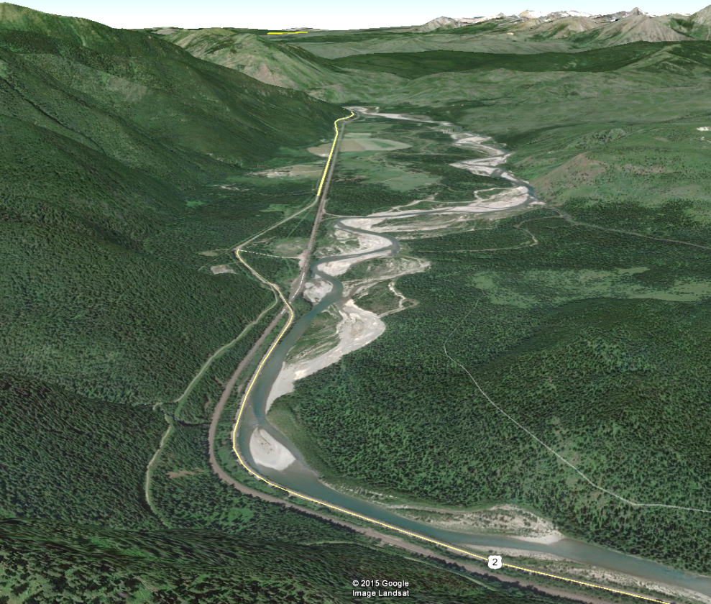
Groundwater: movement through an aquifer
23
Nyack floodplain aquifer – 16 km²
Downstream
Upstream

Slide 24
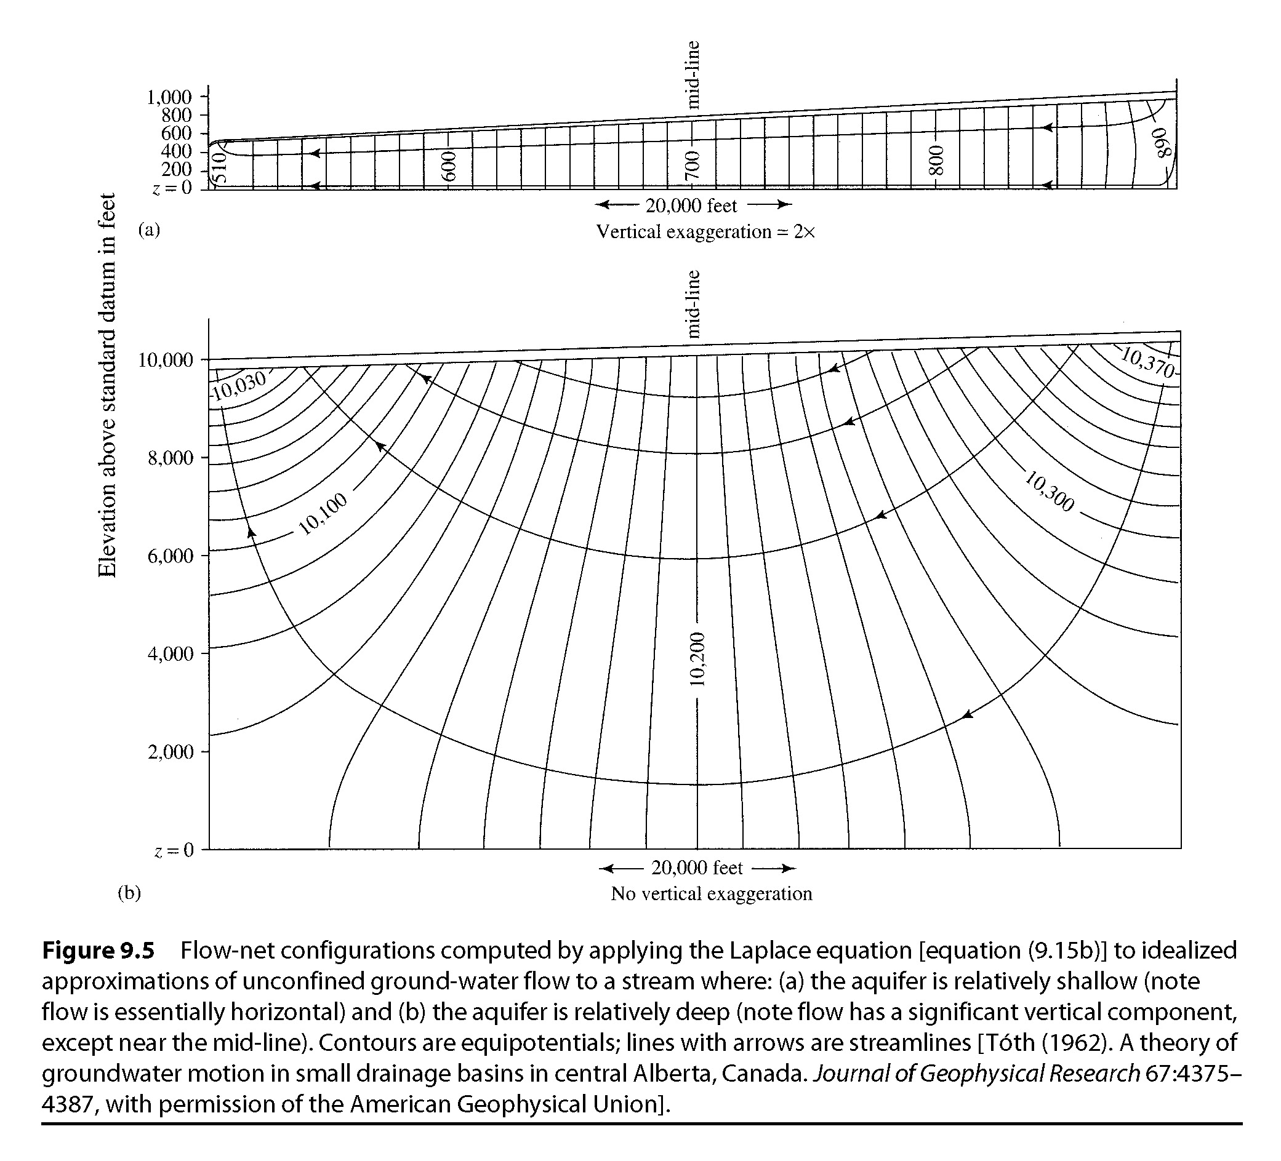
Groundwater: flow nets
24
Downstream
Upstream
Upwelling
Bedrock
Downwelling
Discharge
Recharge
Sediment
Middle Flathead River loses and regains about 30% of the channel flow at low flow conditions on the Nyack floodplain
Subsurface topography “bends”
Flow lines

Slide 25
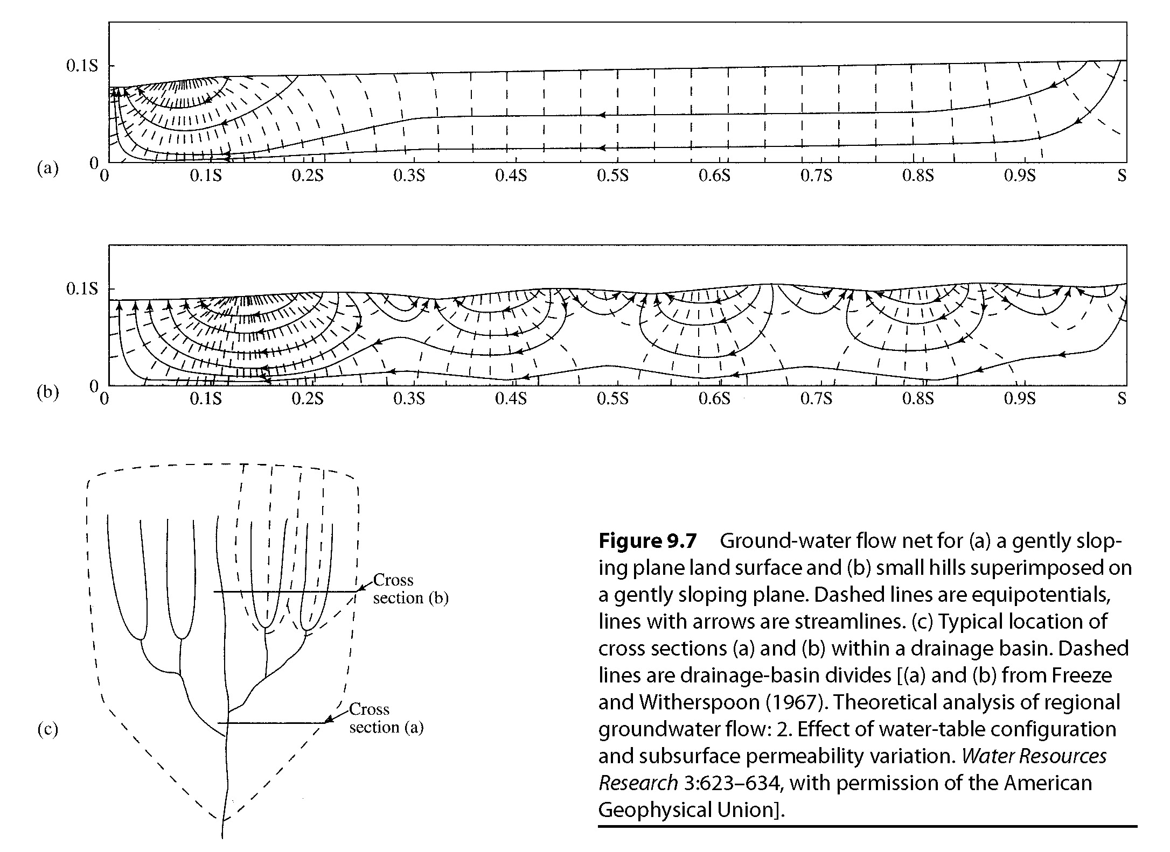
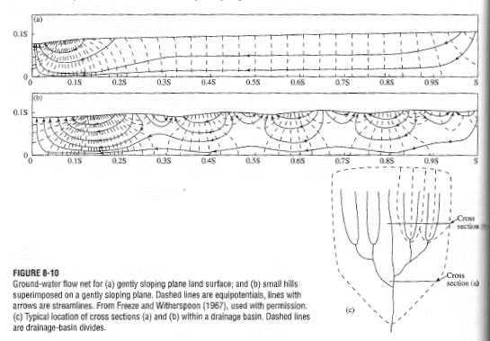
Groundwater: nested flow paths
25

Slide 26
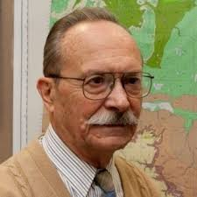
Groundwater: nested flow paths
26
Recharge
Recharge
Discharge
Discharge
Intermediate flow path
Local flow path
Regional flow path
József Tóth
(1963) A theoretical analysis of groundwater flow in small drainage basins
Surface topography “bends”
Flow lines

Slide 27
Water balance: conservation in a control volume
27
Local groundwater flow
Local groundwater flow
$G_{IN}$ for the topographic
watershed on the right
Regional groundwater flow direction
$$≠$$
Topographic slope direction
Regional groundwater flow

Slide 28
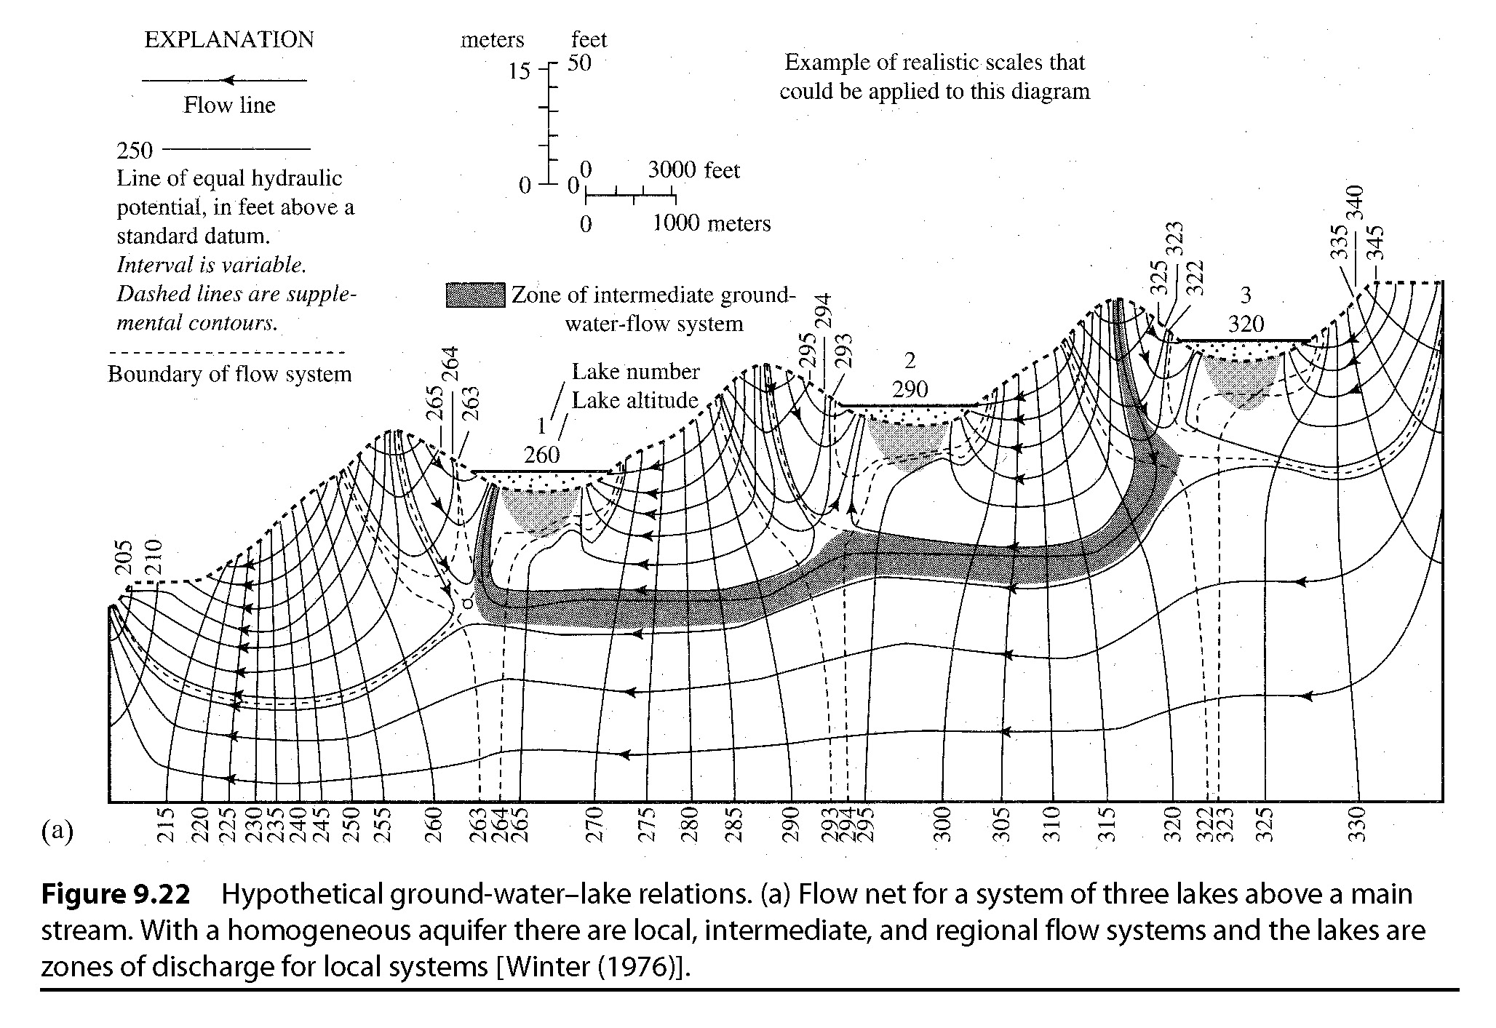
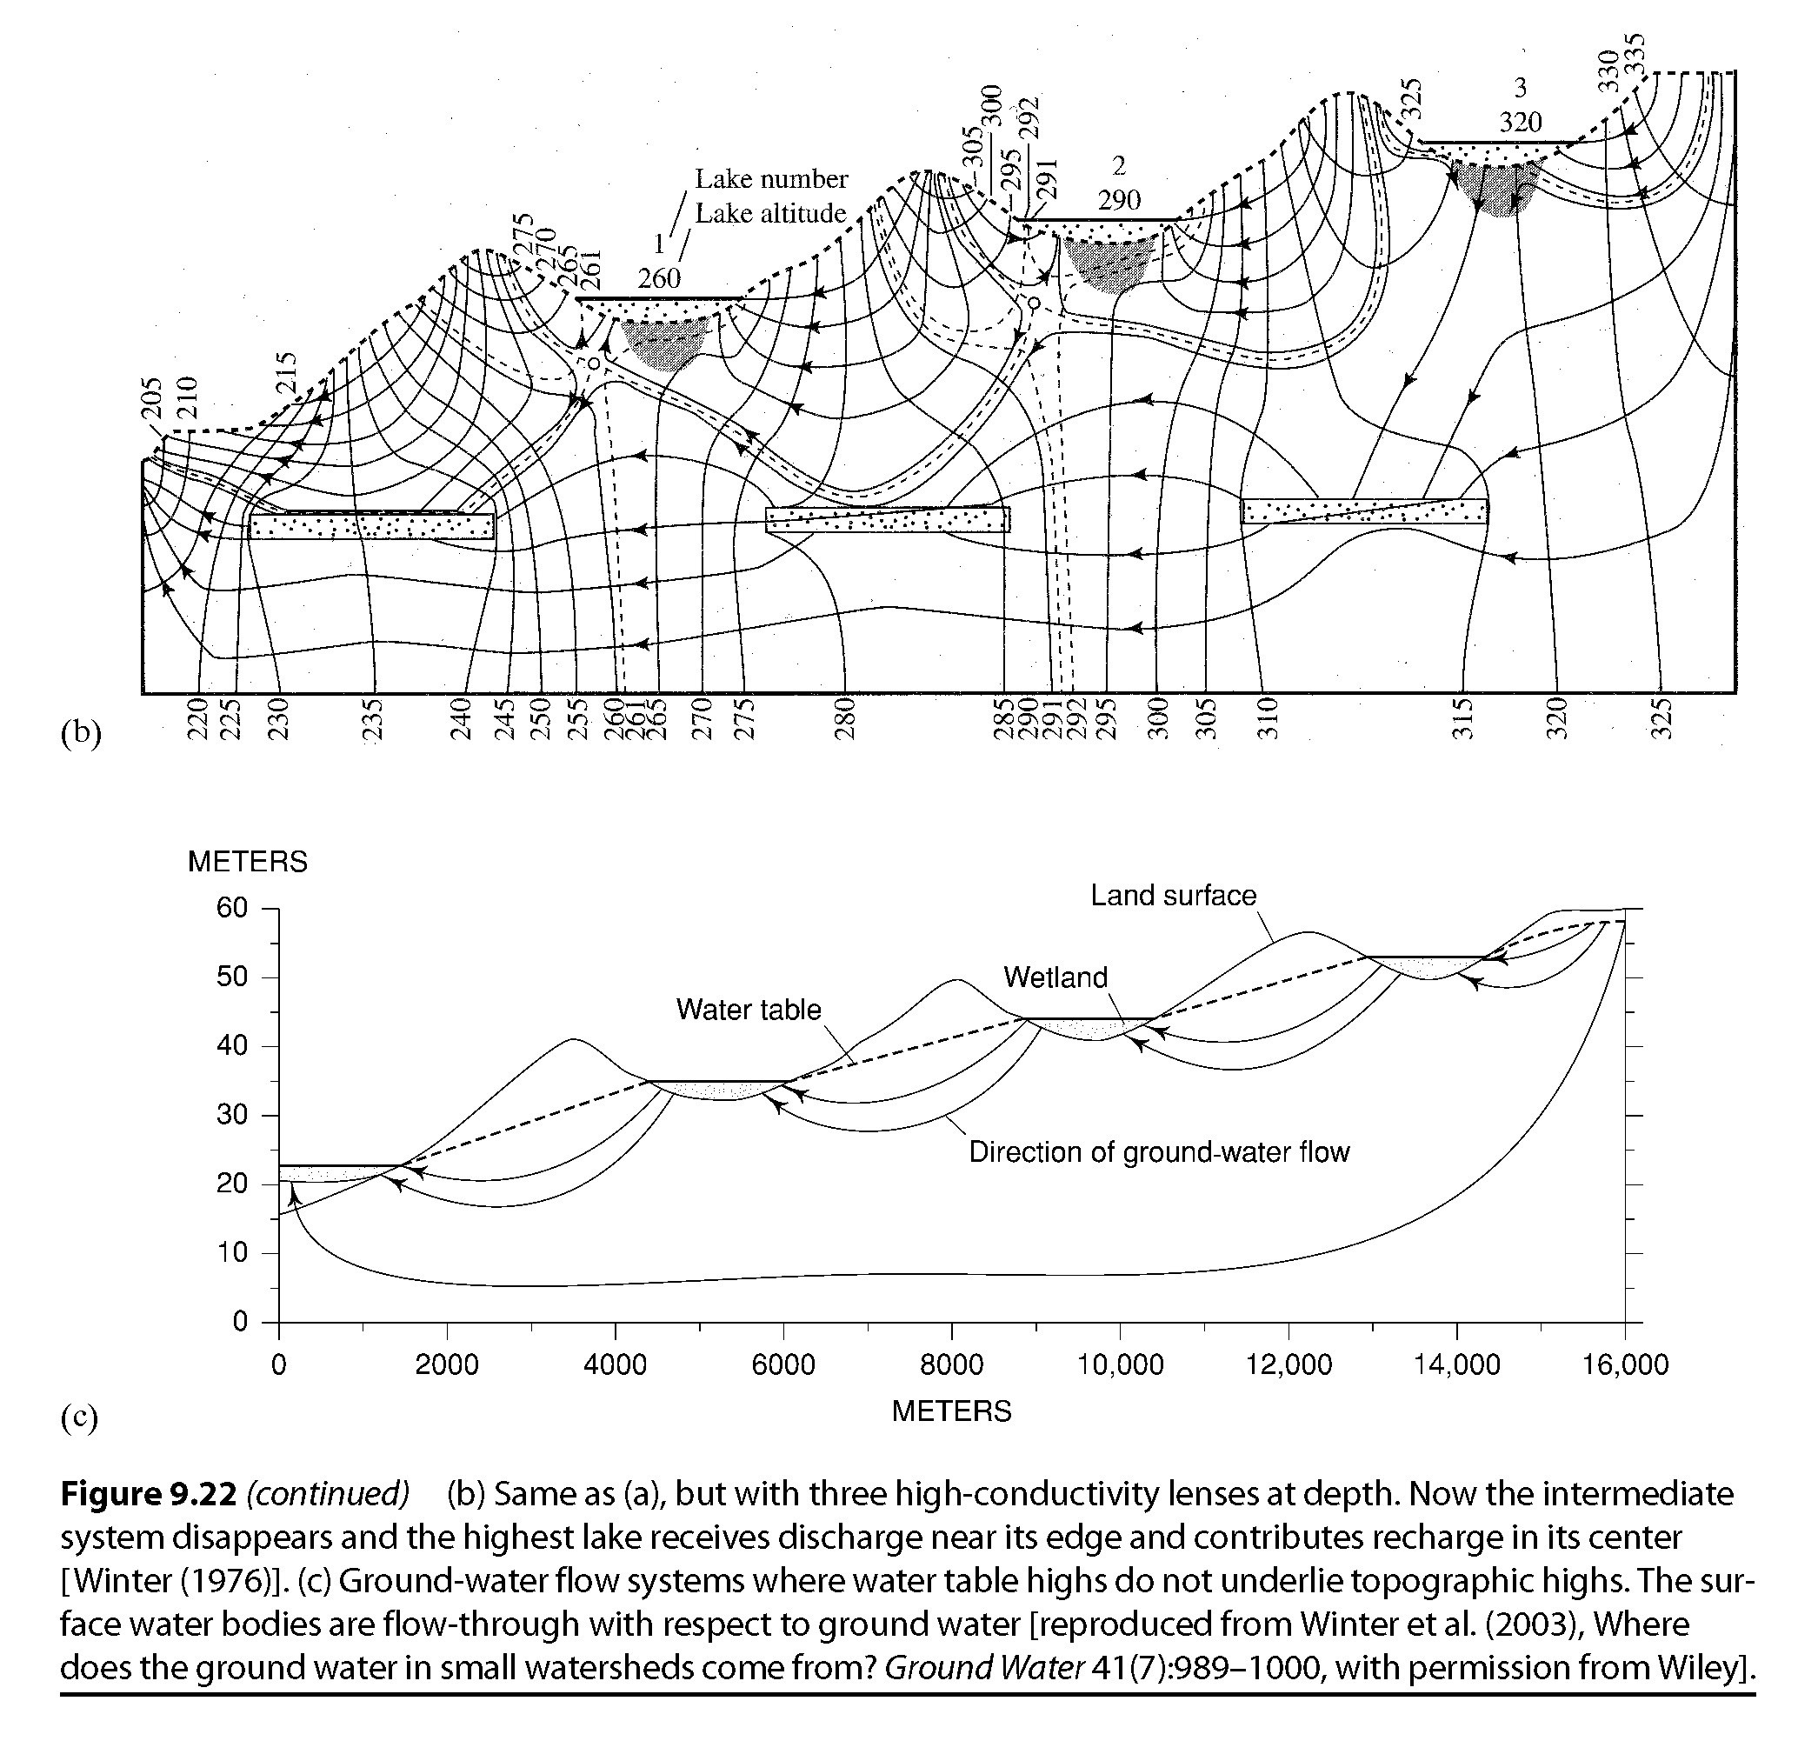
Groundwater: conductivity is spatially variable
28
Recharge
Recharge
Discharge
Recharge
Recharge
Recharge
Discharge
Discharge
Discharge
Discharge
Flow lines will converge toward higher conductivity areas,
Flow lines will diverge around lower conductivity areas

Slide 29
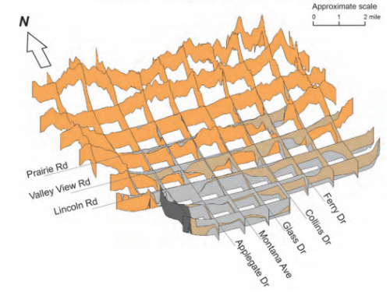
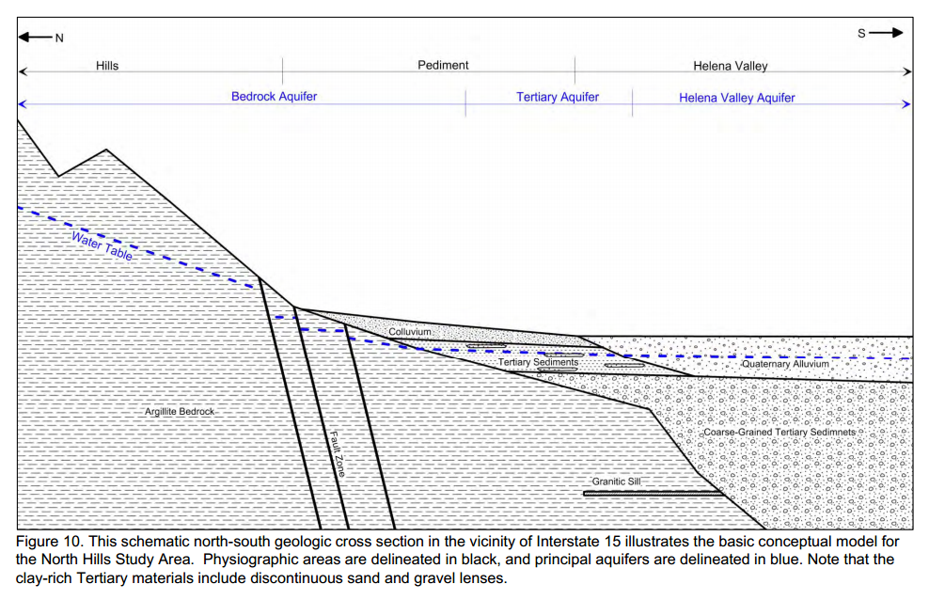
Groundwater: geology matters
29
Lower K
Higher K
Hydraulic gradients tend to be steeper where
the hydraulic conductivity is lower.
Hydraulic gradients tend to be shallower where
the hydraulic conductivity is higher.

Slide 30
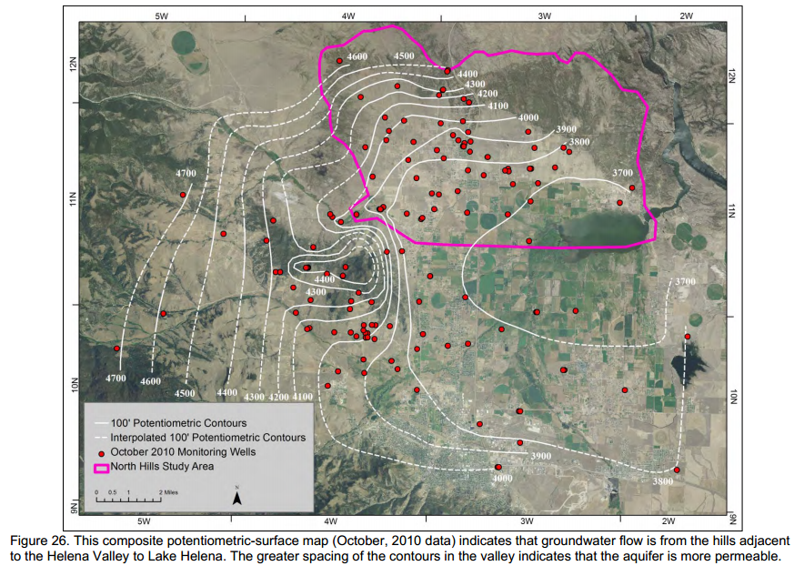
Groundwater: map of potentiometric surface
30

Slide 31
Groundwater: topics covered
31
Water in porous substrate: the fundamental vocabulary and concepts necessary for defining aquifers
Storage in aquifers: describing the amount of water that can be stored in porous media relative to a given change in the total hydraulic head
Groundwater movement: basic principles of predicting the direction and flux of groundwater movement
Understanding variation in groundwater flow nets: the characteristics of surface and subsurface topography that cause equipotential and flow lines to “bend”
Exchange with surface waters: interpreting the consequences of the intersection of subsurface flow nets with surface waters
Groundwater flux and velocity: basic calculations of different characteristics of groundwater movement based on Darcy’s law

Slide 32
Stream-subsurface exchange: interaction of flow nets and rivers
32
Equipotential
lines
(water table surface)
Groundwater discharges to river
River water balance has a net gain
Flow lines
(arrows indicate direction of downward hydraulic gradient)
River recharges groundwater
River water balance has a net loss
River reaches
Groundwater flow parallel to river
Plan (overhead) views
of groundwater flow
nets and river reaches
River water balance is neutral

Slide 33
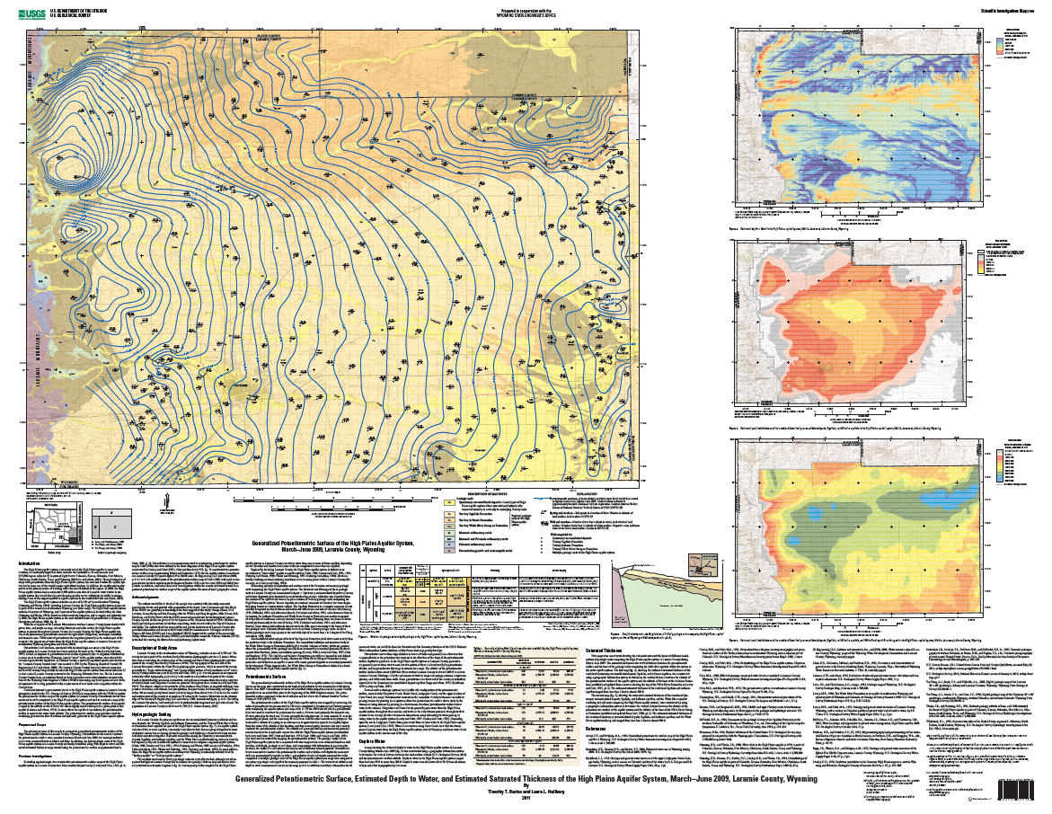
33
Potentiometric surface of the high plains aquifer near Cheyenne Wyoming
Cheyenne

Slide 34
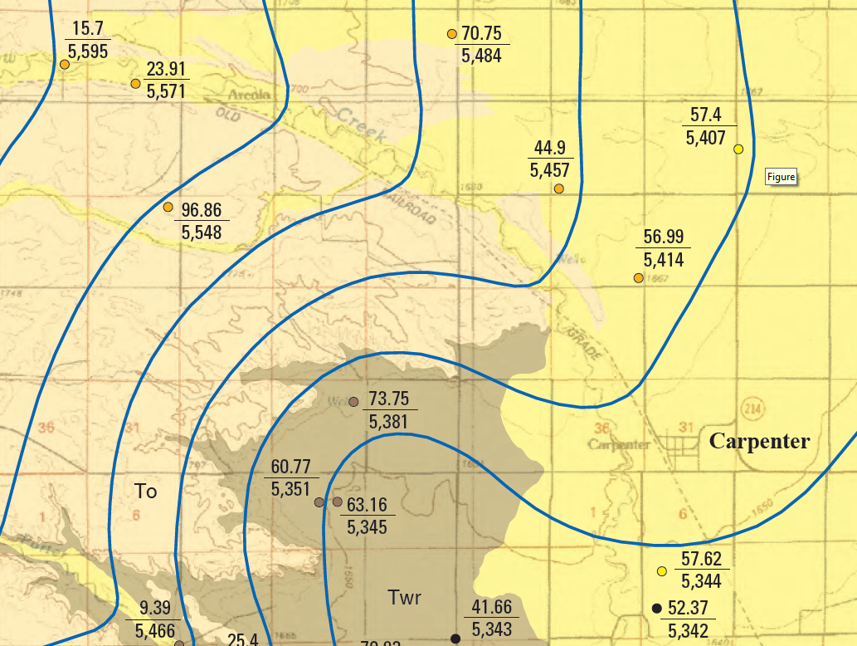
34
Is this reach of Crow Creek likely generally gaining water from groundwater discharge or losing water to groundwater recharge?
Down gradient
Losing water to groundwater recharge

Slide 35
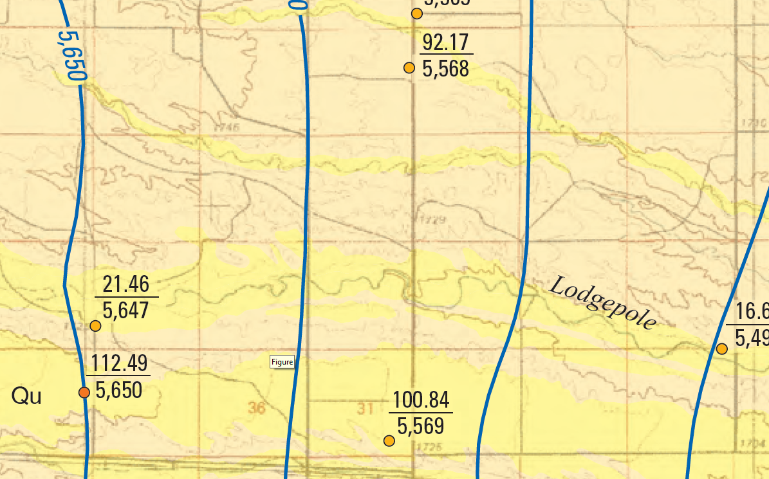
35
Down gradient
Is this reach of Lodgepole Creek likely generally gaining water from groundwater discharge or losing water to groundwater recharge?
Neither, likely net neutral

Slide 36
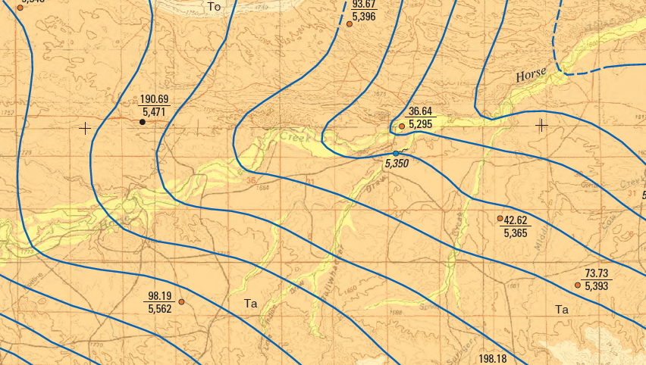
36
Is this reach of Horse Creek likely generally gaining water from groundwater discharge or losing water to groundwater recharge?
Down gradient
Gaining water from groundwater discharge

Slide 37
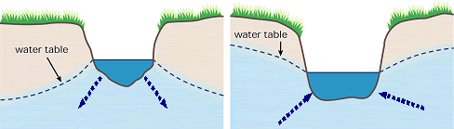
Stream-subsurface exchange: channel water balance
37
Piezometer
Well
Net loss
Net gain
Same potential means same water level in well/piezometer

Slide 38
Stream – subsurface exchange: Stream depletion zones
38
2013 Montana State Legislature passed SB346
Floodplain
A well in a stream depletion zone is limited to a
20 gallon per minute pump rate and a total of
2 acre feet per year
(normally 35 gpm and 10 acre feet)
Well
Stream depletion zone:
An area where hydrogeologic modeling concludes that pumping at 35 gpm would reduce stream flow by 30% within 30 days.
River

Slide 39
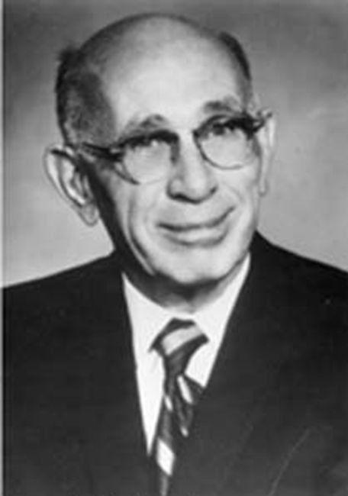
Stream – subsurface exchange: Stream depletion zones
39
Charles Vernon Theis
1935
Floodplain
Drawdown curve,
Cone of depression

Slide 40
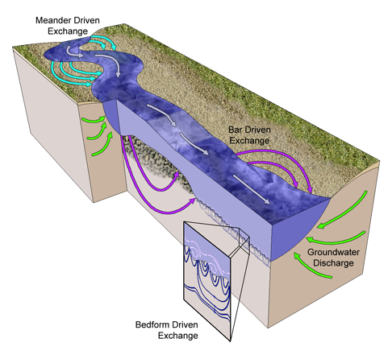
40
Stream-subsurface exchange: hyporheic flow
Susa Stonedahl, accessed 28 October 2014

Slide 41
Stream-subsurface exchange: consequences
41
Dispersion
Indicated by “spreading” of tracer
Surface processes
Transient storage
Indicated by “tailing” of tracer
Tailing
May be caused by exchange with subsurface

Slide 42

Stream subsurface exchange: consequences
42
Turnover: 30% of the stream channel water has been replaced by groundwater over the reach
Downstream
Upstream
Upwelling
Bedrock
Downwelling
Discharge
Recharge
Sediment
Middle Flathead River loses and regains about 30% of the channel flow at low flow conditions on the Nyack floodplain

Slide 43
Groundwater: topics covered
43
Water in porous substrate: the fundamental vocabulary and concepts necessary for defining aquifers
Storage in aquifers: describing the amount of water that can be stored in porous media relative to a given change in the total hydraulic head
Groundwater movement: basic principles of predicting the direction and flux of groundwater movement
Understanding variation in groundwater flow nets: the characteristics of surface and subsurface topography that cause equipotential and flow lines to “bend”
Exchange with surface waters: interpreting the consequences of the intersection of subsurface flow nets with surface waters
Groundwater flux and velocity: basic calculations of different characteristics of groundwater movement based on Darcy’s law

Slide 44
44
Groundwater movement: Darcy’s law
$h=z+ψ=z+\frac{p}{γ_{W}}$
Positive water flux is proportional to a
negative hydraulic gradient (for laminar flow through pores)
$$\frac{Q}{A}$$
$$=−K\frac{Δ\left(z+ψ\right)}{Δl}$$
[L T⁻¹]
(Darcian flux)
$$\frac{Q}{A}=−K\frac{Δh}{Δl}$$
$$\frac{Δh}{Δl}$$
[1]
Hydraulic conductivity ($K$) – a property of a system of fluid flow that quantifies the ease of fluid movement
Henry Darcy
French Engineer
mid-1800s
[L T⁻¹]
Hydraulic conductivity is strongly controlled by the size and connectivity of pores (and viscosity of the fluid)
This is permeability (not porosity)

Slide 45




Stream flow measurement
45
Flux – flow normal (perpendicular) to a surface area
Cross-sectional area, $A$ [L²]
Average velocity $\overline{U}$ [L T⁻¹]
Stream flow $Q=\overline{U}A$
[L³ T⁻¹]
Notes:
This is a stream, and as environmental scientists, we are interested in measuring how much water is in this stream.

Slide 46






Stream – subsurface exchange: velocity in groundwater
46
$$\overline{U}=\frac{Q}{A }$$
For streams:
$$Q=\overline{U}A$$
Water flows in the whole channel
Darcy Flux
$$\frac{Q}{A}=−K\frac{Δh}{Δl}$$
For groundwater:
$$\overline{U}=$$
Water only flows in the pore spaces
Velocity of groundwater, or the velocity of a solute in groundwater
$$\overline{U}=\frac{Q}{Aφ}=−\frac{1}{φ}K\frac{Δh}{Δl}$$
$$\overline{U}>\frac{Q}{A}$$

Slide 47












Stream – subsurface exchange: velocity in groundwater
47
has recently been detected as a contaminated sampling well
How long will it take ($t$) the contaminant to reach the stream?
$$h_{stream}−h_{well}=−1 m$$
Floodplain
Distance from well to stream ($d$) = 100 m
$$φ=0.3$$
$$K=10 m {day}^{−1}$$
$$\frac{Q}{A}=−K\frac{Δh}{Δl}$$
$$=−\left(10 m {day}^{−1}\right)\frac{−1 m}{100 m}=0.1 m {day}^{−1}$$
100 m
$$\overline{U}=\frac{Q}{Aφ}$$
$$=\frac{0.1 m {day}^{−1}}{0.3}=0.33 m {day}^{−1}$$
$$\overline{U}=\frac{d}{t}$$
$$t=\frac{d}{\overline{U}}$$
$$=\frac{100 m}{0.33 m {day}^{−1}}=300 day$$

Slide 48
Groundwater: topics covered
48
Water in porous substrate: the fundamental vocabulary and concepts necessary for defining aquifers
Storage in aquifers: describing the amount of water that can be stored in porous media relative to a given change in the total hydraulic head
Groundwater movement: basic principles of predicting the direction and flux of groundwater movement
Understanding variation in groundwater flow nets: the characteristics of surface and subsurface topography that cause equipotential and flow lines to “bend”
Exchange with surface waters: interpreting the consequences of the intersection of subsurface flow nets with surface waters
Groundwater flux and velocity: basic calculations of different characteristics of groundwater movement based on Darcy’s law

