Slide 1



tinyurl.com/fallpanoramasurvey
Notes:
Time frame: under 1 minute
Talking points:
Welcome and introductions

Slide 2
Building Relationships
Principal Professional Learning
October 2024
Notes:
Time frame: under 1 minute
Talking points:
Welcome and introductions

Slide 3
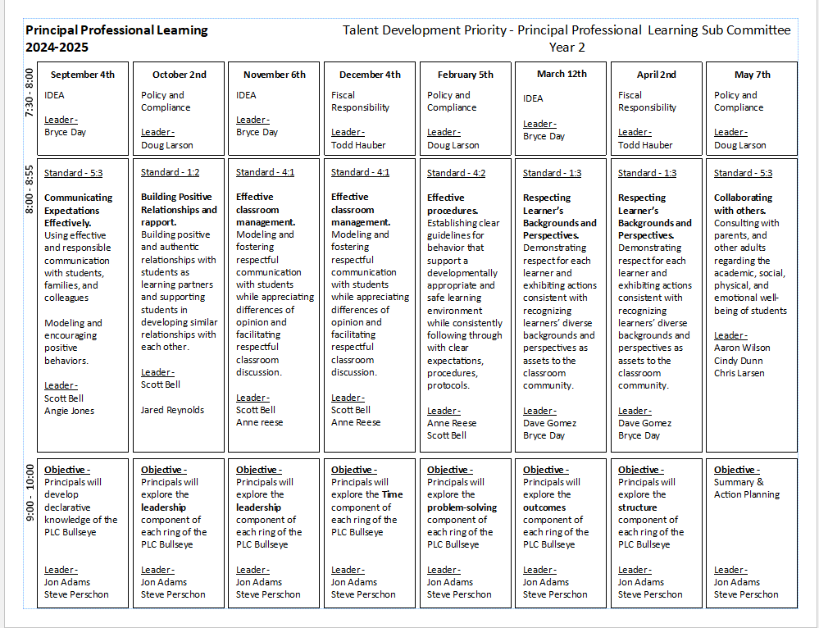
Notes:
Time frame: under 1 minute
Talking points:
Share the scope and sequence for the year

Slide 4

Standards
Teacher Standard 1.2
Building Positive Relationships and Rapport
  Building positive and authentic relationships with students as learning partners and supporting students in developing similar relationships with each other.
Notes:
Time frame: under 1 minute
Talking points:
Introduce the teacher and administrator standards
Share that we will be helping them to understand their role in supporting teachers as well as understanding their own personal skills they use to communicate

Slide 5
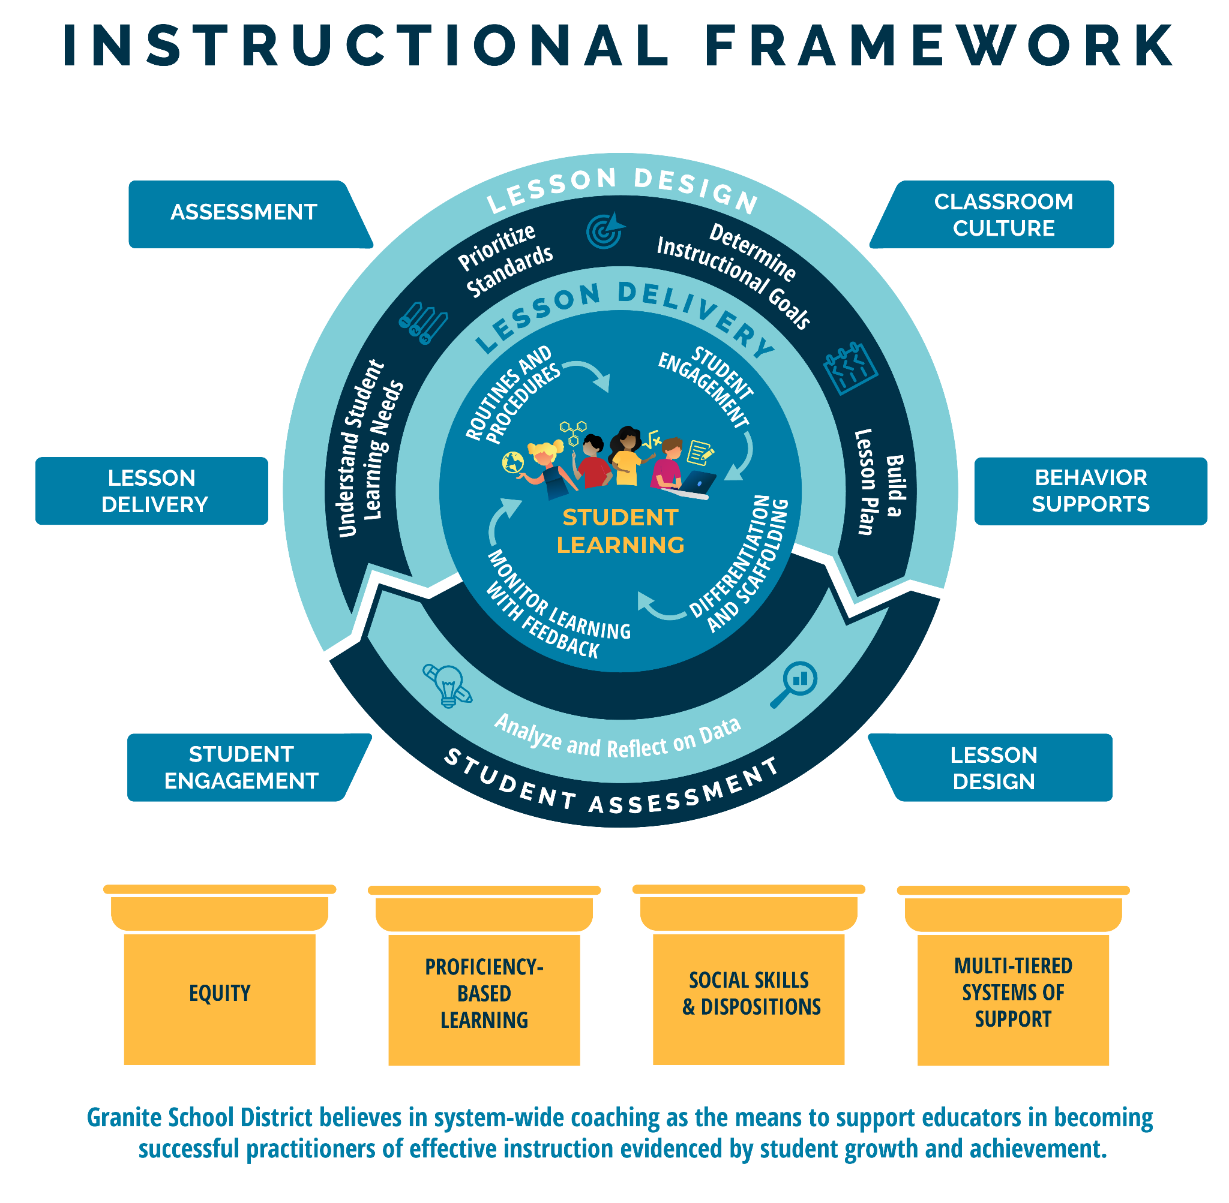
Notes:
Time frame: 1 minute
Talking points:
This is the Granite School District Instructional Framework. This framework is based on the evidence-based instructional practices embedded in the GSD Strategic Plan and represents all of Granite School District priorities. You will notice student learning is at the heart of the framework as it represents our commitment to student learning around which everything else is built. The framework features the basic elements of a high quality instructional cycle including Lesson Design, Lesson Delivery, and Student Assessment. You will notice the evidence-based practices at the lesson delivery level that we expect to see in what the teacher and the student are doing during the lesson. The high quality instructional cycle components are reinforced through ongoing, job-embedded coaching in: lesson design, student engagement, lesson delivery, assessment classroom culture and behavior supports, all of which contribute to meaningful learning and career and college readiness. The framework rests on the foundational pillars of Granite School District’s commitment to Equity, Proficiency-Based Learning, Social Skills and Dispositions and Multi-Tiered Systems of Support.

Slide 6
Objectives
We will learn and apply skills to build positive and authentic relationships with students, staff members, parents and other stakeholders
Notes:
Time frame: under 1 minute
Talking points:
Highlight that we will address communication from the perspective of how an administrator can communicate and how an administrator can support other educators in communication

Slide 7
Essential Questions
How will my Panorama data assist my school in building relationships with students?
What strategies can I use to build relationships with students?
Notes:
Time frame: under 1 minute
Talking points:

Slide 8
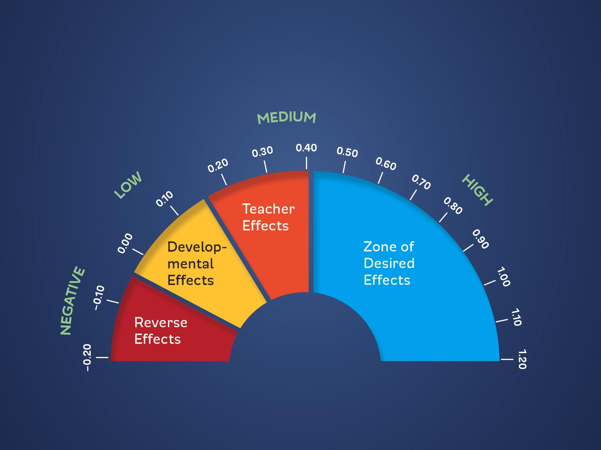
Hattie Research = .72 effect size
Teacher-Student Relationships
Notes:
Time frame: 2 minutes
Lynne to add Hattie Notes
Talking points:
Share the teacher standard that we are working from today
Share the video as a fun way to promote the need for positive communication

Slide 9
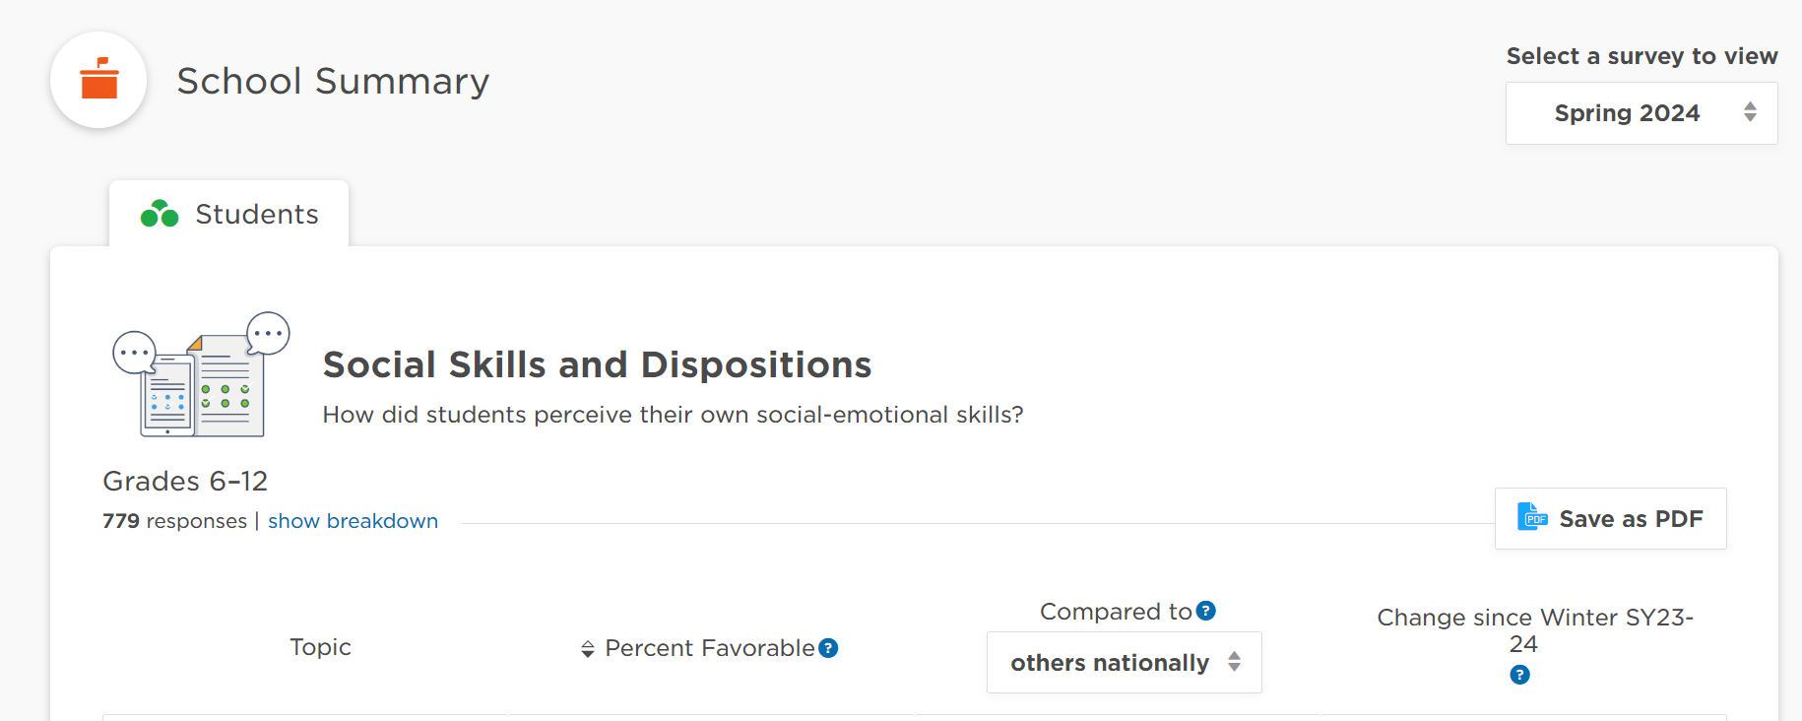
Panorama Data
Notes:
Time frame:
Talking points:

Slide 10
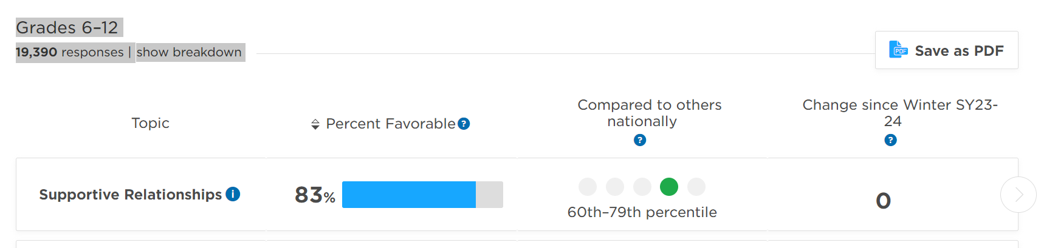
Panorama
Notes:
Time frame:
Talking points:

Slide 11
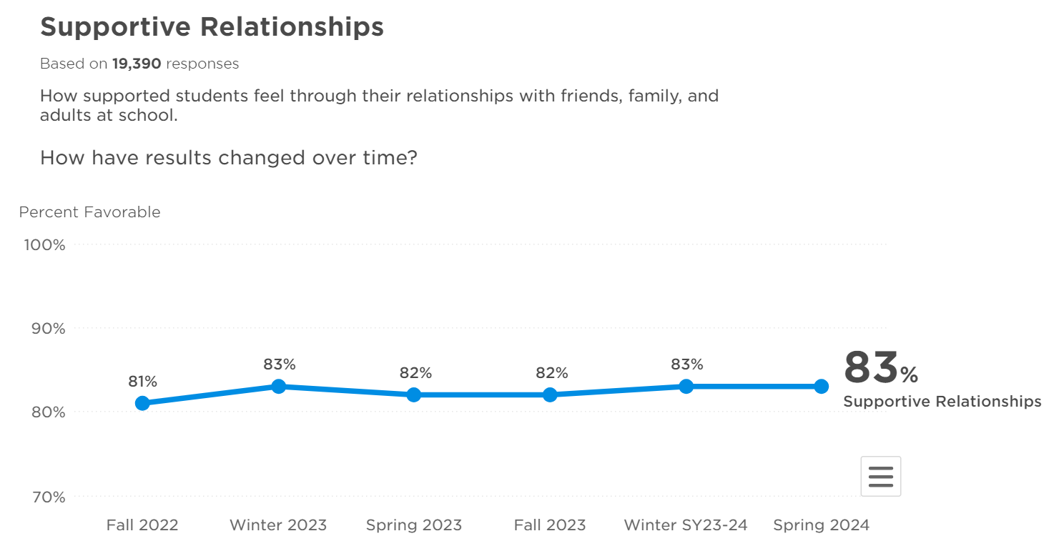
Panorama
Notes:
Time frame:
Talking points:

Slide 12
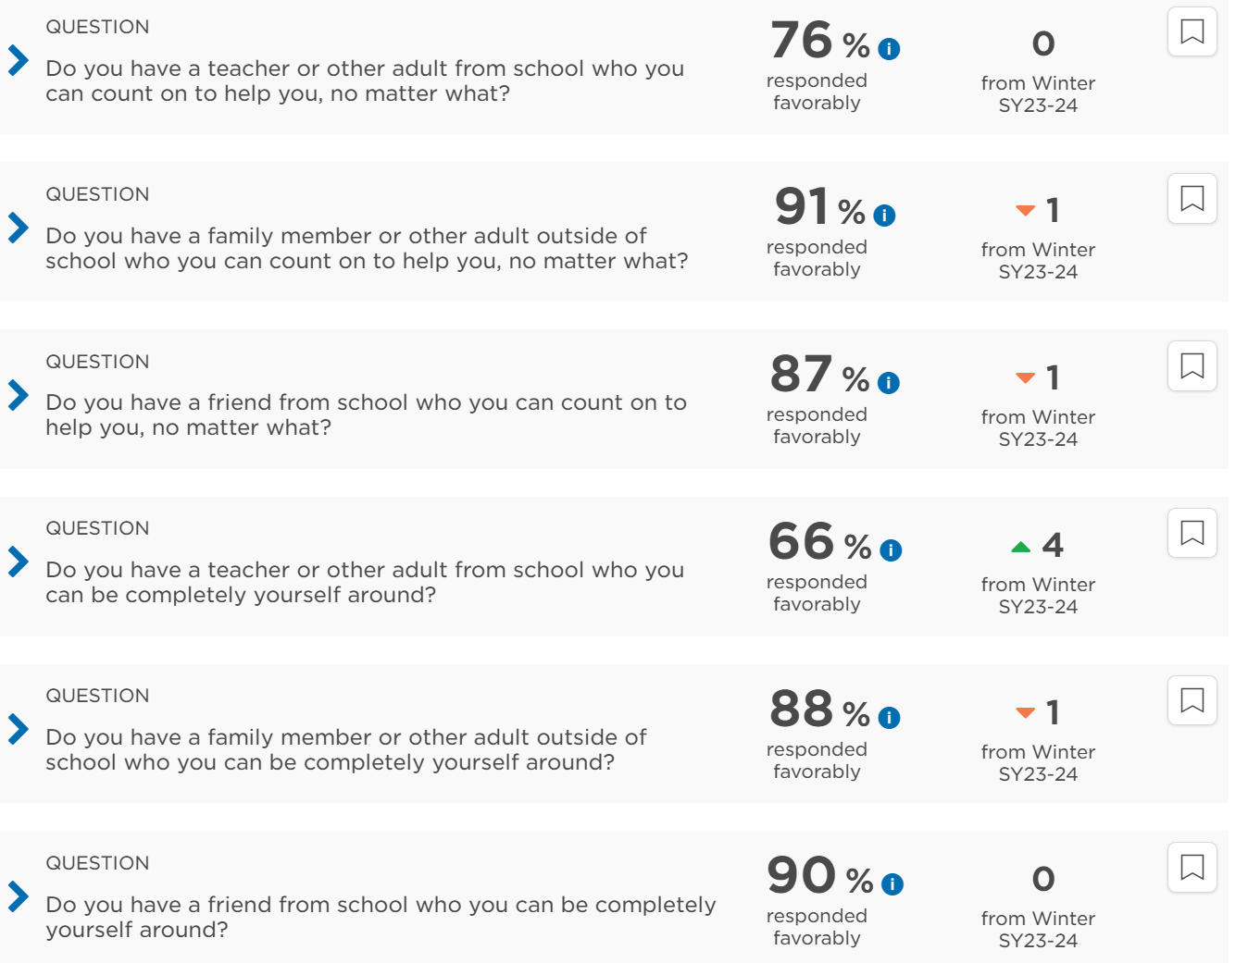
Panorama
Notes:
Time frame:
Talking points:

Slide 13
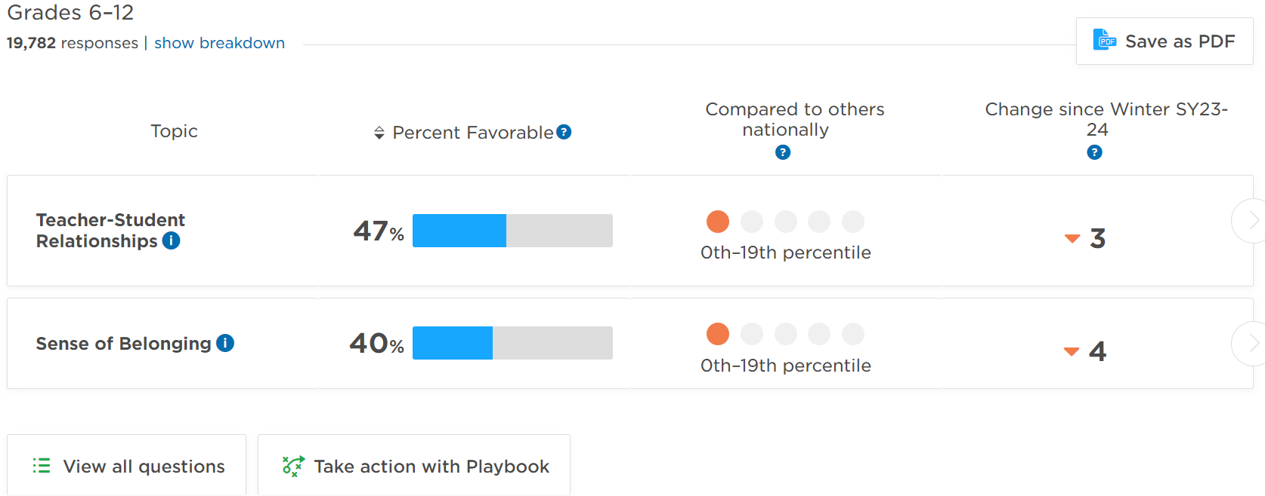
Panorama Playbook
Notes:
Time frame:
Talking points:

Slide 14
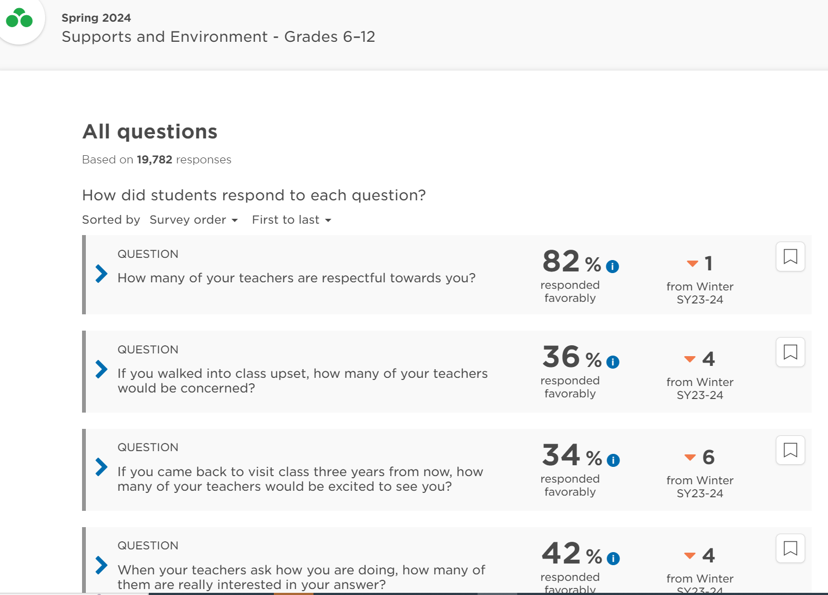
Panorama
Notes:
Time frame:
Talking points:

Slide 15
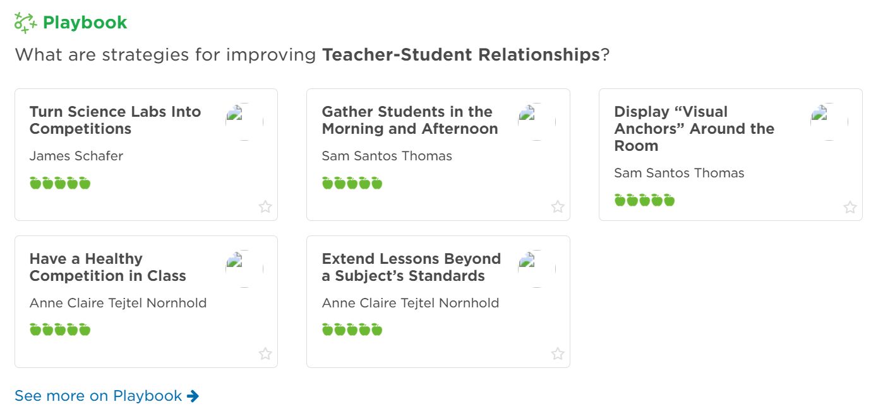
Panorama Playbook
Notes:
Time frame:
Talking points:

Slide 16
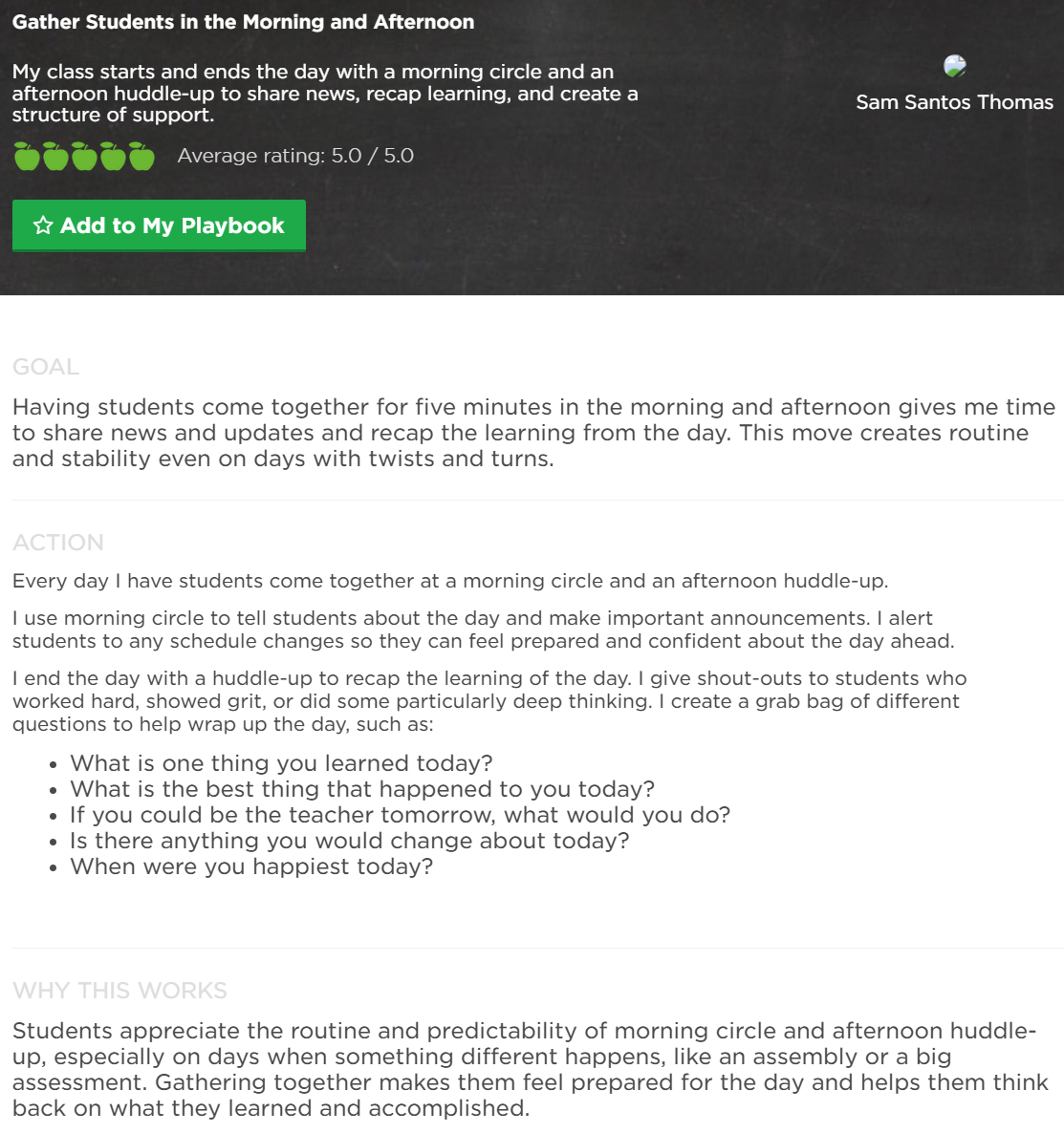
Panorama Playbook
Notes:
Time frame:
Talking points:

Slide 17
Panorama Playbook
Notes:
Time frame:
Talking points:

Slide 18
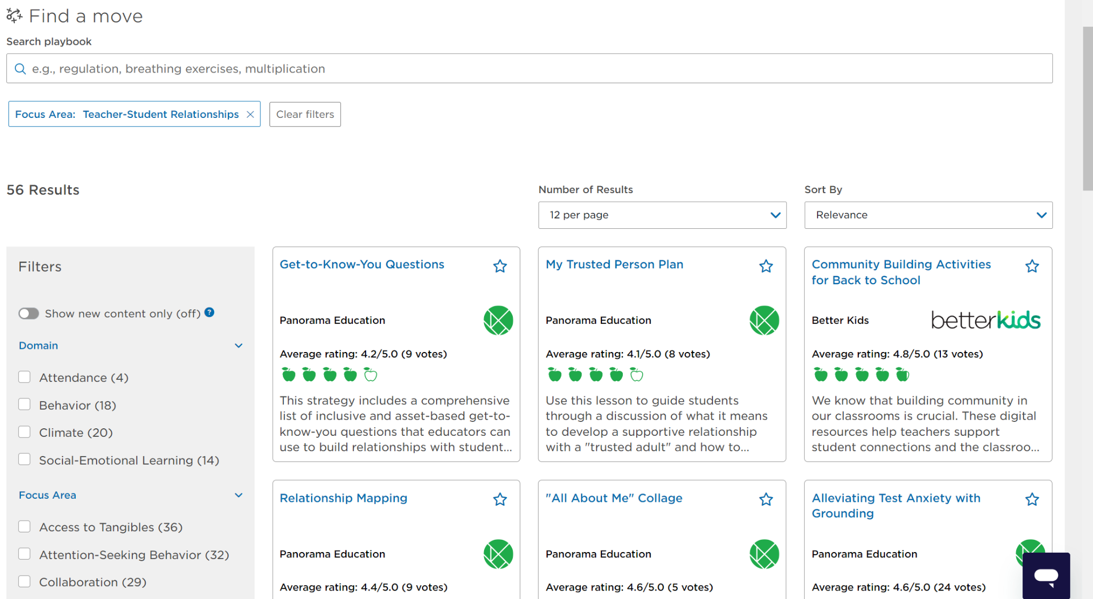
Panorama Playbook
Notes:
Time frame:
Talking points:

Slide 19
What does it mean? And can you use it in a sentence, correctly?
Bussin
Anything that is very good/positive.
Shook
Filled with emotion, this expression means to be extremely moved in some way
Thirsty
Trying to get attention
Cheugy
Something that is out of date or a person who is trying too hard
IRL
In real life, as opposed to online
Mood
A word to signify agreement or a specific vibe
…
Super annoyed, but fine you will do it.
Sleep On
To be ignorant to something or someone’s value

Slide 20
Can you use all of these words in a sentence?
You are welcome to partner up to attempt this.
Skibidi Ohio Alpha
Sigma Riz Toilet

Slide 21
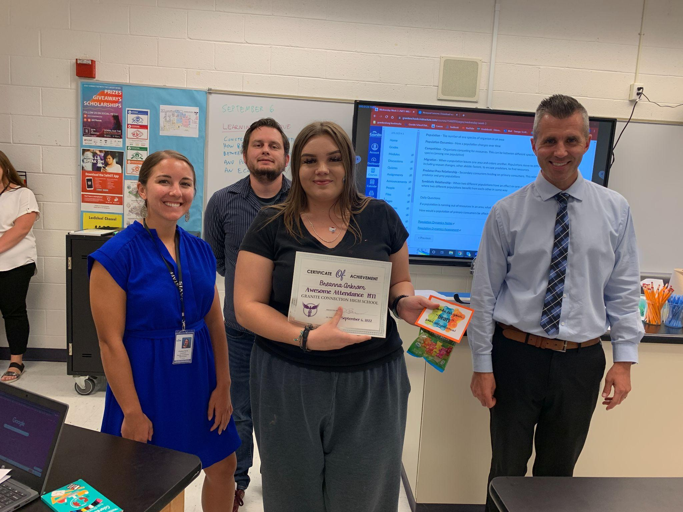
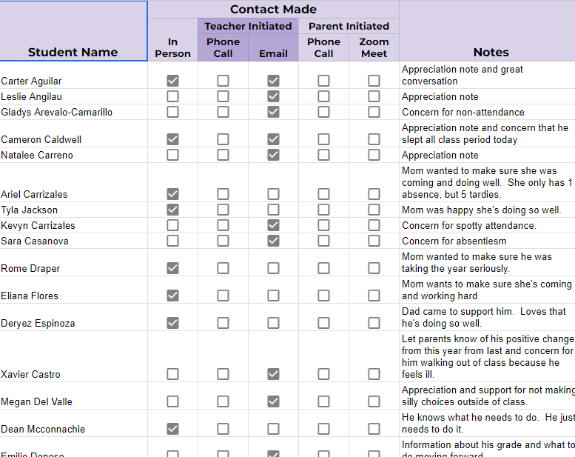
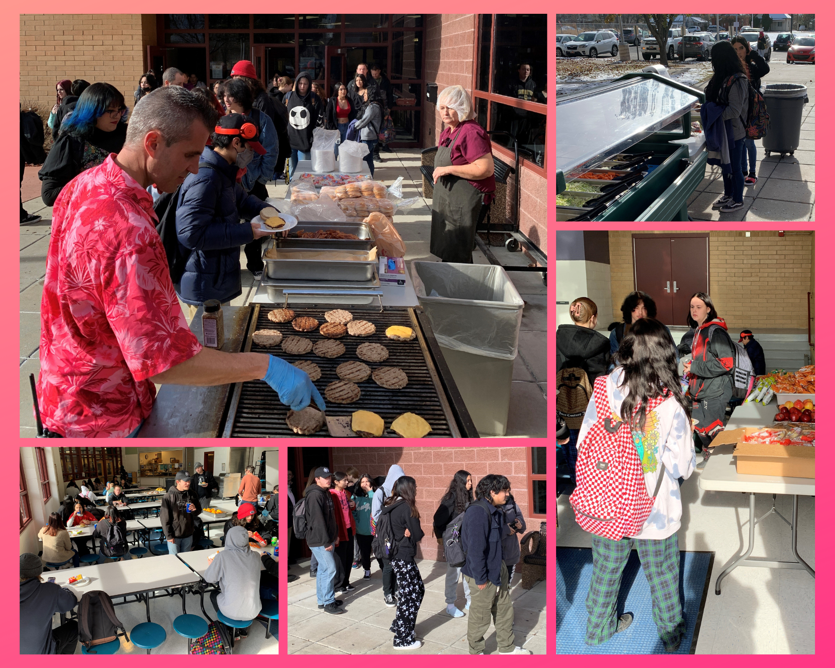
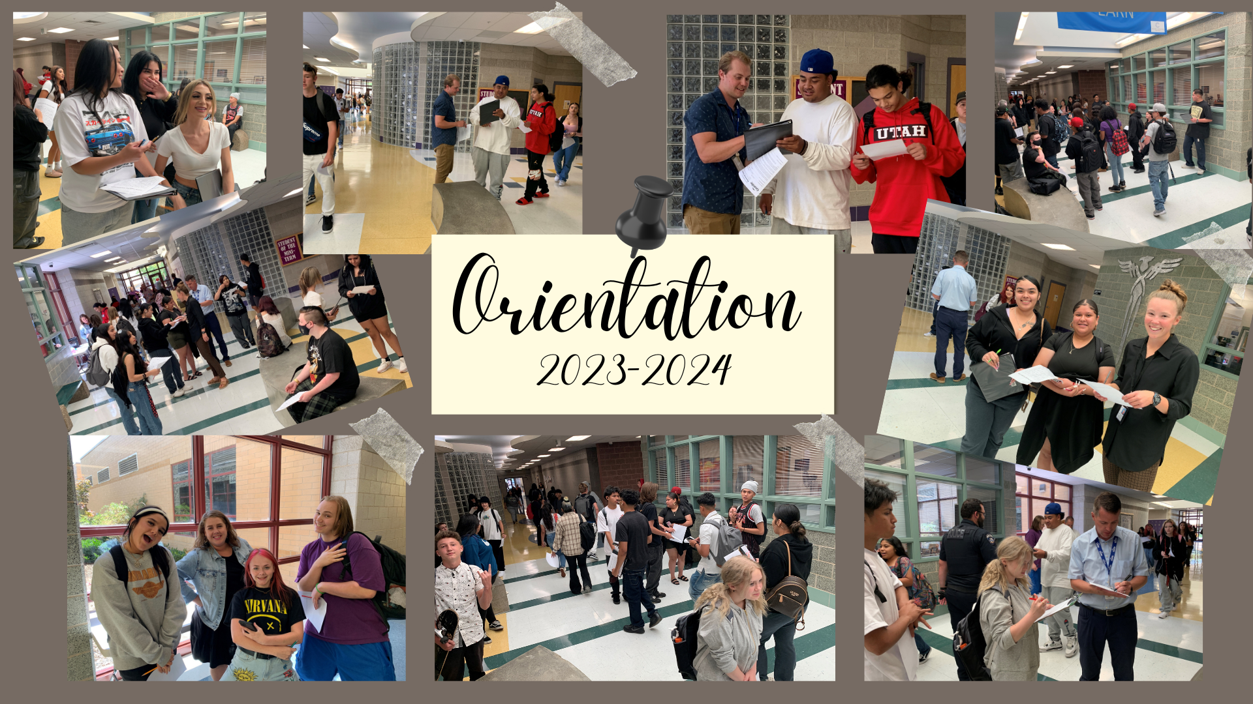
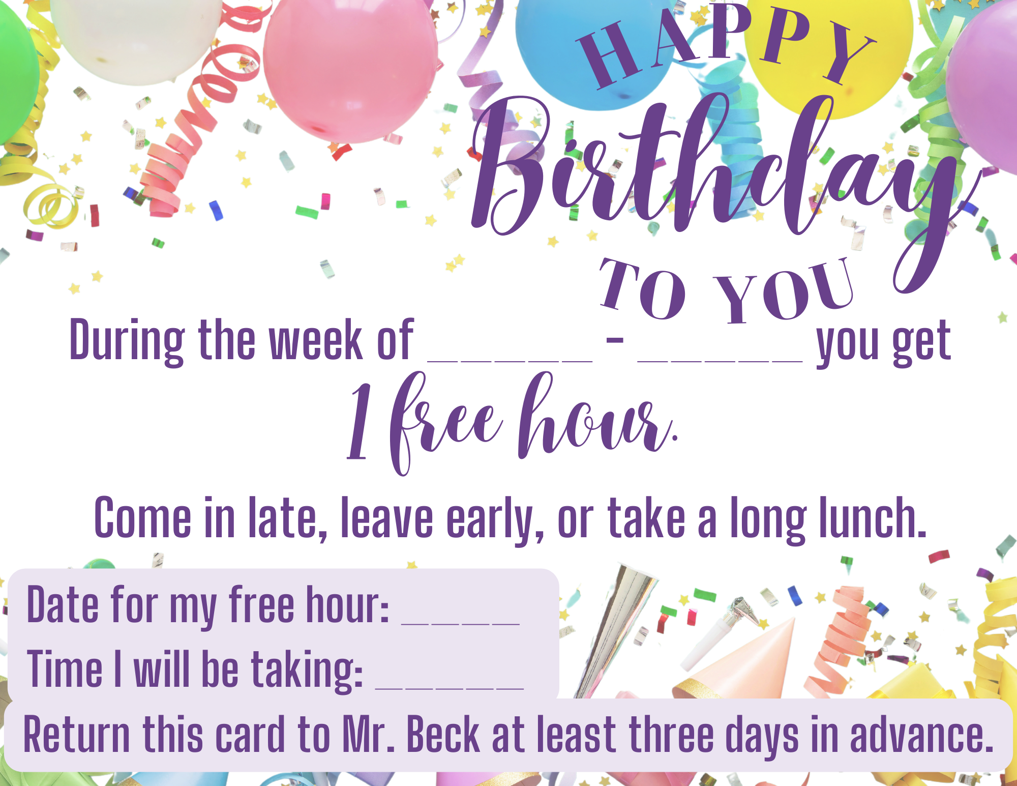
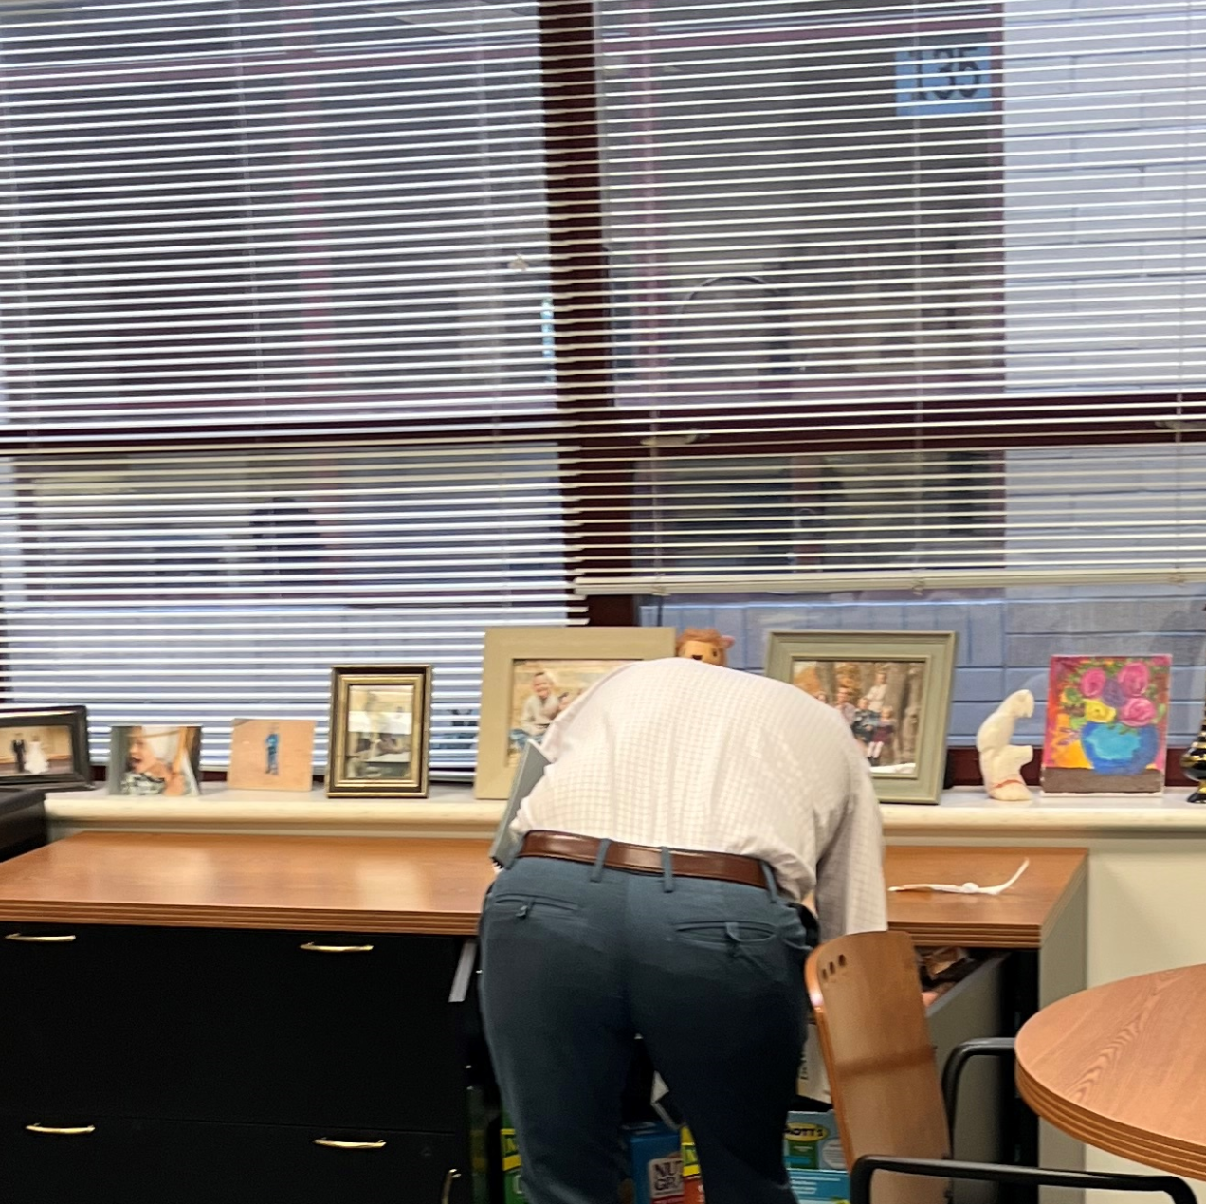
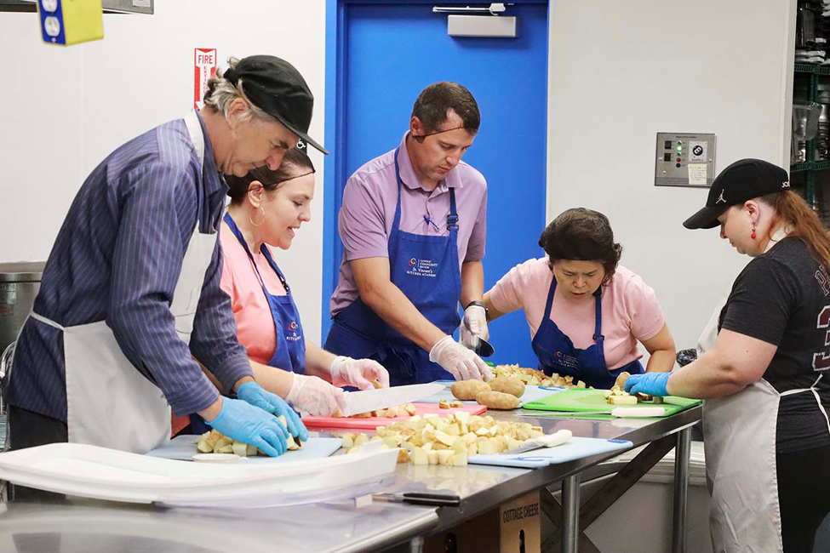
School Share Outs
Dave Beck

Slide 22

School Share Outs

Slide 23
 | Major & Minor Referrals
 | 2020-2021 |  | 2021-2022 |  | 2022-2023 |  | 2023-2024
 | Major - Minor |  | Major - Minor |  | Major - Minor |  | Major - Minor
Total | 1385 | 605 | 1171 | 2092 | 916 | 1865 | 403 | 1356

Slide 24

 | Severe Behaviors
 | 2020-2021 | 2021-2022 | 2022-2023 | 2023-2024
Physical Assaults/Safe School | 8 | 18 | 32 | 7
Mutual Altercation | 6 | 26 | 23 | 14
Aggression | 6 | 43 | 57 | 28
COVID

Slide 25
Safe School Violation
EJH | 7 | 19 | 14 | 12 | 16
School A | 11 | 13 | 6 | 1 | 4
School B | 15 | 8 | 7 | 0 | 5
School C | 3 | 4 | 8 | 3 | 15
School D | 13 | 16 | 11 | 10 | 16
School E | 24 | 13 | 13 | 7 | 6
School F | 10 | 3 | 5 | 0 | 8
School G | 18 | 17 | 11 | 0 | 3
School H | 15 | 33 | 6 | 8 | 10

Slide 26
RISE Proficiency
2024 ELA
RISE Proficiency
2024 Science
RISE Proficiency
2024 Math
Junior Highs | Proficiency
Hunter | 25
Jefferson | 24.1
Eisenhower | 23.9
West Lake | 23.1
Valley | 20.3
Kearns | 19.6
Matheson | 19.5
Kennedy | 19.3
Granite Park | 13.5
Junior Highs | Proficiency
Jefferson | 33.4
Hunter | 31.3
Eisenhower | 28.5
West Lake | 27.3
Valley | 25.4
Kearns | 24.9
Kennedy | 24
Matheson | 20.3
Granite Park | 19.4
Junior Highs | Proficiency
Eisenhower | 27.4
West Lake | 21.1
Valley | 18.8
Hunter | 18.5
Matheson | 17.5
Jefferson | 14.3
Kearns | 14.3
Kennedy | 11.4
Granite Park | 9.8

Slide 27
RISE Overall
Proficiency 2024
Junior Highs | Proficiency
Eisenhower | 26
Hunter | 25
Jefferson | 24
West Lake | 23
Valley | 22
Kearns | 20
Matheson | 19
Kennedy | 18
Granite Park | 14

Slide 28
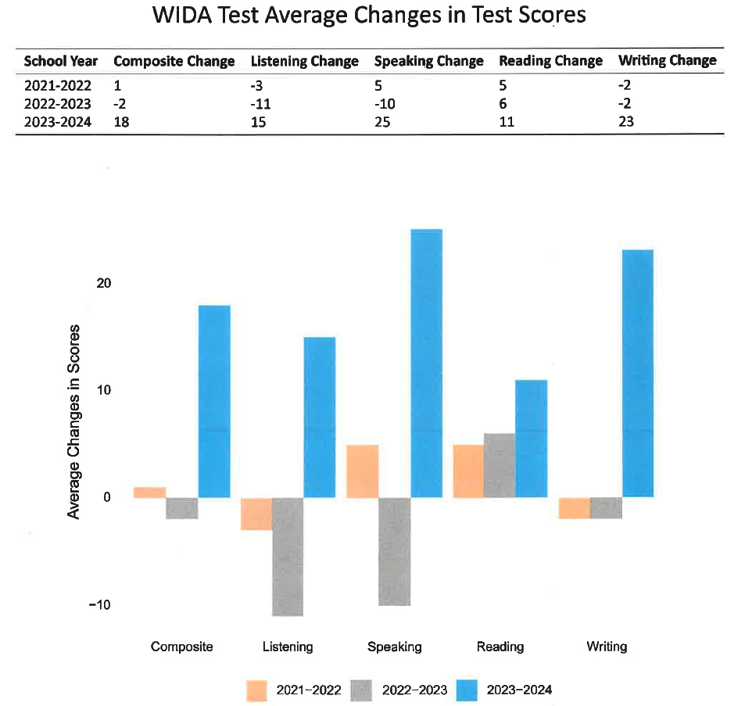
+20
+26
+35
+5
+25

Slide 29

School Share Outs
Surface vs. Depth
Effort - time
Consistency/Frequency - Continual process
Adaptability - Visibility
Strategic and intentional

Slide 30
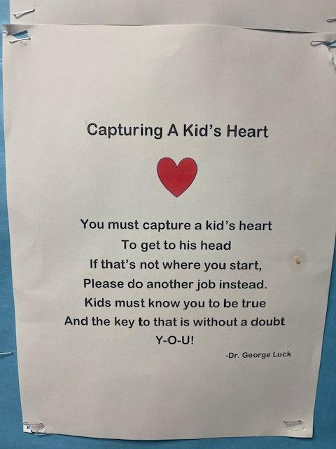
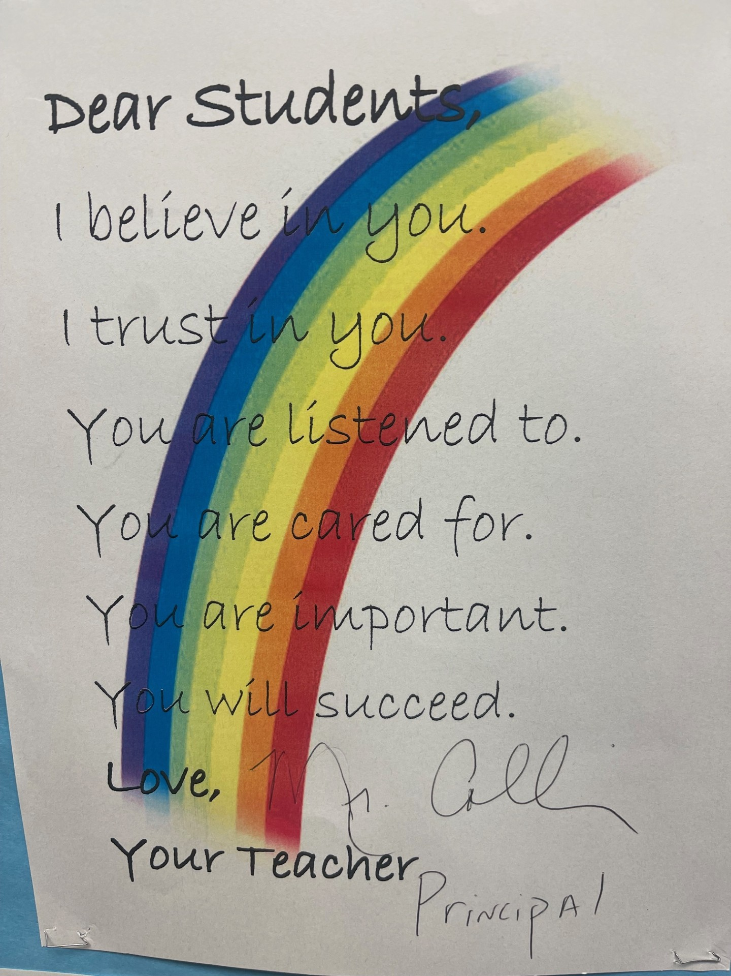

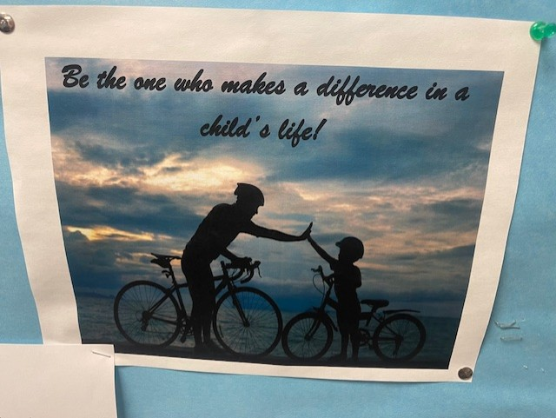
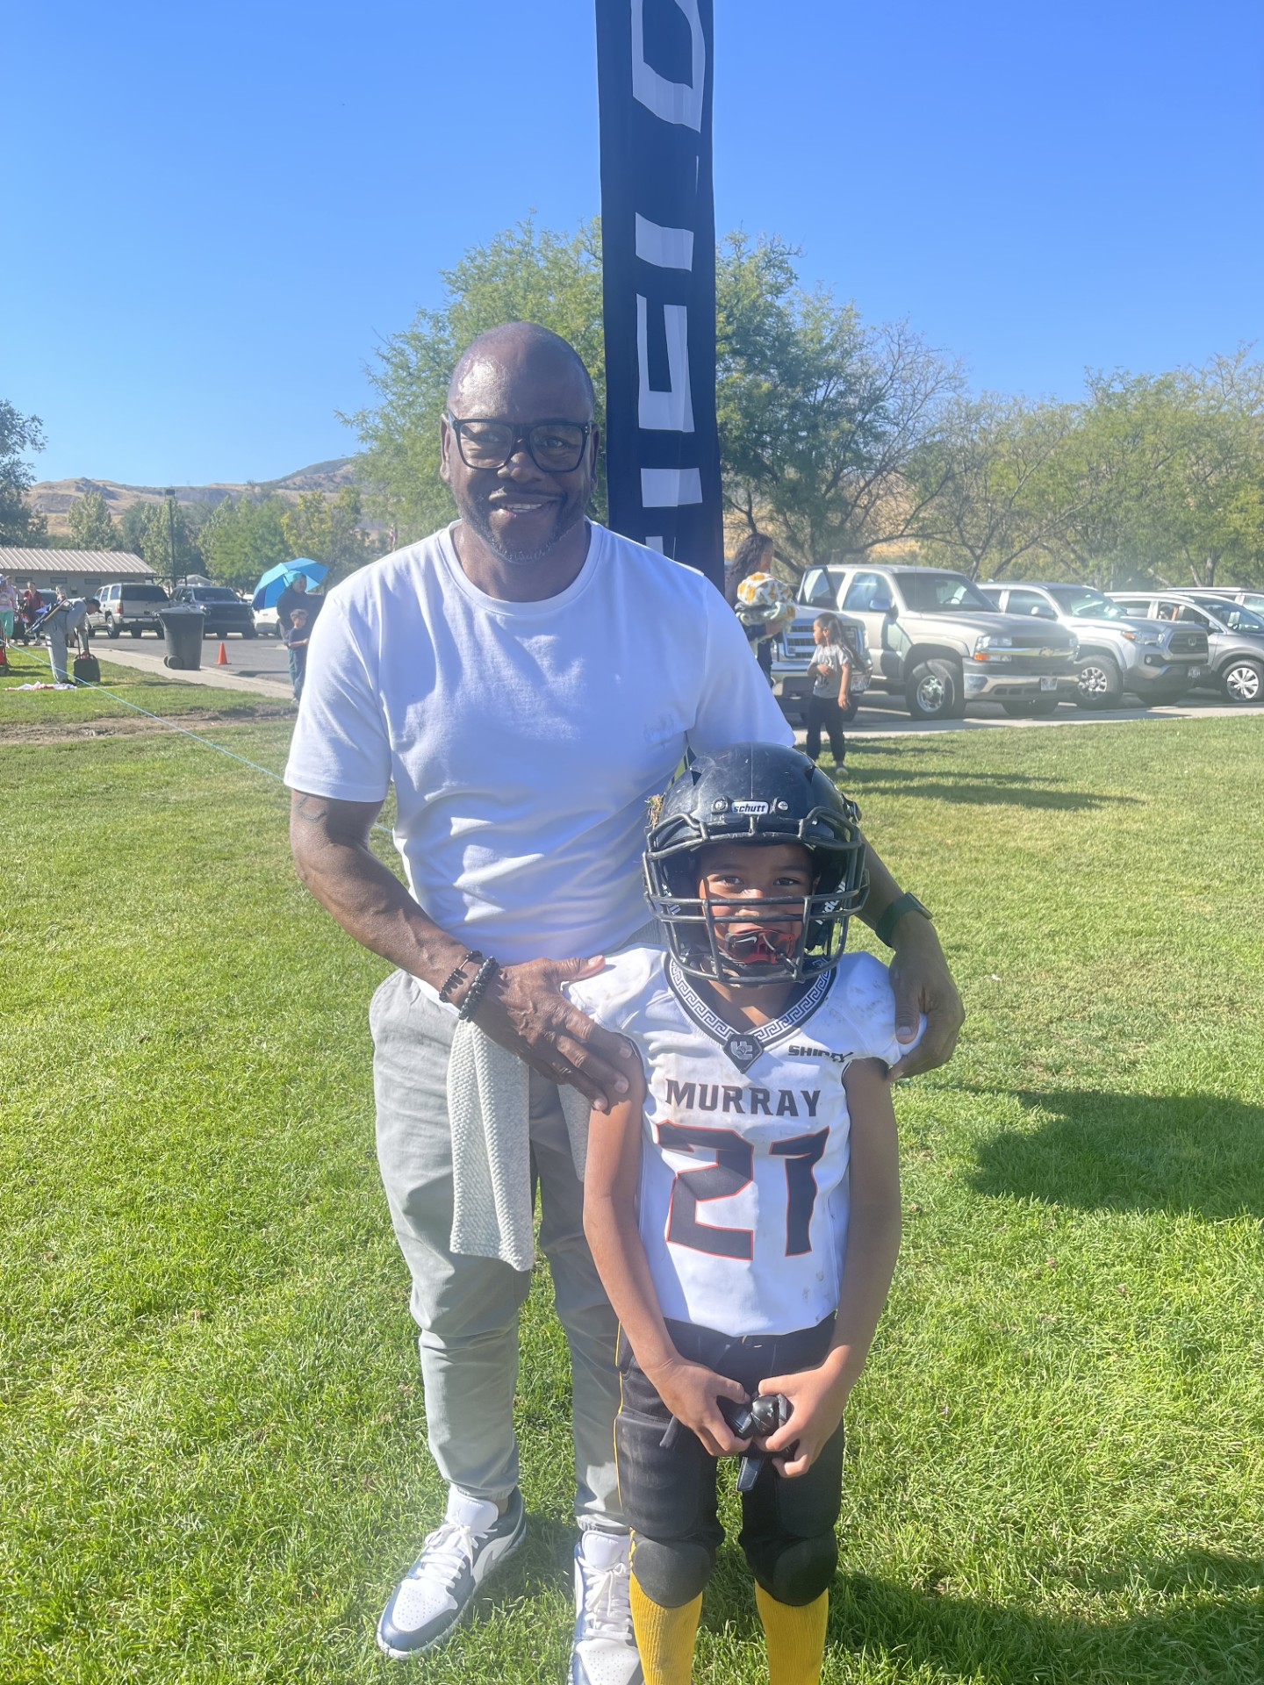
School Share Outs
Milton Collins

Slide 31
“No significant learning can occur without a significant relationship.”
-Dr. James Comer
Maurice Falk Professor of Child Psychiatry, Yale Child Study Center
Notes:
Time frame: 1 minute
Talking points:
This reinforces that building relationships is a first step to student learning

Slide 32
The End

