Slide 1


Principal Collaboration
Problem Solving PLC Barriers
March

Slide 2


Objective
Principals will explore the problem-solving Leadership Component of each ring of the PLC Bullseye.

Slide 3

Shared Norms
Meeting Norms
Be on time and prepared
Stay engaged
Speak your truth
Assume best intent

Slide 4

Collective Commitments
Clear expectations
Common consensus
Collaborative action
Positive interdependence
Results oriented
Effective feedback
Continuous improvement
Evidence-based practices

Slide 5
Problem Solving the Leadership Component

Slide 6
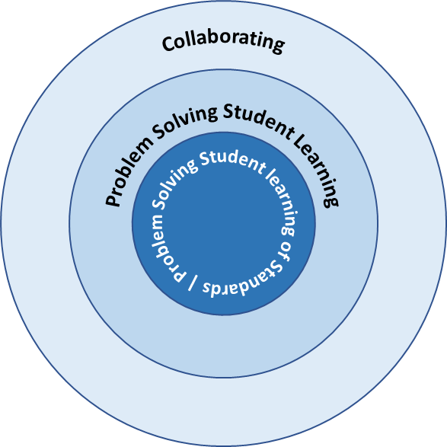
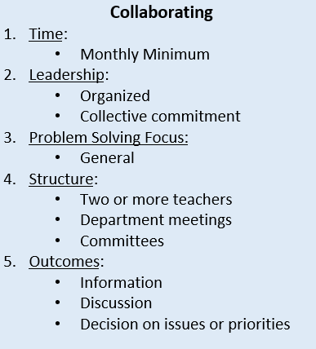
PLC Target - Good - Better - Best
Notes:
Time: 1 Min
Presenter Notes:

Slide 7
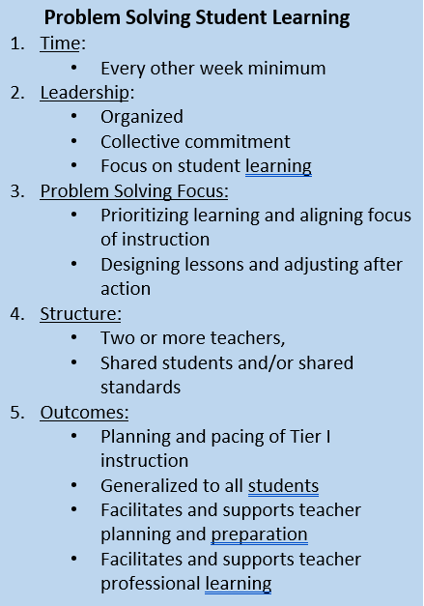
PLC Target - Good - Better - Best
Notes:
Time: 1 Min
Presenter Notes:

Slide 8
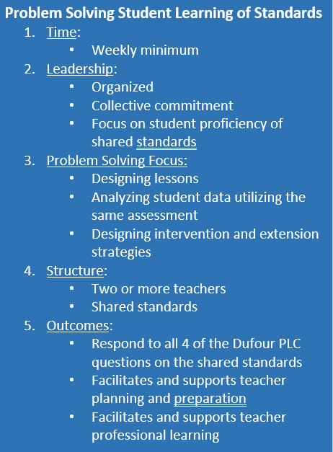
PLC Target - Good - Better - Best
Notes:
Time: 1 Min
Presenter Notes: Also hand out the

Slide 9
Conflict Resolution
How do you define conflict resolution?
  What does it look like in your schools?
How would you define Productive vs. Unproductive Conflict?
  What does it look like in your schools?
Notes:
Time: 5 min
Presenter Notes: Conflict Resolution Quadrants - Social Emotional Competency - Ability to form positive relationships, ability to work in a team, ability to deal effectively with conflict.
Give participants time to share and report out examples of non-productive conflict they have grappled with.

Slide 10
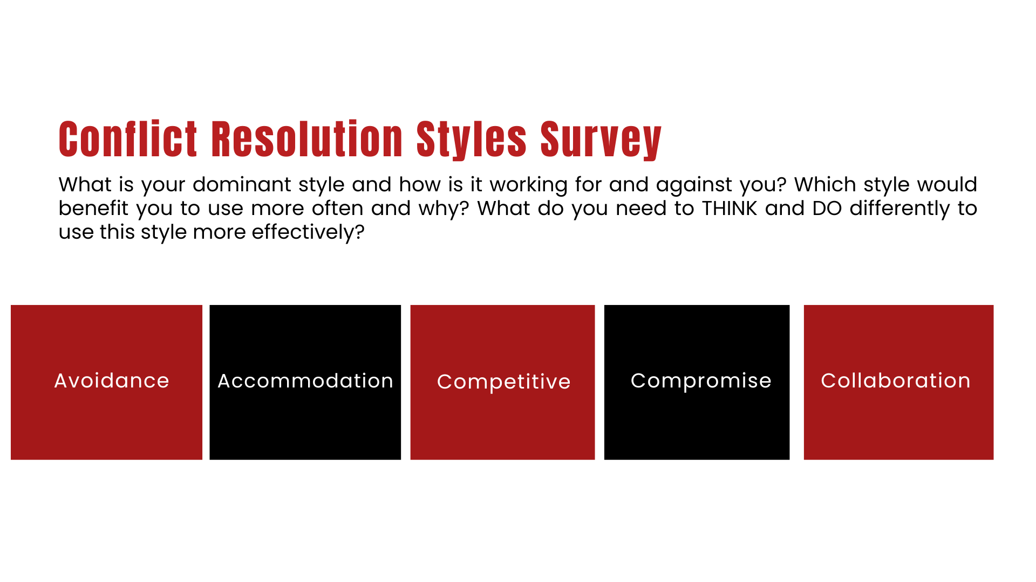


Slide 11

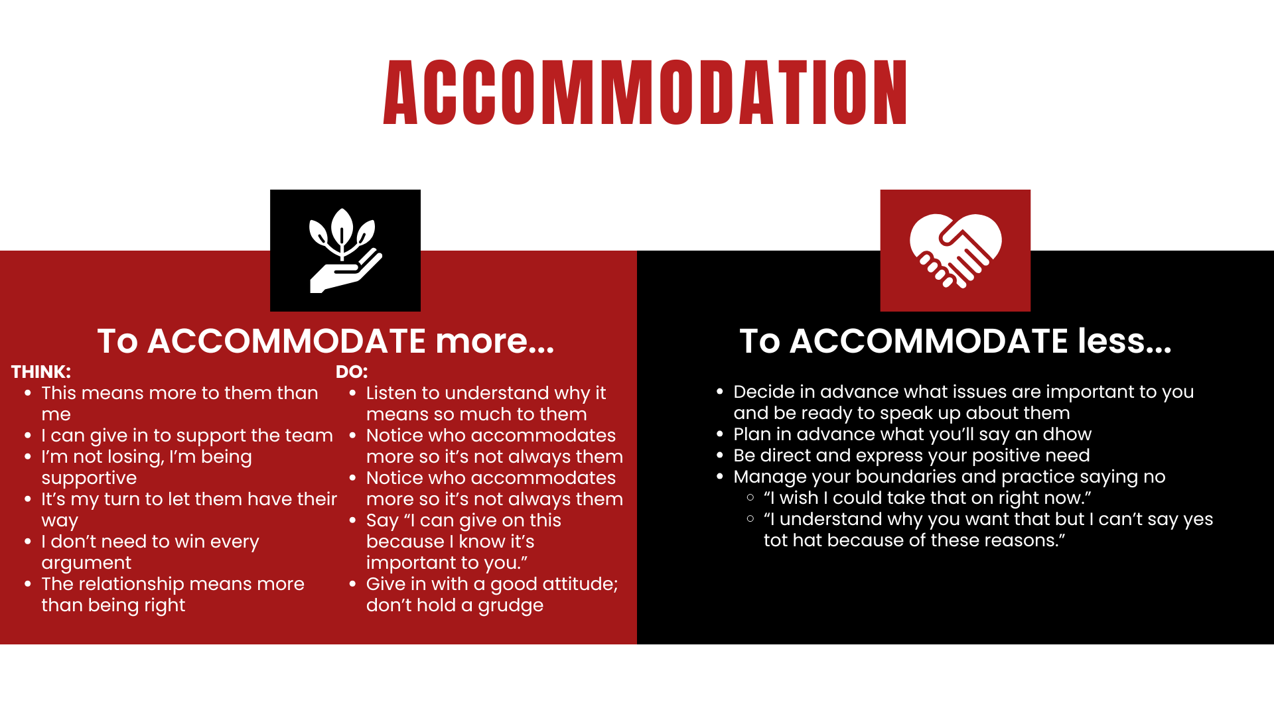

Slide 12
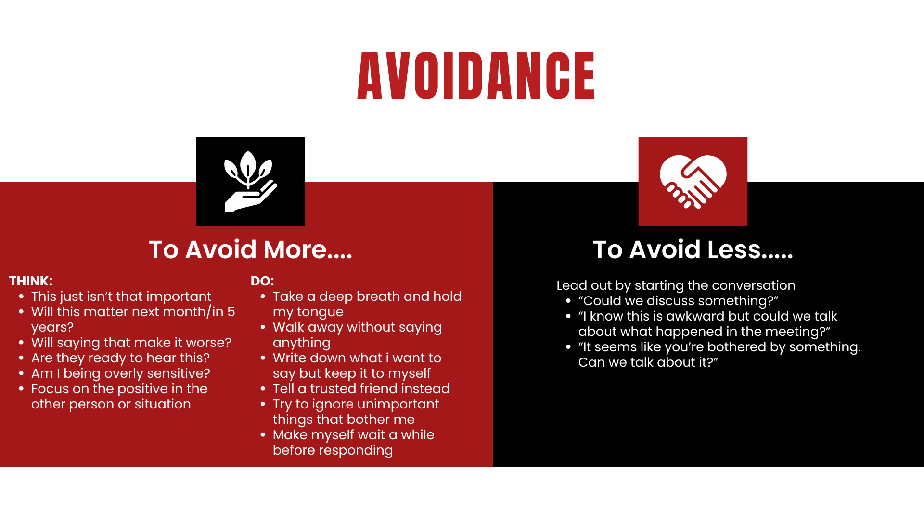

Slide 13
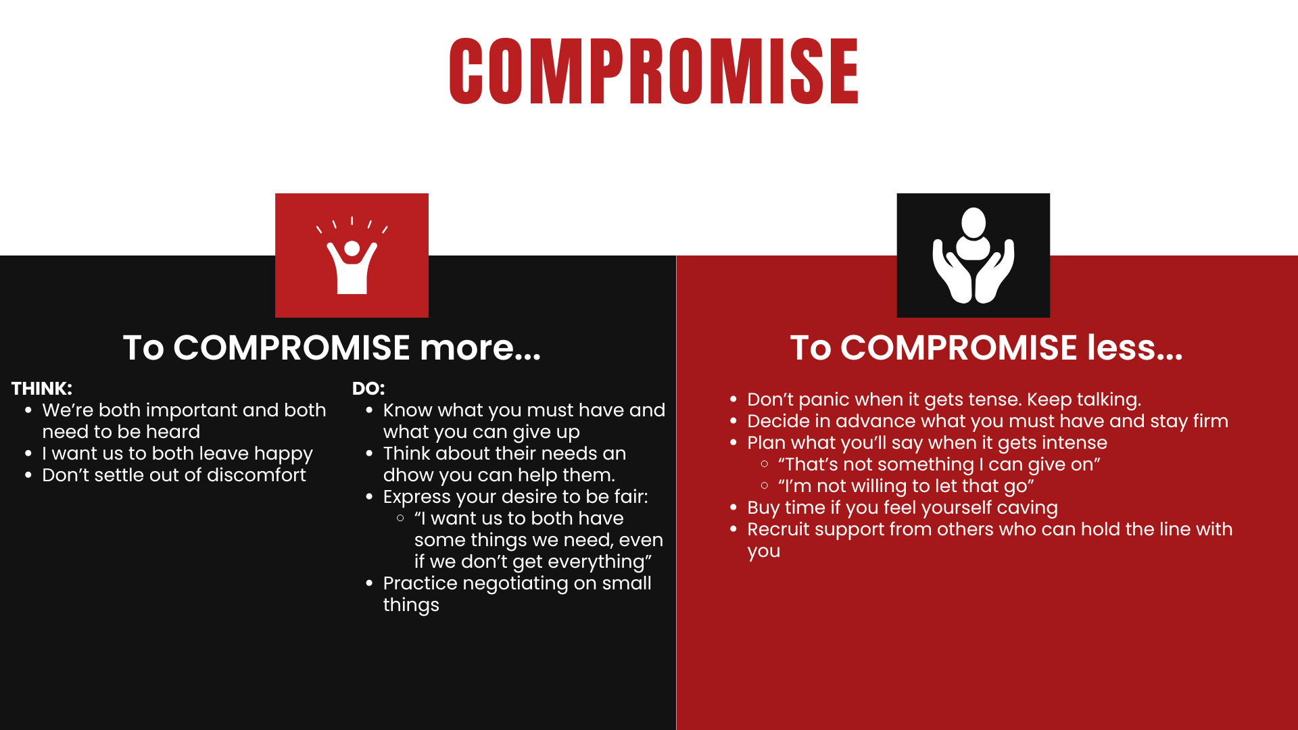

Slide 14
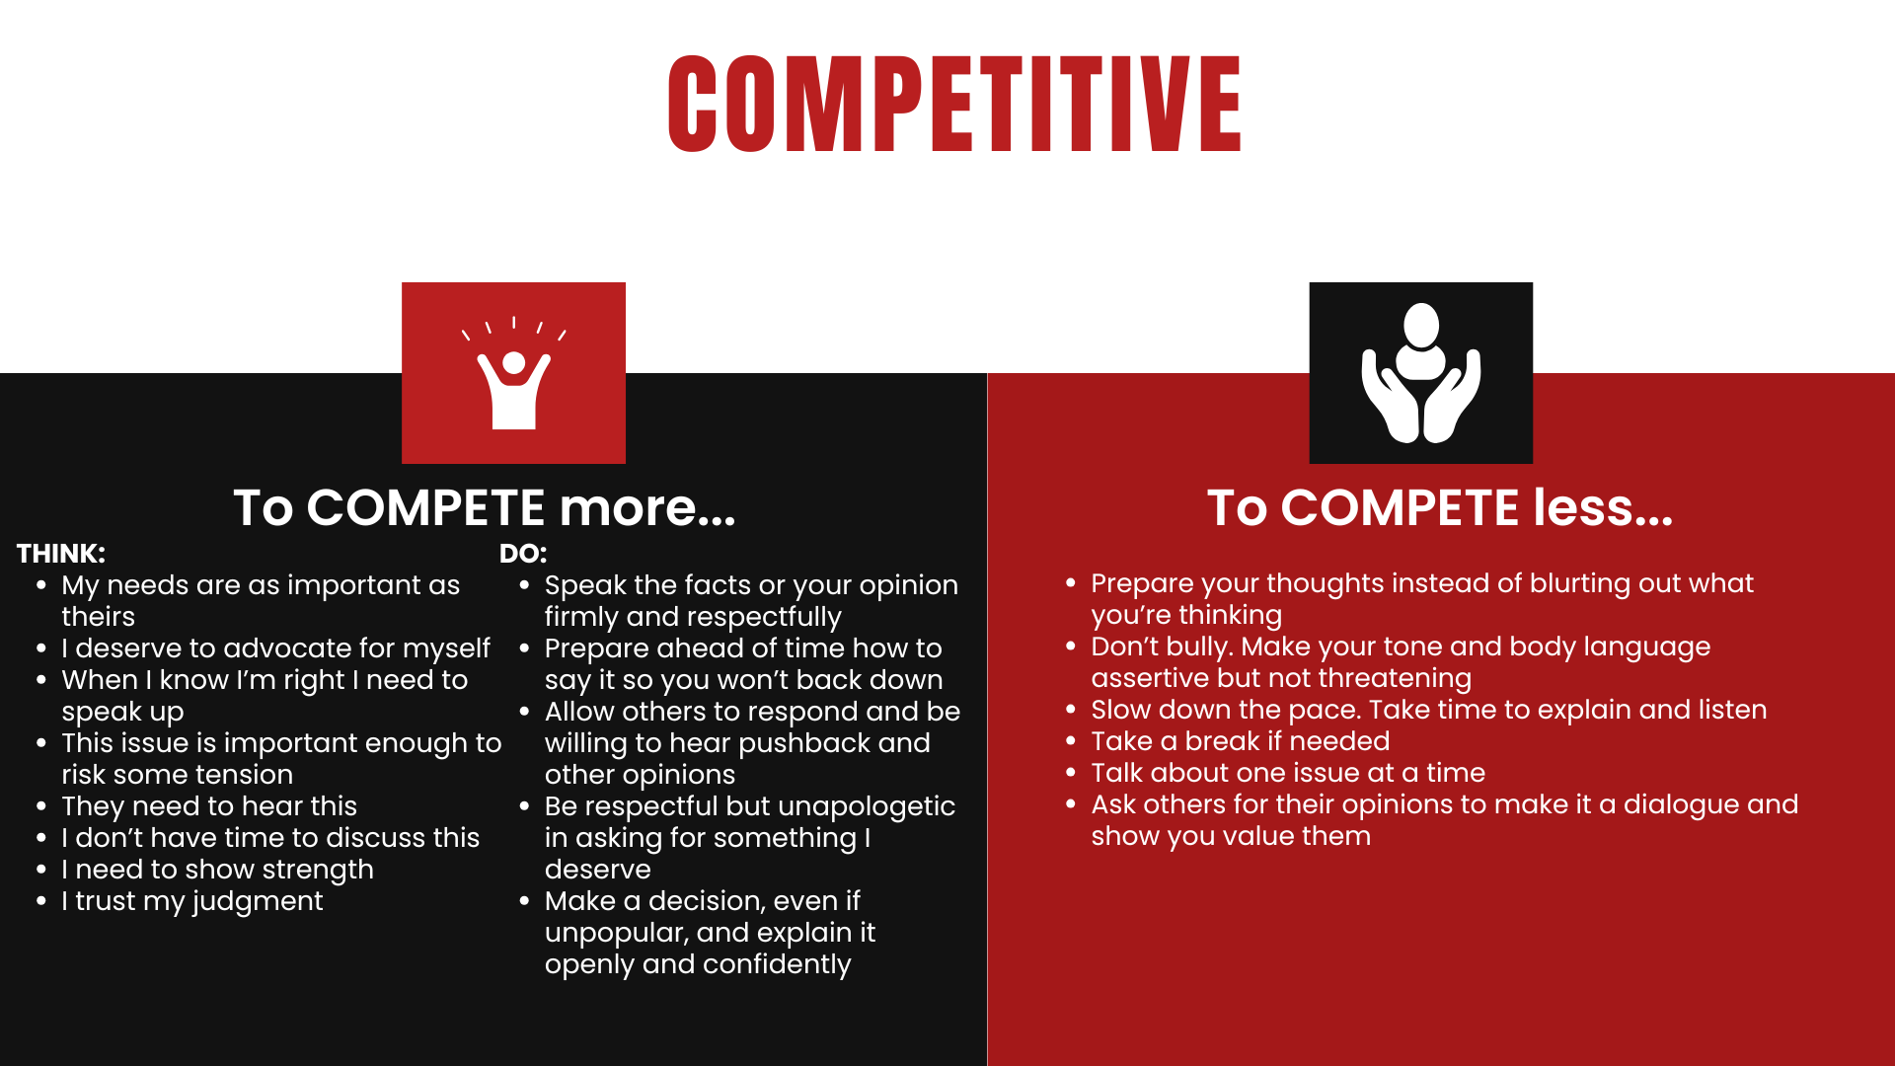

Slide 15
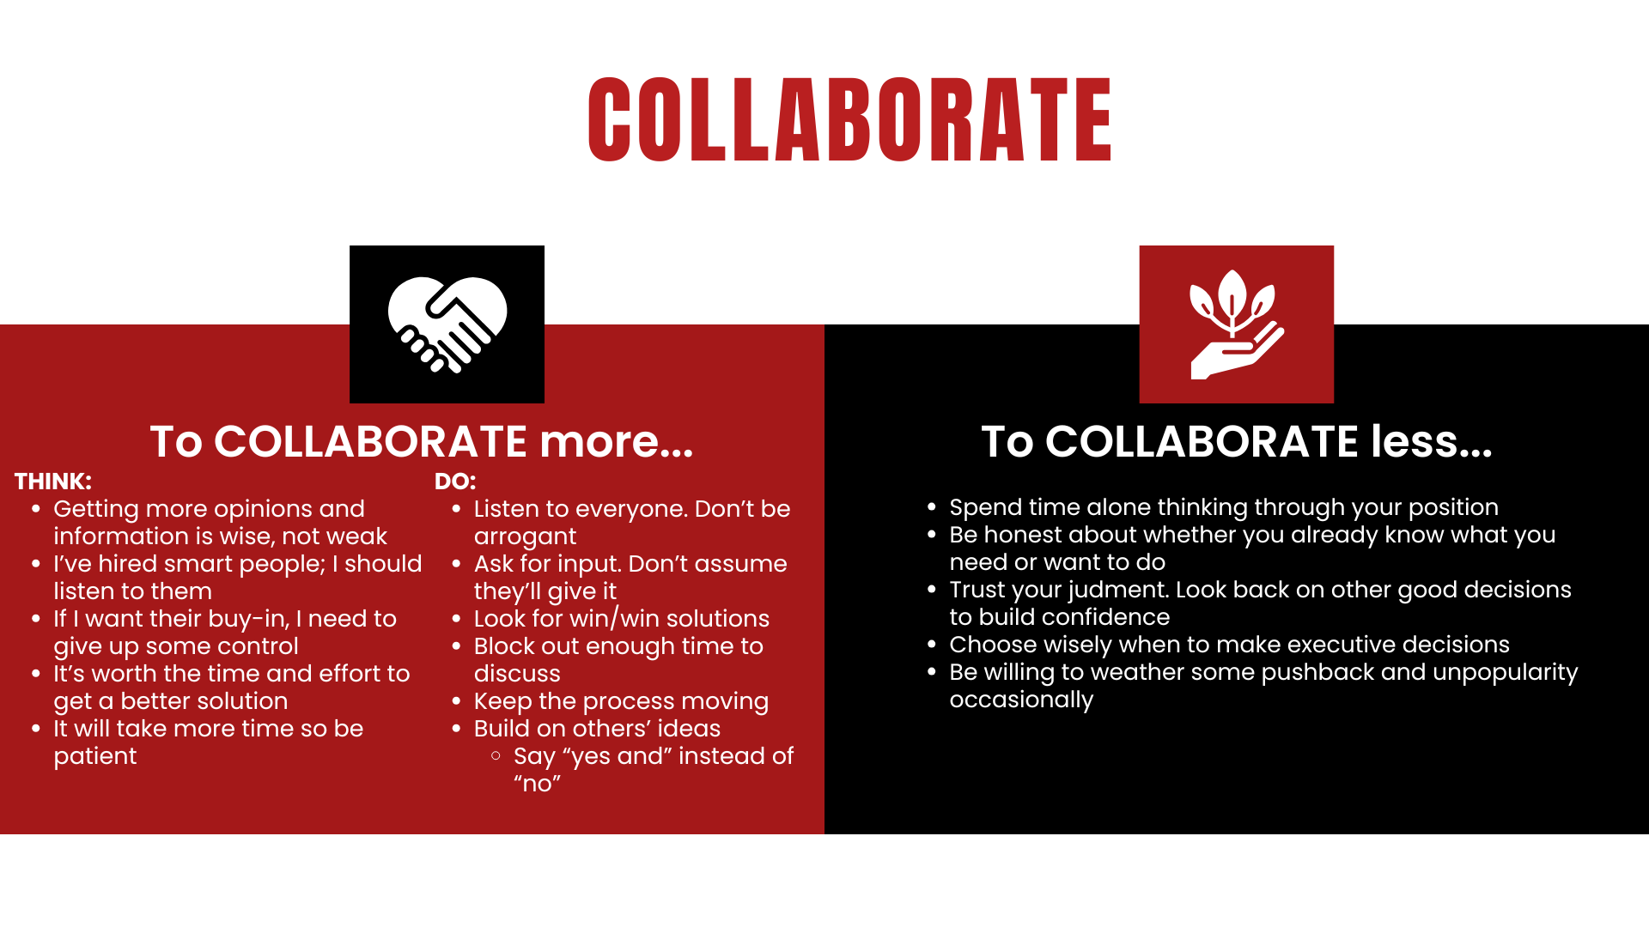
Presentation adapted from Dr. Cummings, U of U, David Eccles School of Business

Slide 16
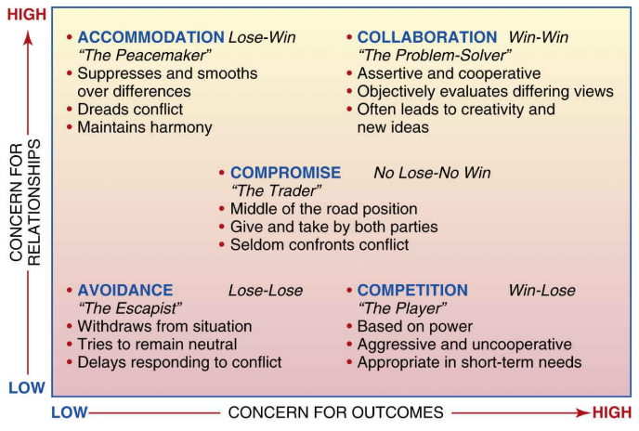
Notes:
Time: 5 min
Presenter Notes: Conflict Resolution Quadrants - pull this up as a reference for the next several slides.
Walk the participants through this model so they are familiar.

Slide 17
Conundrums
How do you view the issue of having teachers be in more than one PLC?
  Meeting once a week only allows for problem solving in one subject area.
  Meeting once a week only allows for problem solving in one standard in one subject area at a time. Work through entire cycle, more about standard than subject area.
  Thoughts? Agree? Disagree?
Notes:
Start with process then move to product.
Finesse by principal recognizing the need for buy-in

Slide 18
Conundrums
How is the subject determined? How are the standards determined?
Principal?
Teachers?
Leadership Team?
Continuous Improvement Plan?
DLI - Nuances of shared standards or not
Notes:
Start with process then move to product.
Finesse by principal recognizing the need for buy-in

