Slide 1
CHAMPIONS
LEAGUE

Slide 2
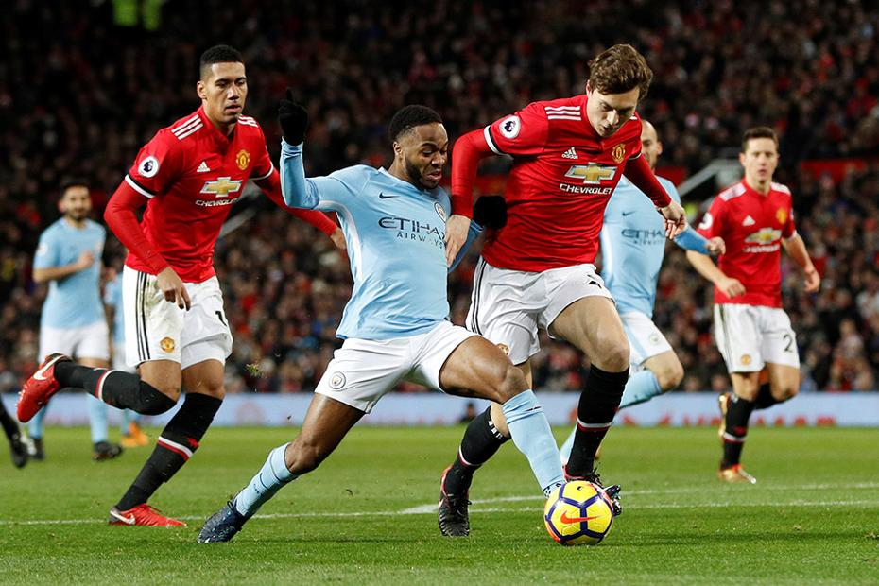
CHAMPIONS LEAGUE
The UEFA Champions League is an annual club football competition organized by the Union of European Football Associations (UEFA). It is one of the most prestigious club competitions in the world and is open to the champion clubs of all UEFA member associations.
The competition was first held in 1955, and since then it has grown in popularity, with some of the biggest and most successful clubs in the world competing for the title each year. The Champions League features a group stage, followed by knockout rounds, with the winner being crowned the champion of Europe.
The Champions League is watched by millions of fans worldwide and is renowned for its high level of competitiveness and excitement. The tournament is also known for its iconic theme music and for being a platform for some of the greatest players and teams in the history of football.

Slide 3
HISTORY
1955 - 1992
1993 - 1997
The European Champion Clubs' Cup, as the Champions League was originally known, was launched in 1955 with just 16 teams competing for the title. The competition grew steadily in popularity over the next few decades, with the number of teams gradually increasing.
The Champions League underwent a major overhaul in the early 1990s, with the introduction of a group stage and a knockout format, as well as changes to the seeding and qualification process. This helped to create a more competitive and exciting tournament and helped to establish the Champions League as one of the top club competitions in the world.
2001 - Present
1998 - 2000
The Champions League has continued to evolve and grow in popularity, with new teams and players emerging and new challenges being faced. Despite the challenges posed by the COVID-19 pandemic, the Champions League remains one of the top club competitions in the world, watched by millions of fans around the globe.
The Champions League reached new heights of popularity in the late 1990s and early 2000s, with the introduction of high-profile sponsors and the growth of television coverage. Some of the greatest teams in the history of the sport, such as Real Madrid, Manchester United, and Bayern Munich, dominated the competition during this period.

Slide 4

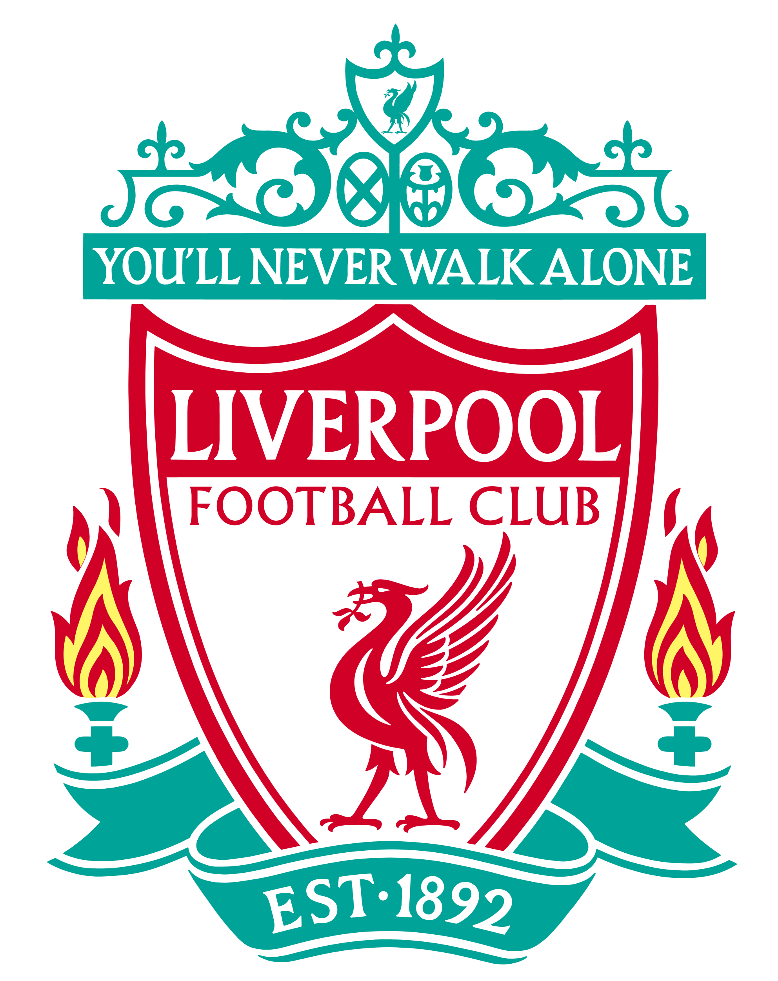
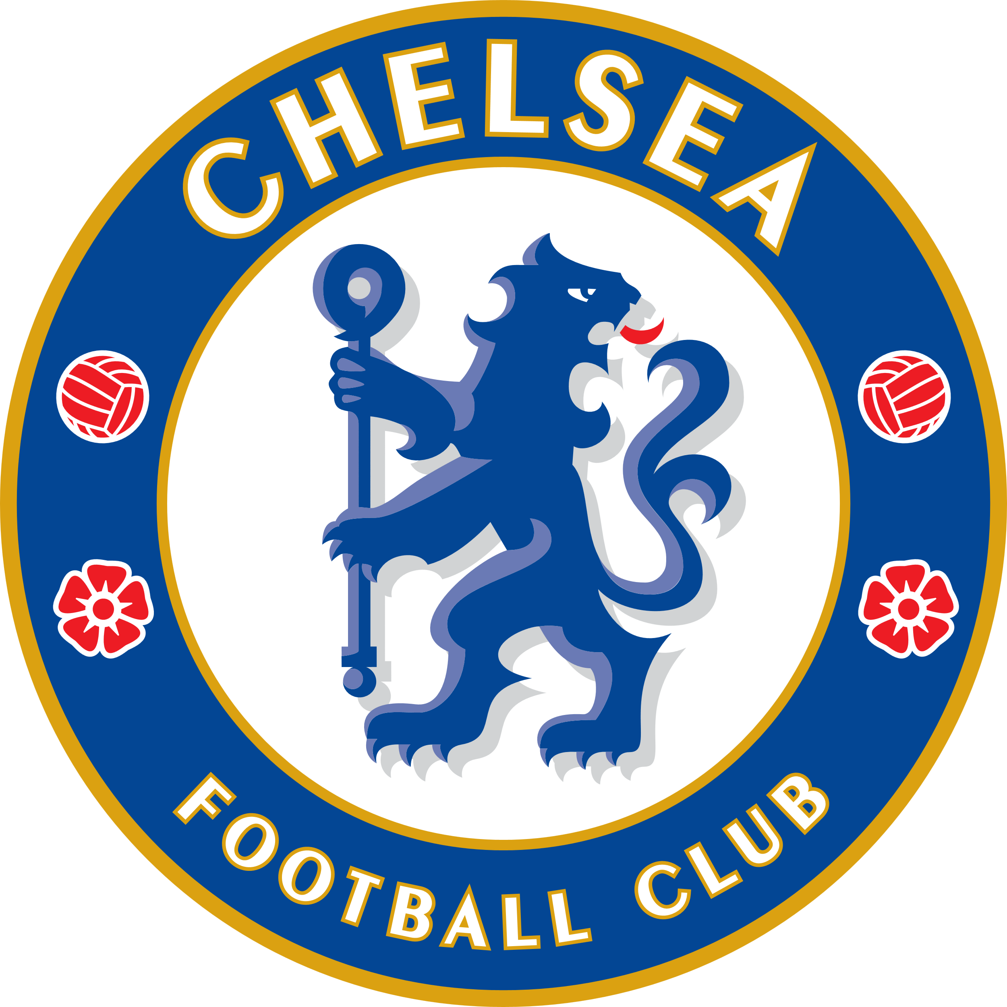



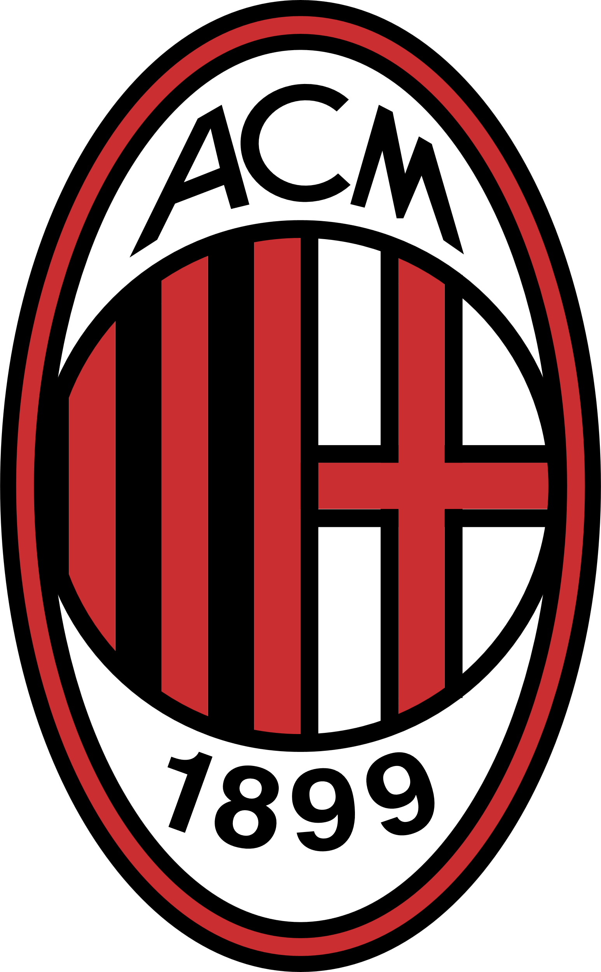

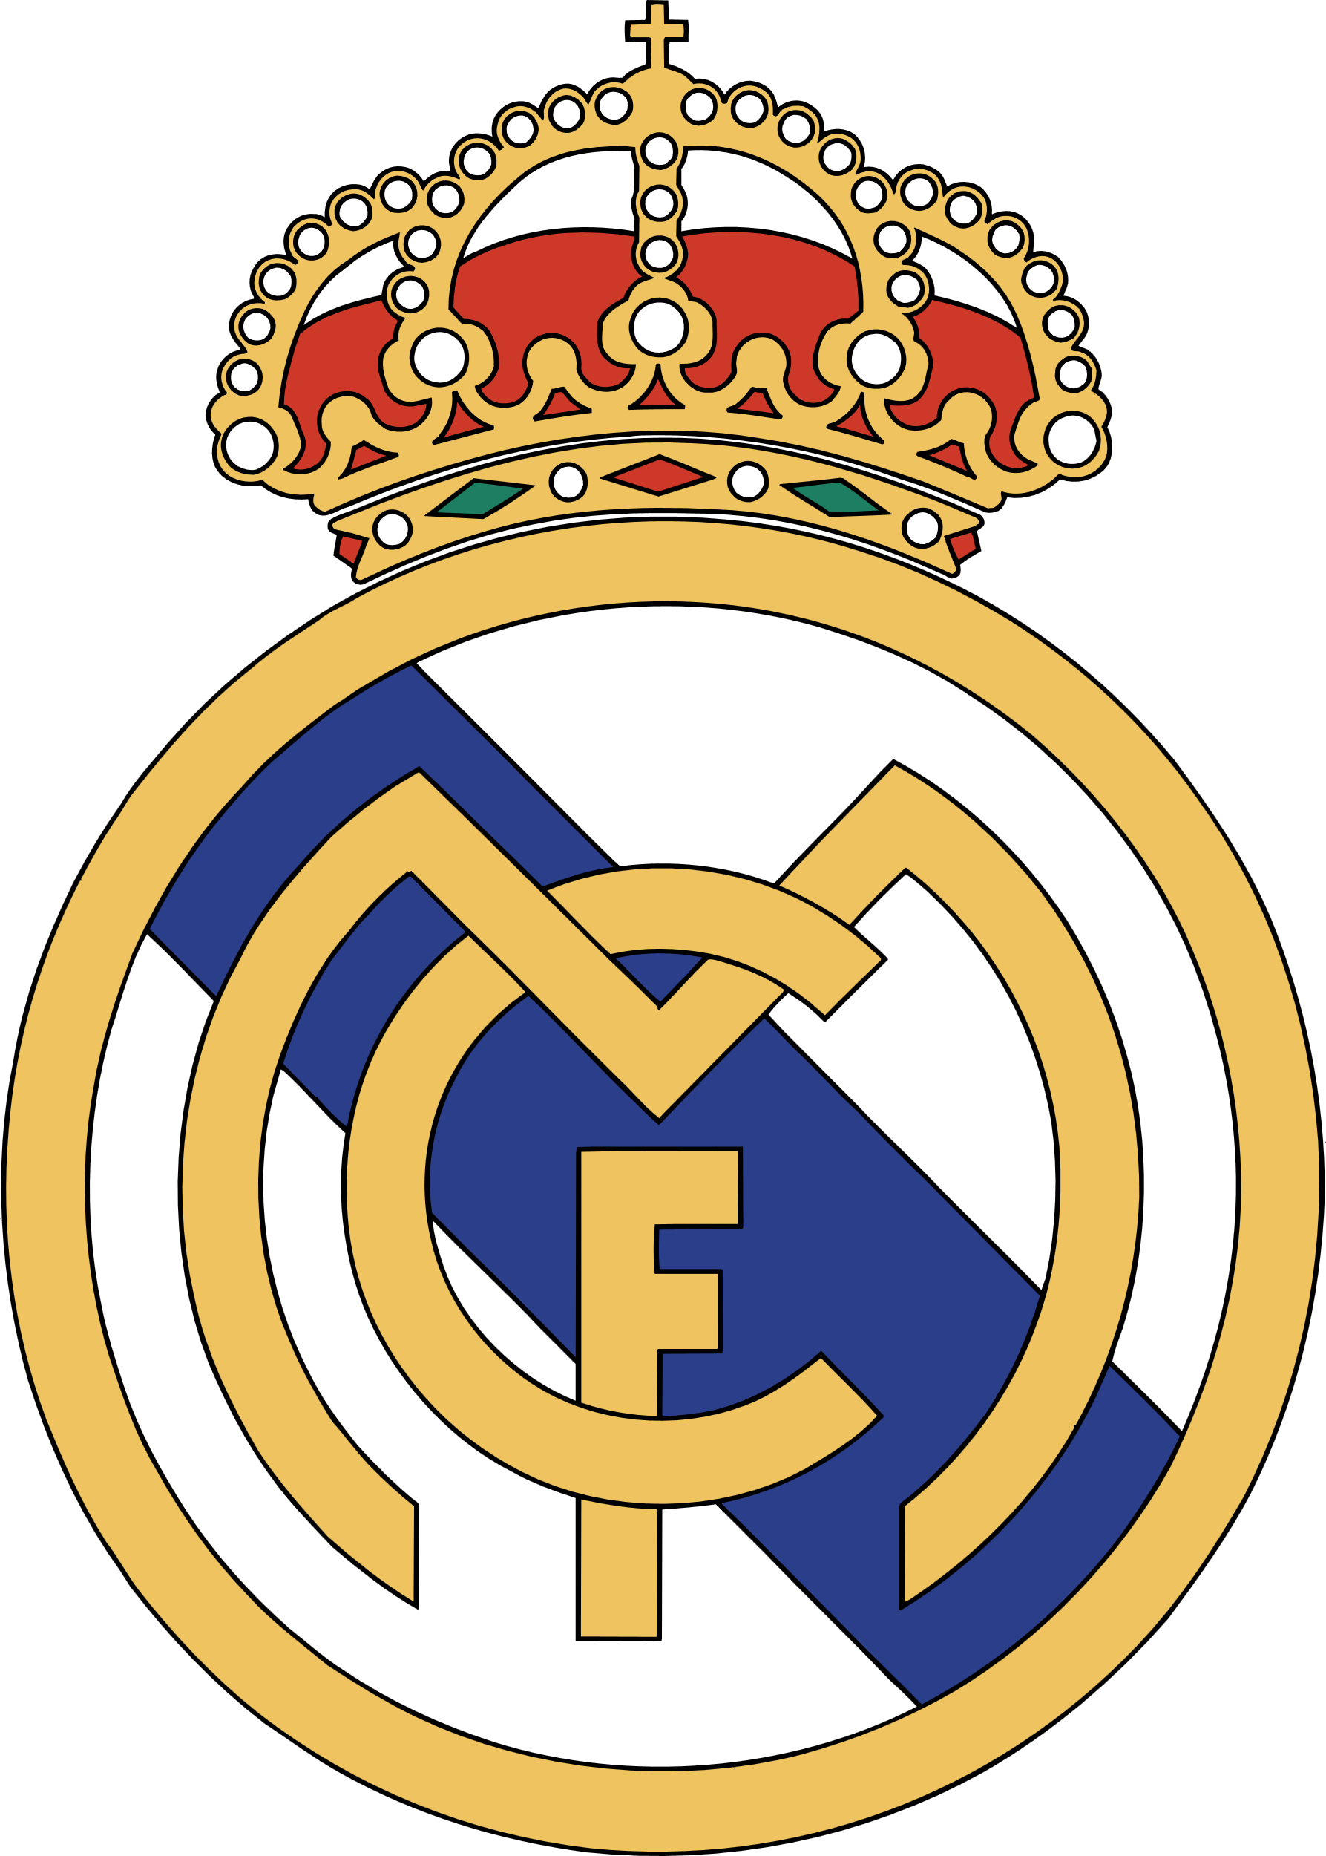
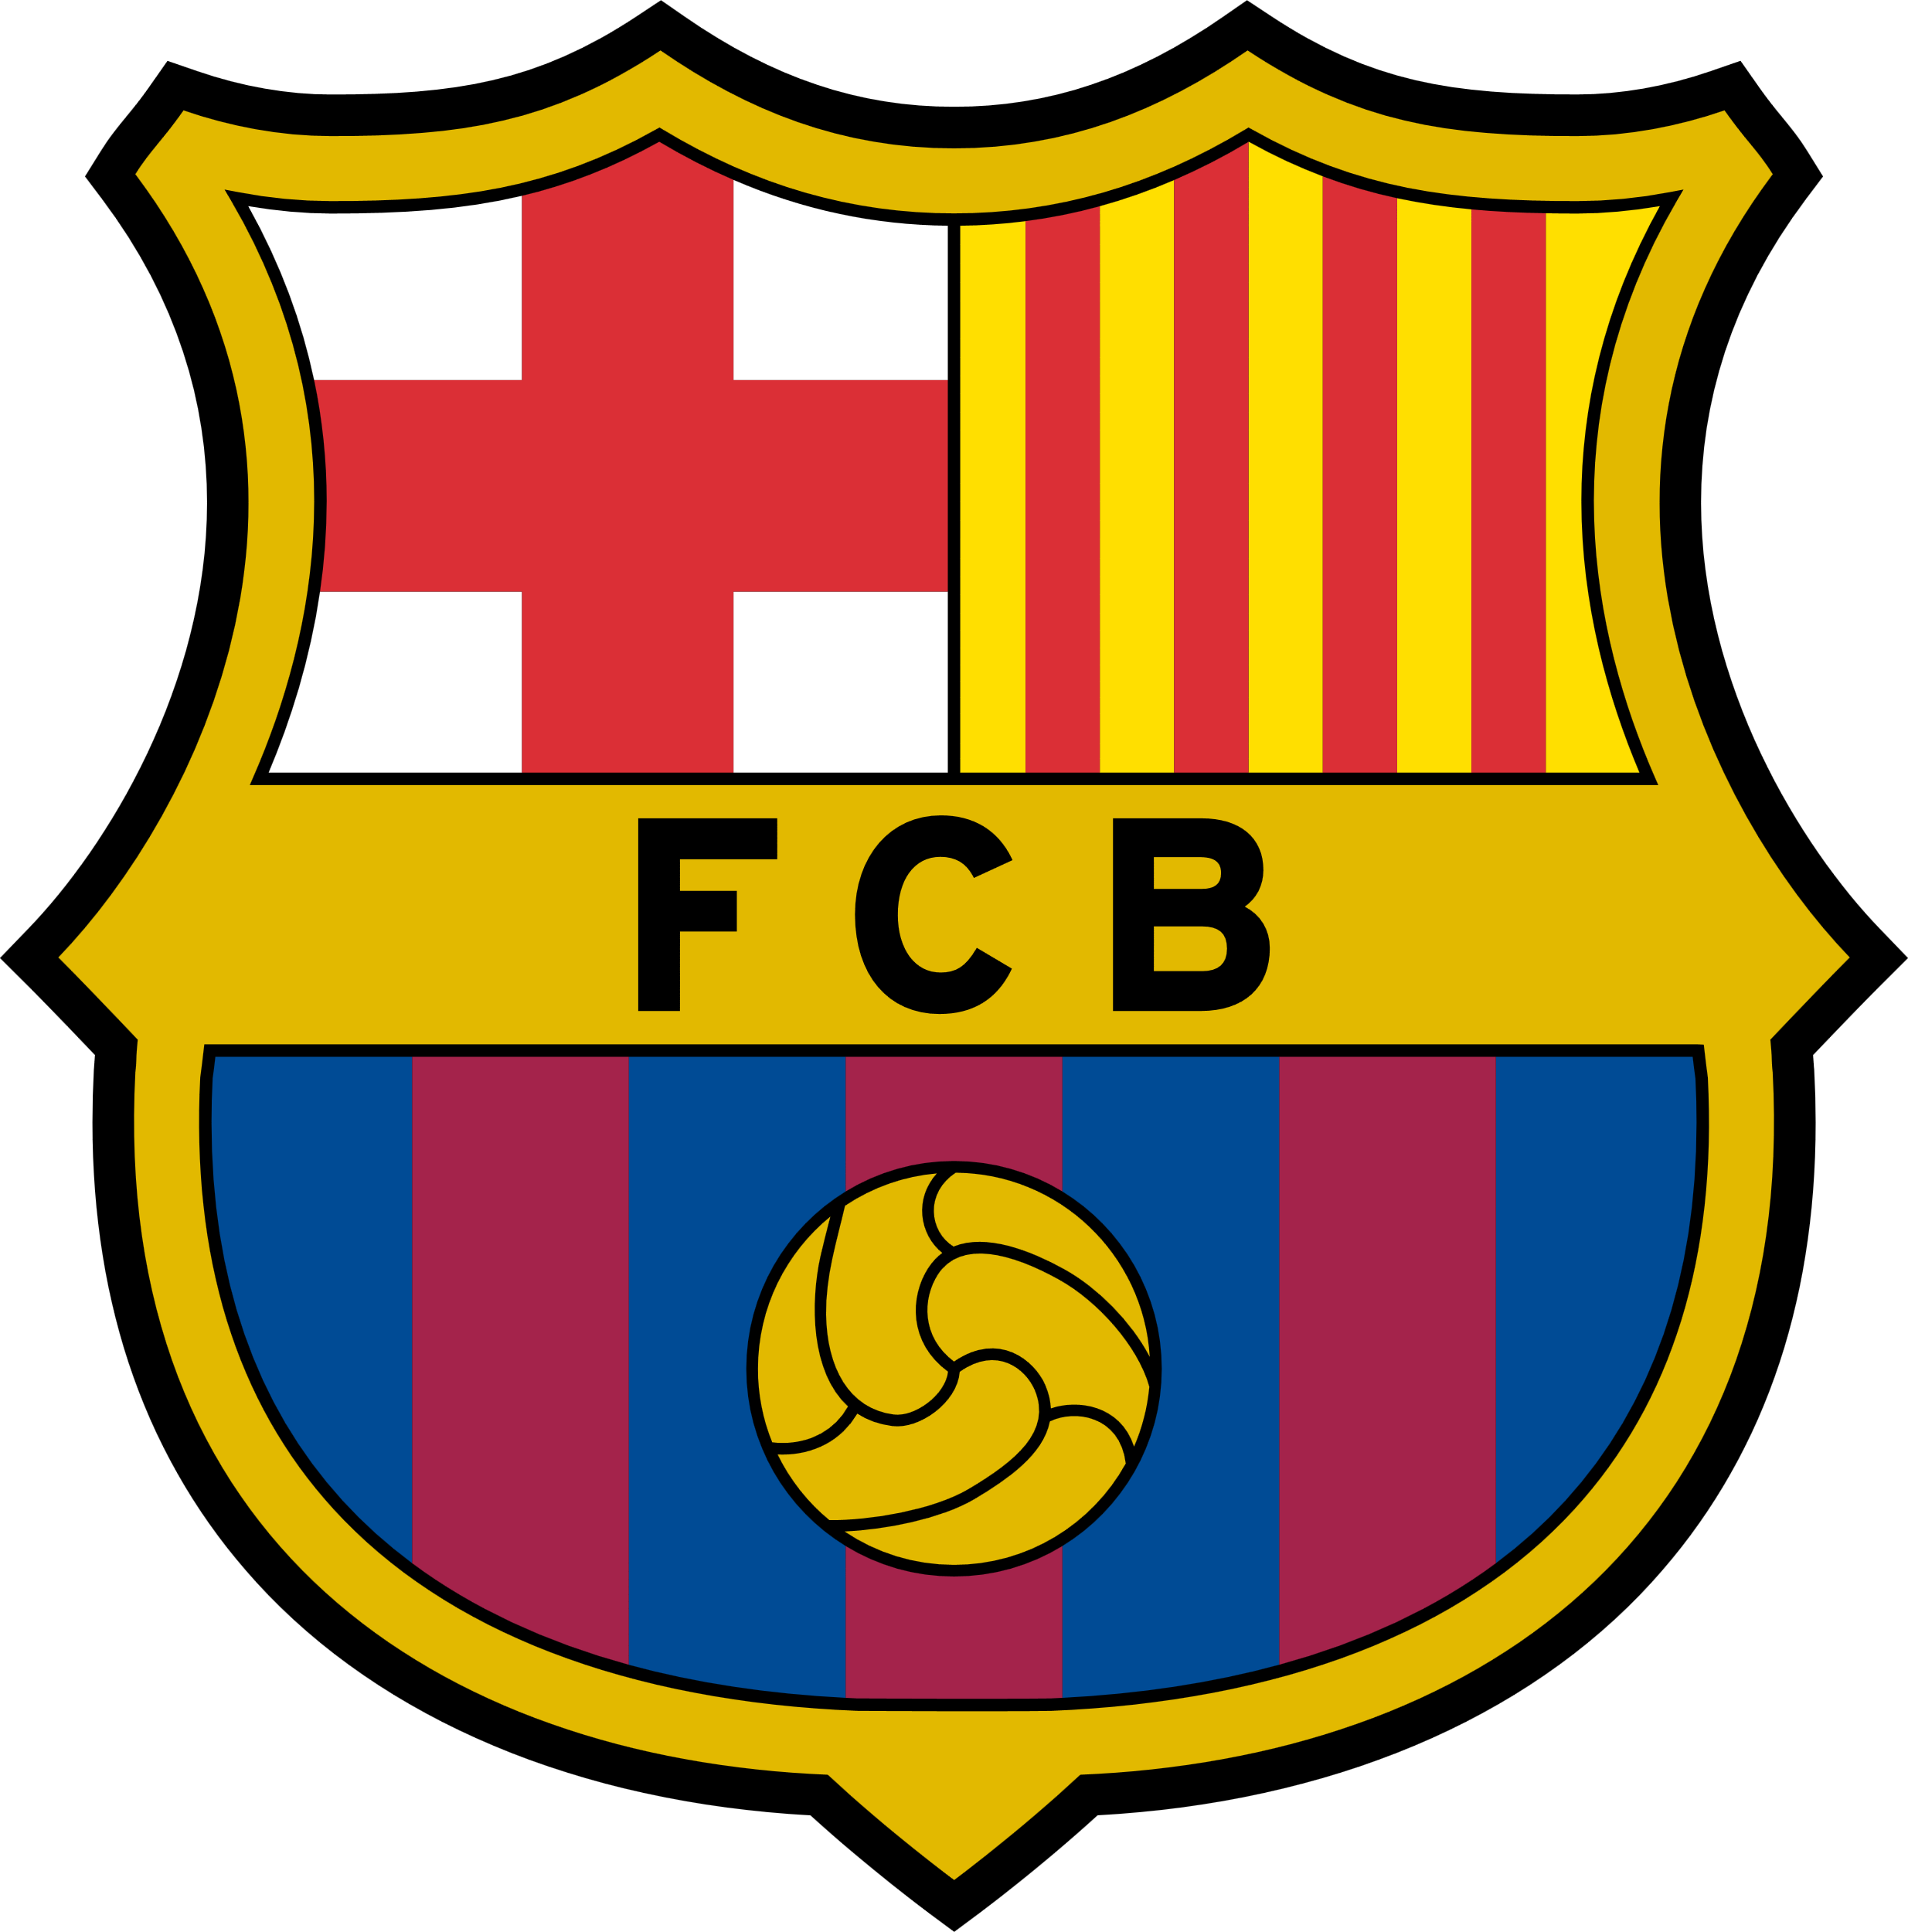

TEAM LOCATIONS
The UEFA Champions League is a European club football competition that features teams from various countries. Some of the countries that regularly have teams participating in the Champions League include:
Spain :
Barcelona, Real Madrid, and Atletico Madrid
England :
Manchester United, Liverpool, and Chelsea
Italy :
Juventus, AC Milan, and Inter Milan
Germany :
Bayern Munich, Borussia Dortmund, and RB Leipzig
France :
Paris Saint-Germain, Olympique Marseille, and AS Monaco

Slide 5
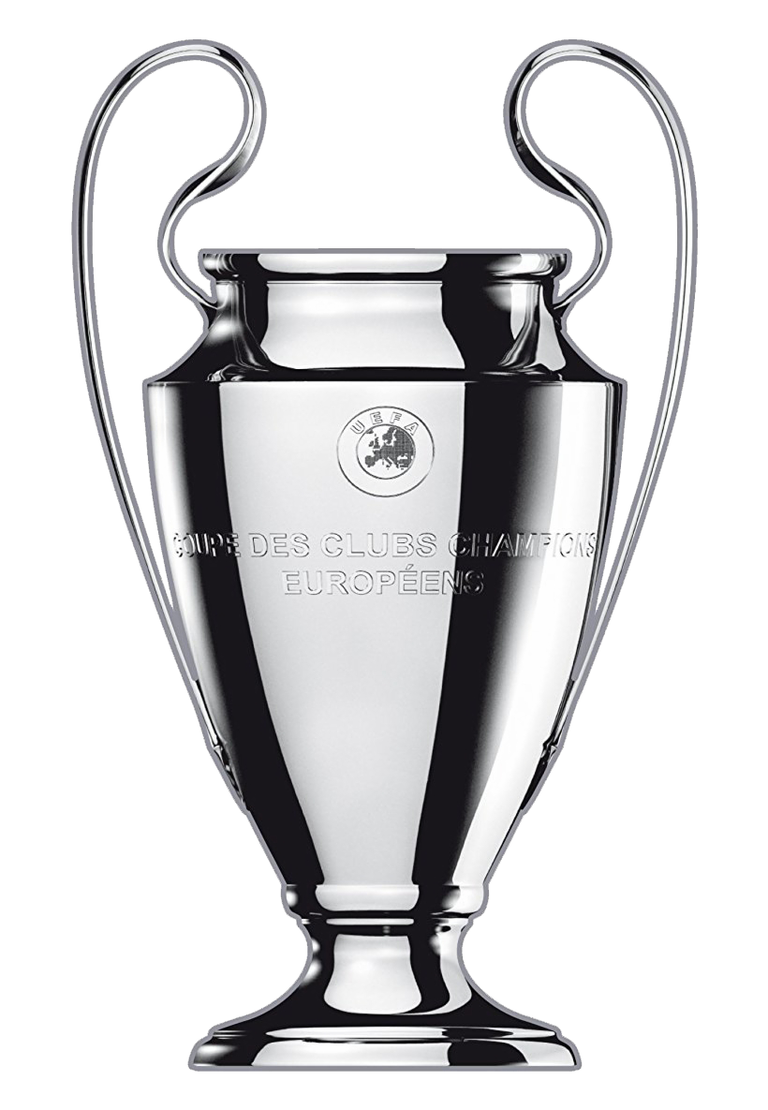
CHAMPIONS LEAGUE TROPHY
The Champion's League trophy is a silver trophy awarded annually to the winner of the UEFA Champions League, the most prestigious club football competition in Europe. The trophy was introduced in the 1967-68 season and has been awarded to the winner of the competition every year since.
The trophy stands at 60 cm tall and weighs 7.5 kg and is made of sterling silver. It features a hexagonal base with a malachite ring, with the names of the winning teams and the year they won the competition engraved on it. The trophy is also adorned with a representation of Nike, the Greek goddess of victory, holding a cup above her head.
Winning the Champions League trophy is considered one of the greatest achievements in club football, and the competition is widely regarded as the pinnacle of the sport. The trophy is a symbol of excellence, and winning it is a coveted prize for the top clubs in Europe.
Overall, the Champions League trophy is an iconic symbol of one of the greatest club football competitions in the world, and a symbol of the passion, skill, and dedication of the players and teams who compete for it.

Slide 6
CHAMPIONS LEAGUE WINNERS
A total of 22 clubs have won the Champions League/European Cup. Real Madrid hold the record for the most victories, having won the competition fourteen times, including the inaugural edition. They have also won the competition the most consecutive times, with five straight titles from 1956 to 1960. Juventus have been runners-up the most times, losing seven finals
2011
2012
2013
2014
2015
2016
2017
2018
2019
2020
2021
2022

Slide 7
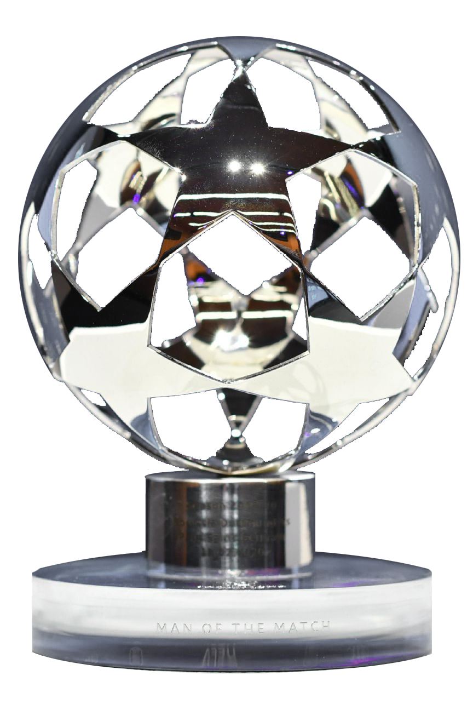
MAN OF THE MATCH
The Champions League Man of the Match trophy is awarded to the player who has been deemed to have made the greatest impact in a Champions League match. The award is presented to the recipient after the match and is considered a great honor by players and fans alike.
The Man of the Match trophy is designed to celebrate and recognize individual performance, and is a way of acknowledging the skill, effort, and commitment of the players who take to the field in the Champions League. The recipient is selected by a panel of experts, who evaluate the players' performances based on a range of criteria, including goals scored, assists provided, defensive contributions, and overall impact on the game.
Winning the Man of the Match trophy is a significant accomplishment for a player and is a testament to their individual ability and impact on the game. It is also a recognition of their contribution to their team's success in the Champions League and reflects their impact on the competition.

Slide 8


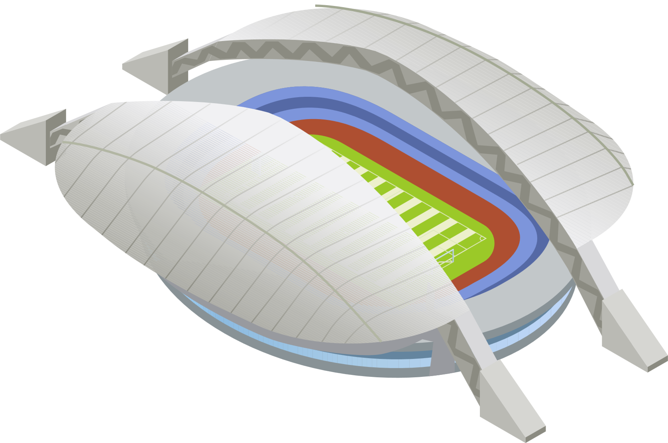
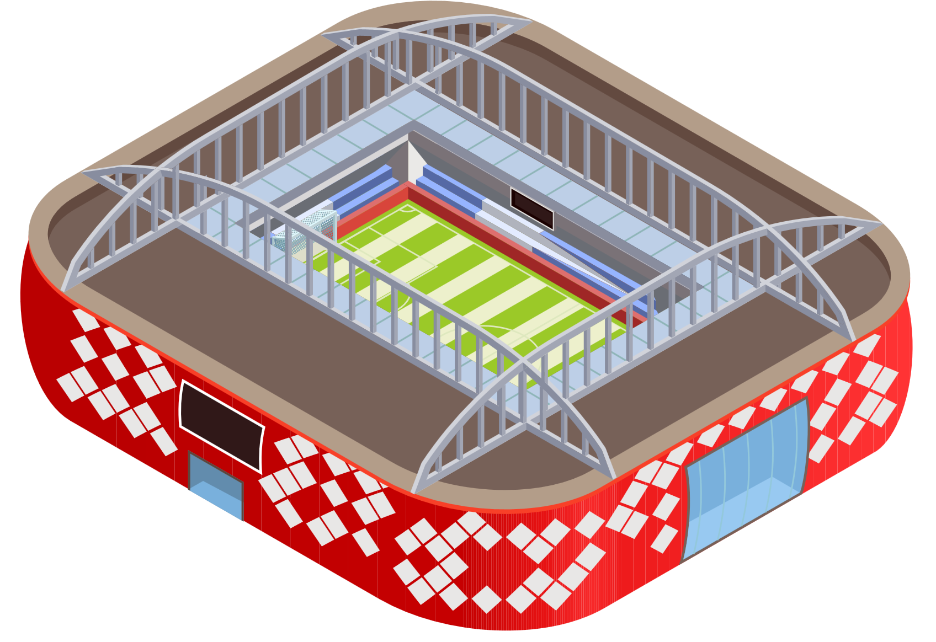
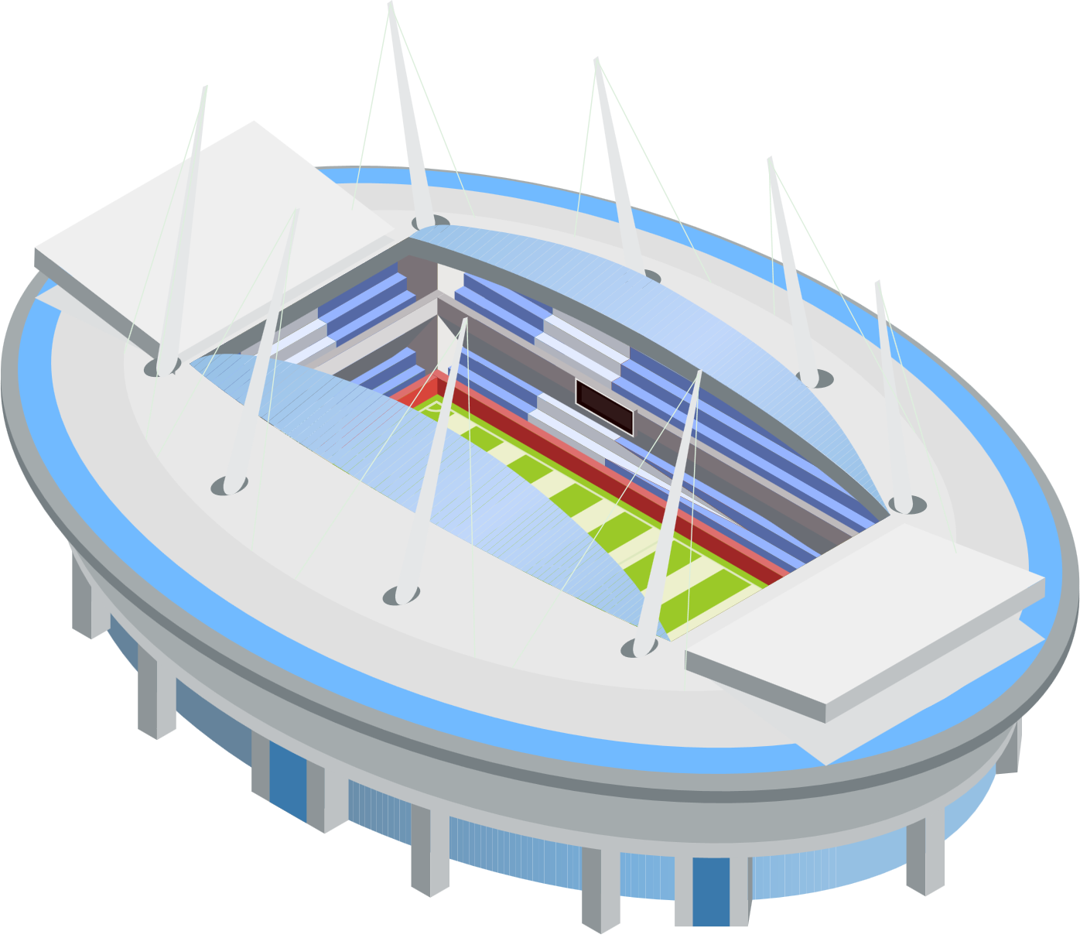
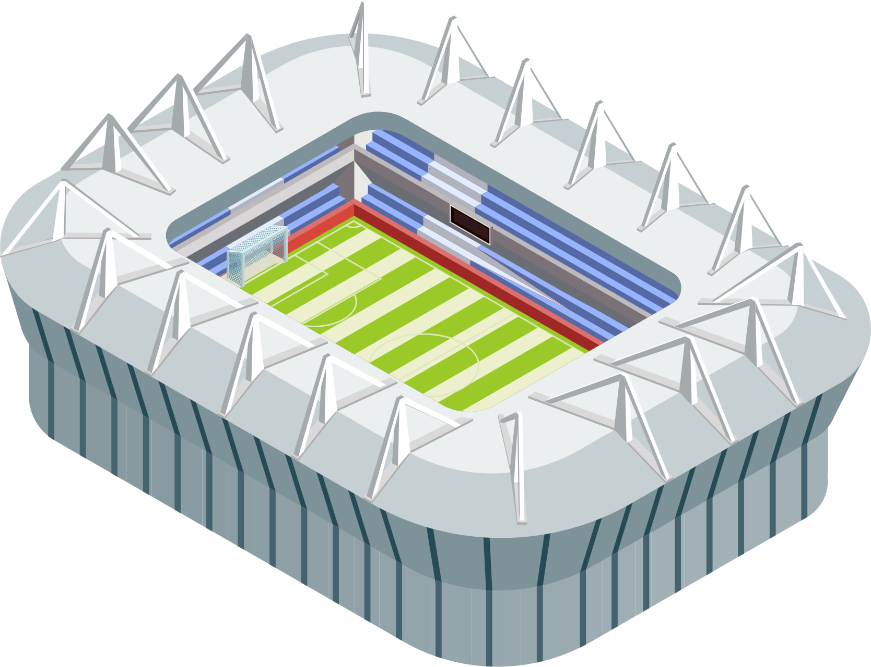
CHAMPIONS LEAGUE TROPHY
A stadium must be rated as category four in order to host games in the playoffs of the qualifying stage for the UEFA Champions League, or any game in the main competition. Category four is also required to host any game in the main competition of the UEFA Europa League, UEFA Europa Conference League, UEFA Nations League or the UEFA European Championship final tournament.
Stade de France
Wembley Stadium
Metropolitano Stadium
France - 80,698
England - 90,000
Spain - 68,456
San Siro
Allianz Arena
Atatürk Olympic Stadium
Italy - 80,018
Germany - 75,024
Turkey - 74,753

Slide 9
MAJOR TEAMS
The UEFA Champions League is a European club football competition that features many of the best teams from across the continent. Some of the most successful and well-known teams in the competition include:
Paris Saint-Germain
FC Barcelona
Real Madrid CF
PSG is a professional football club based in Paris, France. They compete in Ligue 1, the top division of French football.
Professional football club based in Barcelona, Catalonia, Spain, that competes in La Liga, the top flight of Spanish football.
Spanish professional football club based in Madrid. The club is estimated to be the world's most valuable football team
Manchester United
Chelsea F.C.
FC Bayern Munich
Professional football club based in England. The club competes in the Premier League, the top division in the English football league.
An English professional football club based in West London. The club competes in the Premier League, the top division of English football
German professional sports club based in Bavaria. Bayern is the most successful club in German football history

Slide 10
FEW FACTS ON CHAMPIONS LEAGUE
Real Madrid bagged majority of the wins
Ever since its inception in 1955, only 22 football clubs have managed to win the Champions League, out which Real Madrid won the cup 14 times, making it the highest number of wins in the Champions League.
Champions League is supported by UEFA foundation for children
The UEFA foundation for children is a unanimous foundation that brings the art of football to kids from across the world.
English clubs have managed to win five cups
The Champions League is dominated by the English clubs, snagging wins after wins. Around five English clubs have managed to win the Champions League.
The fastest goal in the tournament happened in the first 11 seconds
Roy Makaay, a popular footballer from Bayern Munich, managed to create this record, scoring the match's first goal within the first 11 seconds against Real madrid.

Slide 11







UEFA OFFICIAL SPONSORS AND PARTNERS
UEFA, the governing body of European football, has several official sponsors and partners. Here are some of the main sponsors of UEFA as of my knowledge cut-off in 2021:

Slide 12
SCHEDULE
The schedule of the competition is as follows. All matches are played on Tuesdays and Wednesdays apart from the preliminary round final and the final.
Phase | Round | Draw Date | First leg | Second Leg
Qualifying | Preliminary round | 13 June 2023 | 27 June 2023 (semi-finals) | 30 June 2023 (final)
 | First qualifying round | 20 June 2023 | 11–12 July 2023 | 18–19 July 2023
 | Second qualifying round | 21 June 2023 | 25–26 July 2023 | 1–2 August 2023
 | Third qualifying round | 24 July 2023 | 8–9 August 2023 | 15 August 2023
Play-offs | Play-off round | 7 August 2023 | 22–23 August 2023 | 29–30 August 2023
Group Stage | Matchday 1 | 31 August 2023 | 19–20 September 2023
 | Matchday 2 |  | 3–4 October 2023
 | Matchday 3 |  | 24–25 October 2023
 | Matchday 4 |  | 7–8 November 2023
 | Matchday 5 |  | 28–29 November 2023
 | Matchday 6 |  | 12–13 December 2023
Knockout phase | Round of 16 | 18 December 2023 | 3–14 & 20–21 February 2024 | 5–6 & 12–13 March 2024
 | Quarter-finals | 15 March 2024 | 9–10 April 2024 | 16–17 April 2024
 | Semi-finals |  | 30 April – 1 May 2024 | 7–8 May 2024
 | Final |  | 1 June 2024 at Wembley Stadium, London

Slide 13
ASSOCIATION RANKING
In European football, the UEFA coefficients are statistics based in weighted arithmetic means used for ranking and seeding teams in club and international competitions. Introduced in 1979 for men's football tournaments, and after applied in women's football and futsal, the coefficients are calculated by UEFA,
Rank
Association
Coeff.
Teams
Rank
Association
Coeff.
Teams
1
England
106.641
4
9
Scotland
36.900
2
2
Spain
96.141
4
10
Russia
34.482
0
3
Italy
76.902
4
11
Serbia
33.375
2
4
Germany
75.213
4
12
Ukraine
31.800
2
5
France
60.081
3
13
Belgium
30.600
2
6
Portugal
53.382
3
14
Switzerland
29.675
2
7
Netherlands
49.300
2
15
Greece
28.200
2
8
Austria
38.850
2
16
Czech Republic
27.800
1

Slide 14
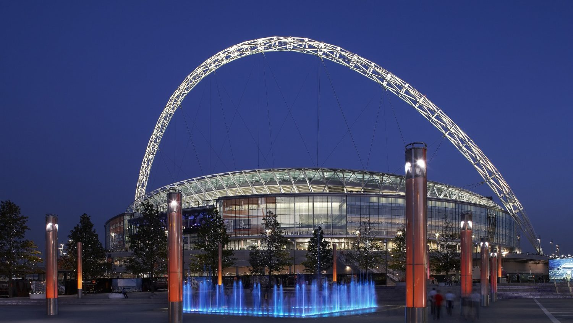
2024 UEFA CHAMPIONS LEAGUE FINAL
The 2024 UEFA Champions League final will be the final match of the 2023–24 UEFA Champions League, the 69th season of Europe's premier club football tournament organized by UEFA, and the 32nd season since it was renamed from the European Champion Clubs' Cup to the UEFA Champions League. It will be played at Wembley Stadium in London, England, on 1 June 2024. Due to the postponement and relocation of the 2020 final, the final hosts were shifted back a year, with London instead hosting the 2024 final.
Record attendance
100,000
Ed Sheeran Concert,
June 2022
Executive suites
Capacity
Field Size
166
90k
105m×68m

Slide 15
THANKS

