Slide 1
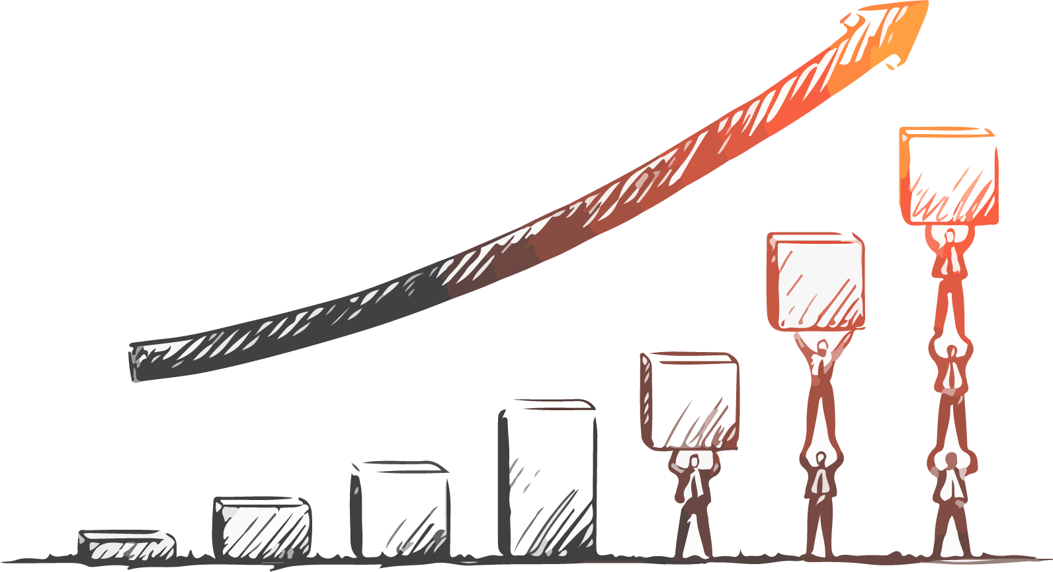
Annual Report Powerpoint Template
www.freepptbackgrounds.net

Slide 2

Contents
Your Agenda
01
Job Completion
02
Achievement
03
Experience
Next Tear's Work Plan
04

Slide 3
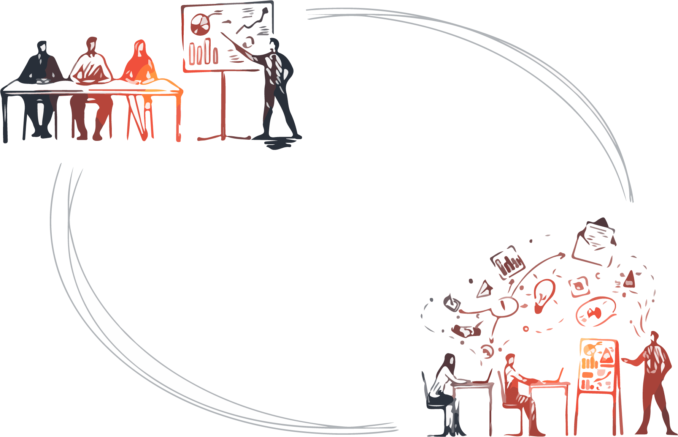

Job Completion
What We Do
Job completion
Click here to add a titleClick here to add a titleClick here to add a titleClick here to add a title

Slide 4
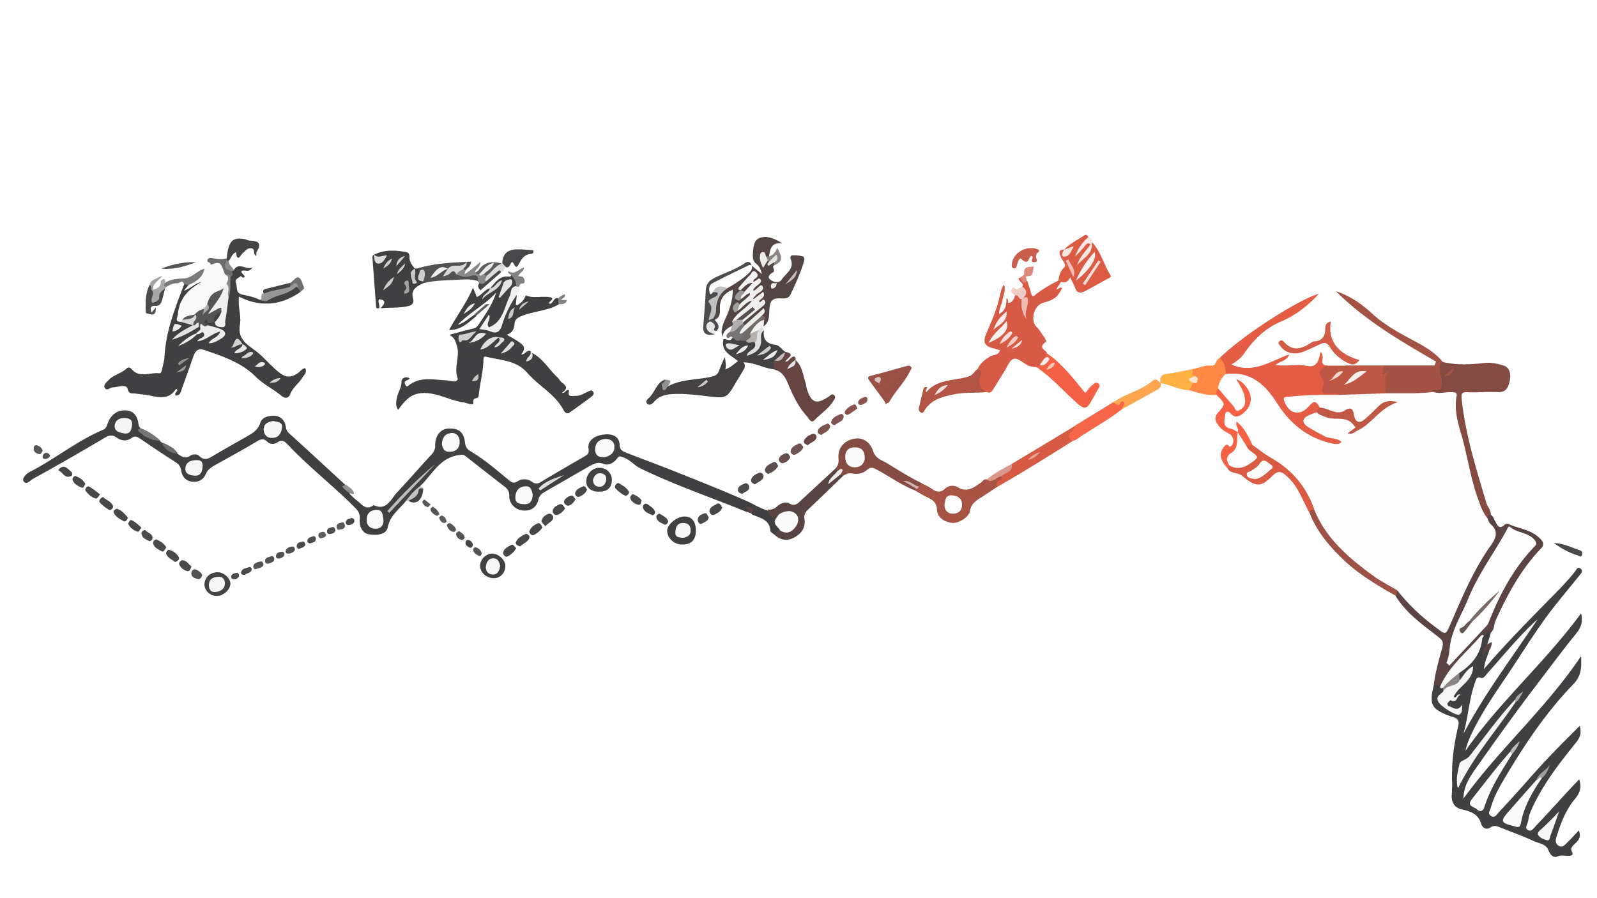

Job Completion
Our Millstone
May
June
July
August
Is the color of gold
Butter and ripe lemons
In the spectrum of visible light
Type your content here

Slide 5



Achievements
01
Plan completed
It is a very sad thing
02
Sales Index
We certainly do not forget
03
Completion
I believe that people

Slide 6

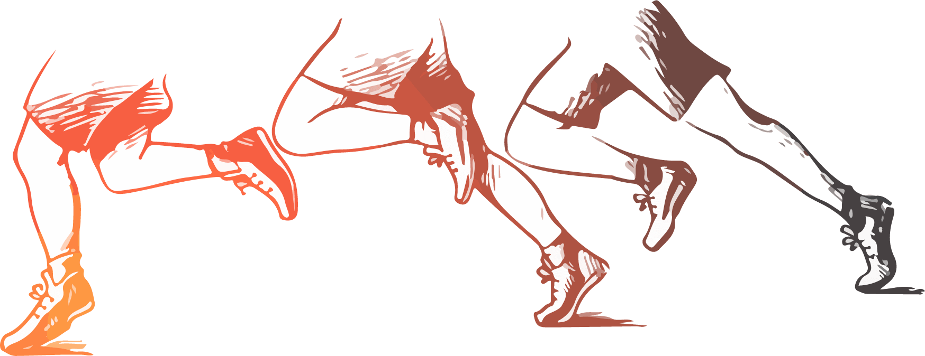
Sales Index
Project sales indicators
Implementation
Enter the comprehensive description of the above chart here Type your content here
I believe that people would be alive today if there were a death penalty.

Slide 7

Completion
Completion
The time is now, the place is here. Stay in the present. You can do nothing to change the past, and the future will never come exactly as you plan

Slide 8
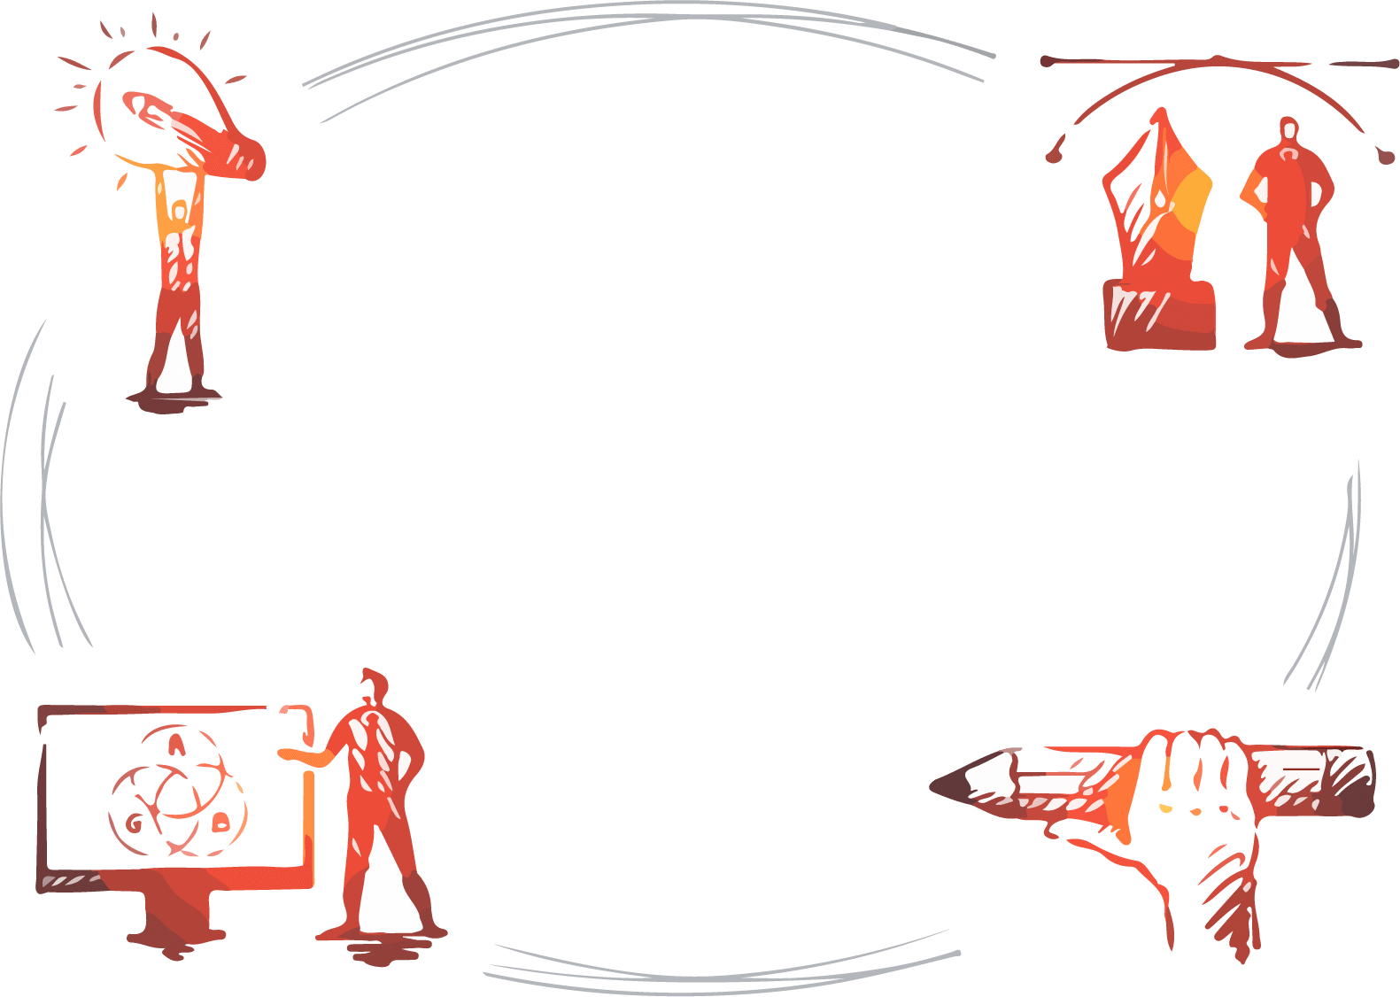
Title Text Content
Grow
İdea
What We Do
Social Media
Drawing

Slide 9
Main Results
2019
When you feel in your gut what
2016
2017
2018
There is only one difference
The time is now, the place is here.
I believe that people would be

Slide 10

Project Completion
01
02
03
04
Briefing
Evaluation
Workshops
Design
Skiing consists of wearing $3,000 worth of clothes
When you feel in your gut what
I'm convinced that about half of what separates
There is only one difference between

Slide 11
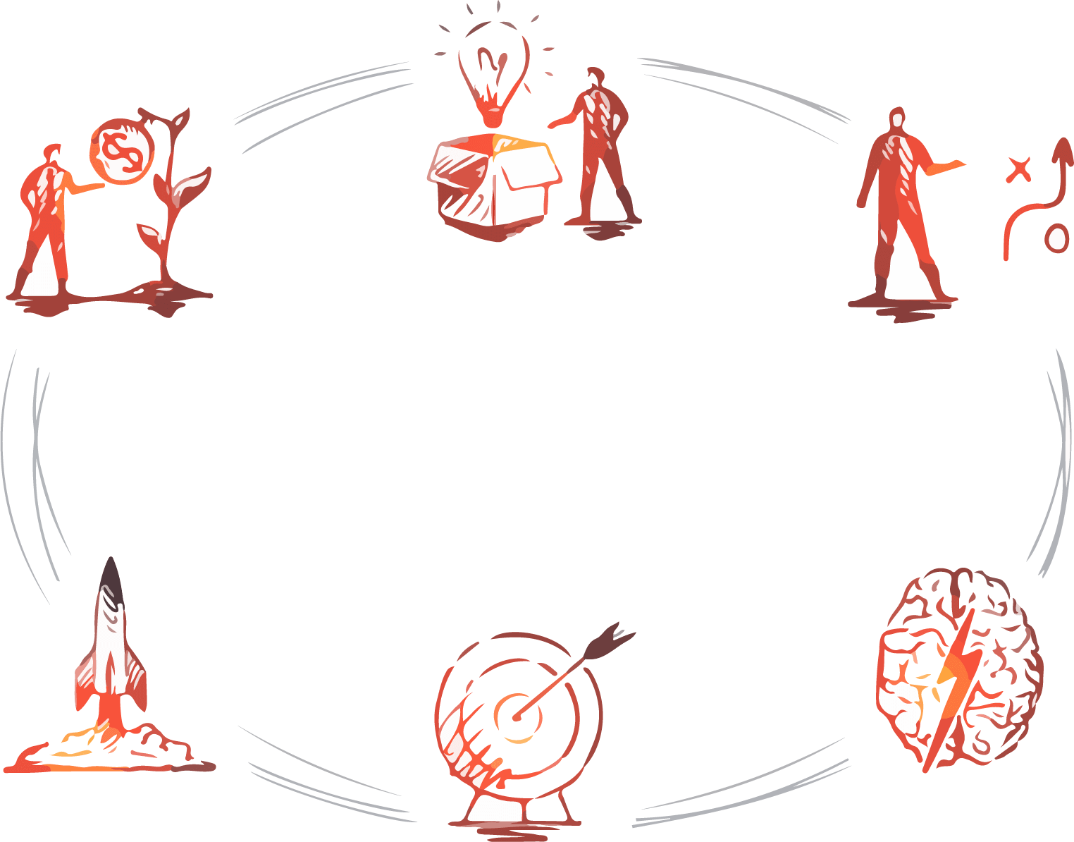
Leadership
Innovation
Teamwork
Experience and Summary
What We Do
Operation
Market
Optimization

Slide 12

Project Completion
E-commerce
Fashion
Energy
Finance
Real Estate
Startup
Arts & Culture
We certainly do not forget you as soon as you forget us. It is, perhaps, our fate rather than our merit. We cannot help ourselves. We live at home, quiet, confined, and our feelings prey upon us. You are forced on exertion. You have always a profession, pursuits, business of some sort or other, to take you back into the world immediately

Slide 13

Mistakes and Problems
Trues
Falses
Add a detailed text description here. It is recommended to be related to the title and conform to the overall language style.
The time is now, the place is here. Stay in the present. You can do nothing to change the past, and the future will never come exactly as you plan or hope for.

Slide 14

Teamwork
Market
Type your content here, or by copying your text
Optimization
Operation
Type your content here, or by copying your text
Where is our way out
Our Business Presentation

Slide 15
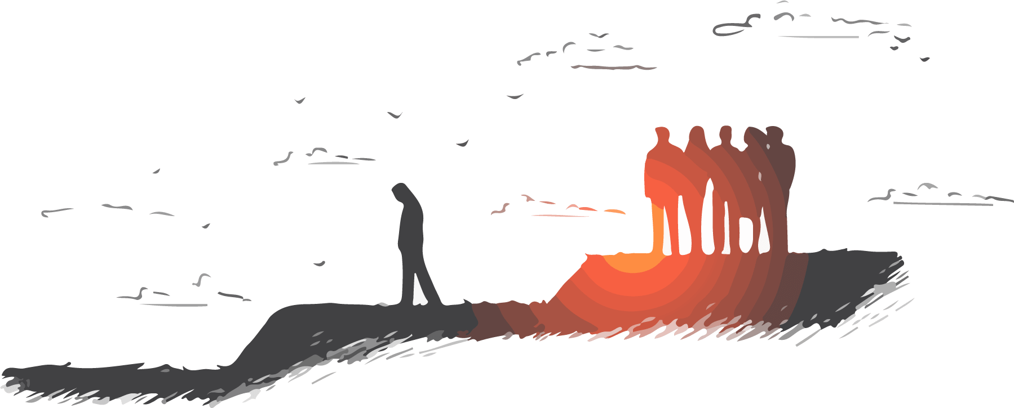

01
02
03
04
Main results
Exquisite
Sales Index
Completion
We certainly do not forget
I feel very strongly that change is good
I believe that people would
Genius hath electric power which earth can never tame.

Slide 16
Experiences and Lessons
Teach
We certainly do not forget you as soon as you forget us. It is, perhaps, our fate rather than our merit. We cannot help ourselves. We live at home, quiet, confined, and our feelings prey upon us. You are forced on exertion. You have always a profession, pursuits, business of some sort or other, to take you back into the world immediately, and continual occupation and change soon weaken impressions. All the privilege I claim for my own sex (it is not a very
Contents
About
Company
Add a detailed text description here. It is recommended to be related to the title and conform to the overall language style

Slide 17
Market
I believe that people would be alive today if there were a death penalty.
Woe be to him that reads but one book.
Dynamic
Title
To see what is in front of one's nose needs a constant struggle.
Completion
There is only one difference between a madman and me. I am not mad.
Operation
Take calculated risks. That is quite different from being rash.

Slide 18

Solution
Educate
Market
Service
Content
Internet

Slide 19

New Project Incubation
Educate
Woe be to him that reads but one book.
Key words
Woe be to him that reads but one book.

Slide 20
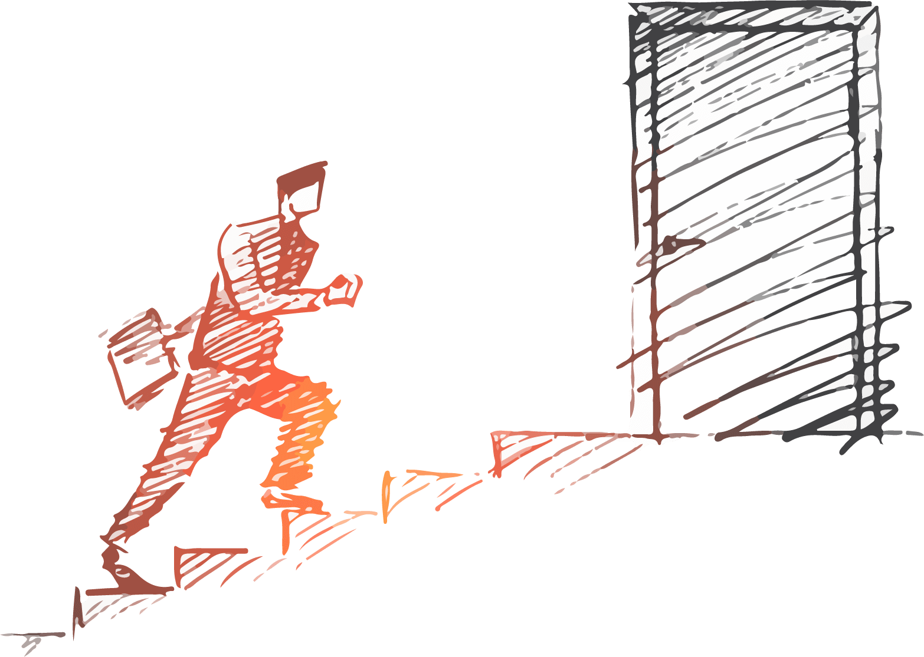

Project Analysis
What you plan to do
Enterprise honor
There is only one difference between a madman and me. I am not mad.
I'm convinced that about half of what separates the successful entrepreneurs from the non-successful ones is pure perseverance.

Slide 21
Team Building
01
Completion
Group
Fit
Make
Take calculated risks
Team
02
Achievements
To see what is in front
03
Main results
A torn jacket is soon

Slide 22

Market Analysis
Market
There is only one difference between a madman and me. I am not mad.
Service
Content
That is quite different from being rash.
Take calculated risks.

Slide 23

Teamwork
Teamwork
There is only one difference between a madman and me. I am not mad.
01
02
03
04

Slide 24
Company Team
2019
2020
Educate
Job completion
When you feel in your gut what you are and then dynamically pursue it - don't back down and don't give up - then you're going to mystify a lot of folks.
I'm convinced that about half of what separates the successful entrepreneurs from the non-successful ones is pure perseverance.

Slide 25
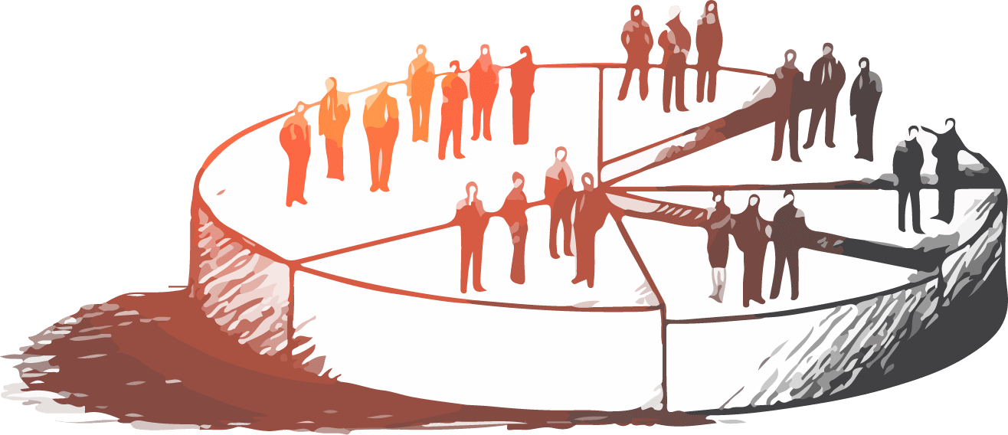
Market Target
Marketing
Woe be to him that reads but one book.
Strategy
To see what is in front of one's nose needs a constant struggle.
Marketing
Strategy
A large income is the best recipe for happiness I ever heard of.
Genius hath electric power which earth can never tame.

Slide 26
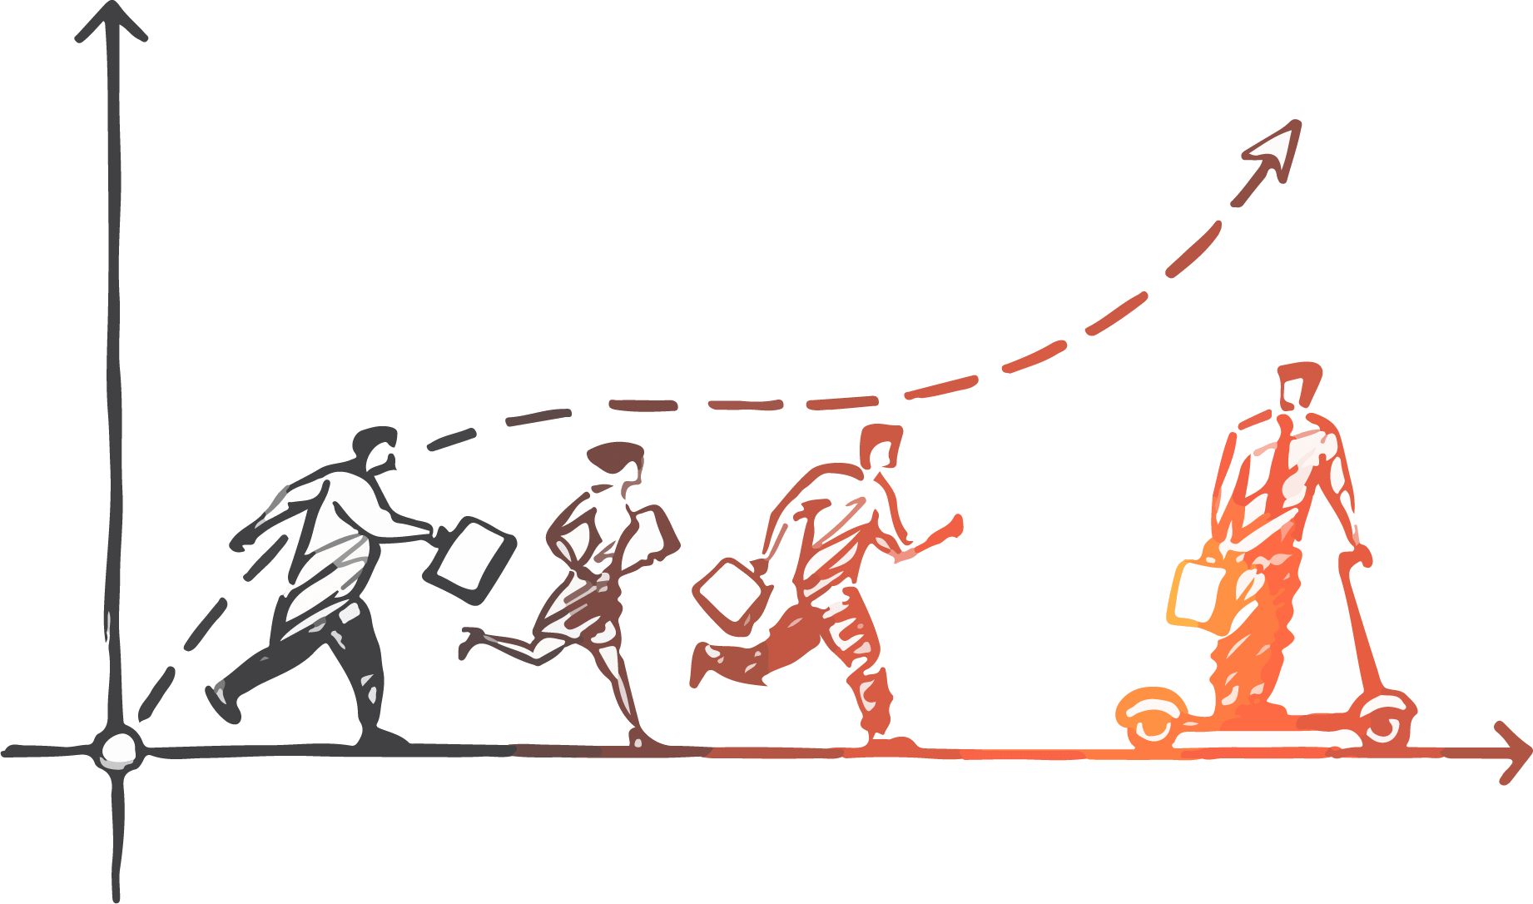
Marketing Strategy
赢
Enterprise honor
Woe be to him that reads but one book.

Slide 27

Thanks for Your Appreciation
www.freepptbackgrounds.net

