Slide 1
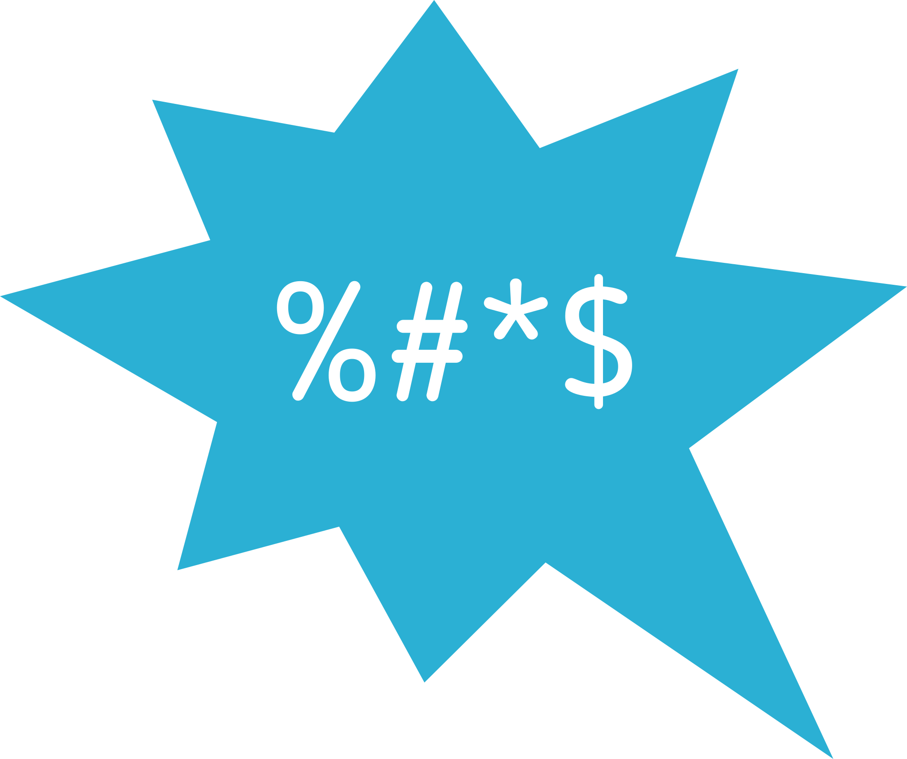
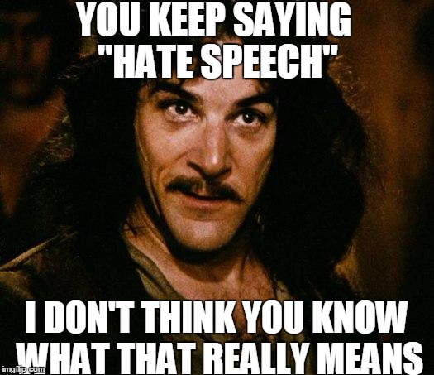
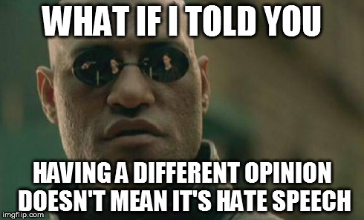


What is hate speech? > Media Production > What is hate speech to us?
What is hate speech to us?

Slide 2
The SELMA project defines online hate speech as:
“every form of expression written or said (including text messages, images, music, videos, games, paintings, symbols, signs, other forms of art), expressed and disseminated by an individual or group of people, through all forms of electronic digital communication such as media, websites, forums, blogs, social media platforms, emails, targeting against an individual or group of people based on a core characteristic of them, in particular on their gender or gender identity, race or ethnic origin, sexual orientation, religious affiliation or belief, disability, with the intention to spread hate, harass, threaten and provoke directly or indirectly violence against the specific individuals or members of groups within the societies.”

Slide 3
A simplified form is:
“Any online content targeting someone's core characteristics with the purpose of spreading hate, threatening or provoking violence against them.”

Slide 4


What does the term hate speech mean to you?
When people are being hateful online, what characteristics do they target people for?
Some young people that the SELMA project spoke to said that hate speech is:
Saying bad and degrading things about others
Hating, or speaking offensively to other people online and on social media
Are they right?
What do you think about their comments?
Have you (or a friend) experienced hate speech?
What happened?
How did you/they feel?
Who was involved?
How do they feel now?

Slide 5

We need to create our own, agreed definition of hate speech for our group.
Take a look at the definitions provided on the sheet…
What is good about them?
What is bad about them?
Do you understand them?
Is there anything missing from them?
Now it’s our turn...we need to define hate speech.
Let’s start by thinking about what it’s not...

Slide 6


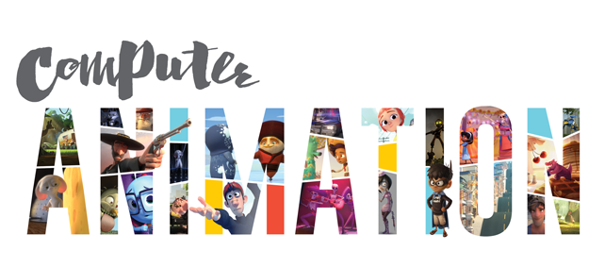

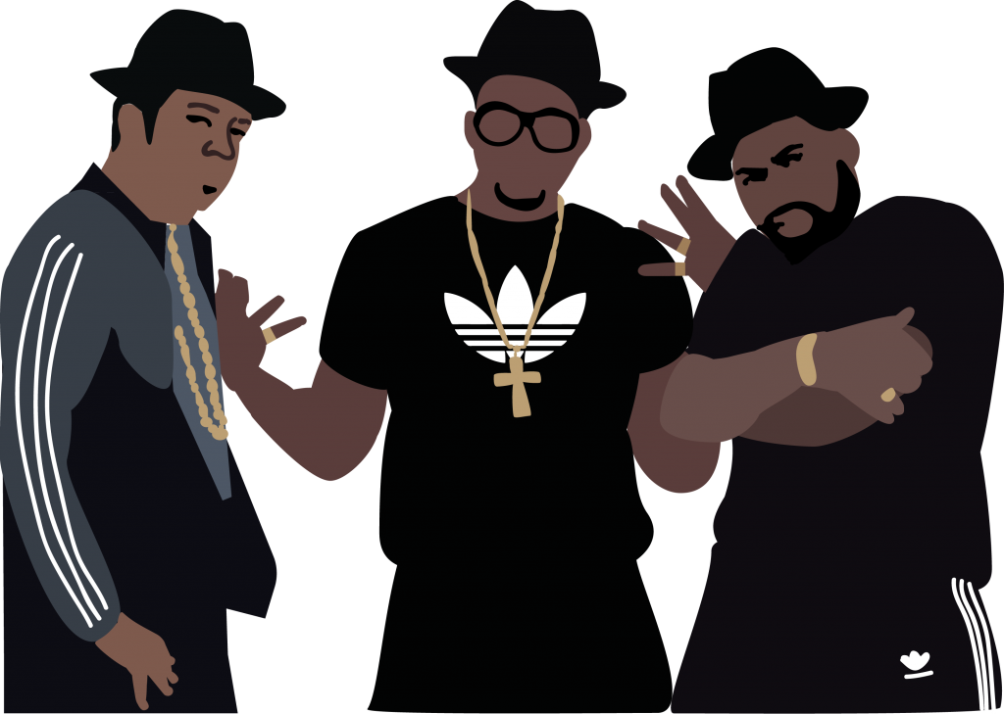
Now we need to have some fun with the definition we’ve created.
We need to make this more accessible for everyone.
Your next job is to recreate the definition in a more fun and engaging way.
You can use: animation, a meme, poetry or rap for this work...the next slide has some examples.

Slide 7

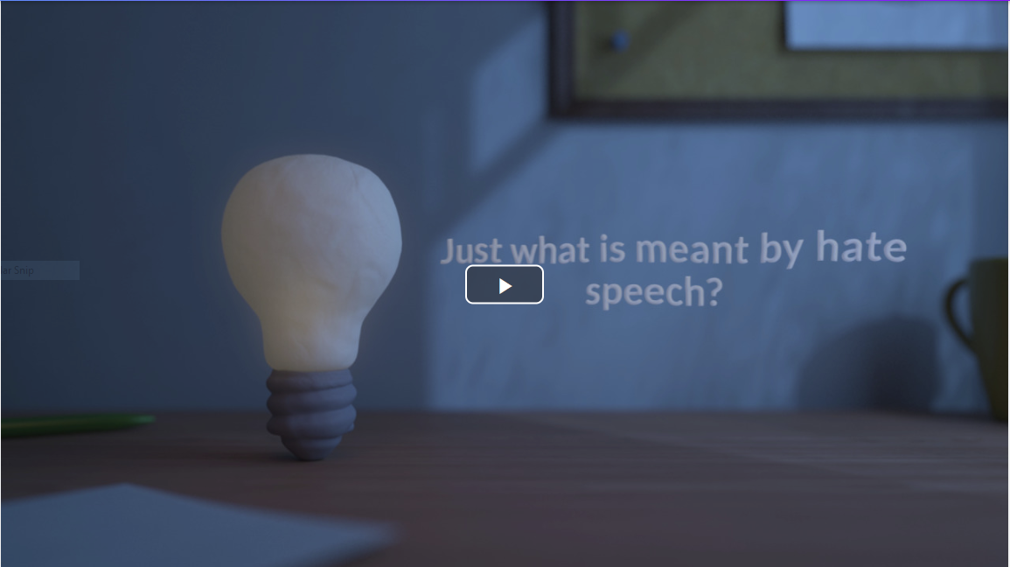
Try making an animation -
https://biteable.com/, is free to sign up

Slide 8

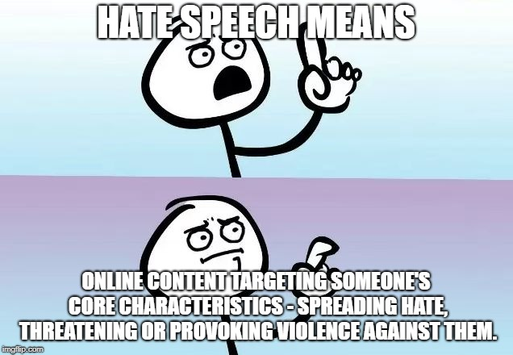
Or you could try making a meme with a free generator online

Slide 9

How about some poetry instead?
Acrostic poem
Hate speech -
Advocacy or promotion of hate,
Targeting a person or group.
Expressing insults,
Stereotypes and stigmas.
Presented online on the grounds of
Ethnicity, descent, colour, race age
Exploiting disability, language, religion, sex, gender
Characteristics personal to the individual or group
Hate speech.
Haiku
Hate Speech is content
Targeting people’s being
Provokes, threatens. Hate.

Slide 10


You could even try rapping!
Check out this ‘bad’ rap...

Slide 11








www.hackinghate.eu
#SELMA_eu

