Slide 1
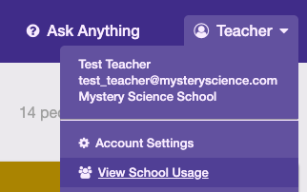
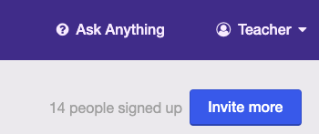
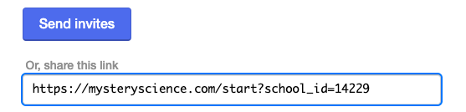
Staff training presentation prep & notes For presenter only
Use this 20 min presentation to introduce your peers to fun, profound science! Tip: use the slides as a structure--and talk about why you love Mystery Science. Here are two draft emails you can send to colleagues, before and after the talk, to make sure they can access your school’s Mystery Science account.
Send before the staff meeting
Hi fellow teachers,
I’ll be sharing why I use Mystery Science at our upcoming staff meeting [insert date, time, location].
I’d love to help you get started with this easy, engaging resource! You can join our school’s Mystery Science account by clicking on this link:
[insert your school’s link—see instructions on the right]
Bring your laptop with you to the meeting: that way, I can help you get set up and be ready to go :)
Best,
Send after the staff meeting
Hi there:
Thanks for letting me share my excitement about Mystery Science!
Now that you know what it’s all about, make sure you activate your account; here’s our school’s link again:
[insert your school’s link—see instructions on the right]
Pick a Mystery to teach--and let me know if you have any questions, or just share how it went when you teach!
Best,
How to find your school’s unique link
Select School Usage in your account
Click on Invite Others on that screen
Copy the link with your school ID from the pop-up

Slide 2
Notes:
2018: https://docs.google.com/presentation/d/1V3G1ig2UBWFjEgwq1cSBvDwAR3-MhvocwX3r7NGOLf0/edit#slide=id.g4325c61bd6_0_0

Slide 3
Mystery Science Open and go lessons that inspire kids to love science
What is Mystery Science?
Why is it great?
How does it work?
How do I get started?
Notes:
Introduce yourself, and share how long you’ve used Mystery Science, and maybe an anecdote on what got you excited, then discuss the four things you’ll cover today

Slide 4
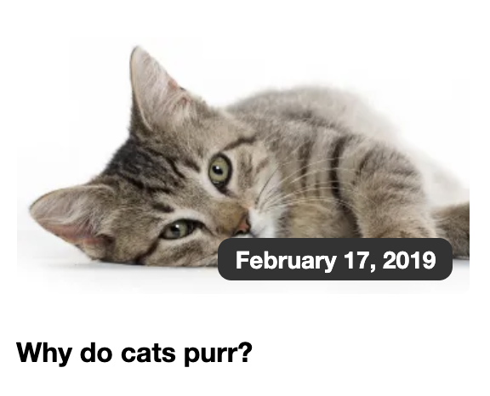
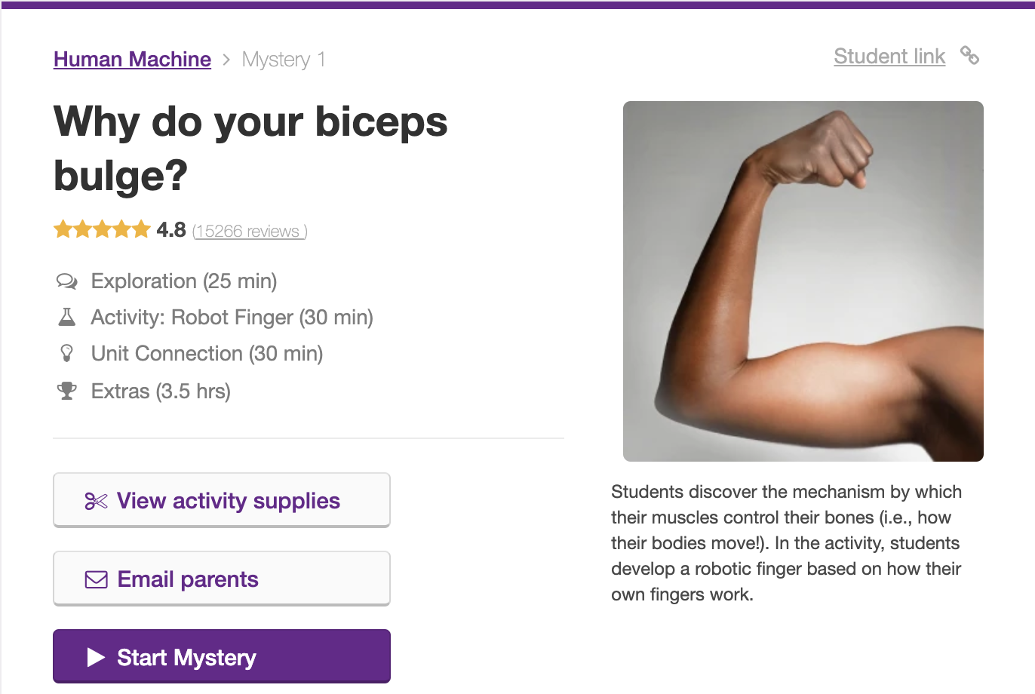
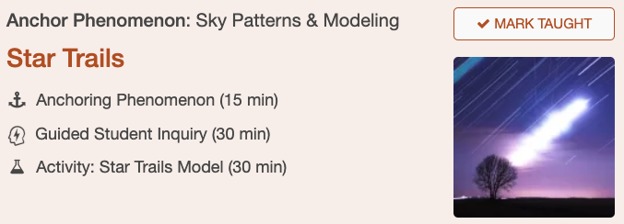
One program, three resources to fit your teaching approach and time!
MINI-LESSONS
FULL LESSONS
ANCHOR LAYER
10-20 min
Morning meetings
Getting into science
1 hour (+ more for extras)
Core curriculum
Teach key standards, with a virtual science co-teacher
2+ hours/week
Deeper exploration
Adds anchor phenomena, anchor connections, and performance tasks
4th & 5th grades; 3rd being added in 2019/20
Notes:
Share the three different parts of Mystery Science. If you use both mini-lessons and full-length lessons, mention how you use them. Let your colleagues know that the rest of the presentation discusses the full lessons. If you haven’t used the Anchor Layer yourself, that’s ok! Just mention that it’s a way for teachers to grow with Mystery Science: when you or another teacher is ready for deeper NGSS-aligned teaching, and has the time to do it, the Anchor Layer makes that possible. (It’s currently available for all 4th and 5th grade units; 3rd grade is being added during the 2019/20 school year.) In case you’re curious, or colleagues ask, you can turn on the Anchor Layer in your account settings.

Slide 5
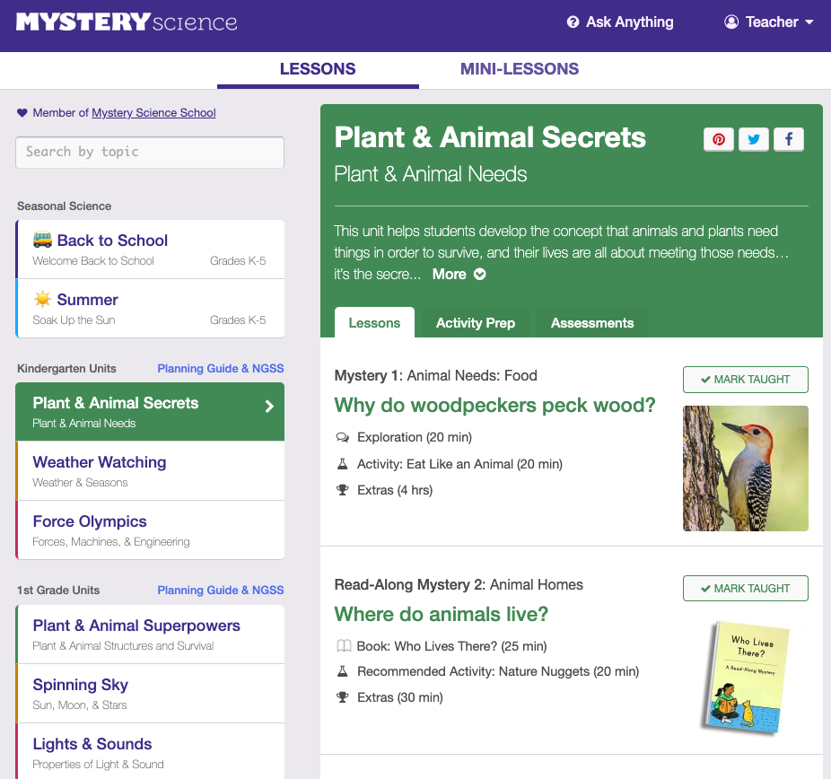
FULL LENGTH, STANDARDS-ALIGNED LESSONS FOR K-5
Notes:
Mystery Science offers a full curriculum of standards-aligned lessons for K-5. It’s all online—this is the home page, from where you can pick your grade, and the unit you want to teach.

Slide 6
Mystery Science is
easy!
A virtual science expert co-teacher by your side
Pre-planned lessons, with cool visuals, “wows” are guaranteed :)
Built-in guided discussions
Minimal prep with easy-to-gather supplies
Step-by-step directions for all hands-on activities
No professional development required
Notes:
Mystery Science is created by teachers, for teachers. They really listen to what we need in the classroom, and make it easy to teach science. You don’t have to be a science expert—there’s a virtual co-teacher named Doug who provides all the science content, so you’re free to help your students understand and engage. Prep is minima—no binders or long instructions, and no specialized materials. And classroom management is built in—with everything from discussion breaks in the video, to looping step-by-step instructions, so every student can follow. If you want to teach Mystery Science in the next week, you can easily do that!

Slide 7
Mystery Science is engaging!
“I love these lessons! Everything is right there. The video clips and questions are great. My students get so involved and everyone participates. As I walk around the classroom, I hear great discussions between students.”
— Toni (3rd grade teacher, Grayling, MI)
Notes:
Share some examples here of how your students engage. Specific anecdotes are best!

Slide 8
Mystery Science is aligned to standards!
Designed for the Next Generation Science Standards (NGSS)
Aligned to many state-specific standards
Arizona
Florida
Georgia
North Carolina
Ohio
Tennessee
Texas
More coming soon!
Notes:
If you are in an NGSS state, you can show the next slide; otherwise, you can find your state’s standards, if your state is listed at this link:
mysteryscience.com/docs/statename e.g., mysteryscience.com/docs/arizona

Slide 9
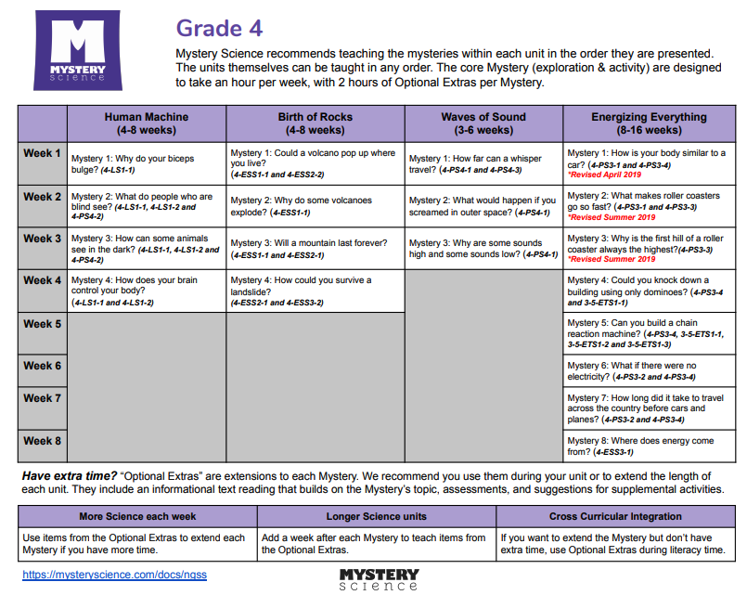
Next Generation Science Standards planning overview--4th grade example

Slide 10
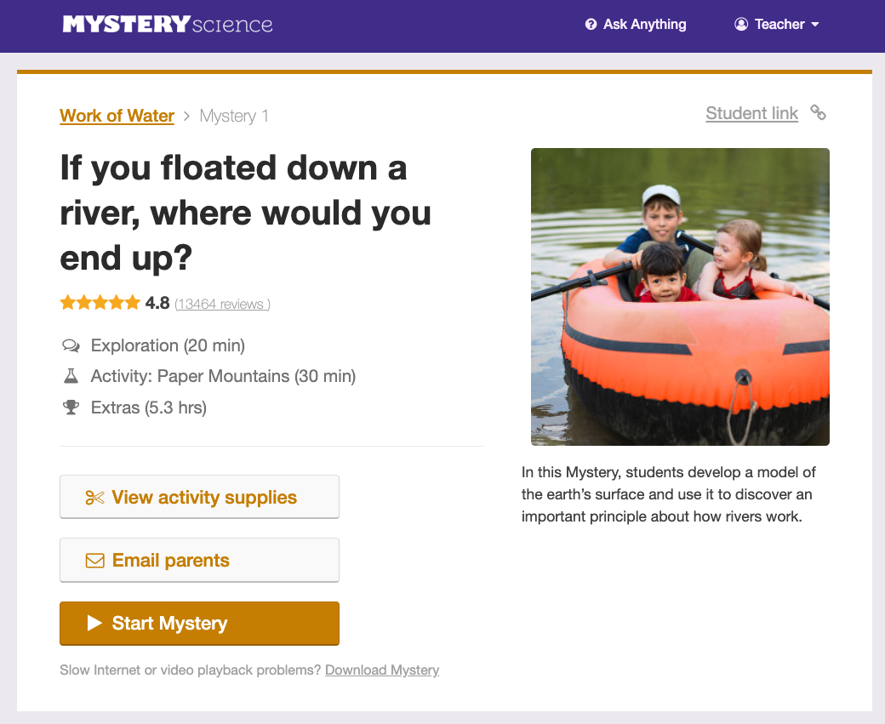
Let’s take a look at how a Mystery unfolds
Notes:
Every lesson starts with a question—the Mystery that the students will solve. In this 2nd grade unit, it’s “If you floated down a river, where would you end up?”
If you find any of the additional features helpful (student link, ability to download a Mystery, or parent email) you can briefly mention this.

Slide 11
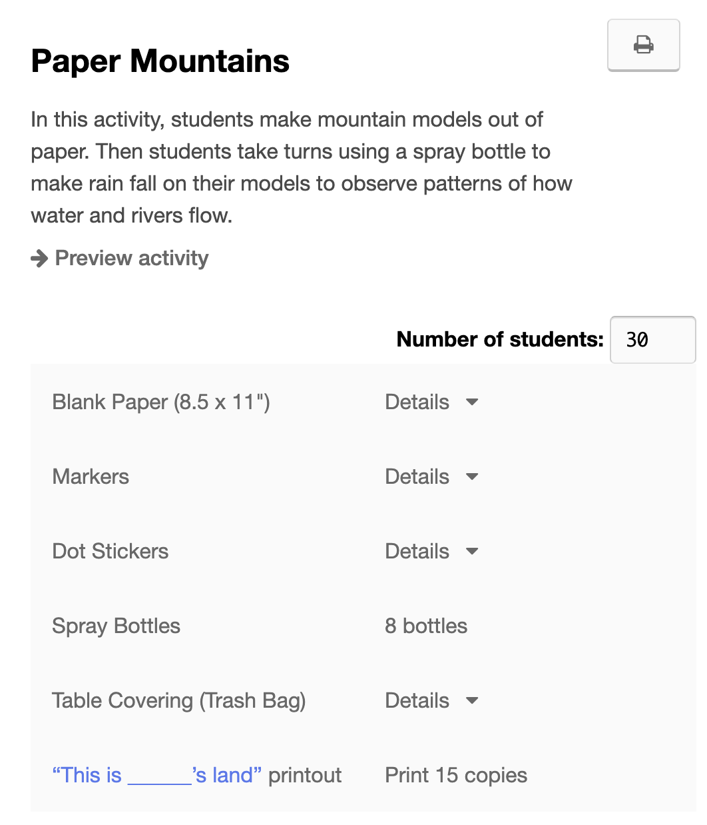
Easy prep
Collect some simple materials you have on hand or can get easily and print a few pre-made worksheets.
Notes:
Share why you find Mystery Science prep so much easier than most other science programs :)

Slide 12
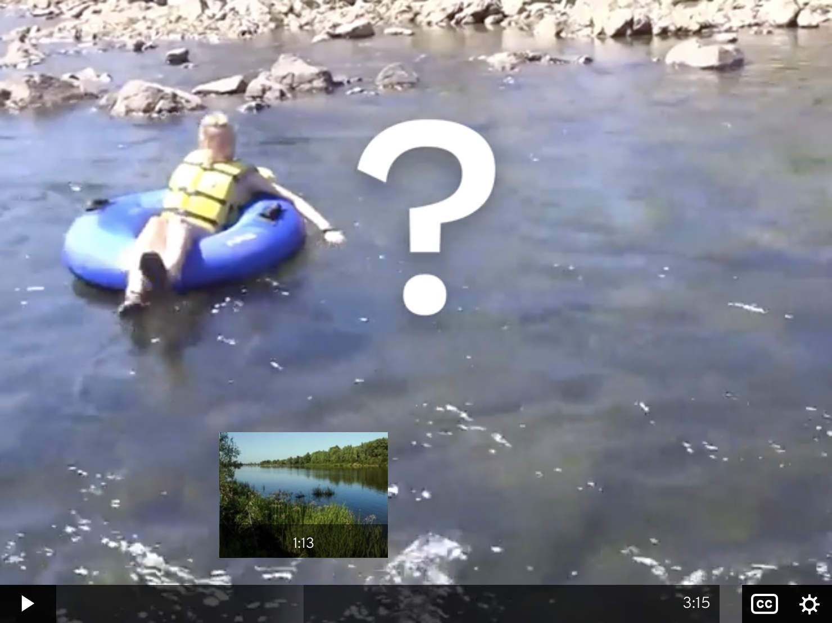
Video introduction:
A short video sets up the Mystery—the question that guides the exploration—and offers clues to help students solve it.
Notes:
Doug is a great story-teller: he gets the kids really curious, so they are engaged! By the end of the video, they are motivated to solve the Mystery, and they can’t wait to share their ideas during each of the discussion prompts!

Slide 13
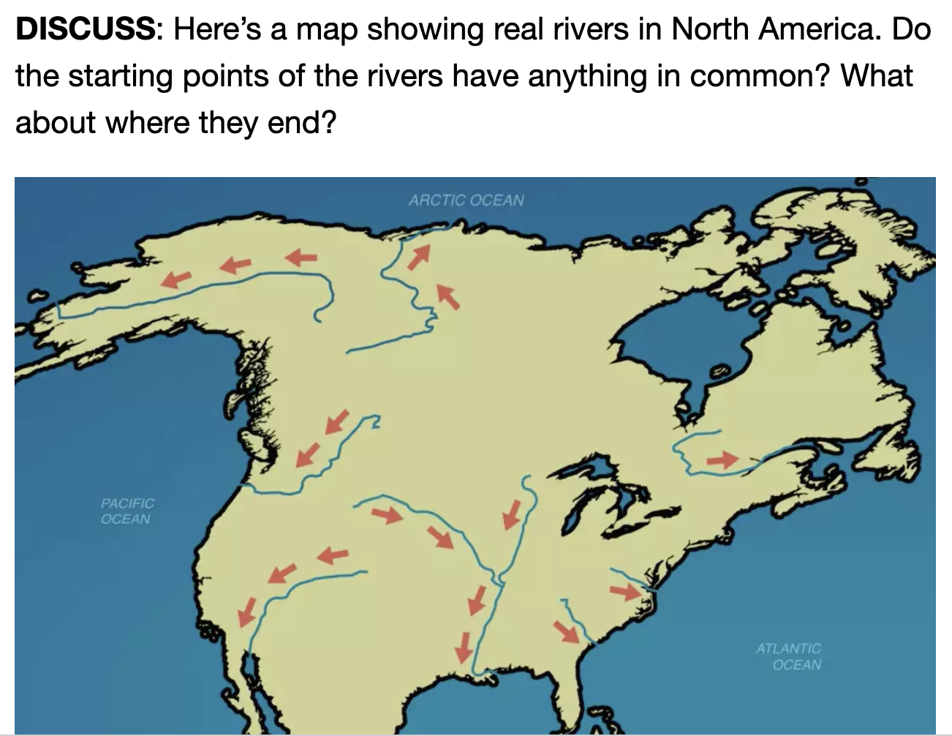
Discussion prompts:
The video pauses after each clue with a question for your class to discuss.
Notes:
The video has built-in breaks for discussion. That’s great, because they’ve planned carefully so the students can share their ideas, and stay engaged. They don’t just feed the content—they have the students go on a virtual journey which they enjoy!
If you have an anecdote of a great discussion, or just comments on the cool use of science concepts during the discussions in class, share them here.

Slide 14
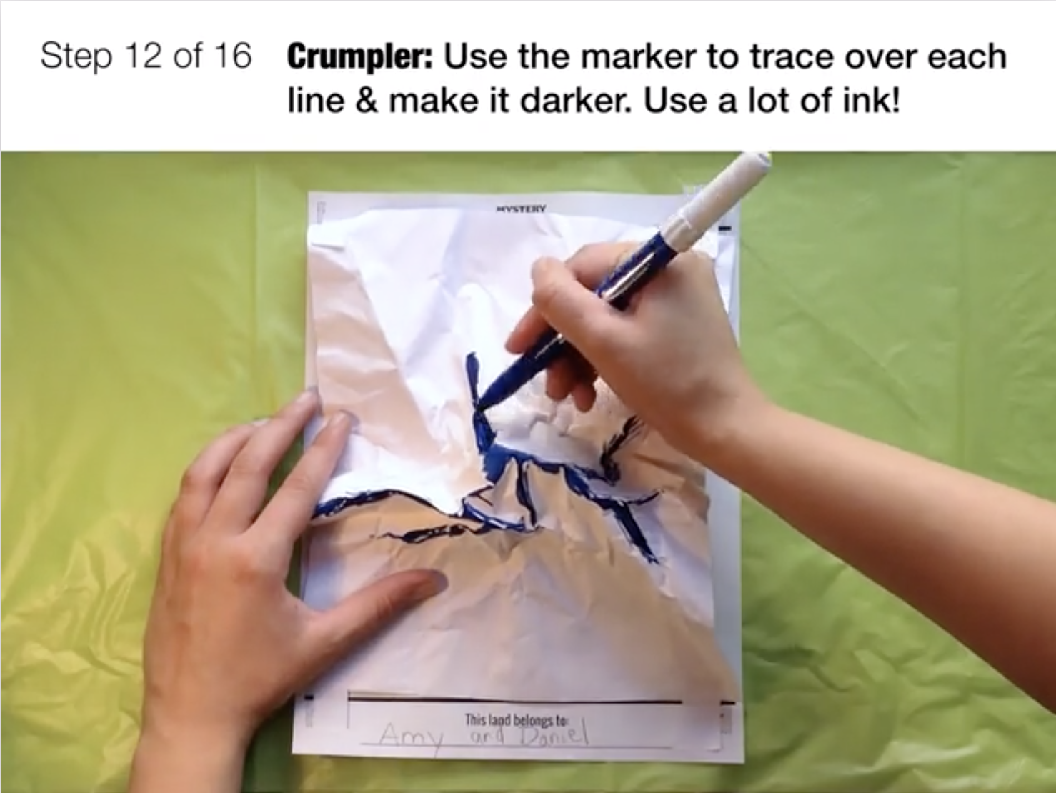
Step-by-step activity:
Step-by-step instructions guide students through a hands-on activity that helps them discover the answer to the Mystery.
Notes:
Share how while hands-on activities can often be chaotic and challenging to manage, the ones in Mystery Science are really well thought out. The step-by-step with looping video allows kids to catch up if they’ve missed instruction the first time. Timers are built into the slides, to ensure the class stays on track. The videos also offer little tips, like using a fingernail to really crease paper, so all kids can succeed!

Slide 15
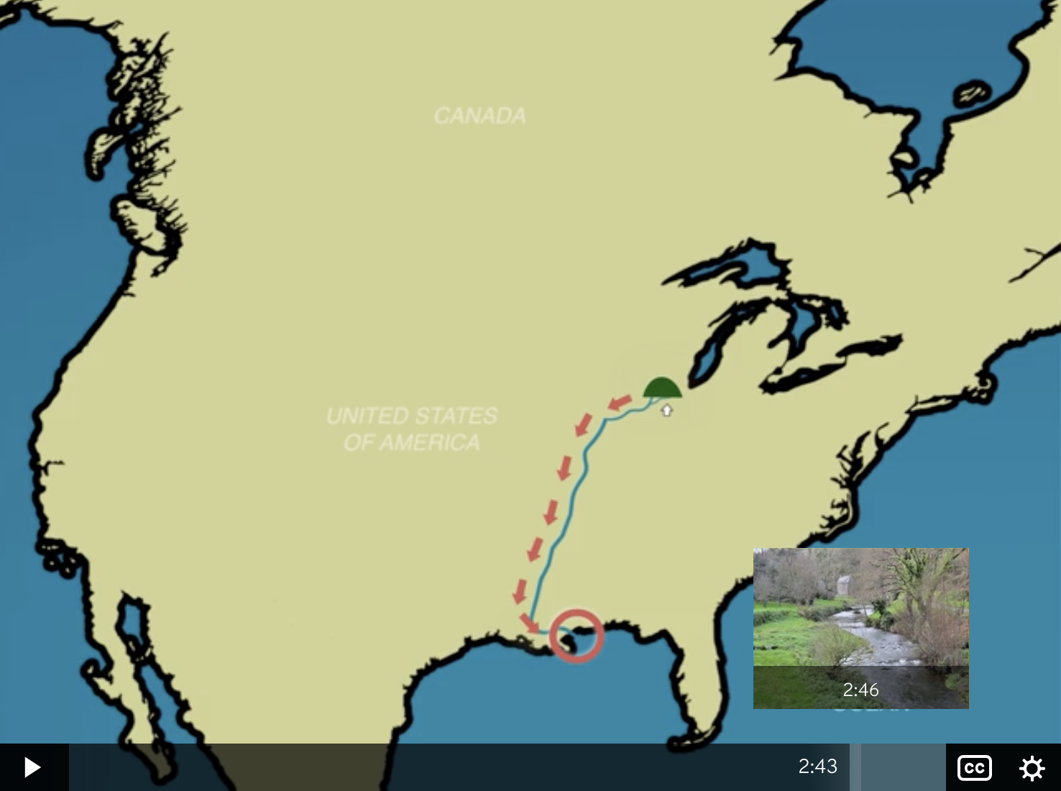
Video summary:
A short video ends the lesson, helping students integrate their insights and retain what they learned.
Notes:
After the hands-on activity, a video brings it all together, and helps all students to see the answer to the Mystery question. This is a great set-up for the assessments...

Slide 16
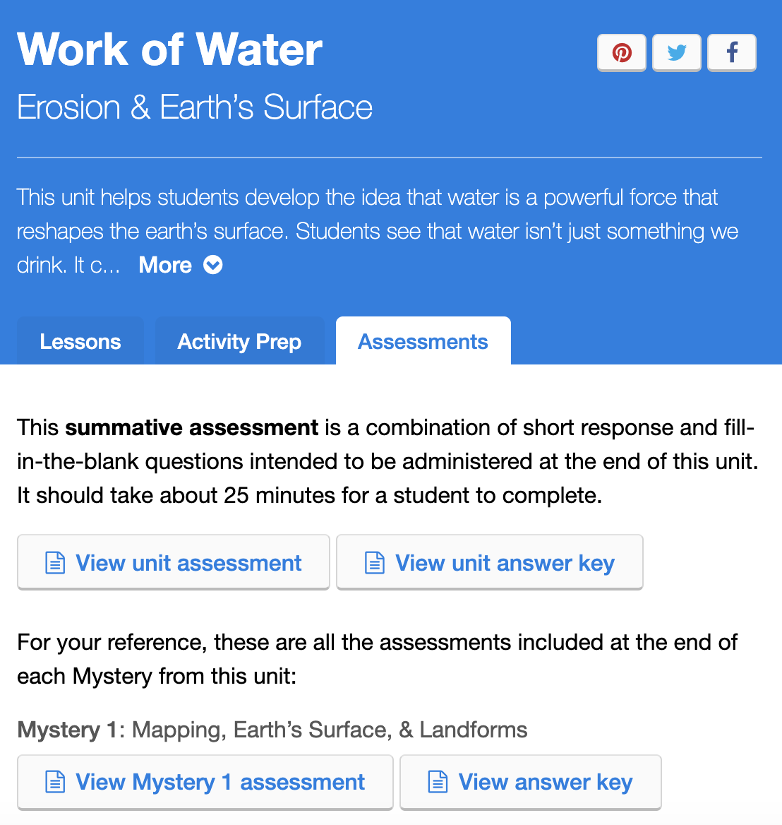
Editable assessments:
Lesson and end-of-unit assessments are easy to edit to your needs and print out.
Notes:
Each Mystery has its own assessment. For K-2, it often includes drawing; for the upper grades, it’s mostly writing, but may also include some drawing of models.
All assessments and other printables are in Google Docs or Slides—so they are easy for a teacher to edit or share via Google Classroom.

Slide 17
Choose a Mystery and get started today!
Pick any unit in your grade. We recommend starting with the first Mystery—but you can also search by topic :) Questions? Contact support@mysteryscience.com, or call 650-550-0670, and a real person will answer!
Notes:
Pick a volunteer, have them choose their lesson they will teach, and show them how to get there. A great ending of the presentation is to ask your colleagues to write down on a piece of paper which Mystery they will teach, and when :)
If people have brought their laptops, you can also put up your school’s link to sign-up, and make sure that everyone has access.
If they have any issues, remind them that they can reach out to us at support@mysteryscience.com, or via phone at 650-550-0670.

