Slide 1
E
N
E
N
D
D
O
F
T
E
O
F
T
H
E
H
Y
R
Y
E
A
R
E
A
K
B
K
A
P
B
O
A
P
O
O
R
O
S
C
R
S
C

Slide 2

Type something here
A
b
O
U
t
m
E
Far far away, behind the word mountains, far from the countries Vokalia and Consonantia, there live the blind texts. Separated they live in Bookmarksgrove right at the coast of the Semantics, a large language ocean. A small river named Duden flows by their place and supplies it with the necessary regelialia.

Slide 3
Type Something here.
Far far away, behind the word mountains, far from the countries Vokalia and Consonantia, there live the blind texts. Separated they live in Bookmarksgrove right at the coast of the Semantics, a large language ocean. A small river named Duden flows by their place and supplies it with the necessary regelialia. It is a paradisematic country, in which roasted parts of sentences fly into your mouth.

Slide 4
Type something here.
S
c
E
N
C
e
I
Far far away, behind the word mountains, far from the countries Vokalia and Consonantia, there live the blind texts. Separated they live in Bookmarksgrove right at the coast of the Semantics, a large language ocean. A small river named Duden flows by their place and supplies it with the necessary regelialia. It is a paradisematic country, in which roasted parts of sentences fly into your mouth.

Slide 5
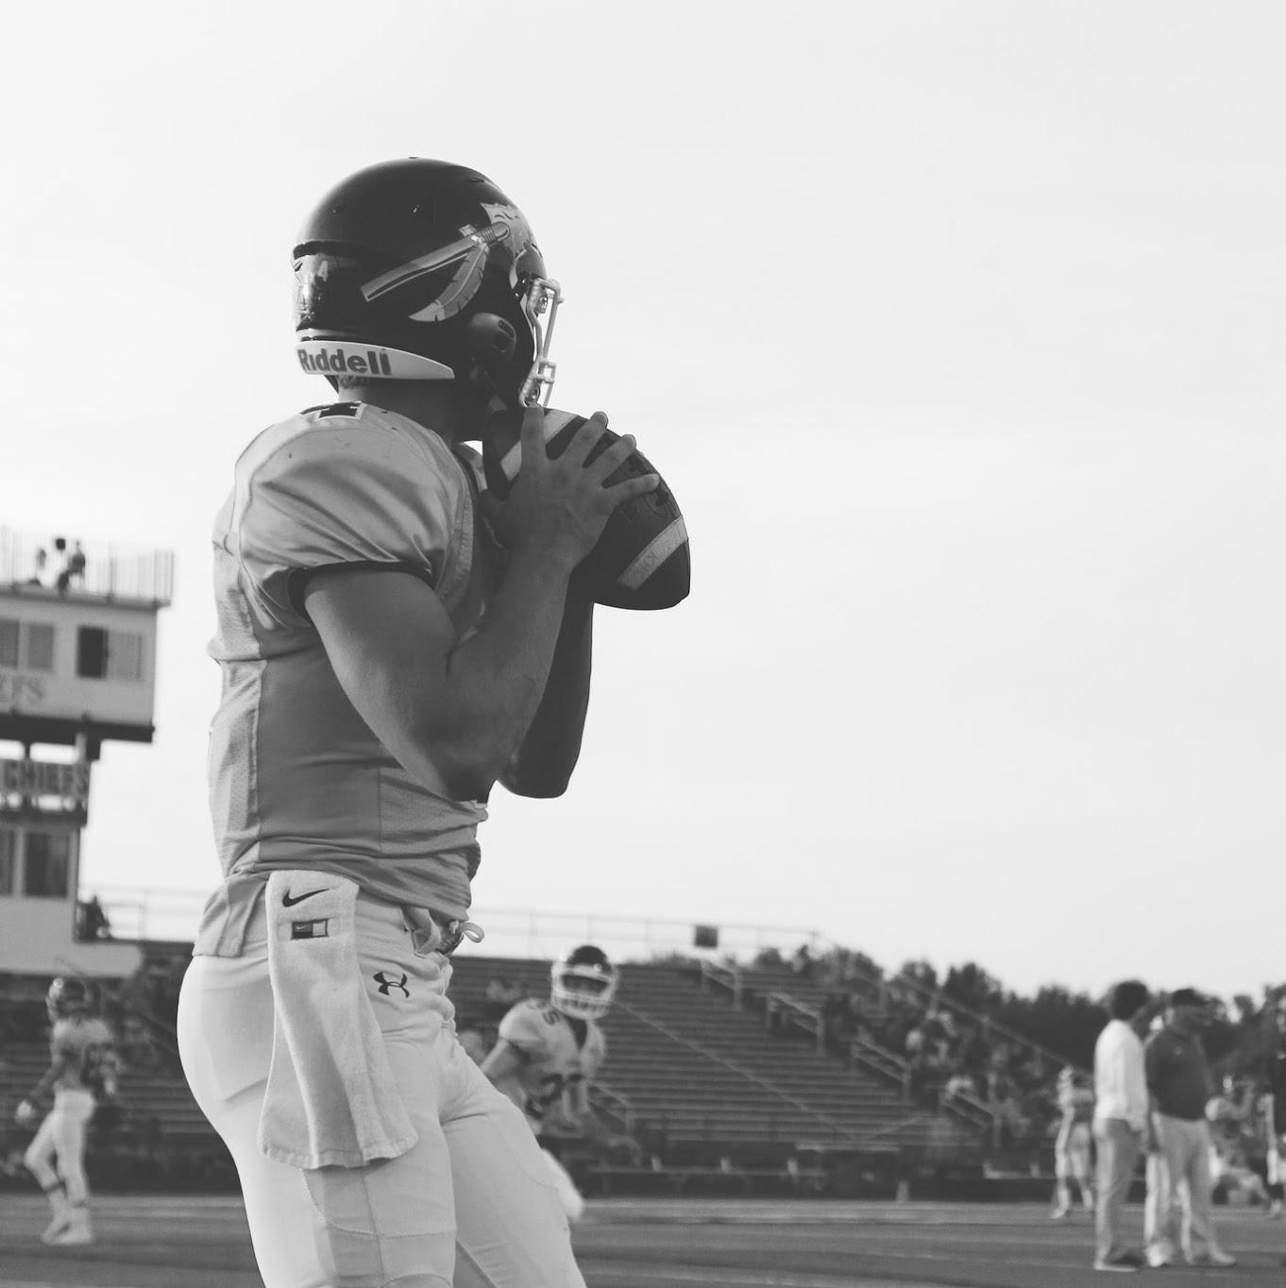
Type something here.
S
p
O
R
t
s
T
i
m
e
Far far away, behind the word mountains, far from the countries Vokalia and Consonantia, there live the blind texts. Separated they live in Bookmarksgrove right at the coast of the Semantics, a large language ocean. A small river named Duden flows by their place and supplies it with the necessary regelialia.

Slide 6

Type something here.
S
p
O
R
t
s
T
i
m
e
Far far away, behind the word mountains, far from the countries Vokalia and Consonantia, there live the blind texts. Separated they live in Bookmarksgrove right at the coast of the Semantics, a large language ocean. A small river named Duden flows by their place and supplies it with the necessary regelialia.

Slide 7
Favorite moment
M
Y
Far far away, behind the word mountains, far from the countries Vokalia and Consonantia, there live the blind texts.
Separated they live in Bookmarksgrove right at the coast of the Semantics, a large language ocean. A small river named Duden flows by their place and supplies it with the necessary regelialia.

Slide 8
Type something here.
Far far away, behind the word mountains, far from the countries Vokalia and Consonantia, there live the blind texts.
Separated they live in Bookmarksgrove right at the coast of the Semantics, a large language ocean. A small river named Duden flows by their place and supplies it with the necessary regelialia.

Slide 9
Favorite lesson
M
Y
Far far away, behind the word mountains, far from the countries Vokalia and Consonantia, there live the blind texts.
Separated they live in Bookmarksgrove right at the coast of the Semantics, a large language ocean. A small river named Duden flows by their place and supplies it with the necessary regelialia.

Slide 10
I liked the most.
W
h
A
T
Far far away, behind the word mountains, far from the countries Vokalia and Consonantia, there live the blind texts.
Separated they live in Bookmarksgrove right at the coast of the Semantics, a large language ocean. A small river named Duden flows by their place and supplies it with the necessary regelialia.

Slide 16
Credits:
Presentation Template: SlidesMania
Sample Images: Unsplash

