Slide 1
FOSSIL OIL
Powerpoint Template
www.freepptbackgrounds.net

Slide 2
CONTENTS
01
03
Cancel
Calculate
02
04
Certification
Choose

Slide 3
CONTENTS
01
CANCEL

Slide 4
Competition
A complex idea can be conveyed with just a single still image, namely making it possible to absorb large amounts of data quickly.

Slide 5
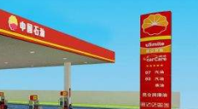
Convince
Complete
Get a modern PowerPoint Presentation that is beautifully designed.
I hope and I believe that this Template will your Time, Money and Reputation.
Confirm
Complain
Far far away, behind the word mountains, far from the countries
Get a modern PowerPoint Presentation that is beautifully designed.

Slide 6
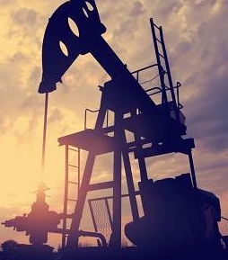
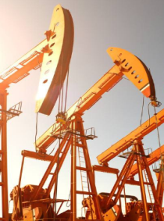
Deadline
Date
Customer
You have to be signed in to your Google account.
You will get a copy of this document on your Google Drive and will be able to edit, add or delete slides.
Click on the button under the presentation preview that says "Use as Google Slides Theme.

Slide 7
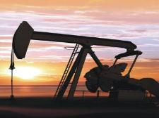
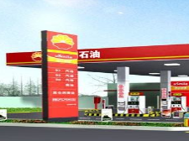
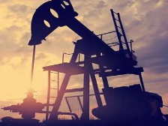
Decide
You will get a copy of this document on your Google Drive and will be able to edit, add or delete slides. You have to be signed in to your Google account.

Slide 8
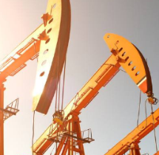
01
Add or delete slides. You have to be signed in to your
02
Is the color of gold, butter and ripe lemons. In the spectrum of visible light, yellow is
03
We use well-known development methodologies to create a customized

Slide 9
CONTENTS
02
CERTIFICATION

Slide 10
2016
2020
Pleasant Shopping
Your Vision
Decision
2010
2019
Digital Storytelling
Branding Tools
Dispatch
Dismiss
Difference
Develop

Slide 11
Growth
Goal
Fund
Fix
Encourage
Employ
Education
Distribute
Enter the comprehensive
The user can demonstrate
Enter the comprehensive
The user can demonstrate

Slide 12
Fossil Oil
Hearing
We certainly do not forget you as soon as you forget us.
It is a very sad thing that nowadays there is so little useless information.
It is a very sad thing that nowadays there is so little useless information.
We certainly do not forget you as soon as you forget us.

Slide 13
Improve
3
Increase
2
Industry
We live at home, quiet, confined, and our feelings prey upon us. You are forced on exertion
1
All the privilege I claim for my own sex (it is not a very enviable one; you need not covet it), is that of loving longest, when existence
We live at home, quiet, confined, and our feelings prey upon us. You are forced on exertion

Slide 14
CONTENTS
03
CALCULATE

Slide 15
Inform
Install
Genius hath electric power which earth can never tame. Lydia M. Child
I
I
I believe that people would be alive today if there were a death penalty. Nancy Reagan
Knowledge
Join
K
J
I believe that people would be alive today if there were a death penalty. Nancy Reagan
Genius hath electric power which earth can never tame. Lydia M. Child

Slide 16
Tech
I feel very
Startup
Public
A large income is the best
Education
Woe be to him that reads but one book.

Slide 17
01
02
Always give your best
never worry for results.
Be an encourager, the worl
d has enough critics already.
03
04
Always give your best
never worry for results.
Be an encourager, the world
has enough critics already.

Slide 18
Fashion
Culture
Do you wonder what the difference between ignorance and genius is? A Genius has limits but an ignorant doesn’t have any.
Arts
Enjoy the little things in life, because one day you will look back and realize they were the big things.

Slide 19
+
+
=
E-commerce
Energy
Real
Estate
Everyone wants, happiness. No one wants pain. But you can’t have a rainbow without a little rain.
Enjoy the little things in life, because one day you will look back and realize they were the big things.
Everyone wants, happiness. No one wants pain. But you can’t have a rainbow without a little rain.
Enjoy the little things in life, because one day you will look back and realize they were the big things.

Slide 20
CONTENTS
04
CHOOSE

Slide 21
Workshops
Evaluation
Briefing
God sometimes removes people from your life to protect you. Do not run after them.

Slide 22
Quality
Assurance
Design
Workshops
45%
68%
79%
92%
People who touch your heart are always with you.
Everybody has three chars ; the one is come out
People who touch your heart are always with you.
You can’t change what’s going on around you until you start changing

Slide 23
Hearing
20%
Implementation
Growth
15%
10%
Fix
You can’t change what’s going on around you until you start changing what’s going on with you.
Quality
People who touch your heart are always with you.
Goal
35%
20%
Fund

Slide 24
To see what is in front of one's nose needs a constant struggle. George Orwell
A torn jacket is soon mended; but hard words bruise the heart of a child. Henry Wadsworth Longfellow

Slide 25
Improve
Increase
Industry
Inform

Slide 26
THANK YOU !
Fossil Oil Powerpoint Template
www.freepptbackgrounds.net

Slide 27
FreePPTBackgrounds.net
Powerpoint Templates
Free Powerpoint Presentation Template (.PPTX)
You can upload Google Slides..
Google Slides
Select slide and edit your presentation
You can download and share your presentation!
Free Powerpoint Templates: https://www.freepptbackgrounds.net/browse
Abstract Powerpoint Templates: https://www.freepptbackgrounds.net/abstract
Animal and Wildlife Presentation: https://www.freepptbackgrounds.net/animals-wildlife
Love Powerpoint Templates: https://www.freepptbackgrounds.net/love
Business & Finance Google Slides: https://www.freepptbackgrounds.net/business-finance
Music Powerpoint Slides: https://www.freepptbackgrounds.net/music
Christmas Google Slides: https://www.freepptbackgrounds.net/christmas
Education Google Slides: https://www.freepptbackgrounds.net/education
Flowers Powerpoint Templates: https://www.freepptbackgrounds.net/flowers
Food and Drinks Slides: https://www.freepptbackgrounds.net/food-drink
Flags Powerpoint Templates: https://www.freepptbackgrounds.net/flags
Medical Google Slides: https://www.freepptbackgrounds.net/healthcare-medical
Nature Powerpoint Templates: https://www.freepptbackgrounds.net/nature
Religious Google Slides: https://www.freepptbackgrounds.net/religious
Sports Powerpoint Slides: https://www.freepptbackgrounds.net/sports
Technology Google Slides: https://www.freepptbackgrounds.net/technologies
Transportation Powerpoint Templates: https://www.freepptbackgrounds.net/car-transportation

