Slide 1
Disclaimer: The information in the following slides are a guide to assist in the Sales Tax Registration Process. At the end of the registration process, there will be a submit button. Once submit is clicked, the business has registered with the state and is obligated to the state filing frequencies and, if any, fees and penalties. Businesses should contact Sales Tax and More before hitting submit if questions arise. Unfortunately, your registration process will need to start over as states typically have a timeout period. There is a fee associated with the assistance of the registration. If the slides show information that is not consistent with what is shown on the website, please contact us, and we will correct this information as quickly as possible. Call Sales Tax and More at (972) 737-4559 or email info@salestaxandmore.com

Slide 2
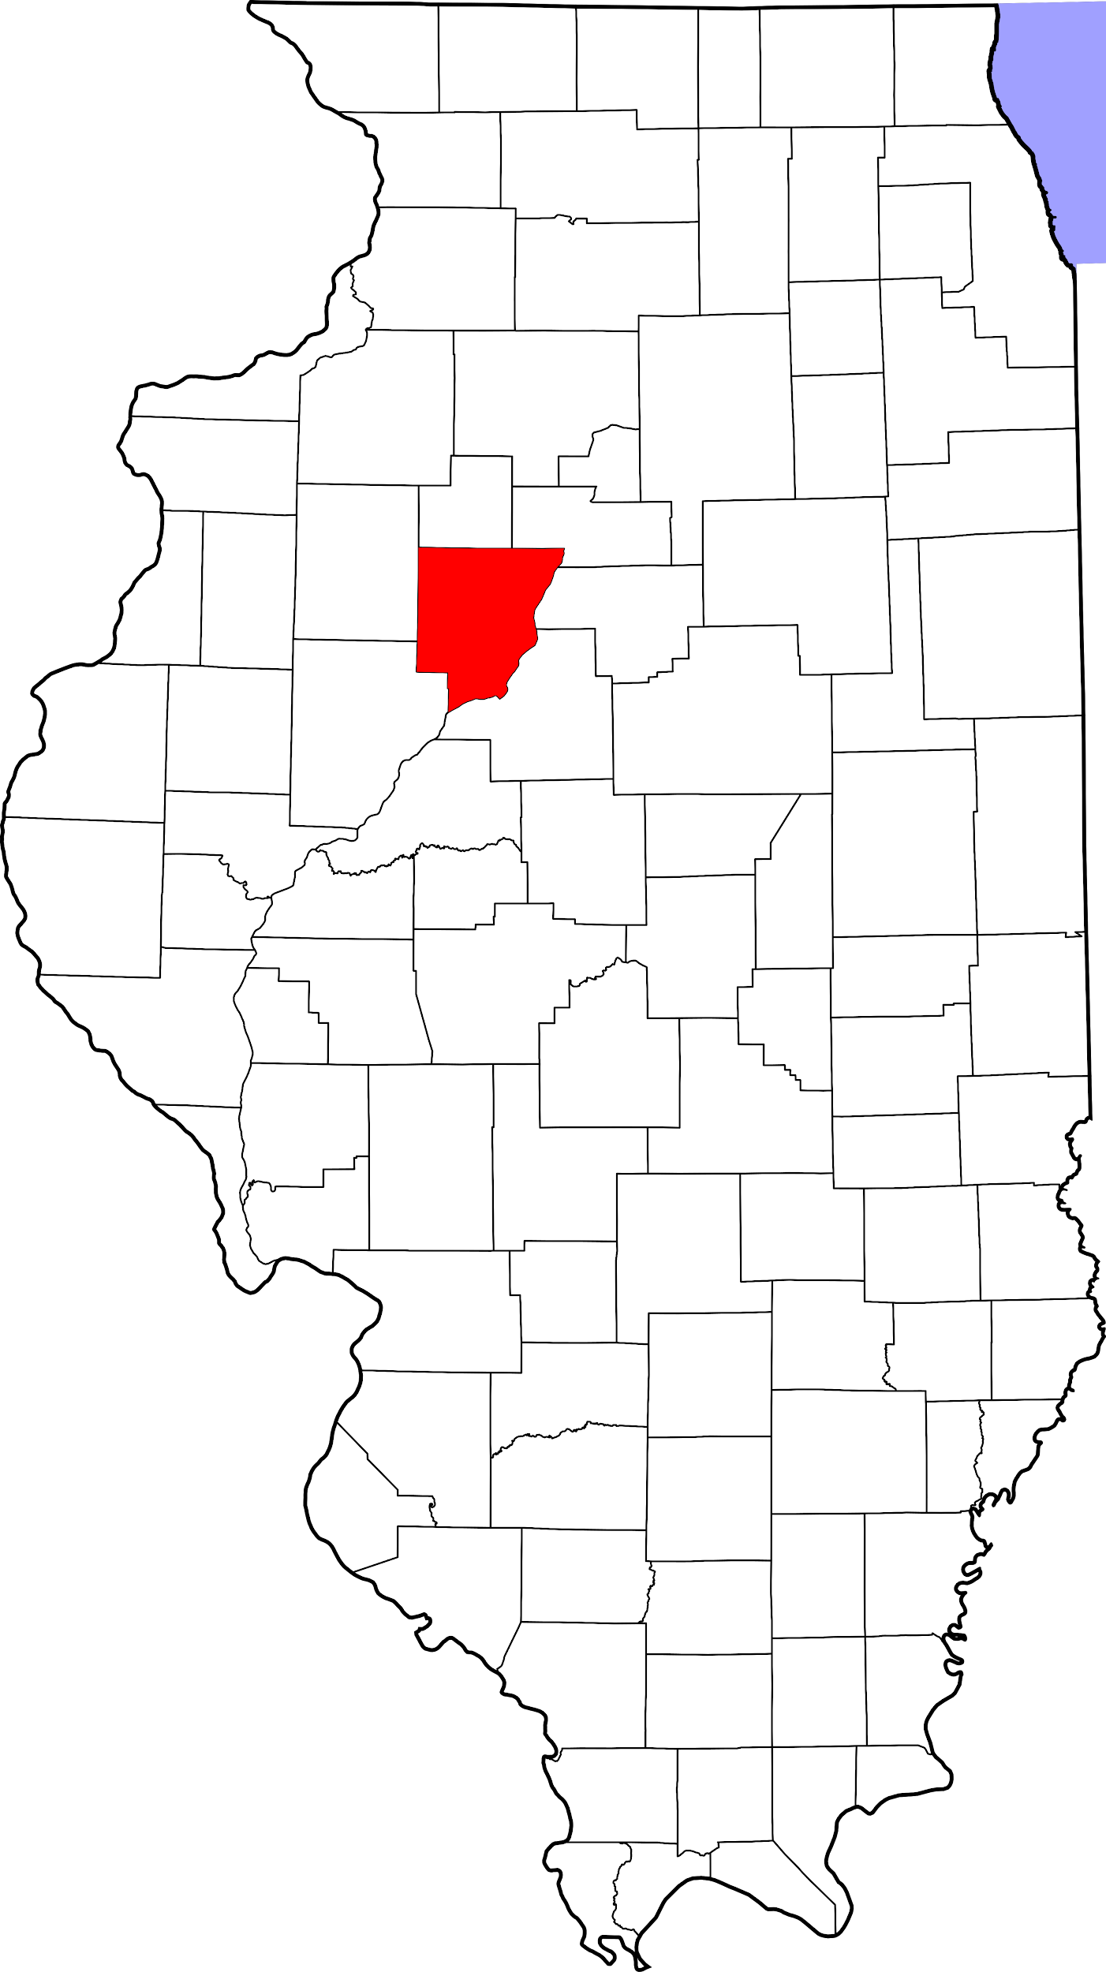


Illinois Sales Tax Registration Instructions
https://mytax.illinois.gov/_/#1
Tax Type:
Use Tax
https://www.salestaxandmore.com/

Slide 3
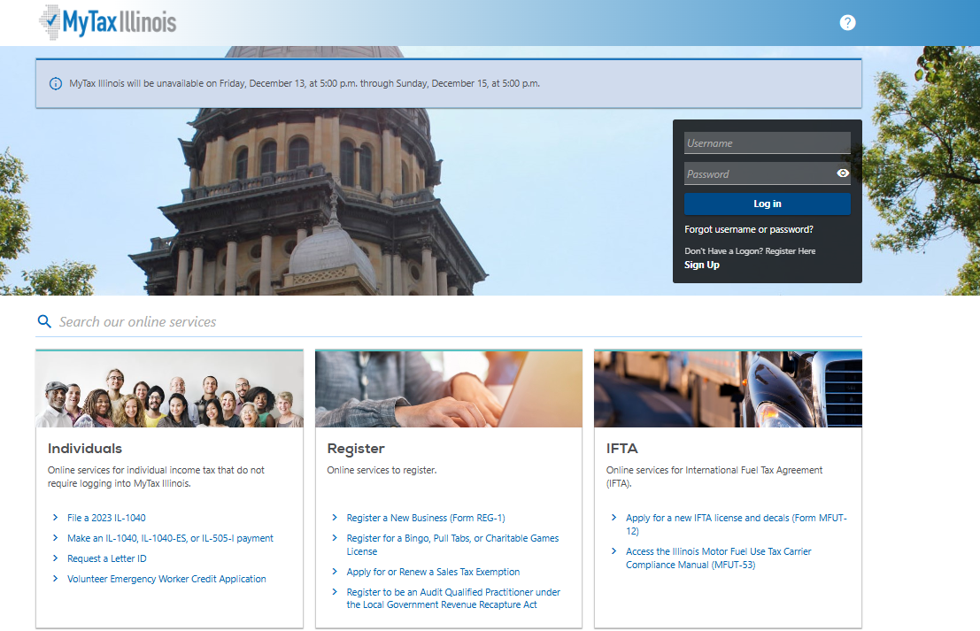
Sales Tax and More - IL Registration
Step 1: Register a New Business (form REG-1)
https://www.salestaxandmore.com/

Slide 4
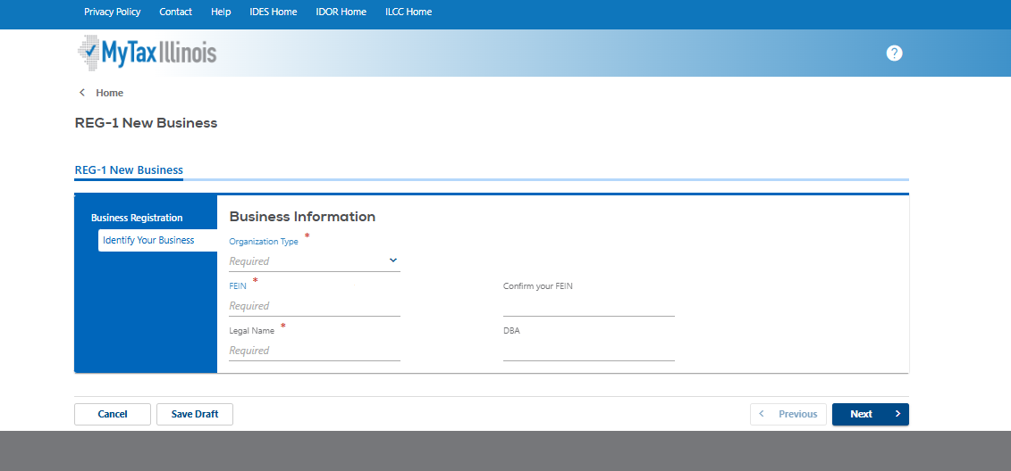
Sales Tax and More - IL Registration
Step 2: Business Information
Organization Type: choose appropriate choice from the drop down menu based on your business organization- ( Corp, LLC’s, Gov Entity, etc)
FEIN: Type in and then Confirm it by typing it in again
Legal Name: Type in Legal Name of the business
DBA: Leave blank
Click Next
https://www.salestaxandmore.com/

Slide 5
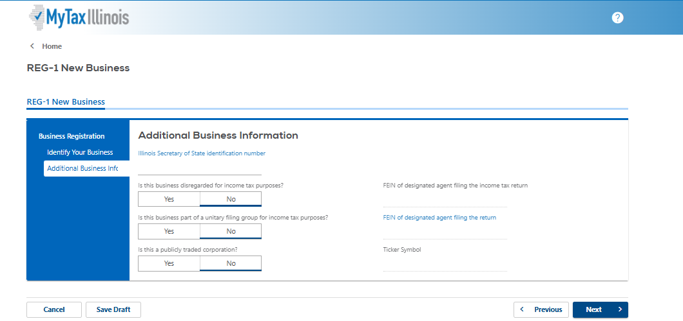
Sales Tax and More - IL Registration
Step 3: Additional Business Information
Skip- Illinois Secretary of State identification number; unless formed in IL- then its required
Is this business disregarded for income tax purposes? NO
Is this business part of a unitary filing group for income tax purposes? NO
Is this a publicly traded corporation?NO
Leave the Right side blank
Click Next
https://www.salestaxandmore.com/

Slide 6
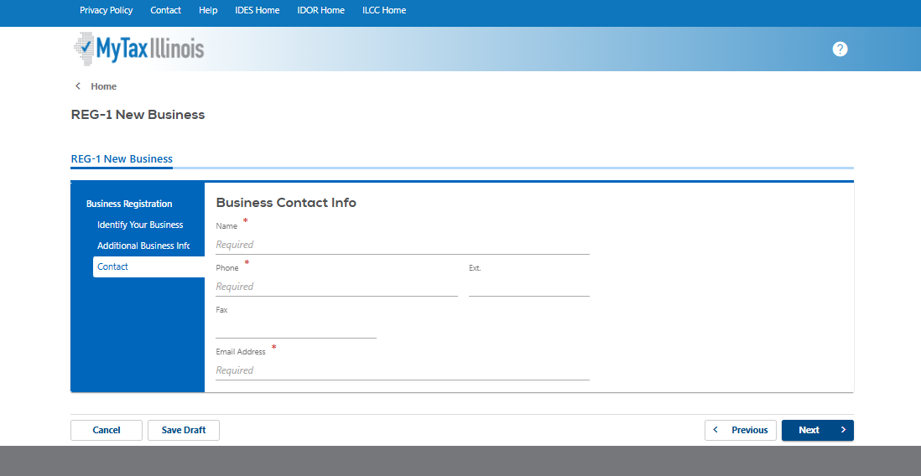
Sales Tax and More - IL Registration
Step 4 Buisness Contact Info
Name: Type in your business contact name first and last
Phone: Type in Phone Number and Extention if applicable
Fax: Can type in fax number or skip
Email address: Type in company email address
Click Next
https://www.salestaxandmore.com/

Slide 7
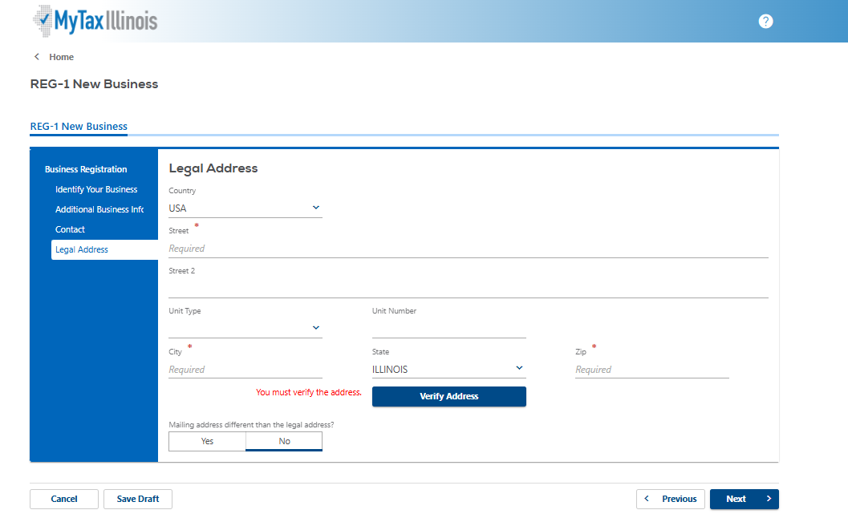
Sales Tax and More - IL Registration
Step 5 Legal Address
Country: Choose Country from the drop down list- if not USA
Street: Type in street address
Street 2: Use if need
Unit Type: Choose from drop down list if applicable
Unit Number: Type in unit number for the Unit type if applicable
City: Type in City
State: Choose from drop down list if USA
Zip: Type in Zip code
Click Verify Address
Mailing address different than the legal address? Yes or No depending on your business mailing address
Click Next
https://www.salestaxandmore.com/

Slide 8
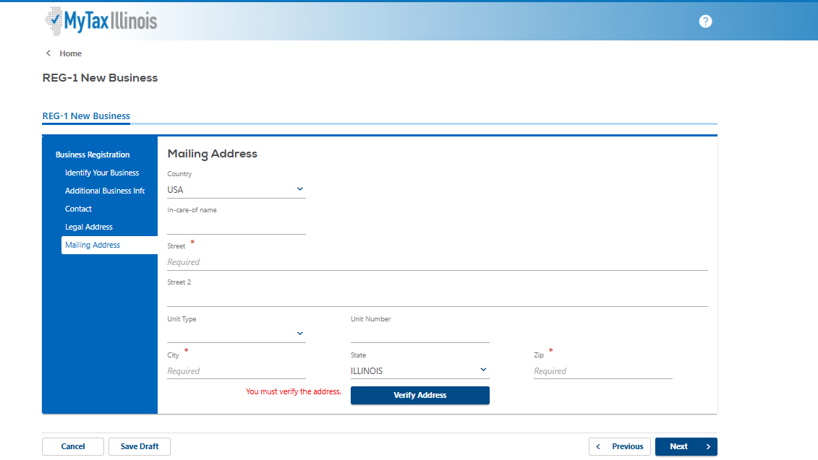
Sales Tax and More - IL Registration
Step 6 Mailing address- only if different from Legal will this screen appear .. so if mailing address is the same as the legal address move on to the next slide
Country: Choose Country from the drop down list- if not USA
In-Care-of Name: if applicable
Street: Type in street address
Street 2: Use if need
Unit Type: Choose from drop down list if applicable
Unit Number: Type in unit number for the Unit type if applicable
City: Type in City
State: Choose from drop down list if USA
Zip: Type in Zip code
Click Verify Address
Click Next
https://www.salestaxandmore.com/

Slide 9
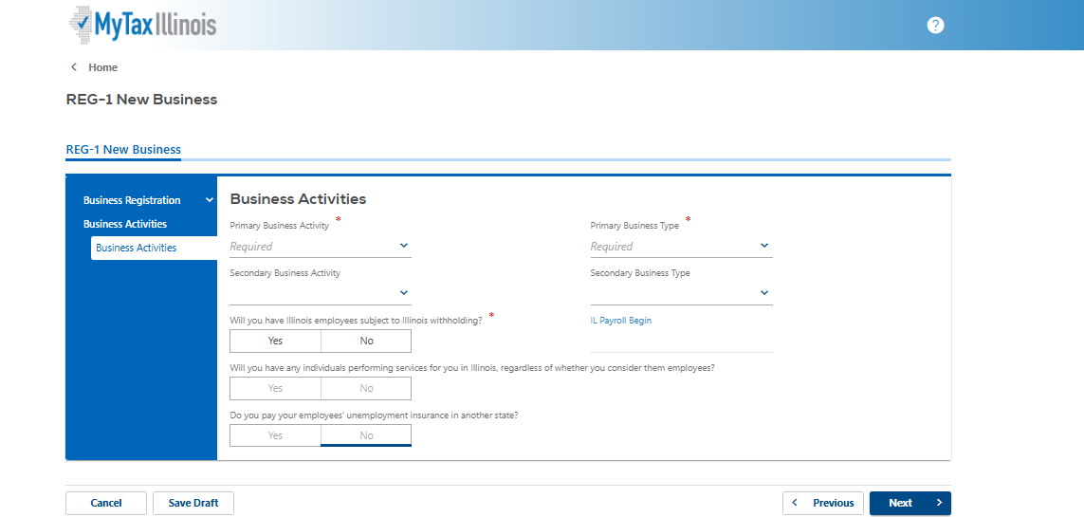
Sales Tax and More - IL Registration
Step 7 Business Activities
Primary Business Activity: Choose Retail from the drop down menu
Primary Business Type: Choose Other Retail Not Listed from the drop down menu
Secondary Business Activity and Secondary Business Type: Skip
IL payroll Begin: Skip
Will you have Illinois employees subject to Illinois withholding?NO
Will you have any individuals performing services for you in Illinois, regardless of whether you consider them employees?NO
Do you pay your employees' unemployment insurance in another state?NO
Example on next slide
Click Next
https://www.salestaxandmore.com/

Slide 10
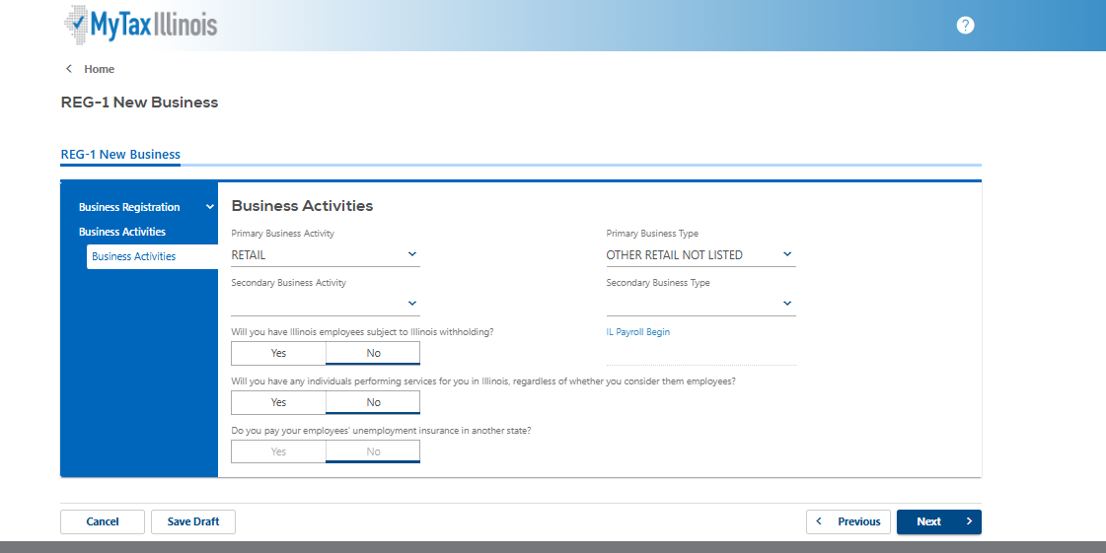
Sales Tax and More - IL Registration
Step 7 Example of previous step all filled out
Next Slide
https://www.salestaxandmore.com/

Slide 11
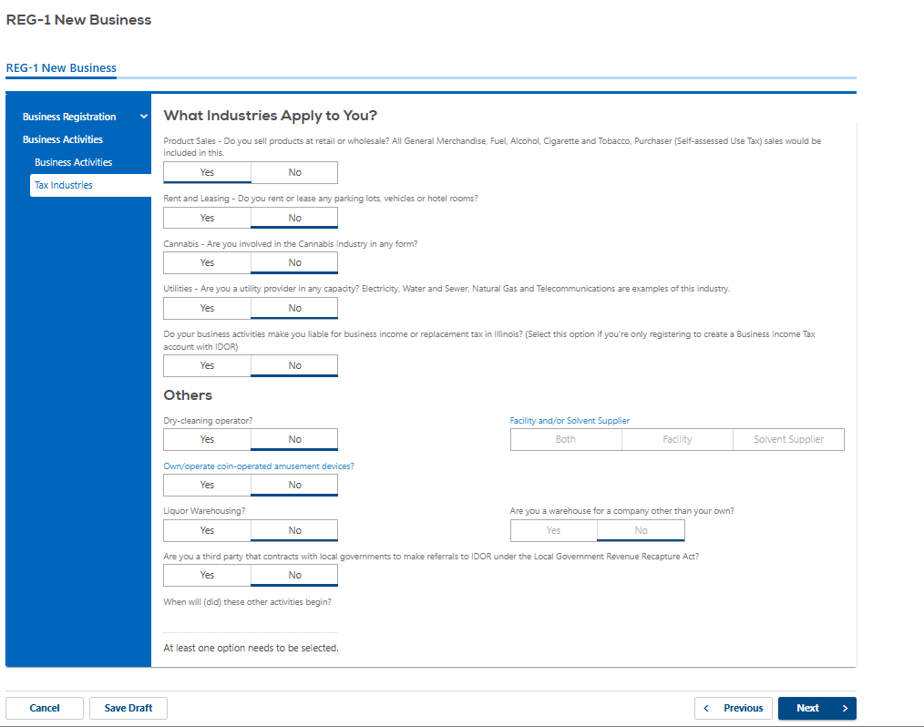
Sales Tax and More - IL Registration
Step 9: What Industries Apply to You?
Product Sales - Do you sell products at retail or wholesale? All General Merchandise, Fuel, Alcohol, Cigarette and Tobacco, Purchaser (Self-assessed Use Tax) sales would be included in this. YES
Rent and Leasing - Do you rent or lease any parking lots, vehicles or hotel rooms?NO
Cannabis - Are you involved in the Cannabis Industry in any form?NO
Utilities - Are you a utility provider in any capacity? Electricity, Water and Sewer, Natural Gas and Telecommunications are examples of this industry.NO
Do your business activities make you liable for business income or replacement tax in Illinois? (Select this option if you're only registering to create a Business Income Tax account with IDOR)NO
Others
Dry-cleaning operator?NO
Own/operate coin-operated amusement devices?NO
Liquor Warehousing?NO
Are you a third party that contracts with local governments to make referrals to IDOR under the Local Government Revenue Recapture Act?NO
Click Next
https://www.salestaxandmore.com/

Slide 12
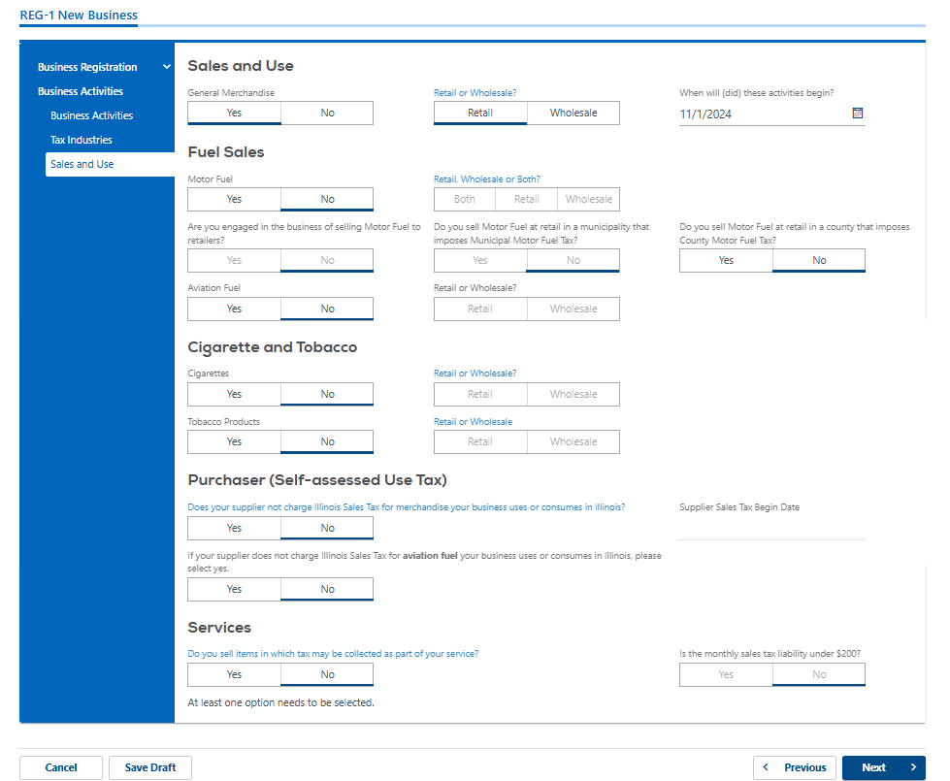
Sales Tax and More - IL Registration
Step 10: Sales and Use Tax
General Merchandise: YES
Retail or Wholesale? RETAIL
When will (did) these activities begin? Choose effective date from the calendar
Fuel Sales: Motor Fuel? NO Aviation Fuel? NO
Cigarettes and Tobacco: Cigarettes? NO Tabacco Products? NO
Purchaser (Self-assessed Use Tax):Does your supplier not charge Illinois Sales Tax for merchandise your business uses or consumes in Illinois?NO
If your supplier does not charge Illinois Sales Tax for aviation fuel your business uses or consumes in Illinois, please select yes.NO
Services: Do you sell items in which tax may be collected as part of your service?NO
Click Next
https://www.salestaxandmore.com/

Slide 13
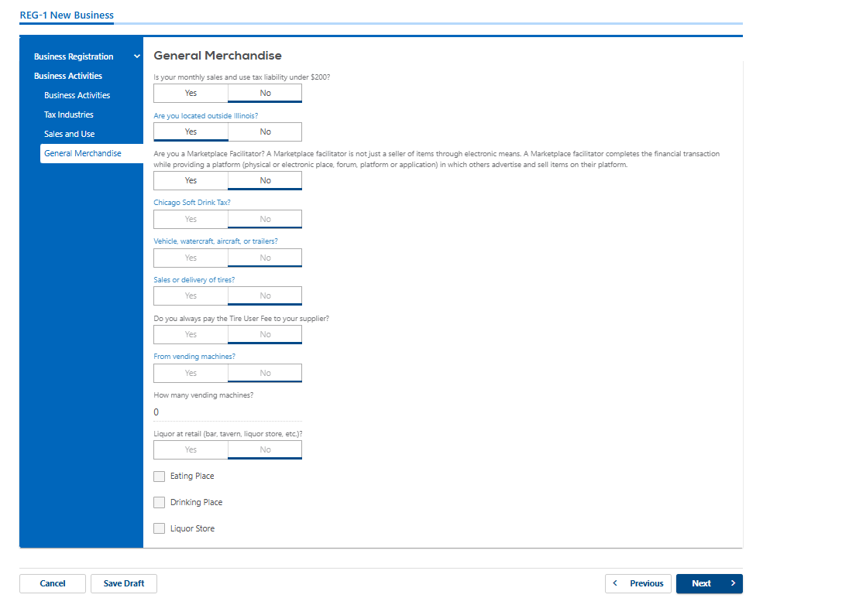
Sales Tax and More - IL Registration
Step 11 General Merchandise
Is your monthly sales and use tax liability under $200? NO
Are you located outside Illinois? YES
Are you a Marketplace Facilitator? NO
Chicago Soft Drink Tax? NO
Vehicle, watercraft, aircraft, or trailers? NO
Sales or delivery of tires? NO
Form vending machines? NO
Liquir at retail? NO
Click Next
https://www.salestaxandmore.com/

Slide 14
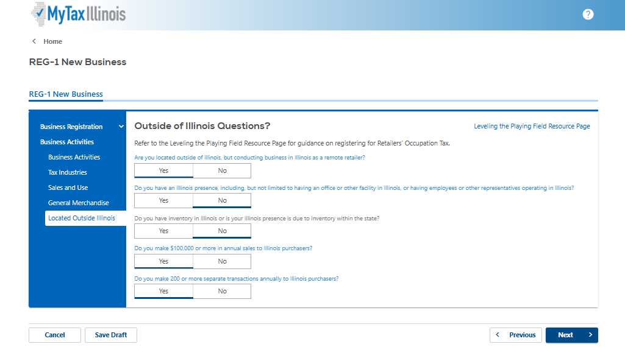
Sales Tax and More - IL Registration
Step 13 Outside of Illinois Questions
Are you located outside of Illinois, but conducting business in Illinois as a remote retailer? YES
Do you have an Illinois presence, including, but not limited to having an office or other facility in Illinois, or having employees or other representatives operating in Illinois? NO
Do you have inventory in Illinois or is your Illinois presence is due to inventory within the state? NO
Do you make $100,000 or more in annual sales to Illinois purchasers? YES
Do you make 200 or more separate transactions annually to Illinois purchasers? YES
Click Next
https://www.salestaxandmore.com/

Slide 15
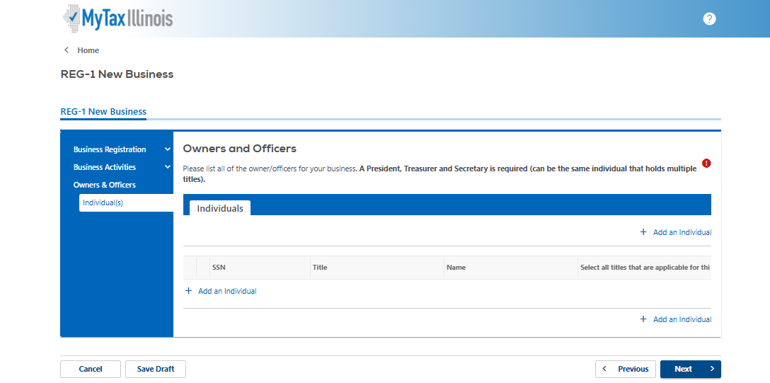
Sales Tax and More - IL Registration
Step 14 Owners and Officers
Click + Add an Individual
Go to next slide
https://www.salestaxandmore.com/

Slide 16
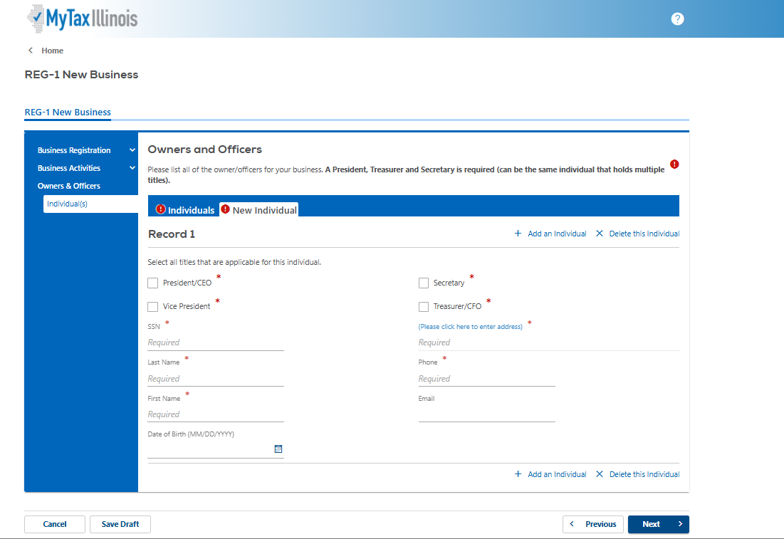
Sales Tax and More - IL Registration
Step 14: Owners and Officers Continued
Select all titles that are applicable for this individual:
President/CEO, Secretary,Treasurer/CFO- you must have one of these each of these- see example on slide 18
Vice President if applicable- not a required title
SSN: Type in SSN
Last Name: Type in Last Name
First Name: Type in First Name
Date of Birth: highly recommended to input birthday for this individual, but not required
Phone: Type in Business phone
Please Click here to enter address- see next slide for example
Email: Not required
Click + Add an individual until all Owners and Officers are added
Click Next
https://www.salestaxandmore.com/

Slide 17
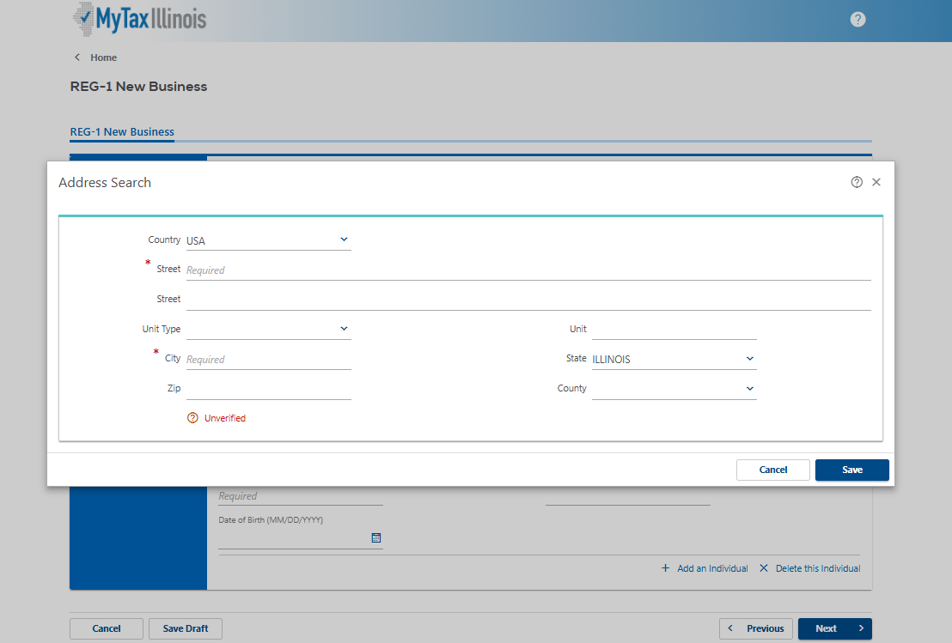
Sales Tax and More - IL Registration
Step 16
Country: Choose Country from the drop down list- if not USA
Street: Type in street address- required
Street: Use if needed
Unit Type: Choose from drop down list if applicable
Unit:Type in unit number if applicable
City: Type in City- required
State: Choose from drop down list if USA
Zip: Type in Zip code
Click Unverified to verify the address
Click Save
Next Slide
https://www.salestaxandmore.com/

Slide 18
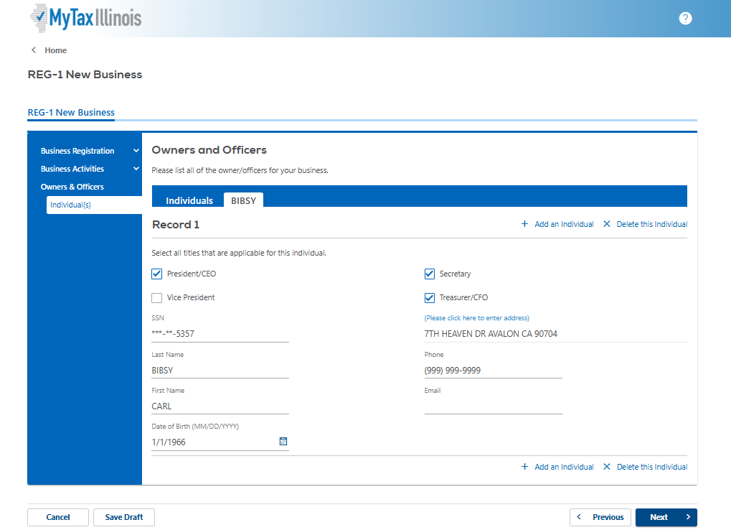
Sales Tax and More - IL Registration
Step 16- Example of Owners and Officers
Click Next once all are added
https://www.salestaxandmore.com/

Slide 19
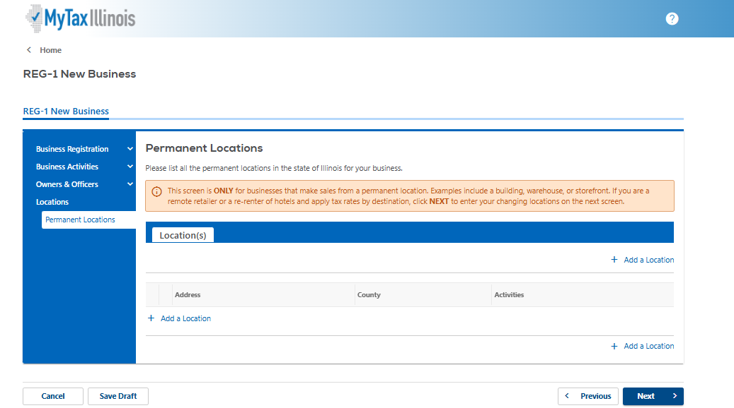
Sales Tax and More - IL Registration
Step 17 Permanent Locations
Just Click Next
https://www.salestaxandmore.com/

Slide 20
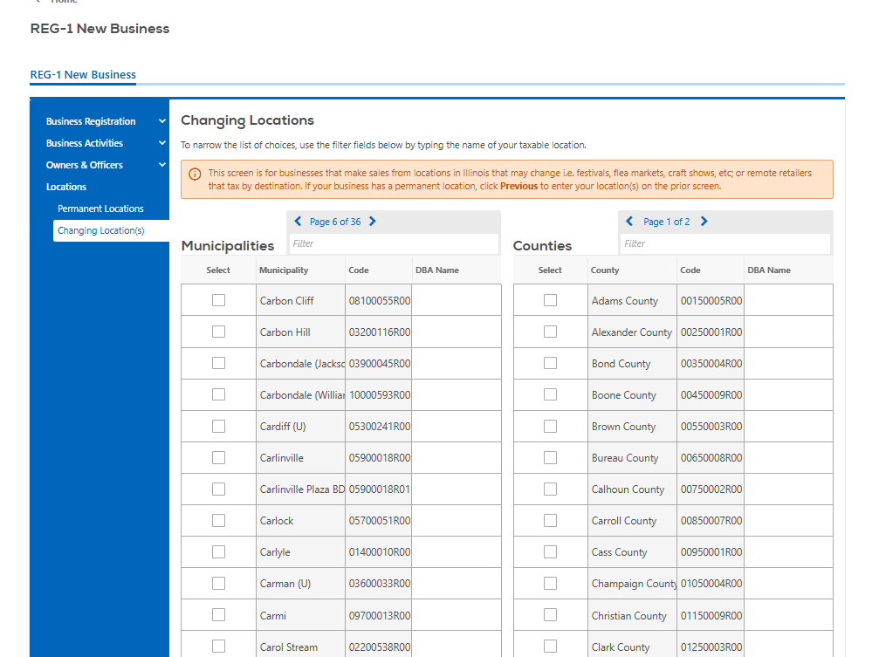
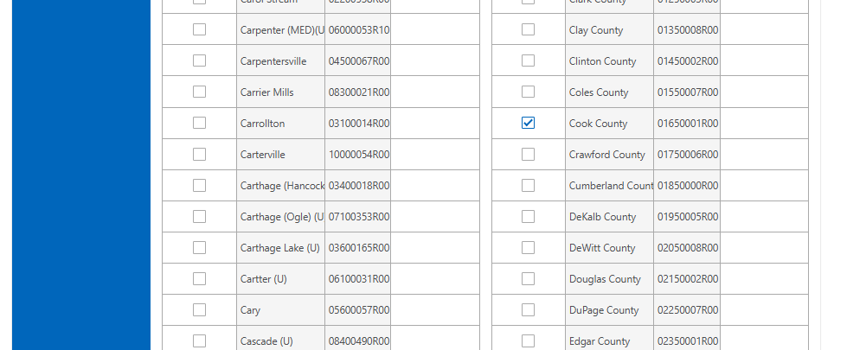
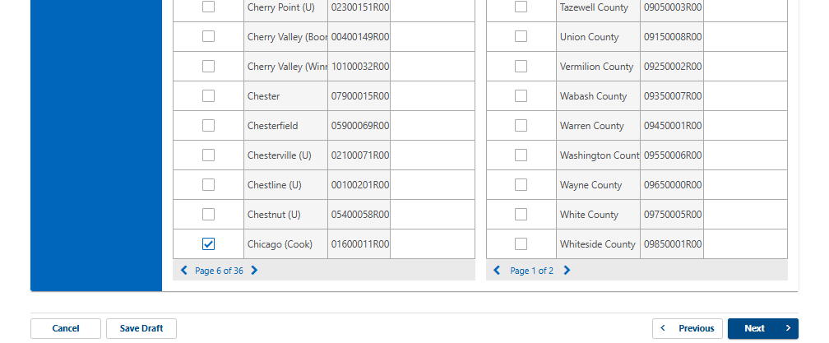
Sales Tax and More - IL Registration
Step 18 Changing Locations
Highly recommended to Choose at the minimum
Municipalities: Chicago- bottom of page 6
Counties: Cook County
Add any others that your company needs to or you can add others as needed
Highly recommended to Save a Draft at this point
Click Next
https://www.salestaxandmore.com/

Slide 21
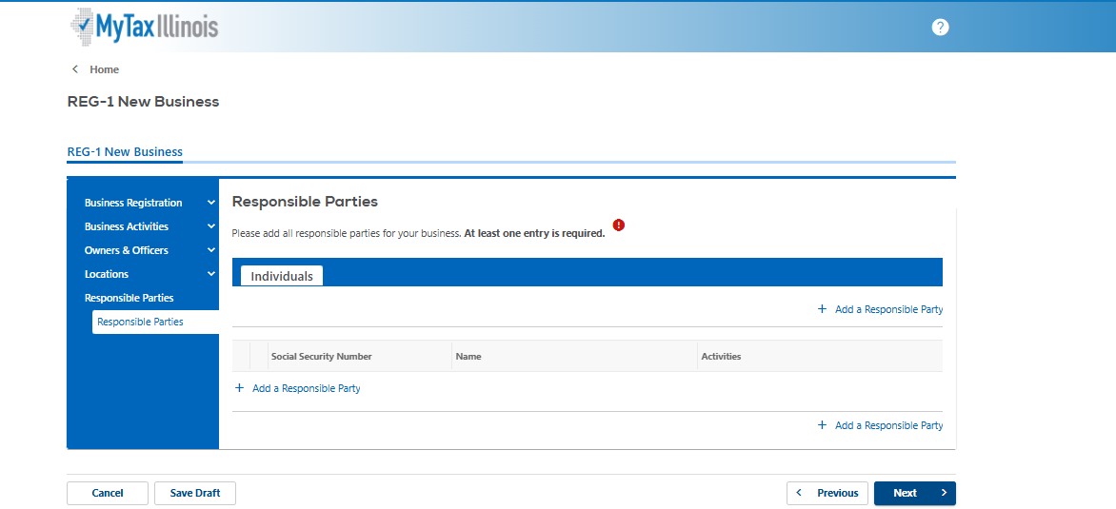
Sales Tax and More - IL Registration
Step 19 Responsible Parties
Click + Add a Responsible party Next slide
https://www.salestaxandmore.com/

Slide 22
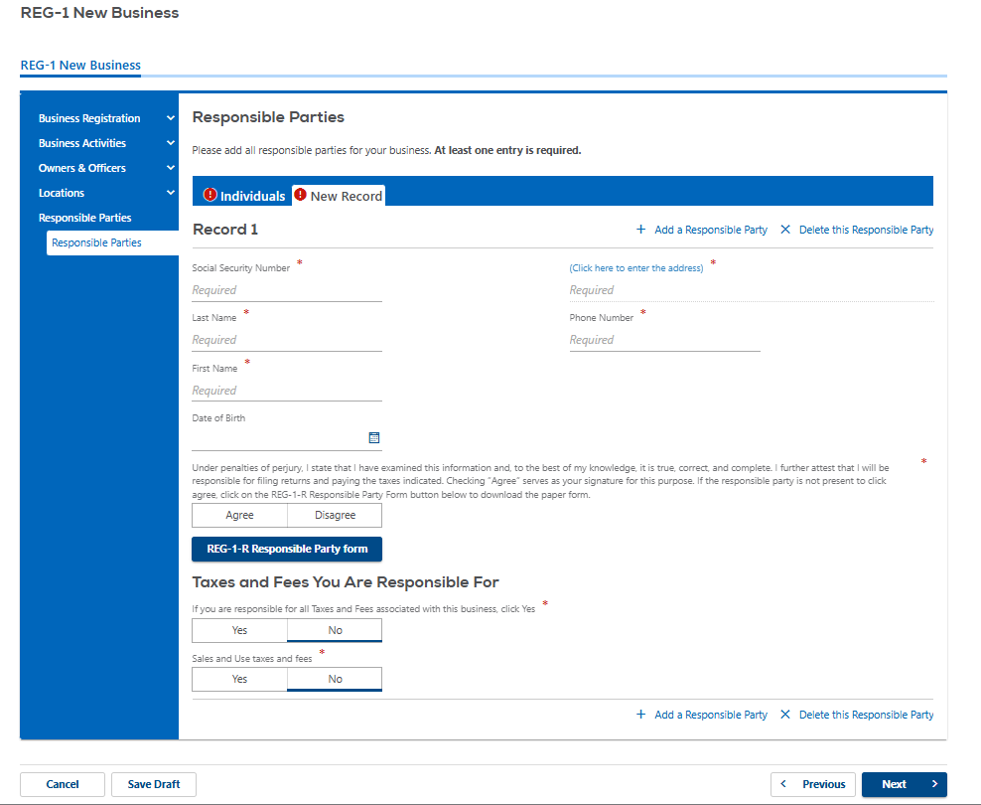
Sales Tax and More - IL Registration
Step 21 Responsiblie Parties
SSN: Type in SSN
Last Name: Type in Last name
First Name: Type in first name
Date of Birth: High recommended to enter
Under penalties of perjury, I state that I have examined this information and, to the best of my knowledge, it is true, correct, and complete. I further attest that I will be responsible for filing returns and paying the taxes indicated. Checking “Agree” serves as your signature for this purpose. If the responsible party is not present to click agree, click on the REG-1-R Responsible Party Form button below to download the paper form. AGREE
Click here to enter the address- see next slide for instructions
Phone Number: Type in business phone number
Taxes and Fees You Are Responsible For
If you are responsible for all Taxes and Fees associated with this business, click Yes- YES
Sales and Use taxes and fees- YES
Click + Add a Responsible party until all are added
Click Next
https://www.salestaxandmore.com/

Slide 23
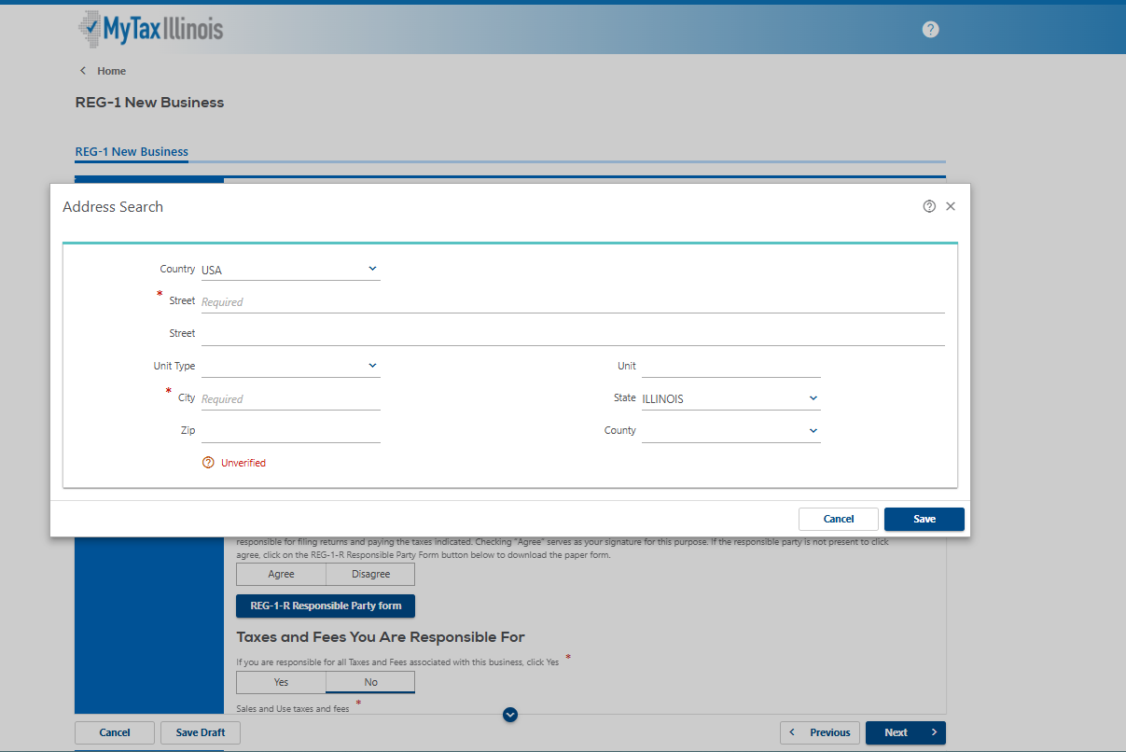
Sales Tax and More - IL Registration
Step 22
Enter - Username and password
Click - Logon
https://www.salestaxandmore.com/

Slide 24
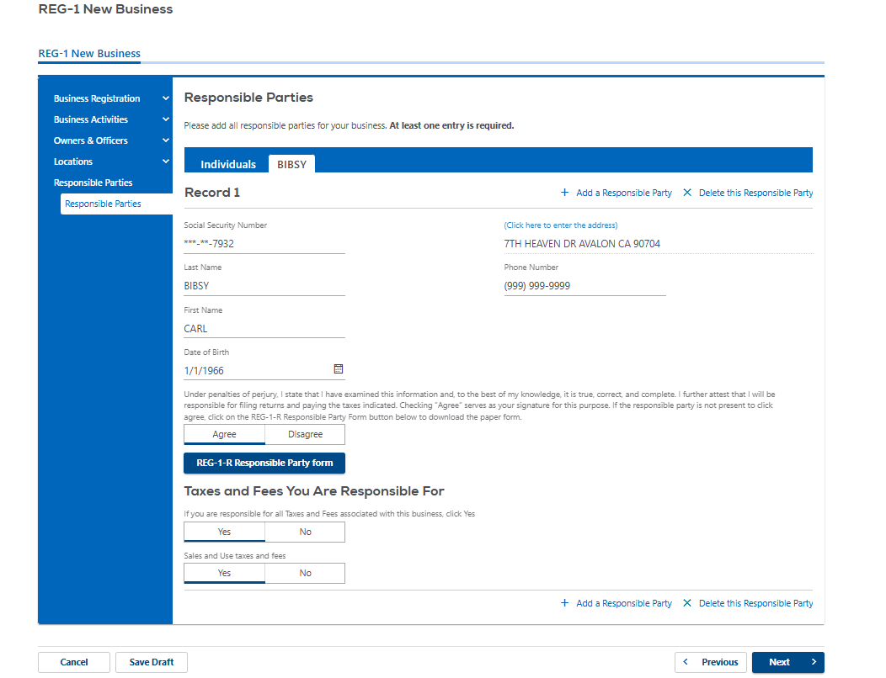
Sales Tax and More - IL Registration
Step 23 Example of Responsible Parties
Go to next Slide
https://www.salestaxandmore.com/

Slide 25
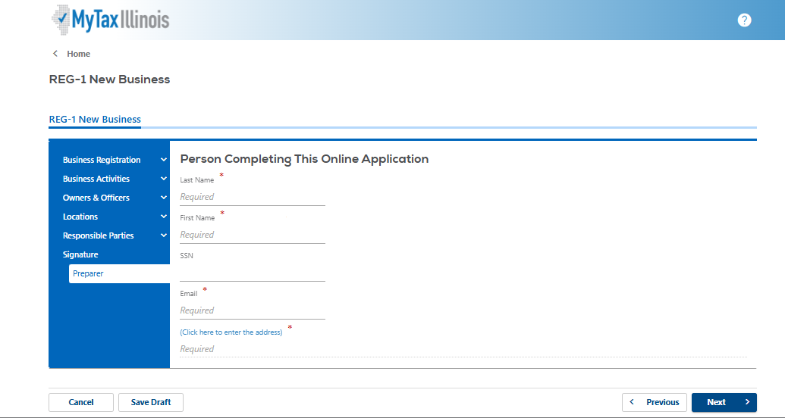
Sales Tax and More - IL Registration
Step 24 Person Completing This Online Application
Last Name: Type in Last Name of Person Completing the form
First Name:Type in Last Name of Person Completing the form
SSN: SKIP- not required
Email: type in business email address
Please Click here to enter address- see next slide for example
Click Next
https://www.salestaxandmore.com/

Slide 26
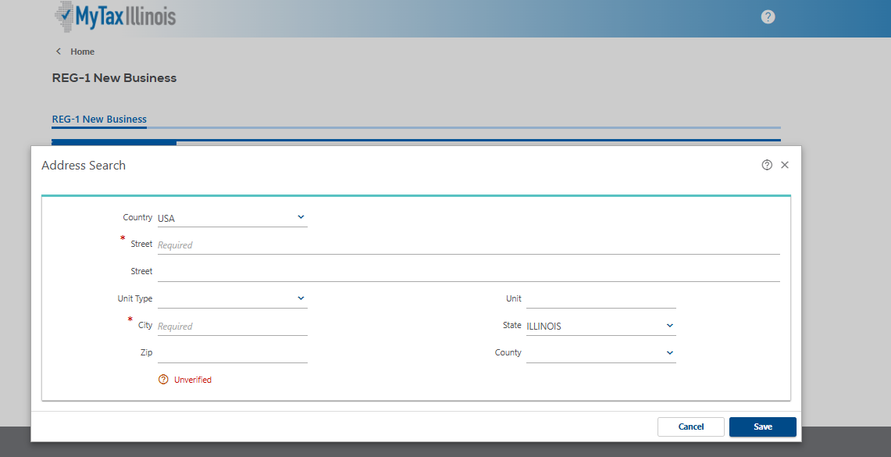
Sales Tax and More - IL Registration
Step 24 Person Completing This Online Application- Continued
Country: Choose Country from the drop down list- if not USA
Street: Type in street address
Street: Use if needed
Unit Type: Choose from drop down list if applicable
Unit: Type in unit number for the Unit type if applicable
City: Type in City- required
State: Choose from drop down list if USA
Zip: Type in Zip code
Click Unverified to verify the address
Click Save
Next slide
https://www.salestaxandmore.com/

Slide 27
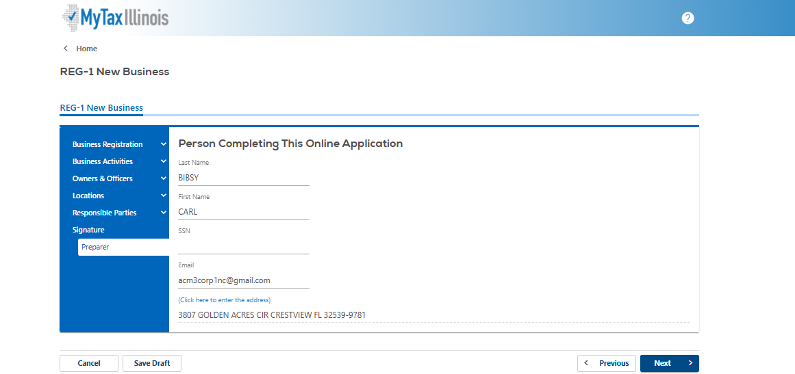
Sales Tax and More - IL Registration
Step 24 Person Completing This Online Application- Example
Click Next once it looks like this, Next slide
https://www.salestaxandmore.com/

Slide 28
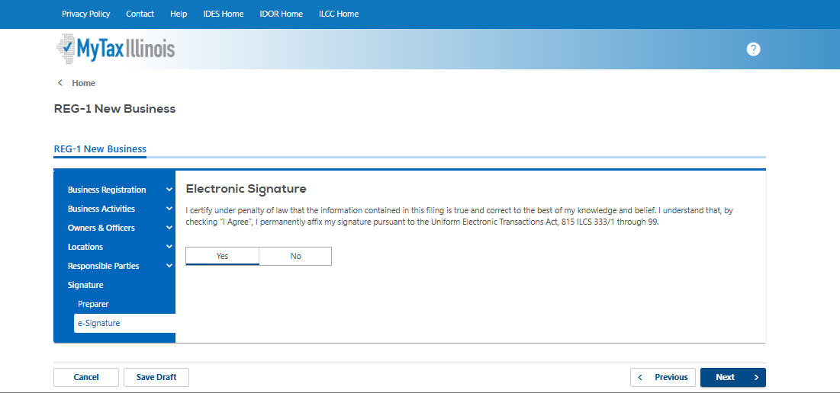
Sales Tax and More - IL Registration
Step 26 Electronic Signature
I certify under penalty of law that the information contained in this filing is true and correct to the best of my knowledge and belief. I understand that, by checking “I Agree”, I permanently affix my signature pursuant to the Uniform Electronic Transactions Act, 815 ILCS 333/1 through 99. YES
Click Next
https://www.salestaxandmore.com/

Slide 29
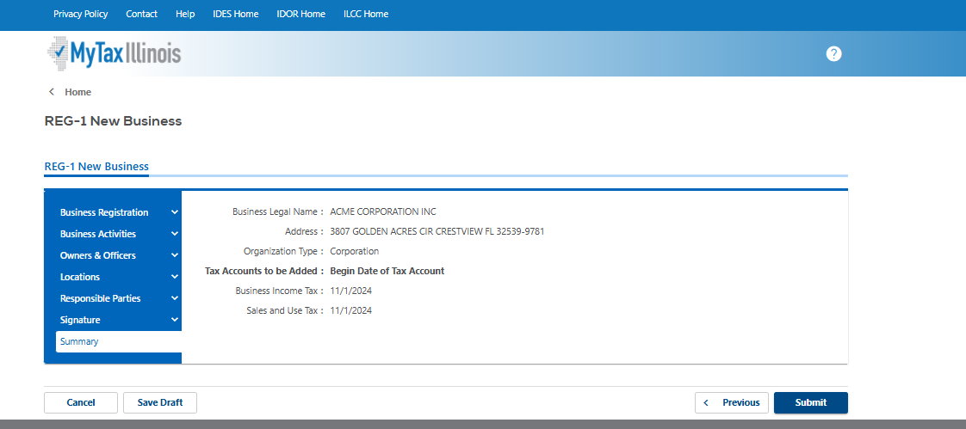
Sales Tax and More - IL Registration
Step 27 This is the summary page, Highly recommended to Hit Save Draft and then Review the entire document before hitting submit. Next slide
https://www.salestaxandmore.com/

Slide 30
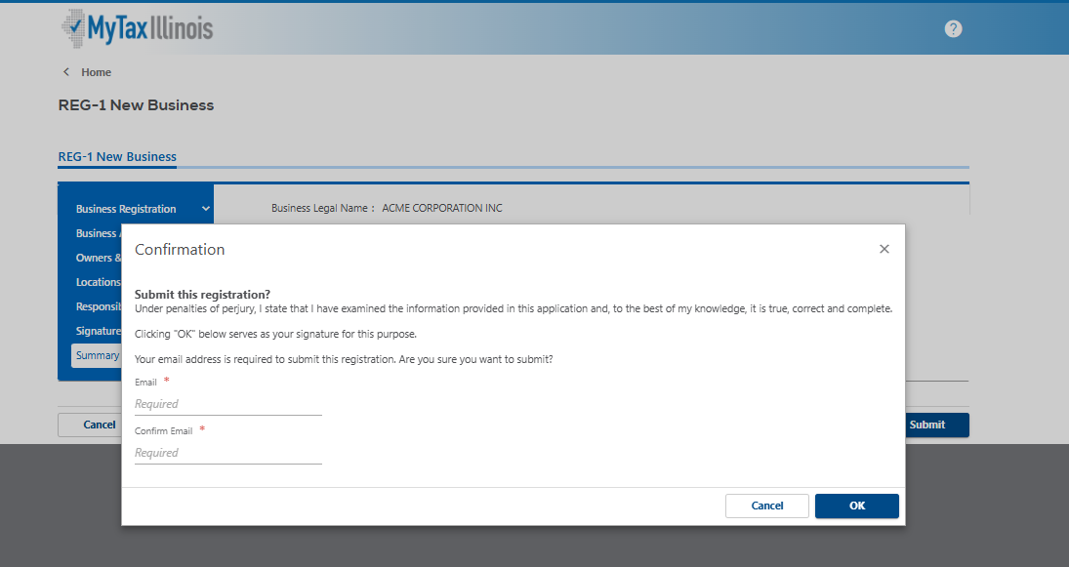
Sales Tax and More - IL Registration
Step 28 Final step Submit enter business email 2 times and Click OK, the next slide shows a confirmation page example
https://www.salestaxandmore.com/

Slide 31
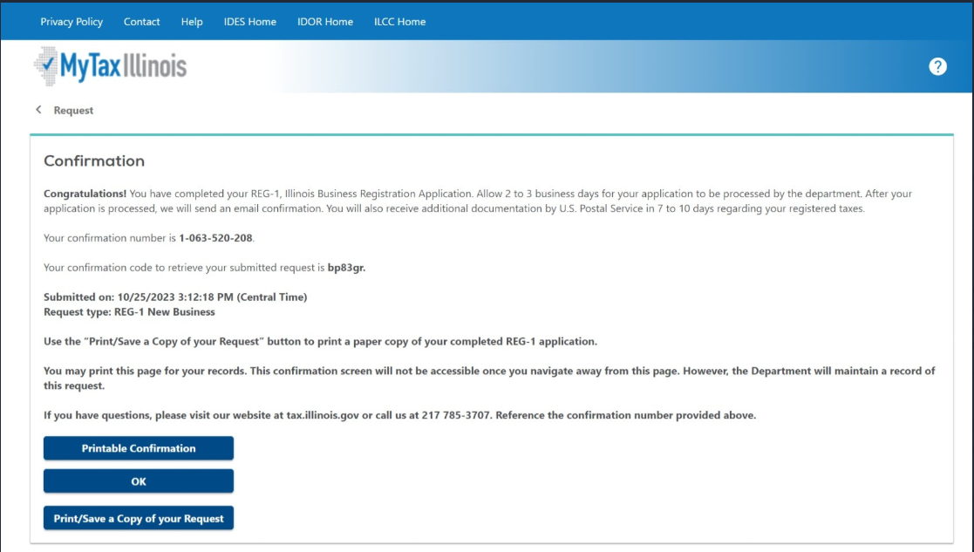
Sales Tax and More - IL Registration
Step 29 Confrimation Example and email is also sent to the email provided in the registration
https://www.salestaxandmore.com/

