Slide 1
Lecture on
PCO 351 (General Principles of Pharmacology)
Pharmacodynamics
Niger Delta University
December, 2022
Professor Jonah Sydney Aprioku

Slide 2
Binding of drug molecules
Most drugs combine with some molecular structures on the surface of or within the cell to produce a pharmacological response.
These critical binding sites of drugs are often referred to as 'drug targets' and most drug targets are protein molecules.
Some drugs (e.g., antimicrobial, anticancer drugs), mutagenic and carcinogenic agents interact directly with DNA rather than protein.
Four types of regulatory proteins as primary drug targets:
        receptors, enzymes,
        carrier molecules (transporters) and
        ion channels.

Slide 3
Drug receptors & biological responses
Receptor is any target molecule with which a drug molecule has to combine in order to elicit its specific effect.
Receptors are molecular substances or macromolecules in tissues that not only combine chemically with the drug but also with endogenous molecules.
It is generally assumed that all receptors with which drugs combine are receptors for neurotransmitters, hormones, or other physiological substances.
Thus, the discovery of a specific receptor for a group of drugs can lead to a search for previously unknown endogenous substances that combine with those same receptors.
For example, evidence was found for the existence of endogenous peptides with morphine-like activity termed endorphins and enkephalins. It is now clear that morphine mimics endorphins or enkephalins by combining with same receptors

Slide 4
Theories of drug actions
  The interaction of the drug and the receptor results in a molecular change in the receptor, such as an altered configuration or charge distribution, and thereby triggers a chain of events leading to a response.
  The drug–receptor interaction can be better appreciated through a specific example (the end-plate region of a skeletal muscle fiber).
  The end-plate region of a skeletal muscle fiber contains large numbers of receptors having a high affinity for the transmitter acetylcholine (Ach). The sequence of events that lead to response can be shown diagrammatically as follows:
  Ach + receptor → Na⁺ influx → Action potential → Increased free Ca²⁺ → Contraction

Slide 5
Agonists and Antagonists
Agonists are drugs or chemicals that interact with a receptor and initiate a cellular reaction. An agonist mimics the actions of endogenous compounds that interact with same receptor. E.g., acetylcholine, nicotine and carbamylcholine, are agonists for the receptors in the skeletal muscle end plate.
Antagonists are drugs or chemicals that interact with a receptor and prevents the interaction of an agonist with its receptor. An antagonist is unable to initiate a cellular reaction, but binds and occupies the receptor site to make it inaccessible to agonists. E.g., d-tubocurarine is an antagonist of acetylcholine at the end-plate receptors. Administration of d-tubocurarine therefore results in muscle relaxation.

Slide 6
Drug specificity
For a drug to be useful as either a therapeutic or a scientific tool, it must have a considerable degree of selectivity in its actions. That is, it must show a high degree of binding site specificity.
It follows also that the drug targets or receptors with which drugs interact must generally show a high degree of ligand specificity; they will interact with only structurally related or complementary ligands and ignore closely related molecules.

Slide 7
Drug receptor classification
Receptors are generally classified based on pharmacological responses. However, with advancement of knowledge and modern technology, newer experimental approaches are also used, which include:
    Direct measurement of ligand binding to receptors
    Molecular cloning which permits the classification receptors at a much finer level of detail than can be reached through pharmacological analysis.
    Analysis of biochemical pathways that are linked to receptor activation

Slide 8
Chemistry of drug receptor binding
Biological receptors are capable of combining with drugs in a number of ways, and the forces that attract the drug to its receptor must be sufficiently strong and long-lasting to permit the initiation of the sequence of events that ends with the biological response. These forces are chemical bonds, and which form the initial drug–receptor complex:
Ionic bond: 5 kcal/mole, reversible
Hydrogen bond: reversible, important in establishing the selectivity and specificity of drug–receptor interactions.
Van der Waals bond: 0.5 kcal/mole, reversible, important for structure–activity relationships among related agonists
Covalent bod: 100 kcal/mole, irreversible complexes
The magnitude of the response is a function of the concentration of drug-receptor complexes formed at any given time.

Slide 9
Drug-receptor interactions equations
A + R AR AR* Response
B + R BR No Response
Affinity is k₁/k₂, and efficacy is represented by k₃/k₄.
Ligand A is an agonist, because it leads to activation of the receptor (R), whereas ligand B is an antagonist.
k₁
k₃
k₂
k₄
k₁
k₂

Slide 10
Potency vs Efficacy
Affinity is the measure of the net molecular attraction between a drug (or neurotransmitter or hormone) and its receptor.
Efficacy is a measure of the efficiency of the drug–receptor complex in initiating the signal transduction process. Thus, the tendency of a drug to bind to the receptors is governed by its affinity, whereas the tendency for it, once bound, to activate the receptor is denoted by its efficacy. Agonists will possess high efficacy, whereas antagonists will in the simplest case, have zero efficacy. E.g., adrenaline (agonist) and propranolol (antagonist) have comparable affinities for the β-adrenoceptor but differ in efficacy.
Full agonists: Drugs with sufficient efficacy to elicit a maximal tissue response
Partial agonists: Drugs with intermediate levels of efficacy, such that even when 100% of the receptors are occupied the tissue response is submaximal

Slide 11
Potency vs Efficacy
Potency and intrinsic activity are simple measurements, respectively, of the relative positions of dose–response curves on their horizontal axes and of their relative maxima.
Potency is the amount of drug that is needed to produce a given response.

Slide 12
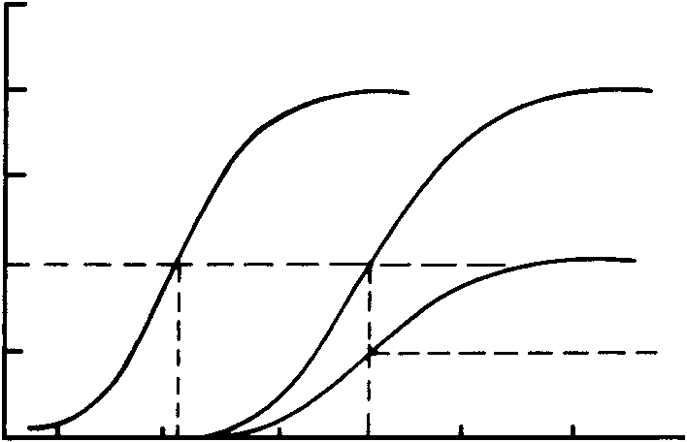
Potency vs Efficacy
Potency and intrinsic activity are simple measurements, respectively, of the relative positions of dose–response curves on their horizontal axes and of their relative maxima.
100
Figure 1. Dose–response curves of three hypothetical drugs that increase heart rate
the dose–response curve for drug a lies to the left of the curve for drug b indicates that drug a is more potent
Drugs a and b produce the same maximum response
Drug c has less maximum effect than either drug a or drug b. Drug c is said to have a lower intrinsic activity than the other two.
100
80
a
b
80
a
b
60
60
Increase in Heart Rate (beats/min)
40
c
40
c
20
20
0
0.1
0.3
1
3
10
30
g/kg

Slide 13
Potency vs Efficacy
E.g., adrenaline (epinephrine) and propranolol have comparable affinities for the β-adrenoceptor but differ in efficacy. Drugs with intermediate levels of efficacy, such that even when 100% of the receptors are occupied the tissue response is submaximal, are known as partial agonists, to distinguish them from full agonists, the efficacy of which is sufficient that they can elicit a maximal tissue response.

Slide 14
Spare receptors
Several full agonists are capable of eliciting maximal responses at very low occupancies, often less than 1%. The mechanism linking the response to receptor occupancy has a substantial reserve capacity and such systems may be said to possess spare receptors, or a receptor reserve.
This is common with drugs that elicit smooth muscle contraction e.g., acetylcholine and its analogues but less so for other types of receptor-mediated response, such as secretion, smooth muscle relaxation or cardiac stimulation, where the effect is more nearly proportional to receptor occupancy.
The spare receptors do not increase its response.

Slide 15
Second messengers
Many receptors are capable of initiating a chain of events involving second messengers.
Key factors in many of these second-messenger systems are proteins termed guanine nucleotide–binding proteins or simply G proteins.
G proteins have the capacity to bind guanosine triphosphate (GTP) and hydrolyze it to guanosine diphosphate (GDP).
G proteins couple the activation of several different receptors to the next step in a chain of events. The next step often involves the enzyme adenylyl cyclase.

Slide 16
Second messengers
Many neurotransmitters, hormones, and drugs can either stimulate or inhibit adenylyl cyclase through their interaction with different receptors; these receptors are coupled to adenylate cyclase through either a stimulatory (G_{S}) or an inhibitory (G₁) G protein.
The activation of adenylyl cyclase enables it to catalyze the conversion of ATP to cAMP, which in turn can activate a number of enzymes known as kinases. Each kinase phosphorylates a specific protein or proteins.
Such phosphorylation reactions are known to be involved in the opening of some calcium channels as well as in the activation of other enzymes.

Slide 17
Second messengers
Receptor-coupled G proteins can also activate other enzymes or directly influence ion channel functions.
Examples of G protein couple receptors: norepinephrine and epinephrine (α- and β-adrenoceptors), 5-hydroxytryptamine (serotonin or 5-HT receptors), and muscarinic acetylcholine receptors.
The specific binding sites for agonists occur at the extracellular surface, while the interaction with G proteins occurs with the intracellular portions of the receptor.
The general term for any chain of events initiated by receptor activation is called signal transduction.

Slide 18
Dose-response relationship
The degree of effect produced by a drug is generally a function of the amount administered and this relationship can be expressed in terms of a dose–response curve.
In general, biological responses to drugs are graded; that is, the response continuously increases (up to the maximal responding capacity of the given responding system) as the administered dose continuously increases.
When a graded dose–response relationship exists, the response to the drug is directly related to the number of receptors with which the drug effectively interacts.

Slide 19
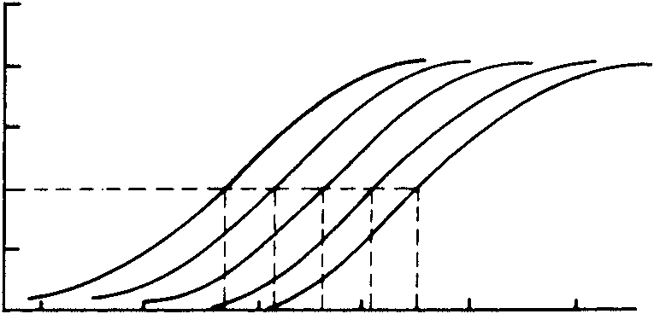
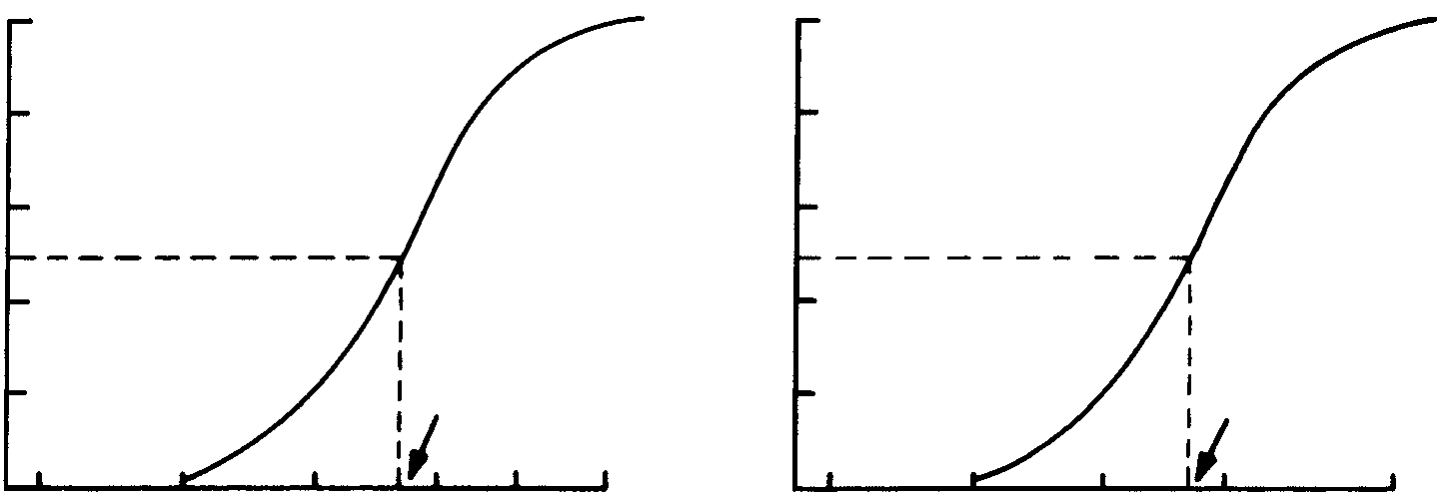
Quantal relationship vs Graded doses
Quantal relationship expresses the relationship between dose and some specified quantum of response within a given population- obtained from a quantal dose–response curve (Figures 2a and 2b).
Graded dose response expresses graded responses to graded doses in a single animal (or patient); that is, as the dose is increased, the response increases. graded dose–response curve (Figure 3).
Fig. 2a
Fig. 2b
100
Fig. 3
100
100
a
b
d
100
100
80
c
e
80
80
80
80
60
60
60
100
Animals Protected (%)
Increase in Heart Rate (beats/min)
60
60
Animals Killed (%)
80
40
40
40
40
ED₅₀
40
60
abcde
20
20
LD₅₀
20
40
20
ED
50
20
LD
50
1
2
20
3
5
7
10
10
20
30
50
100
0.001
0.01
0.1
1.0
10
100
Phenobarbital (mg/kg)
Phenobarbital (mg/kg)
0
Levaterenol (g/kg)

Slide 20
Drug antagonism
Drug Antagonism occurs when the effect of one drug is diminished or completely terminated in the presence of another.
Types classified as follows:
Chemical antagonism
Physiological (Functional) antagonism
Pharmacokinetic Antagonism
Competitive antagonism
Noncompetitive antagonism

Slide 21
Drug antagonism cont.
Chemical antagonism: involves a direct chemical interaction between two substances in solution resulting in the loss of action of the active drug. Example is the use of chelating agents (e.g., dimercaprol) that bind with and inactivate heavy metals (e.g., mercury, arsenic, and gold) and enhance their removal from the body.
Physiological antagonism: interaction of two agonists that act independently of each other but happen to cause opposite effects. Thus, indirectly, each tends to cancel out or reduce the effect of the other. Example is acetylcholine and adrenaline. Acetylcholine slows the heart, and epinephrine accelerates it. Acetylcholine stimulates intestinal movement, and epinephrine inhibits it, etc

Slide 22
Drug antagonism cont.
Pharmacokinetic antagonism: occurs when the concurrent administration of two drugs results in the reduction of the concentration of the active drug at its site of action.
This may result from:
inhibition of the rate of absorption of the active drug from the gastrointestinal tract
increase in the metabolic degradation of the active drug or
increase in the rate of renal excretion of the active drug

Slide 23
Drug antagonism cont.
Competitive antagonism: most frequently encountered type of drug antagonism in clinical practice. The antagonist combines with the same site on the receptor as does the agonist, but unlike the agonist, does not induce a response; that is, the antagonist has little or no efficacy. The antagonist competes with the agonist for its binding site on the receptor.
Competitive antagonists types:
Reversible competitive or equilibrium competitive- bond formed between the antagonist and the receptor is loose. The antagonism increases as the concentration of the antagonist increases. Conversely, the antagonism can be overcome (surmounted) if the concentration of the agonist at the receptor sites is increased (Figure 3). Examples atropine, d-tubocurarine
irreversible competitive or nonequilibrium competitive: bond formed between the antagonist and the receptor is covalent and not readily reversible.

Slide 24

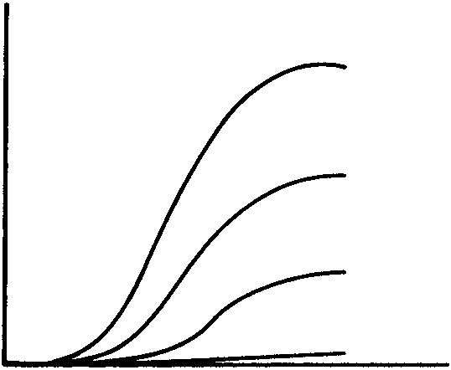
Drug antagonism cont.
A
a
b
c
.
d
a
b
c
d
Figure 3: Idealized dose–response curves of an agonist in the absence (a) and the presence (b, c, d) of increasing doses of an (A) equilibrium-competitive antagonist; (B) a non–equilibrium-competitive antagonist.
Response
B
a
a
Response
b
b
c
c
d
d
Dose of agonist (geometric scale)

Slide 25
Drug antagonism cont.
Noncompetitive antagonism: the antagonist acts at a site beyond the receptor for the agonist. The difference between a competitive and a noncompetitive antagonist can be appreciated from the following scheme, in which two agonists, A and B, interact with totally different receptor systems, RA and RB, to initiate a chain of events leading to contraction of a vascular smooth muscle cell.
The practical difference between a noncompetitive antagonist and a irreversible-competitive antagonist is specificity. The noncompetitive antagonist antagonizes agonists acting through more than one receptor system; the irreversible-competitive antagonist antagonizes only agonists acting through one receptor system.
The antihypertensive drugs diazoxide (increases K⁺ permeability), verapamil, nifedipine (block the influx of Ca²⁺ through the cell membrane) are few examples of therapeutically useful noncompetitive antagonists’.

Slide 26
Tachyphylaxis and tolerance
Generally, the effect of some drugs gradually diminish when they are given continuously or repeatedly. When this phenomenon develop within a short period of time (e.g., within a few minutes) it is described as tachyphylaxis or desensitization. When the decrease in responsiveness to a drug is more gradual (e.g., taking days or weeks to develop), the phenomenon is described as tolerance.
Other related terms include refractoriness and drug resistance. The term refractoriness is used mainly in relation to a loss of therapeutic efficacy, while drug resistance is used to describe the loss of effectiveness of antimicrobial or antitumour drugs.

Slide 27
Tachyphylaxis and tolerance
Mechanisms of tachyphylaxis and tolerance:
Change in receptors
Loss of receptors: E.g., β-adrenoceptors
Exhaustion of mediators: e.g., amphetamine
Increased metabolic degradation of the drug
Physiological adaptation
Active extrusion of drug from cells (mainly relevant in cancer chemotherapy)

Slide 28
THANK YOU

