Slide 1
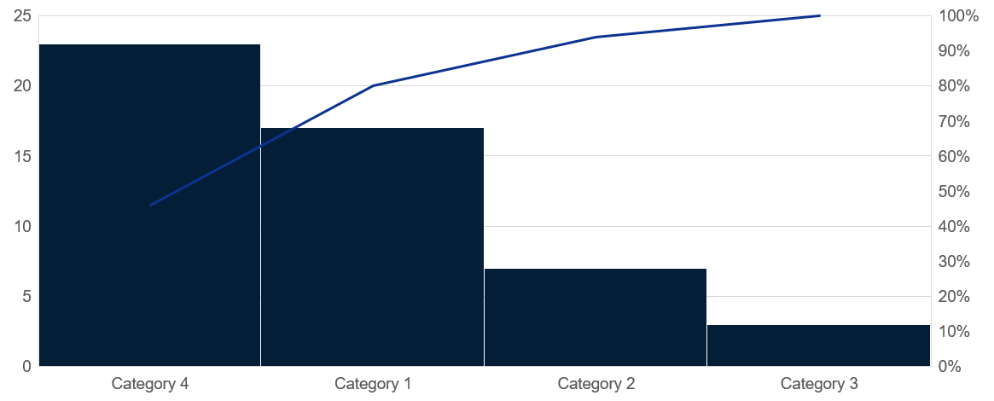
Histogram
Click to edit Header text styles
Source: Complete if required

