Slide 1
CAMOUFLAGE
Free Template
Here is where your presentation begins

Slide 2
Contents
Contents
01
03
Get a modern PowerPoint Presentation that is beautifully designed.
Get a modern PowerPoint Presentation that is beautifully designed.
Contents
Contents
02
04
Get a modern PowerPoint Presentation that is beautifully designed.
Get a modern PowerPoint Presentation that is beautifully designed.
Agenda Infographic

Slide 3
BANG!
Here you can introduce yourself, write your email...

Slide 4
TABLE OF CONTENTS
01
02
03
04
INTRODUCTION
EQUIPMENT
OUR MISSIONS
OUR TEAM
You can talk about the topic of the section here
You can talk about the topic of the section here
You can talk about the topic of the section here
You can talk about the topic of the section here

Slide 5
Hello!
I am Jayden Smith
I am here because I love to give presentations. You can find me at @username

Slide 6
INTRODUCTION
You can add here a subtitle

Slide 7
INTRODUCTION
Venus is a planet with a beautiful name and is the second one from the Sun. It’s terribly hot—even hotter than Mercury—and its atmosphere is extremely poisonous

Slide 8
Infographic Style
We Create Quality
Professional PPT Presentation
You can simply impress your audience and add a unique zing and appeal to your Presentations. I hope and I believe that this Template will your Time, Money and Reputation.
Content Here
Content Here
Content Here
You can simply impress your audience and add a unique zing and appeal to your Presentations.
You can simply impress your audience and add a unique zing and appeal to your Presentations.
You can simply impress your audience and add a unique zing and appeal to your Presentations.

Slide 9
TWO COLUMNS
MERCURY
VENUS
Mercury is the closest planet to the Sun and the smallest one in the Solar System. It was named after a god
Venus has a beautiful name and is the second planet from the Sun. Its atmosphere is poisonous

Slide 10
This is a slide title
Here you have a list of items
And some text
But remember not to overload your slides with content
Your audience will listen to you or read the content, but won’t do both.

Slide 11
LIST OF REQUIREMENTS TO JOIN THE ARMY
You can write an item on your list here
You can write an item on your list here
You can write an item on your list here
You can write an item on your list here
You can write an item on your list here
You can write an item on your list here
You can write an item on your list here
You can write an item on your list here
You can write an item on your list here
You can write an item on your list here

Slide 12
Big concept
Bring the attention of your audience over a key concept using photos, icons or illustrations

Slide 13
EQUIPMENT FOR MISSIONS
MARS
JUPITER
SATURN
Despite being red, Mars is actually a cold place full of iron oxide dust
It’s a gas giant and the
biggest planet in the Solar System
Yes, this is the ringed one. It’s composed of hydrogen and helium

Slide 14
A
WESOME
Presentation
We Create Quality
Professional PPT Presentation
You can simply impress your audience and add a unique zing and appeal to your Presentations. I hope and I believe that this Template will your Time, Money and Reputation.
Content Here
Content Here
You can simply impress your audience and add a unique zing and appeal to your Presentations.
You can simply impress your audience and add a unique zing and appeal to your Presentations.

Slide 15
TYPES OF MILITARY HELMETS
MERCURY
VENUS
NEPTUNE
SATURN
It’s the closest planet to the Sun
It has a beautiful name, but it’s hot
It’s the farthest planet from the Sun
This planet has several rings

Slide 16
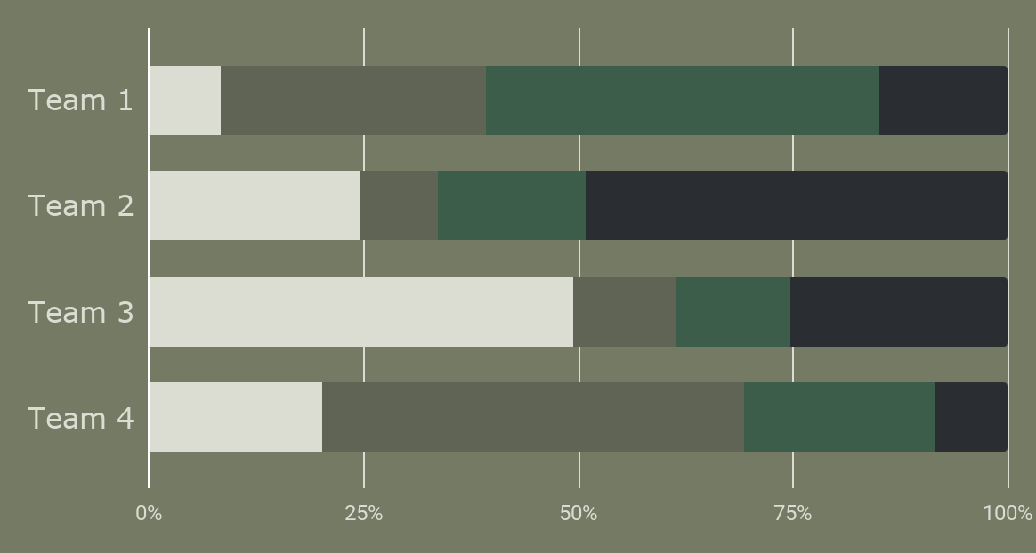
COVERAGE COLORS
Mercury
Jupiter
Venus
Mars
To modify this graph, click on the link, change the data and paste the resulting graph here

Slide 17
OUR MEANS OF TRANSPORT
30% WATER
50% GROUND
20% AIR
Mars is actually a cold place
Jupiter is the biggest planet
Venus has a beautiful name

Slide 18
PERCENTAGES
25%
30%
40%
Mercury is the smallest planet
Mars is actually a cold place
Venus has a beautiful name

Slide 19
OUR MISSIONS
You can add here a subtitle

Slide 20
In two or three columns
Yellow
Is the color of gold, butter and ripe lemons. In the spectrum of visible light, yellow is found between green and orange.
Blue
Is the colour of the clear sky and the deep sea. It is located between violet and green on the optical spectrum.
Red
Is the color of blood, and because of this it has historically been associated with sacrifice, danger and courage.

Slide 21
MISSIONS AROUND THE WORLD
You can enter some relevant text here to explain this map
Mercury
Jupiter

Slide 22
TIMELINE OF MISSIONS
2008
2010
2017
2020
Saturn is a gas giant and has several rings
Mercury is the smallest planet of them all
Jupiter is a gas giant and the biggest planet
Venus is the second planet from the Sun

Slide 23
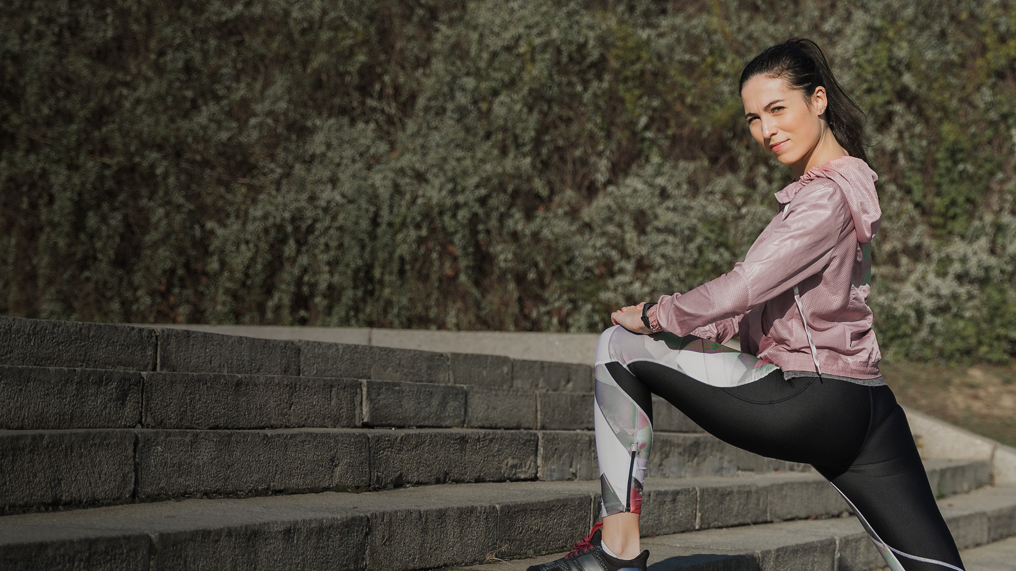
A PICTURE IS WORTH A THOUSAND WORDS

Slide 24
TWO MILITARY CONCEPTS
MERCURY
VENUS
Mercury is the closest planet to the Sun and the smallest one in the Solar System. It was named after a god
Venus has a beautiful name and is the second planet from the Sun. Its atmosphere is poisonous

Slide 25
—SOMEONE FAMOUS
“This is a quote, words full of wisdom that someone important said and can make the reader get inspired.”

Slide 26
SPECIAL AWARDS
MERCURY
VENUS
MARS
JUPITER
SATURN
NEPTUNE
Mercury is the closest planet to the Sun
Venus is the second planet from the Sun
Despite being red, Mars is actually a cold place
It’s the biggest planet in the Solar System
Saturn is the ringed one and a gas giant
Neptune is the farthest planet from the Sun

Slide 27
558,098,300
Big numbers catch your audience’s attention

Slide 28
Infographic Style
Add Contents Title
Get a modern PowerPoint Presentation that is beautifully designed. I hope and I believe that this Template will your Time, Money and Reputation. Easy to change colors, photos and Text. You can simply impress your audience. You can simply impress your audience and add a unique zing and appeal to your Presentations.
Add Contents Title
Get a modern PowerPoint
Get a modern PowerPoint
Get a modern PowerPoint
Get a modern PowerPoint

Slide 29
38,000h
10h 8m
800 km
Mercury is the closest planet to the Sun
Despite being red, Mars is a cold place
Jupiter is the biggest planet of them all

Slide 30
OUR MILITARY TEAM
GENERAL
COLONEL
MAJOR
Captain
Lieutenant
Sergeant
Corporal

Slide 31
Choose the tone
Formal
Informal
If you are using a presentation to defend your thesis, it’s better to choose a formal tone.
If you’re going to show your project to your classmates, a dynamic and funny approach could be better.

Slide 32
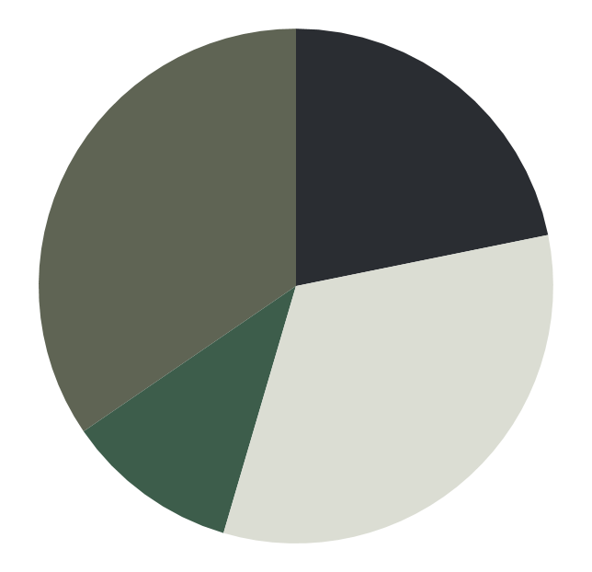
ARMY
MARS
JUPITER
VENUS
EARTH
Mars is actually a cold place
Jupiter is the biggest planet
Venus has a beautiful name
Earth is where we live on

Slide 33
ARMY RANKS
COLONEL | Despite being red, Mars is actually a cold place | Mars is full of iron oxide dust
LIEUTENANT | Jupiter is the biggest planet of them all | Jupiter is the fifth planet from the Sun
CORPORAL | Venus has a beautiful name, but it’s hot. | Venus is the second planet from the Sun
SOLDIER | Mercury is the smallest and innermost planet | It was named after the Roman messenger god

Slide 34
AWESOME WORDS

Slide 35
ARMY CONCLUSIONS
Mercury is the closest planet to the Sun and the smallest one in the Solar System—it’s only a bit larger than the Moon. The planet’s name has nothing to do with the liquid metal, since Mercury was named after the Roman messenger god

Slide 36
THANK YOU
Mercury is the closest planet to the Sun and the smallest one in the Solar System—it’s only a bit larger than the Moon
Please keep this slide for attribution

Slide 37
https://plantillaspowerpoint.org

Slide 38
ALTERNATIVE RESOURCES

Slide 39
ALTERNATIVE RESOURCES

Slide 40
ALTERNATIVE RESOURCES

Slide 41
ALTERNATIVE ICONS

Slide 42
ALTERNATIVE RESOURCES

Slide 43
...and our sets of editable icons

Slide 44
Educational Icons
Medical Icons

