Slide 1

Speak like Yoda, You Will!
String manipulation fun with Python
https://readysetcompute.com/
This work is licensed under CC BY-NC-SA 4.0
Notes:
Image generated by Grok

Slide 2

Learning Objectives
Split and join
Split and join strings in Python
Rearrange
Rearrange word order
Use
Use input/output creatively
Debugging
Practice debugging

Slide 3
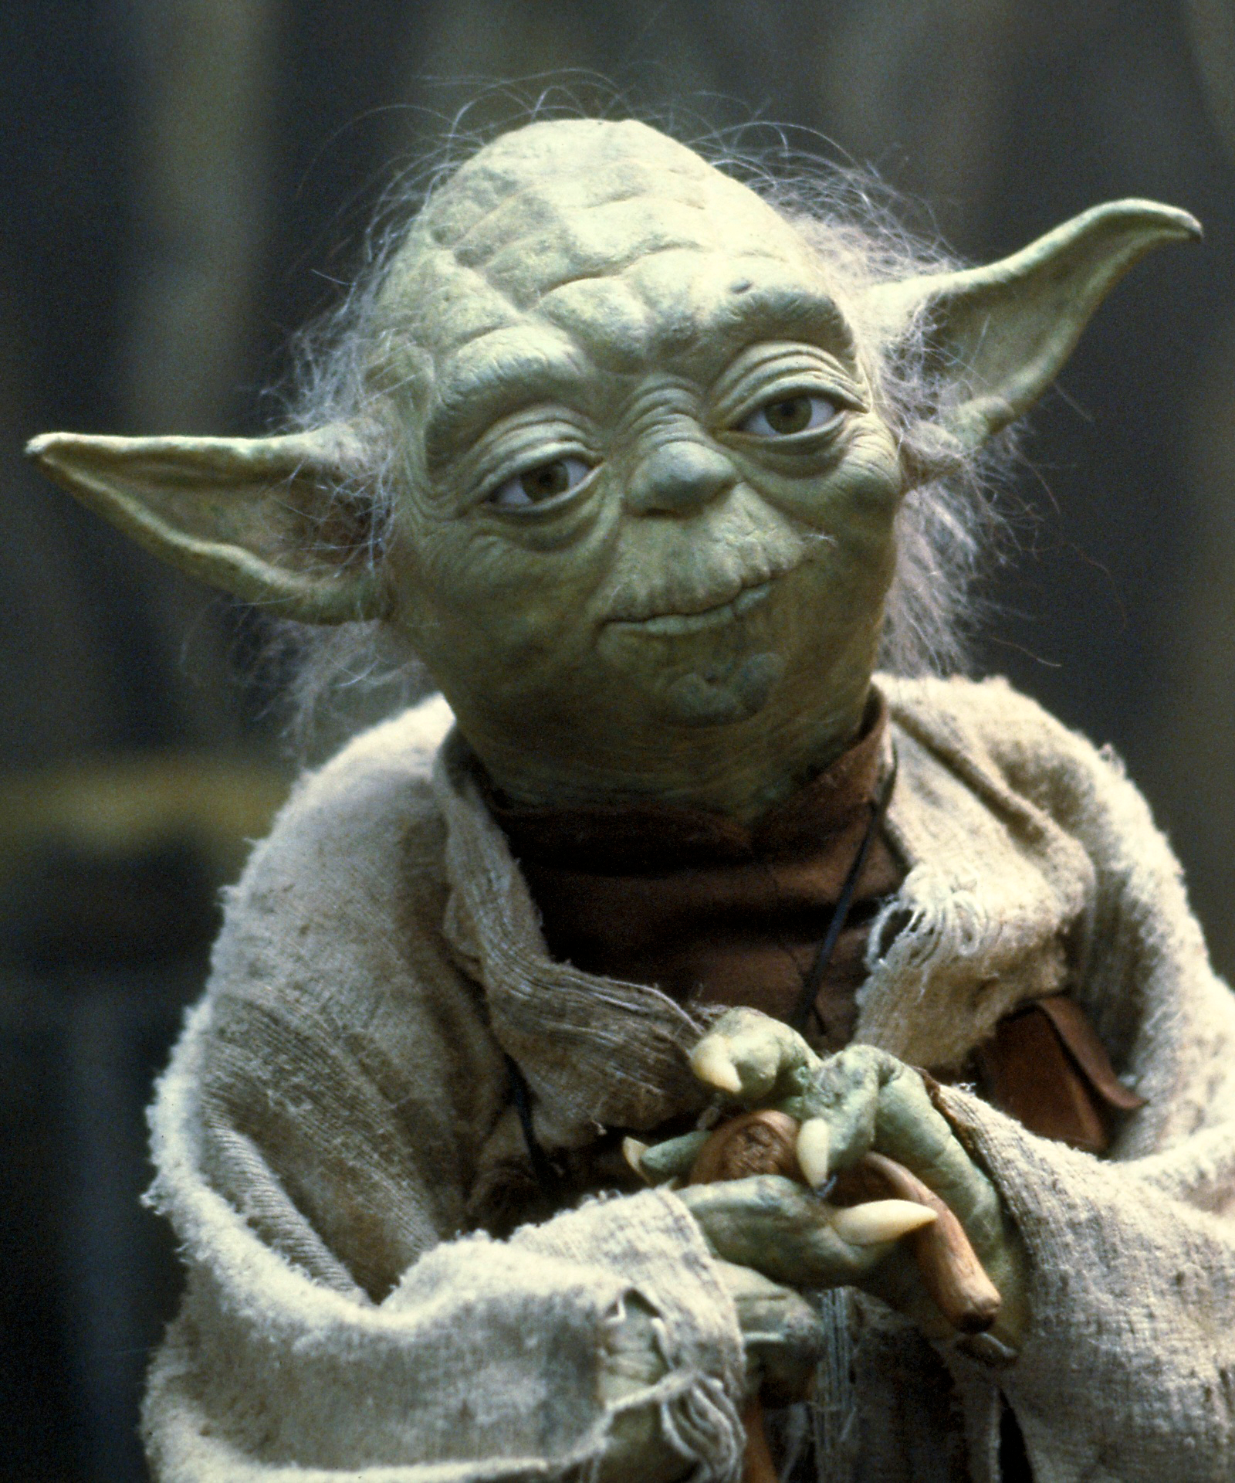
Who is Yoda?
Jedi Master from Star Wars
Famous for unusual speech
'Strong with the Force, you are.'
Notes:
Image used from Publicity photos

Slide 4
What is Yoda-Speak?
• English: Subject-Verb-Object
- I ate my lunch.
• Yoda: Object-Subject-Verb
- My lunch, I ate.
Subject-Verb-Object

Slide 5
Example Transformations
• Normal: You must do your homework.
• Yoda: Do your homework, you must.
• Normal: We are going on a school trip.
• Yoda: Going on a school trip, we are.

Slide 6
Plan for Today
Break a sentence into words
Rearrange it
Handle any input
Add a loop for fun

Slide 7
Step 1 - Basic Input
sentence = input("Enter a sentence:")
words = sentence.split()
print(words)

Slide 8
Step 2 - Rearranging
def to_yoda_speak(sentence):
words = sentence.split()
if len(words) < 4:
return sentence
mid = len(words) // 2
return ' '.join(words[mid:] + words[:mid])

Slide 9
Step 3 - Interactive Loop
while True:
sentence = input("Type a sentence (or 'exit'):")
if sentence == 'exit':
break
print("Yoda says:", to_yoda_speak(sentence))

Slide 10
Challenge Yourself!
Include examples which can be randomly chosen
Add punctuation support
Save results to a file

Slide 11
Reflection
What did you find easy?
What was tricky?
What did you learn about text in Python?

Slide 12


ReadysetCompute.com

