Slide 1
Installing Tier2/3 Behavior Supports in Schools:
The Principal’s Role
Lucille Eber
Director, Midwest PBIS Network
Notes:
The importance of Principals as instructional leaders in schools has been established. This involves leading the learning of teachers to improve the effectiveness of their instruction. The Principal’s role in guiding interactions between teachers and students applies to the instruction of social behavior as well as to academic learning. However, the learning curve for behavior instruction may be steeper than for academics as systems have historically relegated leadership of behavior interventions to Special Education.
This presentation describes the development, content and delivery of a professional development course for Principals regarding their role in multi-tiered systems of school-wide positive behavior supports (SWPBS), with specific focus on higher level behavior supports. This course for Administrators, which grew out of experiences with a federally funded “Tertiary PBIS Demonstration Project” (2006-2010), focuses on the role of the building principal to support the installation of the systems and practices needed to ensure effective supports for students with increasingly complex behavior needs.

Slide 2
Big Ideas:
Principal as Instructional Leader for Behavior
Specific Training Course for Administrators to clarify systems/data/practices and their leadership roles at Tiers 2/3 of SW-PBIS.
How does the example of this training align with research and best practices for ensuring principals function as effective leaders?
How can we embed behavior specific capacity for Principals within the overall behavioral PD for the school/district teams?
    What research is needed to guide the design of PD?
Notes:
The information I am sharing is actually a retrospective view at what we did as we jumped into a Tier 2/3 Demo process and quickly realized training the school-based teams was not enough. We developed a course for building (and district administrators that was linked to the state system for administrative recertification (1 course required for all administrators every year). Did the course have an impact on implementation and/or sustainability?

Slide 3
Context:
PBIS Implementation History in IL

Slide 4
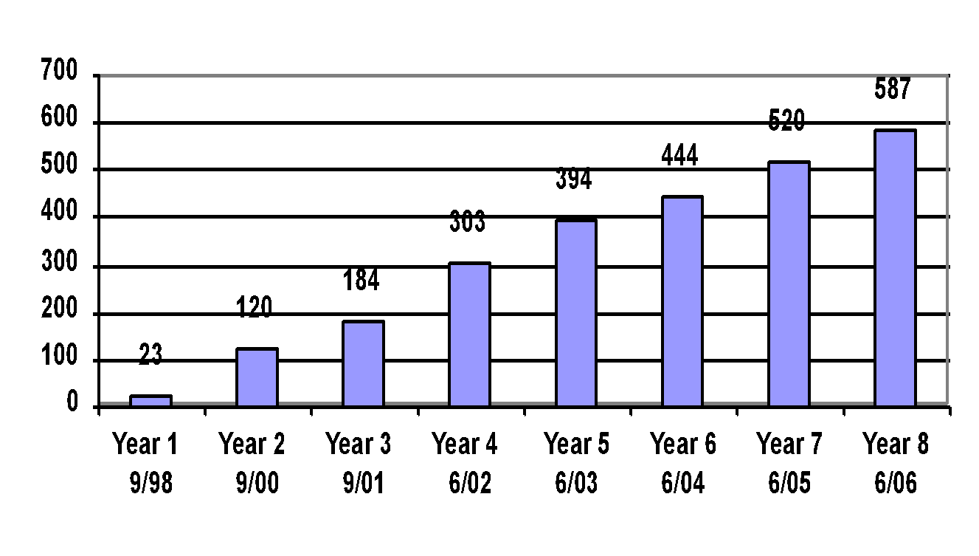
Trained and Implementing PBIS Schools Over Eight Years as of June 30, 2006

Slide 5
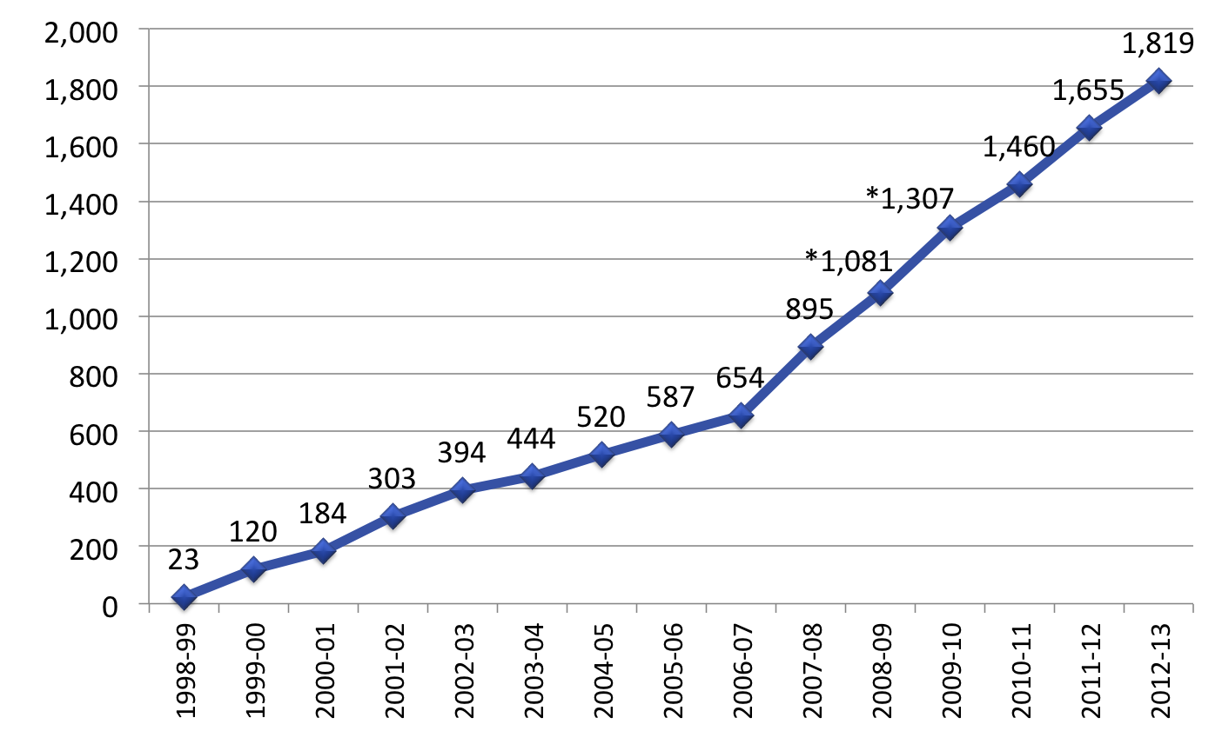
Implementing PBIS Schools Over 14 Years
* Excludes CPS data

Slide 6
Exploration-Adoption
USDOE OSEP Tertiary Demo Project 2006-2010
District Leadership Team Support (DLT) and onsite coaching
Tier 2/3 School-based Tier 2/3 Implementers
Administrator Training (Principals)
Notes:
At the initiation of Tier 2/3 Demo project, we focused on TA to DLTs and tran fro school-based teams including Principals. It became apparent the Principals initially wanted to simply have their staff trained in the Tier 3 interventions and we found that wasn’t working. The interventions were not being implemented or monitored following training, even though a) we focused on the system components in the buildings as we trained the teams and b) the Principals participated in the professional development. We refocused Training and TA to guiding DLT’s, coaches and building administrators

Slide 7
Installation of Tier 2/3 Administrator Training
6 Demo Districts (2007-08)
4 Replication Districts (2009-10)
Regionally (2010….)
State Conferences (2010….)

Slide 8
Is there a steeper learning curve for Tier 2/3 behavior (than Tier 1 behavior)?
Typically relegated to special education
Existing SpEd routines may actually interfere with installation of EBP’s?
Notes:
The importance of Principals as instructional leaders in schools has been established. This involves leading the learning of teachers to improve the effectiveness of their instruction. We believe the Principal’s role in guiding interactions between teachers and students applies to the instruction of social behavior as well as to academic learning. However, the learning curve for behavior instruction may be steeper than for academics as systems have historically relegated leadership of behavior interventions to Special Education. (Is there any research to support this hypothesis?)

Slide 9
Challenges/Obstacles to
Effective Implementation
Referrals to Sp. Ed. seen as the “intervention”
FBA seen as required “paperwork” vs. a needed part of designing an intervention
Interventions the system is familiar with vs. ones likely to produce an effect
  (ex: student sent for insight based counseling at point of misbehavior)
Notes:
What may have to change to increase effectiveness (Sp Ed viewed by us as part of the problem!)

Slide 10
Tier 2/Tier 3…..
Changing Existing Systems
Harder than starting from scratch (i.e. Tier 1)
Schools think they are “already doing it”…
  Need to “deconstruct” some existing teaming approaches and practices
  Data not being used except to justify placements
Notes:
The need for strong leadership

Slide 11
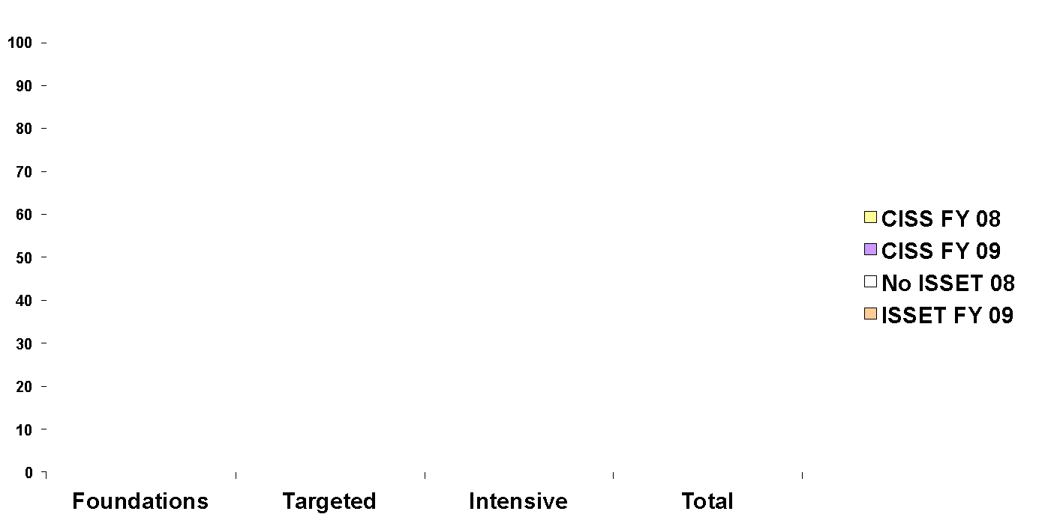
School A CISS Self-Assessment Scores & External ISSET Scores
% Implementation Fidelity
Levels of Implementation
Notes:
‹#›
High Self Evaluation compared to an external evaluation of practice. The “we think we are already doing it” syndrome.

Slide 12
Retrospective Thinking….

Slide 13
Engagement Strategies
Use relevant (their) data
Show examples with data (guilt?)
Validate/explain that it is hard
Address District expectations/structures needed

Slide 14
What are the skill sets and how do they overlap?
Leadership, Management, ‘people skills’
Organizational structures
How to use various types of data
Behavior knowledge

Slide 15
Leadership
Nuances to watch for to guide towards accuracy and efficiency
Ability to know enough to ask the right questions of their teams
Guide and support people toward change for more effectiveness and accountability
Determine which staff need to what level of information and PD (all/some/few)
Understand need to invest in practice/feedback for fluency

Slide 16
Leadership Focus: Principal interaction with District Team
Establish Universal screening process
Establish benchmark #s per their school population; ensure adequate fte allocation
Re-establish more efficient teaming structures
Re-define roles of staff
SystemTasks

Slide 17
Overall Content
Administrator’s Role: Key Messages for Leaders
Tier 2/3 District and Building readiness criteria
Systems, data and practices for advanced tiers
Ongoing assessment of current Tier 2/3 structures in their school
Action plan to leave the 1-day training with and take back to their schools to implement

Slide 18
Specifics of the Content:
  Context for Tier 1 as foundation for Tiers 2/3
  Lead/expect research-based approach to behavior
  Tools and procedures at the school level
  Changing roles of specialized staff
  Examples of interventions with potential errors leaders need to watch for and correct

Slide 19
Tools/Processes
(*for Completing AA1241 Credit Components)
Multi-Tiered Action Plan (MAP)*
Triangle Activity (data and interventions)*
Interspersed Quick Reflection/Assessments

Slide 20
Tools Used to Build Capacity for Secondary/Tertiary Implementation
Guiding Questions Tool
Secondary/Tertiary Tracking Tool
Systems Response Tool
Reverse Request for Assistance Tool
Benchmarks of Advanced Tiers

Slide 21
Quick Reflection:
Interspersed Applications to their School
Where is your school/district at with implementation of advanced Tiers?
  Blank Triangle Activity

Slide 22
Assessing your Current SW-PBIS
Systems, Data and Practices
Data
Systems/Practices
Tier 3/Tertiary Interventions 1-5%
_____________________
_____________________
_____________________
1-5% Tier 3/Tertiary Interventions
        ___________________________
        ___________________________
        ___________________________
Tier 2/Secondary Interventions 5-15%
___________________________
___________________________
___________________________
___________________________
___________________________
___________________________
5-15% Tier 2/Secondary Interventions
        ____________________________
        ____________________________
        ____________________________
        ____________________________
        ____________________________
        ____________________________
Tier 1/Universal Interventions80-90%
________________________
________________________
________________________
________________________
________________________
________________________
80-90% Tier 1/Universal Interventions
        ____________________________
        ____________________________
        ____________________________
        ____________________________
        ____________________________

Slide 23
Overall Content
Administrator’s Role: Key Messages for Leaders
Tier 2/3 District and Building readiness criteria
Systems, data and practices for advanced tiers
Ongoing assessment of current Tier 2/3 structures in their school
Action plan to leave the 1-day training with and take back to their schools to implement

Slide 24
Administrators Need to…
Have knowledge of behavior support for Tier 2/Tier 3 to guide/lead any “corrections” needed.
Know why a behavior plan may not be working and need to know how to “troubleshoot” a plan.
Ensure that systems are in place and interventions are offered routinely and rapidly at all 3 tiers to allow ALL kids to be successful

Slide 25
Context:
Some “Big Picture” Challenges
Low intensity, low fidelity interventions for behavior/emotional needs
Habitual use of restrictive settings (and poor outcomes) for youth with disabilities
High rate of undiagnosed MH problems (stigma, lack of knowledge, etc.)
Changing the routines of ineffective practices (systems) that are “familiar” to systems

Slide 26
Basic Behavior Knowledge
  Behavior support is the redesign of environments, not the redesign of individuals
  Positive behavior support plans define changes in the behavior of those who will implement the plan. A behavior support plan describes what we will do differently.
Do ALL staff understand
the context for effective
behavior interventions?
Notes:
Understanding what to model and lead; giving them “language” to use with staff

Slide 27
Reframe on ‘Behavior Change’
The change is an instructional process
We change student behavior
by changing
adult behavior
Interventions = changes in staff procedures & practices
Notes:
Understanding what to model and lead; giving them “language” to use with staff

Slide 28
Administrators Role:
Dealing with the Tough Issues
Adult response to problem behavior.
  Adults need to model being respectful in their communications with students around behavior.
  Non-examples that need correcting?
School personnel should not get to choose NOT to give students evidenced based interventions.
Notes:
Use academic analogy

Slide 29
Student “Need” or System “Need”?
There is a high use of restrictive settings for students with EBD; and the outcomes for these students are not good.
There is no self-contained classroom nor one-to-one aide for students with EBD in life/society after high school; just jail.
Students removed from general education due to emotional/behavioral factors, are more likely to go to jail than to have good “life” outcomes.
References:
Bradley, Henderson, Monfore (2004) Bullock and McArthur (1994), Rutherford and Nelson (2005), Rutherford, Nelson and Woford (1985), Grosenick, George, George, Lewis (1991), Greenbaum, Dedrick, Freidman, Kutash, Brown, Lardieri (1996), Mathur (2007), Quinn (2004)
Moore, Soloman, “Mentally IL Offenders Stretch the Limits of Juvenile Justice”,
New York Times, August 10, 2009 page 1
Notes:
In case Principals think that restrictive placements are helpful for students….

Slide 30
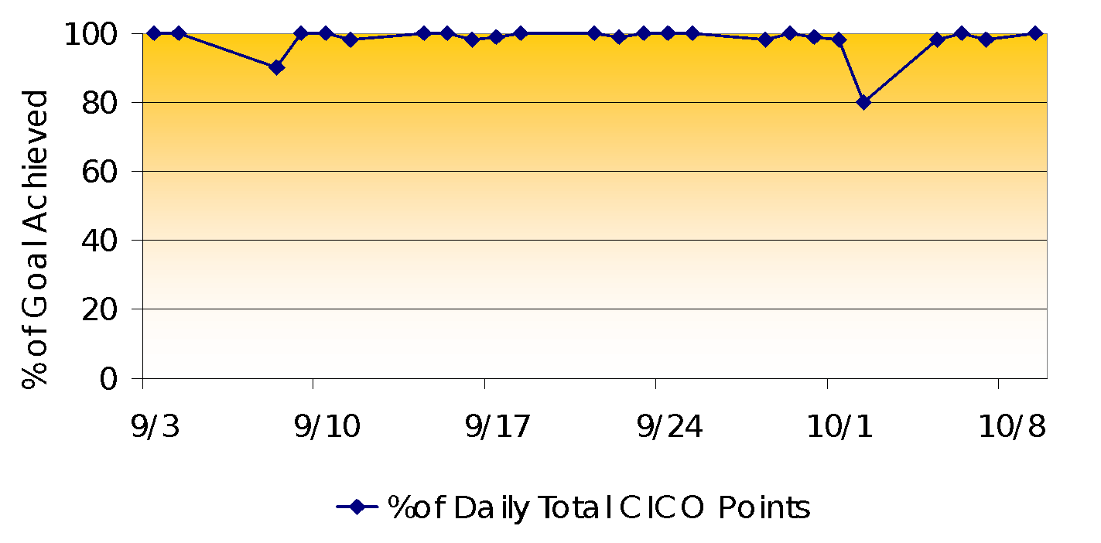
Student Successfully Transitions out of Special Education Placement
Kendall’s Daily Point Data for Behavioral Goals

Slide 31
Did Kendall “Need” a Restrictive Placement?
Or Effective Interventions?

Slide 32
Administrative Support
What Does it Look Like?
The Administrator:
  Participates in team meetings
  Builds fluency (train with the team)
  Participates in adult practices
  Provides channels of communication
  Provides financial support
  Acknowledges the “doers”
  Deals with accountability issues

Slide 33
Administrator needs to ensure systems are in place. For example:
Meeting Student Needs:
ODR form needs to include ‘motivation for behavior’
Consider screening a second time during year
Monitoring:
Progress updates (data samples) to teachers quarterly
Parents to be notified about individualized plans and progress

Slide 34
Administrators Role is to Ensure That…
No intervention is administered w/o progress monitoring.
The Special Education focus changes from “did we deliver the intervention?” to “did the student experience success/get better?”
Ensure that “research based interventions ”always used; – don’t get to choose not to deliver interventions.
Equip teachers to be confident to handle.

Slide 35
Failed Interventions are Not Neutral
They leave a residual effect…

Slide 36
Overall Content
Administrator’s Role: Key Messages for Leaders
Tier 2/3 District and Building readiness criteria
Systems, data and practices for advanced tiers
Ongoing assessment of current Tier 2/3 structures in their school.
Action plan to leave the 1-day training with and take back to their schools to implement

Slide 37
Components of Tier 2/3 Model
Differentiated Teaming Structures
  Across all 3 Tiers
  Assigned roles for Coordination/Facilitation
A Full Continuum of Interventions
  Scaling up and down the continuum
Universal Screening
  Beyond ODRs
Ongoing Use of More Specified Data
  Tools for Monitoring Systems and Outcomes

Slide 38
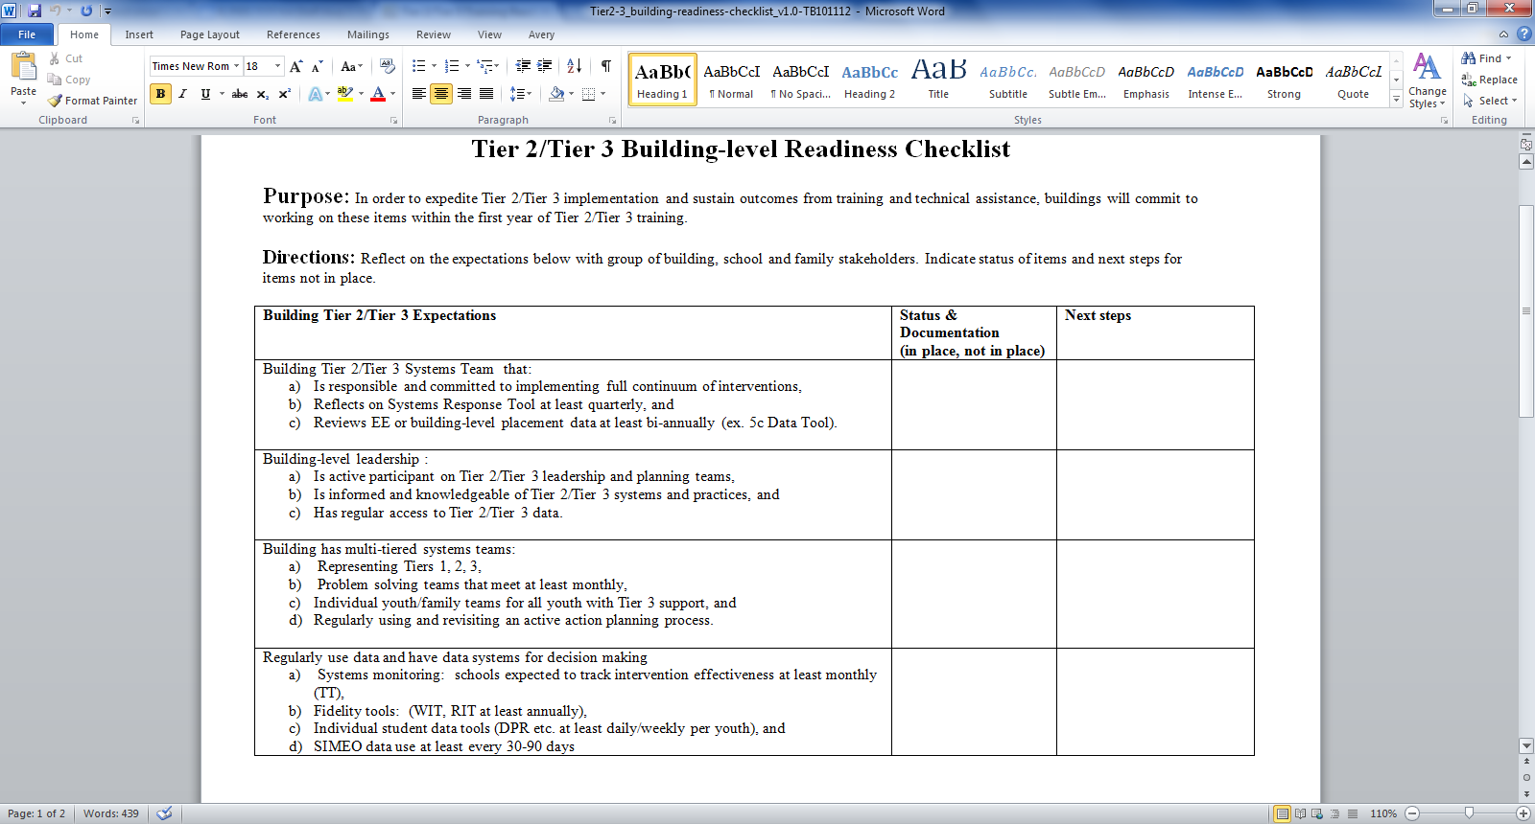

Slide 39
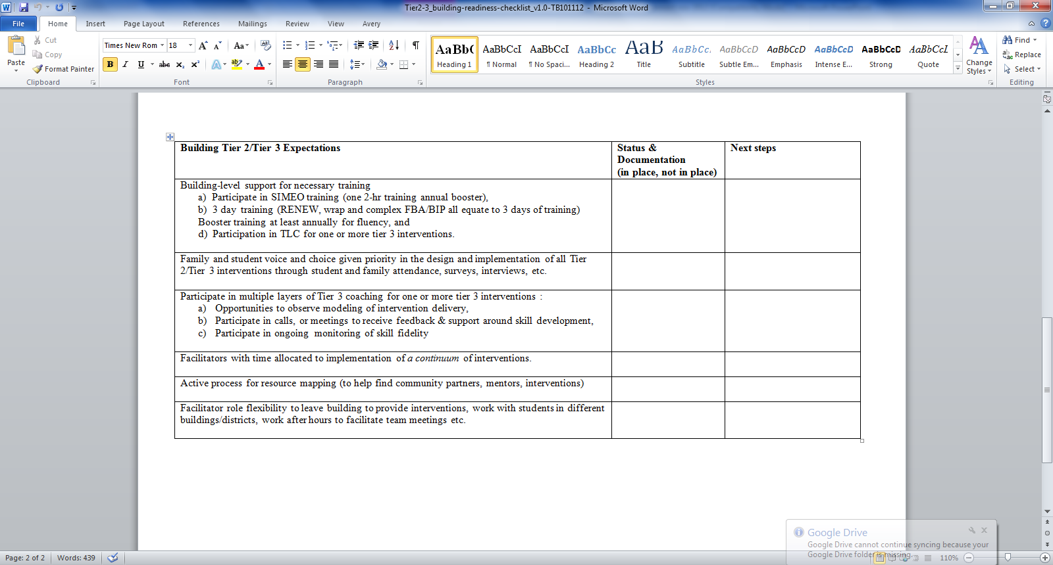

Slide 40
Quick Assessment/Reflection
Where is your district/school(s) with regards to the readiness criteria?
Notes:
Relating the information to what is happening in their district? What role can the princpall(s) play at the District Leadership Level?

Slide 41
Overall Content
Administrator’s Role: Key Messages for Leaders
Tier 2/3 District and Building readiness criteria
Systems, data and practices for advanced tiers
Ongoing assessment of current Tier 2/3 structures in their school.
Action plan to leave the 1-day training with and take back to their schools to implement

Slide 42
Data-Based Decision Making
Numbers to Keep in Mind
7-15% -expected to need and be supported by Tier 2 interventions
1-5%: - expected to need and be supported by Tier 3 interventions
70% of youth (receiving intervention “X”) should be responding to intervention
Rules for ‘determining response’ must be defined
    Ex. Daily Progress Report (DPR) cards: Student maintains an 80% average on DPR for 4 weeks

Slide 43
Quick Reflection Assessment: Student Access to Intervention
Total enrollment of your school?
Number of students accessing CICO?
Number of students on complex function-based or wraparound plans?
Percent of total population of the school?

Slide 44
Coordinator vs. Facilitator
Coordinator
Organizes and/or oversees the specific interventions such as CICO, S/AIG & Group with Individual Features
Roles include: scheduling meetings, review & collect data to share during team meetings, etc…
Facilitator
Directly provides intervention support services to youth/families
Roles include: meeting with students for CICO, running groups
Notes:
Clarifying Principal’s role in ensuring staff are clear about their roles and are accountable

Slide 45
Positive Behavior Interventions & Supports:
A Response to Intervention (RtI) Model
Tier 1/Universal
School-Wide Assessment
School-Wide Prevention Systems
ODRs,Credits,
Attendance,
Tardies, Grades,
DIBELS, etc.
Tier 2/
Secondary
Tier 3/
Tertiary
Check-in Check-out (CICO)
Assessment
Intervention
Social/Academic Instructional Groups (SAIG)
Daily Progress
Report (DPR)
(Behavior and Academic Goals)
Group Intervention with Individualized Feature (e.g., Check and Connect - CnC and Mentoring)
Competing Behavior
Pathway, Functional
Assessment Interview,
Scatter Plots, etc.
Brief Functional Behavior Assessment/
Behavior Intervention Planning (FBA/BIP)
Individual Student
Information System (ISIS)
Complex or Multiple-domain FBA/BIP
SIMEO Tools:
HSC-T, RD-T, EI-T
Wraparound
USDOE-OSEP Tertiary Demo Project
#H326M0060010

Slide 46
Tier 2 “Wellness Check”…
How are you allocating staff?
  Facilitators of interventions (practice-data)
    You don’t need to be a clinician to deliver the intervention; ‘save’ your clinical staff for other tasks
  Coordinators of interventions (system-data)
    Progress monitoring is crucial
What do your numbers look like?
    Most kids on simplest intervention (CICO)
No interventions should be delivered unless progress-monitored through teams using data

Slide 47
Check-in-Check-out (CICO)
Merely an extension of Tier 1
Some get high frequency scheduled positive contact with adults
Youth solicit the positive contact/feedback
Low effort for teacher if built on Tier 1
Need to have 7-12% accessing if it is to come to be a routine in your school(s)
If you only have 1-2% on CICO, those are likely to be kids who need more….

Slide 48
Why do you want 7-12% on CICO?
Youth who here-to-for would have gotten nothing (until they ‘got worse”) now get a positive boost of support (the ‘sea of ineligibility’).
All teachers will expect that every day they will have kids cross their threshold who need higher rate of positive contact.
Quicker/easier to support kids who need Tier 3.
Structure to build transference and generalizing from Social Skills instructional groups and function-based behavior plans.

Slide 49
Corrections that may be needed
“Groups” that are not evidence-based
Clinicians “seeing” students w/o clarity of intervention and data to determine effectiveness
Notes:
Clarifying the Princpal’s role in ensuring EBPs are used

Slide 50
Social Skills/Academic Instructional Groups:
Selection into groups based on youths’ reaction to life circumstance not existence of life circumstances
  ex. fighting with peers, not family divorce
Goals for improvement common across youth in same group
  ex. use your words
Data used to measure if skills are being USED in natural settings (vs. in counseling sessions)
  transference of skills to classroom, café etc.
Stakeholders (teachers, family etc.) have input into success of intervention
  ex. Daily Progress Report
Notes:
‹#›
‹#›
‹#›

Slide 51
We Know the System Features Needed to Support the Effective Practices…
A Team unique to each individual child & family
  Blend the family/natural supports with the school representatives who know the child best
A defined Meeting Process
  Meet frequently and use data
  Develop, implement, review range of interventions
Facilitator Role
  Bringing team together
  Blending perspectives; guiding consensus
  Systematic use of data (strengths and needs)

Slide 52
Tier 3 Interventions
Person-Centered (voice and choice)
Highly individualized (unique team per student)
Multiple Data Sources (add Tier 3 data- Perception data)
Complex function-based behavior plans
Wraparound/RENEW/Family Focused Plans

Slide 53
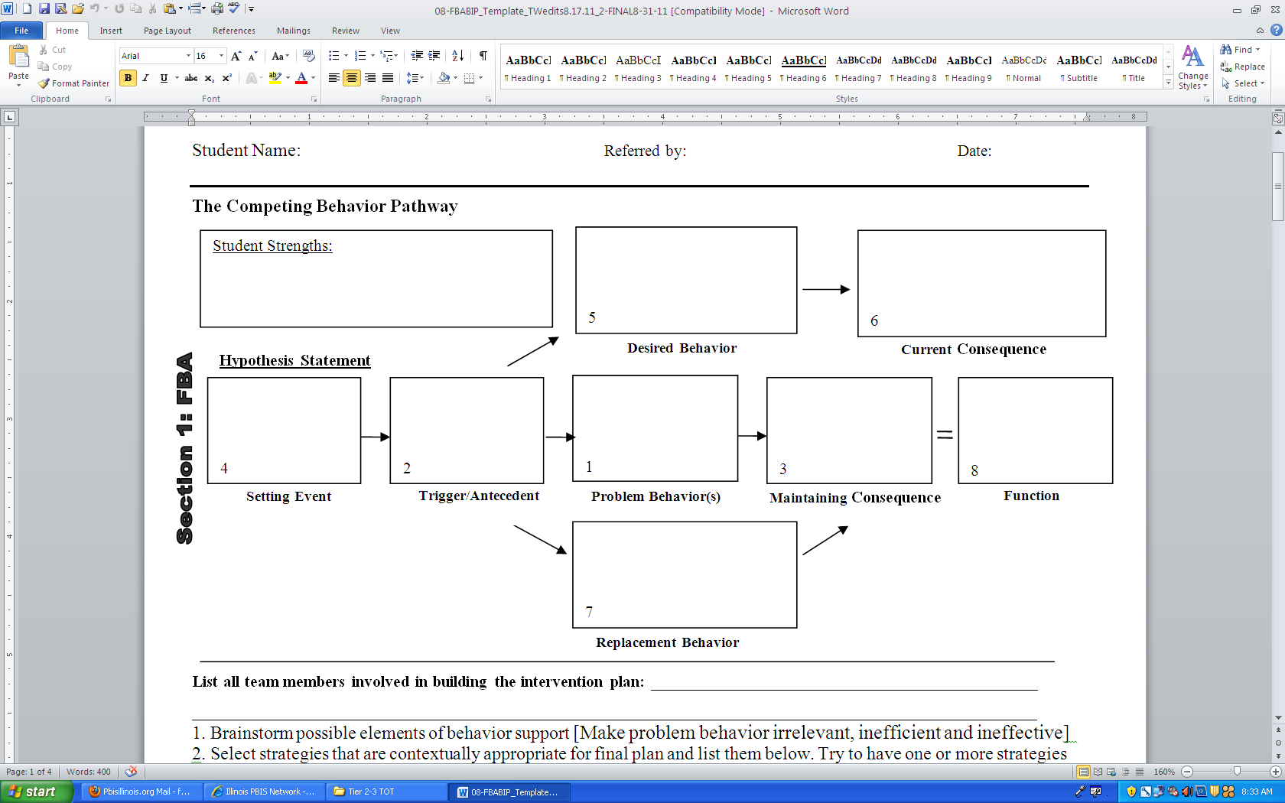

Slide 54
Behavioral Pathway
Setting Event
Days with Gym
Antecedent
Less structured activities that involve competition
Problem Behavior
Negative comments about activity and to peers leading to physical contact
Consequence
Sent out of P.E. class
Function
To escape setting

Slide 55
Common Mistakes Seen in Behavior Intervention Plans
Becoming ‘immobilized’ by setting events beyond the control of the school, ex. student does not take medication at home
Skipping the replacement behavior : Must have a alternative or replacement behavior that student is taught, practiced, reinforced
Not enough teaching strategies and practice
Putting all the “eggs in one ‘consequence’ basket”, ex. If you’re good all week, you can have a soda on Friday

Slide 56
Brief Function-based Interventions
Setting Event Strategies
Add check-in before gym
Antecedent Strategies
Behavior Lessons for all students about using respectful language with self and others and how to be a good sport
. More frequent activities with less focus on competition (parachute, 4-square, etc...)
Pre-correct
Teaching Strategies
Teach social skills (getting along with others, friendship, problem solving, sportsmanship)
Teach how to approach gym teacher to ask for a drink of water to leave setting.
Teach student how to re-enter and continue with activity
Consequence Strategies Acknowledging/rewarding student when uses new skills (asking for a drink of water to leave, using respectful language with peers, being a good sport, etc..)

Slide 57
What is Wraparound?
Wraparound is a process for developing family-centered teams and plans that are strength and needs based
  (not deficit based)
  across multiple settings and life domains.

Slide 58
Who is Tier 3-Wraparound for?
Youth with multiple needs across home, school, community
Youth at-risk for change of placement (youth not responding to current systems/practices)
The adults in youth’s life are not effectively engaged in comprehensive planning (i.e. adults not getting along very well)

Slide 59
Implementing Wraparound:
Key Elements Needed for Success
Engaging students, families & teachers
Team development & team ownership
Ensuring student/family/teacher voice
  Getting to real (big) needs
Effective interventions
  Serious use of strengths
  Natural supports
  Focus on needs vs. services
Monitoring progress & sustaining
System support buy-in

Slide 60
Four Phases of Wraparound Implementation
I. Team Preparation
  - Get people ready to be a team
  - Complete strengths/needs chats (baseline data)
II. Initial Plan Development
  - Hold initial planning meetings (integrate data)
  - Develop a team “culture” (use data to establish voice)
III. Plan Implementation & Refinement
  Hold team meetings to review plans (ongoing data collection
  and use)
  - Modify, adapt & adjust team plan (based on data)
IV. Plan Completion & Transition
  - Define good enough (Data-based decision-making)
  “Unwrap”

Slide 61
Overall Content
Administrator’s Role: Key Messages for Leaders
Tier 2/3 District and Building readiness criteria
Systems, data and practices for advanced tiers
Ongoing assessment of current Tier 2/3 structures in their school.
Action plan to leave the 1-day training with and take back to their schools to implement

Slide 62
Daily Progress Report (DPR) Sample
NAME:______________________ DATE:__________________
Teachers please indicate YES (2), SO-SO (1), or NO (0) regarding the student’s achievement
in relation to the following sets of expectations/behaviors.
EXPECTATIONS | 1 st block | 2 nd block | 3 rd block | 4 th block
Be Safe | 2 1 0 | 2 1 0 | 2 1 0 | 2 1 0
Be Respectful | 2 1 0 | 2 1 0 | 2 1 0 | 2 1 0
Be Responsible | 2 1 0 | 2 1 0 | 2 1 0 | 2 1 0
Total Points
Teacher Initials
Adapted from Grant Middle School STAR CLUB
Adapted from Responding to Problem Behavior in Schools: The Behavior Education Program by Crone, Horner, and Hawken
Notes:
‹#›

Slide 63
“Social & Academic Instructional Groups”
Daily Progress Report (DPR) Sample
NAME:______________________ DATE:__________________
Teachers please indicate YES (2), SO-SO (1), or NO (0) regarding the student’s achievement
in relation to the following sets of expectations/behaviors.
EXPECTATIONS | 1 st block | 2 nd block | 3 rd block | 4 th block
Be Safe | 2 1 0 | 2 1 0 | 2 1 0 | 2 1 0
Be Respectful | 2 1 0 | 2 1 0 | 2 1 0 | 2 1 0
Be Responsible | 2 1 0 | 2 1 0 | 2 1 0 | 2 1 0
Total Points
Teacher Initials
Walk to class
Keep hands to self
Use appropriate language
Raise hand to speak
Bring materials
Fill out assignment notebook
Adapted from Grant Middle School STAR CLUB
Adapted from Responding to Problem Behavior in Schools: The Behavior Education Program by Crone, Horner, and Hawken
Notes:
‹#›

Slide 64
Daily Progress Report (DPR) Sample
NAME:______________________ DATE:__________________
Teachers please indicate YES (2), SO-SO (1), or NO (0) regarding the student’s achievement
in relation to the following sets of expectations/behaviors.
“Individualized Student Card After FBA/BIP"
EXPECTATIONS | 1 st block | 2 nd block | 3 rd block | 4 th block
Be Safe | 2 1 0 | 2 1 0 | 2 1 0 | 2 1 0
Be Respectful | 2 1 0 | 2 1 0 | 2 1 0 | 2 1 0
Be Responsible | 2 1 0 | 2 1 0 | 2 1 0 | 2 1 0
Total Points
Teacher Initials
Use your words
Use deep breathing
Keep arm’s distance
Use #2 voice level when upset
Ask for breaks
Self-monitor with DPR
Adapted from Grant Middle School STAR CLUB
Adapted from Responding to Problem Behavior in Schools: The Behavior Education Program by Crone, Horner, and Hawken
Notes:
‹#›

Slide 65
Teams need to track and monitor interventions by category:
1. How many students are receiving each intervention?
2. How many students are responding to each intervention?
3. What data is used to monitor each intervention type?
Tier 2/Tier 3 (Secondary/Tertiary) Tracking Tool
Progress Monitoring Secondary/Tertiary Interventions

Slide 66

USDOE-OSEP Tertiary Demo Project
#H326M0060010

Slide 67

USDOE-OSEP Tertiary Demo Project
#H326M0060010

Slide 68
3-Tiered System of Support
Necessary Conversations (Teams)
Universal
Team
Meeting
Secondary Systems Team
Meeting
Problem Solving Team Meeting
Tertiary Systems Team Meeting
Standing team; uses FBA/BIP process for one student at a time
Uses process data; determines overall intervention effectiveness
Plans schoolwide & classroom supports
Uses process data; determines overall intervention effectiveness
Universal Support
Check-In Check-Out
Skills Groups
Complex
FBA/BIP
Wraparound
Brief
FBA/BIP
Group w. individual
feature
Brief FBA/BIP
USDOE-OSEP Tertiary Demo Project
#H326M0060010
Notes:
‹#›
‹#›
Relate to the teams they may have operating in their schools

Slide 69
Do You Need to Change Teaming Structure in your School(s)?
Quick Reflection/Assessment:
How many students have been talked about at ‘______’
  meeting this year?
How many got an intervention that you have data to indicate
they got an intervention that is working?
Have you ever been at a meeting where you talked about one student for an hour and at the end you were no closer to having effective strategies than when you started?
Notes:
Relating the information to what is happening in their school

Slide 70
Overall Content
Administrator’s Role: Key Messages for Leaders
Tier 2/3 District and Building readiness criteria
Systems, data and practices for advanced tiers
Ongoing assessment of current Tier 2/3 structures in their school
Action plan to leave the 1-day training with and take back to their schools to implement

Slide 71
End of Day Action Planning
District level planning needs?
Building-level planning needs?
Re-positioning staff to coordinate and facilitate evidence-based interventions?
Changings in teaming structures?
Initiate System Tools (Tracking tool, Systems Response Tool, Reverse Request Tool)

Slide 72
What Are the Next Steps needed at Your School?
Schedule planning meetings?
Review the tools?
Use the blank triangle as a planning tool?
Develop your Multi-tiered Action Plan (MAP)?
Other?

Slide 73
Challenges/Obstacles
Lack of District commitment
Weak leadership skills of some individuals
Poor data systems

Slide 74
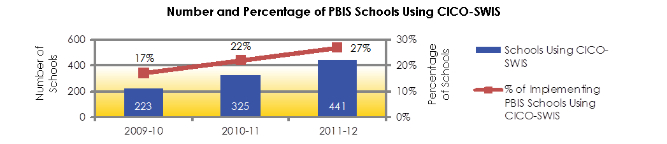
More Schools Progress
Monitor at Tier 2
Notes:
State context

Slide 75
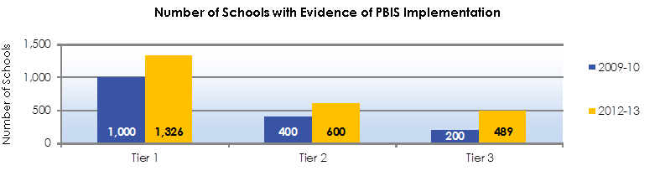
More Schools Implement Tier 2/Tier 3 Interventions
Notes:
During 2012-13, approximately 73% of Illinois PBIS schools (1,326) had documentation of Tier 1 PBIS implementation through active use of self-assessment and progress monitoring tools. Tier 2/Tier 3 implementation has greatly increased over the past three years with over 600 schools documenting Tier 2 implementation, and close to 500 schools self-assessing and monitoring the fidelity of implementation at Tier 3 during 2012-13. Over 300 schools had reached full fidelity at Tier 2, and 111 of schools implementing Tier 3 documented full fidelity in 2012-13.

Slide 76
Leadership Development Embedded in District PD Plan for Advanced Tiers
2015: A quick (partial) example….
Notes:
Can we incorporate same content into an overall PD plan for a district? The following slides provide a PD plan recently developed for a “Race to the Top” district who requested a Tier 2 implementation plan over a 15 month period. Although the components have been implemented in other distircts, this particular arrangement of PD has not yet been implemented (it is under review by the district).

Slide 77
Readiness Phase
Readiness Phase –
  Establishing the foundational infrastructure for a sustainable CR-PBIS system of supports.
Activities | Month/ Visit # | Duration, Format, Audience
A. District Readiness Support Webinar Clarify expectations with DLT Establish PD Plan/Timeline and Coaching Structure Introduce Tiered Fidelity Inventory Introduce Universal Screening process | May 2015 | 1 webinar Participants: DLT, district and building coaches, building admin
B. District Readiness Support Webinar 2 Review fidelity/discipline data, evaluation & coaching plan Decide on Universal Screening use and tool selection | May 2015 | 1 webinar Participants: DLT, district and building coaches, building admin
C. District Readiness Support Webinar 3 Tiered Fidelity Inventory: Purpose, process, timeline | May 2015 | 1 webinar Participants: coaches, admin

Slide 78
Readiness Phase
Activities | Month/ Visit # | Duration, Format, Audience
D. District and Coach Readiness Collaboration Overview of Systems and Practices Key Features Data for identifying/monitoring (Tools) District action plan development | May 2015; Visit 1 | 2 days on-site training Participants: DLT, district and building coaches, building admin
E. School Team Readiness Training Overview of Systems and Practices Key Features Tools for identifying/monitoring School action plan development | June 2015; Visit 2 | 1 day on-site training per cohort Participants: School-teams from each cohort, building coaches & admin, district coach
F. Team Initiated Problem Solving (TIPS) for team-based data informed decision-making | June 2015; Visit 2 | 1 days on-site training per cohort Participants: School-teams, building coaches & admin, coach
Phase I Summary | 2 On-site visits | 3 Webinars 8 Days On Site

Slide 79
Installation Phase
Installation Phase –
  Training and building capacity with the practices for a continuum of supports
Activities | Month/ Visit # | Duration, Format, Audience
A. Tier II foundational interventions for all schools Check-in Check-out & Social skills groups Data/tools for identifying &progress-monitoring: | June 2015; Visit 3 | 1 day on-site training per cohort Participants: school-teams, coaches & building admin, district coach
B. Additional Tier II interventions for Middle &High School Academic Seminar Data for identifying and progress-monitoring | June 2015; Webinar | 1 webinar Participants: school teams, building coach and admin, district coach
C. Modifying Tier II foundational interventions Function Based problem solving process for Tier II Data for identifying and progress-monitoring | August 2015; Visit 4 & 5 | 2 days on-site training per cohort Participants: school-teams, building/district coach & admin
D. Action planning for Tier II implementation Data for selection &integration of EBPs into CR-PBIS Timeline for Implementation & Evaluation Action planning finalized | August 2015; Visit 6 | 1 days on-site training per cohort Participants: school-teams, building coach & admin, district coach
Phase II Summary | 4 On-site visits | 1 Webinar 12 Days on site

Slide 80
Implementation Phase
III. Implementation Phase –
Supporting fidelity of implementation, and building capacity for sustainability
Activities | Month/ Visit # | Duration, Format, Audience
A. Follow up TA calls for cohorts CICO Social Skill Groups; Academic Seminar (MS and HS) Function based problem solving TIPs; Progress Monitoring Tools; Screening Data; TFI data | Monthly Calls (Sept 2015 through June 2016) | 30 webinars total: Participants: school-teams, building coach & admin, district coach
B. DLT On-Site Meetings: Review status of district action planning Review of behavioral outcomes and Intervention fidelity data Facilitate District team based problem solving Review status of resources aligned to implementation targets Planning of additional supports for buildings with challenges | Oct, Dec, Feb, April, June; Visits 7-11 | 5 half days/2.5 days total: half-day meeting per visit Participants: DLT, building admin, and district coach
C. Coaches (Building and District) On-Site Meetings Review school action plans; Coaching tips and strategies Review of l outcome and fidelity data; Booster trainings | Oct, Dec, Feb, April, June; Visits 7-11 | 5 half days/2.5 days total on-site: half-day meeting per visit Participants: coaches

Slide 81
Implementation Phase
Activities | Month/ Visit # | Duration, Format, Audience
D. Booster Training for Buildings Needing Additional Support Participate in team meetings; Retrain as necessary Review of behavioral outcomes and Intervention fidelity data Review and update action plan: prioritize activities | Oct, Dec, Feb, April, June; Visits 7-11 | 10 days on-site: 2 days per visit 5 visits to targeted buildings Participants: school teams, school admin, and district coach
E. District and Building Leadership TA Calls: district planning Review of behavioral outcomes and Intervention fidelity data Facilitate District team based problem solving. | Sept, Nov, Jan, Mar, May | 1 webinar during each month Participants: DLT, building admin, and district coaches
F. Maximizing Specialized Service Staff to Implement Tier II Train on the shift in FTE, roles and responsibilities to facilitate Tier II implementation | Oct, Feb; Visits 7 and 9 | 2 day Participants: district clinicians, DLT, coaches; school admin
Phase III Summary | 5 On-site visits | 35 Webinars 17 Days on site

Slide 82
Planning for Full
Implementation Phase
IV. Planning for Full Implementation Phase –
Planning for full implementation of CR-PBIS Tier II
Activities | Month/ Visit # | Duration, Format, Audience
A. Review of data to make decision about need for expanding the continuum by integrating Mental Health interventions Selecting evidence-based practices: Consumer Guide for EBPs Develop the plan to integrate MH interventions in continuum Quick overview of each interventions Target populations & Suggestions for implementation Identify intervention(s) to get more information/pricing | Spring 2016; Visit 12 | 3 days on-site for selection and planning to invest in MH interventions; Participants: DLT, district coach, school coaches, school admin
B. Technical assistance on selection of interventions Introduce possible Mental Health interventions to the DLT, coaches in webinar 1. Review and consider use of: Using Discipline Data within SWPBIS to Identify and Address Disproportionality: A Guide for School Teams (webinar 2) Review strategies for supporting coaches beyond 2016 SY | Spring 2016 | 2 webinars Participants: DLT, district coach, school coaches, school admin
Phase IV Summary | 1 On-site visits | 2 Webinars 3 Days on site

Slide 83
Discussion Questions
Does the ‘behavior feature’ require specific professional development for Principals?
How is this experience developing/installing a Training course for building administrators similar or different to what we have learned about the Principal’s role in improved achievement outcomes? (current research/knowledge)
What can we learn from this dialogue that may validate/strengthen or change current approaches to clarifying the Principal’s role in installing effective behavior systems in schools? (applying what we know)
What types of research would contribute to more efficiently building required skills/knowledge of building leaders with regard to behavior support at Tiers 2/3?

