Slide 1
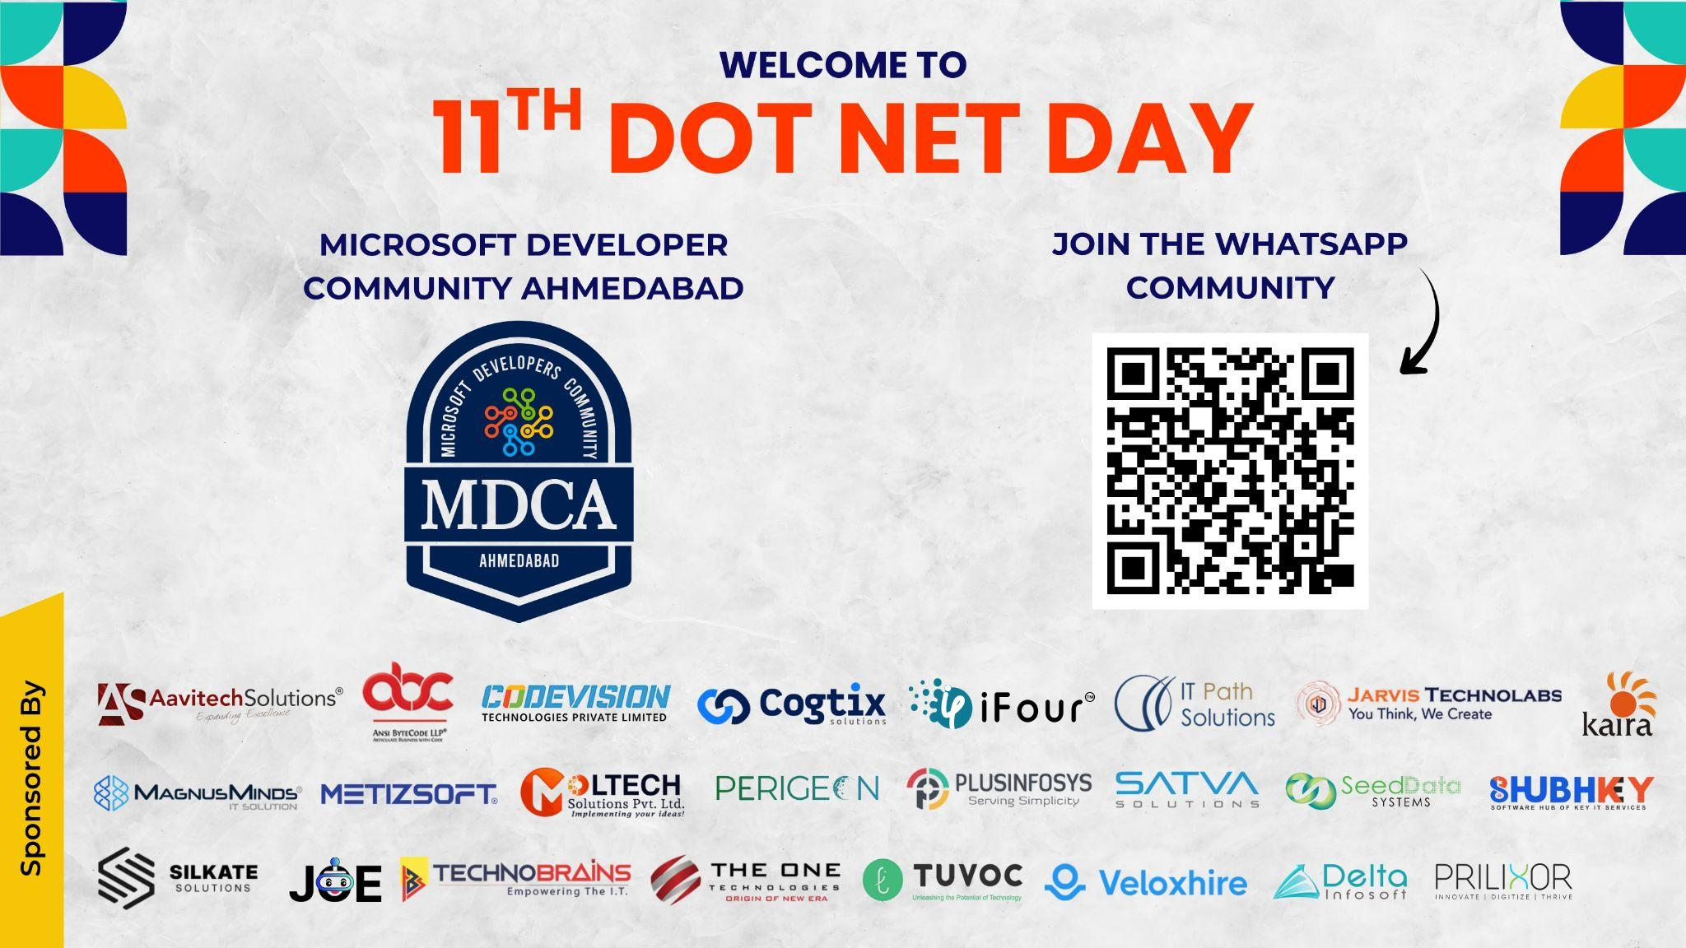

Slide 2

Consult
Deploy agentic workflows inside IT companies
Train
Development teams - from first agent to production
Build
Every pattern taught is one used in production
Jigar Joshi
Agentic AI Architecture & Consultant
I do not teach Agentic AI from slides.
I build it to teach it
Founder/CEO · Wan Buffer Services

Slide 3


Slide 4

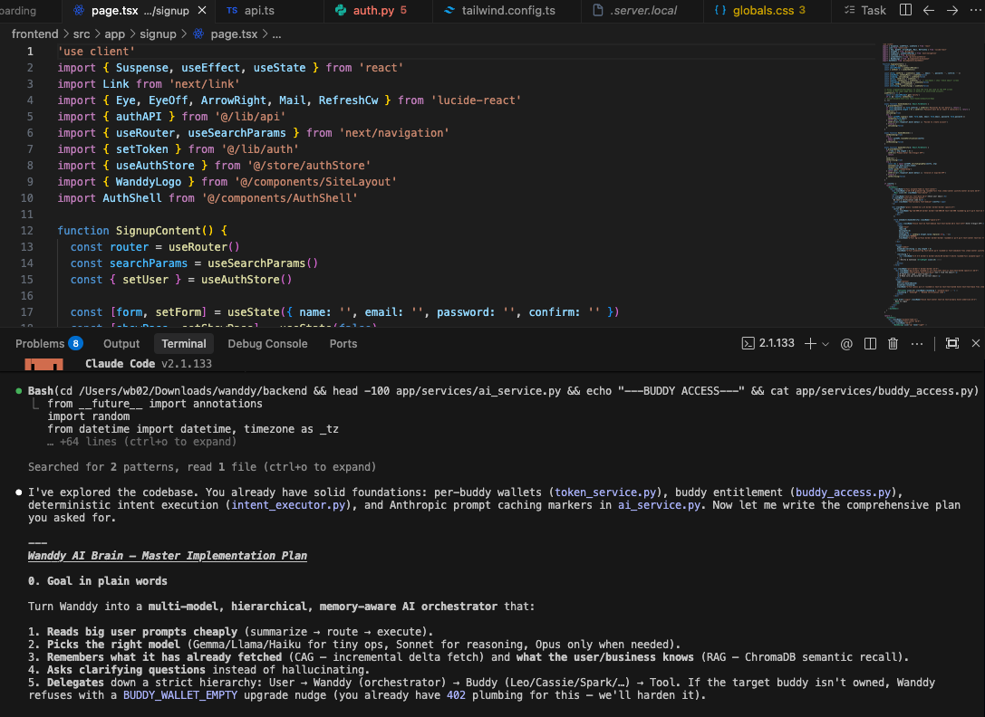
THE REFRAME
You've been told AI can write your code.
You've been told to be careful with it.
Today is about what comes next:
AI that runs
without you in
the IDE at all.
Autonomous agents. Real Jira tickets. Real code. Live deployment. In 60 minutes.
Jigar Joshi · Agentic AI Architecture & Consultant & CEO - Wan Buffer Services 04

Slide 5

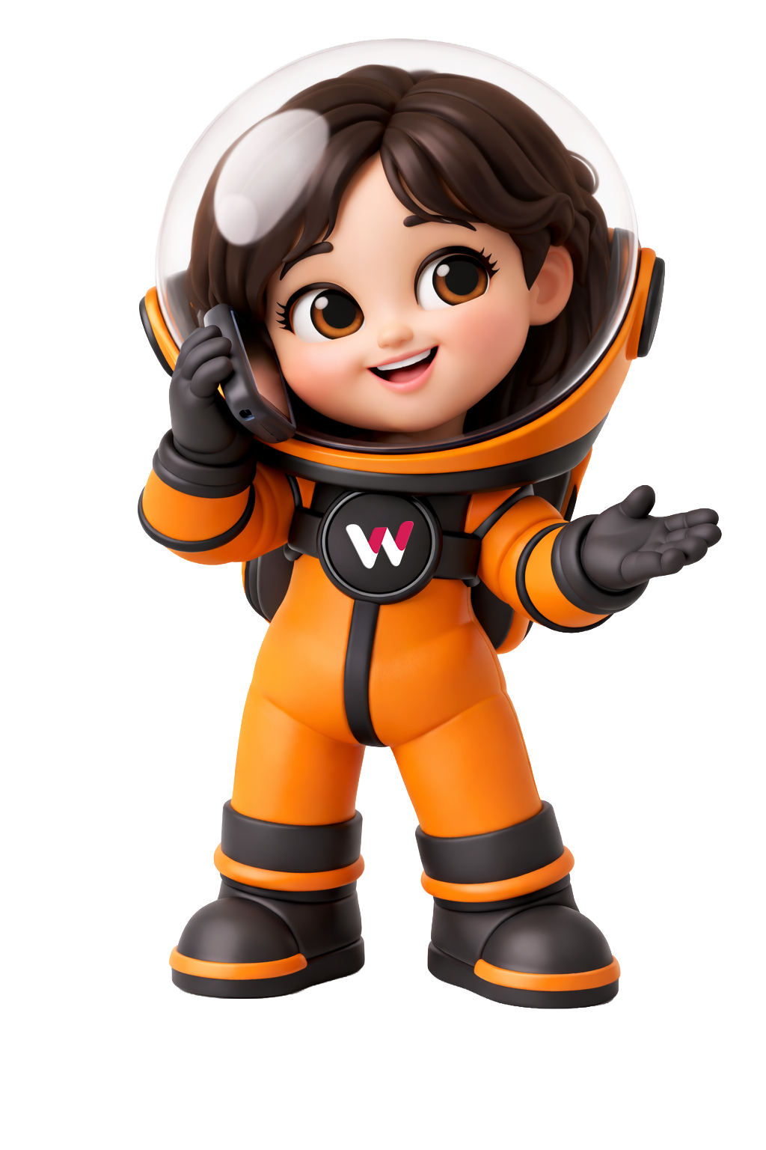
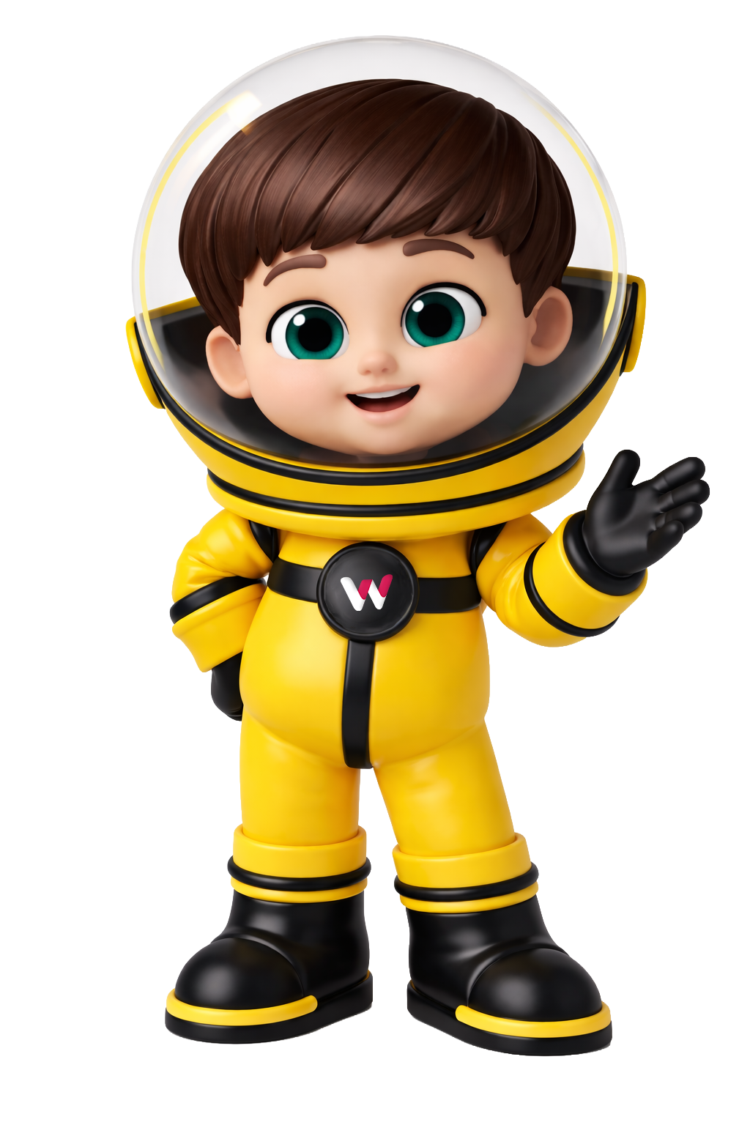
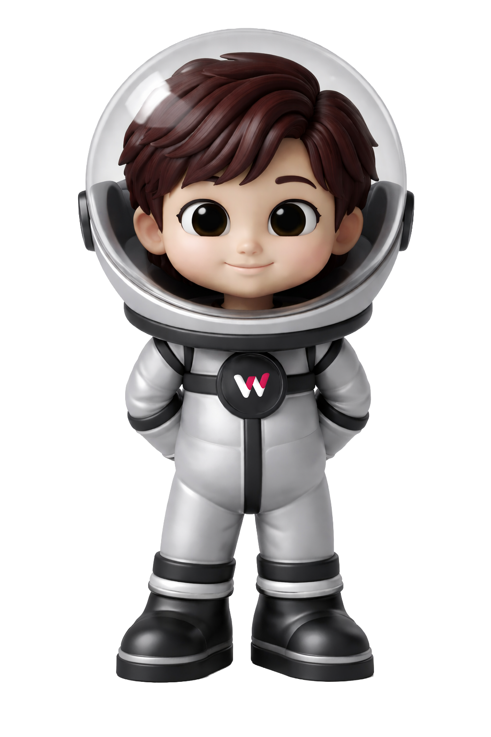


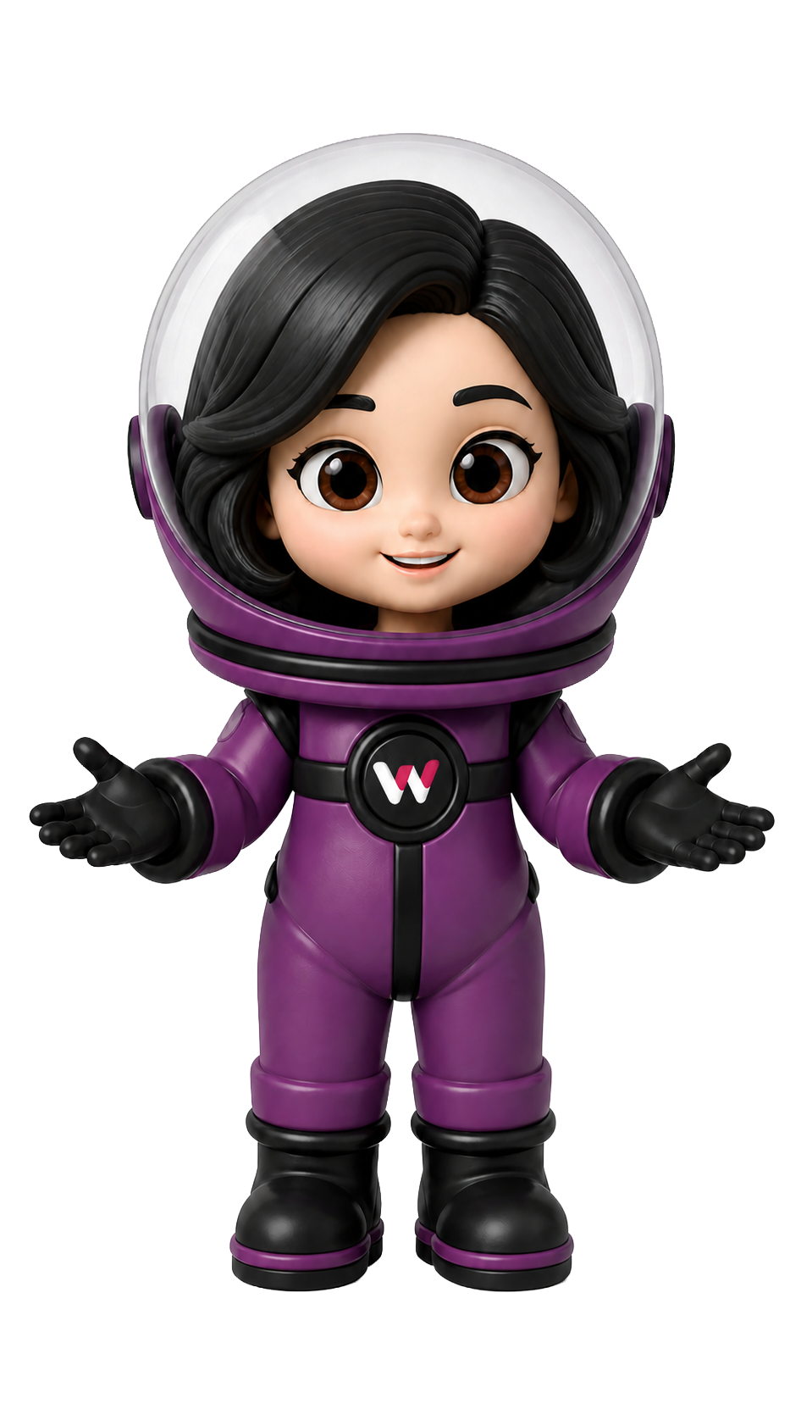
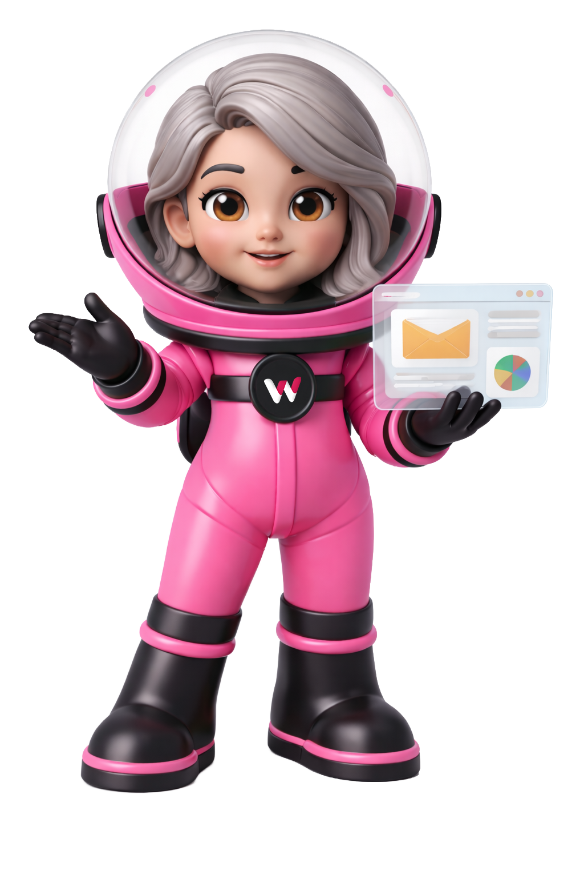
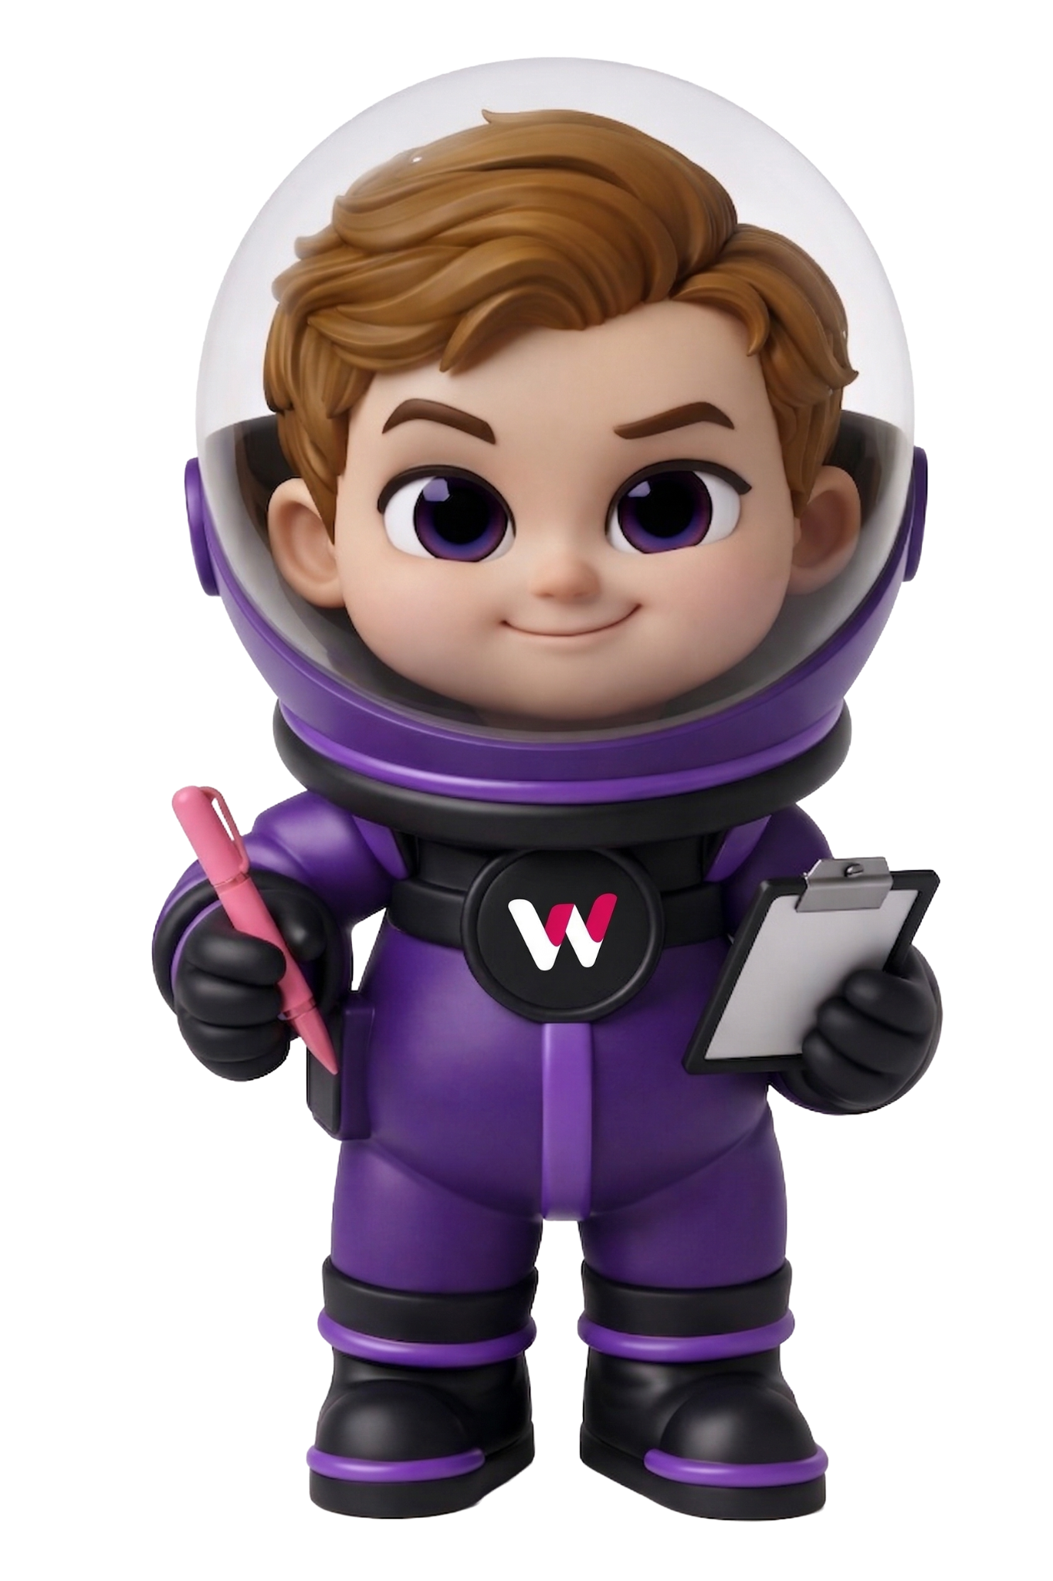


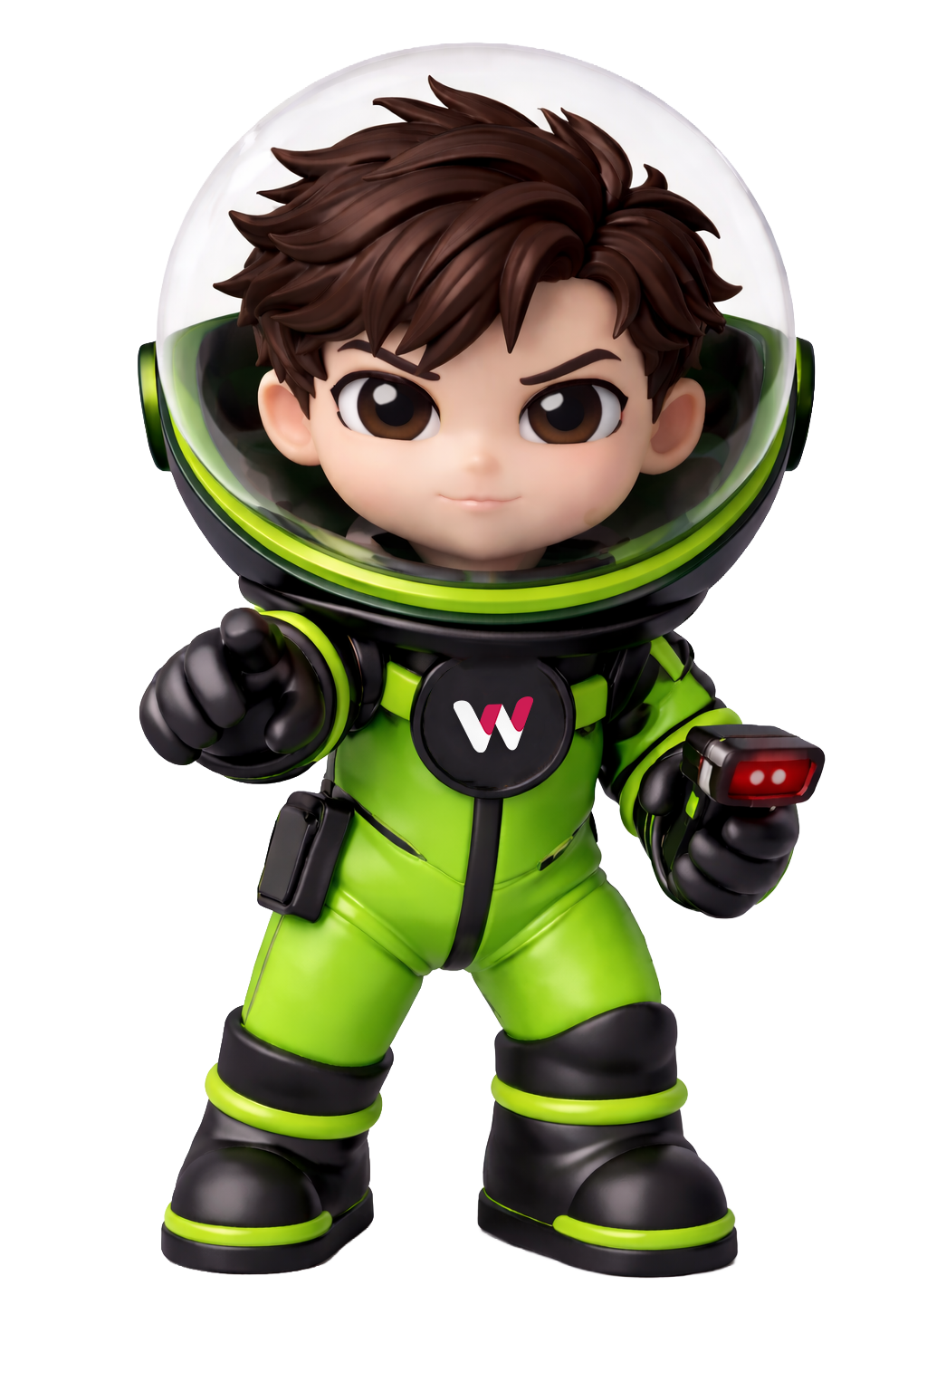
Our Agentic
Virtual Family
I’m Wanddy
Meet my Agentic AI
Virtually buddies.

Slide 6
Before slides.
Let’s give goal
Anything reasonable. Restaurant menu. Yoga schedule. Booking form. Portfolio.
I'll type it in Discord. The agents will build it. We'll watch it go live.
!build a ___________________________
Jigar Joshi · Agentic AI Architecture & Consultant & CEO - Wan Buffer Services 18

Slide 7
READING THE ROOM
In Chhello Show, the boy spends the whole film trying to understand how the projector works —
what makes the magic.
Today I'm not going to show you the magic.
I'm going to show you the mechanism.
QUICK SHOW OF HANDS
Who has actually built an AI agent before?
Written the code · made it call tools · ran a loop
Jigar Joshi · Agentic AI Architecture & Consultant & CEO - Wan Buffer Services 05

Slide 8



FOUNDATION · 90 SECONDS
An agent is three things working together.
LLM
TOOLS
LOOP
The brain that decides what to do.
Functions the LLM can call to act on the world.
The cycle that lets it keep going until done.
Claude · GPT · Gemini
search_jira() · create_ticket() · send_email()
Reason → Act → Observe → repeat
Take any one of these three away - you don't have an agent. You have a chatbot, a script,
or a one-shot prompt.
Jigar Joshi · Agentic AI Architecture & Consultant & CEO - Wan Buffer Services 06

Slide 9
FOUNDATION · 90 SECONDS
How an agent actually thinks.
The ReAct loop — reason, act, observe, repeat.
1
REASON
2
ACT
What is the user asking? What do I need to find out?
Call a tool to take action.
"I need to check the Jira ticket status"
search_jira("PRJ-002")
3
OBSERVE
4
REPEAT
Read the result of that action.
Use what you learned. Loop back to Reason.
"Status: In Progress, assigned to Rakesh"
"Now I know enough to answer." → Step 1
Every agent today follows this loop. The only difference is what tools you give it — and how you control it.
Jigar Joshi · Agentic AI Architecture & Consultant & CEO - Wan Buffer Services 07

Slide 10



TODAY'S PROMISE
In the next 60 minutes you will see
A real agentic system
Build any app, live
The architecture you can run
Five specialist agents — Business Analyst, Planner, Backend, Frontend, Reviewer — coordinating like a software team.
You suggest the app from the audience. I type the command in Discord. The agents build it. We watch it appear.
Production patterns from 150+ agents shipped at Wan Buffer. What works, what fails, where to start.
Jigar Joshi · Agentic AI Architecture & Consultant & CEO - Wan Buffer Services 08

Slide 11
BEFORE · YOUR IT SERVICES TEAM TODAY · HOW NEW PROJECT KICKOFF WORKS NOW
New Client Project Kickoff -
Current Human Process at a typical IT services org
Scenario: Smile Dental Clinic asks for a patient booking site with admin panel.
1
Account Manager
Day 1
2
Project Manager
Day 1–2
3
Dev Lead
Day 2
Receives brief on WhatsApp. Forwards to PM and dev lead.
Opens spreadsheet. Manually lists tasks from memory. Estimates hours.
Reviews spreadsheet. Adds tasks PM missed. Asks 3 clarifying questions.
⚠ Brief gets buried in 40 messages. Two people interpret it differently.
⚠ 2–3 hours of work. Tasks missed. Dependencies untracked.
⚠ Half a day lost before a single line of code.
4
PM + Dev Lead
Day 3
5
Dev Team
Day 3–4
6
PM (Friday)
Weekly
45-min meeting to align on task order, ownership, week-1 expectations.
Devs start. Two work on overlapping tasks. One blocks three others.
Manually emails client status. Collects updates from each dev on WhatsApp.
⚠ Same conversation happens on the next project. Not documented.
⚠ Rework. Delay. Client follow-up call needed.
⚠ 30 min of status collection per project per week. Scales badly.
Result: 3–4 days lost · 2–3 missed tasks · client-side delays · scales badly across 20 projects
Jigar Joshi · Agentic AI Architecture & Consultant & CEO - Wan Buffer Services 09

Slide 12
AFTER · SAME CLIENT · SAME TEAM · AGENTIC PIPELINE IN PLACE
Same Kickoff -
How the process changes with an agentic system
Same Smile Dental Clinic brief. Same team. Different operating model.
1
Account Manager
30 sec
2
Business Analyst Agent
20 sec
Pastes the brief into Discord. Hits enter.
Expands brief into user stories, acceptance criteria, edge cases.
✓ No email. No forwarding. Brief goes straight to the agent system.
✓ What took a BA half a day now takes 20 seconds. Nothing missed.
3
Planner Agent → Jira
30 sec
4
Backend + Frontend Executors
2 min
Breaks stories into backend + frontend tasks. Creates real Jira tickets.
Pick tickets in parallel. Write ASP.NET Core + React. Reviewer validates.
✓ PM's 2-hour spreadsheet replaced. Dependencies mapped.
✓ Working code. Tests pass. Deployed. Client can use it now.
Result: under 4 minutes · zero missed tasks · working app deployed · scales to every project
Jigar Joshi · Agentic AI Architecture & Consultant & CEO - Wan Buffer Services 10

Slide 13
WHY MULTI-AGENT
One agent doing everything is worse than
five agents doing one thing each.
ONE AGENT · FULL TASK
PIPELINE · SPECIALIST AGENTS
✗ Context window fills up — quality drops
✓ Each agent has one focused job
✗ Error in step 1 corrupts step 4
✓ Fresh context per stage
✗ Cannot retry one step independently
✓ Step 1 output verified before step 2
✗ Hard to debug — everything is one blob
✓ Retry any step independently
✗ System prompt tries to do too much
✓ Each stage is testable and debuggable
✗ Can't swap one piece without breaking the whole
✓ Swap or upgrade one without touching others
Every developer's first instinct: build one big agent. Production's first lesson: break it into many small ones.
Jigar Joshi · Agentic AI Architecture & Consultant & CEO - Wan Buffer Services 11

Slide 14


AGENT MEMORY
Three types of memory.
Use the right one for the job.
SHORT-TERM
WORKING
LONG-TERM
WHERE STORED
WHERE STORED
WHERE STORED
Conversation context window
Structured state dict passed between agents
Vector database (Chroma, Pinecone, FAISS)
USED FOR
USED FOR
USED FOR
Current session state, recent tool results, user messages
Results from previous agents in the current task
Project documentation, client SOPs, knowledge base
LIFETIME
LIFETIME
LIFETIME
Disappears when session ends
Lives for one task run
Persists forever, survives restarts, scales
EXAMPLE: Today's chat between agent and user
EXAMPLE: Planner's output passed to the Coder
EXAMPLE: Company SOPs, client briefs, past tickets
Pick the wrong memory type — your agent forgets everything or remembers too much. Both are expensive.
Jigar Joshi · Agentic AI Architecture & Consultant & CEO - Wan Buffer Services 12

Slide 15
THE FOUNDATIONAL PATTERN
Separate the thinking from the doing.
PLANNER AGENT
EXECUTOR AGENT
INPUT
INPUT
User task
One step + previous results
OUTPUT
OUTPUT
Numbered step list (JSON)
Completed step result
[
{step: 1, do: "Read brief"},
{step: 2, do: "Create stories"},
{step: 3, do: "Generate tickets"}
]
→ Receives Step 1 → calls read_brief()
→ Returns result → passes forward
→ Receives Step 2 → calls create_stories()
→ Continues until plan complete
Plans never execute. Only plans.
Executors never plan. Only execute.
Planner never executes. Executor never plans. Each agent does exactly one job.
Jigar Joshi · Agentic AI Architecture & Consultant & CEO - Wan Buffer Services 13

Slide 16
STATE MANAGEMENT
How does Agent B know what Agent A did?
A state dict — the shared brain across the pipeline.
state = {"brief": "Build dentist booking"}
# Agent 1 reads brief, writes output
state["stories"] = business_analyst(state)
# Agent 2 reads stories, writes plan
state["plan"] = planner(state)
# Agent 3 creates Jira tickets
state["tickets"] = jira_creator(state)
1
Agents read what others wrote
Each agent reads from state. Everyone shares one dict.
2
Agents write to unique keys
No two agents overwrite each other's work.
3
No direct calls between agents
Agents never talk to each other directly. Only through state.
State is the only thing agents share. No callbacks. No direct calls. Just one dict that grows as the pipeline runs.
Jigar Joshi · Agentic AI Architecture & Consultant & CEO - Wan Buffer Services 14

Slide 17





THE SYSTEM
Five agents. One software team.
Each agent has one job. Together they ship working software.
01
02
03
04
05
Business Analyst
Planner
Backend Executor
Frontend Executor
Reviewer
Expands the brief into user stories and acceptance criteria.
Breaks stories into tasks. Creates real Jira tickets.
Picks backend tickets. Writes ASP.NET Core + EF Core code.
Picks frontend tickets. Writes React + TypeScript code.
Builds both stacks. Runs tests. Updates Jira status.
Plain Python · Anthropic SDK · Langflow visualisation · Guardrails · Real Jira
Jigar Joshi · Agentic AI Architecture & Consultant & CEO - Wan Buffer Services 15

Slide 18
PRODUCTION SAFETY
Without guardrails, agents do exactly what
you didn't want them to.
INPUT GUARDRAILS
OUTPUT GUARDRAILS
Block the request before it reaches the agent.
Validate the agent's output before anything happens with it.
⊘ Destructive intent ("delete production database")
⊘ Hardcoded API keys or secrets
⊘ Out-of-scope requests ("send marketing email")
⊘ Unsafe code (eval, exec, shell injection)
⊘ Cost-bomb requests ("analyze every file")
⊘ Output schema is valid JSON
⊘ PII without authorization
⊘ Generated code actually compiles
"build a script to delete all my Jira tickets"
os.system(user_input)
⊘ BLOCKED: destructive intent
⊘ BLOCKED: shell injection risk
Every guardrail you add is a production agent that doesn't get fired at 2 AM.
Jigar Joshi · Agentic AI Architecture & Consultant & CEO - Wan Buffer Services 16

Slide 19
THE FLOW
How the system runs in real time
Discord command
build a dentist booking page
Business Analyst
user stories, acceptance criteria
Planner → Real Jira tickets
JIRA
tasks split: backend + frontend
Backend Executor
Frontend Executor
⇣ PARALLEL ⇣
writes ASP.NET Core code
writes React code
Reviewer
builds both, runs tests, updates Jira
Live deployment
ngrok URL + QR code → audience scans
Jigar Joshi · Agentic AI Architecture & Consultant & CEO - Wan Buffer Services 17

Slide 20

LESSONS FROM PRODUCTION
What 150+ agents in production taught us
The 3 things that broke at Wan Buffer services — and what we changed.
01
02
03
WHAT BROKE
WHAT BROKE
WHAT BROKE
Agents work on your laptop. They die in production.
One agent doing many jobs is worse than five agents doing one each.
Without guardrails, agents do exactly what you didn't want them to.
WHY
WHY
WHY
No retries. No timeouts. No cost limits. One stuck loop = one ₹15,000 OpenAI bill.
When the system prompt tries to handle planning + coding + reviewing, output quality collapses.
An agent will happily delete your repo, drop your tables, or paste your API keys to a third party.
THE FIX
THE FIX
THE FIX
Every agent gets a circuit breaker, cost ceiling, and observable state. No exceptions.
Single responsibility per agent. Pipelines, not god-prompts. Easier to debug and replace.
Input + output guardrails on every agent. Human gate for any irreversible action.
Jigar Joshi · Agentic AI Architecture & Consultant & CEO - Wan Buffer Services 21

Slide 21
WHERE THIS GOES NEXT
MCP is the REST of agentic AI.
Today every agent system rebuilds tool integrations from scratch. Tomorrow they don't.
TODAY · HARDCODED TOOLS
TOMORROW · MCP SERVERS
✗ Every agent reimplements its own Jira tool
✓ One Jira MCP server, used by every agent
✗ Every agent reimplements its own Slack tool
✓ One Slack MCP server, reused everywhere
✗ Tool changes require code changes everywhere
✓ Tool changes propagate instantly to all agents
✗ No shared tool registry across teams or projects
✓ Shared registries across teams and orgs
✗ Agent ↔ tool coupling is tight and brittle
✓ Agent ↔ tool decoupled like REST decoupled web
In 2026, agents that win will be the ones using MCP. Agents that lose will be the ones that hardcoded everything.
Jigar Joshi · Agentic AI Architecture & Consultant & CEO - Wan Buffer Services 22

Slide 22


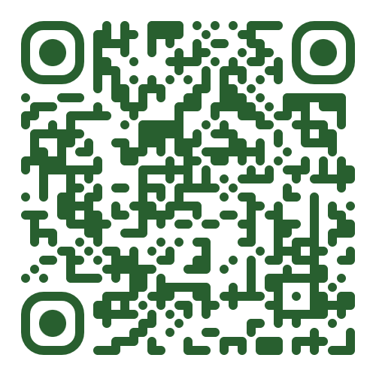
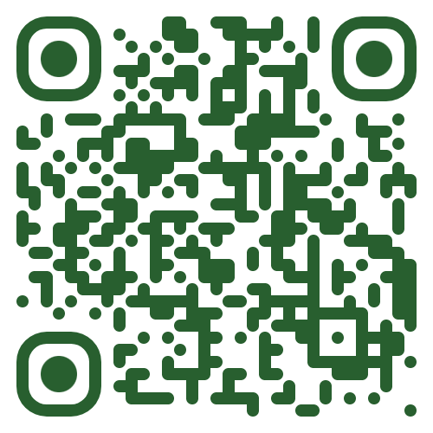
If your team needs an agentic system —
let's talk.
WHATSAPP
LINKEDIN
Quick chat, today
Daily agentic AI
Reply within hours · personal · best for hot conversations
Follow for production lessons · case studies · behind the scenes
Jigar Joshi · Agentic AI Architecture & Consultant & CEO - Wan Buffer Services

