Slide 1
Making 5
Mrs Barrett

Slide 2
Key principles
This box is to indicate to the teacher (user) that stage of the instructional cycle. It won’t be visible in a recorded lesson, but is there for teachers who download the slides for their own use.
The ‘I do’ phase involves the explanation - indicates where a teacher would be explaining a concept.
Moving from ‘I do’ to ‘We do’ involves modelling - indicates that the teacher is demonstrating a skill or modelling a process.
Check for Understanding - Questions posed to check whether students have understood and to inform next steps.
‘You do’ - Practice - indicates places where students will attempt questions independently.
I
W
I do
We do
CfU
Check for
Understanding
Y
You do

Slide 3






Engagement icons
This icon is to indicate to the teacher (user) a suggested engagement norm. It won’t be visible in a recorded lesson, but is there for teachers who download the slides for their own use.
Whiteboards
All students respond to the teacher’s question, showing their responses at the same time.
Turn and talk
Students discuss with the person next to them.
Cold call
The teacher asks a question, gives wait time, then calls on individual students to respond.
Choral response
Students respond orally all together.
In your book
Students respond to a prompt in their exercise book or booklet.
Thumbs up, thumbs down
Students indicate whether they agree or disagree with a statement, or whether something is an examples or non-example.

Slide 4


In this lesson, you will need:
Worksheet, exercise book or paper
Pencil and coloured markers

Slide 5
Learning intentions: Maths, Early Stage 1
Numbers can be explored and represented as quantities.
Students are learning that:
Mathematicians represent numbers to help us see something about numbers
The way we structure representations can help us to subitise a collection.

Slide 6


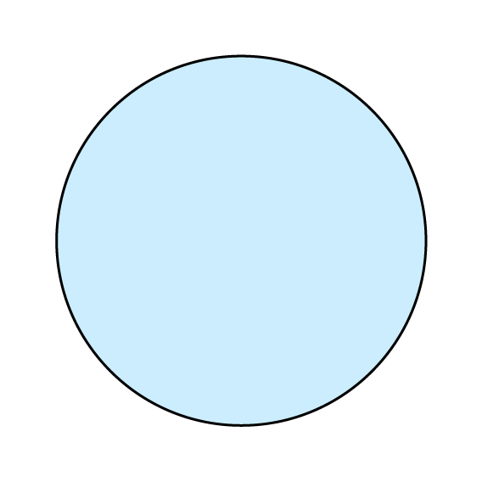
number
F-1
6
six
Notes:
Number - the amount or the value

Slide 7
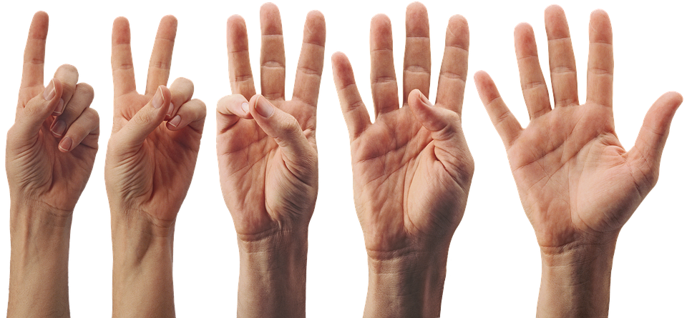
3
4
2
I
1
5
Credit: Pixabay
Notes:
This is a hand- how many fingers does it have? Lets count them.
turn to the person next to you and give them a high five. Do you know what it’s called high five? It’s because we have five fingers!

Slide 8

3
3
CfU
CfU
2
4
2
4
1
1
5
Credit: Pixabay
Notes:
Which hand is showing five fingers? Is it this one? Or this one?

Slide 9
2
3
1
4
5
W
E
E
E
CfU
CfU
Credit: Pixabay
Notes:
How else can I show the number five? What if I show three fingers on one hand and two on the other hand? What does that make? COUNT Yes, five!

Slide 10
1
4
5
3
W
E
E
E
CfU
CfU
2
Credit: Pixabay
Notes:
What about if I had one and four fingers ? how many does that make? Yes five!

Slide 11

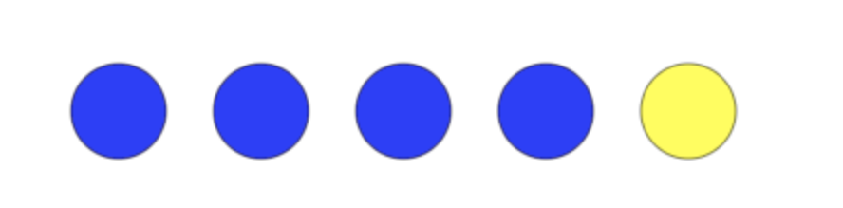
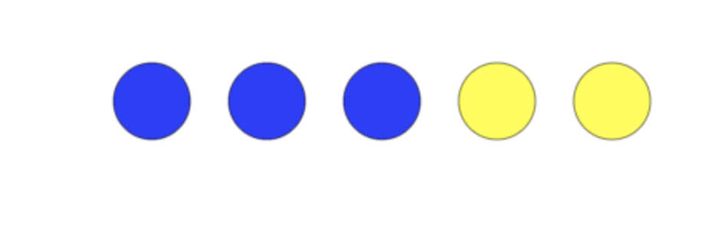
1
2
3
4
5
W
1
2
3
4
5
1
2
3
4
5
Credit: Mathsbot
Notes:
Now I’ve got some counters- I’m going to put out five counters.
Let’s count COUNT
If I have four blue counters and one yellow counter do I still have five? LETS COUNT - COUNT WITH ME counters yes!
WHat about of I have three blue counters and two yellow counters- do I still have five counters?COUNT WITH ME Yes

Slide 12
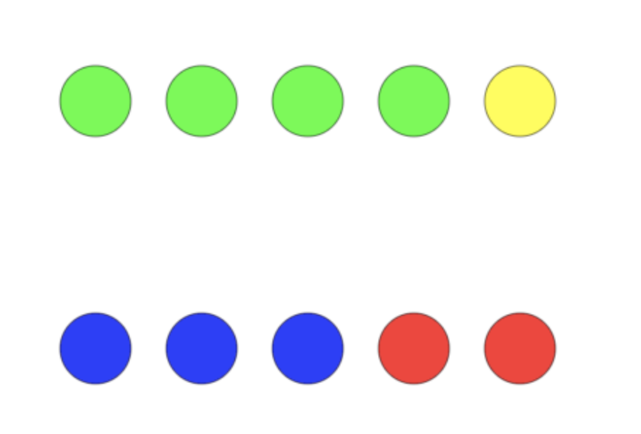
CfU
CfU
Credit: Mathsbot
Notes:
Now it’s your turn- If I have four green counters and one yellow counter do I still have five counties altogether? THUMBS UP/DOWN
WHat about if I have three blue counters abn two red counters? Yes!

Slide 13
CfU
CfU
Credit: Mathsbot
Notes:
Now it’s your turn- If I have four green counters and one yellow counter do I still have five counties altogether? THUMBS UP/DOWN
WHat about if I have three blue counters abn two red counters? Yes!

Slide 14
5
W
Notes:
NCR.
How its time to do the worksheet. Please get your worksheet and and pencil.
What we need circle the boxes that are showing the number five, or five objects in the box.
Lets’ try the first one- how many objects are there ? Let’s count the moons - COUNT how many? Only four?
WHat about the next box? How many? COUNT
Now id; like you to complete the worksheet. Off you go.

Slide 15
Y
Independent practice

