Slide 1
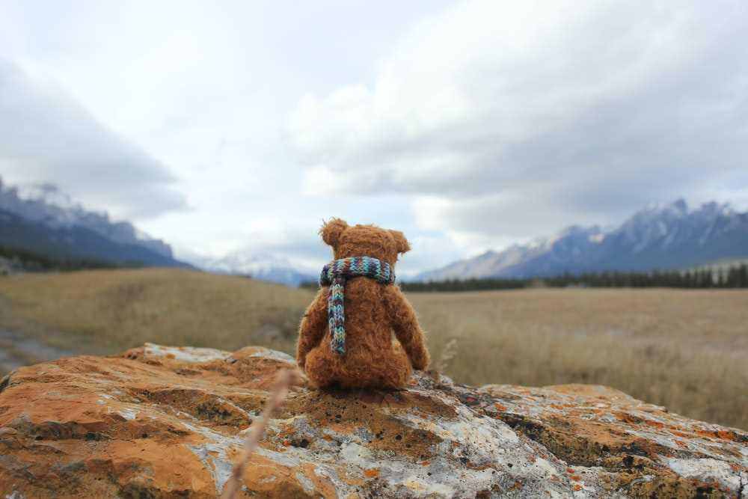

Teddy Bear
Free Template

Slide 2
Agenda Style
01
Contents
Get a modern PowerPoint Presentation that is beautifully designed. I hope and I believe that this Template will your Time.
02
Contents
Get a modern PowerPoint Presentation that is beautifully designed. I hope and I believe that this Template will your Time.
03
Contents
Get a modern PowerPoint Presentation that is beautifully designed. I hope and I believe that this Template will your Time.
04
Contents
Get a modern PowerPoint Presentation that is beautifully designed. I hope and I believe that this Template will your Time.

Slide 3
Introduction
Venus has a beautiful name and is the second planet from the Sun. It’s terribly hot, even hotter than Mercury, and its atmosphere is extremely poisonous

Slide 4
Whoa!!
This can be the part of the presentation where you introduce yourself

Slide 5
Table of contents
01
02
Let’s warm up
About your bear
03
04
Color & number
Extra activities
You can describe the topic of the section here
You can describe the topic of the section here
You can describe the topic of the section here
You can describe the topic of the section here

Slide 6
—Someone Famous
“This is a quote, words full of wisdom that someone important said and can make the reader get inspired.”

Slide 7

01
Let’s warm up
You can enter a subtitle here if you need it

Slide 8
Bring your teddy bear
Jupiter
Venus
Jupiter is a gas giant and the biggest planet in the entire Solar System
Venus has a beautiful name and is the second planet from the Sun

Slide 9
Infographic Style
ALLPPT Layout
Clean Text Slide for your Presentation
Get a modern PowerPoint Presentation that is beautifully designed. I hope and I believe that this Template will your Time.
80%
Text
Your Content Here
Get a modern PowerPoint Presentation that is beautifully designed. I hope and I believe that this Template will your Time, Money and Reputation. Easy to change colors, photos and Text. Get a modern PowerPoint Presentation that is beautifully designed.

Slide 10
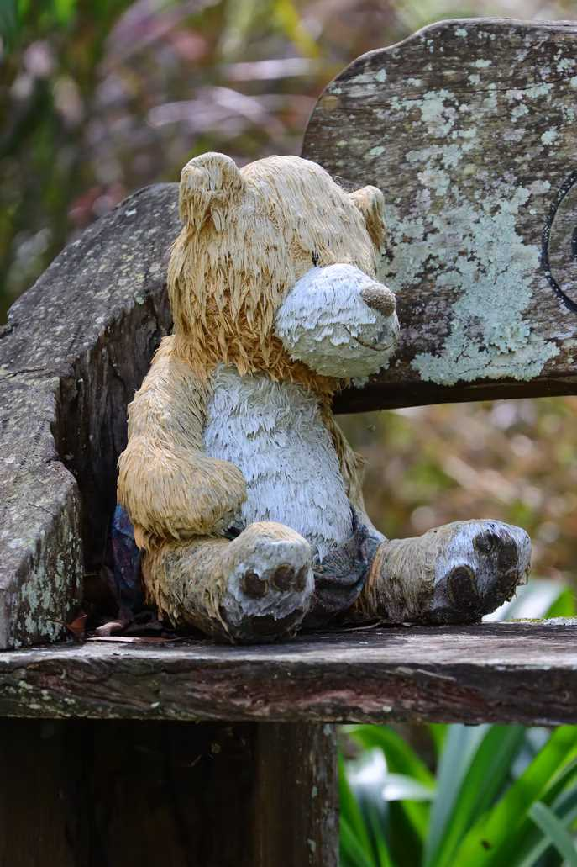
Additional Resources
Write a small intro about the chapter. Cras nec quam eu neque tempus bibendum. Vestibulum porta metus odio, convallis interdum magna pellentesque tincidunt. Vivamus pellentesque.

Slide 11

02
About your bear
You can enter a subtitle here if you need it

Slide 12
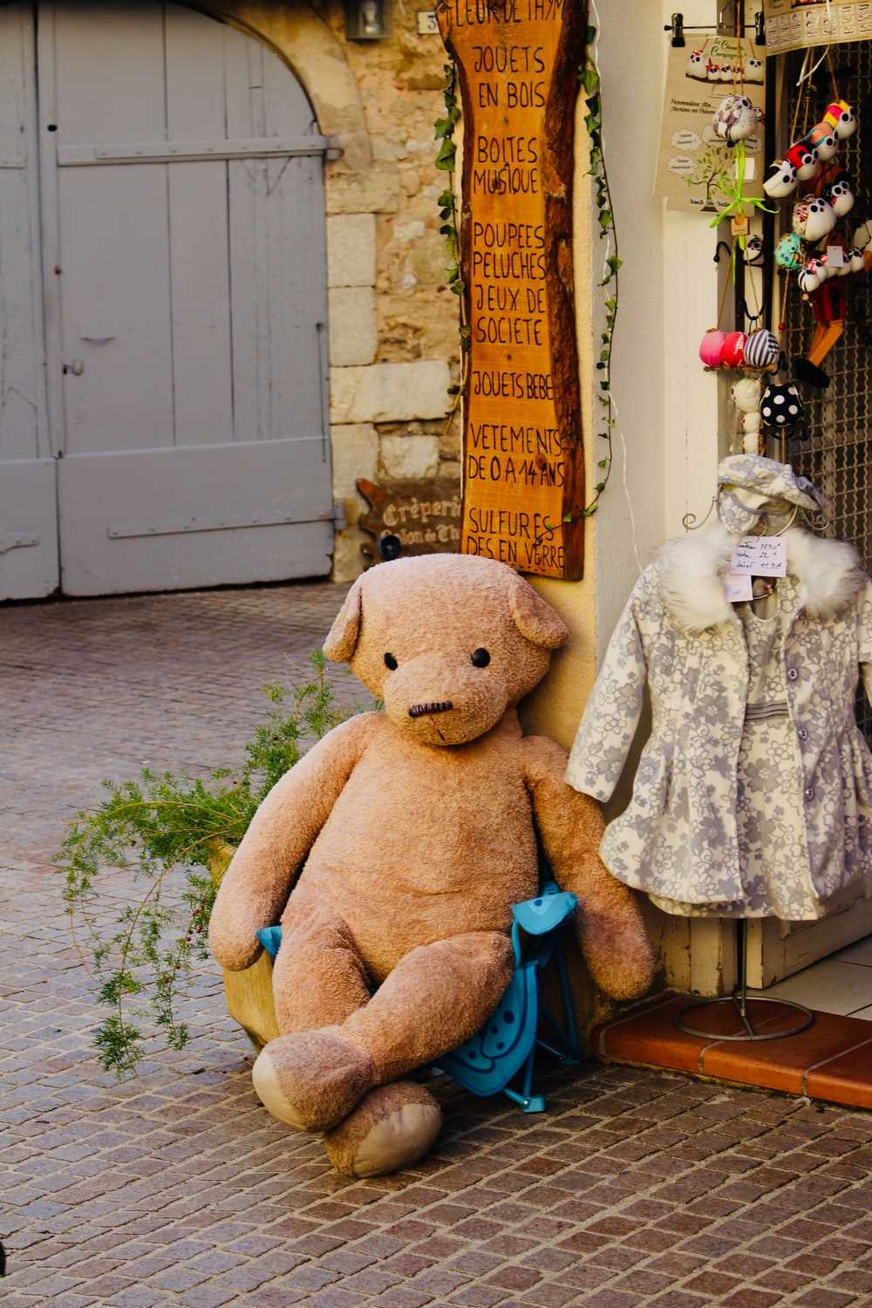
Task Template 1
A
Answer A
Integer vel vehicula nisi, sed consectetur lorem..
X
EXERCISE 1 / CHAPTER 1
Write here a small description of the task or small notes to give a context about the exercise.
Answer B
Integer vel vehicula nisi, sed consectetur lorem.
Question, how can you solve this problem?
Answer C
Integer vel vehicula nisi, sed consectetur lorem.
Add some caption for the context of the image here

Slide 13
Teddy bear story
Tell your classmates the story of your teddy bear
Step 01
Step 02
Step 03
Step 04
Neptune is the farthest planet from the Sun
The Moon is Earth’s only natural satellite
Despite being red, Mars is a cold place
Mercury is the closest object to the Sun

Slide 14

A picture always reinforces the concept
Images reveal large amounts of data, so remember: use an image instead of a long text. Your audience will appreciate it for sure
Images reveal large amounts of data, so remember: use an image instead of a long text. Your audience will appreciate it for sure

Slide 15

New words that we are going to learn
Mercury
Venus
Jupiter
Saturn
Mercury is the closest planet to the Sun
Venus is the second planet from the Sun
It’s the biggest planet in the Solar System
Saturn is a gas giant and has several rings

Slide 16
333,000.00
9h 55m 23s
386,000 km
The Sun’s mass compared to Earth’s
Jupiter’s rotation period
Distance between Earth and the Moon

Slide 17

A picture is worth a thousand words

Slide 18
10,000,000
Big numbers catch your audience’s attention

Slide 19

Awesome words
Because key words are great for catching your audience’s attention

Slide 20
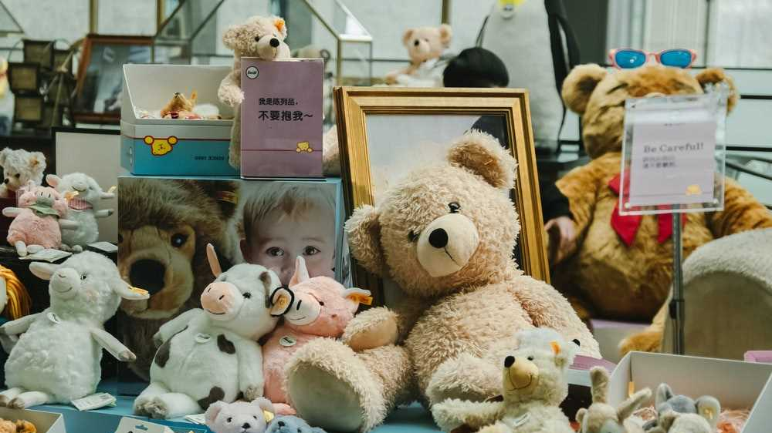
A picture is worth a thousand words

Slide 21
Parts of your teddy bear
Match each part of the teddy bear with its correct name
Venus
Jupiter
Mars
Venus is the second planet from the Sun
It’s the biggest planet in the Solar System
Despite being red, Mars is a very cold place

Slide 22

Choose your bear adjectives
Drag the words that define your teddy bear to the circle
Soft
Brown
Yellow
Cute
Short
Friendly

Slide 23

Infographic Style
Content Here
Content Here
You can simply impress your audience and add a unique zing and appeal to your Presentations.
You can simply impress your audience and add a unique zing and appeal to your Presentations.
Add Text
Add Text
Simple PowerPoint Presentation
Simple PowerPoint Presentation
Content Here
Content Here
You can simply impress your audience and add a unique zing and appeal to your Presentations.
You can simply impress your audience and add a unique zing and appeal to your Presentations.

Slide 24

03
Color & number
You can enter a subtitle here if you need it

Slide 25
Your teddy bear's favorite things
Select the favorite elements of your teddy bear and drag them to the circle
Additional Resources
Write a small intro about the chapter. Cras nec quam eu neque tempus bibendum. Vestibulum porta metus odio, convallis interdum magna pellentesque tincidunt. Vivamus pellentesque.

Slide 26
How to make teddy bear pancakes
01
02
03
Mars
Jupiter
Saturn
Despite being red, Mars is actually a very cold place
It’s a gas giant and the biggest planet in the Solar System
Saturn is composed mostly of hydrogen and helium

Slide 27

Roman empire
Latin language
Despite being red, Mars is actually a cold place. It’s full of iron oxide dust
Greek language
Mercury is the closest planet to the Sun and the smallest one

Slide 28
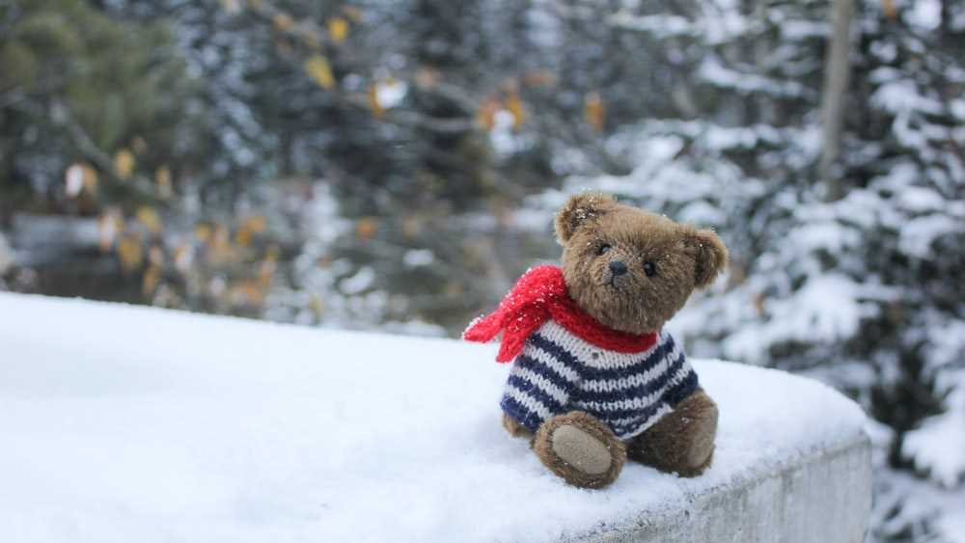
Awesome
Words
Your teddy bear's favorite things

Slide 29
Thanks!
Do you have any questions?
addyouremail@example.com
+91 620 421 838
Free Template

Slide 30
FUENTE
ELABORADO POR :
plantillaspowerpoint.org
IMAGES :
unsplash.com
FONTS :
Cinzel Decorative
Arial

Slide 31
RESOURCES

Slide 32
RESOURCES

Slide 33
RESOURCES

Slide 34
Fully Editable Icon Sets: A

Slide 35
Fully Editable Icon Sets: B

Slide 36
Fully Editable Icon Sets: C

