Slide 1

Product App
Introduction To Platform Apps - Product App
Document Version - 22nd October 2020

Slide 2
What’s in it for me?
Overview of the Product App
1.1 Introduction
1.2 What is Product app used for?
User Guide

Slide 3
What’s in it for me?
Overview of the Product App
1.1 Introduction
1.2 What is Product app used for?
User Guide

Slide 4
Overview

Slide 5
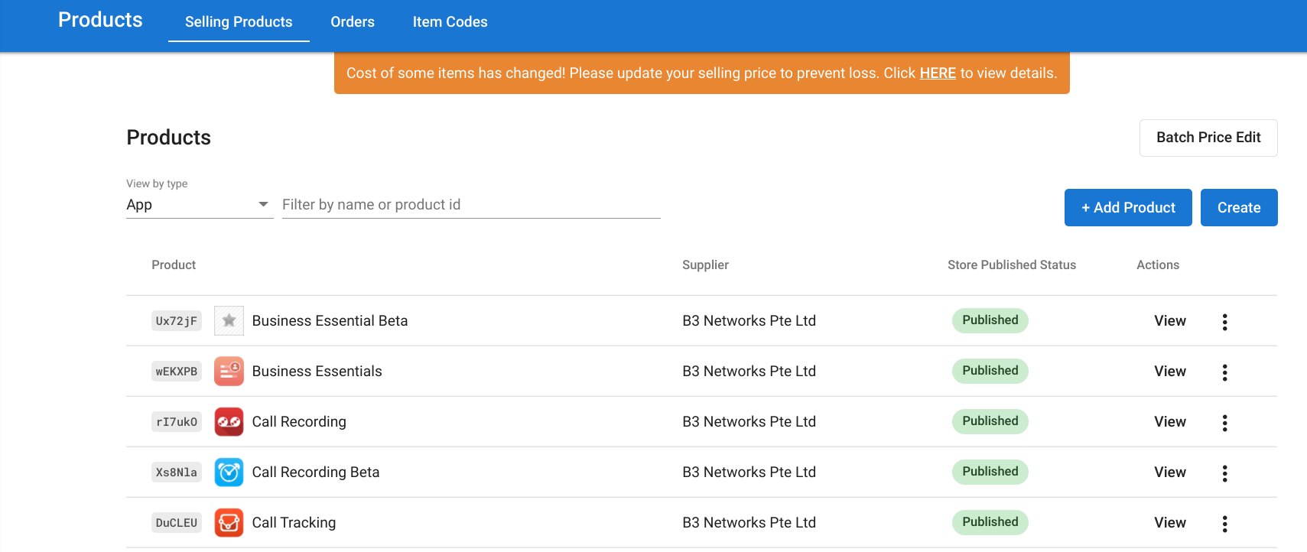
Introduction
B. What is this app used for?
App allows the management of cloud communication app pricing, DDI number inventory and routing SKUs
Add products to the store (B3networks’s products & your own products)
Configure selling price

Slide 6
2. User Guide

Slide 7
2.1 Add products to the store

Slide 8
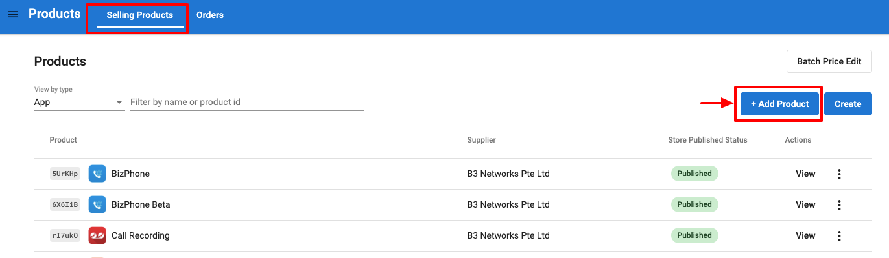
Add products to the store (products distributed by B3networks)
If you want to add some products distributed by another service provider (e.g. SIP from B3networks), please follow the steps below:
1. Go to Product app > [Selling products] > [Add product]

Slide 9
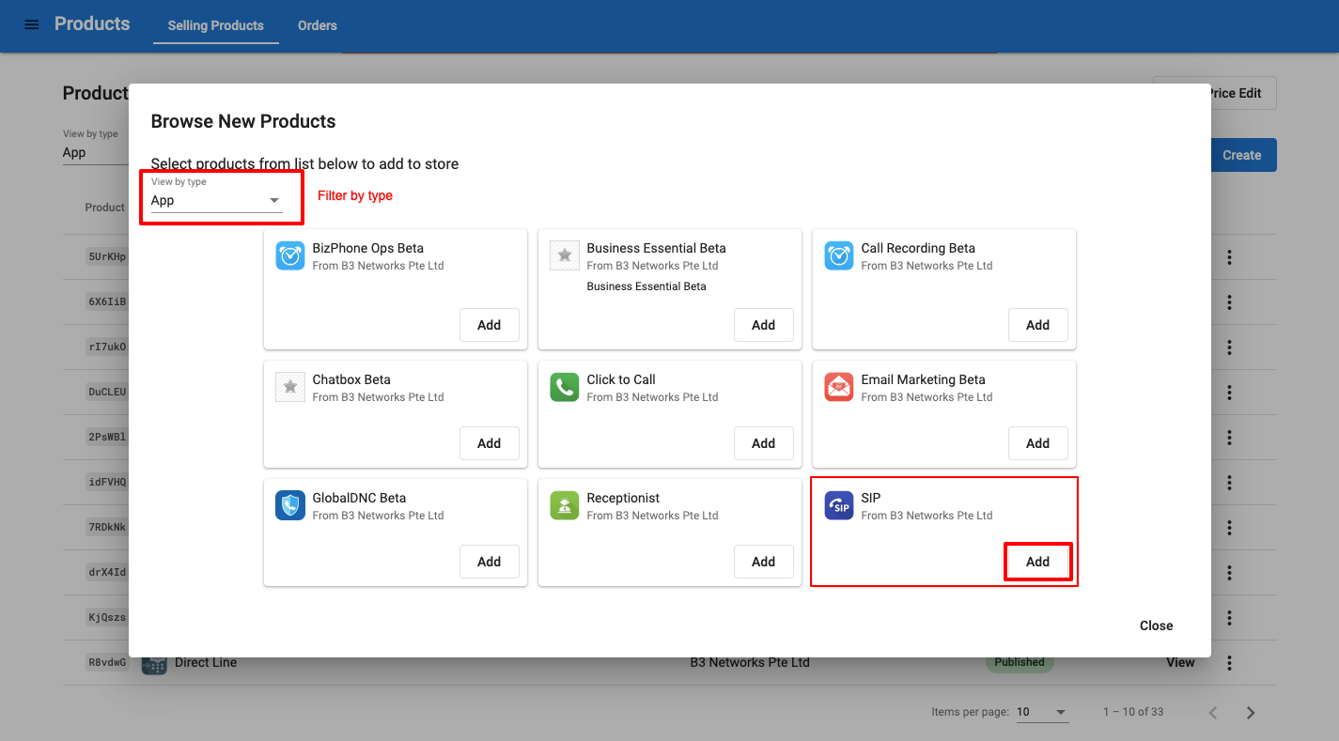
Add products to the store (products distributed by B3networks)
2. Choose a product to add (e.g. SIP) > [Add]

Slide 10
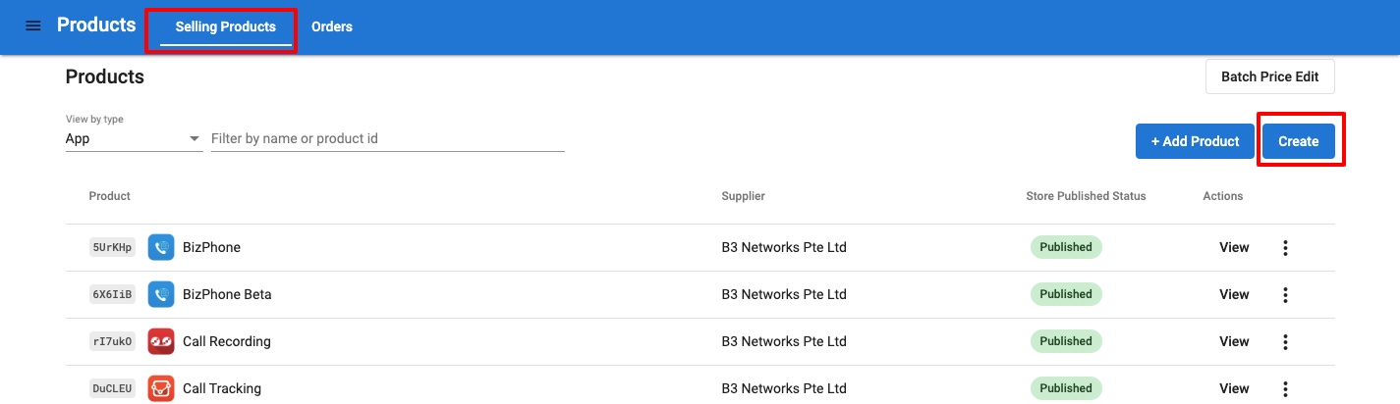
B. Add products to the store (your own products - Hardware & services)
If you want to add your own products (hardware and service) to the store, please follow the steps below:
Go to Product app > [Selling products] > [ Create]

Slide 11
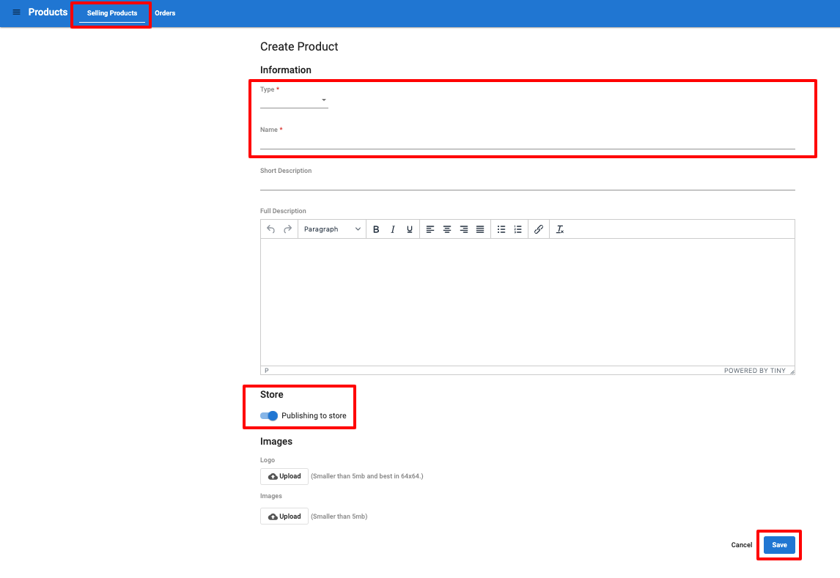
B. Add products to the store (your own products - Hardware & services)
2. Fill in info to create new product
Select type (Hardware or Service)
Give your product a name
Give it a description (if any)
Publish it to Store if you want. Otherwise, toggle it off.
Upload a logo and some images to illustrate your products (image size is less than 5Mb)
Save.

Slide 12
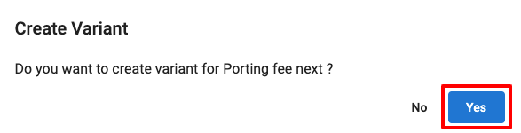
B. Add products to the store (your own products - Hardware & services)
3. Click Yes to create Variant for the product (e.g. Porting fee)

Slide 13
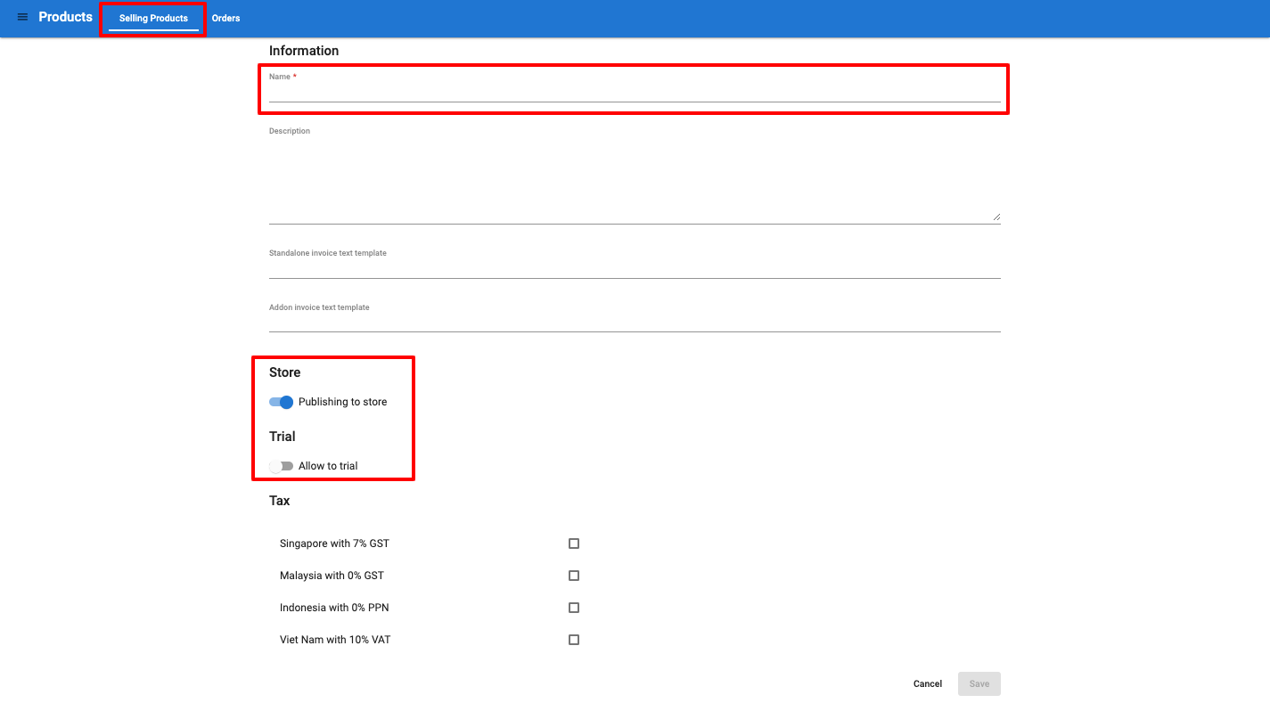
B. Add products to the store (your own products - Hardware & services)
4. Fill in the information for the Variant
Name
Description (optional)
Invoice text (define how it is displayed in the invoice sent to customer. You can only modify the invoice text for the product that you distribute)
Publish to store
Allow trial or not
Configure tax in specific countries
Save

Slide 14
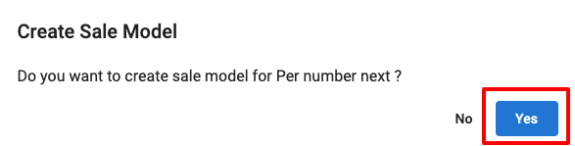
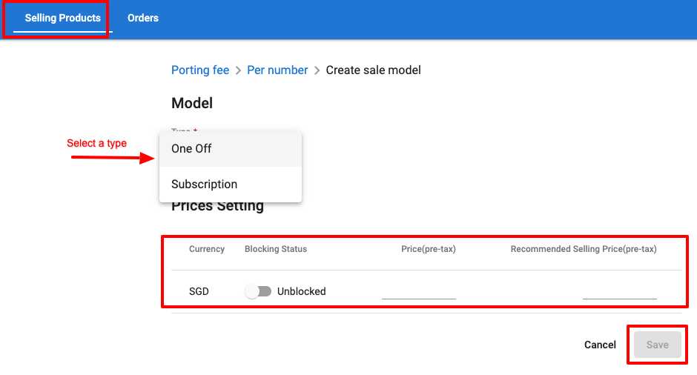
B. Add products to the store (your own products - Hardware & services)
6. Choose a model > Set up a price and Save
5. Click Yes to create Sale model
(how the Variant should be charged)

Slide 15
2.2 Configure selling price

Slide 16
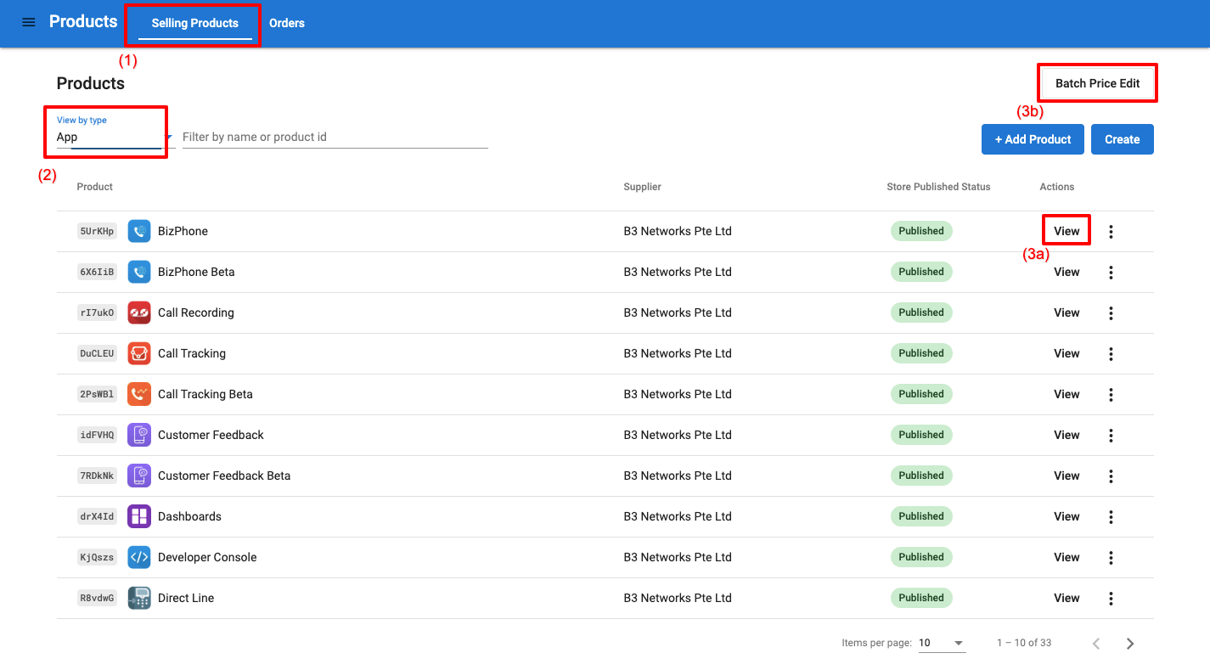
Configure selling price
Go to Product app > [Selling products]
Filter by type
App: pricing of applications such as SIP, Bizphone, Call recording...
Telecom: pricing of usage, i.e. outgoing call, fax, sms; incoming call, fax, sms; DNC check
Number: pricing of numbers (DIDs)
Hardware: pricing of hardware, e.g. phone, handset, door-bell system
Service: pricing of service, e.g. admin fee, porting fee, number activation fee
Edit the price (2 ways)
Edit single product at [View]
[Batch Edit]

Slide 17
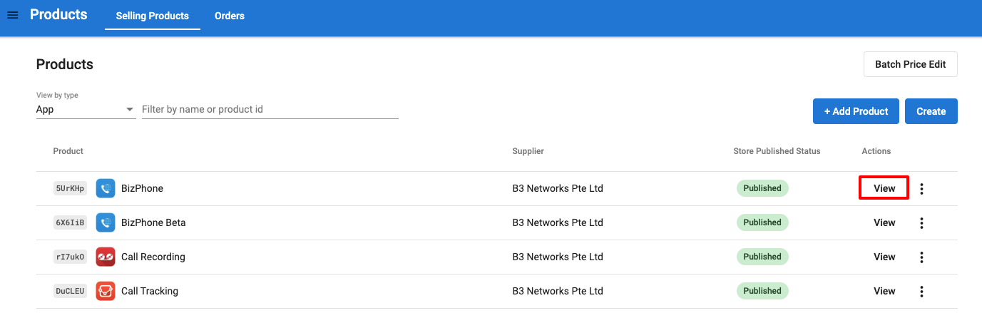
Configure selling price (cont’d)
3a. Edit single price
a1. View a product

Slide 18
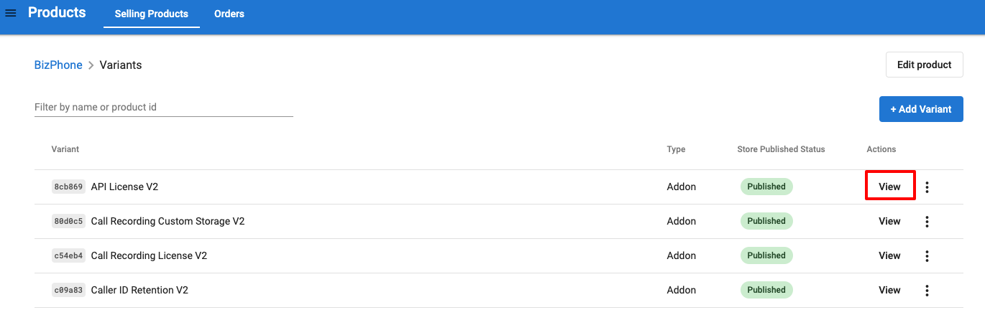
Configure selling price (cont’d)
3a. Edit single price
a2. View a variant that needs to change the price. You can filter by its name

Slide 19
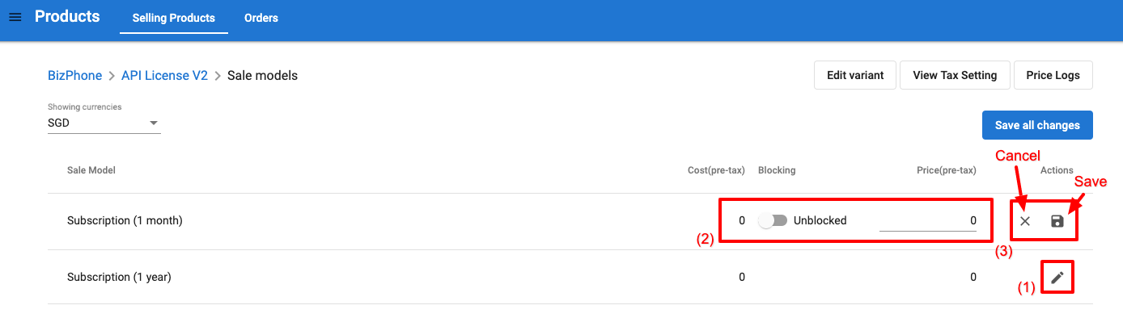
Configure selling price (cont’d)
3a. Edit single price
a3. Click the pencil icon to edit > Edit price > [Cancel] or [Save] the change

Slide 20
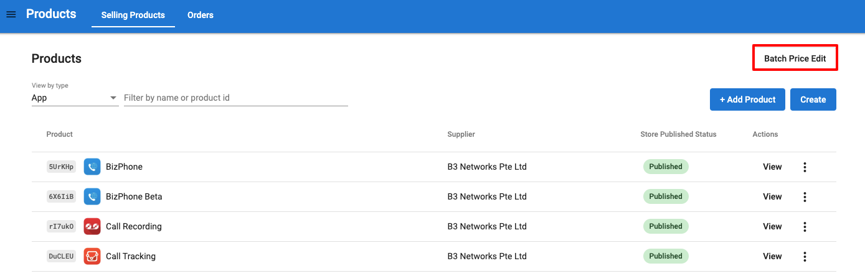
Configure selling price (cont’d)
3b. Edit multiple pricing at a time
b1. Choose Batch edit

Slide 21
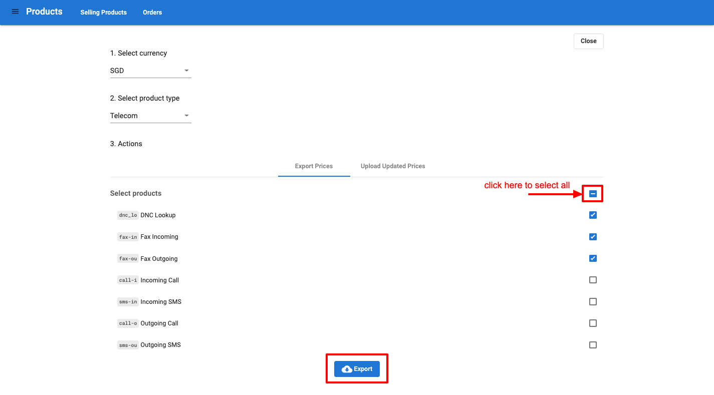
Configure selling price (cont’d)
3b. Edit multiple pricing at a time
b2. Select Currency > Select type > Select the product(s) > Download the current pricing

Slide 22
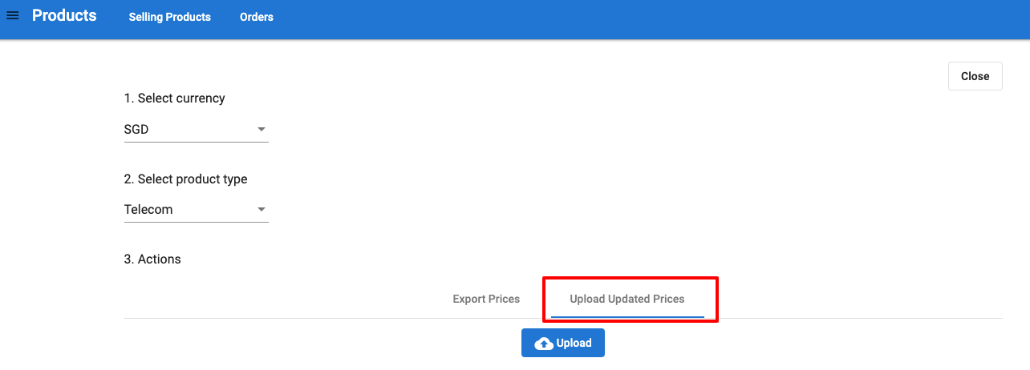
Configure selling price (cont’d)
3b. Edit multiple pricing at a time
b3. Upload new pricing

Slide 23
2.3 Price change alert

Slide 24
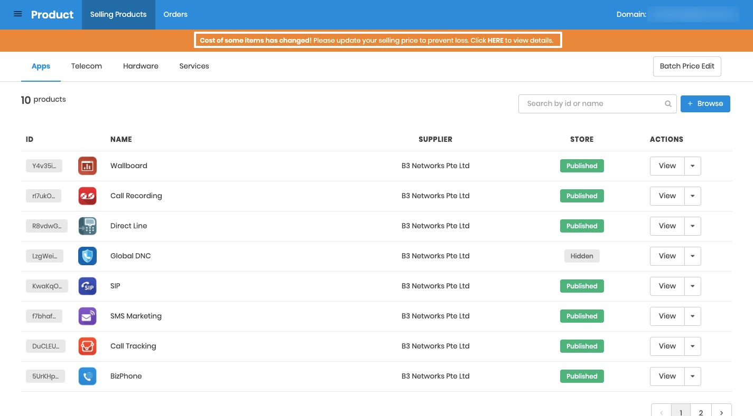
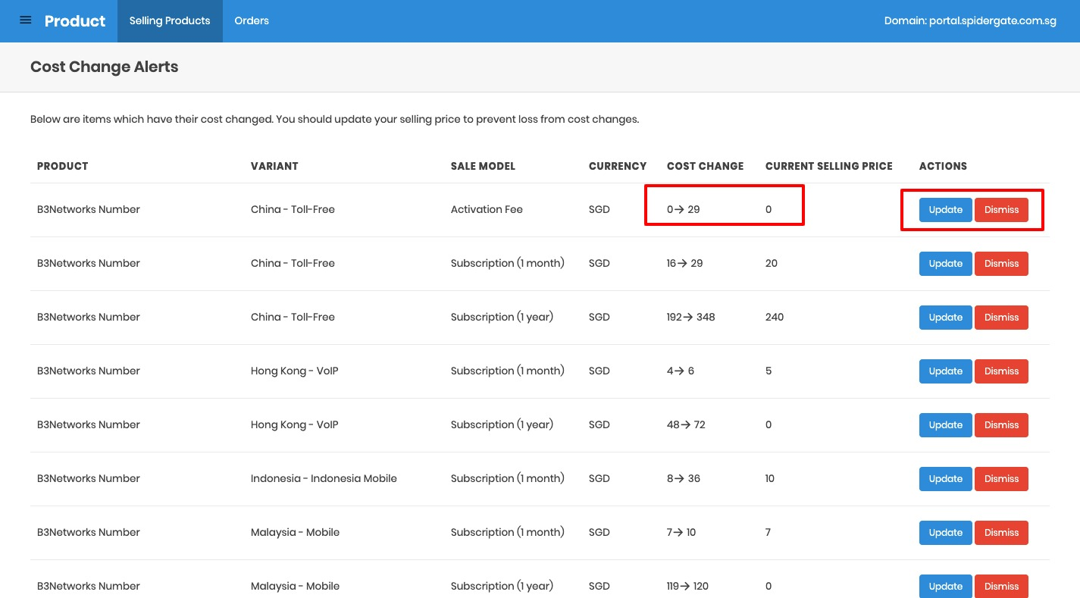
Price change alert
If the service provider updates the costing to you, you will be alerted when you go to Product app.
You would need to click HERE to see the change and update your price list if you wish.

Slide 25
Thank You
For comments and feedbacks please contact:
academy@b3networks.com

