Slide 1

AIParkinScan (AIPS) brought to you by Team 8 (HANNA)
of the Applied Deep Learning Track
Notes:
[Nishil]
Hi everyone! Welcome judges, teammates, mentors, families, and friends to the Team 8 MIT Futuremakers 2022 Create-a-thon presentation.
We are happy to see everyone, and excited to share our project with you all!
Under the theme of Physical Health and Mental Well-being Management, our team worked on a project to create AIParkinScan or AIPS for short, which is an Artificial Intelligence software for the easy and accurate diagnosis of Parkinson’s Disease.

Slide 2

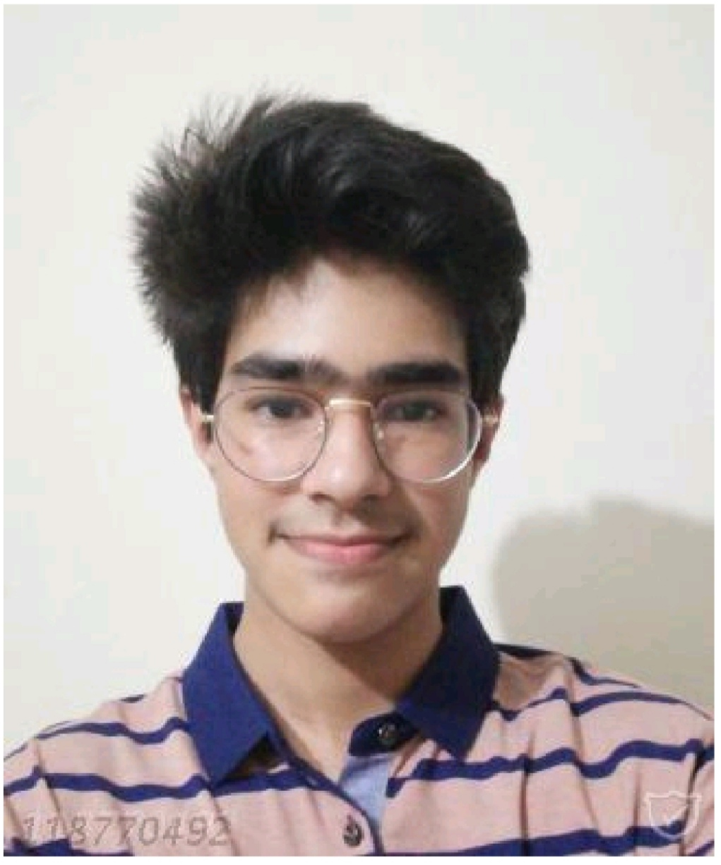

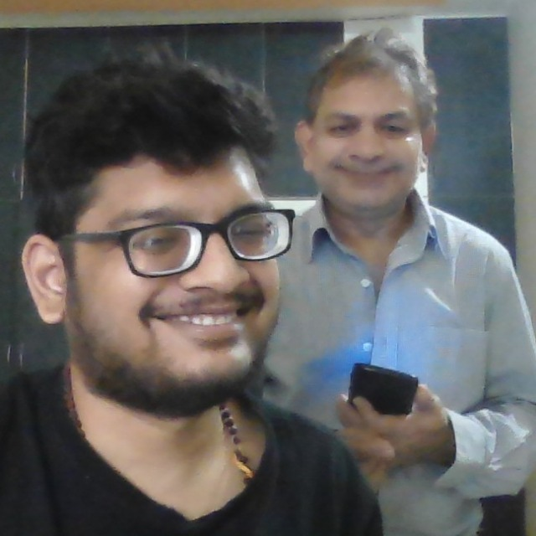
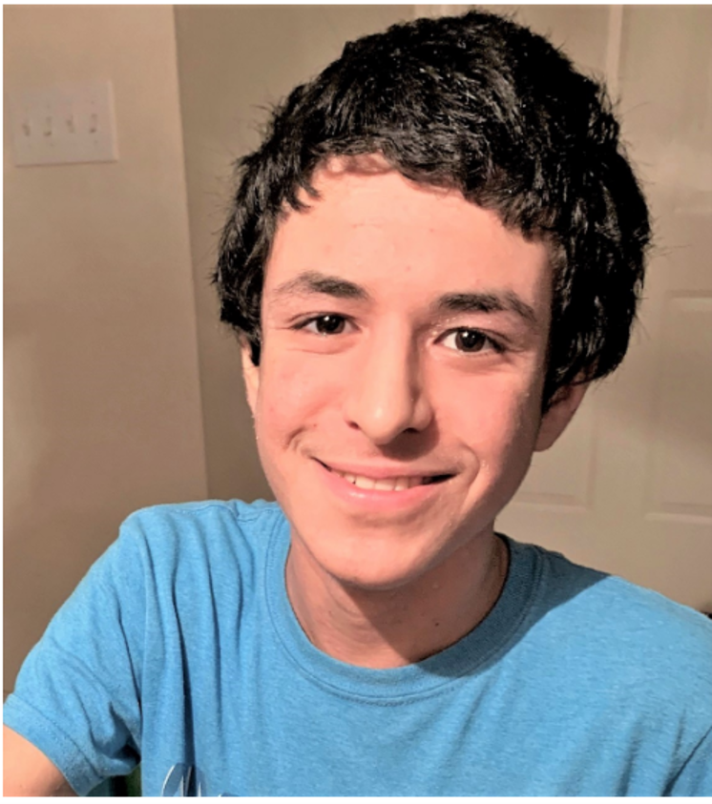
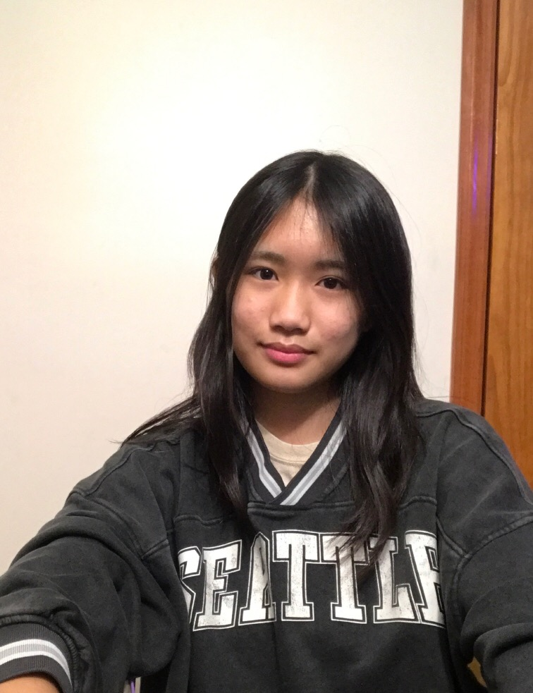


Hassan Mushtaq
Sophomore, Ohio Wesleyan University
Aadarsha Gopala Reddy
Senior, Ohio Wesleyan University
Nisarg Parikh
Mentor
Nishil Rally
Senior, Green Hope High School
Allie Kam
Junior, Great Neck South High School
Notes:
[Nishil]
Before we move on to sharing our project with you in detail, we would like to introduce our team- HANNA. My name is Nishil Rally (everyone says their name).
And our mentor is Nisarg Parikh
Now the motivation behind this product came from the fact that Parkinson’s Disease is a progressive illness- a disorder of the central nervous system- specifically the brain and spinal cord- that affects movement, generally in people over age 60. It also hit close to home when Allie shared that her grandmother has Parkinson’s. So now I’ll hand it over to Allie to talk about her family’s journey.

Slide 3

Allie’s Personal Story
July 2019, Allie’s 70-year-old grandmother started having tremors in her hand and changes in mood
Was diagnosed with Parkinson’s Disease
Got lucky with early diagnosis
Notes:
[Allie]
Thank you Nishil. In July 2019, my aunt noticed that my grandmother recently started to have tremors in her hands, as well as a change in her mood.
While most might attribute this just mere side effects of old age, as my grandmother was 70 years old, my aunt works in healthcare, so she suspected there was something more.
Eventually, she took my grandmother to see the doctor, where she was diagnosed with Parkinson's.
My grandmother was lucky and was diagnosed early; however, people often don’t notice the symptoms of Parkinson's in those around them.
This makes me wonder; had my aunt not been a healthcare professional for 10 years, would anybody else be able to see this was happening to my grandmother?

Slide 4
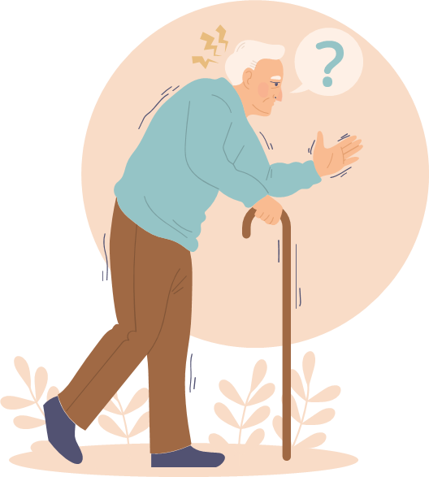
Parkinson’s Disease
Parkinson’s starts with a tremor in one hand.
Symptoms include:
Slow Movement
Stiffness
Loss of Balance
Caused by:
Degeneration of the brain’s basal ganglia
Deficiency of dopamine
Heredity is uncommon
Notes:
[Allie]
Parkinson’s disease, or PD, is a neurodegenerative disorder that primarily affects movement and causes uncontrollable shaking, stiffness, and difficulty with balance and coordination. It is caused by degeneration and loss of nerve cells in the brain’s basal ganglia.
There is currently no known cure, and while PD is not fatal, it can cause a multitude of complications.

Slide 5

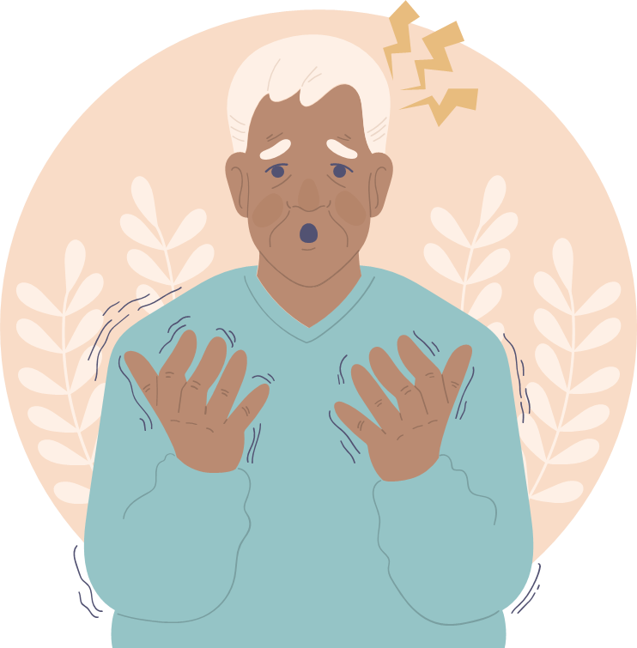
Parkinson’s Disease
1 in 500 develop Parkinson’s Disease. Usually, people >60 start
showing symptoms
but, 1 in 20 with Parkinson’s are <60.
Second most common neurodegenerative disease
(NHS, Parkinson’s Foundation)
Notes:
[Allie]
Here are some basic statistics on Parkinson's.
About 1 in 500 people developed PD each year, and currently more than 10 million people worldwide are living with it.
Most that diagnosed are over the age of 60, although 1 in 20 diagnosed are under 60.
It is the second most common neurodegenerative disease, after Alzheimer's.

Slide 6

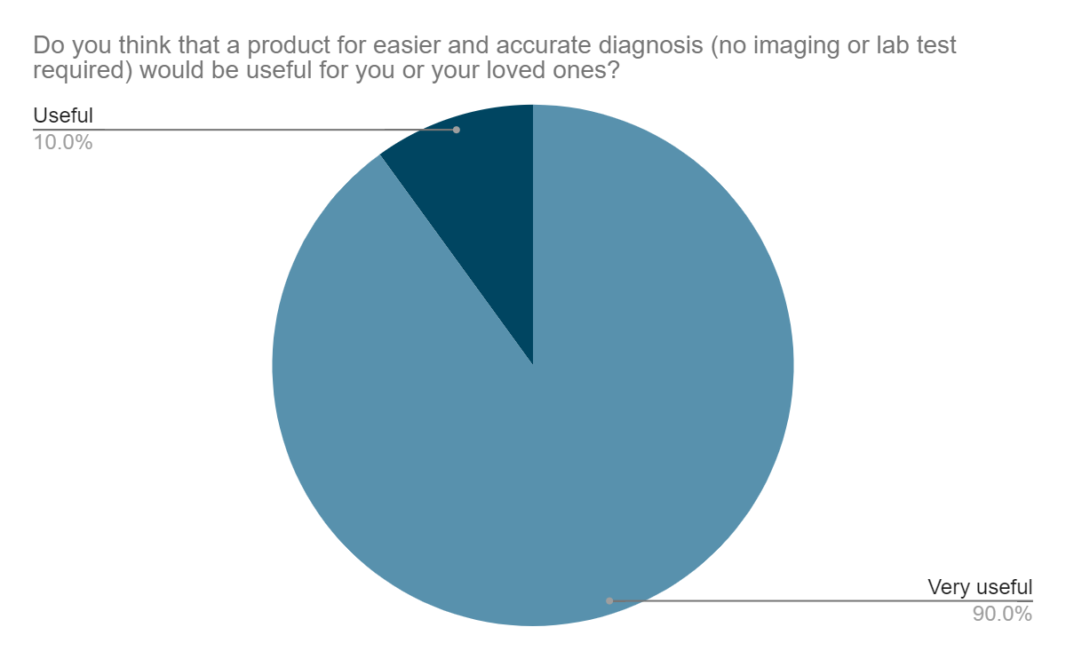
“Diagnosis can be difficult because symptoms are similar to other conditions/diseases. Lengthy testing options available can still provide inaccurate results.” - Researcher from survey
“... any strategy that would help with early detection of Parkinson’s would likely prove substantially beneficial in starting treatment early and maintaining quality of life.” (Fernando L., family member of Parkinson’s patient)
Notes:
[Allie]
We conducted a primary survey, and the results showed that diagnosis of Parkinson’s is a frustration for medical professionals since there is no proper method or tool to diagnose it. As shown on this pie chart, 90% of our survey respondents said that a product for easy and accurate diagnosis would be very useful. So, there is a clear market for our product.
Now, I am going to hand it over to Nishil.

Slide 7

User Research
Key points
Early Detection
Independence
Quick Access to local Resources
Tests are useful for monitoring disease progression
Notes:
[Nishil]
Along with our survey, after conducting research for our project, a few key points came to light. Firstly, early detection of Parkinson’s is extremely important.
The primary users of our software will be PD patients, especially those that live alone, and are in greater need of care, so as to be able to live independently.
Availability of local medical and other resources is very important for our users.
Our diagnostic tests are useful not just for initial testing, but also using these tests for disease progression.

Slide 8

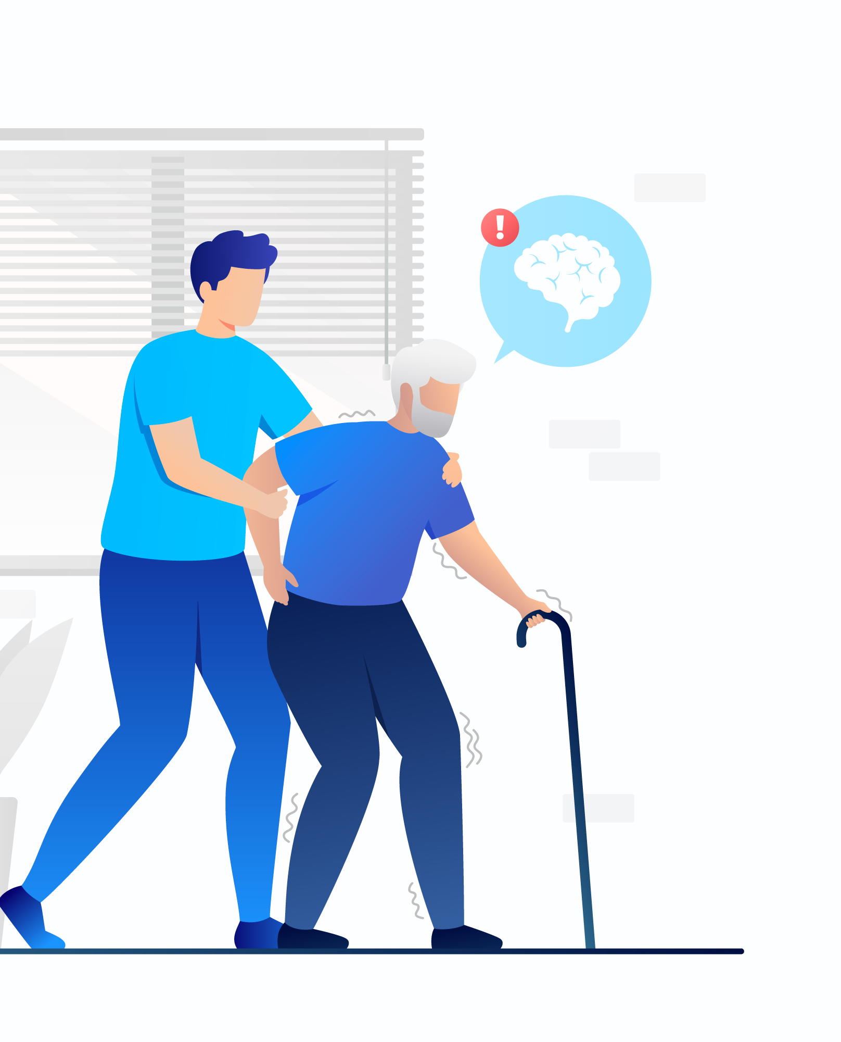
AIParkinScan (AIPS) An Artificial Intelligence software for easy and accurate diagnosis of Parkinson’s disease
Identified Problem:
No standard diagnostic test
Diagnosis is difficult
Varied symptoms
Our Goal: To use new technologies to create a product/software that
can help to test and diagnose anyone for Parkinson’s disease- even
those in the early stage of the disease
The Solution: An accurate, easy-to-use, inexpensive diagnostic tool that can predict if anyone has, or is at risk, of having Parkinson’s disease. We call this creative tool AIParkinScan.
Notes:
[Nishil]
So on this slide I am going to explain the problem, goal, and solution with respect to diagnosing Parkinson’s. Despite the fact that millions suffer from Parkinson’s there are currently NO standard diagnostic tests for this disease. Only clinical diagnosis is done based on findings of a neurological exam and patient information. For many people it takes years before they are accurately diagnosed. In addition to this, symptoms of Parkinson’s vary from person to person and since a number of other illnesses have similar symptoms, misdiagnoses can occur.
From our survey, we identified a need for creating a diagnostic test for Parkinson’s disease. Our goal was to use new technologies to create a product/software that can help to test and diagnose anyone for Parkinson’s disease- even those in the early stages, is efficient, accessible, and inexpensive, and can also be useful to track disease progression. The solution that we came up with, was creating a diagnostic tool that can predict if anyone has, or is at risk, of having Parkinson’s disease. We call this creative tool AIParkinScan- an Artificial Intelligence software for easy and accurate diagnosis of Parkinson’s disease. Later in this presentation we’ll talk more about the features and technology used in making this diagnostic tool.

Slide 9



Competitive Analysis
Common applications in the market
Exercise and Cognitive Training apps
Symptoms Tracking apps
Resource Providing apps
No commercial or consumer application or software exists that can easily identify Parkinson’s and provide immediate resources to the patient.
Notes:
[Aadarsha]
We researched the wide internet for applications that help patients identify, help and resource themselves about Parkinson’s. We found several physical exercise and cognitive training apps, symptom tracking apps, and apps that provide resources. None of these apps help in identifying whether a person has Parkinson’s. They do help in maintaining a stable lifestyle, but do not aid in early diagnosis.

Slide 10
AIParkinScan Features & Technology
Multimodal Learning Model
Computer Vision identifies
Micrographia and
Voice tremors
Notes:
[Aadarsha]
Our website uses multimodal learning to help diagnose various symptoms of PD.
For example, it asks for a drawing of a spiral to detect micrographia, which is abnormally small or cramped handwriting. It is a secondary motor symptom experienced by people with Parkinson's disease.
Another feature is that our website can take an audio clip to analyze the voice for any tremors or slurred speech.
The model creates a new segment of an audio file, and converts it to a spectrogram to determine if the user has Parkinson’s.

Slide 11
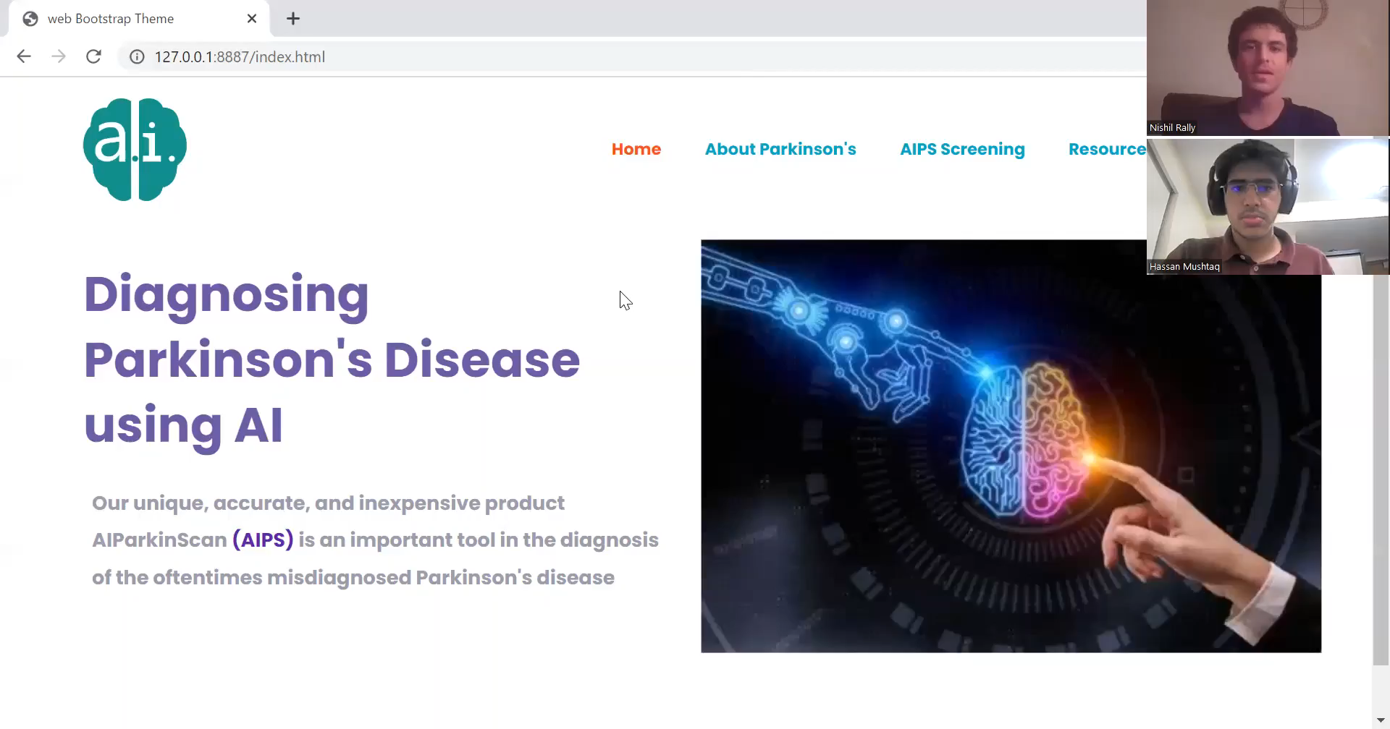
Our Product Demo
Notes:
[Hassan]
This is a video demonstration of our product.

Slide 12
Future Improvements
Using facial features as an additional factor
Localized medical help
Mental Health tracking and resources
Recognizing other common diseases that accompany Parkinson's (e.g., dementia)
Notes:
[Hassan]
In the future, we would like to generalize our product to include other neurodegenerative diseases, such as Alzheimer's and Huntington’s which also involve degeneration of the nervous system, so our product could include more tests to diagnose and also differentiate between the different diseases.
We would also like to include a questionnaire that is used to monitor both the non-motor symptoms of PD, as well as the person’s mental health.
We will also provide a list of local resources that patients can use to easily connect with specialists and medical professionals.
Lastly, we will expand on the different ways that Parkinson’s is diagnosed.
We can include more tests that monitor posture, facial expressions, etc.
We will also allow users to create individual accounts using a secure login page, so that their test results can be stored, and users can refer to them to track any disease progression, if applicable.

Slide 13
Thank you!
Notes:
[Nishil]
Thank you for tuning in to our presentation judges, teammates, mentors, families, and friends. We hope you liked our idea. We can answer any questions you have now.

