Slide 1
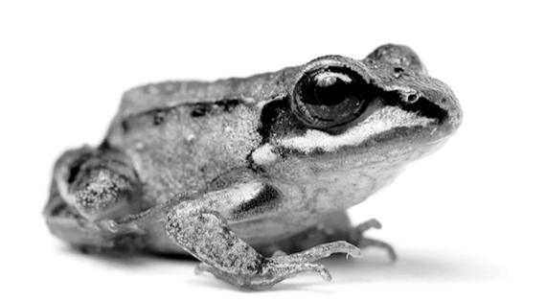
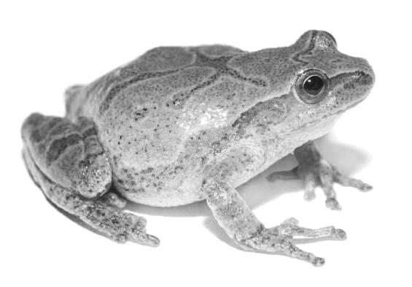
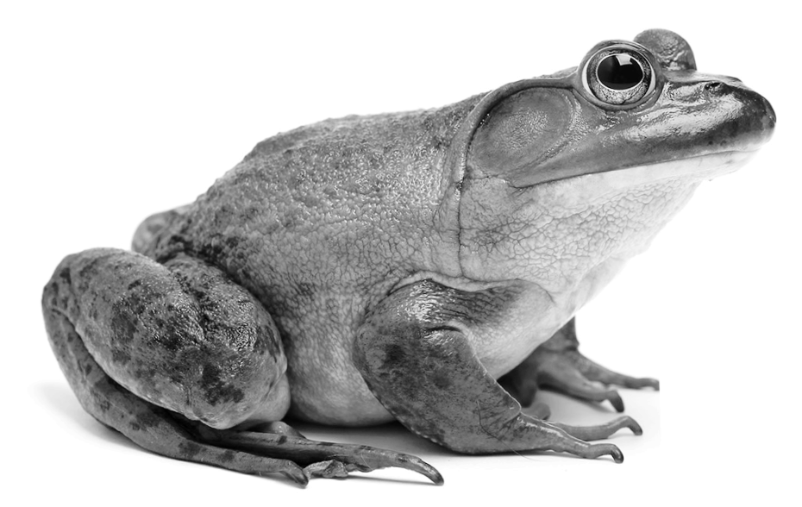
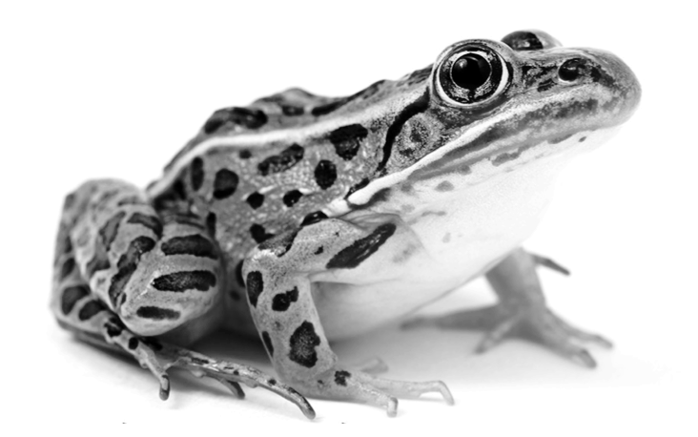
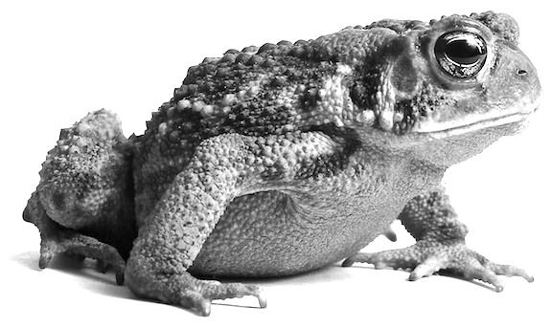

ANSWER KEY
Name: _____________________
Who’s Calling?
Learn to identify frogs by their calls:
Kind of frog | Write a few words to remind yourself of what it sounds like.
Wood Frog | Student answers will vary.
Spring Peeper | Student answers will vary.
American Bullfrog | Student answers will vary.
Northern Leopard Frog | Student answers will vary.
American Toad | Student answers will vary.
2. What kind of frog do you hear in Challenge #1?
Spring Peeper
3. What kind of frog do you hear in Challenge #2?
Northern Leopard Frog
Why do frogs say “ribbit”?

Slide 2
ANSWER KEY
Name: _____________________
How Many Kinds of Frogs?
4. Listen to which kinds of frogs each place has:
OAKWOOD POND
SWEDE LAKE
In spring, this tiny pond is a shallow puddle in the woods. In summer, it dries up. There are no flowing streams or swamps here.
This lake has swampy places with many plants, places with shallow water, and streams flowing into the lake. There’s water here all year long.
Oakland Pond: check off what kinds of frogs you hear
Wood Frog | X
Spring Peeper | X
American Bullfrog
Northern Leopard Frog
American Toad
Swede Lake: check off what kinds of frogs you hear
Wood Frog
Spring Peeper | X
American Bullfrog | X
Northern Leopard Frog | X
American Toad | X
5. Which place has more types of frogs?
My claim is that ________________ has more
kinds of frogs. My evidence is that
Swede Lake
I heard four different kinds of frogs in Swede Lake, but only two kinds of frogs in Oakwood Pond.
Why do frogs say “ribbit”?

