Slide 1





Vampire
Free Presentation Template by EaTemp

Slide 2




Welcome
Welcome to the world of fantasy! Join us on a journey to explore the mystical creatures, enchanted lands, and magical wonders that exist beyond our reality. Discover the wonders and secrets of this exciting realm and unlock the power of imagination.

Slide 3

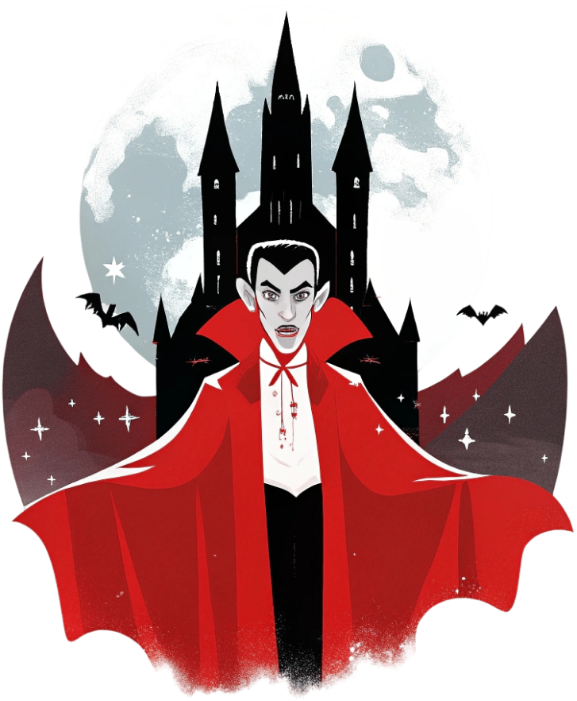


Table of Contents
Introduction
01
02
Encounters
The Extraordinary Realm
Unicorn Sightings
Wonders
03
04
Magic
Wishes Granted
Spellcasting
Adventure
05
06
Conclusion
Happily Ever After
Embrace the Fantasy

Slide 4




The Realm of the Extraordinary
Welcome to the Fantasy World, a realm of wonder and enchantment where anything is possible. Here, dragons breathe fire, unicorns prance through meadows, and rainbows shine brightly. This world is a place where wishes come true, where potions can be cursed and spells are cast. It's a place of treasure and adventure, where the impossible becomes possible. But the greatest treasure of all is the one that lies within.
The world of fantasy is a reflection of our deepest desires, our fondest dreams, and our wildest imaginations. It's a place where we can let go of the constraints of reality and explore the boundless possibilities of the human mind. In this introduction, we will delve into the mysteries of this realm, uncovering the magic and wonder that lies within. So come with us and let's embark on a journey through the Fantasy World.

Slide 5
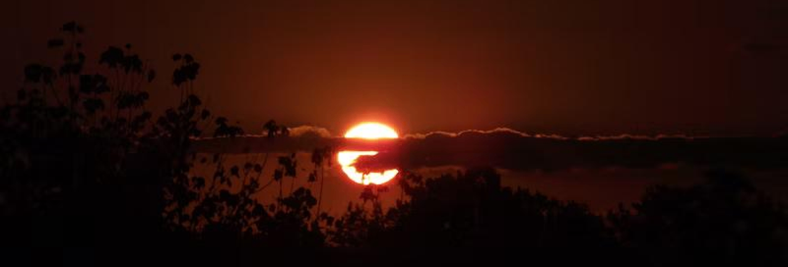



Unicorn Sightings
Dragon Taming
A record of the number of unicorns spotted in the fantasy realm and the beauty and mystery.
A closer look at the art of taming dragons and the brave adventurers who dare to take on these fearsome creatures.

Slide 6

Fantasy is the gateway to the impossible, the land where the ordinary becomes extraordinary, and the impossible becomes possible. It is the realm of the imagination, where anything can happen and everything is possible.
The Dream Weaver

Slide 7
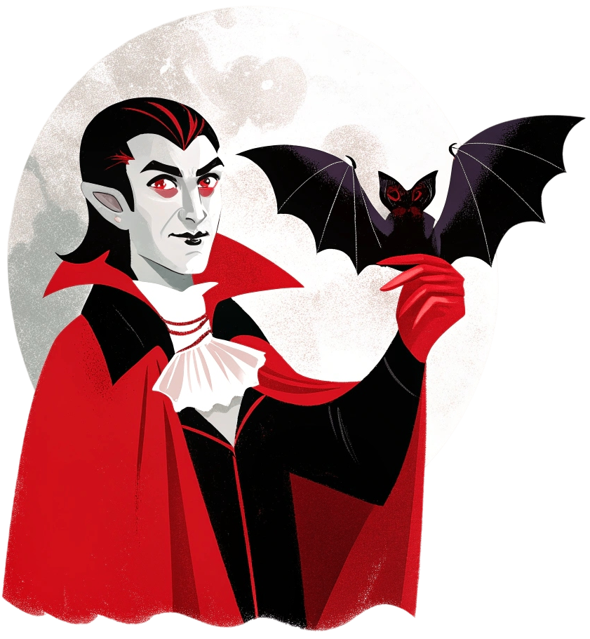
Dragon Taming Technique
A guide to taming and caring for dragons in the realm of magic.
The Art of Unicorn Sighting
Tips and tricks for spotting the elusive unicorns in their natural habitat.

Slide 8






The Magic of Dragons: A Research
Dragon Taming
Archery
Music
"The Art of Archery": Discover the intricacies of the Art of Archery .
"The Music of the Elves": Immerse yourself in the enchanting music.
Life
Unicorn
Unicorn
"The Life of an Elf": Learn about the customs and daily life of the elves.
"The Art of Archery": Discover the intricacies of the Art of Archery .

Slide 9




Pricing Plan
Basic
Elite
Legendary
  Access to the entry-level dungeons.
  A limited number of quests and battles per month.
  Ability to form a small party with fellow adventurers.
  Access to the intermediate and advanced dungeons.
  A greater number of quests and battles
  Ability to form larger parties with fellow adventurers.
  Access to the most challenging dungeons and encounters.
  Unlimited quests and battles per month.
  The ability to form the largest parties with fellow adventurers.
$10/month
$50/month
$100/month

Slide 10






S
W
O
T
Eclipse
Eclipse
Eclipse
Eclipse
Rare event causes unpredictable magic.
Rare event causes unpredictable magic.
Rare event causes unpredictable magic.
Rare event causes unpredictable magic.
Quest
Quest
Quest
Quest
Adventurers seek immortal artifact.
Adventurers seek immortal artifact.
Adventurers seek immortal artifact.
Adventurers seek immortal artifact.

Slide 11

Some Data
75%
Enchanted Creatures
possess the ability to cast spells.
60%
Magic-Wielding Individuals
practice the art of illusions.

Slide 12
234,567
Unicorn Sightings
A tally of the number of unicorns spotted in the fantasy realm.

Slide 13
233 Coins
85%
Treasure Found
Wished Granted
456 Hours
323 Km
Duration of Spell Casting
Journey Distance

Slide 14






Some Graph
100
90
80
70
60
50
34.574
40
Total
30
20
10
0
1
2
3
4
5
6
7
8
Spellcasting Progress
Treasure Found
A record of the number of spells cast per year
A record of the amount of treasure found per month

Slide 15


Portal to Adventure
A web application
A web application designed for discovering the world of fantasy

Slide 16


The Future of Fantasy
An mobile app
An app designed for exploring and experiencing the enchanting realm of fantasy
  Explore a magical world
  Experience fantasy firsthand
  Immerse in a realm of magic
  Discover untold wonders
  Live your fantasy dreams

Slide 17


A web application
A web application designed for discovering the world of fantasy
A Gateway to a World of Fantasy and Wonder
  Immerse yourself in the world of magic and mystery
  Explore uncharted territories and fantastical lands
  Meet mythical creatures and legendary beings
  Uncover treasures and secret treasures

Slide 18
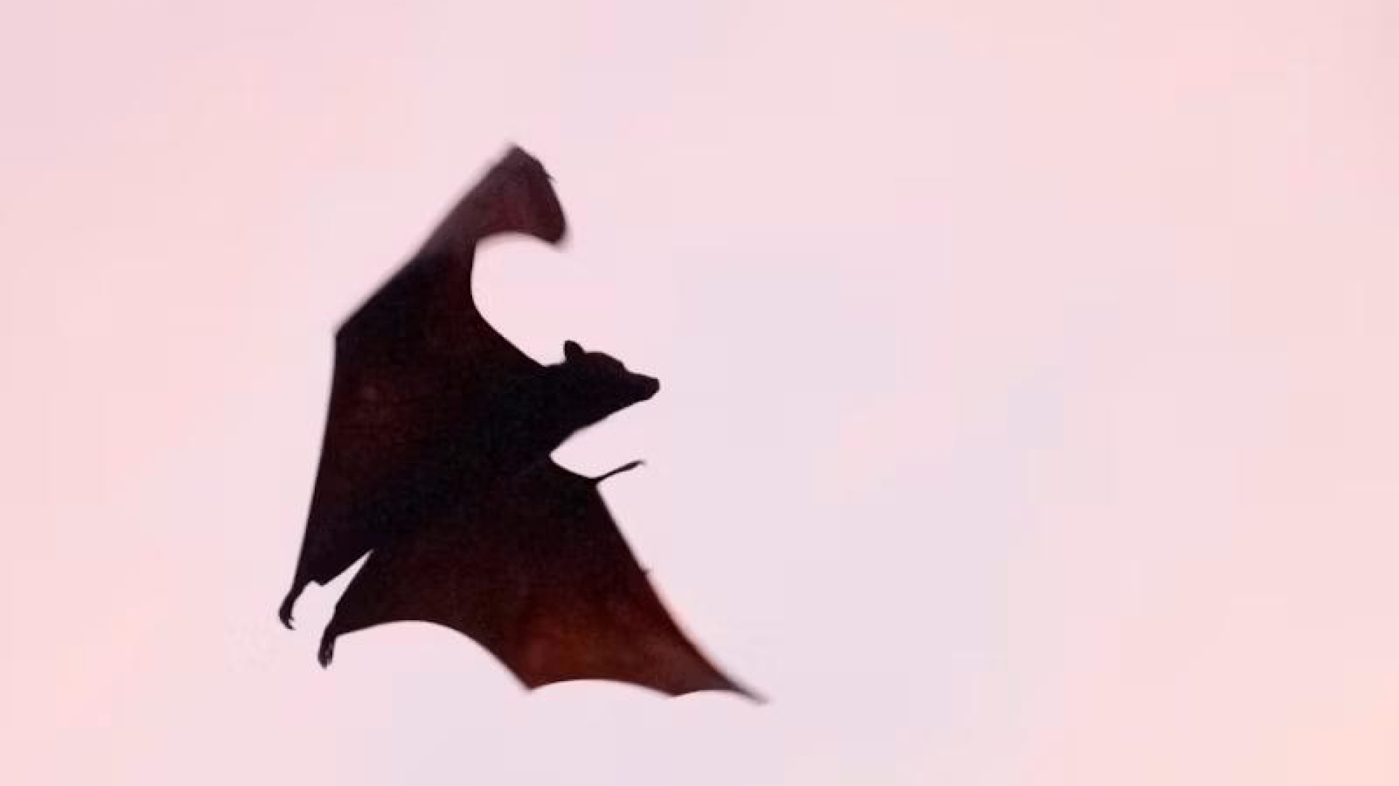
A Magic Picture

Slide 19

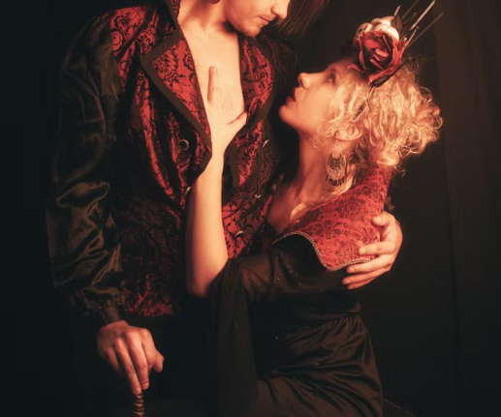
1
Discover the secrets
2
Find your own path
Explore the lush, vibrant forest and uncover the mysteries that lie within.
Choose your own path through the forest, and see where it takes you.
Meet the creatures
Uncover the magic
3
4
Encounter the mythical creatures that call the forest home, from talking animals to fairies.
Learn about the powerful magic that pervades the forest and how it affects all who enter.

Slide 20

Fantasy Realm at a Glance
The Forest
A magical forest filled with animals and enchanted creatures.
The Caves
A network of underground caves filled with crystals.
The Lair
A dangerous and mysterious place where dragons reside.

Slide 21
The Timeline
Transformation
  Kingdoms clash in conflict.
  Peasant discovers magical powers.
  Plot to assassinate leader uncovered.
War
  Eclipse
  Quest for artifact
  Volcano disaster
2021
2022
2020
Rise
2022
Invasion
  Humans acquire Crystal
  Shimmering City established
  City expands, conquers neighbors.
  Kingdom invaded
  Betrayal
  Hero's festival

Slide 22



Our Team
Eldruin
Lunaria
The Fire Mage
The Moon Priestess
Elementalen
The Guardian

Slide 23
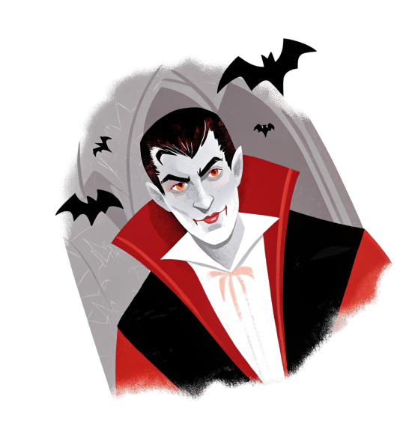
The List
Dragons
Fire-breathing creatures that are often powerful and dangerous
Medieval-like Settings
Worlds with castles, knights, and feudal systems
Chosen One Trope
A hero chosen by destiny to save the world
Magic
An integral part of fantasy stories, can take many forms
The Best Curse
A curse that is unique, creative, and fits within the story
Unique Creatures
A variety of fantastical beings that inhabit the world

Slide 24













Chloe Ng
The Mage
The Organization
Aurielle
Theronis
Dariana
The Priestess
The Warrior
The Shaman
Lyrisa
Lucian
Elvina
Seraphina
Kaelen
The Dreamer
The Conjurer
The Oracle
The Lightbringer
The Sentinel
To download more editable chart, click here

Slide 25
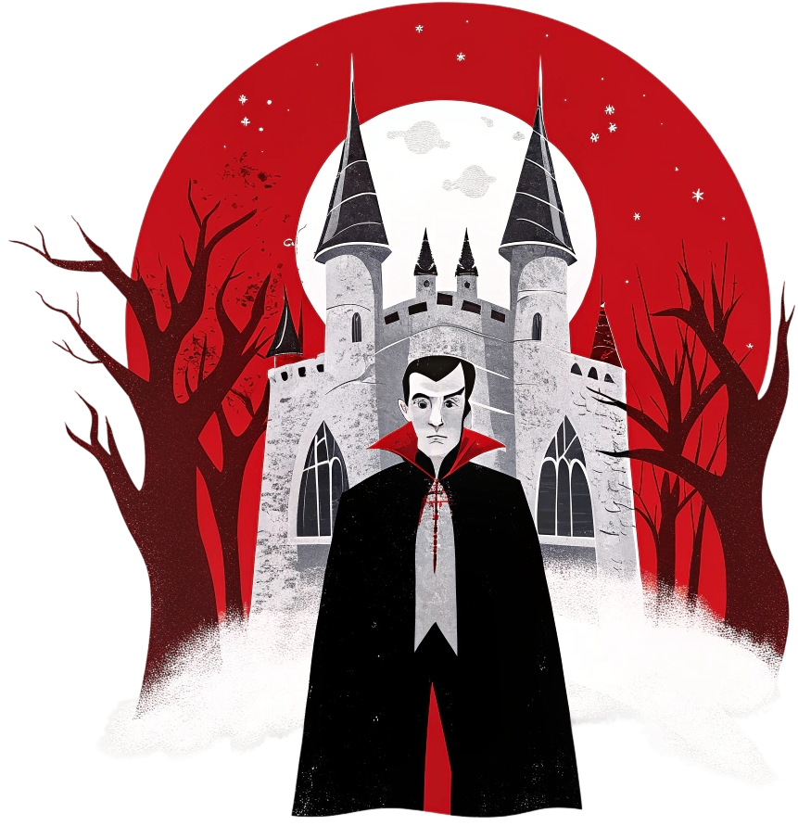
Thank you for choosing EaTemp
• Yes, you can use this for both personal and commercial projects.
• No, you don't have to credit us.
• No, you can't resell or redistribute it, including uploading this template online.
• And you can support us by sharing our site, EaTemp.com, with others.
Credit | Image: Unsplash

