Slide 1


What Makes an Effective Principal:
The Evolving Role of the
School Principal
Jack States
Wing Institute

Slide 2
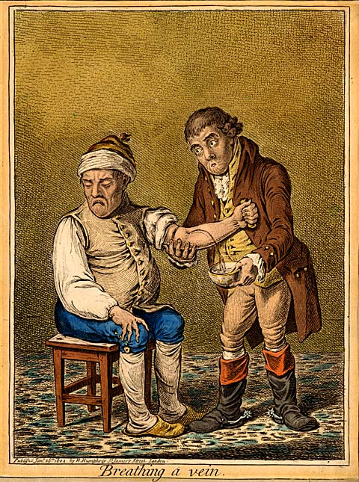



How Important Are Principals?

Slide 3
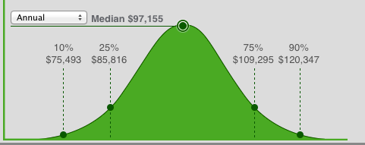
How Do We Assess The Impact Of Principals?
The median annual pay for a typical School Principal in the United States is $97,155 so 50% of the people who perform the job of School Principal in the United Sates are expected to make less than $97,155.
Salary.com reported data as of January 2015

Slide 4
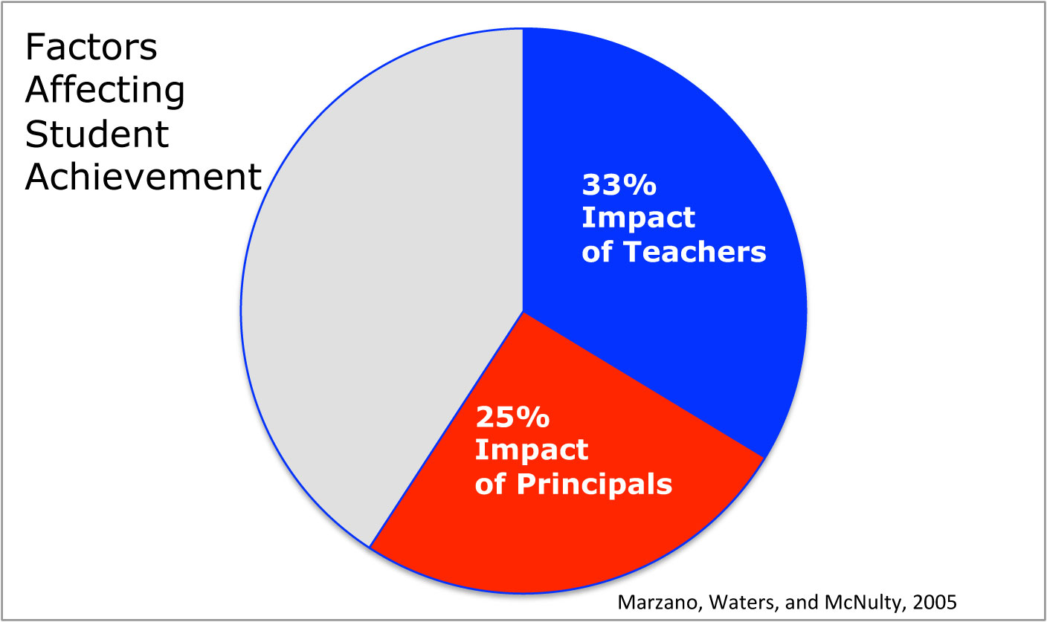

Slide 5
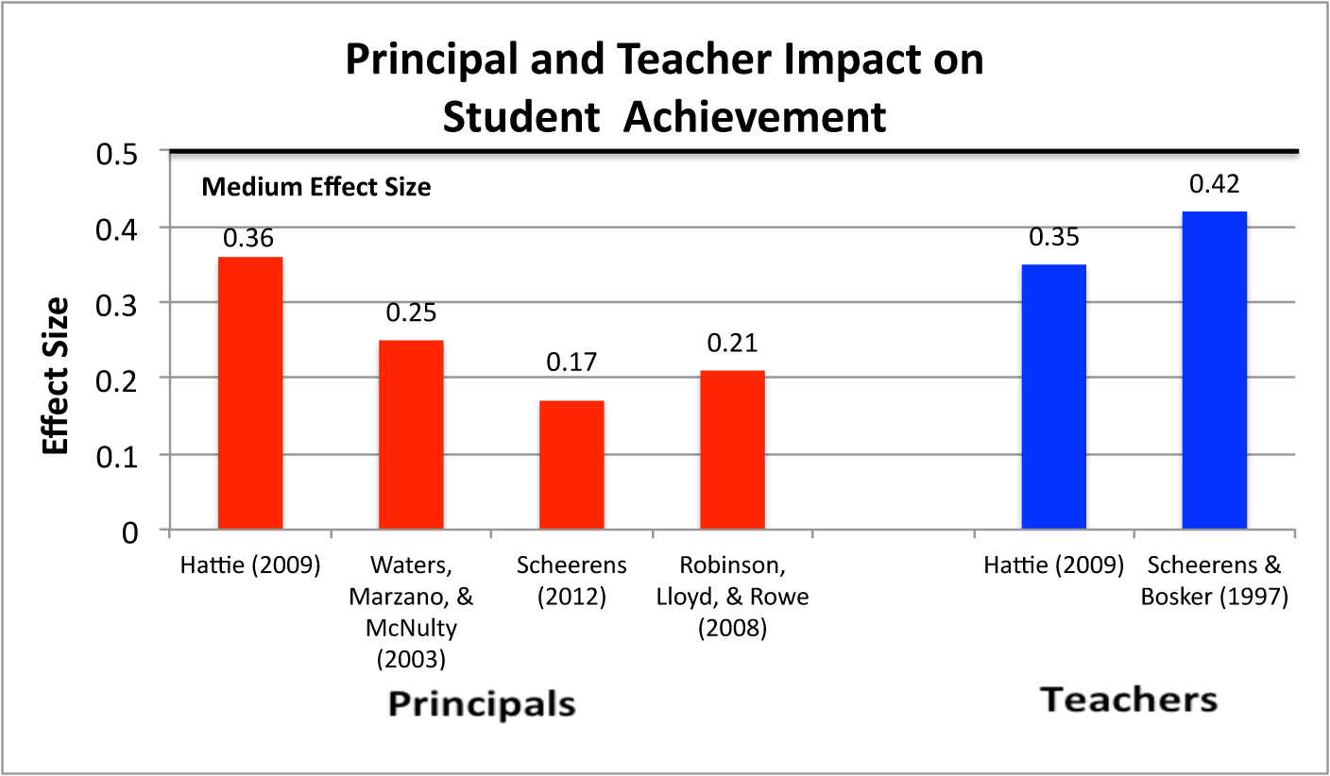
Principals Impact on Student Achievement

Slide 6
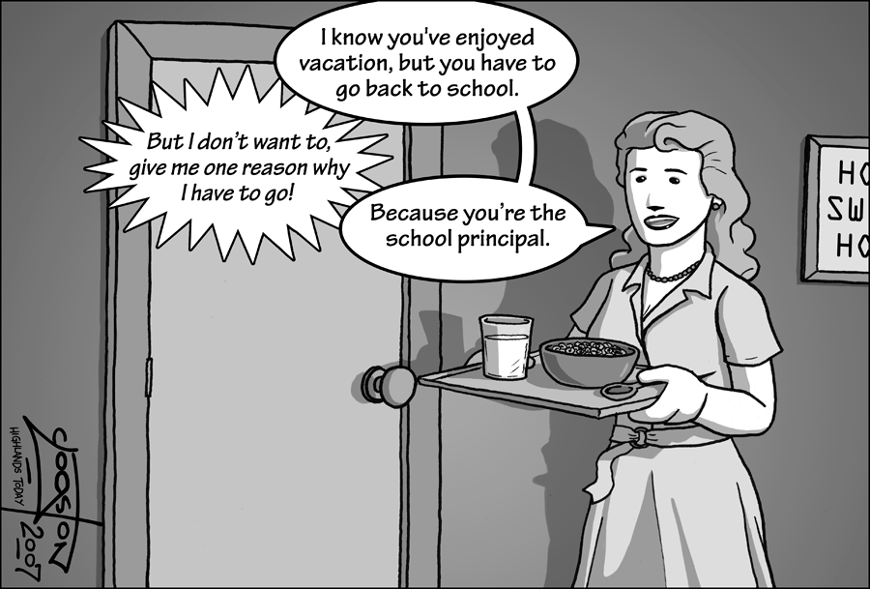
The Evolving Role of the School Principals?

Slide 7
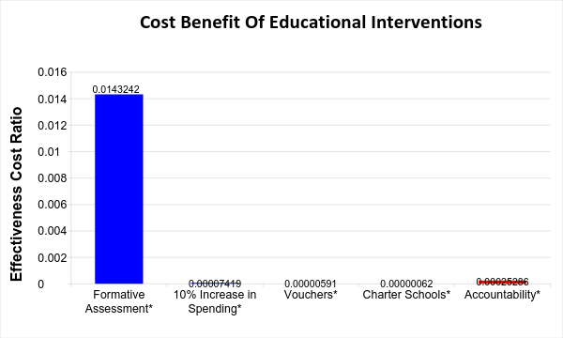
What Results Should We Expect From Accountability
Teaching Intervention
Effectiveness Cost Ratio = Effect Size/Cost Per Student
What Is The Impact Of Accountability?
Yeh, 2007

Slide 8
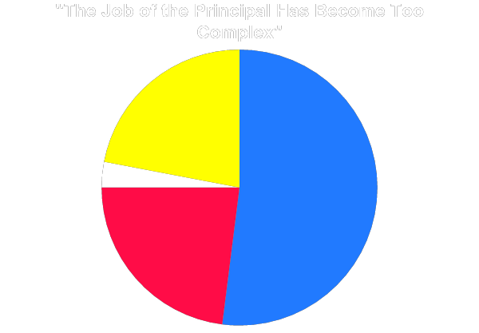
School Principal Overload
Principal | Responsibilities
Community relations | Fiscal management and budgeting
Liaison with school board | Student records keeping
Student intake and enrollment | Attendance
Parent relations | Testing
Conflict resolution | Technology
School safety and security | Data analysis
Student discipline | Regulatory compliance
Facilities | Implementation of new initiatives
Non-teaching personnel management | Resource management (other than curriculum)
Somewhat Disagree
22%
Strongly Disagree
3%
Somewhat Agree
52%
Strongly Agree
23%
MetLife Survey, 2012

Slide 9
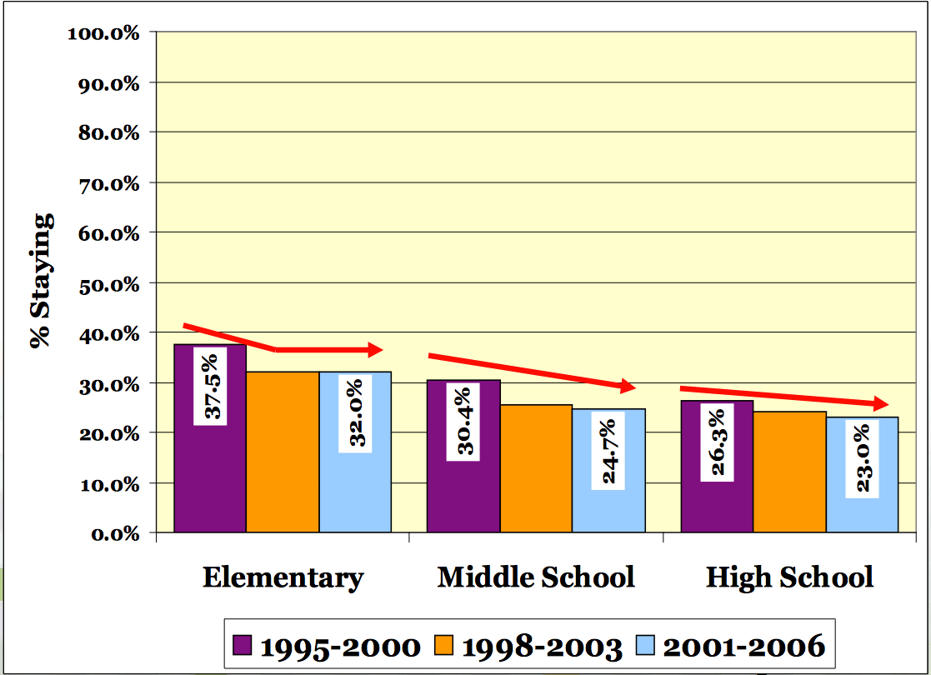
Retention of Principals Declining in Texas
Fuller, E.J. & Young, M.D. (2008)

Slide 10
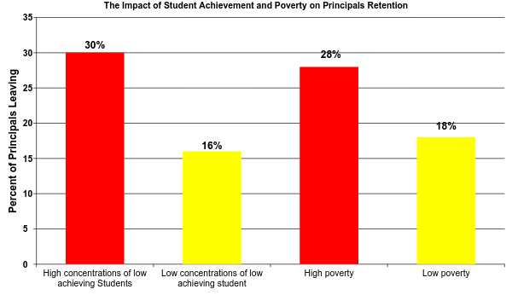
What is the Impact of Student Achievement and Poverty on Principal Retention?
Béteille, T., Kalogrides, D., & Loeb, S. (2012)

Slide 11
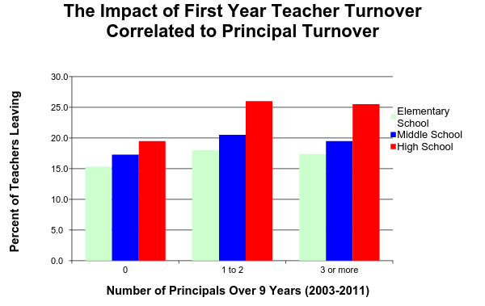
What is the Effect on Teacher Tenure When Principals Leave?
Fuller, E.J. & Young, M.D. (2008)
Notes:
Consequence: Greater chaos into the system, floundering initiatives, and greater teacher turnover

Slide 12
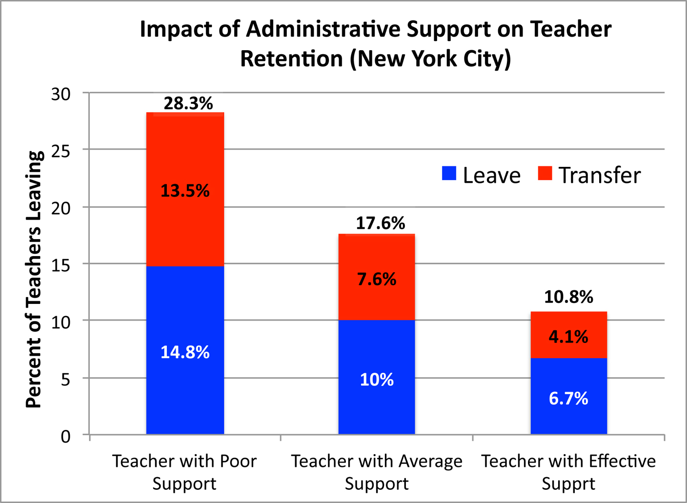
Administrators Impact on Turnover
Boyd, D., Grossman, P., Ing, M., Lankford, H., Loeb, S., & Wyckoff, J. (2011)

Slide 13
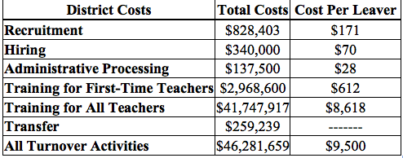
What is the Cost of Having an Ineffective Principal?
Barnes, G., Crowe, E., & Schaefer, B. (2007).

Slide 14
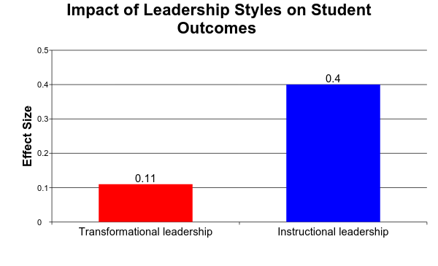
Do Leadership Styles Make a Difference?
Medium
Small
Robinson, Lloyd, and Rowe, 2008

Slide 15



What Organizational Performance Management Tells Us
Curriculum
Graduation
Teaching
Input
Process
Outcomes
Feedback
Loop
Rummler and Brache, 1990

Slide 16
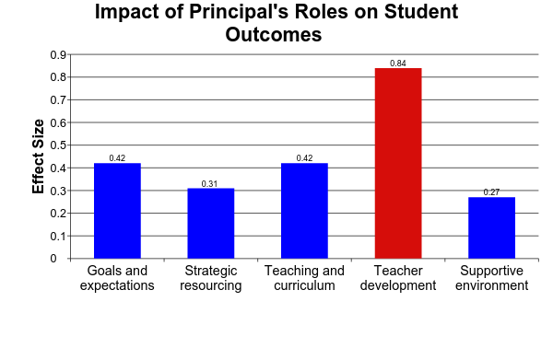
What Principals Do Makes a Difference
Large Effect Size
Robinson, Lloyd, and Rowe, 2008

Slide 17
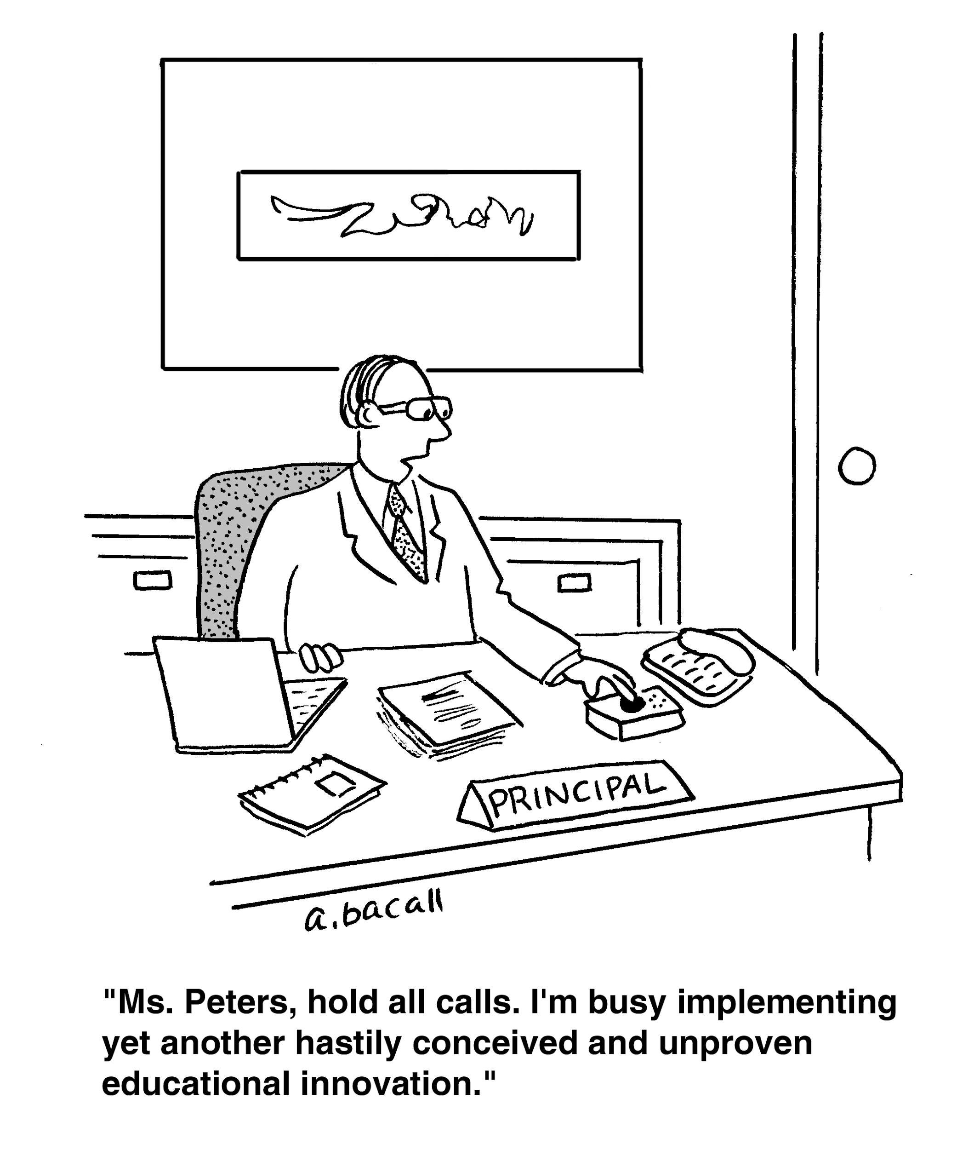
How Effective Is The Average Principal At Their Job?

Slide 18
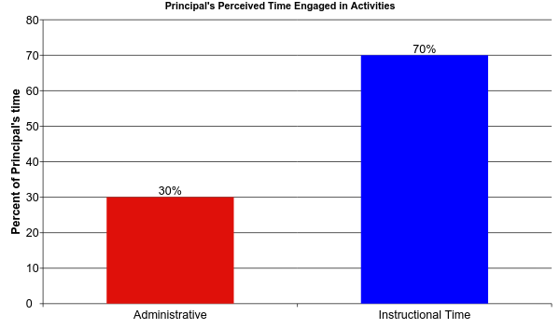
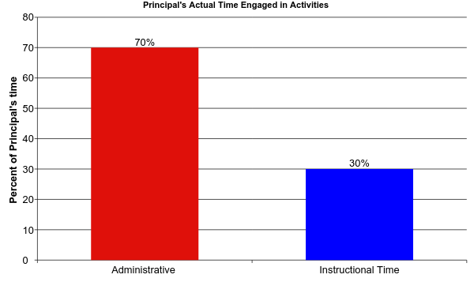
How Principals Spend Their Time
Turnbull et al., 2009

Slide 19
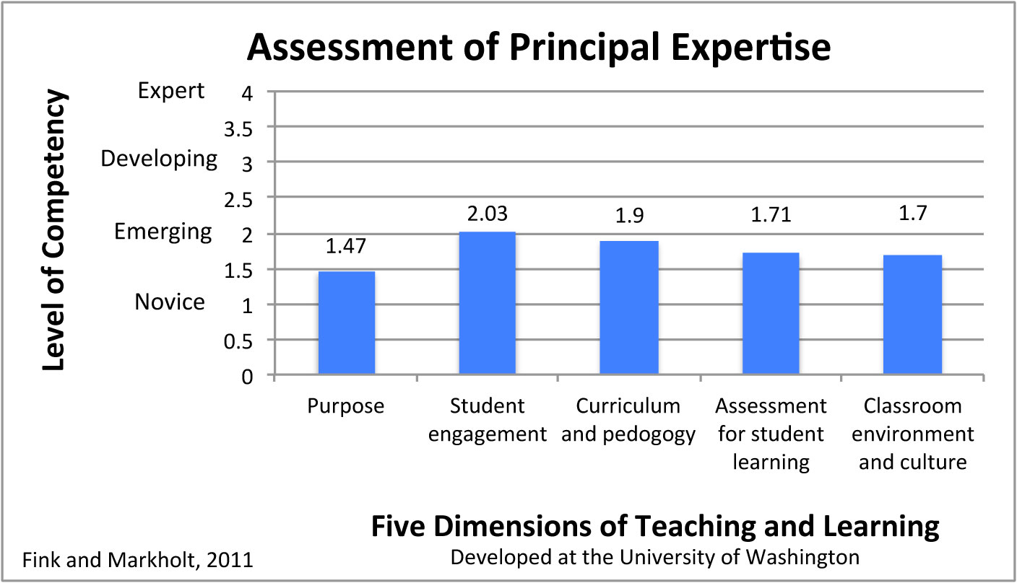
How Effective Are Principals at Identifying Valued Teachers

Slide 20
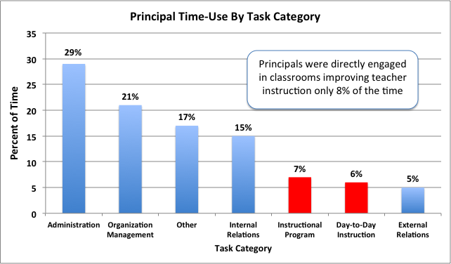
How Principals Use Their Time
Horng, E. L., Klasik, D., & Loeb, S. (2010)

Slide 21
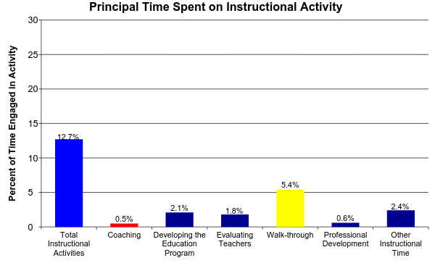
How Much do Principals Spend on Instructional Activities?
An increase of 1% time spent coaching increased math achievement by 1.4 percent of standard deviation
Grissom, Jason A., Susanna Loeb, and Ben Master. (2012)

Slide 22
Summation
Professional judgment and research both support the importance of principals and leadership
The role of the principals has expanded dramatically, but the stress of the job is increasing principal turnover and in turn is impacting teacher tenure, costing dollars, and impacting student achievement
In spite of the heavily load, we know what is critical to principal success, focus on instruction, but that isn’t where principals are investing their time.
Success requires well trained principals, working with a team to implement best organizational practices

