Slide 1

Wedding Frame
Powerpoint Template

Slide 2

Invitation
A complex idea can be conveyed with just a single still image, namely making it possible to absorb large amounts of data quickly.
A complex idea can be conveyed with just a single still image, namely making it possible to absorb large amounts of data quickly.
A complex idea can be conveyed with just a single still image, namely making it possible to absorb large amounts of data quickly.

Slide 3


Selen
Mehmet
Click on the button under the presentation preview that says "Download as PowerPoint template". You will get a .pptx file that you can edit in PowerPoint.
Click on the button under the presentation preview that says "Download as PowerPoint template". You will get a .pptx file that you can edit in PowerPoint.

Slide 4

Click on the button under the presentation preview that says "Download as PowerPoint template". You will get a .pptx file that you can edit in PowerPoint.

Slide 5



Is the color of milk and fresh snow, the color produced by the combination of all the colors of the visible spectrum.

Slide 6

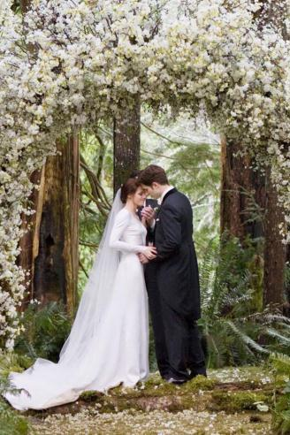


Slide 7
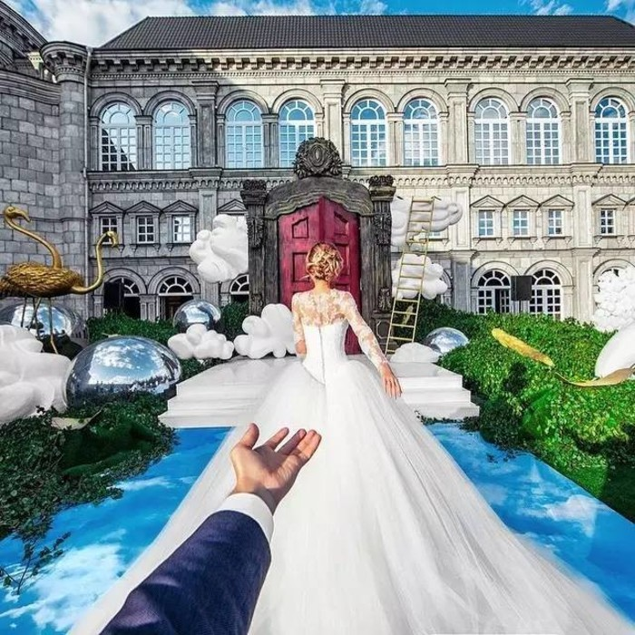


Slide 8



Button
Is the color of milk and fresh snow, the color produced by the combination of all the colors of the visible spectrum.

Slide 10

Is the color of milk and fresh snow, the color produced by the combination of all the colors of the visible spectrum.
Button

Slide 11



Slide 12
Button
Button
Button

Slide 13


Slide 14


Slide 15



Is the color of milk and fresh snow, the color produced by the combination of all the colors of the visible spectrum.
Is the color of milk and fresh snow, the color produced by the combination of all the colors of the visible spectrum.
Is the color of milk and fresh snow, the color produced by the combination of all the colors of the visible spectrum.

Slide 16


Slide 18


Slide 19

Is the color of milk and fresh snow, the color produced by the combination of all the colors of the visible spectrum.

Slide 20
Thank
You!
Freepptbackgrounds.net

