Slide 1

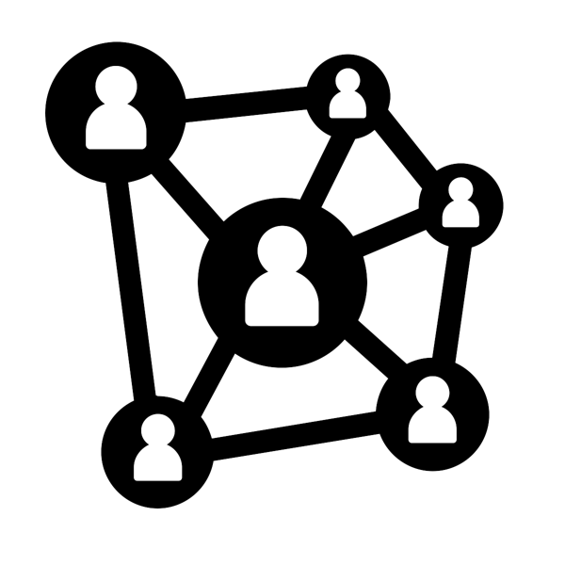



Match the message to the platform
Working with online stakeholders > Media Analysis > Match the message to the platform

Slide 2















Platform cards
Facebook
YouTube
WhatsApp
MAU | 2.32 billion
Content types
Connections | 5
Optimised for
Adverts?
Reactions
MAU | 1.9 billion
Content types
Connections | 4
Optimised for
Adverts?
Reactions
MAU | 1.5 billion
Content types
Connections | 3
Optimised for
Adverts?
Reactions | REPLY
MAU = Monthly Active Users

Slide 3






Platform cards
Messenger
WeChat
Instagram
MAU | 1.3 billion
Content types
Connections | 3
Optimised for
Adverts?
Reactions
MAU | 1.06 billion
Content types
Connections | 3
Optimised for
Adverts?
Reactions
MAU | 1 billion
Content types
Connections | 5
Optimised for
Adverts?
Reactions
MAU = Monthly Active Users

Slide 4










Platform cards
Tumblr
TikTok
Twitter
MAU | 642 million
Content types
Connections | 3
Optimised for
Adverts?
Reactions
MAU | 500 million
Content types
Connections | 3
Optimised for
Adverts?
Reactions
MAU | 335 million
Content types
Connections | 5
Optimised for
Adverts?
Reactions
MAU = Monthly Active Users

Slide 5








Platform cards
Reddit
LinkedIn
Snapchat
MAU | 330 million
Content types
Connections | 5
Optimised for
Adverts?
Reactions
MAU | 294 million
Content types
Connections | 4
Optimised for
Adverts?
Reactions
MAU | 255 million
Content types
Connections | 2
Optimised for
Adverts?
Reactions
Subscribe
MAU = Monthly Active Users

Slide 6










Platform cards
Pinterest
SoundCloud
___________
MAU | 250 million
Content types
Connections | 1
Optimised for
Adverts?
Reactions
MAU | 175 million
Content types
Connections | 1
Optimised for
Adverts?
Reactions
MAU
Content types
Connections
Optimised for
Adverts?
Reactions
MAU = Monthly Active Users

Slide 7
Message cards
Sharing a link to an article that raises awareness about an issue you care about
Posting a photo that will provoke a strong reaction
Sharing an infographic about an issue you care about
Broadcasting live to voice your thoughts on a breaking news story
Writing a short comment to criticise a public figure
Writing a long message to convey your opinions about a controversial topic

Slide 8
Message cards
Share a recording of an interview with an influential person
Create a montage of images to highlight the seriousness of an issue you care about
Post an inspirational quote or message to persuade people to act
Sharing details of a local rally/protest
Vlogging about recent news stories or your own experiences
Use photos to convey an important message about an issue you care about

Slide 9
Message cards
Debate a controversial subject anonymously to share your views
Use memes to make a bold statement
Join a local community’s online group to raise awareness of your campaigning
Share creative video content to get noticed and make a point
Use hashtags to find views from like minded people
Create a private group to discuss campaign plans

Slide 10
Message cards
Share a message publicly to urge all users to take immediate action
Share a message publicly that is intended to be seen by an influential figure
Share a message intended to shame a company/organisation for their lack of action
Share content that will reach a wider audience through hashtags
Ask a difficult question with the hope of having an expert respond
Be in complete control of comments people make about your content

Slide 11








www.hackinghate.eu
#SELMA_eu

