Slide 1

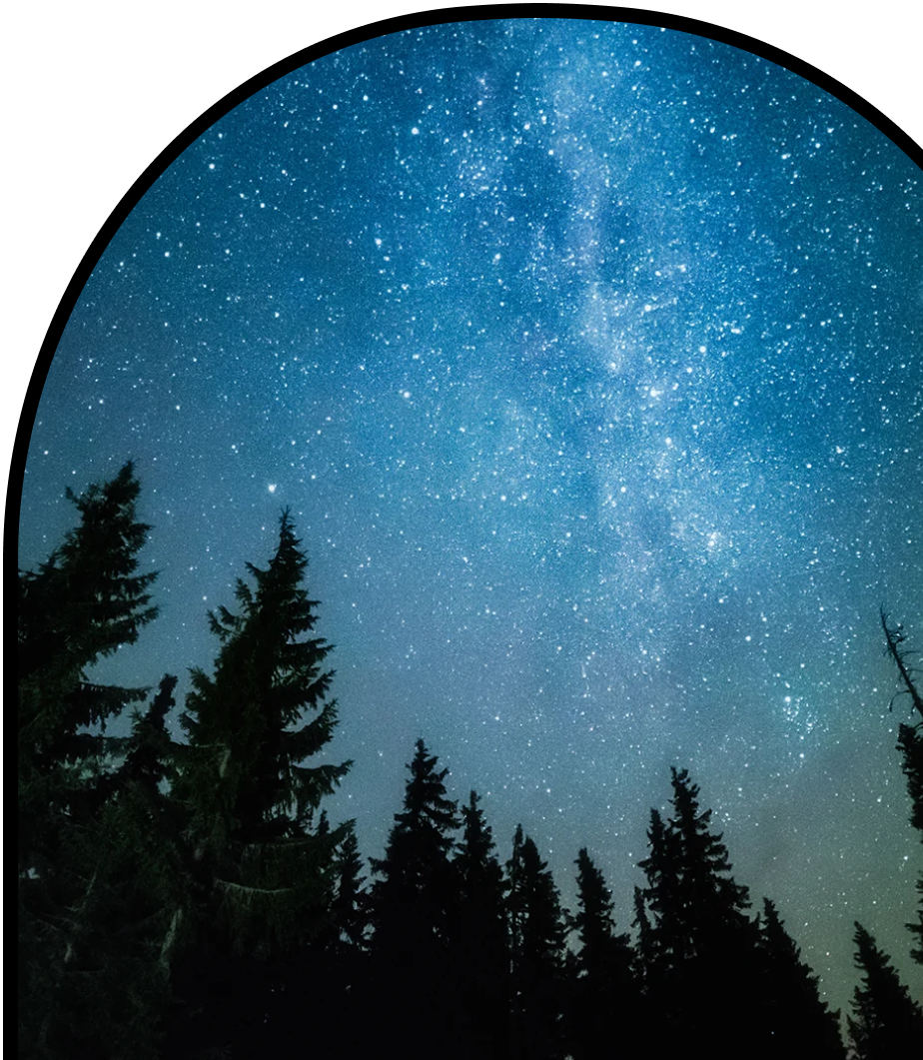
Anchor Layer Teacher Guide
A curriculum companion for Anchor Layer users
Grade 1
Night Patterns
Unit Web Link • Pacing Guide • Other Units

Slide 2
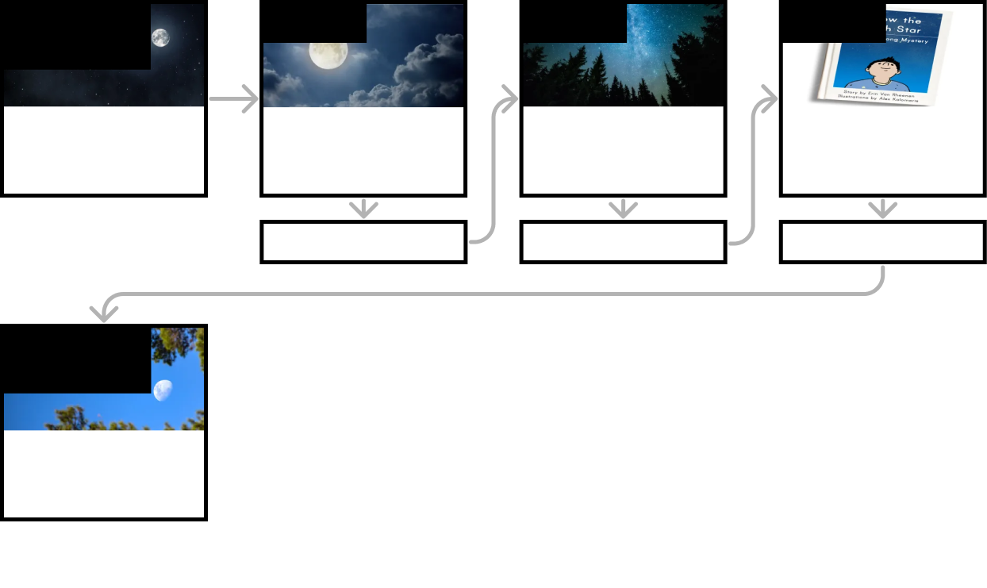
Night Patterns • Grade 1
Anchor Layer Teacher Guide
Unit Summary
In this unit, students explore the Moon and stars. They observe and record the appearance of the Moon to determine its cyclical pattern. They also determine why stars are only visible at night.
Performance Expectations | Science & Engineering Practices | Disciplinary Core Ideas | Crosscutting Concepts
• 1-ESS1-1. Use observations of the sun, moon, and stars to describe patterns that can be predicted. | • Analyzing and Interpreting Data • Planning and Carrying Out Investigations • Developing and Using Models • Constructing Explanations and Designing Solutions • Obtaining, Evaluating, and Communicating Information | • ESS1.A: The Universe and its Stars | • Patterns • Cause and Effect
Anchor Phenomenon
Lesson 1
Lesson 2
Lesson 3
Night Patterns
Moon Mysteries
Moon Phases & Patterns
When can you see a full moon?
Stars & Daily Patterns
Why do the stars come out at night?
Stars & Seasonal Patterns
How can the stars help you if you get lost?
Anchor Connection
Anchor Connection
Anchor Connection
Performance Task
Night Patterns
When can we see the Sun, Moon, & stars?
‹#›

Slide 3
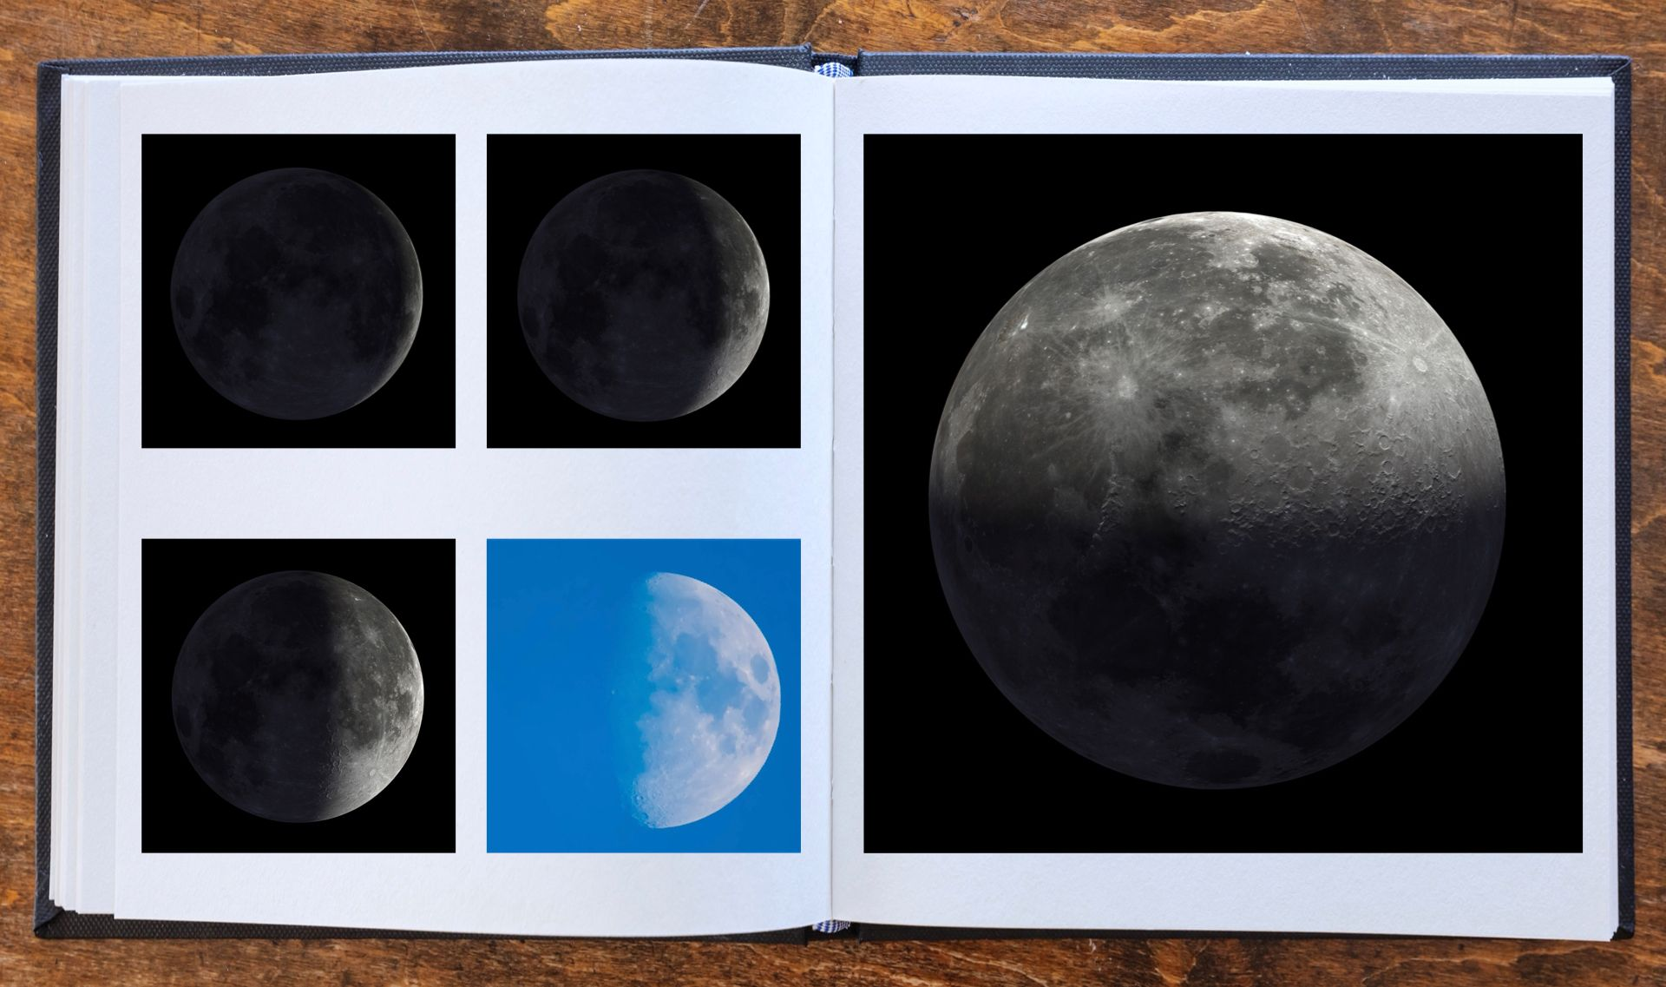
Night Patterns • Grade 1
Anchor Layer Teacher Guide
Anchor Phenomenon Background
Why does the Moon look blue in some photos?
The Moon is something that many, many people associate with the night sky. The association between the Moon and nighttime is so strong that the shape of the Moon is frequently used to represent nighttime itself.
However, you are almost equally likely to see the Moon during the day as you are to see it at night. In fact, the Moon is visible during the day on most days. And yet it is a well-documented misconception among elementary-age students that the Moon is only visible at night.
The Moon is easily visible during both the day and the night because it is both very large and very bright. The Sun is so bright that it outshines most of the other stars. This is why the stars are not easily visible during the day. The Moon is bright enough that we can continue to see it when the Sun rises.
There are other objects in space that can be seen during the day, such as the planets Venus and Jupiter. They are much, much harder to spot, though, because they are much smaller and much dimmer.
‹#›

Slide 4
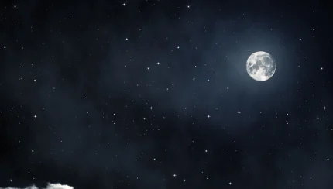
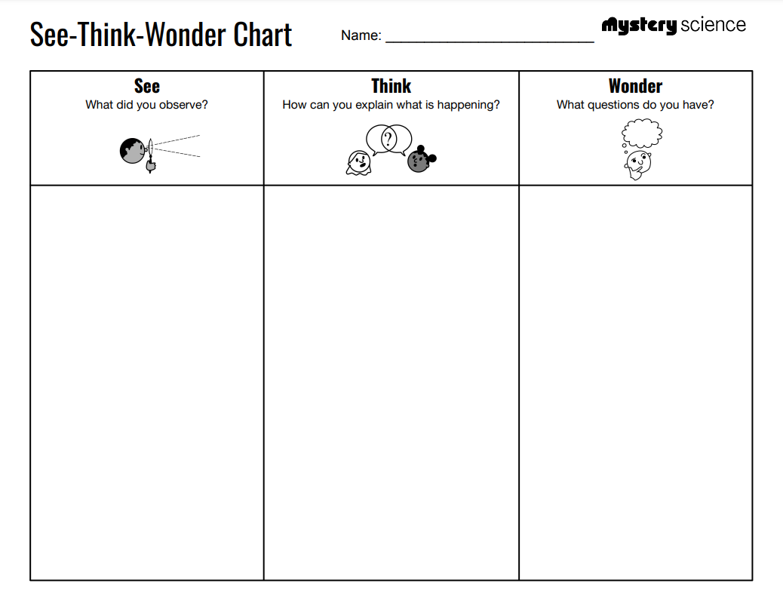
Night Patterns • Grade 1
Anchor Layer Teacher Guide
Anchor Phenomenon: Moon Mysteries
Night Patterns
Anchor Phenomenon Overview
Note: This lesson is part of this unit’s Anchor Layer. If you have the Anchor Layer turned on, we recommend teaching all of the lessons in this unit in order.
The anchor phenomenon for this unit is a set of surprising photos of the Moon.
During the introduction, students generate observations and questions about the phenomenon and create a list of possible explanations for the phenomenon. Students will use these initial ideas to track how their understanding grows throughout the unit.
Anchor Phenomenon 15 mins
Guided Inquiry 15 mins
Student Work Samples & Notes
Students will gather clues during and after each lesson in this unit to help them improve their understanding and explanations. It is important to encourage students to recognize that even if they don't know the perfect answer yet, they are going to learn a lot throughout the unit and will have an opportunity to revisit the phenomenon over time.
The Moon looks gray and white in most pictures
The Moon looks blue and white in one picture
The sky around the Moon is either blue or black
The camera made the Moon blue
The Moon is out during the day
Somebody must have colored the picture
Why is the Moon different colors?
When do you see the Moon?
Does the Moon change colors?
‹#›

Slide 5

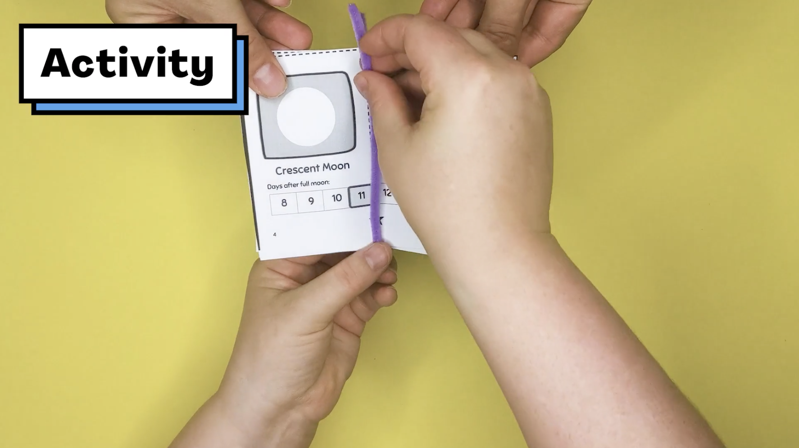
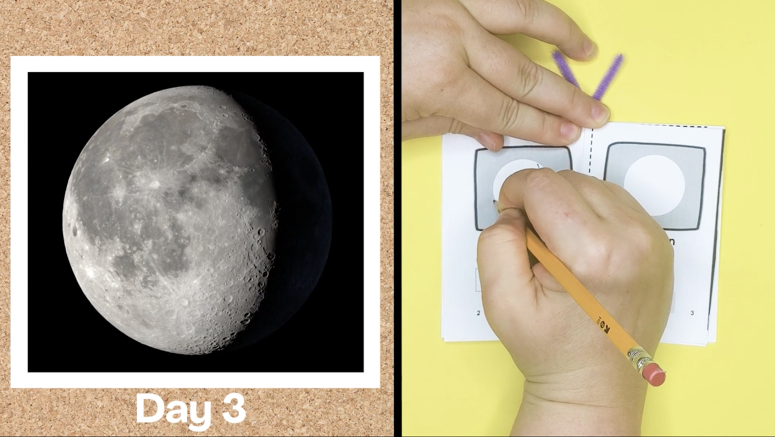
Night Patterns • Grade 1
Anchor Layer Teacher Guide
Lesson 1: When can you see a full moon? (pg 1 of 2)
Moon Phases & Patterns
Overview
In this lesson, students explore all of the different shapes of the Moon that can appear on different nights.
In the activity, My Moon Book, students observe photos of the Moon taken over the course of four weeks and draw pictures of the Moon's phases in their book. They use these observations to discover patterns in how the Moon’s shape changes and predict when the next full moon will appear.
Anchor Connection on Next Page
Exploration 15 mins
Hands-On Activity 35 mins
Wrap-Up 5 mins
Anchor Connection 15 mins
Assessment 20 mins
Activity Notes
We suggest students work in pairs. Each student will construct a Moon Book. Then they will observe photos of the Moon taken over the course of four weeks and draw pictures of the Moon's phases in their book.
This is a long activity. If you have limited time, you can divide this lesson into two sessions. We have marked a natural stopping point after the construction of the book.
Part 1 (create a Moon Book) takes 10 to 15 minutes.
Part 2 (record observations of the Moon in your Moon Book) takes 15-20 minutes.
‹#›

Slide 6
Night Patterns • Grade 1
Anchor Layer Teacher Guide
Lesson 1: When can you see a full moon? (pg 2 of 2)
Moon Phases & Patterns
Anchor Connection
We can look at pictures of the Moon to determine the phase of the Moon. We can also determine if the pictures were taken during the day or the night. The sky is black during the night and blue during the day. So, the pictures tell us both the phase and whether the picture was taken during the day or night.
Students revisit the See-Think-Wonder chart that they worked on during the Anchor Phenomenon. They should understand that photos of the Moon can help us track how the shape of the Moon changes over time. Those same photos can tell us if the photo was taken during the day or the night.
When revising their See-Think-Wonder chart, students may add that the Moon looks blue because the picture was taken during the day.
Connecting Storyline Question
Why can we see the Moon at night and during the day?
Exploration 15 mins
Hands-On Activity 35 mins
Wrap-Up 5 mins
Anchor Connection 15 mins
Assessment 20 mins
‹#›

Slide 7
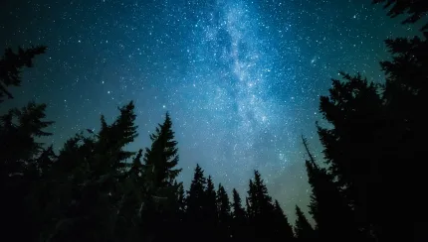
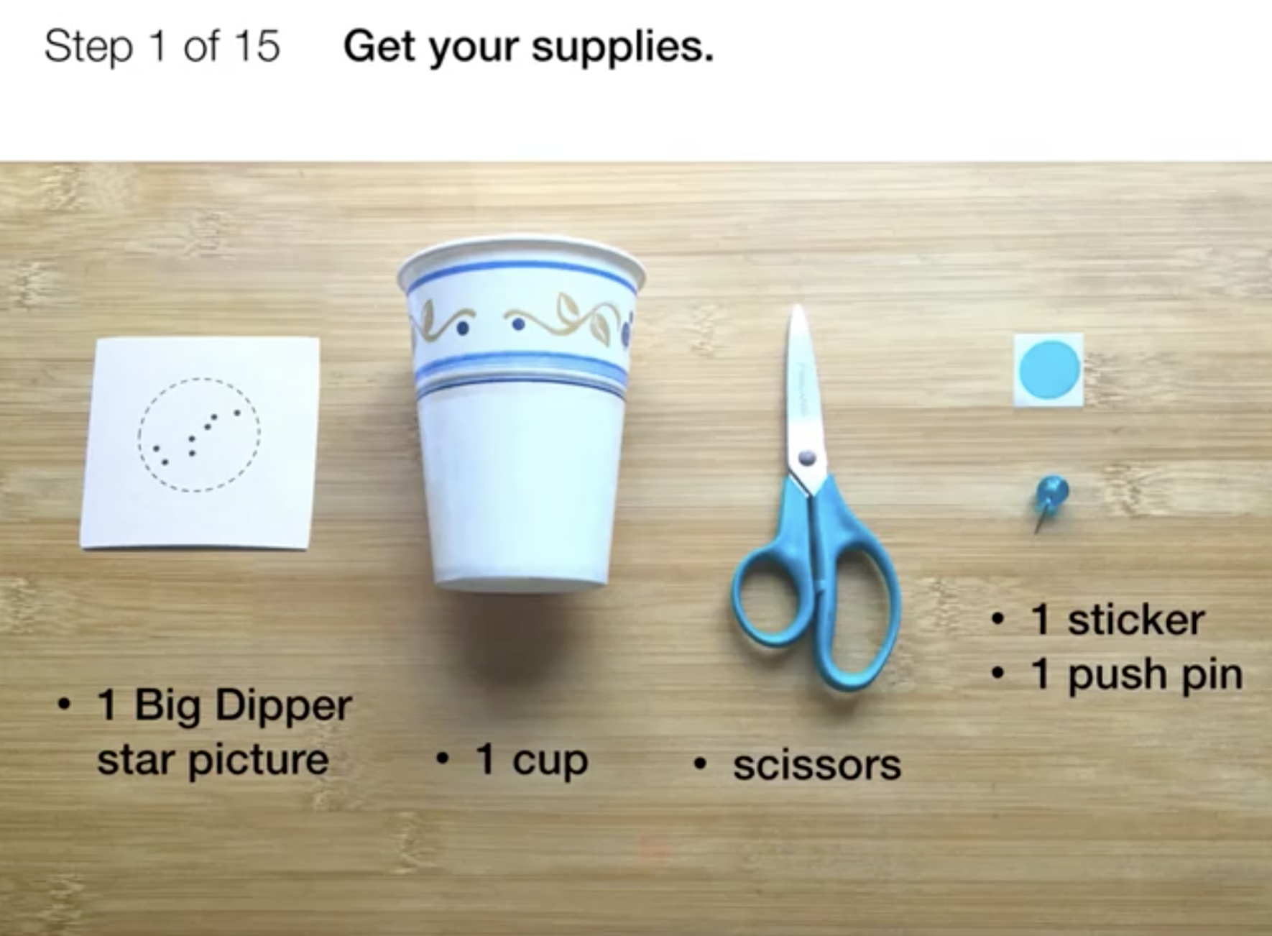
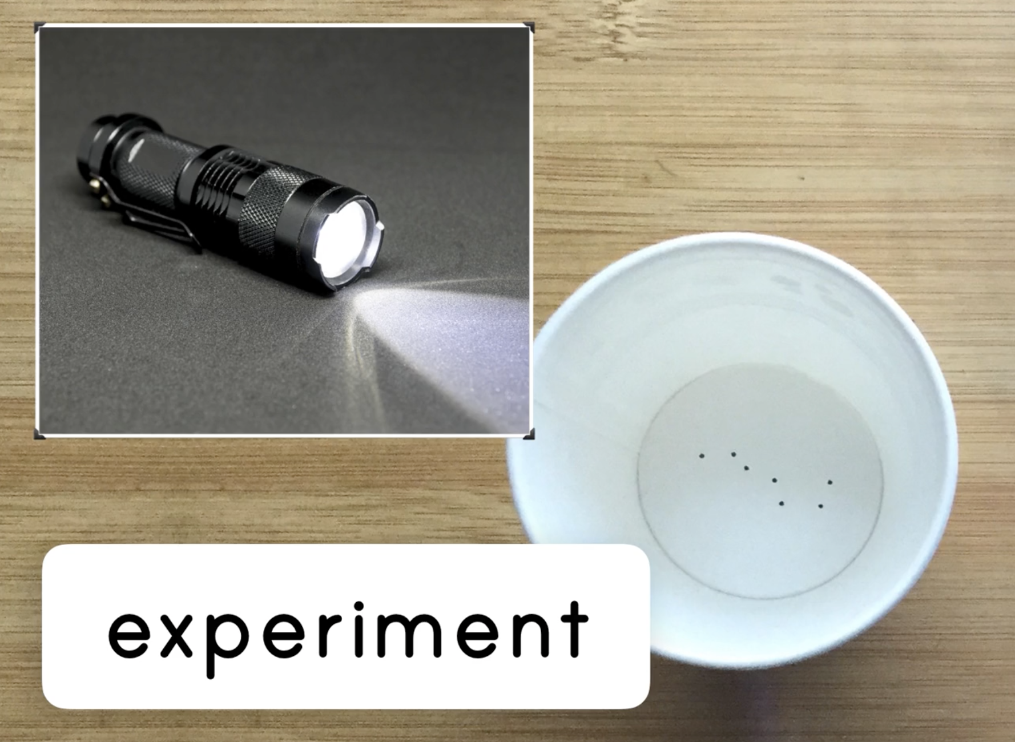
Night Patterns • Grade 1
Anchor Layer Teacher Guide
Lesson 2: Why do the stars come out at night? (pg 1 of 2)
Stars & Daily Patterns
Overview
In this lesson, students use a model to investigate why the stars are visible at night but disappear when the Sun comes out during the day.
In the activity, Star Projector, students use paper cups to project stars onto a sky picture, and observe what happens to these stars when a flashlight acts as a model of the Sun.
Anchor Connection on Next Page
Exploration 11 mins
Hands-On Activity 25 mins
Wrap-Up 4 mins
Anchor Connection 10 mins
Assessment 20 mins
Activity Notes
You will need to do part of this activity in the dark with the lights off and curtains drawn. We suggest students work in pairs. Homeschool students will need two flashlights and a partner to help with a few steps.
Set up activity stations by posting Sky Sheets on walls that will be dark or dimly lit when you pull the shades and turn out the lights. We recommend that each pair of students works at an activity station. If classroom space is limited, we’ve found that one station can comfortably accommodate up to 8 students taking turns.
For more detailed prep instructions, see our lesson page.
‹#›

Slide 8
Night Patterns • Grade 1
Anchor Layer Teacher Guide
Lesson 2: Why do the stars come out at night? (pg 2 of 2)
Stars & Daily Patterns
Anchor Connection
In the previous lesson, students learned that we can see the Moon during the day. In this lesson, students learn why the stars cannot be seen during the day, and apply this to explain why we can see the Moon during the day. The Moon is very bright, and that is why it can be seen during the day while the stars cannot.
Students revisit the See-Think-Wonder chart that they worked on during the Anchor Phenomenon. They should understand that stars are only visible at night because they aren’t bright enough to be seen during the day. The Moon is bright enough to be seen during both the night and the day.
When revising their See-Think-Wonder chart, students may add that the
Moon is visible during the day because it is so much brighter than the stars.
Connecting Storyline Question
Do some stars stay in the same place instead of moving like the Moon does?
Exploration 11 mins
Hands-On Activity 25 mins
Wrap-Up 4 mins
Anchor Connection 10 mins
Assessment 20 mins
‹#›

Slide 9

Night Patterns • Grade 1
Anchor Layer Teacher Guide
Lesson 3: How can the stars help you if you get lost?
Stars & Seasonal Patterns
Overview
In this Read-Along lesson, Ryan’s camping trip with his dad includes a night of stargazing, and a mystery to solve.
The lesson includes a short exercise where students imagine what they might see looking through a telescope. You can extend the lesson with the optional activity, Where Is North?, that helps students learn the cardinal directions.
Anchor Connection
This anchor connection serves as a review of what students have learned in the unit. First, the Moon is visible during the day. Second, the Moon is visible during the day because it is very bright, unlike the stars.
Students revisit the See-Think-Wonder chart that they worked on during the Anchor Phenomenon. They should understand that the Sun changes what we can see in the sky. This happens in a predictable pattern.
Connecting Storyline Question
Do we know when we can see the Sun, Moon, and stars?
Digital Book (W/ Audio) 20 mins
Hands-On Activity 25 mins
Anchor Connection 5 mins
Assessment 20 mins
Activity Notes
We suggest an optional activity that helps students gain a better understanding of the cardinal directions.
Use signs with the cardinal directions on them to label your classroom walls with the appropriate cardinal direction. For more detailed prep instructions, see our lesson page.
‹#›

Slide 10
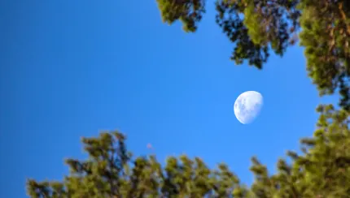
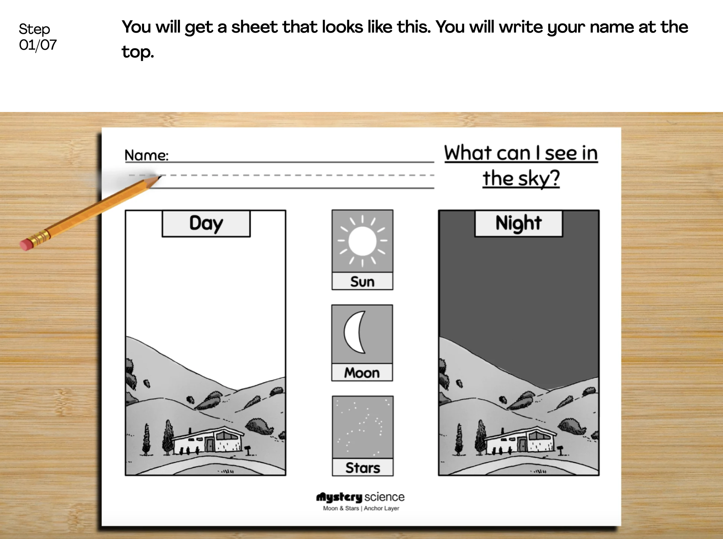
Night Patterns • Grade 1
Anchor Layer Teacher Guide
Performance Task: When can we see the Sun, Moon, & stars?
Night Patterns
Overview
In this performance task, students will apply what they learned over the course of this unit to predict when the Sun, Moon, and stars will be visible in the sky.
Unit Review 10 mins
Hands-On Activity 8 mins
Performance Task Notes
Students can work individually, in pairs, or you may choose to work with small groups. Print as many copies of the Where Will the Sun Be? worksheet as you will need for your students. One copy will be needed for each individual, each pair, or each small group.
Crosscutting Concepts
Patterns: The Moon follows several repeating cycles. One cycle repeats approximately each month, and involves the apparent shape of the Moon changing. The apparent change in shape is caused by a change in which portion of the Moon is illuminated by the Sun over time.
A second, concurrent cycle has to do with when the Moon is visible in sky. In this cycle, the Moon might be visible only during the night, during both the day and the night, or not visible during either. By identifying patterns in these cycles, we can predict the apparent shape of the Moon and when it will be visible in the sky.
‹#›

