Slide 1
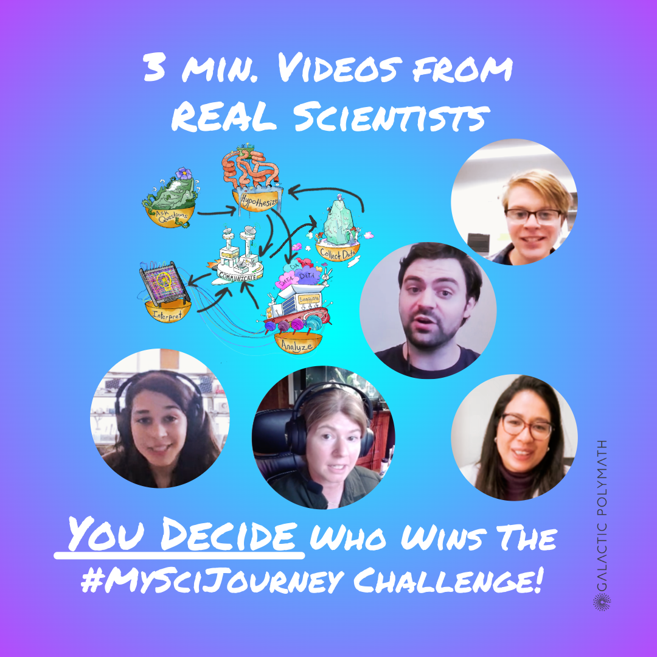
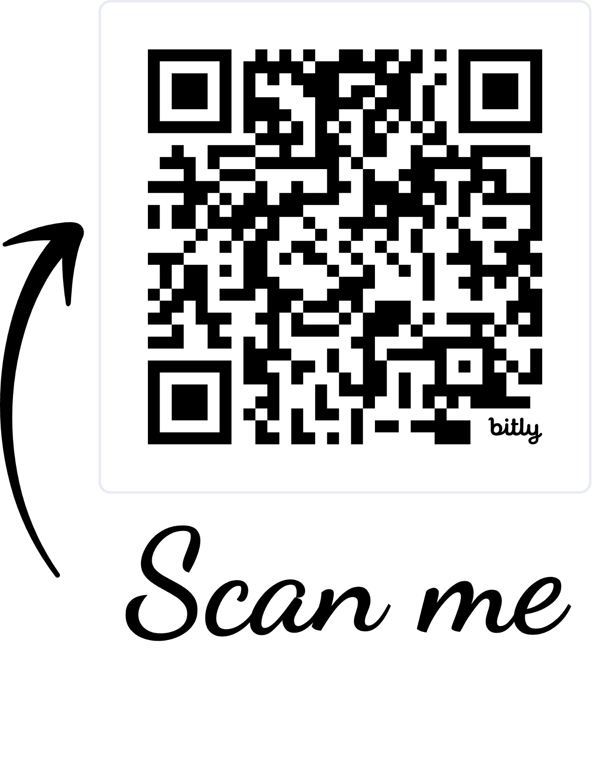



Watch videos in this playlist
Hit “Like” to Vote on Your Favs
Ask the scientist a question or give them kudos in the comments!
bit.ly/4orEdju
a project of
(Check back for new submissions until Nov. 3, 2025)
Awards announced at GP’s Bluesky and LinkedIn accounts on Nov. 18, 2025!
with funding from

Slide 2




Learning Objectives
Students will be able to:
Understand that the nature of science is diverse, dynamic, and requires resilience.
Recognize the non-linear approaches used by real scientists in their research.
Evaluate video content using different methods.

Slide 3

Lesson Ideas
This presentation includes different options on how to incorporate #MySciJourney Videos in your classroom!

Slide 4

Lesson 1
Ask students to sketch their impressions of how science works before and after watching the videos.
My Impressions of
How Science Works
Before Videos
My Impressions of
How Science Works
After Videos
Encourage students to reflect on their thinking:
Did your initial ideas change? Why or why not?
Compare these SciJourneys to a linear way of thinking about the scientific method. How are they different?
What is something new you learned about how science works?

Slide 5
Lesson 2
Ask students to draw a scientist before and after watching the videos.
Draw a Scientist
Before Videos
Draw a Scientist
After Videos
Encourage students to reflect on their thinking:
Did your drawing change? Why or why not?
What role does science play in your life?
There are lots of different branches of science. What kind of science do you like best? Why?
Notes:
Teacher Tip: Check out this page on NSTA for more information about this lesson idea.

Slide 6
Lesson 3
Gauge the extent to which students hold misconceptions about science before and after watching the videos.
Misconceptions about Science
Before Videos
Misconceptions about Science
After Videos
Encourage students to reflect on their thinking:
Which science misconception(s) did you have?
How has your understanding changed after watching the SciJourney videos?
What can we learn from unlocking and understanding our own misconceptions in science?
Notes:
Teacher Tip: Check out this website that describes several misconceptions in science. Select a few that are most relevant to your learners/classroom needs.

Slide 7
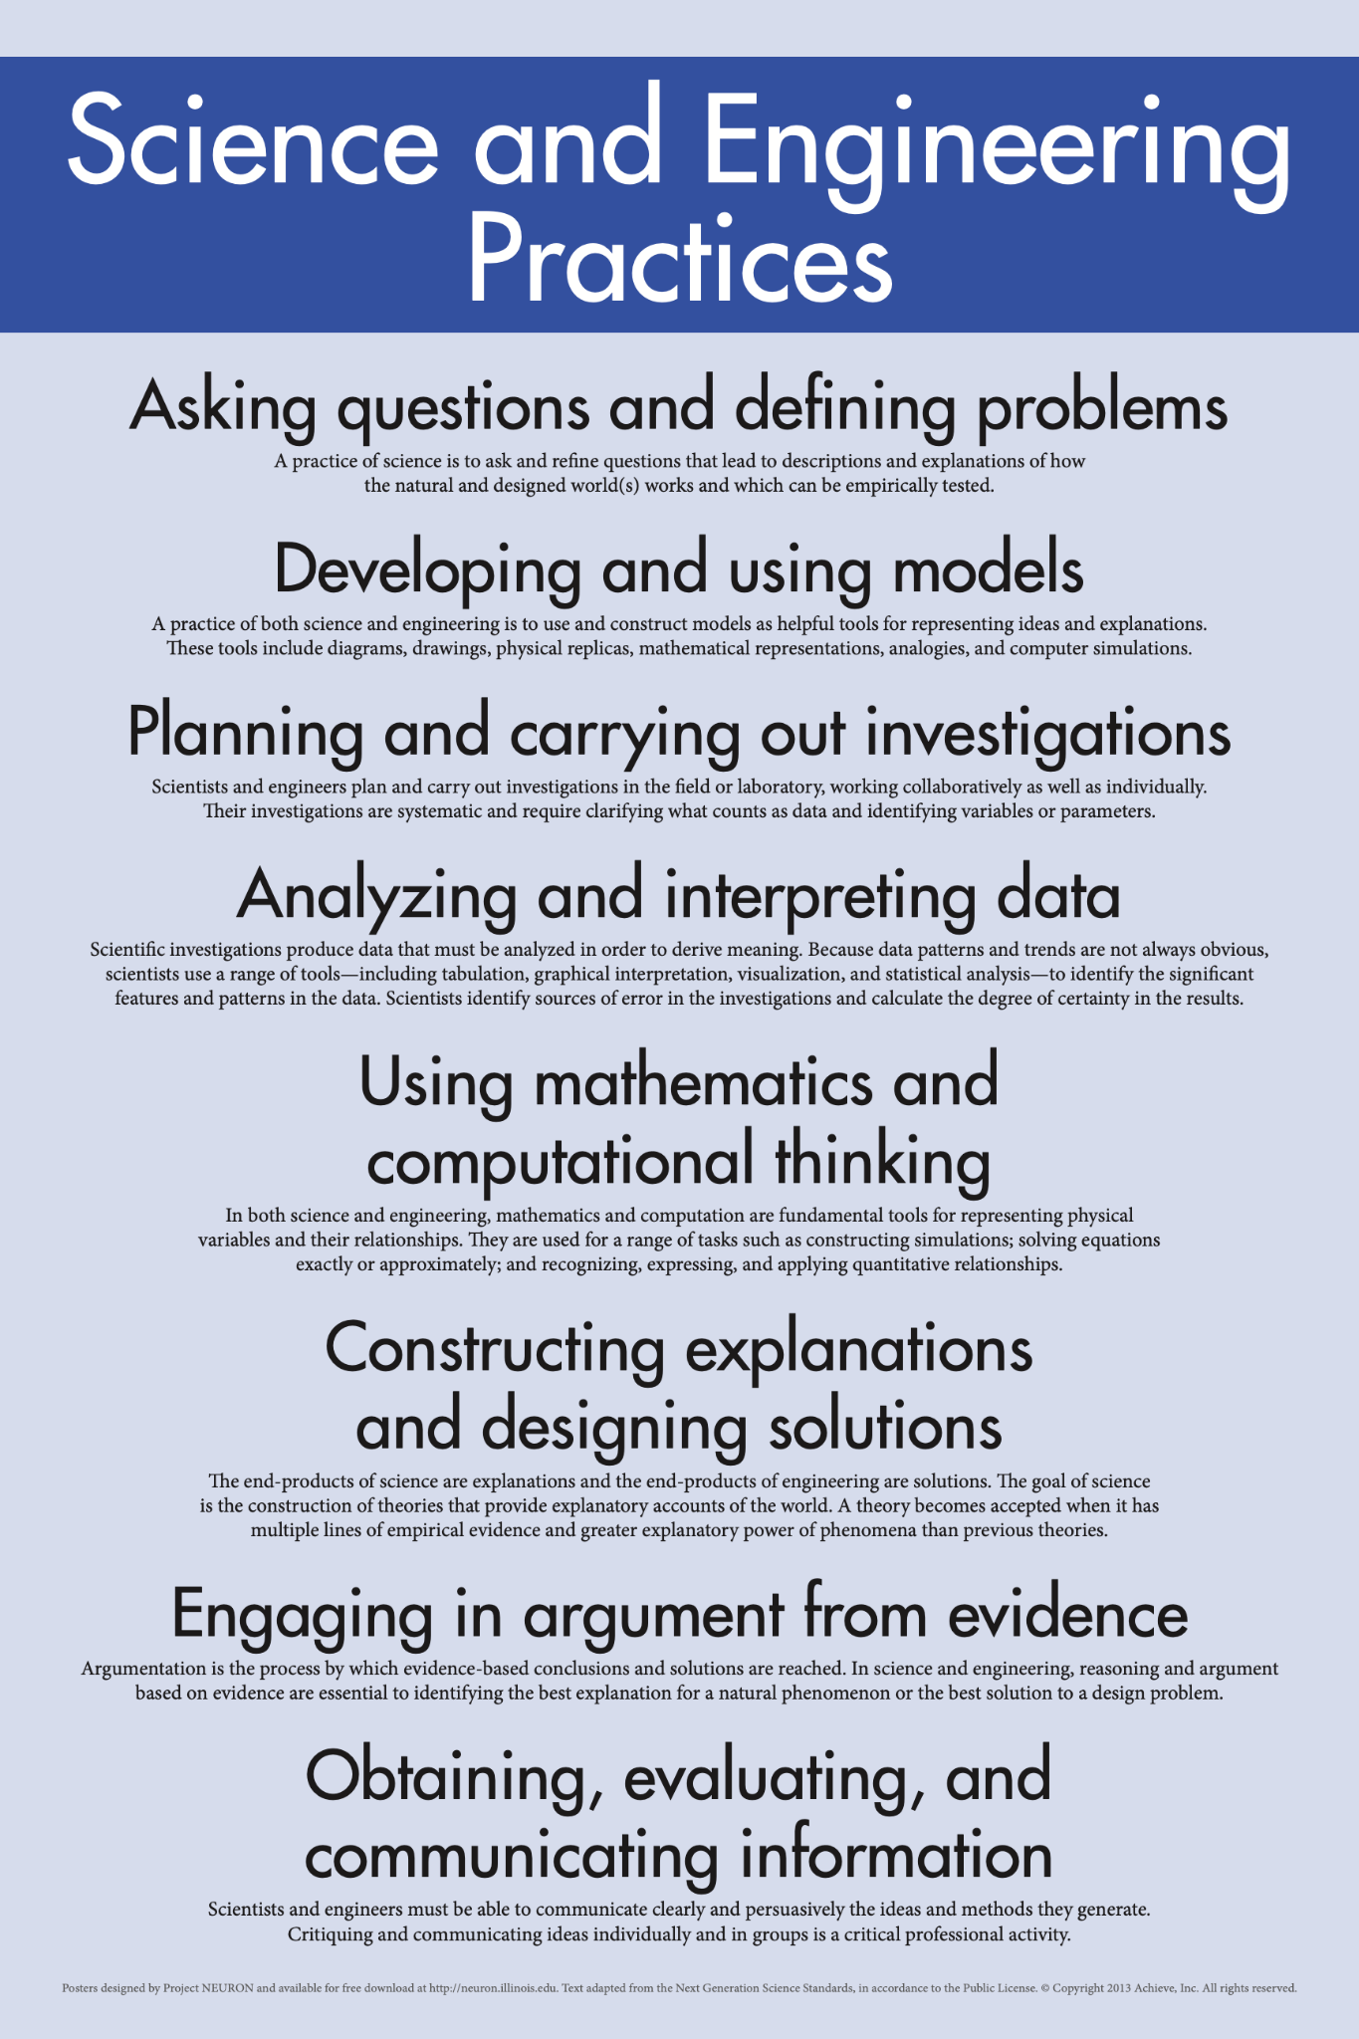
Lesson 4
Connect the videos to the Science and Engineering Practices (SEPs) of the NGSS and consider how these practices connect with other knowledge domains.
Encourage students to reflect on their thinking:
Which SEP was the easiest for you to identify in the videos? The most challenging? Explain your thinking.
How do the SEPs compare and connect with the skills you use in other subjects, e.g., arts and humanities?
Based on what you saw in the videos, how might learning these other subjects also contribute to success in science?
Notes:
Teacher Tip: Use this website to access a PDF one-pager of the Science and Engineering Practices. Use the printout, or create your own checklist version that students can use to identify the SEPs in each of the videos.

Slide 8

Lesson 5
Students can track their video rankings using a basic graphic organizer including: scientist name, gist of their research, and a ranking of the video out of 5 stars.
Encourage students to reflect on their thinking:
In your opinion, which scientist had the most interesting research? Explain.
Which video did you give the highest ranking? Why?
If you could ask one question to any of the scientists about their SciJourney, who would you ask and what?

Slide 9

#MySciJourney - Go Vote!
Now it’s up to you and your classes to help decide the winners of the challenge.
Watch, like, and comment on your favorite #MySciJourney videos by Nov. 15.
Be sure to check back between now and Nov. 3 for new additions to the playlist.
Thanks to our sponsors The National Center for Science Education and Civic Science Media Lab, cash prizes and acclaim will be awarded to the three scientists whose videos have the highest engagement.

Slide 10
Watch videos in this playlist
Hit “Like” to Vote on Your Favs
Ask the scientist a question or give them kudos in the comments!
bit.ly/4orEdju
a project of
(Check back for new submissions until Nov. 3, 2025)
Awards announced at GP’s Bluesky and LinkedIn accounts on Nov. 18, 2025!
with funding from

