Slide 1
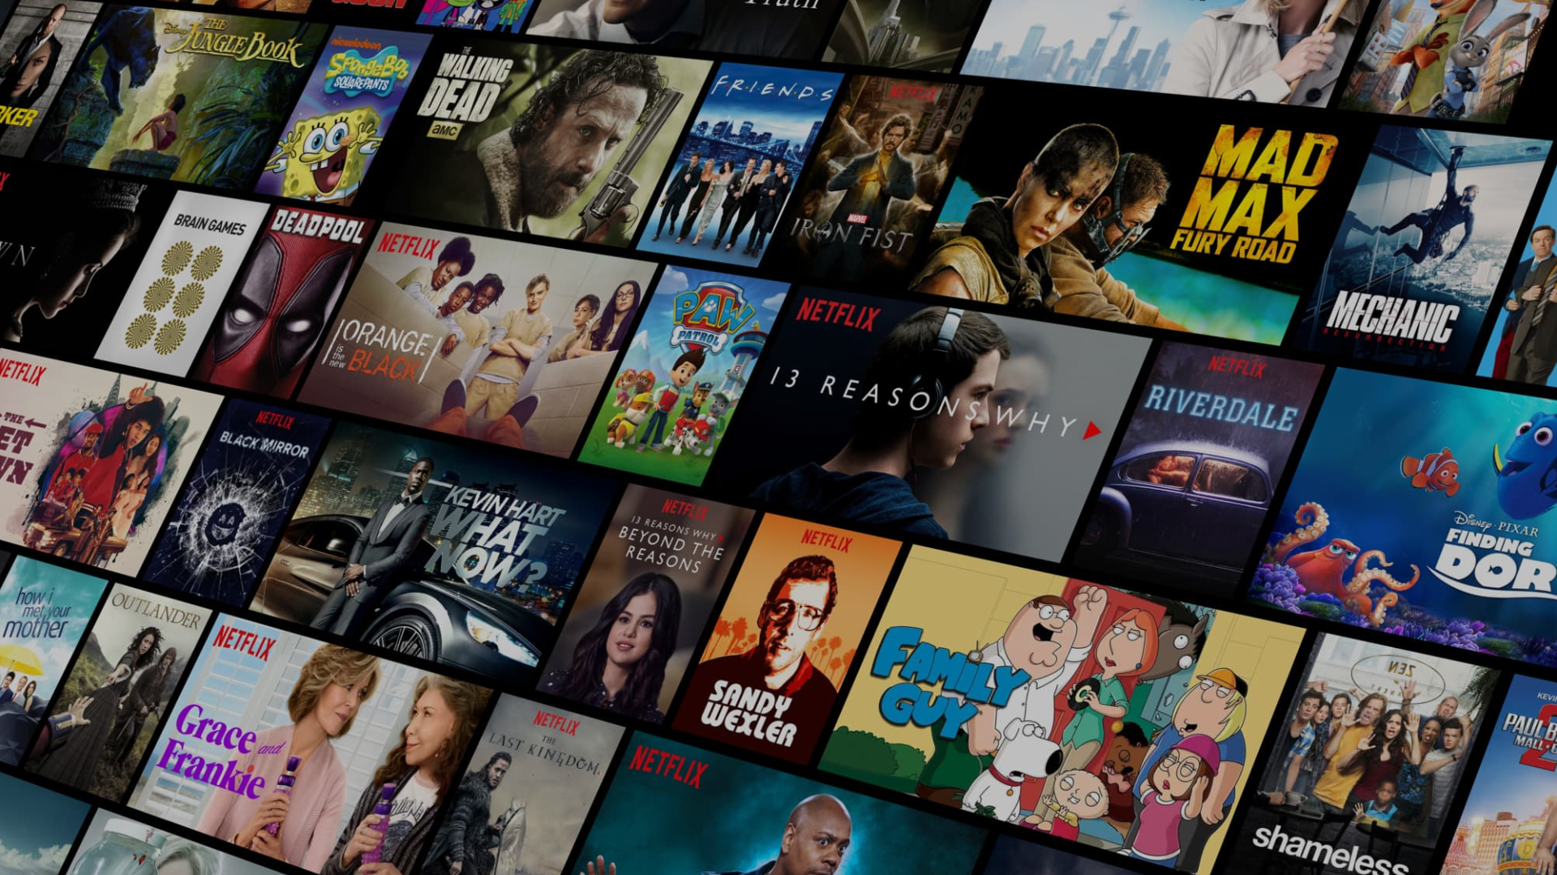


FREE PRESENTATION TEMPLATE

Slide 2


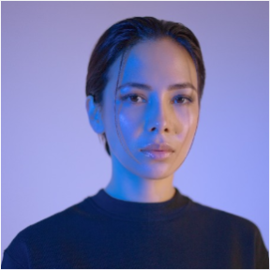
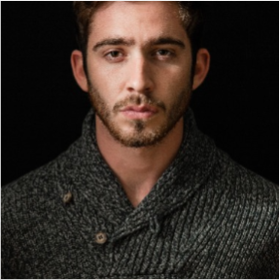


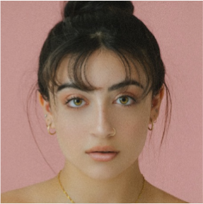
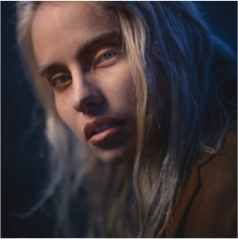

Welcome
Dragon
Unicorn
Elf
Orc
Add Profile

Slide 3
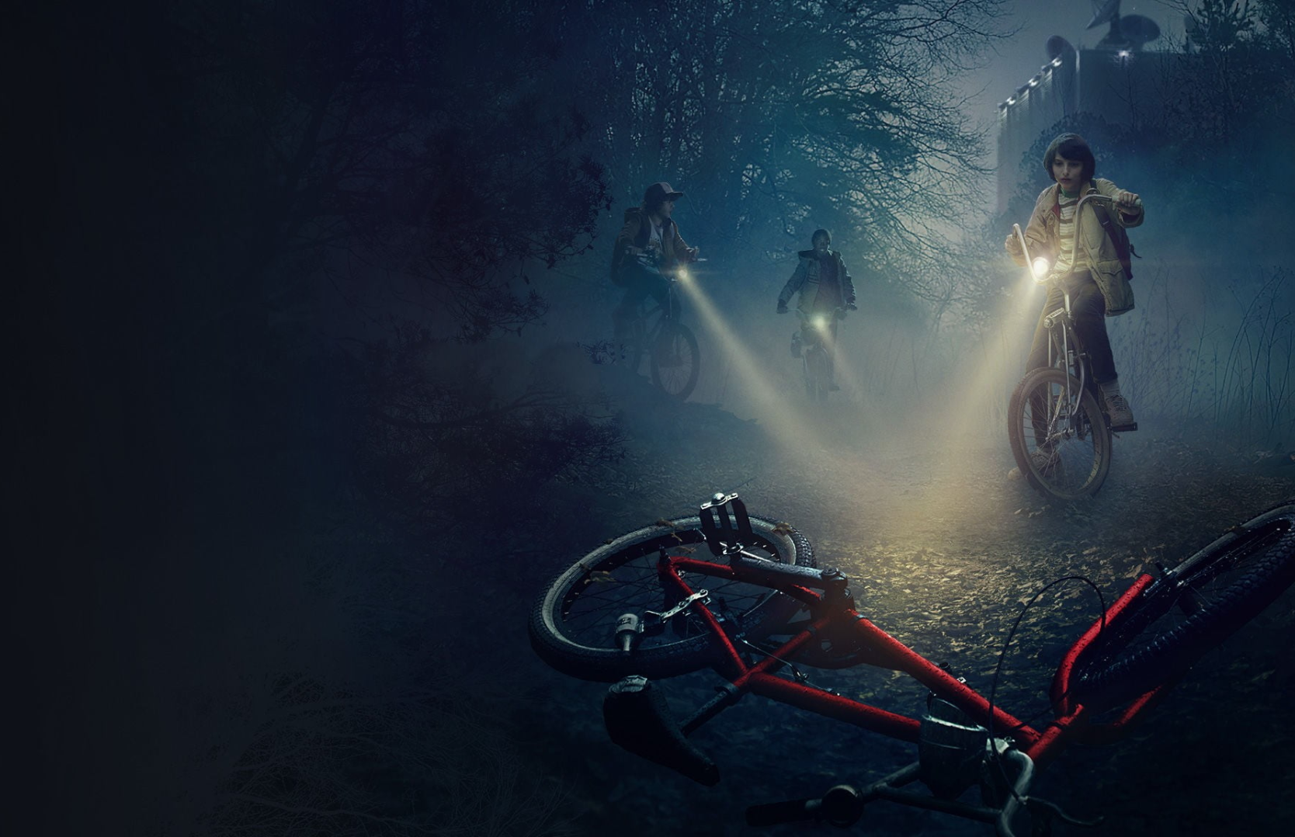














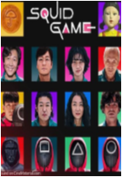
Friday July 8th
Drama | Thriller | Supernatural
Stranger Things
2019 | Director: Shawn Levy | Seasons: 3 (5 Episodes)
Welcome to the Fantasy World, a realm of wonder and enchantment where anything is possible. Here, dragons breathe fire, unicorns prance through meadows, and rainbows shine brightly.
STREAM NOW
ALL EPISODES
POPULAR THIS WEEK
16+

Slide 4




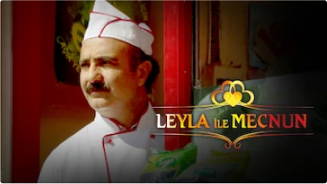



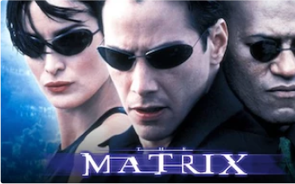
















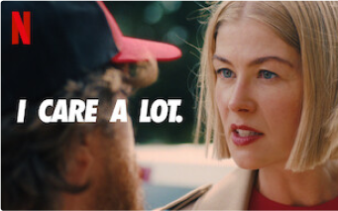



The Realm
The Extraordinary
The Fantasy

Slide 5

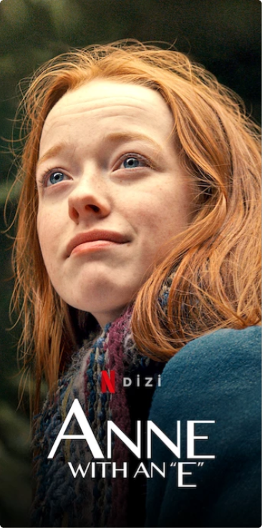






Unicorn Sightings

Slide 6







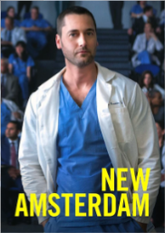






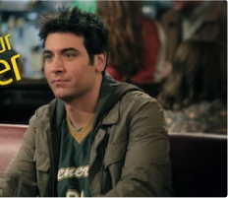


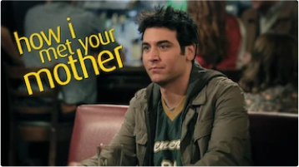

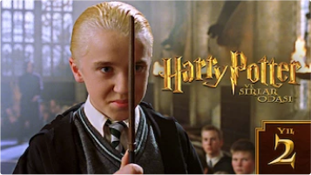
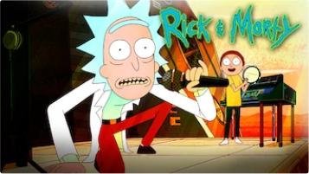












Dragon
Taming
Unicorn

Slide 7


Thank you for choosing EaTemp
We offer free and high-quality slides templates for your presentations. We appreciate you choosing us and hope our templates have been helpful.
As a new website, we rely on your support to grow, so please help us by sharing our site with your friends and colleagues.

