Slide 1
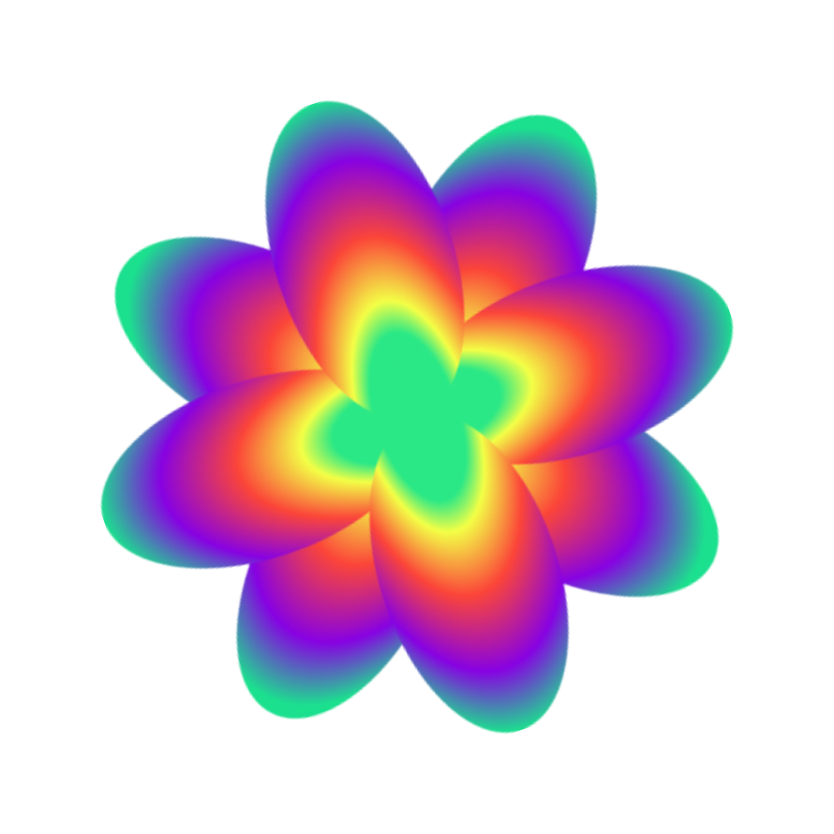
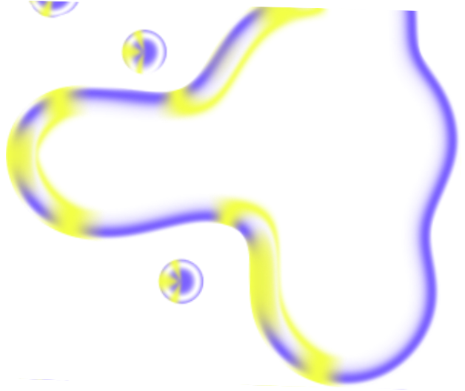
2023 Wrapped
FREE PRESENTATION TEMPLATE

Slide 2
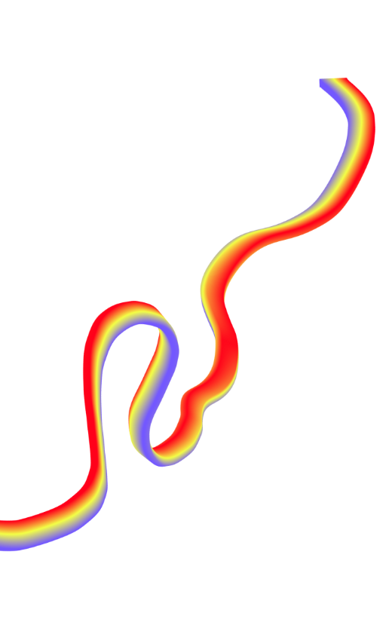
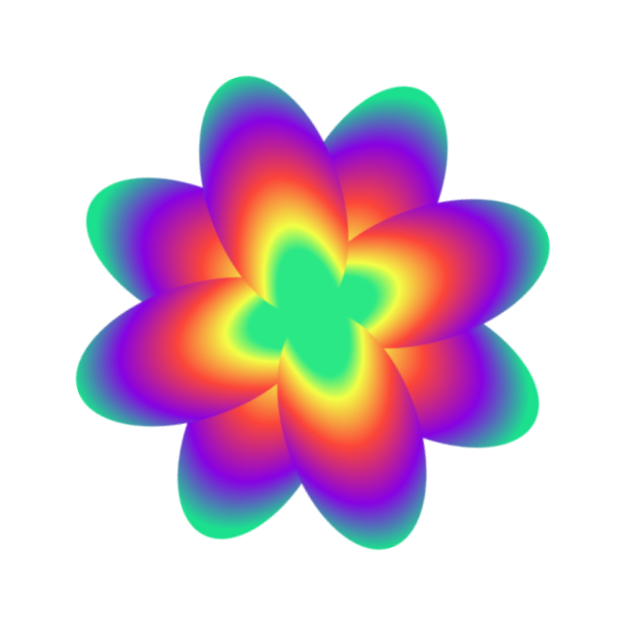
Welcome
Welcome to the world of fantasy! Join us on a journey to explore the mystical creatures, enchanted lands, and magical wonders that exist beyond our reality. Discover the wonders and secrets of this exciting realm and unlock the power of imagination.

Slide 3
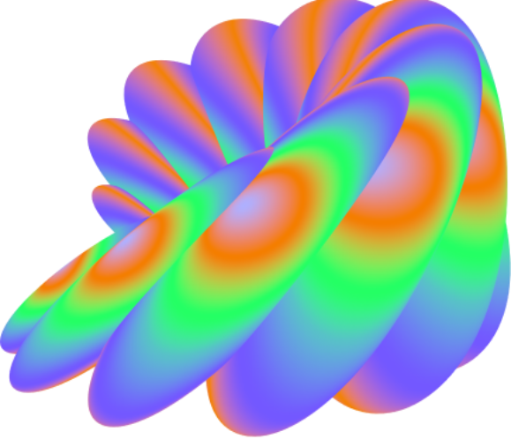
Table of Contents
01
Introduction
02
Encounters
The Extraordinary Realm
Unicorn Sightings
03
Wonders
04
Magic
Wishes Granted
Spellcasting
05
Adventure
06
Conclusion
Happily Ever After
Embrace the Fantasy

Slide 4
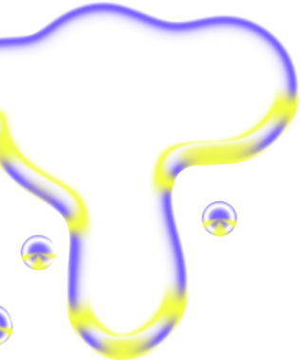
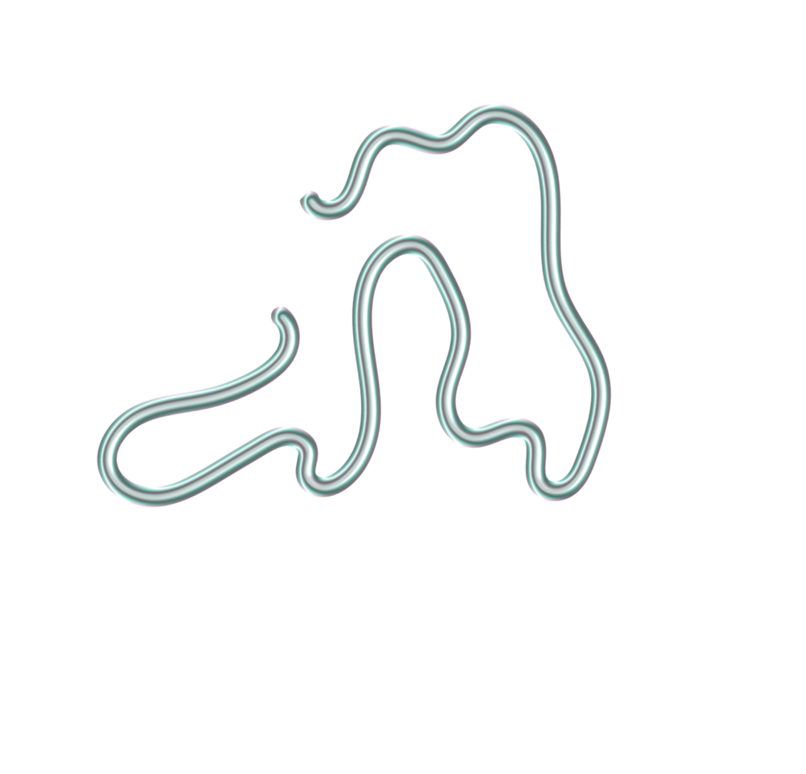
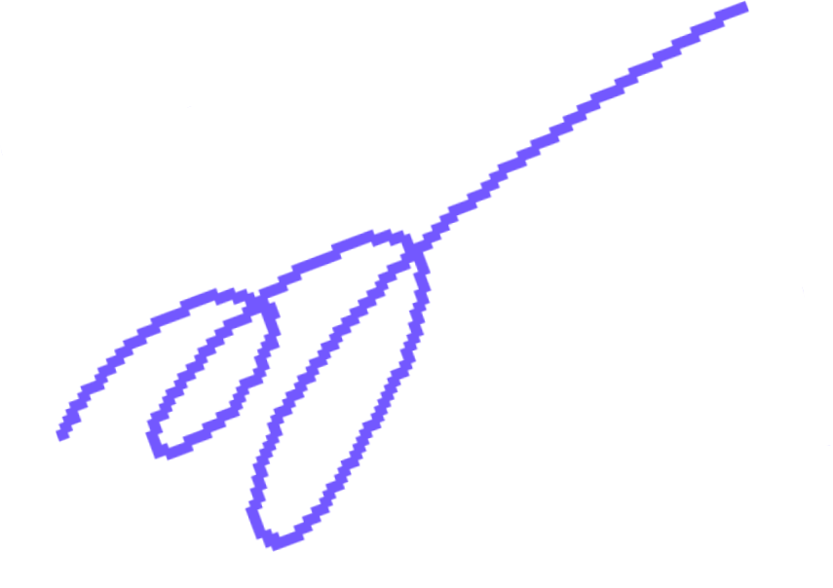
The Realm of the Extraordinary
Welcome to the Fantasy World, a realm of wonder and enchantment where anything is possible. Here, dragons breathe fire, unicorns prance through meadows, and rainbows shine brightly. This world is a place where wishes come true, where potions can be cursed and spells are cast. It's a place of treasure and adventure, where the impossible becomes possible. But the greatest treasure of all is the one that lies within.
The world of fantasy is a reflection of our deepest desires, our fondest dreams, and our wildest imaginations. It's a place where we can let go of the constraints of reality and explore the boundless possibilities of the human mind. In this introduction, we will delve into the mysteries of this realm, uncovering the magic and wonder that lies within. So come with us and let's embark on a journey through the Fantasy World.

Slide 5
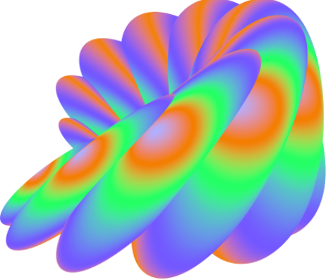
Unicorn Sightings
A record of the number of unicorns spotted in the fantasy realm and the beauty and mystery that surrounds these enchanting creatures.
Dragon Taming
A closer look at the art of taming dragons and the brave adventurers who dare to take on these fearsome creatures.

Slide 6
Unicorn Sightings
A record of the number of unicorns spotted in the fantasy realm and the beauty and mystery.
Unicorn Sightings
A record of the number of unicorns spotted in the fantasy realm and the beauty and mystery.

Slide 7
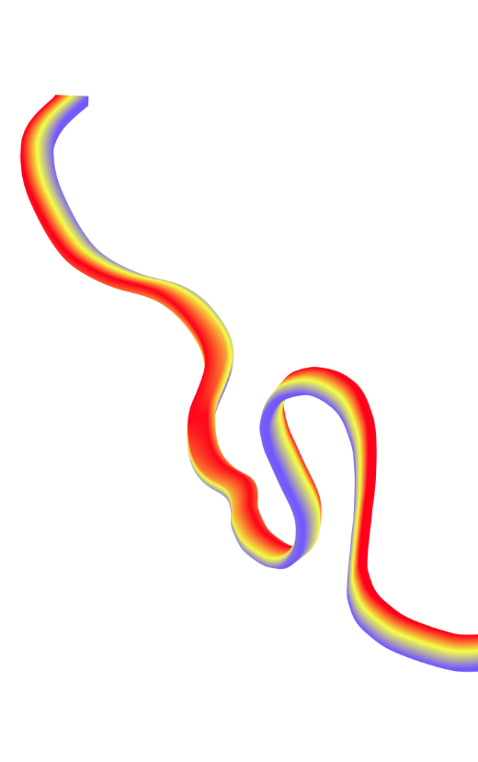
Fantasy is the gateway to the impossible, the land where the ordinary becomes extraordinary, and the impossible becomes possible. It is the realm of the imagination, where anything can happen and everything is possible.
The Dream Weaver

Slide 8
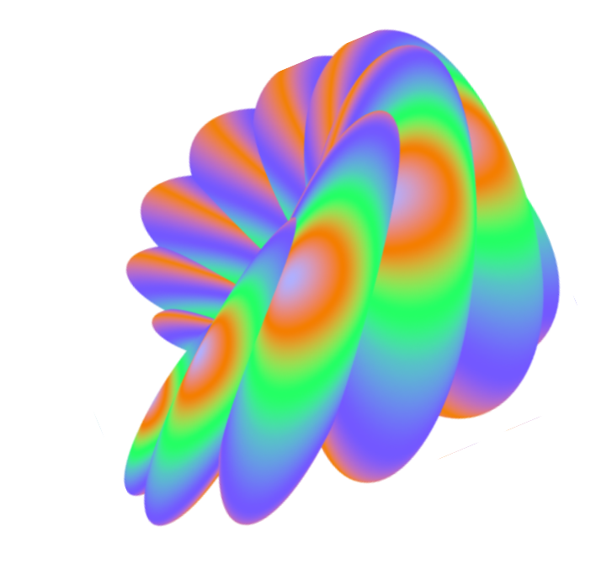
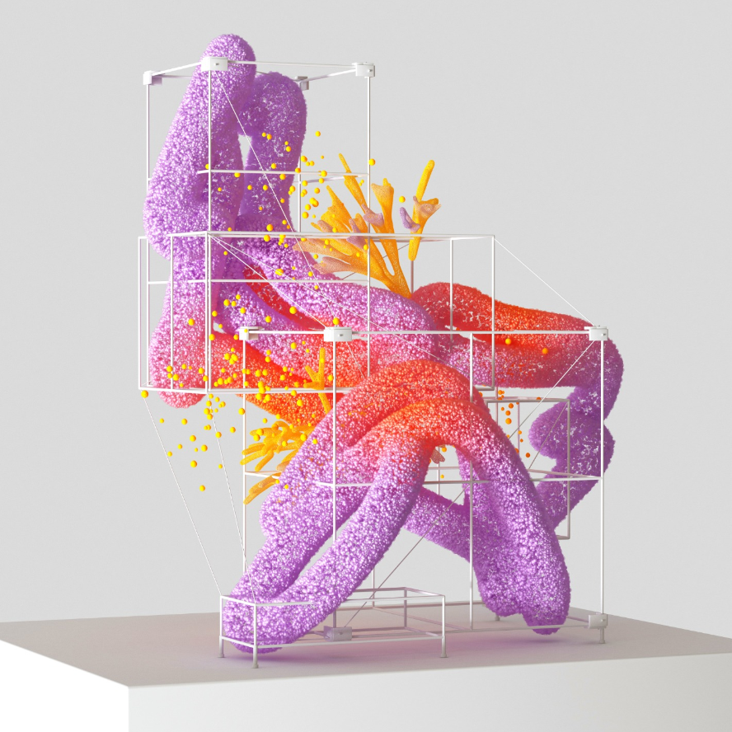
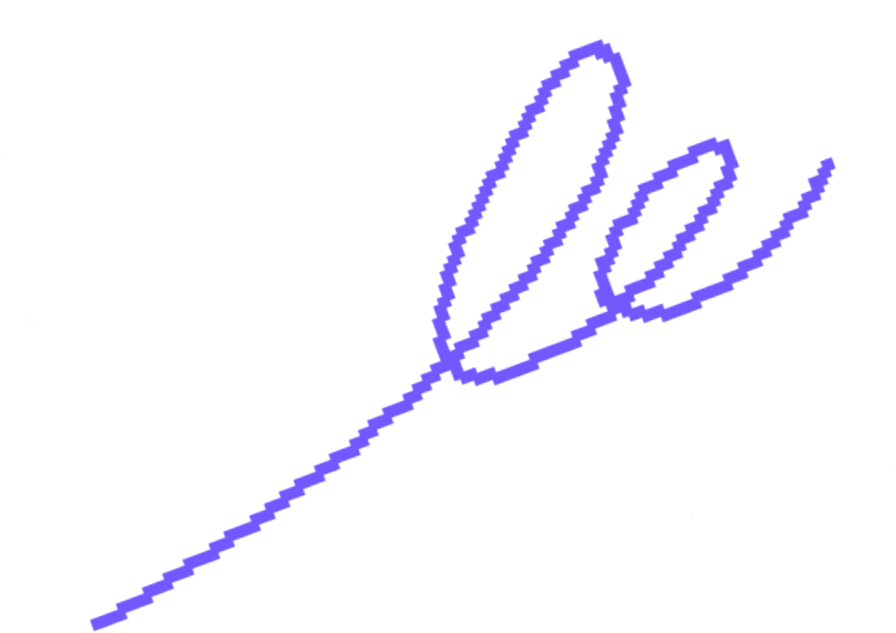
The Art of Unicorn Sighting
Tips and tricks for spotting the elusive unicorns in their natural habitat.

Slide 9
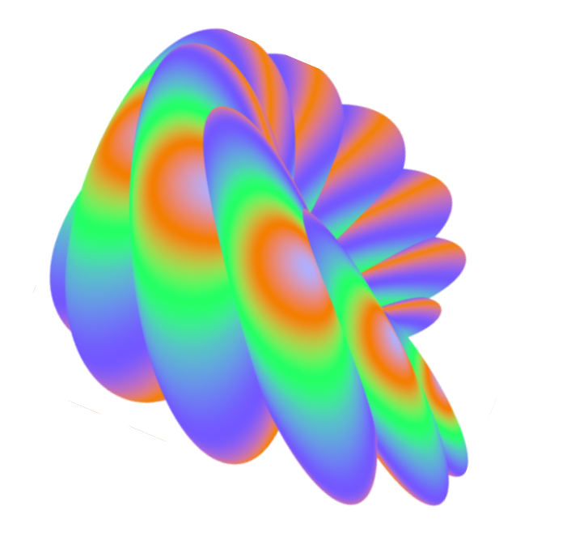
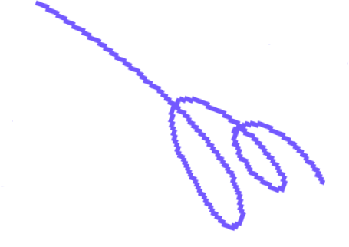
The Magic of Dragons: A Research
6.7M
"The Art of Archery": Discover the intricacies of the Art of Archery .
4.4M
"The Music of the Elves": Immerse yourself in the enchanting music of the elves.
2.3M
"The Life of an Elf": Learn about the customs and daily life of the elves.

Slide 10
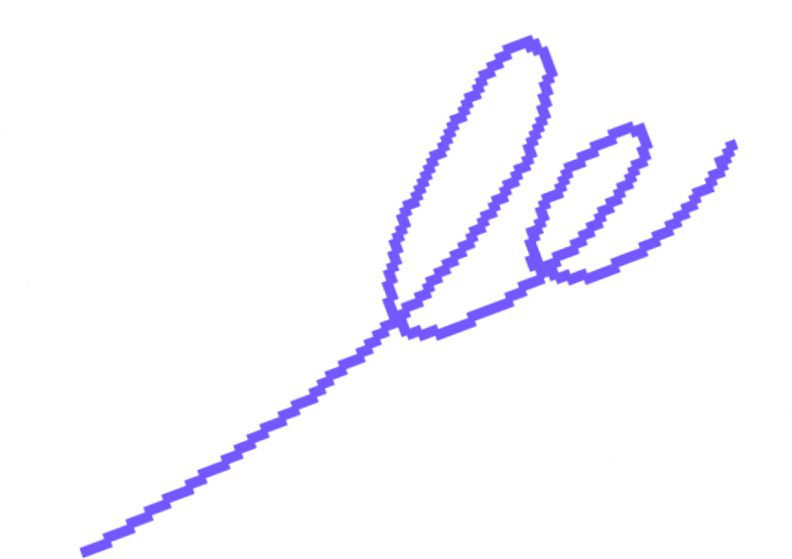
Thank you for choosing EaTemp
We offer free and high-quality slides templates for your presentations. We appreciate you choosing us and hope our templates have been helpful.
As a new website, we rely on your support to grow, so please help us by sharing our site with your friends and colleagues.
Credit | Image: Unsplash

