Slide 1



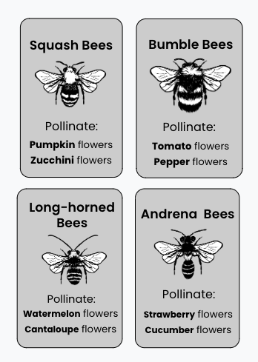
Game Extension
Why are there so many different kinds of flowers?
Plant
Plant
Cucumber
Cantaloupe
You and your students may notice that each Bee Card lists two types of flowers that the bee can pollinate.
If your students would like to continue playing the game, you can add in these additional Plant Cards. Cut out these cards and shuffle them with the original set of Plant Cards.
The rules are exactly the same, so you can refer to the Game Rules sheet.
Cantaloupe
Plant
Plant
Cucumber
Plant
Plant
Cucumber
Cucumber
Plant
Cucumber
Plant
Cucumber

Slide 2
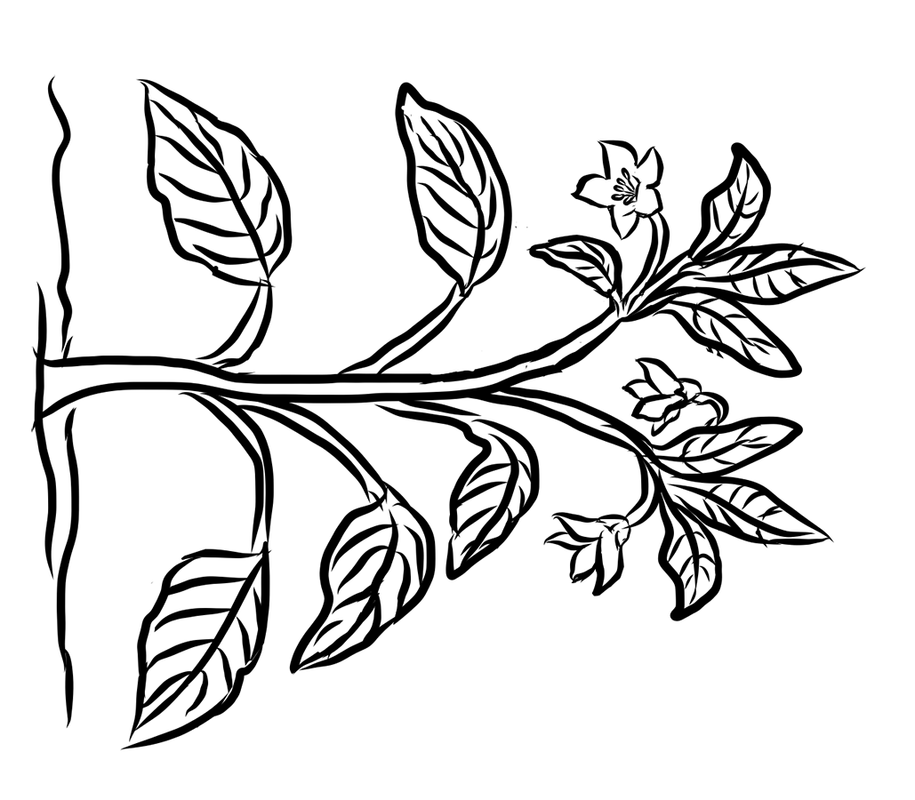
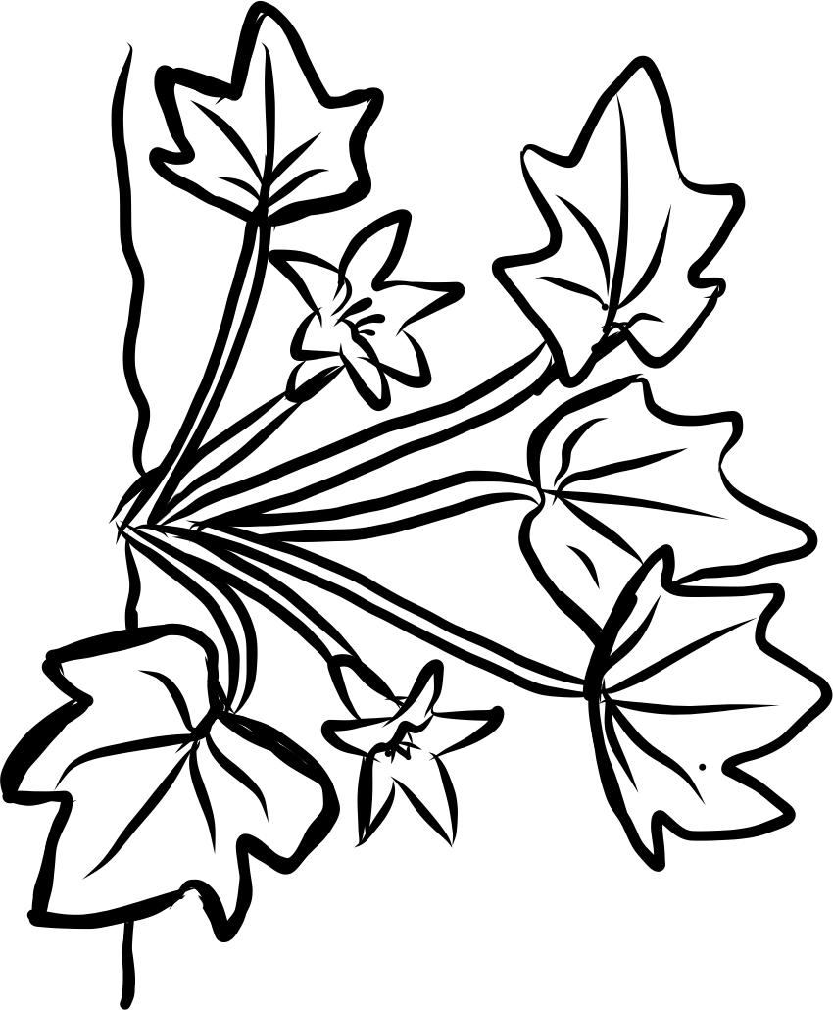
Why are there so many different kinds of flowers?
Plant
Plant
Plant
Pepper
Plant
Cantaloupe
Zucchini
Zucchini
Plant
Cantaloupe
Pepper
Plant
Plant
Plant
Zucchini
Zucchini
Plant
Plant
Plant
Pepper
Plant
Cantaloupe
Pepper
Zucchini
Cantaloupe
Plant
Plant
Plant
Pepper
Pepper
Plant
Zucchini

