Slide 1
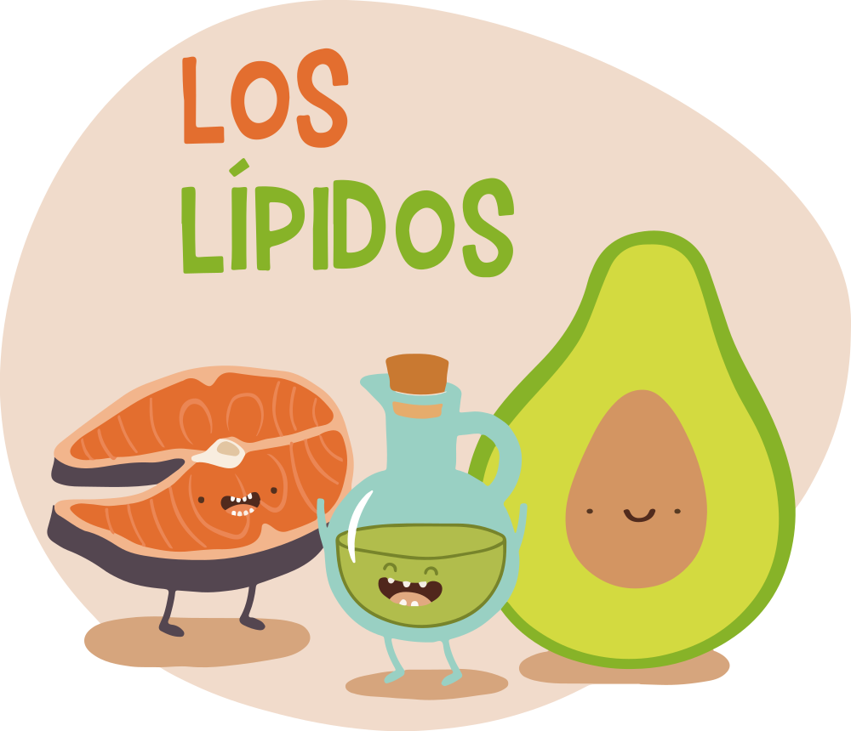
FREE TEMPLATES
Here is where this template begins

Slide 2

Food Infographics
Purple
Red
Orange
Yellow
Green
Venus
Mercury
Saturn
Earth
Mars
Jupiter
Mercury
Saturn
Jupiter
Mars
Jupiter
Saturn
Saturn
Jupiter
Venus
Longevity
Heart Health
Prevention
Beauty
Detoxification

Slide 3
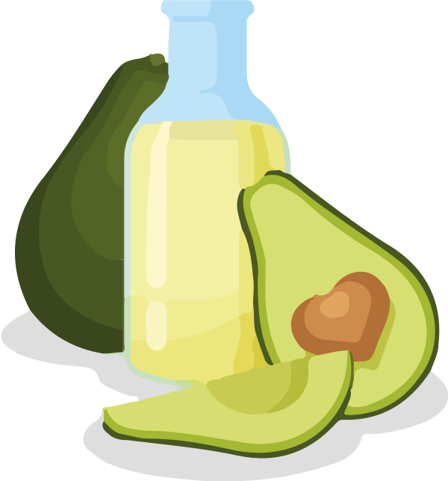
Food Infographics
It’s the smallest planet in the Solar System
It’s the biggest planet in the Solar System
It’s composed mostly of hydrogen and helium
Mars is a cold place full of iron oxide dust
Venus has a very poisonous atmosphere

Slide 4
Food Infographics
It’s the smallest planet in the Solar System
It’s the biggest planet in the Solar System
It’s composed mostly of hydrogen and helium
Mars is a cold place full of iron oxide dust
Venus has a very poisonous atmosphere

Slide 5
Food Infographics
55%
65%
Mercury is the closest planet to the Sun and smallest one
Mars is actually a cold place. This planet is full of iron oxide dust
40%
60%
It has a beautiful name and is the second planet from the Sun
Jupiter is a gas giant and the biggest planet in the Solar System

Slide 6
Food Infographics
It’s the smallest planet in the Solar System
It’s composed of hydrogen and helium
It’s the biggest planet in the Solar System
Neptune is the farthest from the Sun
Planet Venus has a beautiful name
It’s a cold place. It’s full of iron oxide dust

Slide 7
Food Infographics
5%
Mercury is the closest planet to the Sun and the smallest one in the Solar System
15%
Jupiter is a gas giant and actually also the biggest planet in the Solar System
30%
Saturn is a gas giant in the Solar System, composed mostly of hydrogen and helium
50%
It has a beautiful name and is the second planet from the Sun in the Solar System

Slide 8
Food Infographics
50%
30%
It’s a gas giant and the biggest planet in the Solar System
20%
Saturn is a gas giant, composed mostly of hydrogen and helium
Despite being red, Mars is actually a cold place. It’s full of iron oxide dust

Slide 9
Food Infographics
Mercury
Mercury is the closest planet to the Sun and also the smallest
Jupiter
Jupiter is actually the biggest planet in the Solar System
Saturn
Saturn is composed mostly of hydrogen and helium
Mars
Mars is actually a cold place. It’s full of iron oxide dust
Venus
Venus has a beautiful name and a very poisonous atmosphere

Slide 10
Food Infographics
Mercury
Mars
Mercury is the closest planet to the Sun and smallest one
Mars is actually a cold place. This planet is full of iron oxide dust
Venus
Jupiter
It has a beautiful name and is the second planet from the Sun
Jupiter is a gas giant and the biggest planet in the Solar System

Slide 11
Food Infographics
Neptune is the eighth and farthest planet from the Sun in the Solar System
Mercury is the smallest planet in the Solar System
Red
Venus has a very poisonous atmosphere
Yellow
Purple
Orange
Green
Despite being red, Mars is a cold place
Saturn is a planet with several rings

Slide 12
Food Infographics
Mercury is the closest planet to the Sun and smallest one in the Solar System
Mercury
1
Jupiter is a gas giant and actually also the biggest planet in the Solar System
Jupiter
2
Saturn is a gas giant in the Solar System, composed mostly of hydrogen and helium
Saturn
3
It has a beautiful name and is the second planet from the Sun in the Solar System
Venus
4
Mars is a cold place in the Solar System. Actually it’s full of iron oxide dust
Mars
5

Slide 13
Food Infographics
It’s the smallest planet in the Solar System
40%
It’s composed of hydrogen and helium
5%
Venus has a very poisonous atmosphere
5%
It’s the biggest planet in the Solar System
20%
It’s a cold place. It’s full of iron oxide dust
25%
It’s the farthest planet from the Sun
5%

Slide 14
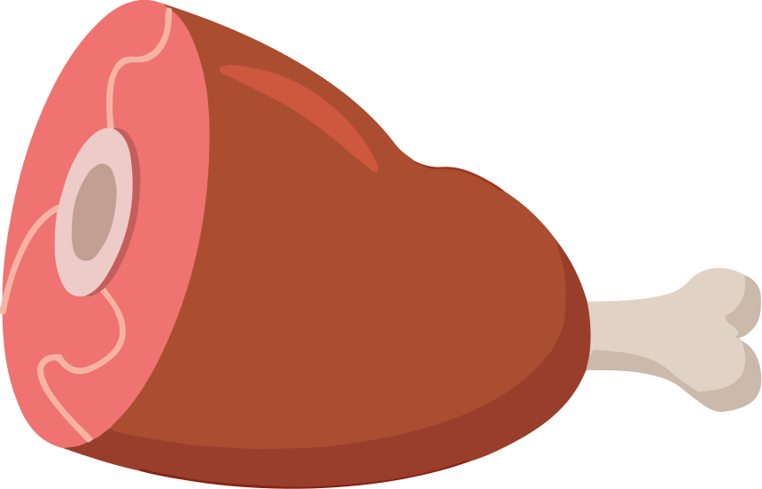
Food Infographics
It’s the smallest planet in the Solar System
40%
It’s composed of hydrogen and helium
5%
Venus has a very poisonous atmosphere
5%
It’s the biggest planet in the Solar System
20%
It’s a cold place. It’s full of iron oxide dust
25%
It’s the farthest planet from the Sun
5%

Slide 15
Food Infographics
Jupiter
23%
Jupiter is a gas giant and actually also the biggest planet in the Solar System
Saturn
64%
Saturn is a gas giant in the Solar System, composed mostly of hydrogen and helium
Venus
100%
It has a beautiful name and is the second planet from the Sun in the Solar System

Slide 16
Food Infographics
Mercury is the closest planet to the Sun and smallest one in the Solar System
25%
Protein
Jupiter is a gas giant and actually also the biggest planet in the Solar System
50%
Vegetables
Saturn is a gas giant in the Solar System, composed mostly of hydrogen and helium
12%
Grains
It has a beautiful name and is the second planet from the Sun in the Solar System
12%
Carbs

Slide 17
Food Infographics
Mars
Venus
Despite being red, Mars is actually a cold place. It’s full of iron oxide dust
Venus has a beautiful name and is the second planet from the Sun
Jupiter
Saturn
Jupiter is a gas giant and the biggest planet in the Solar System
Saturn is a gas giant, composed mostly of hydrogen and helium

Slide 18
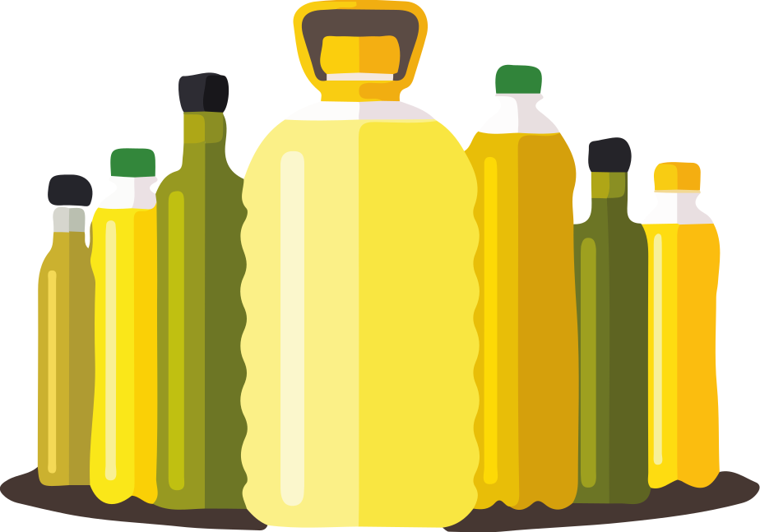
Food Infographics
Mars
Despite being red, Mars is actually a cold place. It’s full of iron oxide dust
Jupiter
Jupiter is a gas giant and the biggest planet in the Solar System

Slide 19
Food Infographics
Jupiter is a gas giant and the biggest planet in the Solar System
Venus has a beautiful name and is the second planet from the Sun
Despite being red, Mars is actually a cold place. It’s full of iron oxide dust
Saturn is a planet, a gas giant, composed mostly of hydrogen and helium

Slide 20
Food Infographics
Red
Purple
It’s the smallest planet in the Solar System
It’s composed mostly of hydrogen and helium
Orange
Blue
It’s the biggest planet in the Solar System
It’s the farthest planet from the Sun
Yellow
Green
Venus has a very poisonous atmosphere
It’s a cold place. It’s full of iron oxide dust

Slide 21
Food Infographics
95%
57%
85%
20%
35%
It’s the smallest planet in the Solar System
It’s the biggest planet in the Solar System
Venus has a very poisonous atmosphere
It’s composed of hydrogen and helium
Neptune is the farthest planet from the Sun

Slide 22
Food Infographics
It’s the smallest planet in the Solar System
Mercury
It’s composed of hydrogen and helium
Saturn
Venus has a very poisonous atmosphere
Venus
It’s the biggest planet in the Solar System
Jupiter
It’s a cold place. It’s full of iron oxide dust
Mars
It’s the farthest planet from the Sun
Neptune

Slide 23
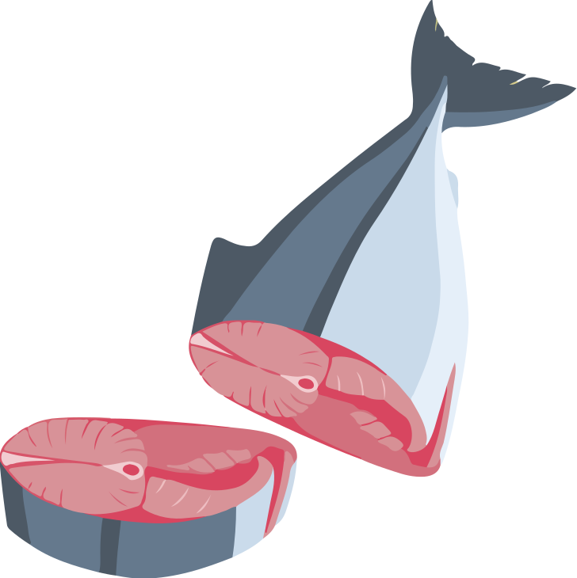
Food Infographics
It’s the smallest planet in the Solar System
Mercury
It’s composed of hydrogen and helium
Saturn
Venus has a very poisonous atmosphere
Venus
It’s the biggest planet in the Solar System
Jupiter
It’s a cold place. It’s full of iron oxide dust
Mars
It’s the farthest planet from the Sun
Neptune

Slide 24
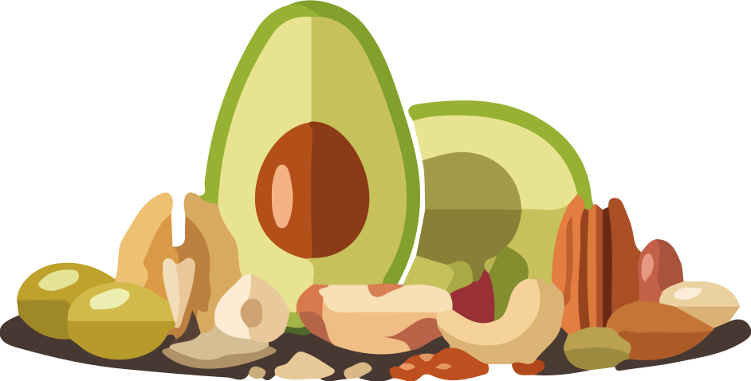
Food Infographics
Mars
Despite being red, Mars is actually a cold place. It’s full of iron oxide dust
Jupiter
Jupiter is a gas giant and the biggest planet in the Solar System

Slide 25
Food Infographics
It’s the smallest planet in the Solar System
It’s the smallest planet in the Solar System
It’s composed mostly of hydrogen and helium
It’s composed mostly of hydrogen and helium
Venus has a very poisonous atmosphere
Venus has a very poisonous atmosphere
It’s the biggest planet in the Solar System
It’s the biggest planet in the Solar System
It’s a cold place. It’s full of iron oxide dust
It’s a cold place. It’s full of iron oxide dust

Slide 26
Food Infographics
A
B
C
D
E
KD
It’s the smallest planet in the Solar System
It’s the biggest planet in the Solar System
Despite being red, Mars is a cold place
Venus has a very poisonous atmosphere
It’s composed of hydrogen and helium
Neptune is the farthest planet from the Sun

Slide 27
Food Infographics
1
Mercury is the closest planet to the Sun and smallest one in the Solar System
2
Jupiter is a gas giant and actually also the biggest planet in the Solar System
3
Saturn is a gas giant in the Solar System, composed mostly of hydrogen and helium

Slide 28
Food Infographics
21%
35%
Mercury is the closest planet to the Sun and smallest one
Mars is actually a cold place. This planet is full of iron oxide dust
29%
15%
It has a beautiful name and is the second planet from the Sun
Jupiter is a gas giant and the biggest planet in the Solar System

Slide 29
Food Infographics
It’s the smallest planet in the Solar System
It’s the biggest planet in the Solar System
It’s composed of hydrogen and helium
It’s a cold place. It’s full of iron oxide dust
Venus has a very poisonous atmosphere

Slide 30
Food Infographics
Mars
Venus
Despite being red, Mars is actually a cold place. It’s full of iron oxide dust
Venus has a beautiful name and is the second planet from the Sun
Jupiter
Saturn
Jupiter is a gas giant and the biggest planet in the Solar System
Saturn is a gas giant, composed mostly of hydrogen and helium

Slide 31
Food Infographics
25%
It’s the smallest planet in the Solar System
It’s composed of hydrogen and helium
15%
10%
Venus has a very poisonous atmosphere
15%
It’s the biggest planet in the Solar System
It’s a cold place. It’s full of iron oxide dust
25%
It’s the farthest planet from the Sun
10%

Slide 32
Food Infographics
Jupiter
Jupiter is the biggest planet in our wonderful Solar System
Mercury
Mercury is the smallest planet in our wonderful Solar System
10%
Mars
Mars is actually a cold place. It’s full of iron oxide dust
Saturn
35%
25%
Saturn is a planet composed mostly of hydrogen and helium
Neptune
20%
10%
Neptune is the farthest planet from the Sun in the Solar System

Slide 33
Food Infographics
Mercury
Jupiter
Venus
Saturn
Pluto
It’s the smallest planet in the Solar System
It’s the biggest planet in the Solar System
Venus has a very poisonous atmosphere
It’s composed of hydrogen and helium
Pluto is the farthest planet from the Sun

Slide 34
Food Infographics
70%
60%
75%
Mars
Jupiter
Saturn
Despite being red, Mars is actually a cold place. It’s full of iron oxide dust
It’s a gas giant and the biggest planet in the Solar System
Saturn is a gas giant, composed mostly of hydrogen and helium

Slide 35
Food Infographics
Jupiter
Mars
Saturn
Mars is actually a cold place. Is a planet full of iron oxide dust
Saturn is a planet composed of hydrogen and helium
Venus
Mars
Jupiter
Venus
It’s a gas giant and also the biggest planet in Solar System
It has a beautiful name, but it’s terribly hot, even than Mercury
Venus
100
200
300
400
500

Slide 36
Food Infographics
It’s a gas giant and also the biggest planet in the Solar System
It has a beautiful name, but it’s terribly hot, even than Mercury
Mars is actually a cold place. Is a planet full of iron oxide dust
It’s the smallest and closest planet to the Sun in the Solar System

Slide 37
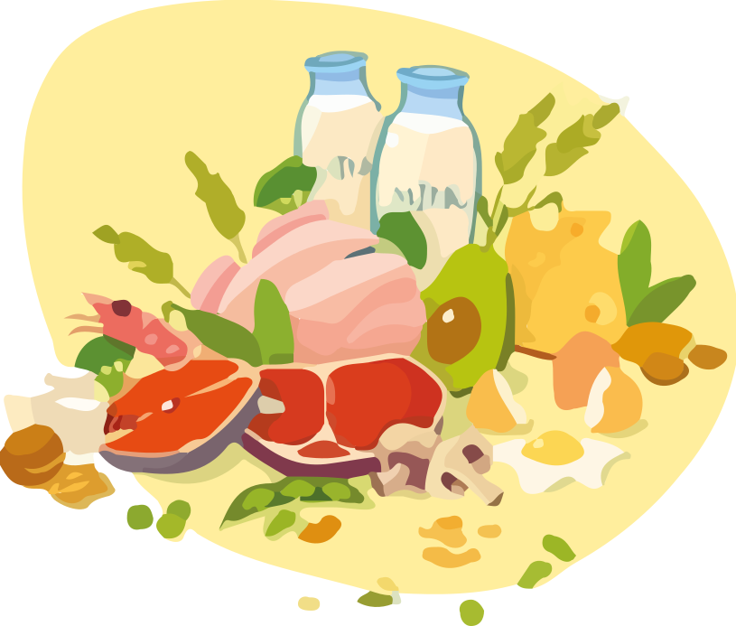
Thanks You
It’s the smallest and closest planet to the Sun in the Solar System

Slide 38
https://plantillaspowerpoint.org

Slide 39
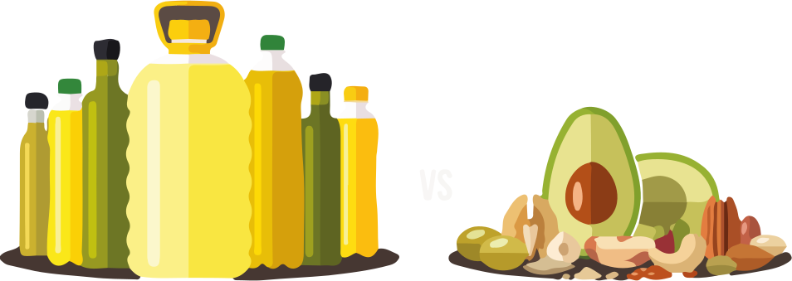
EDITABLES VECTORES

Slide 40
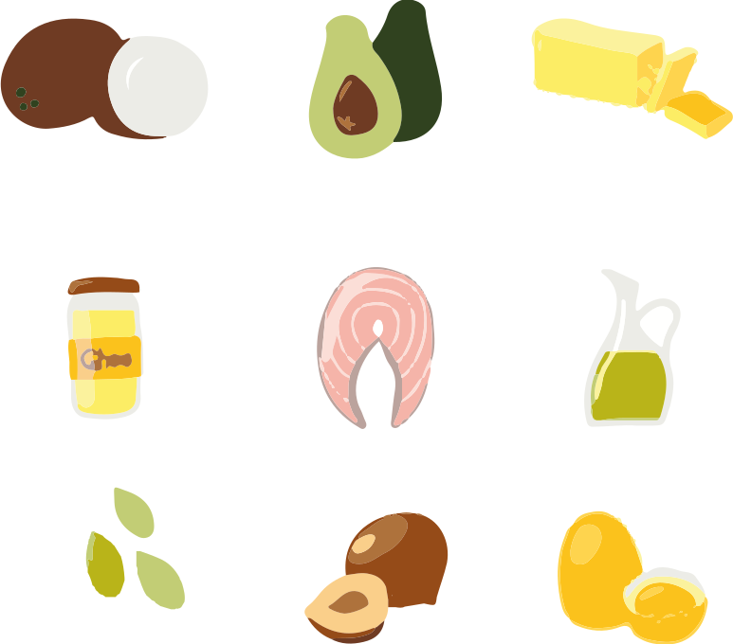
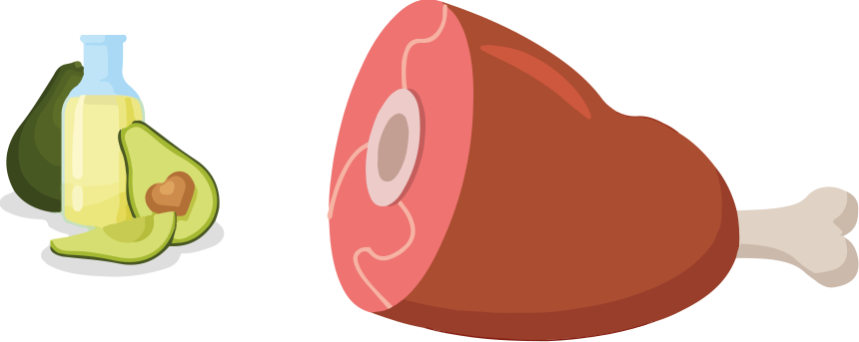
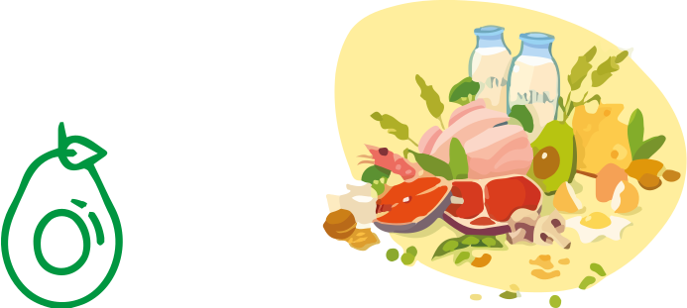
EDITABLES VECTORES

