Slide 1

Introduction to Quality improvement
Ministry of health
Module 1
‹#›
Notes:
‹#›

Slide 2

Objectives
To define quality, quality of healthcare & quality Improvement.
To acquaint learners with the basics of the 5S model.
To establish the relevance of CQI -TQM.
To highlight to the learners on the QI principles & steps
‹#›

Slide 3
What is Quality?
Ability to satisfy stated or implied needs.
Performance according to standards
Conformance to requirements
Fitness for purpose or use
Meeting the customer’s requirements

Slide 4
What constitutes Quality?
Ability to satisfy stated or implied needs.
Performance according to standards.
Conformance to requirements or specifications
Fitness for purpose or use.
Doing right things right
Doing the right things at the right time in a right place.
Meeting the customer’s needs and reasonable expectations
‹#›

Slide 5
Definition of quality & quality of healthcare.
Quality:
  It is the magnitude to which something adheres to a minimum set standard (Swanick & Vaux, 2020).
Quality of healthcare:
  Is the degree of performance concerning the desired standards of interventions known to be safe and have the capacity to improve health using the available resources.
‹#›

Slide 6
Doing the Right Things Right
(Quality Grid)
Doing “right things” means to use effective interventions that meet customer needs.
Doing “things right” entails managing work processes so that the work is organized in a way that works correctly, efficiently, and on time.
‹#›
Notes:
The participants can be given an opportunity to cite some examples of each
‹#›

Slide 7
Quality Grid
How you do it
Do it Right Do it Wrong
Doing Right Thing Right e.g. Prescribed right medicine in right dose | Doing Right Thing Wrong e.g. Prescribed right medicine but wrong dose
Doing Wrong things right e.g. prescribed wrong medicine but right dose | Doing Wrong things wrong e.g. Prescribed wrong medicine and wrong dose
What you do
The Wrong thing The Right thing
‹#›

Slide 8
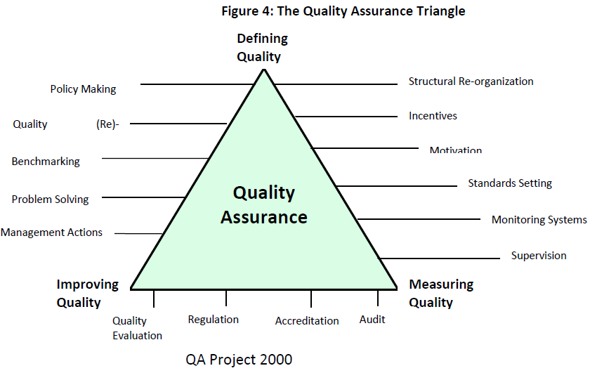
QUALITY ASSURANCE
(A set of activities that are planned for and carried out systematically and continuously to improve Quality of Care)

Slide 9
What is 5S?
5S (literally five initials of words i.e Sort, Set, Shine, Standardise, and Sustain):
  is a set of management activities, origin - Japanese sector.
Firstly:
  “Sort”, “Set” and “Shine” are practiced,
  followed by implementing standards to set up mechanisms to keep their level high.
  “Sustain” is the state that the practice of “Sort”, “Set” and “Shine” becomes routine with the use of the mechanism to “Standardise”.
‹#›

Slide 10
Seven reasons for the popularity of 5S
Visible results enhance the generation of more and new ideas.
The workplace gets cleaned up and better organized.
Hospital and office operations become easier and safer.
Results are visible to everyone - insiders and outsiders.
People are naturally disciplined.
People take pride in their clean and organized workplace.
As a result, the workplace’s good image is sustained due to sustained quality results.
‹#›

Slide 11
Continuous Quality Improvement (CQI)
CQI (KAIZEN):
  originally developed for manufacturing in Japan to improve productivity.
  focuses on the improvement of systems and processes through the use of data.
  closes the gaps between the current performance and the expected standards.
‹#›

Slide 12
Total Quality Management (TQM)
  TQM is a comprehensive and participatory approach to ensure the quality of services.
  In health service delivery, TQM aims to embed awareness of quality in all healthcare processes.
  It involves improvement of the work environment through 5S and work process through CQI.
  This information is summarized in the figures in the next two slides:
‹#›

Slide 13
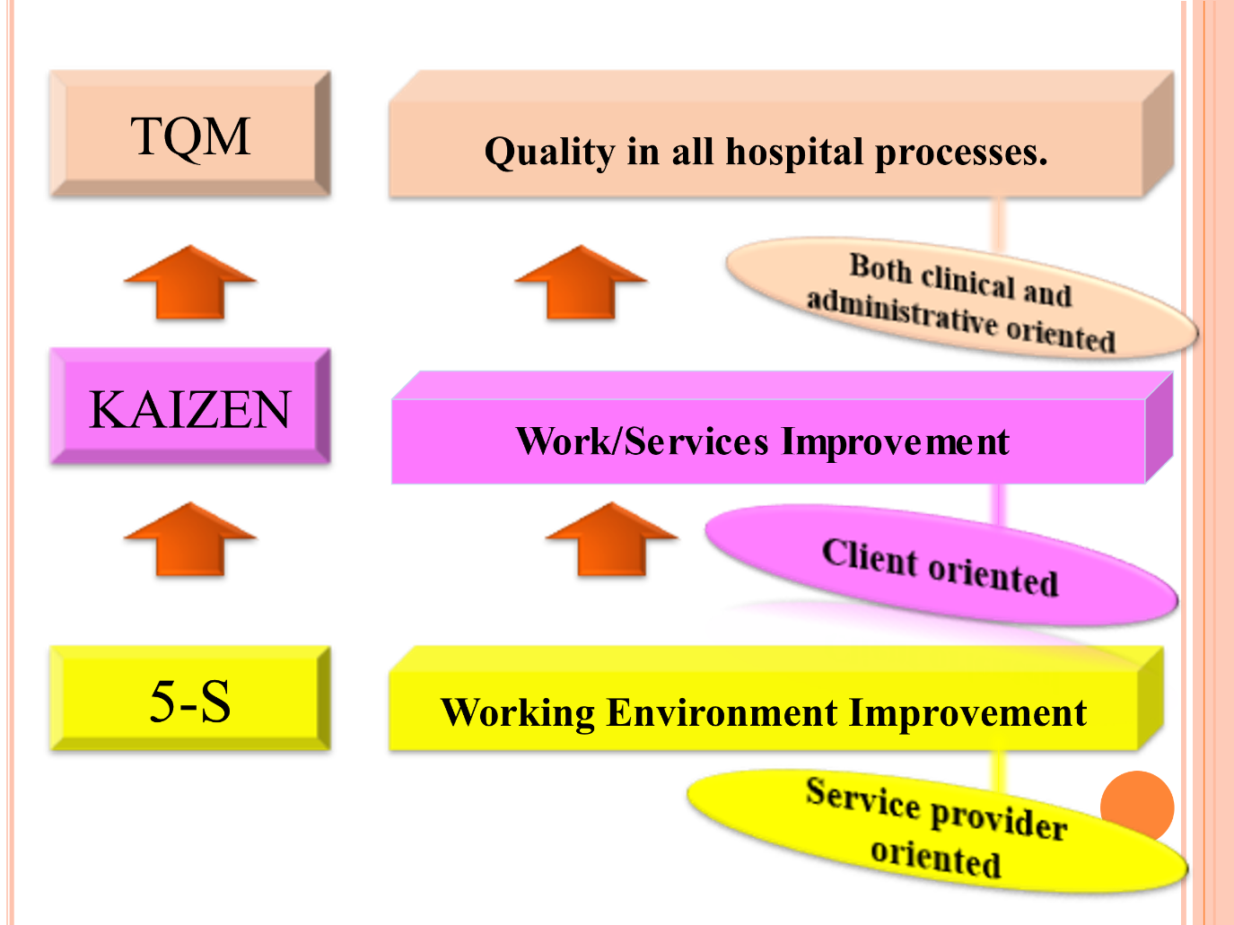
5S-KAIZEN-TQM
‹#›

Slide 14
What is Quality Improvement?
Applying appropriate methods to close the gap between current and expected level of quality/performance as defined by standards
It is a management science that identifies and improves where gaps exist between services actually provided and the expectations for services
Systematically improving service quality by addressing the gaps between current practices and desired standards
‹#›

Slide 15
Fundamental Concept of QI
Improvement requires change, but not every change is an improvement.
And not every change is necessary (Changes must be tested/PDSA)
If a system is not changed, it will continue to achieve the same results
Performance is a characteristic of the system

Slide 16



Principles of QI
  Client focus
  Focus on processes and systems
  Data Use
  Teamwork
This PhotoThis Photo by Unknown Author is licensed under CC BY
‹#›
This PhotoThis Photo by Unknown Author is licensed under CC BY-NC

Slide 17
4 steps in QI
Step 1: Identify the problem. How to identify problems?
Step 2: Analyze the problem. The purpose is to measure performance of the process or system that produces the effect
Step 3: Develop possible solutions to the problem (improvement changes)
Step 4: Test /implement the possible solutions
‹#›

Slide 18
Testing changes
The process used to test proposed solutions (changes) is the PDSA Cycle.
The Plan – Do – Study – Act cycle involves;
  Plan: Includes what activity to be done, by whom, when and resources required
  Do: Execution of the plan
  Study: Time has to be set aside to analyze the data and study the results
  Act: This has to be rationally based on what was learned
‹#›

Slide 19
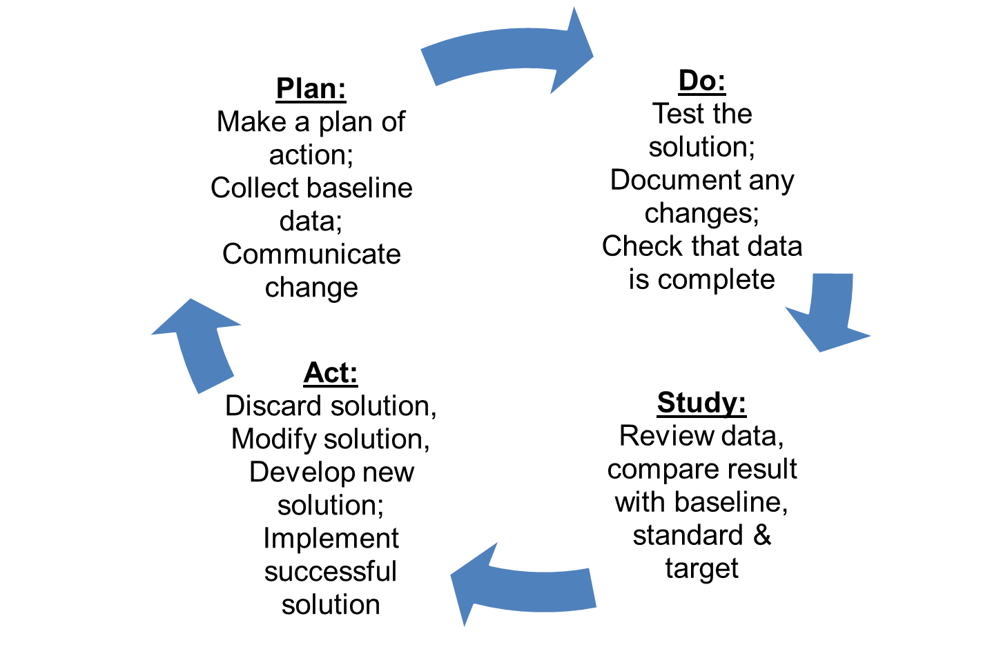
Step 4: Test = PDSA Cycle
Notes:
‹#›

Slide 20

Quality Improvement Tools
Brainstorming: A way for a group to generate as many ideas as possible in a very short time by tapping into group knowledge, experience, and individual creativity
Flow chart: Explains the process of doing something from beginning to end
Cause and effect diagram
Run chart example in next slide

Slide 21
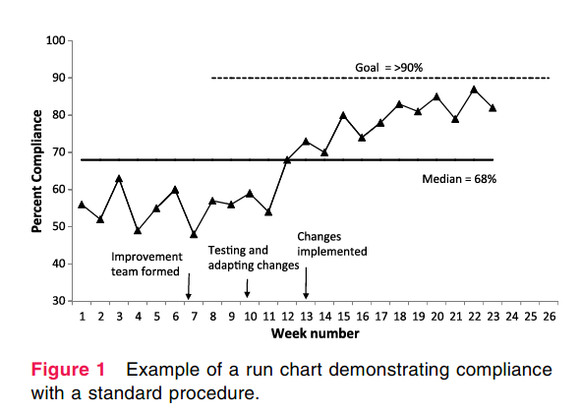

Slide 22


