Slide 1
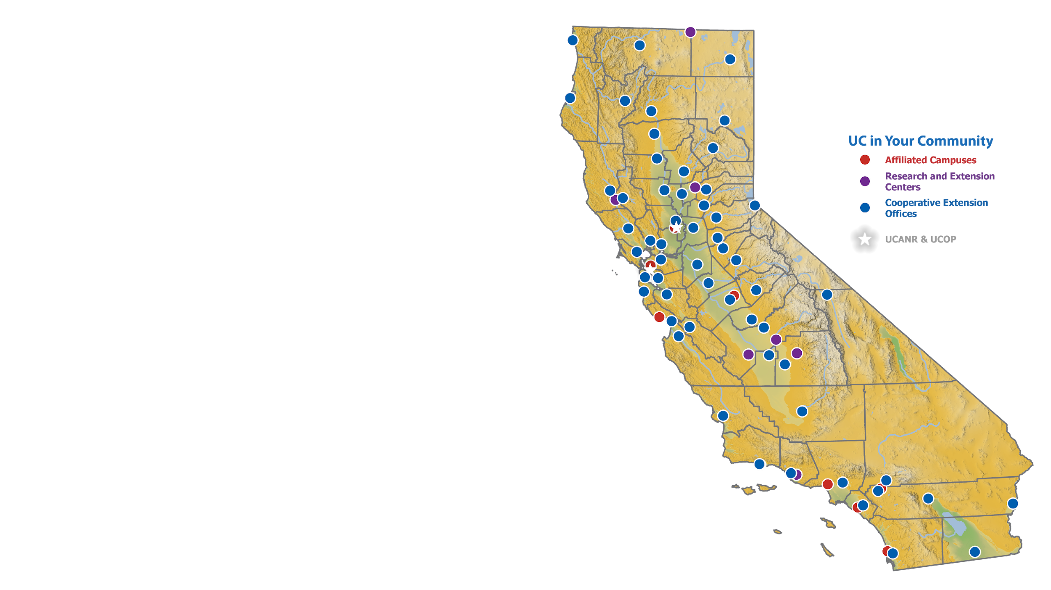

ANR Map Clipart for PowerPoint
Brought to you by:
August 2025

Slide 2

Instructions
Did you know?
IGIS teaches workshops on a range of topics related to mapping and GIS.
For future workshops see our training schedule. For previous workshops, see our YouTube Channel.
igis.ucanr.edu
Copy-paste the maps in this PowerPoint to your presentation.
PNG files are available here.
Need more customization – see our blog post and PowerPoint toolkit: Designing your own map of the UC ANR system without GIS!
For questions, feedback, or help, sign-up for our Office Hours or contact Shane Feirer.

Slide 4
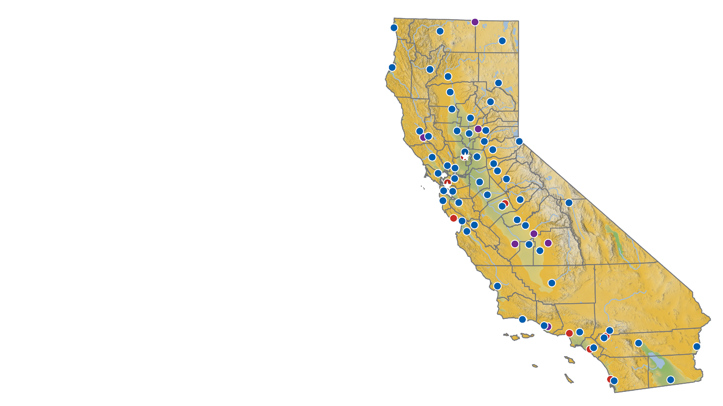

Slide 5
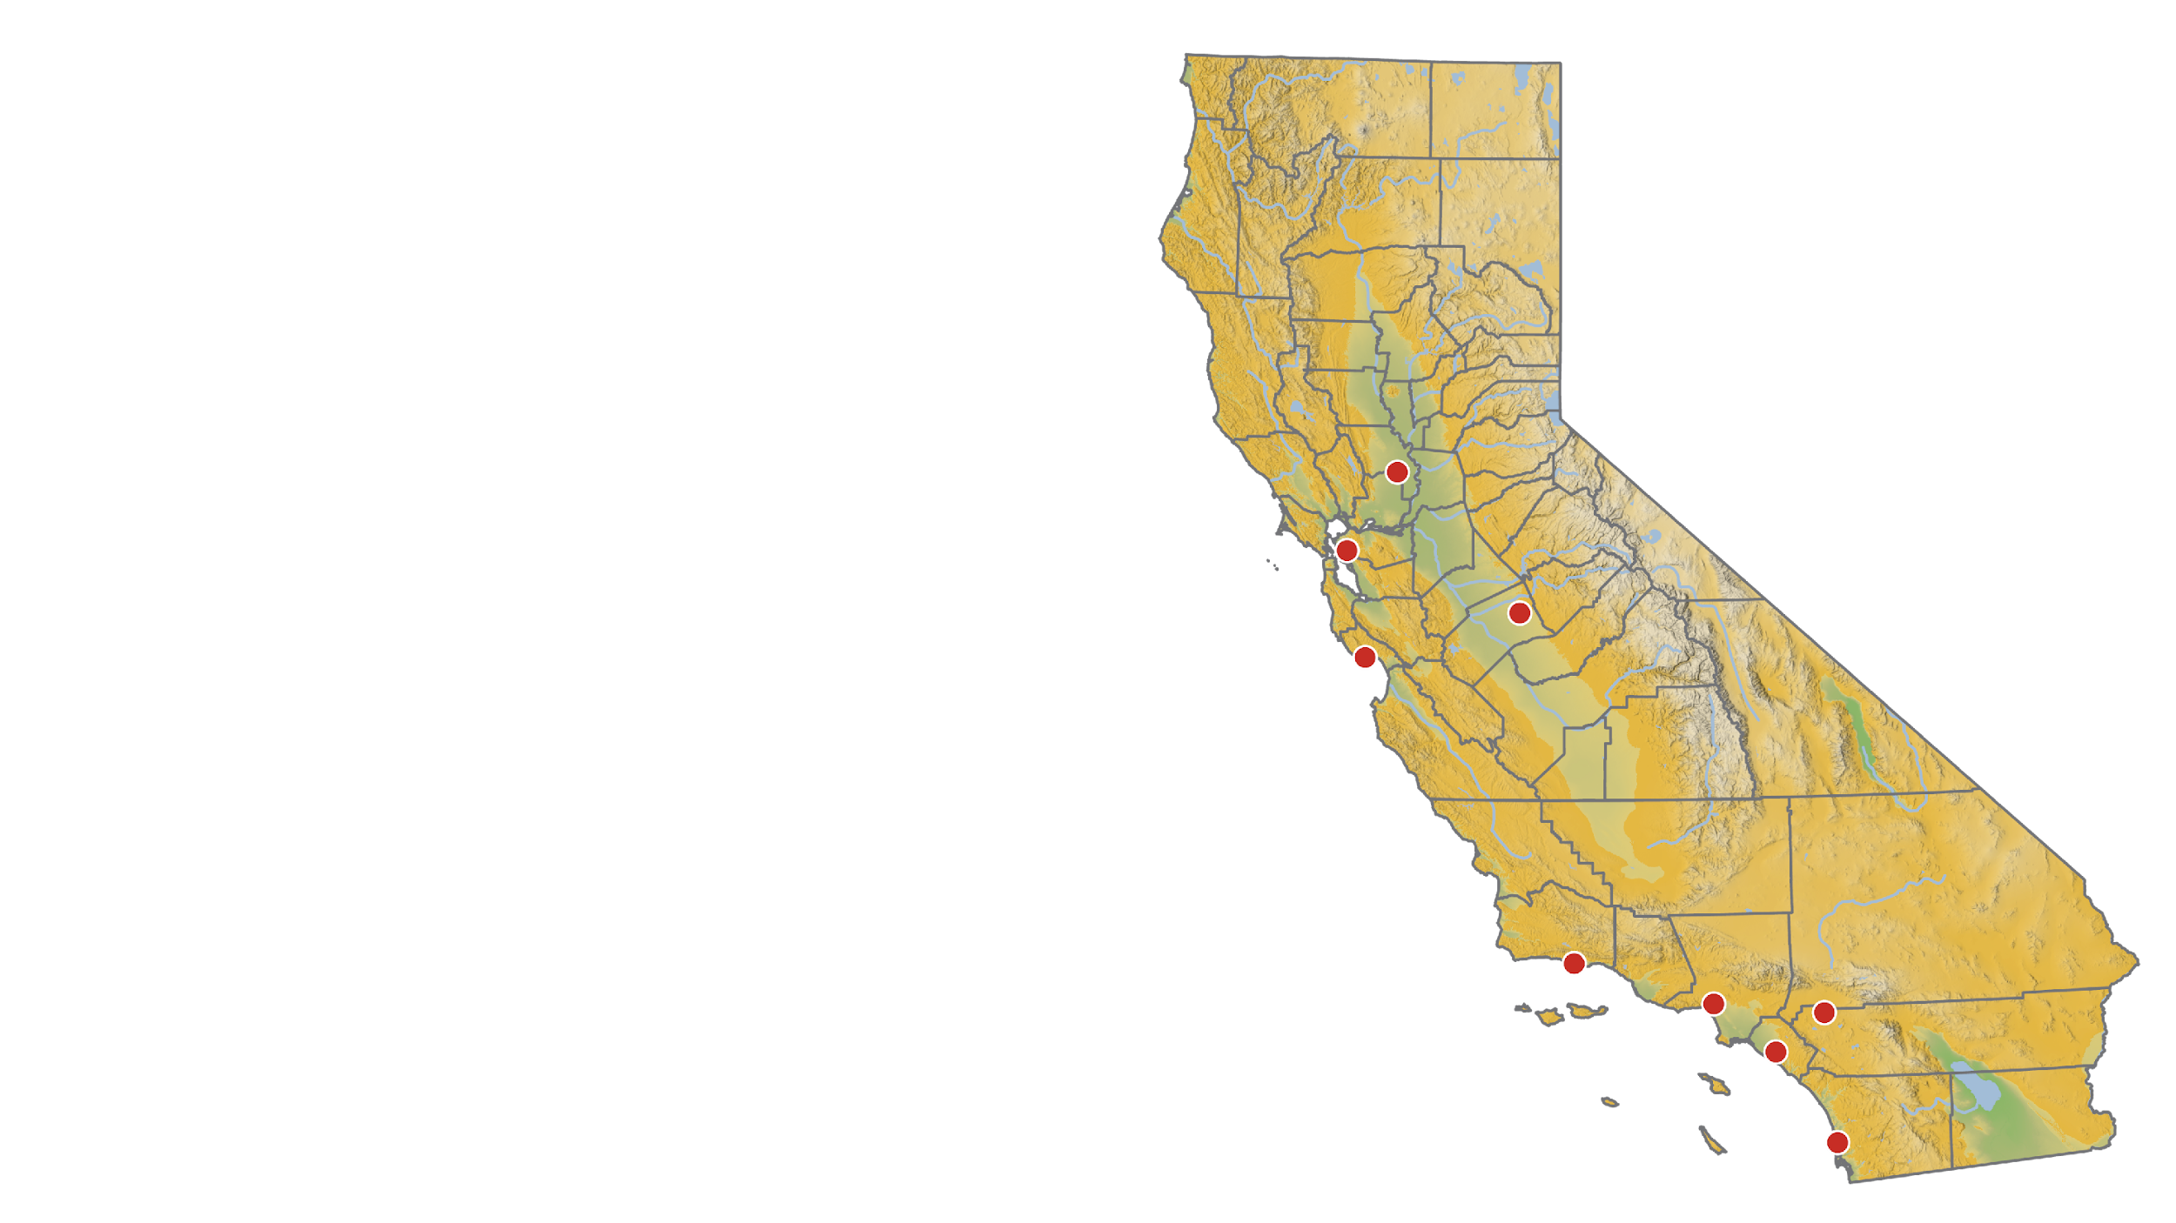

Slide 6
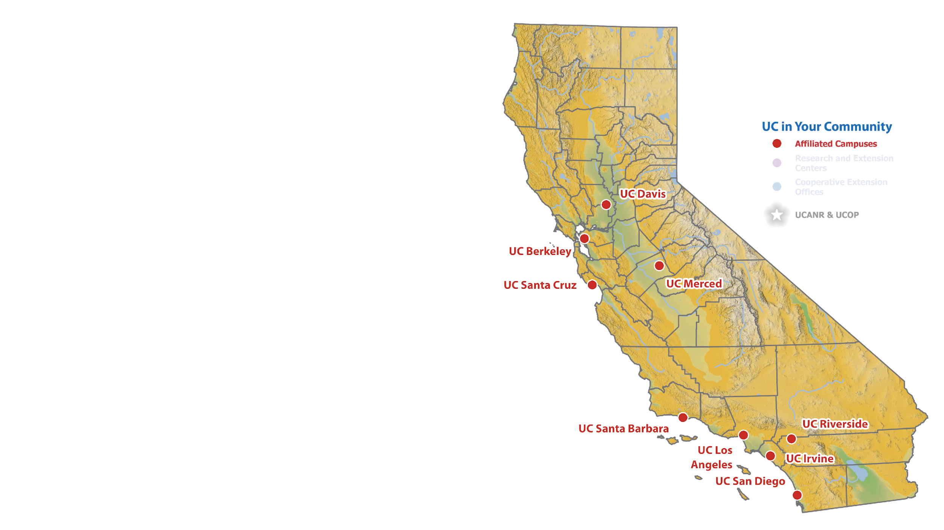

Slide 7


Slide 8


Slide 9
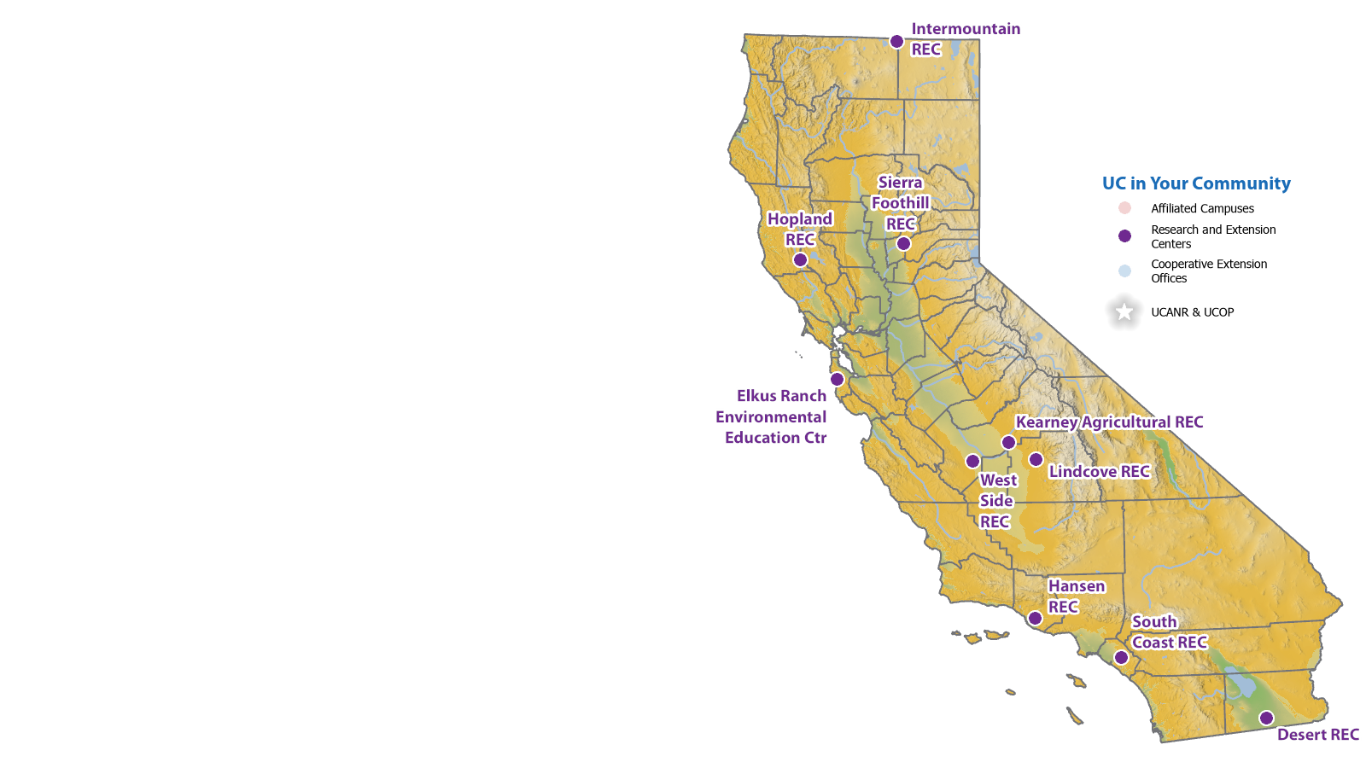

Slide 10
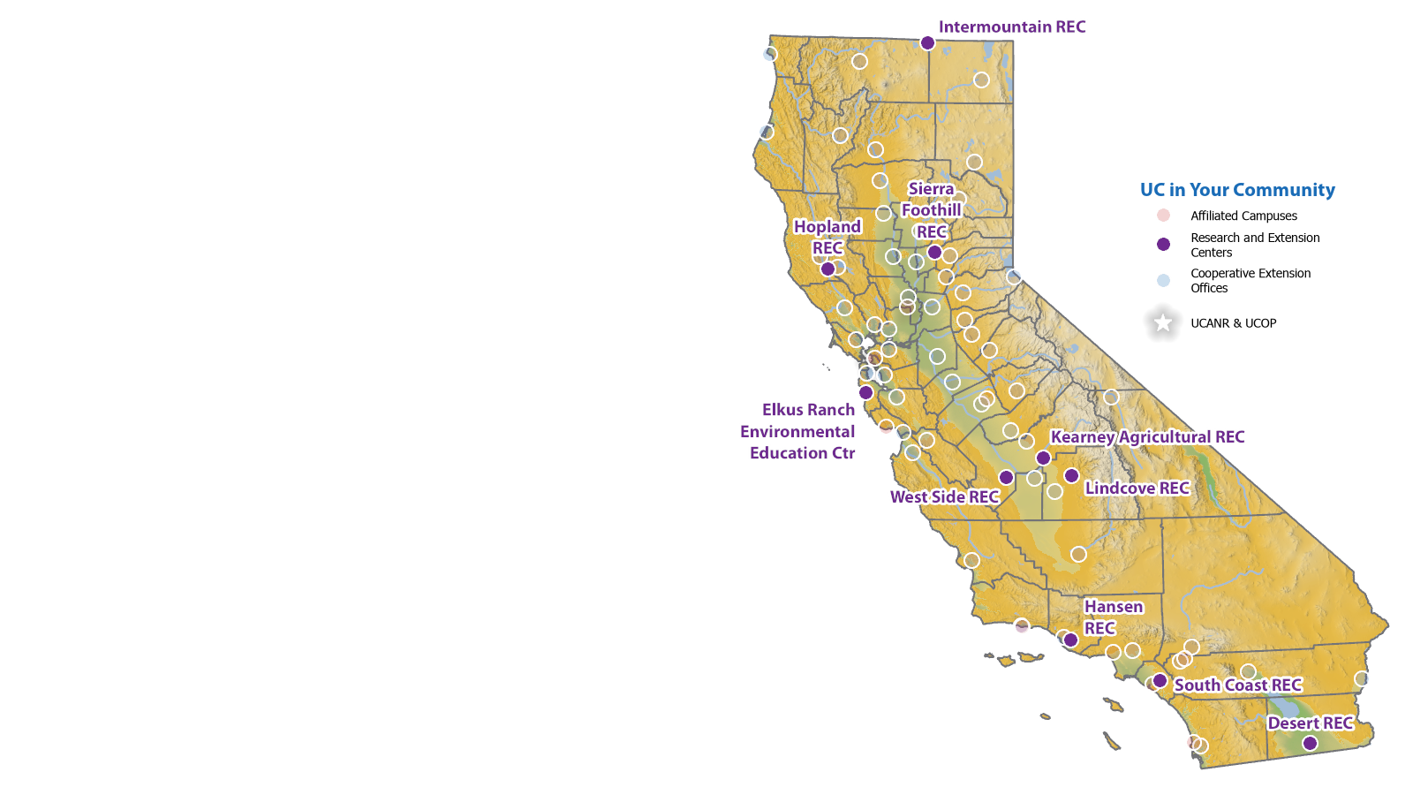

Slide 11
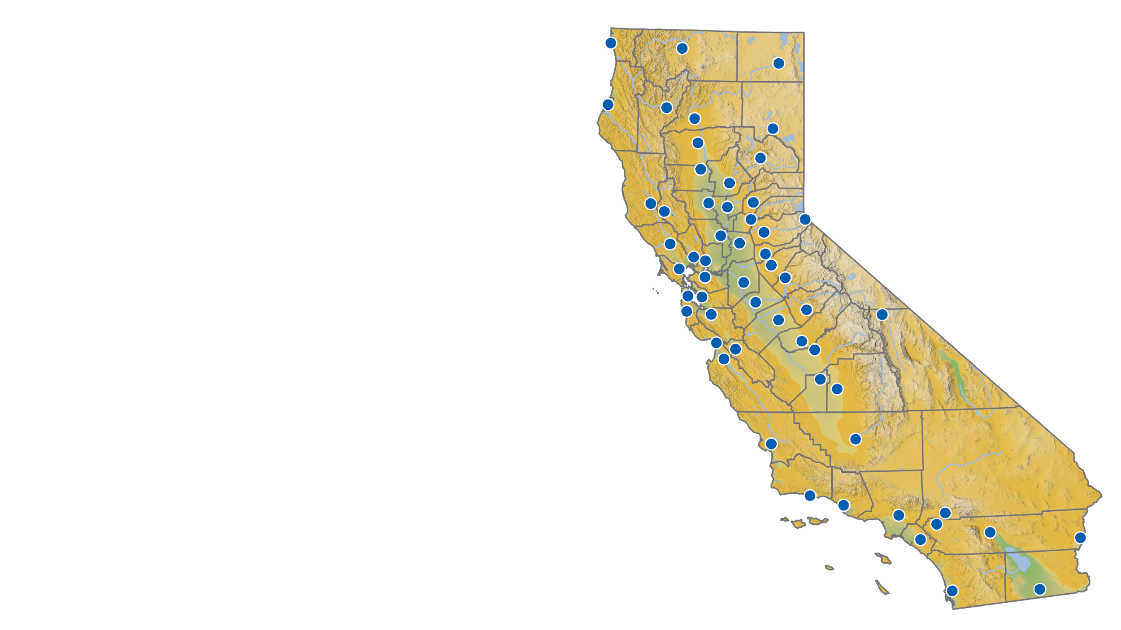

Slide 12
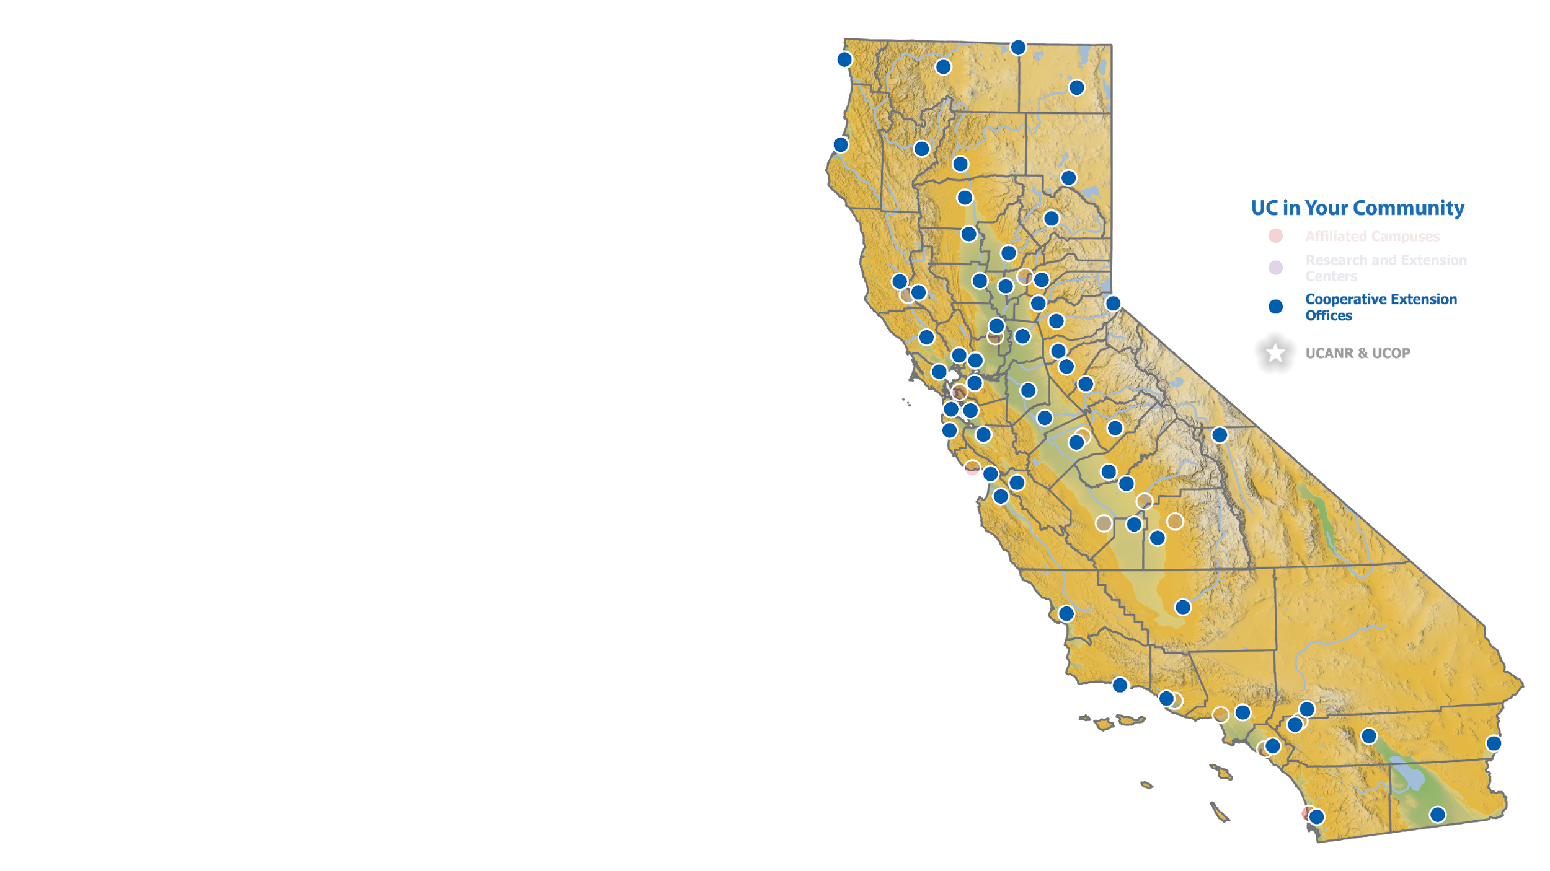

Slide 13
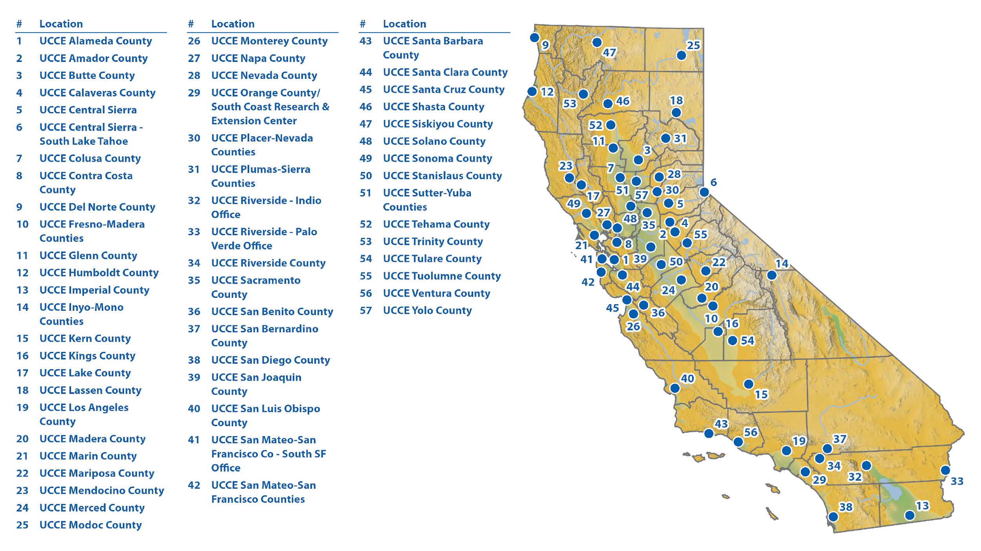

Slide 14
