Slide 1
Take a meta-moment
How does hate speech make me feel? > SEL > Take a meta-moment

Slide 2
Have you ever lost control of your emotions?

Slide 3
The Meta-Moment
How would my “best self” react in this situation?
What strategy can I use so that my actions reflect my “best self”?

Slide 4
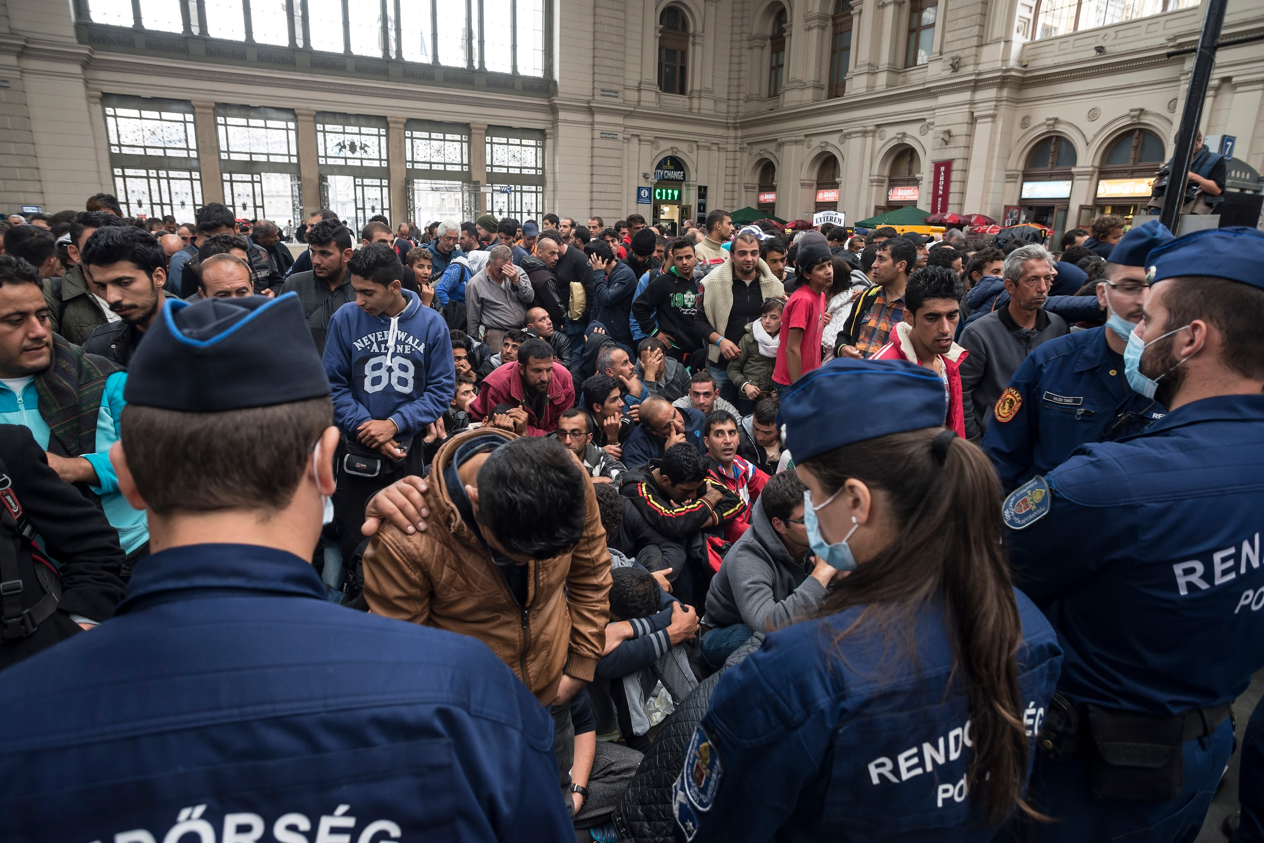
How does this image make you feel?
Budapest city, Hungary - September 10, 2015: A team of hungarian police controlling the situation to maintain order with refugees in the Keleti train station of Budapest city. Many refugees are crossing Hungary from Syria, Pakistan and Afghanistan going to other countries of Europe as Germany, Austria, Denmark and others searching for better futures for their families.

Slide 5
What do we mean by triggers?
seaside
real friend
actions
mountains
smell
sound
music
memory
Grandparent

Slide 6
High
Energy
Low
© RULER Programme. Yale Centre for Emotional Intelligence
Unpleasant
Pleasant
Feelings

Slide 7
© RULER Programme. Yale Centre for Emotional Intelligence

Slide 8
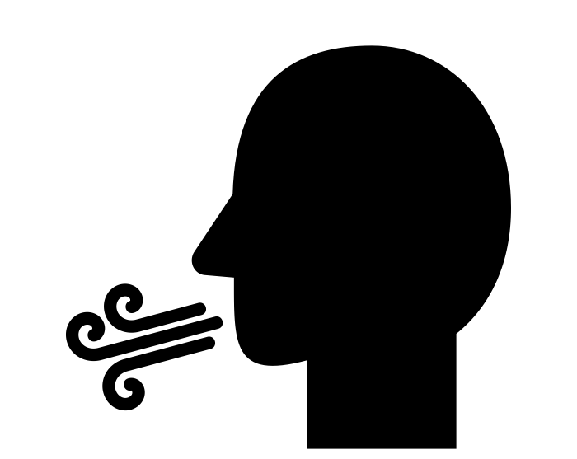
Strategies for in the moment (when in an emotional state)
Breathing
Mindfulness/Relaxation
Reframing
Private self-talk
Visualisation
Distraction
Increasing distance from the situation

Slide 9
Long-term strategies
Taking action for a cause or social issue
Meditation
Spirituality
Physical activity
Other hobbies/activities
Entertainment - Music/TV/Games
Modify the situation
Support from others
Finding solutions to the problem
Setting goals and achieving them
Getting professional help.

Slide 10
Furious
Angry
Irritated
High
Excited
Cheerful
Proud
Energy
Lonely
Miserable
Calm
Low
© RULER Programme. Yale Centre for Emotional Intelligence
Unpleasant
Pleasant
Feelings

Slide 11
www.hackinghate.eu
#SELMA_eu

