Slide 1
How do you feel?
How does hate speech make me feel? > Media Analysis > How do you feel?

Slide 2
On the following slides are comments that people have made online about the photos we explored earlier.
For each comment, consider:
Is it positive or negative?
How it makes you feel?
What strategy would you use to regulate your feelings?
What action would you take in response to the comment?

Slide 3
So many children and our schools are already full? Where will they go?
That smile warms my heart - it shows we are all human and always have something in common.
Great to see our local people helping out the needy. :-)
No wonder she’s smiling - free food, shelter and healthcare. Taking it away from people like me...

Slide 4
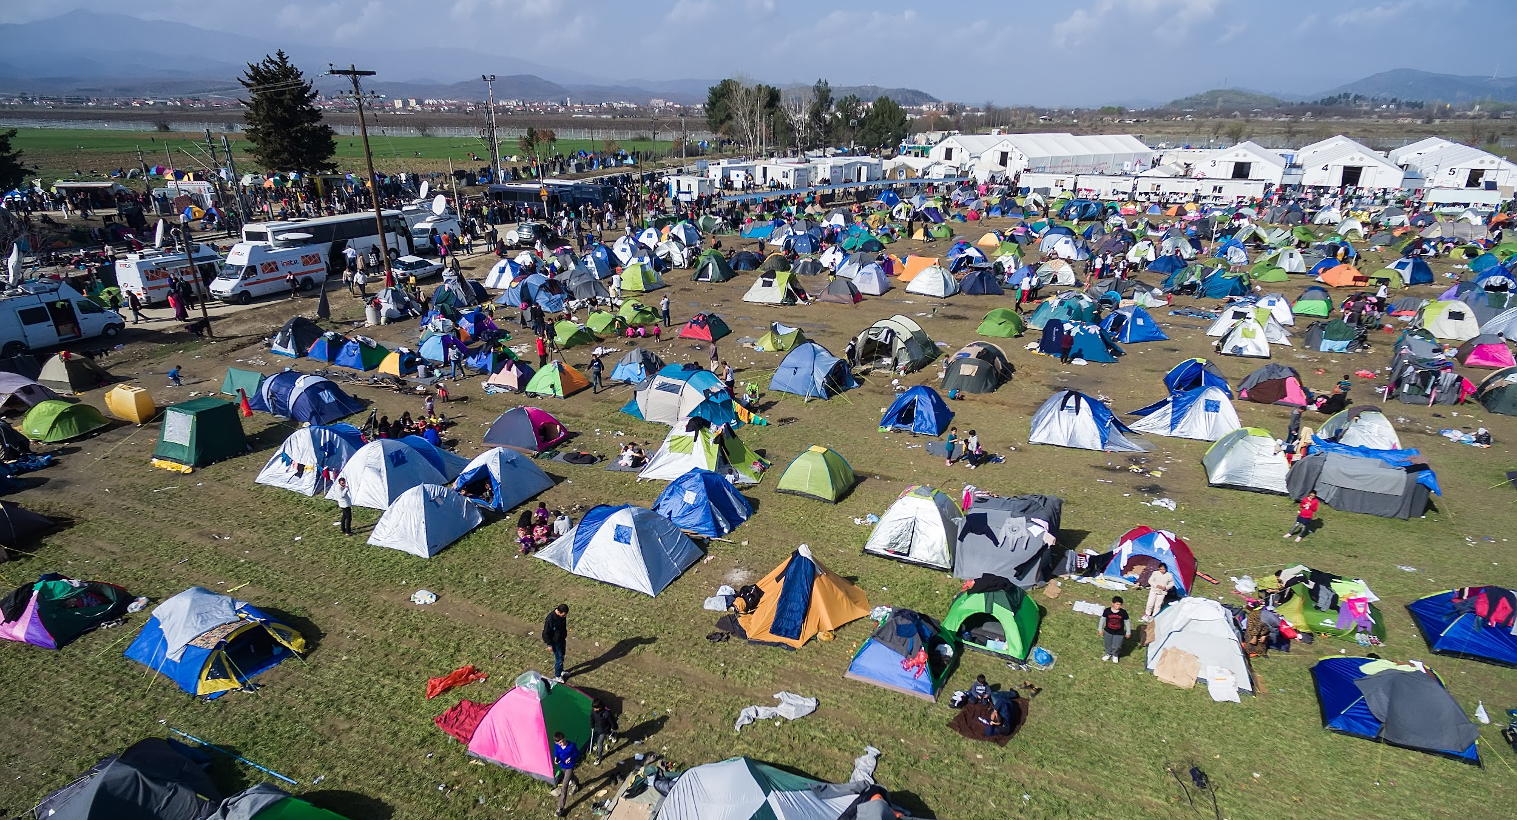
This really shows the scale of the problem. We must do something to help!
Their country is pushing people in. And why not? If we’re so stupid to take them, why wouldn’t they do that?
This used to be a beautiful park; now it’s just filth...

Slide 5
What a lovely idea - I’m sure the children really appreciated this!
Send in the clowns!
A waste of time - how does this help anyone?
Another party gatecrashed by uninvited ‘guests’...

Slide 6
Why do THEY always come to OUR country?
So cute and innocent! You are always welcome!
Which one will grow up to be a terrorist?

Slide 7
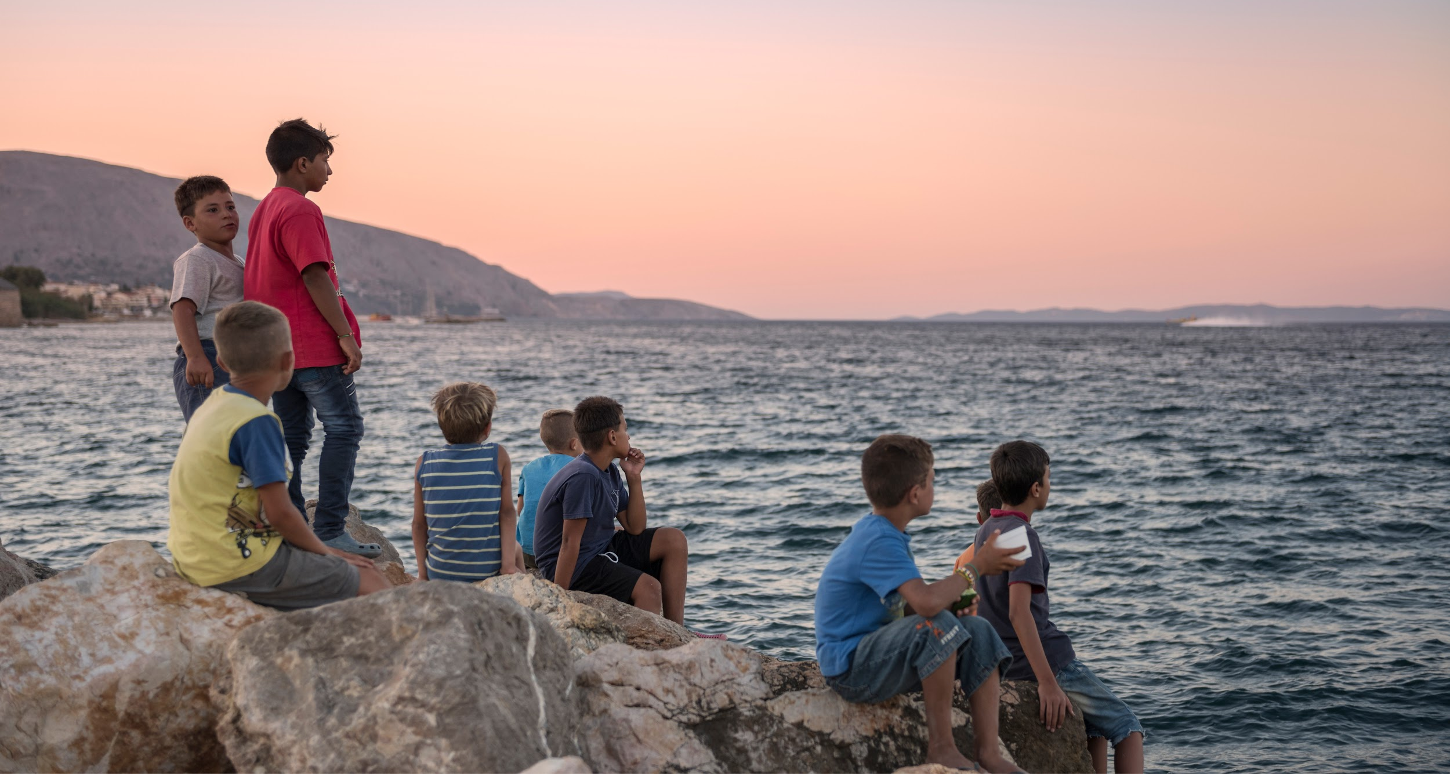
You can travel many miles but you never forget your home...
Like meerkats looking out to sea!
Look as long as you like, your dead dads aren’t coming back!
Based on my country’s attitude, maybe they are thinking they were better off where they were before...

Slide 8
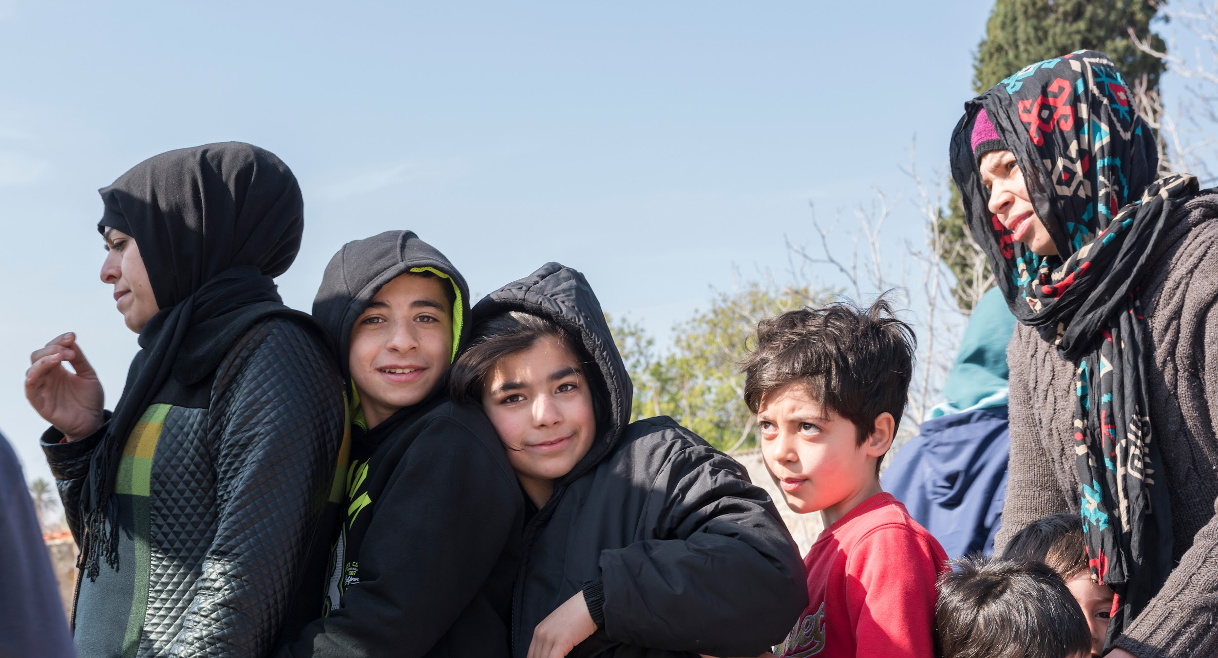
I personally think they should shoot them all at the border...it’ll save us HARD WORKERS billions on our taxes!
I hope they’re going out rather than coming in? GOOD RIDDANCE TO BAD RUBBISH

Slide 9
www.hackinghate.eu
#SELMA_eu

