Slide 1


Hi there,
You can use this slide deck
to host a 30-minute training session for teachers.
Just complete 2 quick steps before the session.

Slide 2

Before the training
Get your school’s join link to share with teachers.
What is a join link? This custom link allows teachers to instantly join your school’s Mystery Science account.
Don’t have the link? No problem! Ask your administrator for your school or district’s join link, or simply head over to mysteryscience.com to make an account.

Slide 3

Before the training
Get your school’s join link to share with teachers.
Email your colleagues to invite them to the training session.
See the next slide for an email template you can copy, paste & adapt!

Slide 4
Email template
Hi fellow teachers,
I’ll be sharing why I use Mystery Science at our upcoming meeting on [INSERT DATE/TIME/LOCATION]. I’d love to help you get started with this easy, engaging resource!
Before the training, please join our school’s Mystery Science account by clicking on this link: [INSERT THE JOIN LINK].
Please bring your laptop to the meeting so we can get you set up and ready to teach!

Slide 5

You’re all set!
The next slide is the start of the training presentation.
Share your screen and have fun!

Slide 6

An introduction to
Mystery
Science

Slide 7
What is Mystery Science?
How can I get started?
What are some quick tips?
Ready to explore on your own?
Agenda

Slide 8
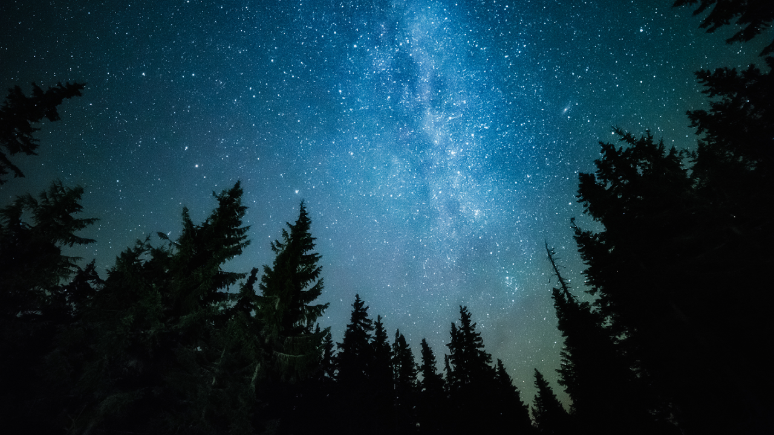
What is Mystery Science?

Slide 9

Open-and-go lessons that inspire kids to love science

Slide 10
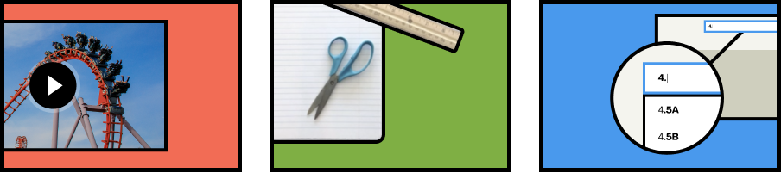
Hands-on science
made easy
Engaging, interactive lessons kids love
Easy-prep
hands-on activities
Standards-aligned science units

Slide 11
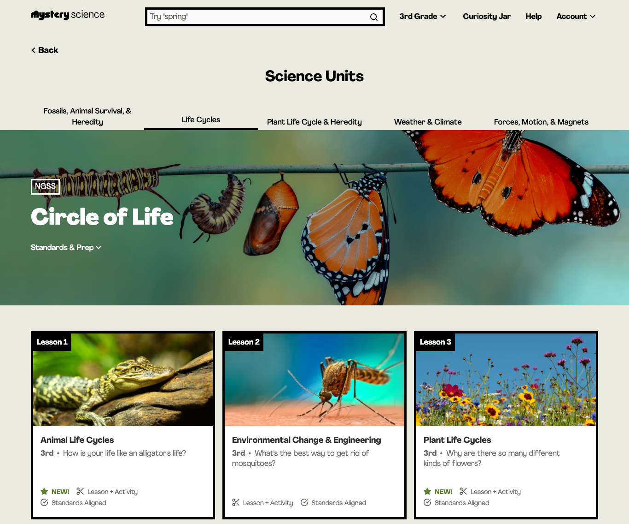
Science units
4-6 units per grade
Each unit has 3-8 lessons
Standards-aligned

Slide 12
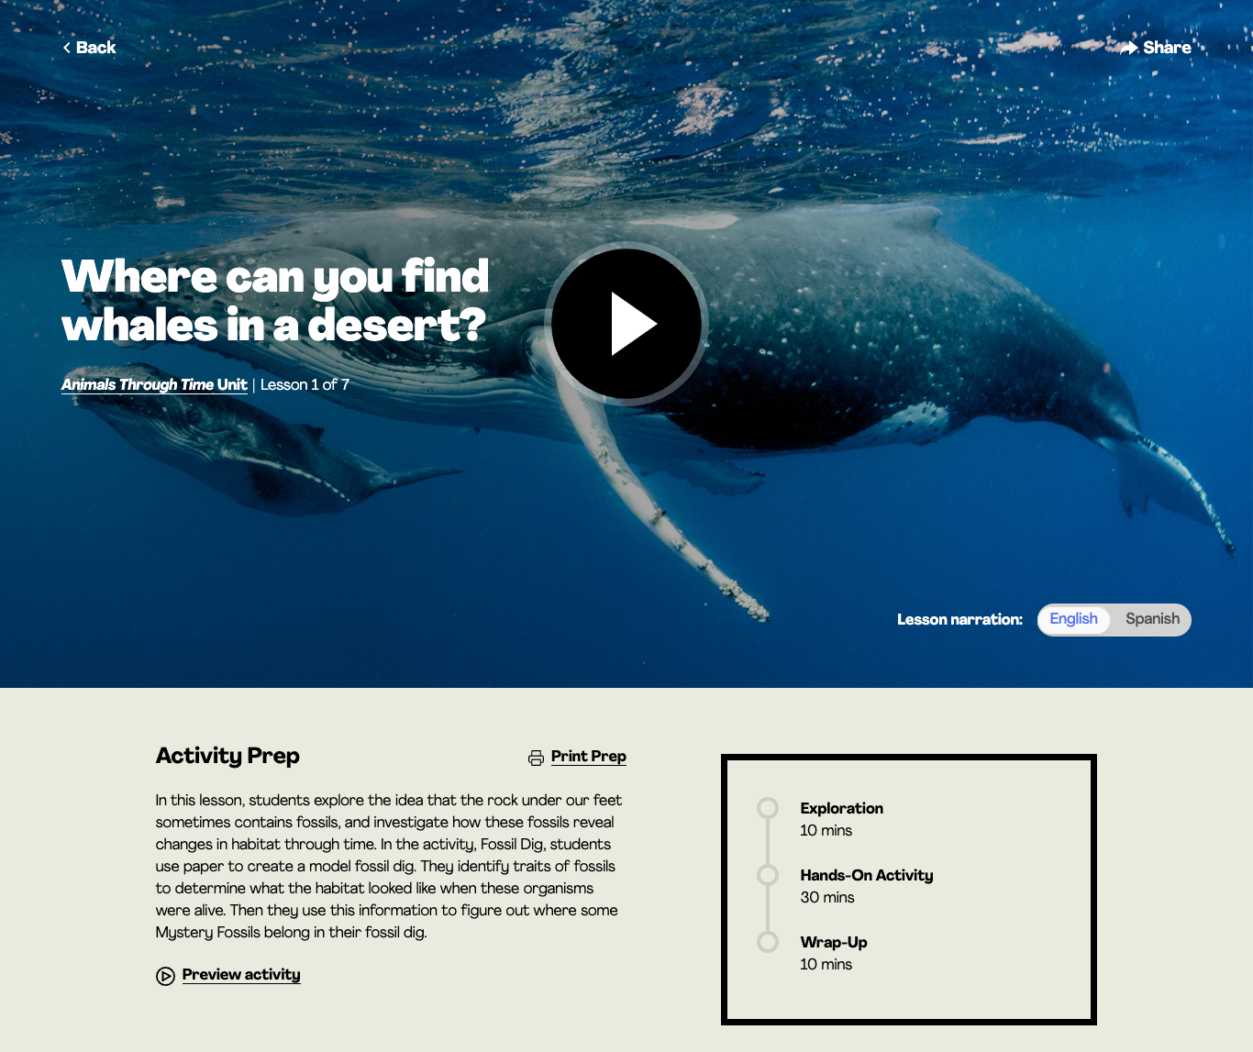
Lessons
Take 45-60 min to teach
Video exploration & discussion
Hands-on activities with step-by-step video instructions
Simple supplies for easy prep

Slide 13
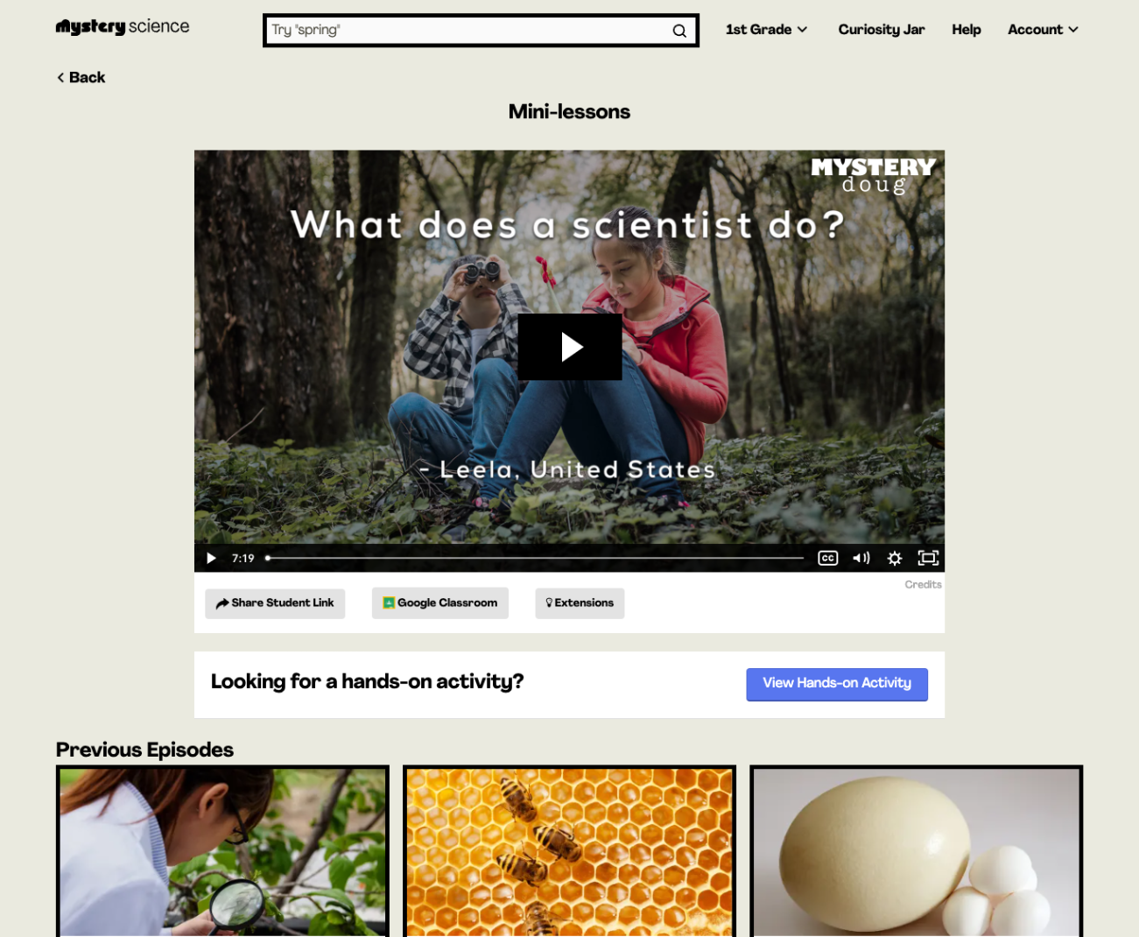
Mini-lessons
5-10 minutes long
Discussion questions
New mini-lesson each week
Over 150 lessons in the archive

Slide 14

How do I get started?

Slide 15
A quick tour…

Slide 16
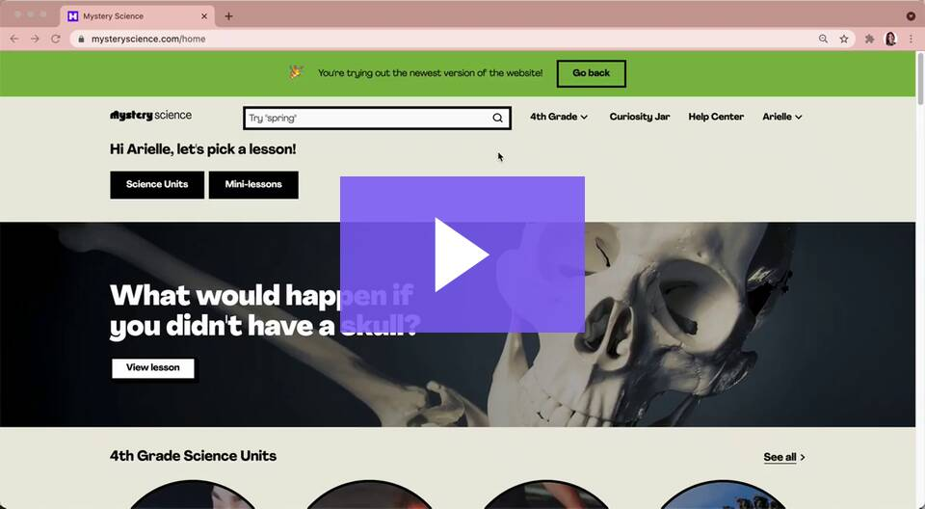
Trouble viewing this video? Watch it here

Slide 17

Don’t miss these Mystery Science features…

Slide 18
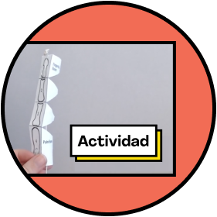
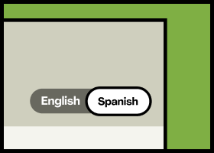
Spanish Resources
Spanish narration for every lesson
Spanish versions of printable and digital worksheets & assessments
Spanish transcripts of each lesson

Slide 19
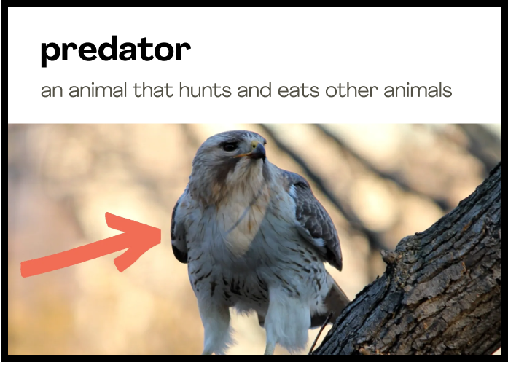
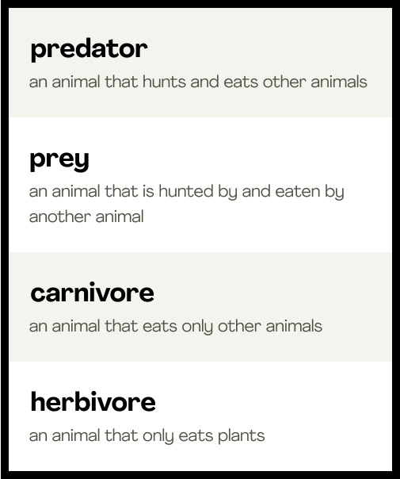
Vocabulary Resources
Visual slideshows with images and videos pulled directly from the lesson
Teacher printouts with terms and definitions
Available in English and Spanish!

Slide 20
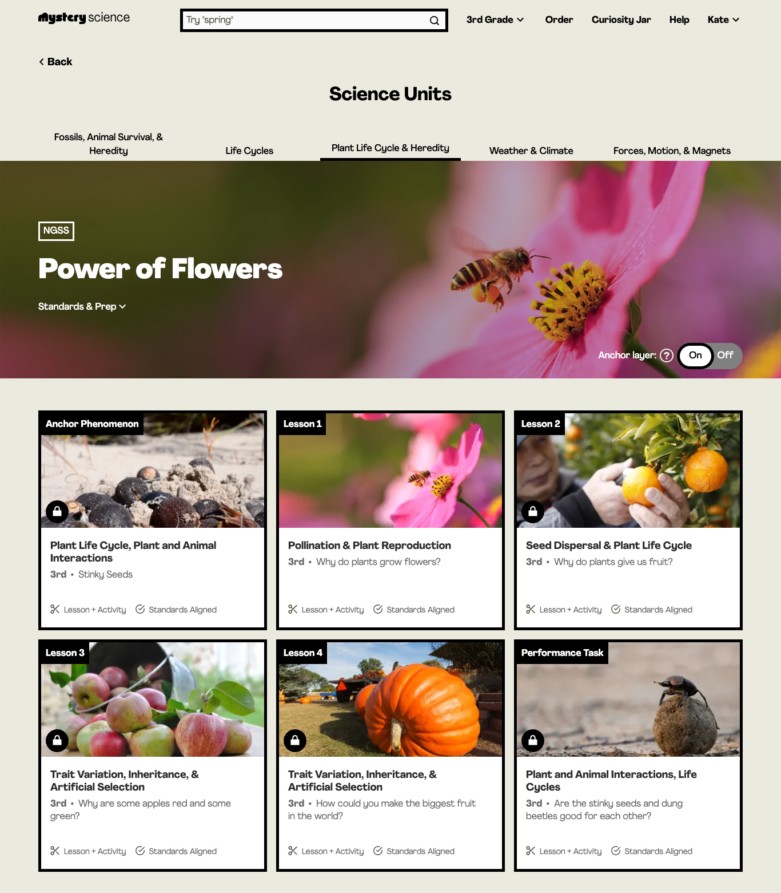

Anchor Layer
Adds 2 lessons to each unit
60-90 minutes per lesson
Starts with an Anchor Phenomenon
Project-based performance task

Slide 21
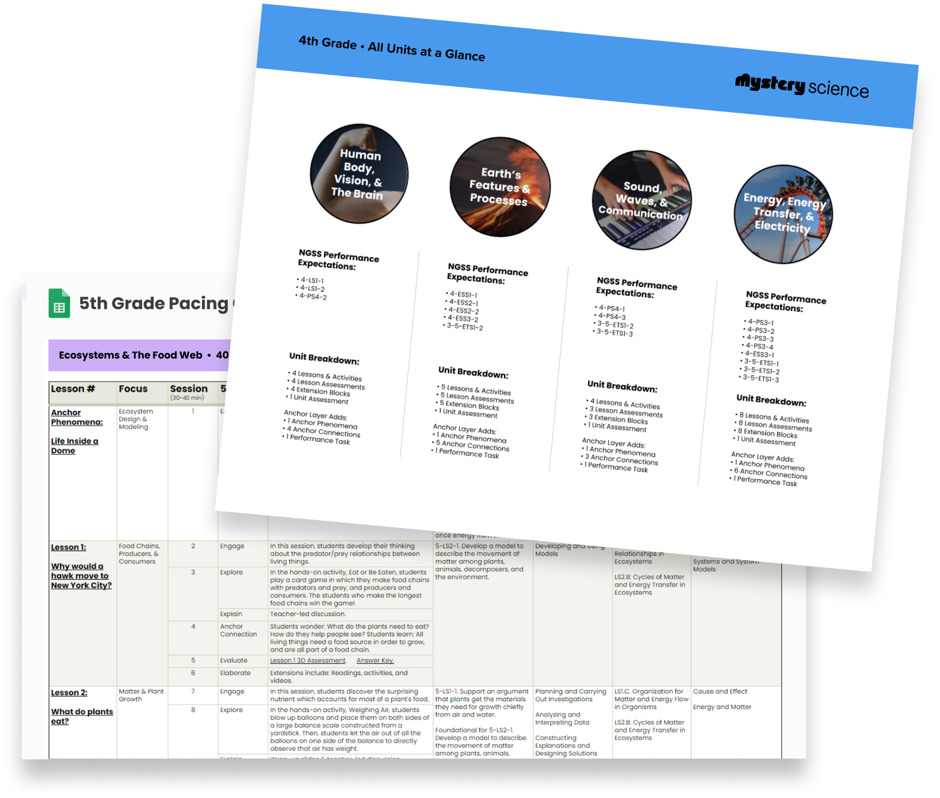
Teacher Tools
State-specific Standards Alignment Guides
Fully editable Pacing Guides
Supply calculator
Printable student booklets
Find all this and more at: mysteryscience.com/getting-started

Slide 22
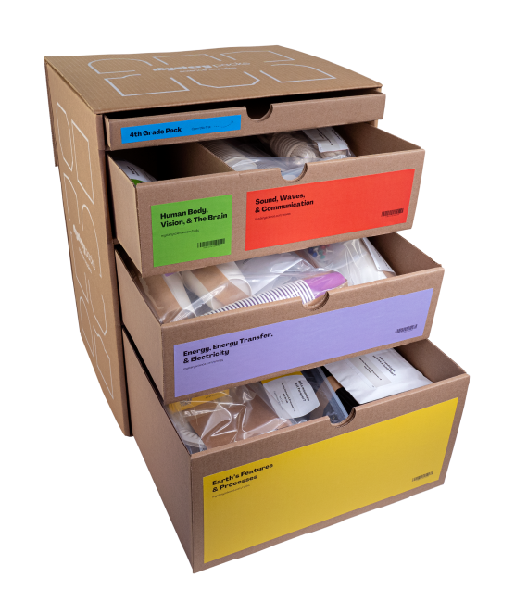
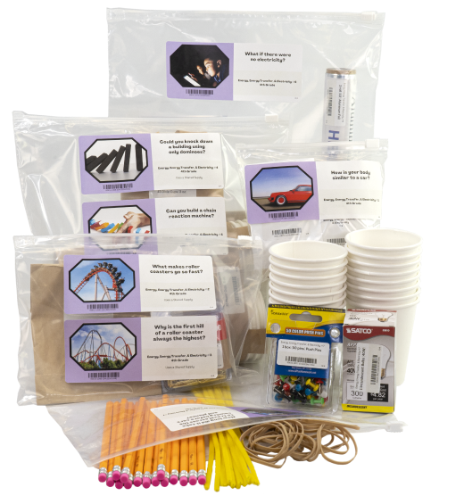
Mystery Packs
Supply kits for Mystery Science hands-on activities
Neatly organized by unit & lesson - save time on prep!
Learn more about packs here: https://mysteryscience.com/packs

Slide 23
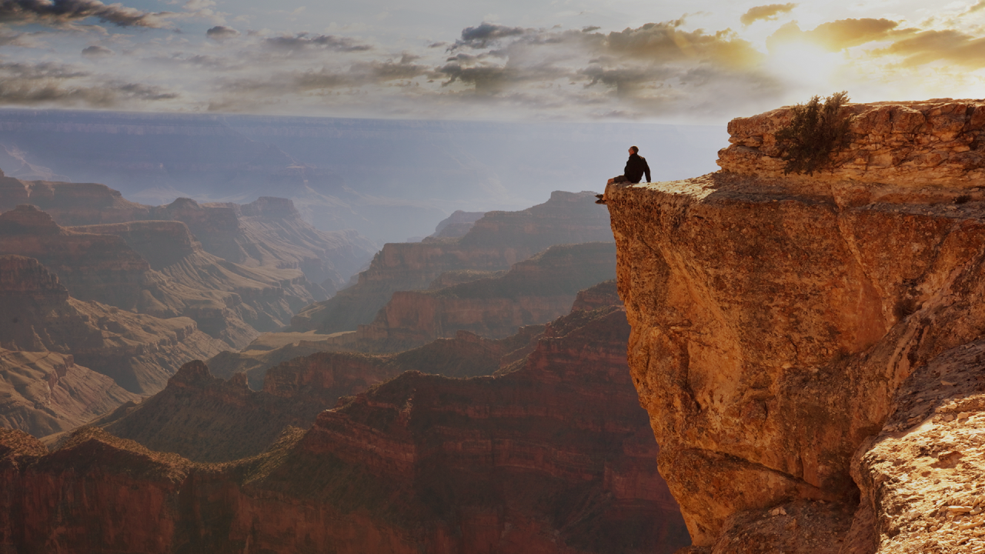
Ready to explore on your own?

Slide 24
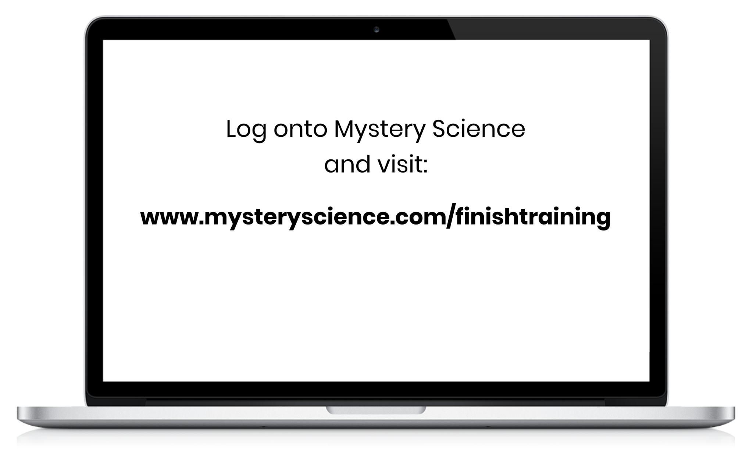
Let’s wrap up with a scavenger hunt!

Slide 25
See if you can…
Change your grade level on the homepage (hint: top of the page)
Find a Science Lesson within the unit
Change the narration to Spanish on the lesson video
Find a Mini-lesson
Find the Student Link for sharing a mini-lesson with students
Find the Supply list and Prep Instructions for that lesson
Find a Science Unit
Change the number of students in the supply list
Find the Standards covered in that unit (hint: scroll down!)
Find the Assessment for the lesson
Turn the Anchor Layer on and off for that unit
Find the English and Spanish versions of a worksheet or printout

Slide 26

Great work and thanks for joining!

